Slide 1
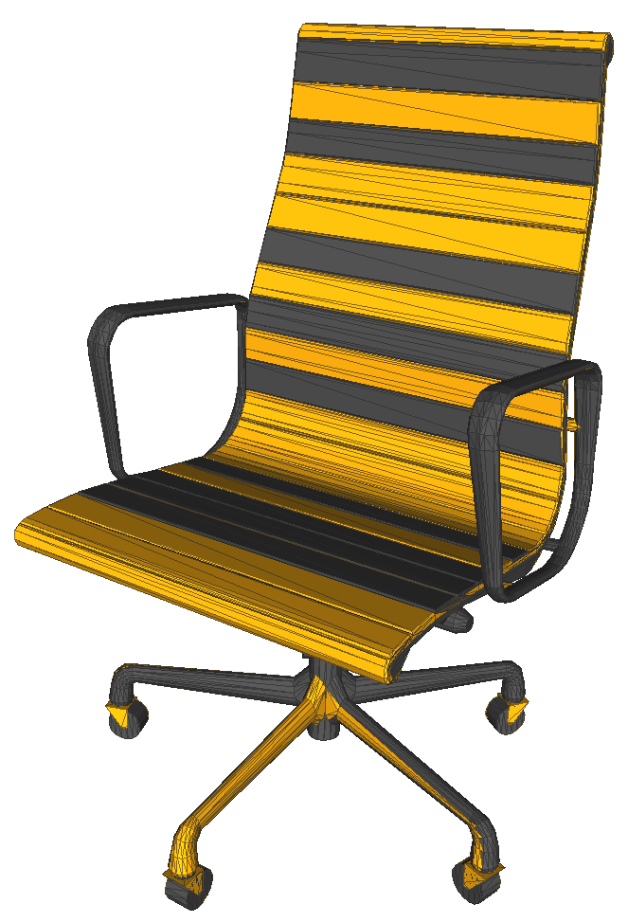
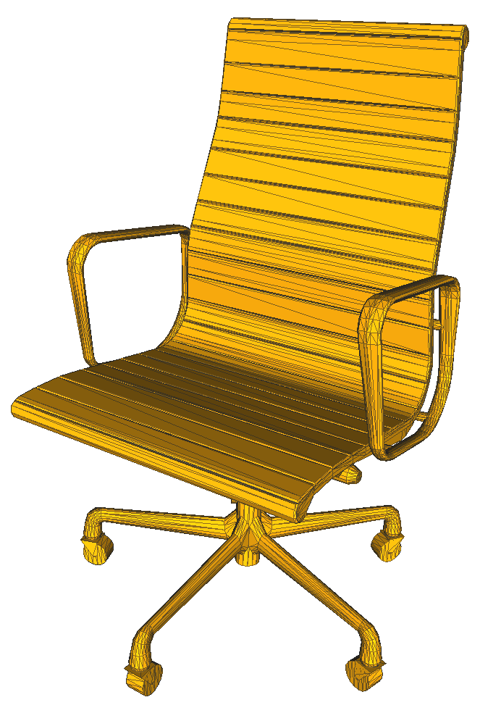
A Simple Method for Correcting Facet Orientations in Polygon Meshes Based on Ray Casting
JCGT paper presentation at I3D 2015
Kenshi Takayama
Alec Jacobson
Ladislav Kavan
Olga Sorkine-Hornung
ETH Zurich / National Institute of Informatics
Columbia University
University of Pennsylvania
ETH Zurich
28 February 2015

Slide 2
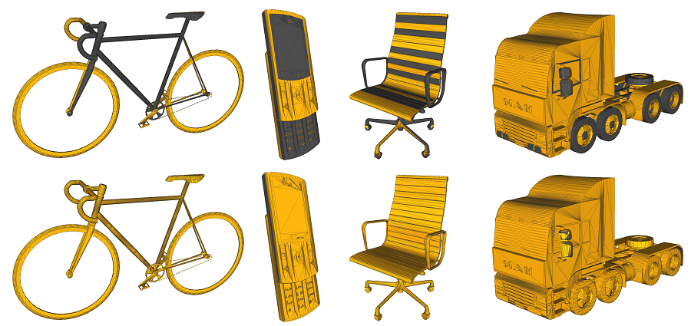
Goal: automatically correct facet orientations in polygon meshes
before
after

Slide 3
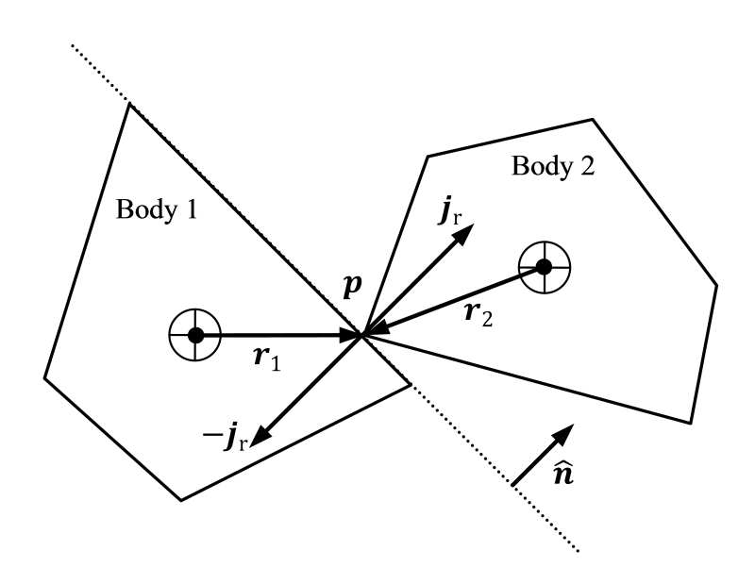
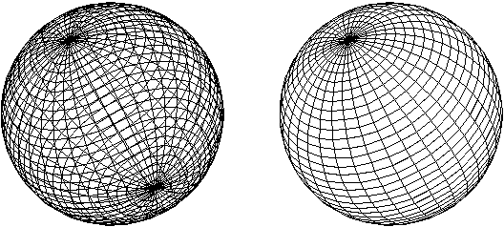
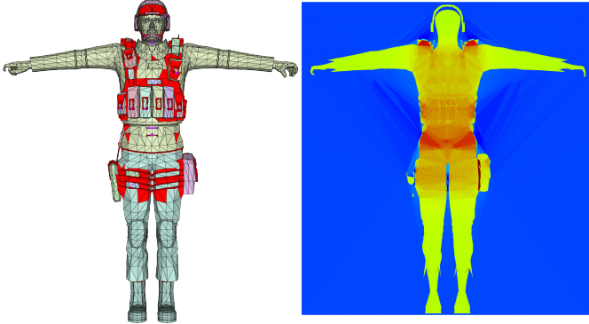
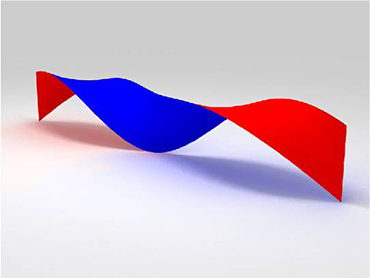
Consistent orientations needed for:
back-face culling
collision response
two-sided material
inside-outside segmentation
[Jacobson13]

Slide 4
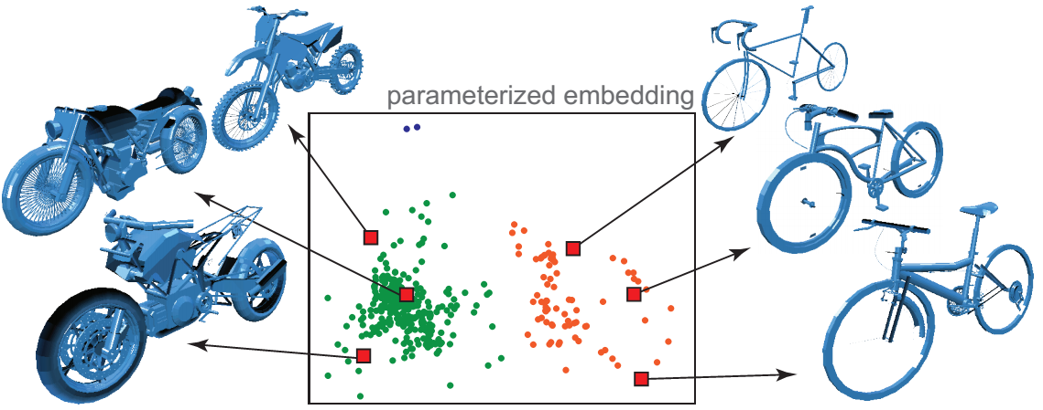
Inconsistent orientations still not uncommon
Teaser of EG14 paper
ShapeSynth [Averkiou 2014]
using Google 3D Warehouse
Caused by:
Orientation-unaware modeling tools (e.g. Google SketchUp)
Compositing meshes from different sources
Practical correction tool not readily available
(apart from those based on manifoldness)

Slide 5
Previous work

Slide 6
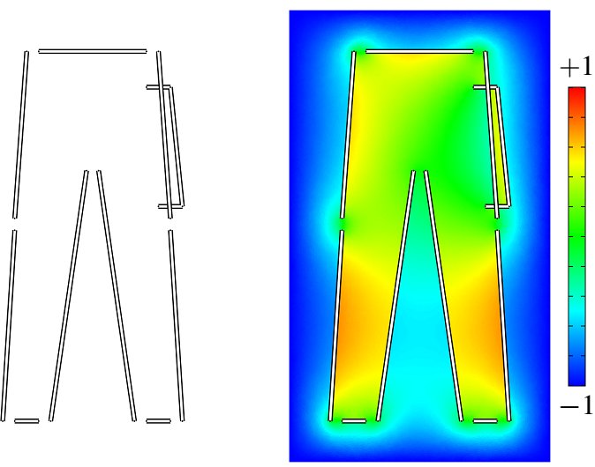
Solidity-based method [Murali97]
Scalar field f(p) indicating solidity at point p ∈ ℝ³
f(p) > 0 ➔ p is inside the solid
f(p) < 0 ➔ p is outside the solid
Sought as harmonic with boundary conditions:
f(p) = −1 for p → ∞
f(p_{front}) = −f(p_{back}) for points on facets
Orient each facet based on integration of f(p) over it
p_{front}
p_{back}

Slide 7
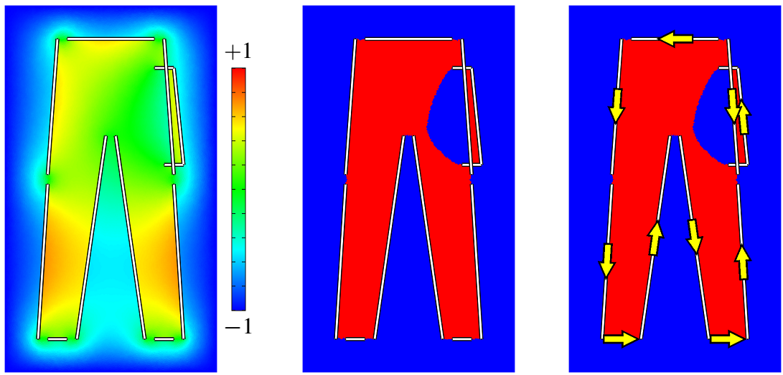
Solidity-based method [Murali97]
inside-out!
Assumes each facet to be boundary between inside & outside
Doesn’t work when facets overlap
Becomes unreliable at self-intersections & open boundaries
f(p) vanishes
binary coloring
resulting orientations

Slide 8
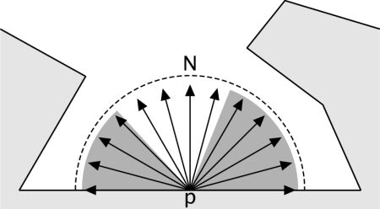
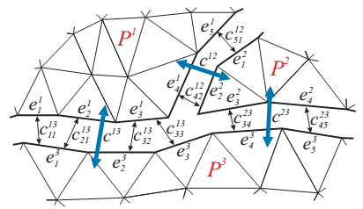
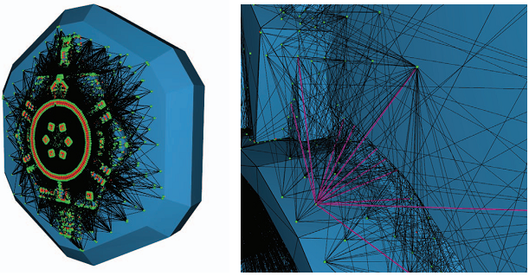
Visibility-based methods [Borodin04; Zhou08]
Step 1: visibility sampling
Step 2:
(Borodin04) greedy propagation
(Zhou08) labeling by graphcut
Step 2 complicated, hard to reproduce ☹
Our claim: Step 1 suffices, Step 2 unnecessary!
[Borodin 2004]
[Zhou 2008]

Slide 9
Algorithm

Slide 10
Visibility sampling by ray casting
(basic idea) Front side is more visible from outside
+1
+1
+1
+1
+1
front
back
+1
counter
+1
+1
+1
+1

Slide 11
Heuristic to handle interior facets
(basic idea) Front side has more “free” space
1.3
1.2
1.2
front
0.2
0.5
back
1.5
0.3
0.5
accumulated
distance
1.1
0.8
1.0
1.2

Slide 12
Failure mode of the heuristic
front
back
accumulated
distance

Slide 13
Failure mode of the heuristic

Slide 14
Ray intersection parity sampling
1 mod 2
→ +1
1 mod 2
→ +1
2 mod 2
→ +0
1 mod 2
→ +1
back
front
counter
3 mod 2
→ +1
1 mod 2
→ +1
2 mod 2
→ +0
4 mod 2
→ +0

Slide 15
Ray intersection parity sampling
Essentially the same effect as [Murali97]
Assumes each facet to be boundary between inside & outside

Slide 16

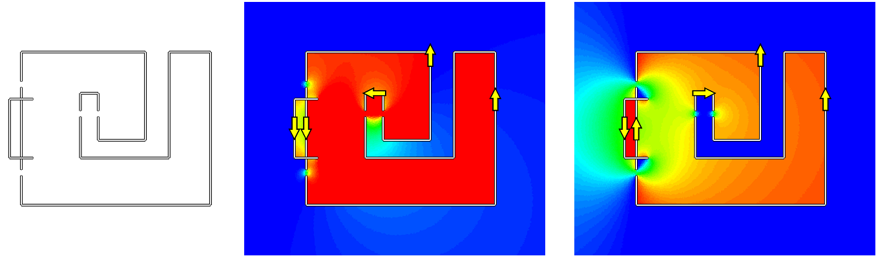
Challenging case: When overlaps and cavities coexist
facets
with visibility
with parity
generalized winding number [Jacobson13]
Never found during our evaluation, mostly of theoretical interest
Parity-based method never used

Slide 17
Evaluation

Slide 18
Dataset
SHREC (SHape REtrieval Contest) 2010 [Vanamali10]
http://www.itl.nist.gov/iad/vug/sharp/contest/2010/Generic3DWarehouse/data.html
3168 meshes from Google 3D Warehouse
Most meshes far from being clean and watertight

Slide 19
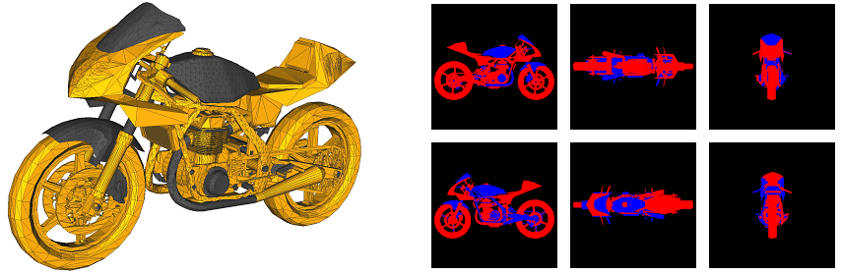
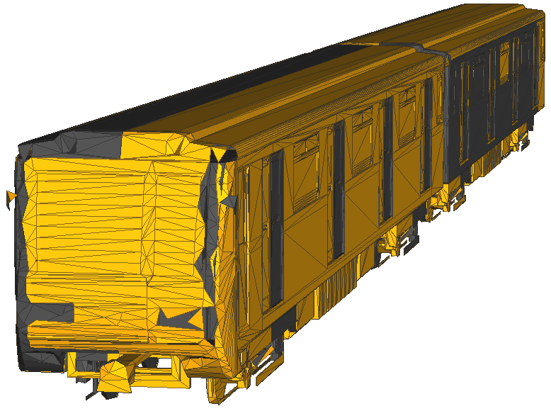
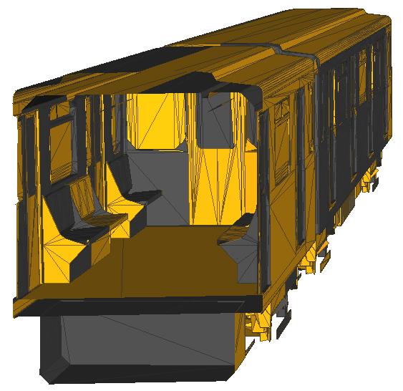
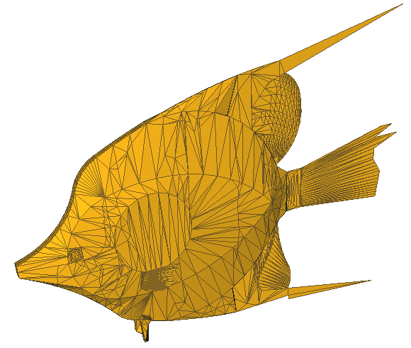
Backfacingness measure
#∎pixels
= 0.28
#∎pixels + #∎pixels
Irrelevant if mesh contains:
Cannot define “ground truth”
Single-faceted geometry
representing thin parts
Interior facets representing internal structures

Slide 20
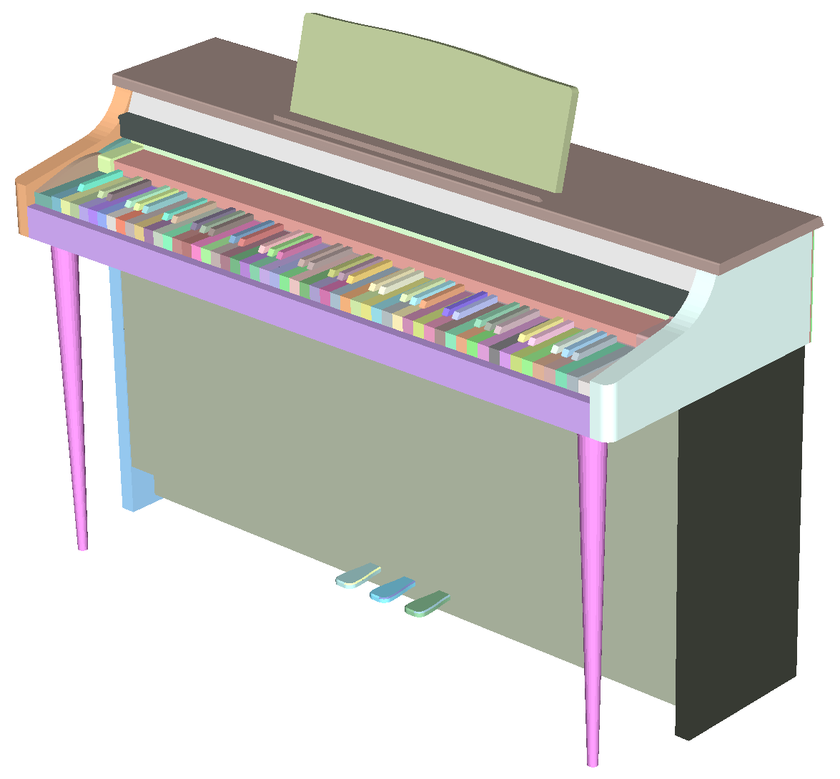
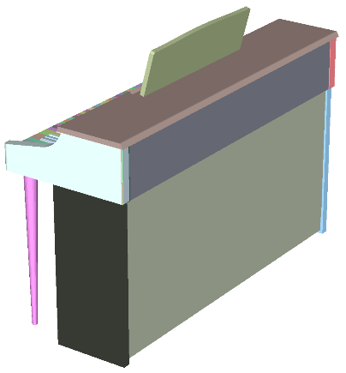
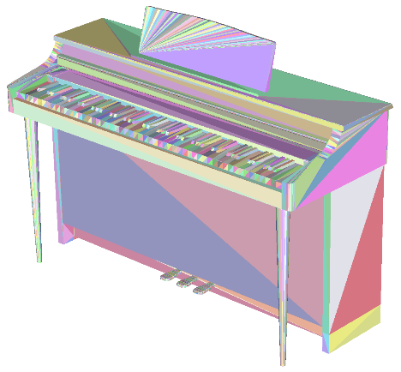
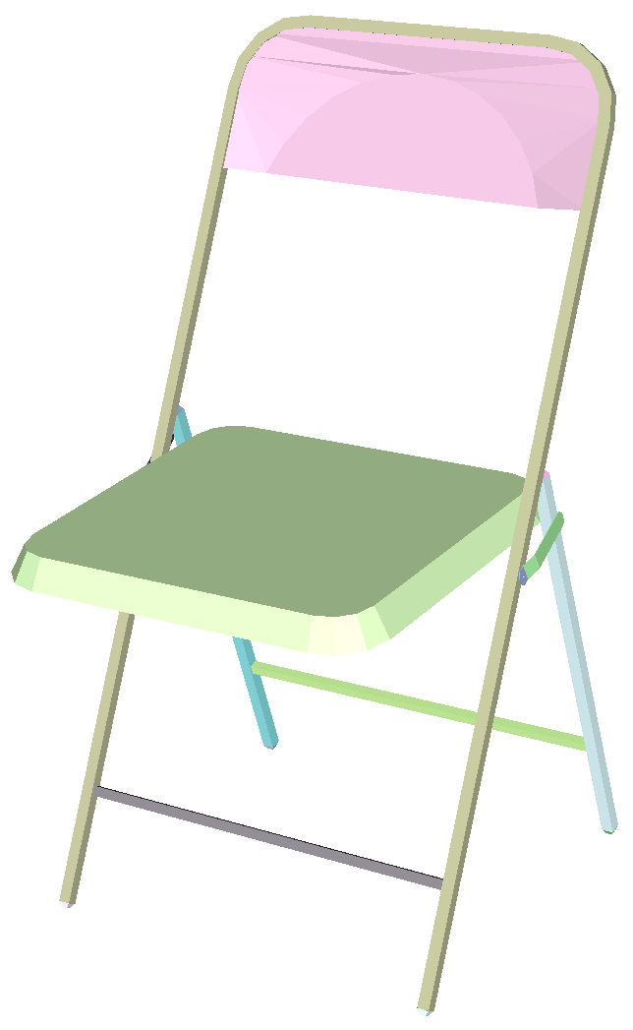
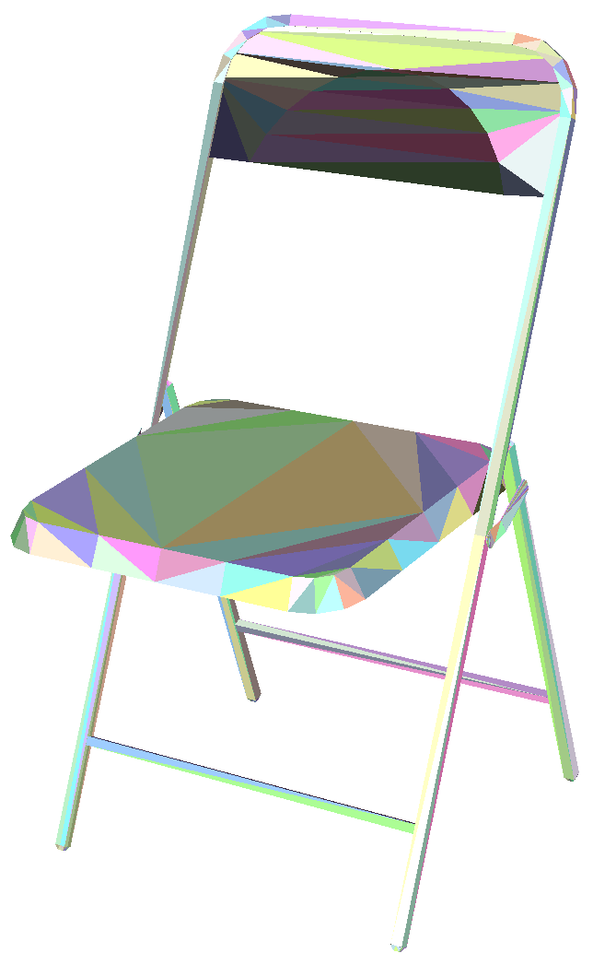
Option: patch-wise vs. facet-wise
Patch: set of facets connected by manifold edges
Weird mesh connectivity might result in weird patches
Facet-wise decision can be sometimes problematic
manifold
non-manifold
same patch!
same patch!
patch-wise
facet-wise

Slide 21
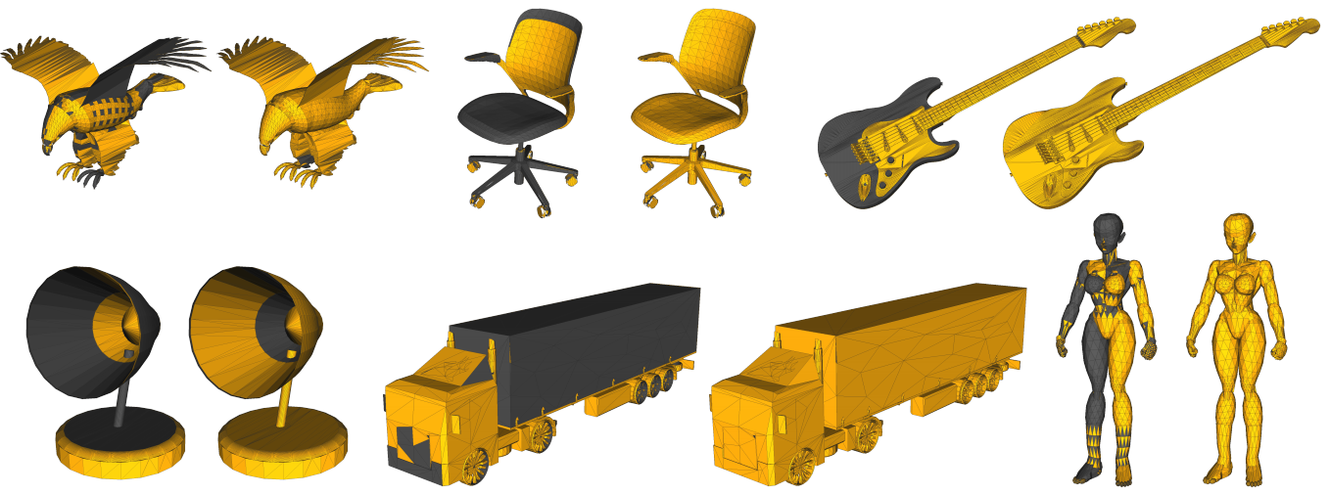
Results
0.63 → 0.088
0.56 → 0.0009
0.55 → 0.0073
0.59 → 0.027
0.57 → 0.005
0.53 → 0.0003
On average: 0.19 (±0.26) → 0.0026 (±0.0063)

Slide 22
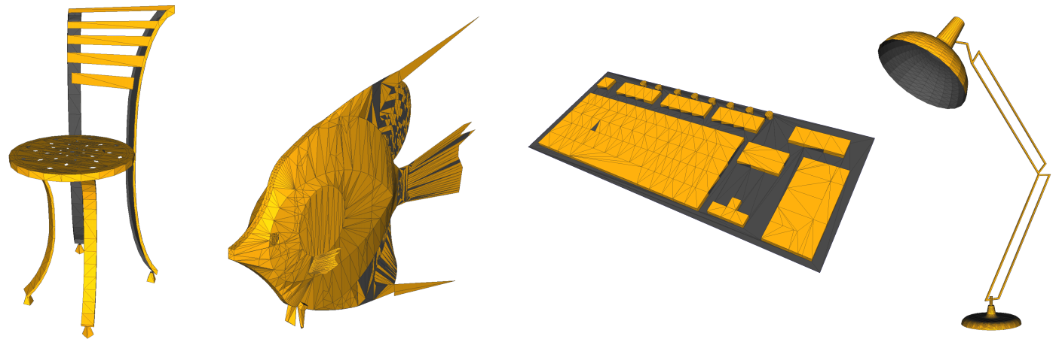
Larger backfacingness remaining
0.37
0.15
0.48
0.25
All belong to single-faceted geometries

Slide 23
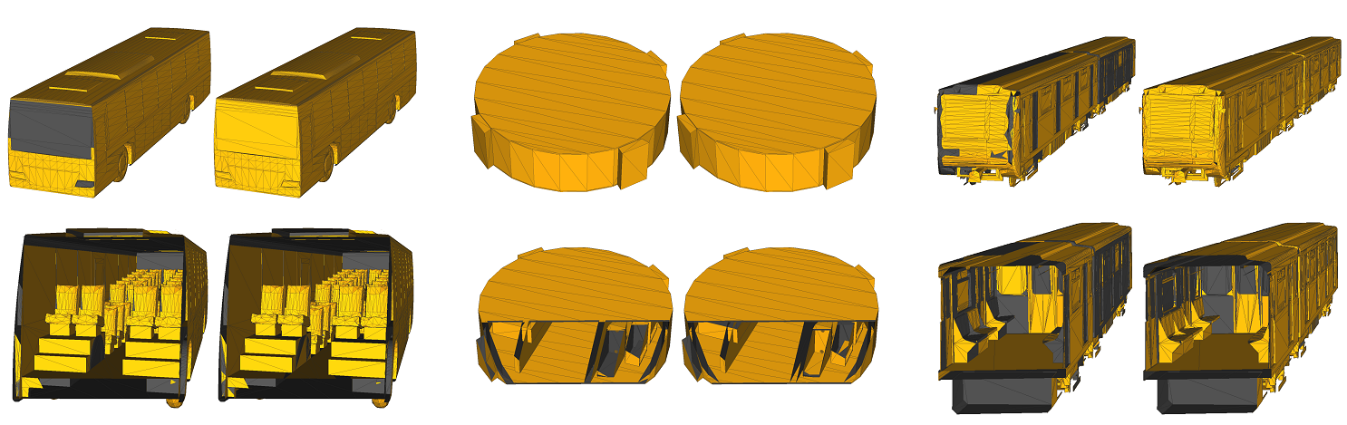
Meshes with interior objects

Slide 24
Thank you!
Demo executable and C++ code available at: http://jcgt.org/published/0003/04/02/
Acknowledgements:
Advice and feedback
Peter Kaufmann, Wenzel Jakob, Nobuyuki Umetani, Melina Skouras, Ilya Baran, Ryan Schmidt
Funding and gift
ERC grant iModel (StG-2012-306877), SNF award 200021_137879, NSF grant IIS-1350330, Adobe Research
Fellowships
Kenshi Takayama: JSPS Postdoctoral Fellowships for Research Abroad
Alec Jacobson: Intel Doctoral Fellowship

