Slide 1
Mathematics and Implementation of Computer Graphics Techniques 2015 Boundary Aligned Smooth 3D Cross-Frame Field Jin Huang, Yiying Tong, Hongyu Wei, Hujun Bao SIGGRAPH Asia 2011
Kenshi Takayama
Assistant Prof @ National Insitute of Informatics
takayama@nii.ac.jp
1st round
25 July 2015

Slide 2
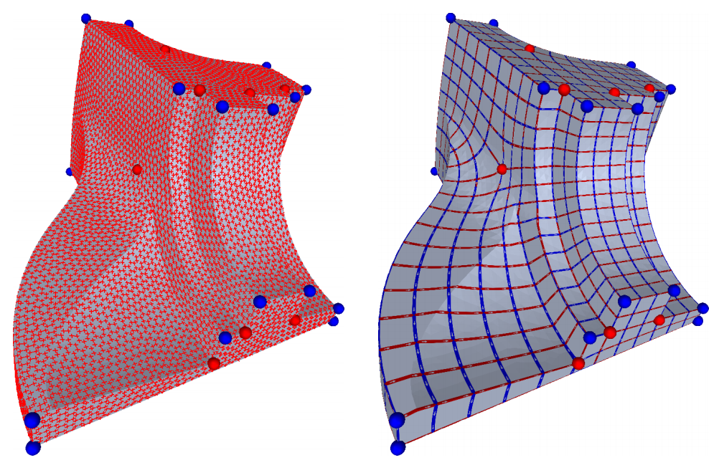
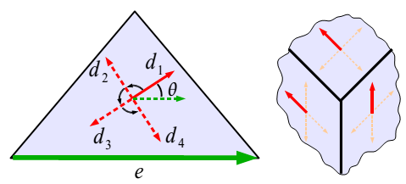
Background: 2D Frame Field & Quad Meshing
2D Frame Field
⬅ Auto-computed
UV Parameterization
⬅ Auto-computed
2D Frame Field
UV Parameterization
= Quad Mesh
Mixed-Integer Quadrangulation [Bommes,Zimmer,Kobbelt,SIGGRAPH09]

Slide 3
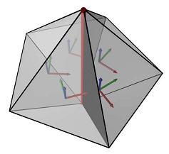
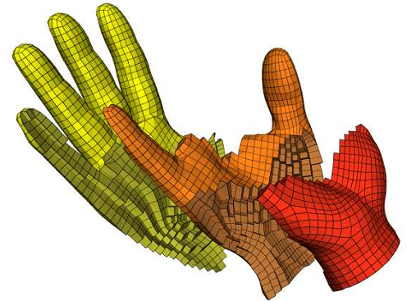
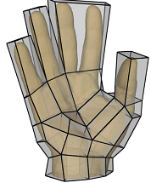
Background: 3D Frame Field & Hex Meshing
3D Frame Field
⬅ Heuristic
UVW Parameterization
⬅ Auto-computed
“Meta-Mesh” to define
3D Frame Field
UVW Parameterization
= Hex Mesh
CubeCover - Parameterization of 3D Volumes [Nieser,Reitebuch,Polthier,SGP11]

Slide 4
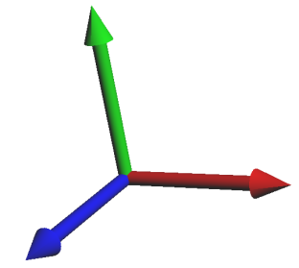
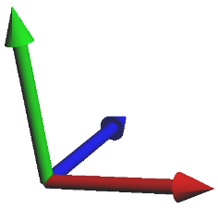
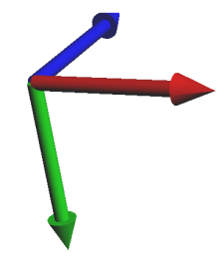
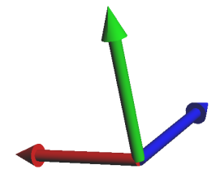
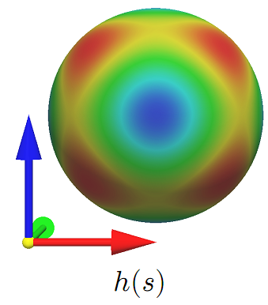


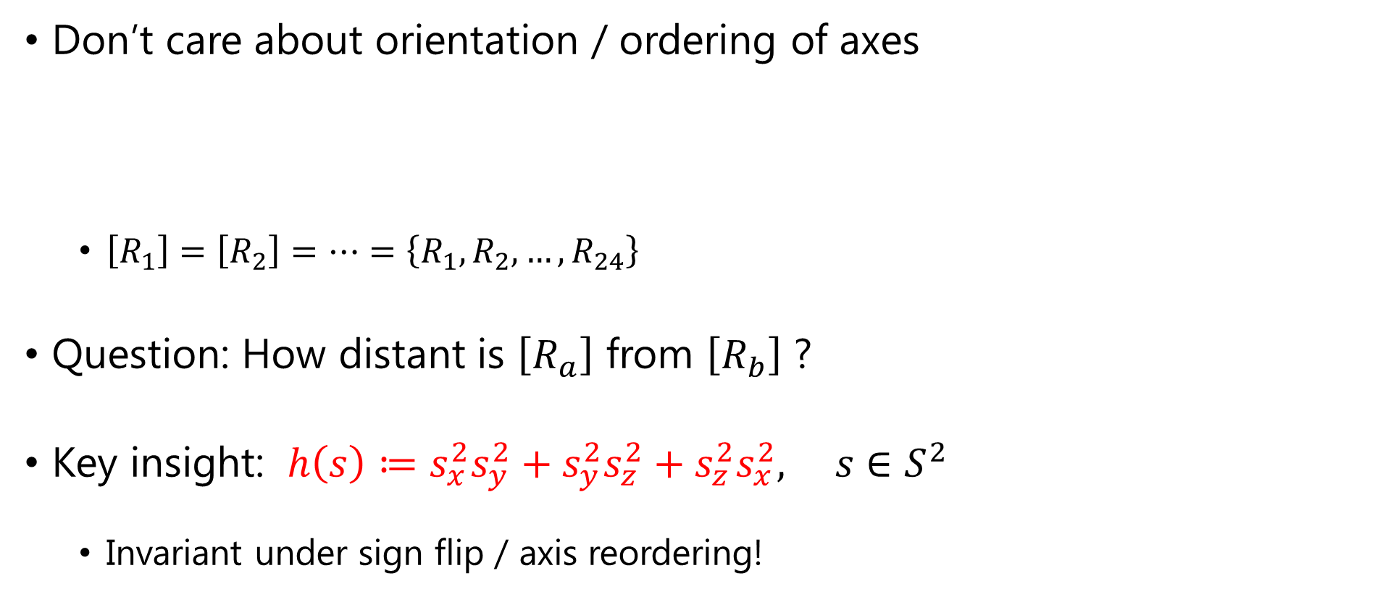


Definition of 3D Frame
Don’t care about orientation / ordering of axes
$\left[R_{1}\right]=\left[R_{2}\right]=…=\left\{R_{1},R_{2},…, R_{24}\right\}$
Question: How distant is $\left[R_{a}\right]$ from $\left[R_{b}\right]$ ?
Key insight: $h\left(s\right)≔s_{x}^{2}s_{y}^{2}+s_{y}^{2}s_{z}^{2}+s_{z}^{2}s_{x}^{2}, s∈S^{2}$
Invariant under sign flip / axis reordering!
$$R_{1}$$
$$R_{2}$$
$$R_{3}$$
$$R_{4}$$
・・・

Slide 5
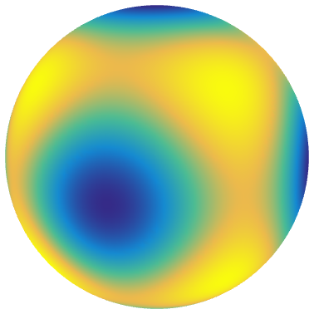
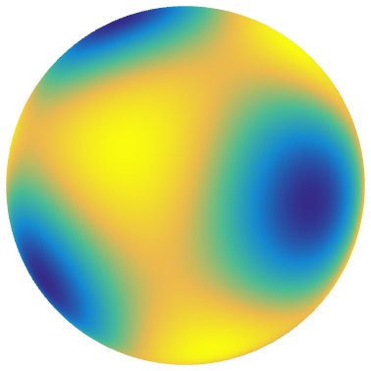


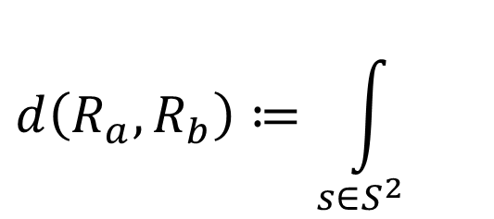


Distance between 3D Frames
$$h\left(s\right)≔s_{x}^{2}s_{y}^{2}+s_{y}^{2}s_{z}^{2}+s_{z}^{2}s_{x}^{2}$$
2
$$d\left(R_{a},R_{b}\right)≔\int_{s∈S^{2}}{}$$
$$ds$$
$$h\left(R_{a}^{⊤}s\right)$$
$$h\left(R_{b}^{⊤}s\right)$$
Integral over an entire sphere ➔ Spherical Harmonics!

Slide 6
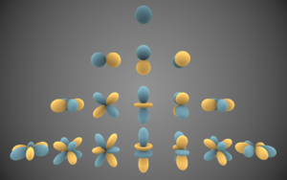


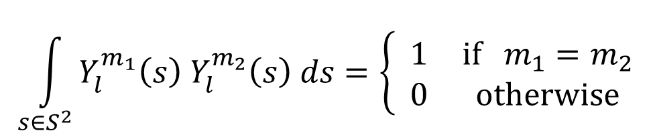
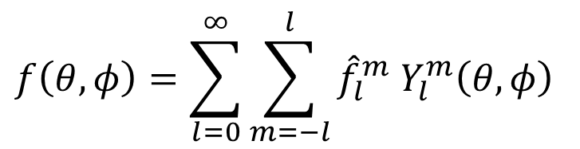
Basics of Spherical Harmonics
Something like Fourier series on sphere
Orthonormality:
-3
-2
-1
0
1
2
3
$$m$$
$$f\left(θ,φ\right)=\sum_{l=0}^{∞}{\sum_{m=−l}^{l}{{\hat{f}}_{l}^{m} Y_{l}^{m}\left(θ,φ\right)}}$$
0
1
2
3
$$\int_{s∈S^{2}}{Y_{l}^{m_{1}}\left(s\right) Y_{l}^{m_{2}}\left(s\right) ds}=\left\{ \begin{matrix}1 & if { m}_{1}=m_{2} \\ 0 & otherwise\end{matrix}\right.$$
$$l$$

Slide 7
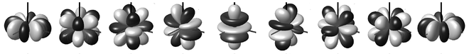


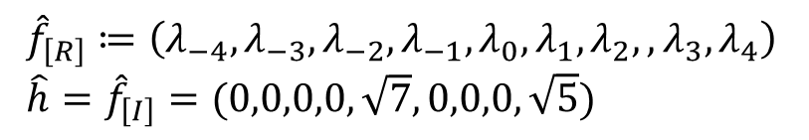


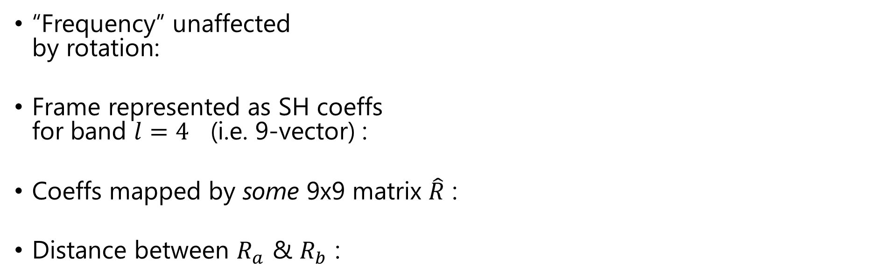


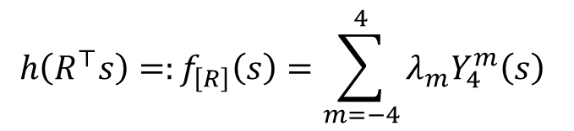
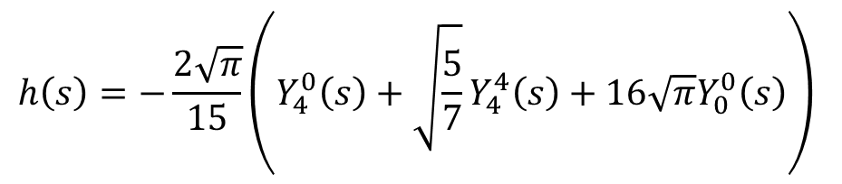

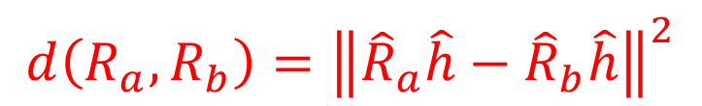




Frame represented by SH
$$Y_{4}^{−4}$$
$$Y_{4}^{−3}$$
$$Y_{4}^{−2}$$
$$Y_{4}^{−1}$$
$$Y_{4}^{0}$$
$$Y_{4}^{1}$$
$$Y_{4}^{2}$$
$$Y_{4}^{3}$$
$$Y_{4}^{4}$$
$$h\left(s\right)=−\frac{2\sqrt{π}}{15}\left(Y_{4}^{0}\left(s\right)+\sqrt{\frac{5}{7}}Y_{4}^{4}\left(s\right)+16\sqrt{π}Y_{0}^{0}\left(s\right)\right)$$
simplify
$$h\left(s\right)≔\sqrt{7}Y_{4}^{0}\left(s\right)+\sqrt{5}Y_{4}^{4}\left(s\right)$$
$$h\left(R^{⊤}s\right)=:f_{\left[R\right]}\left(s\right)=\sum_{m=−4}^{4}{{λ_{m}Y}_{4}^{m}\left(s\right)}$$
“Frequency” unaffected by rotation:
Frame represented as SH coeffs for band $l=4$ (i.e. 9-vector) :
Coeffs mapped by some 9x9 matrix $\hat{R}$ :
Distance between $R_{a}$ & $R_{b}$ :
${\hat{f}}_{\left[R\right]}≔\left(λ_{−4},λ_{−3},λ_{−2},λ_{−1},λ_{0},λ_{1},λ_{2},,λ_{3},λ_{4}\right)$
$\hat{h}={\hat{f}}_{\left[I\right]}=(0,0,0,0,\sqrt{7},0,0,0,\sqrt{5})$
$${\hat{f}}_{\left[R\right]}=\hat{R} \hat{h}$$
$$d\left(R_{a},R_{b}\right)={\left\|{\hat{R}}_{a}\hat{h}−{\hat{R}}_{b}\hat{h}\right\|}^{2}$$

Slide 8

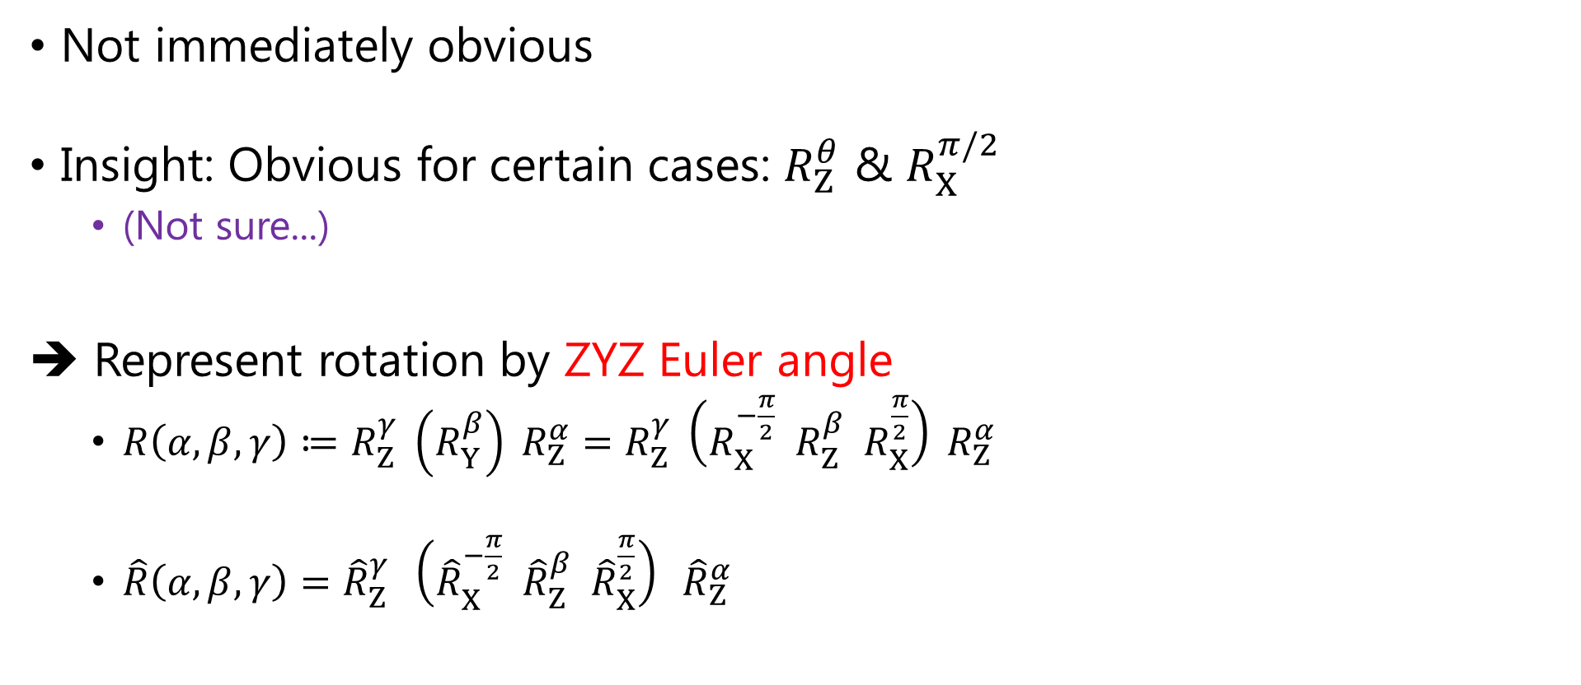
Computing 9x9 $\hat{R}$ from 3D rotation $R$
Not immediately obvious
Insight: Obvious for certain cases: $R_{Z}^{θ}$ & $R_{X}^{π/2}$
(Not sure...)
➔ Represent rotation by ZYZ Euler angle
$R\left(α,β,γ\right)≔R_{Z}^{γ} \left(R_{Y}^{β}\right) R_{Z}^{α}=R_{Z}^{γ} \left(R_{X}^{−\frac{π}{2}} R_{Z}^{β} R_{X}^{\frac{π}{2}}\right) R_{Z}^{α}$
$\hat{R}\left(α,β,γ\right)={\hat{R}}_{Z}^{γ} \left({\hat{R}}_{X}^{−\frac{π}{2}} {\hat{R}}_{Z}^{β} {\hat{R}}_{X}^{\frac{π}{2}}\right) {\hat{R}}_{Z}^{α}$
Rotation about Z axis by θ

Slide 9


Frame that aligns with boundary surface
Coeff for $Y_{4}^{0}$
Frame $\left[R\right]$ aligns with:
Z axis iff ${\hat{f}}_{\left[R\right]}\left(0\right)=\sqrt{7}$
Surface normal $n$ iff $\left({\hat{R}}_{n→Z} {\hat{f}}_{\left[R\right]}\right)\left(0\right)=\sqrt{7}$
$R_{n→Z}$ : Rotation that brings n to Z axis
(Proof in Appendix)

Slide 10
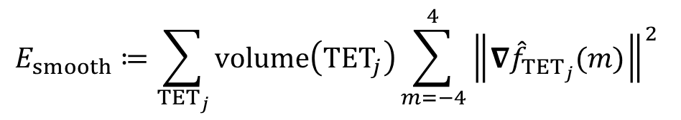
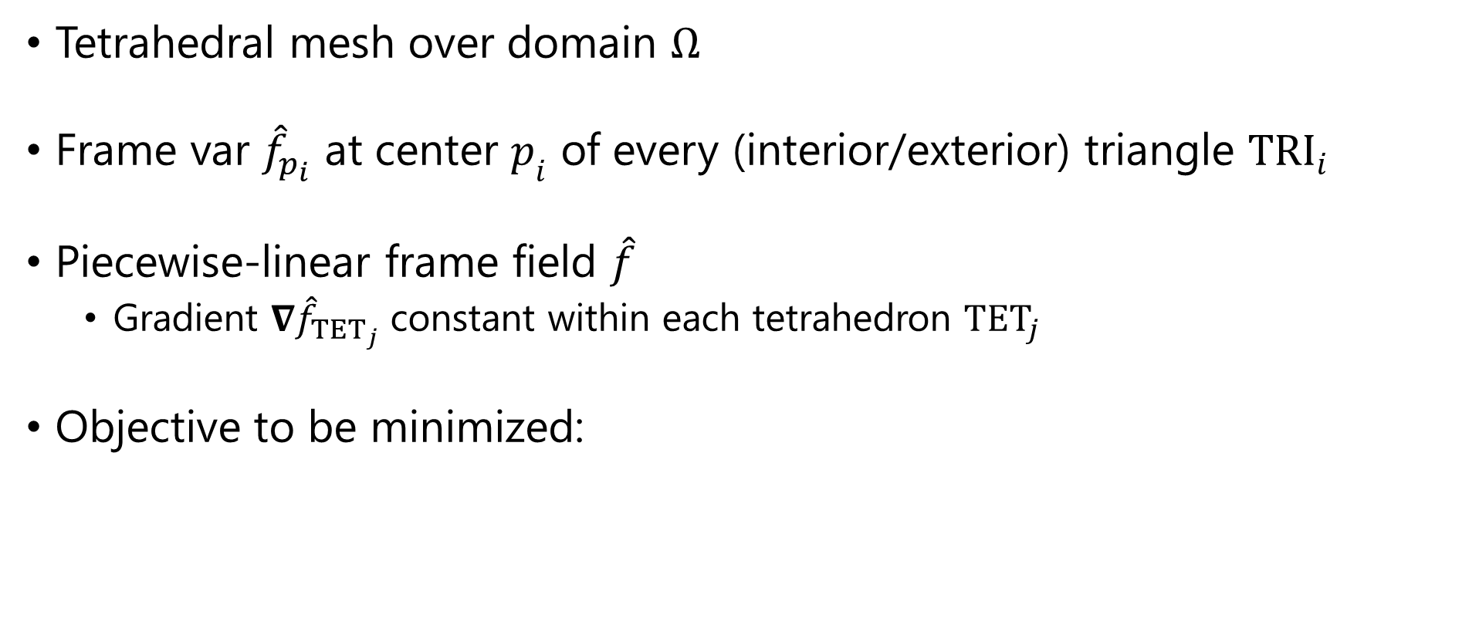
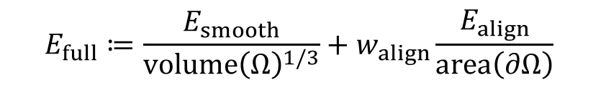
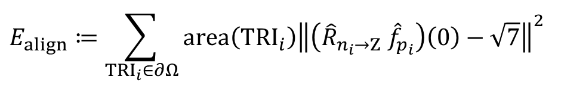
Discretization & Objective
Tetrahedral mesh over domain $Ω$
Frame var ${\hat{f}}_{p_{i}}$ at center $p_{i}$ of every (interior/exterior) triangle ${TRI}_{i}$
Piecewise-linear frame field $\hat{f}$
Gradient $∇{\hat{f}}_{{TET}_{j}}$ constant within each tetrahedron ${TET}_{j}$
Objective to be minimized:
$$E_{smooth}≔\sum_{{TET}_{j}}{volume\left({TET}_{j}\right)\sum_{m=−4}^{4}{{\left\|∇{\hat{f}}_{{TET}_{j}}(m)\right\|}^{2}}}$$
$$E_{full}≔\frac{E_{smooth}}{volume{\left(Ω\right)}^{1/3}}+w_{align}\frac{E_{align}}{area\left(∂Ω\right)}$$
$$E_{align}≔\sum_{{TRI}_{i}∈∂Ω}{area\left({TRI}_{i}\right){\left\|\left({\hat{R}}_{n_{i}→Z} {\hat{f}}_{p_{i}}\right)\left(0\right)−\sqrt{7}\right\|}^{2}}$$

Slide 11
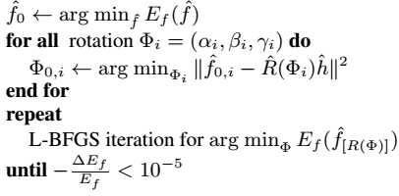
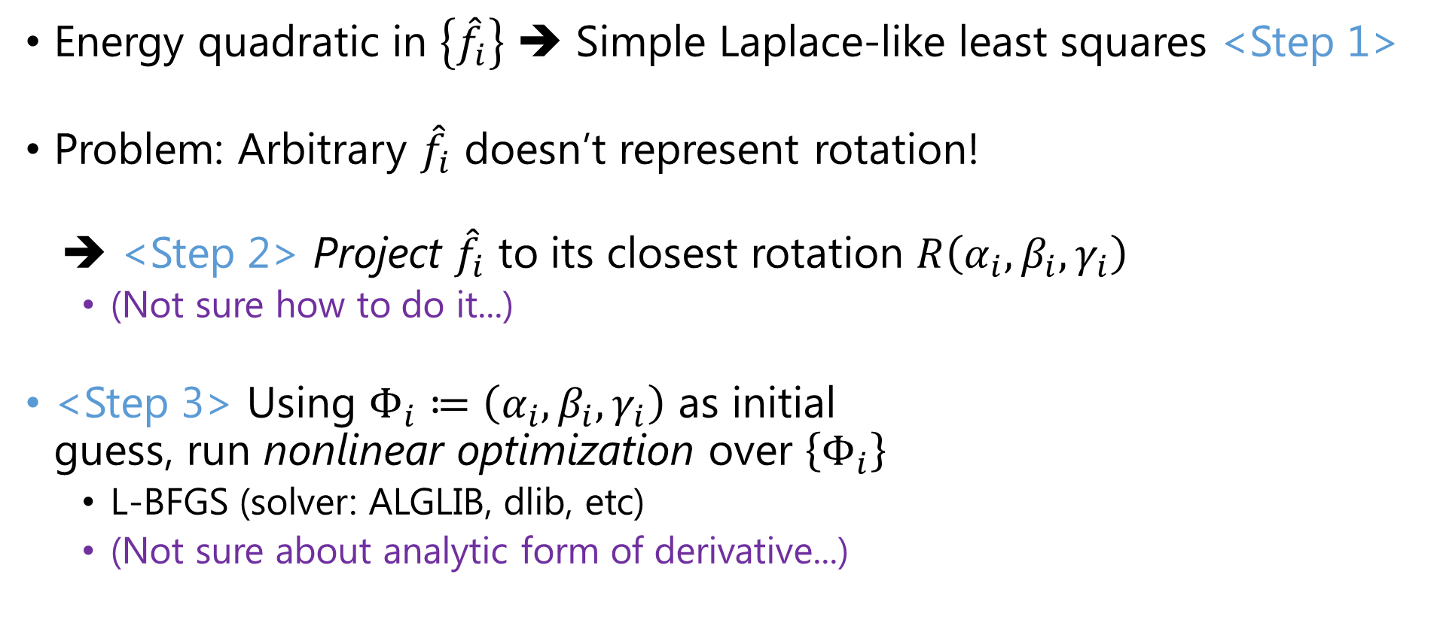
Optimization
Energy quadratic in $\left\{{\hat{f}}_{i}\right\}$ ➔ Simple Laplace-like least squares <Step 1>
Problem: Arbitrary ${\hat{f}}_{i}$ doesn’t represent rotation!
➔ <Step 2> Project ${\hat{f}}_{i}$ to its closest rotation $R\left(α_{i},β_{i},γ_{i}\right)$
(Not sure how to do it...)
<Step 3> Using $Φ_{i}≔\left(α_{i},β_{i},γ_{i}\right)$ as initial guess, run nonlinear optimization over $\left\{Φ_{i}\right\}$
L-BFGS (solver: ALGLIB, dlib, etc)
(Not sure about analytic form of derivative...)

Slide 12
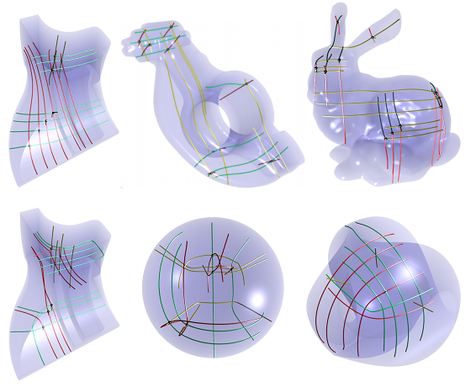
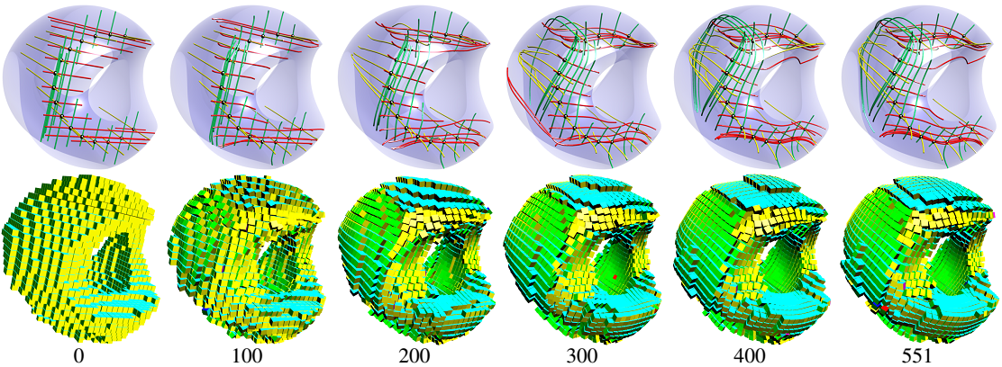
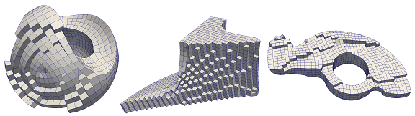
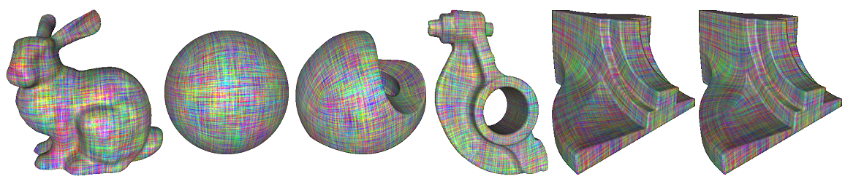
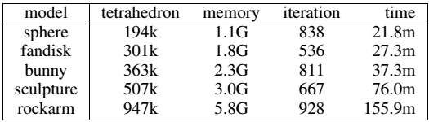
Results & Performance

Slide 13

Questions
Regarding implementation:
Expressions for ${\hat{R}}_{Z}^{θ}$ & ${\hat{R}}_{X}^{π/2}$
Projection of ${\hat{f}}_{i}$ to its closest rotation $R\left(α_{i},β_{i},γ_{i}\right)$
Analytic derivative of $E_{full}$ w.r.t. $\{Φ_{i}\}$
Possible idea for improvement:
Can we sidestep nonlinear optimization by alternating Laplace smoothing and “normalization”?

