Slide 1
Mathematics and Implementation of Computer Graphics Techniques 2015 Boundary Aligned Smooth 3D Cross-Frame Field Jin Huang, Yiying Tong, Hongyu Wei, Hujun Bao SIGGRAPH Asia 2011
Kenshi Takayama
Assistant Prof @ National Insitute of Informatics
takayama@nii.ac.jp
2nd round
3 October 2015

Slide 2
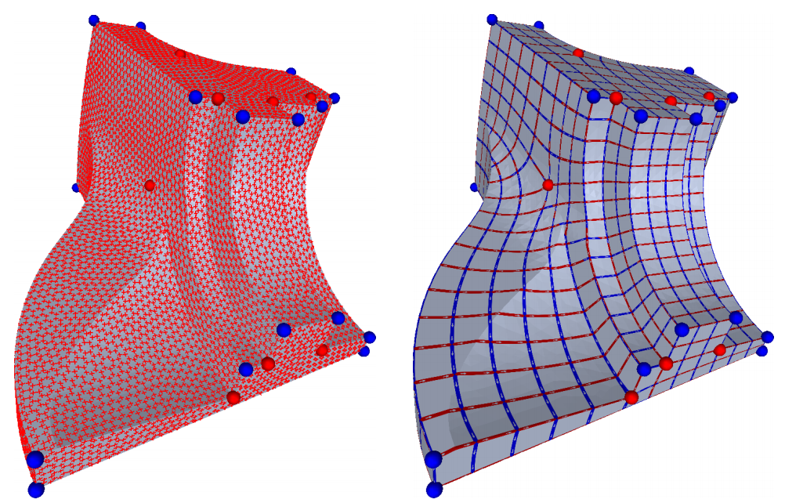
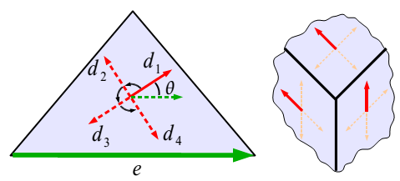
Background: 2D Frame Field & Quad Meshing
2D Frame Field
⬅ Auto-computed
UV Parameterization
⬅ Auto-computed
2D Frame Field
UV Parameterization
= Quad Mesh
Mixed-Integer Quadrangulation [Bommes,Zimmer,Kobbelt,SIGGRAPH09]

Slide 3
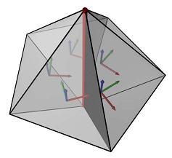
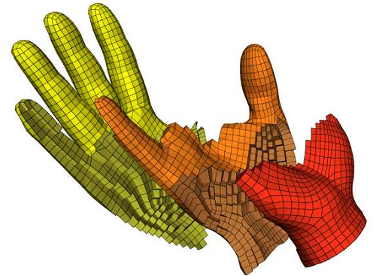
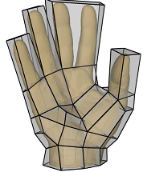
Background: 3D Frame Field & Hex Meshing
3D Frame Field
⬅ Heuristic
UVW Parameterization
⬅ Auto-computed
“Meta-Mesh” to define
3D Frame Field
UVW Parameterization
= Hex Mesh
CubeCover - Parameterization of 3D Volumes [Nieser,Reitebuch,Polthier,SGP11]

Slide 4
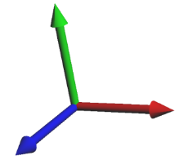
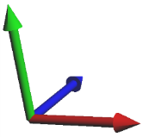
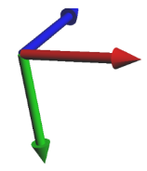
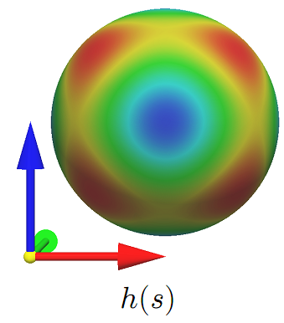
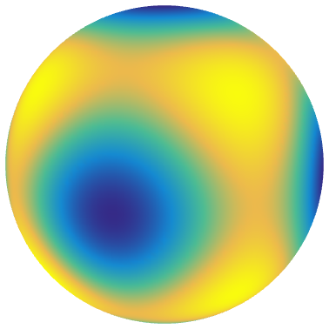
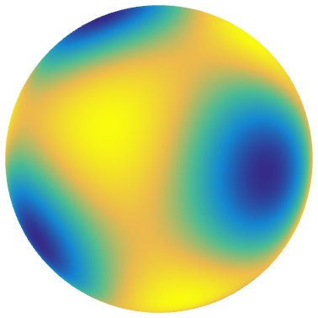



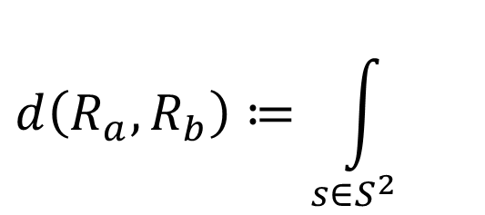




Distance between 3D Frames
$$R_{1}$$
$$R_{2}$$
$$R_{3}$$
・・・
$$h\left(s\right)≔s_{x}^{2}s_{y}^{2}+s_{y}^{2}s_{z}^{2}+s_{z}^{2}s_{x}^{2}$$
2
$$d\left(R_{a},R_{b}\right)≔\int_{s∈S^{2}}{}$$
$$ds$$
$$h\left(R_{a}s\right)$$
$$h\left(R_{b}s\right)$$
Integral over an entire sphere ➔ Spherical Harmonics!

Slide 5
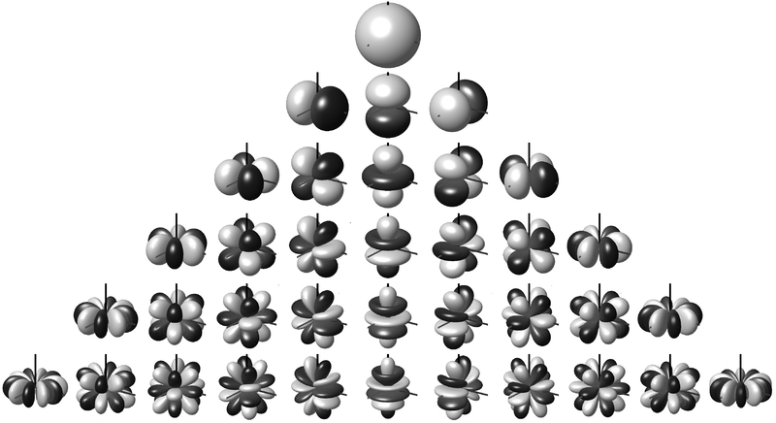
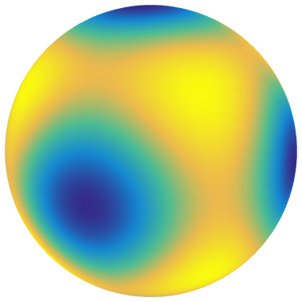
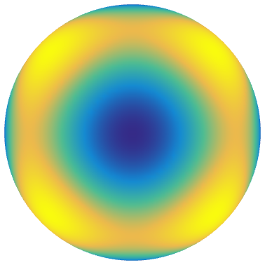



























Representing 3D frames using SH coeffs
$$h\left(R s\right) =λ_{−4}×$$
$${+ λ}_{−3}×$$
$${+ λ}_{−2}×$$
$$h\left(s\right) =s_{x}^{2}s_{y}^{2}+s_{y}^{2}s_{z}^{2}+s_{z}^{2}s_{x}^{2}$$
$$Y_{4}^{−4}$$
$$Y_{4}^{−3}$$
$$Y_{4}^{−2}$$
$${+ λ}_{−1}×$$
$${+ λ}_{0}×$$
$$+ λ_{1}×$$
$$=\sqrt{7}×$$
$$+ \sqrt{5}×$$
$$Y_{4}^{−1}$$
$$Y_{4}^{0}$$
$$Y_{4}^{1}$$
$$Y_{4}^{0}$$
$$Y_{4}^{4}$$
$${+ λ}_{2}×$$
$${+ λ}_{3}×$$
$${+ λ}_{4}×$$
$$Y_{4}^{2}$$
$$Y_{4}^{3}$$
$$Y_{4}^{4}$$
$$λ_{−4}$$
$$λ_{−3}$$
$$λ_{−2}$$
$$λ_{−1}$$
$$λ_{0}$$
$$λ_{1}$$
$$λ_{2}$$
$$λ_{3}$$
$$λ_{4}$$
$$\hat{R}$$
$$0$$
$$0$$
$$0$$
$$0$$
$$\sqrt{7}$$
$$0$$
$$0$$
$$0$$
$$\sqrt{5}$$
$$=$$

Slide 6
































Representing $\hat{R}$ using ZYZ Euler angles
$$R\left(α,β,γ\right)$$
$$R_{Z}\left(γ\right)$$
$$R_{Y}\left(β\right)$$
$$R_{Z}\left(α\right)$$
$$=$$
Rotation about Z axis by $α$
$$R_{Z}\left(γ\right)$$
$$R_{X}\left(−\frac{π}{2} \right)$$
$$R_{Z}\left(β\right)$$
$$R_{X}\left( \frac{π}{2} \right)$$
$$R_{Z}\left(α\right)$$
$$=$$
$$\cos{γ}$$
$$\sin{γ}$$
$$0$$
$$−sin{γ}$$
$$\cos{γ}$$
$$0$$
$$0$$
$$0$$
$$1$$
$$1$$
$$0$$
$$0$$
$$0$$
$$0$$
$$−1$$
$$0$$
$$1$$
$$0$$
$$\cos{β}$$
$$\sin{β}$$
$$0$$
$$−sin{β}$$
$$\cos{β}$$
$$0$$
$$0$$
$$0$$
$$1$$
$$1$$
$$0$$
$$0$$
$$0$$
$$0$$
$$1$$
$$0$$
$$−1$$
$$0$$
$$\cos{α}$$
$$\sin{α}$$
$$0$$
$$−sin{α}$$
$$\cos{α}$$
$$0$$
$$=$$
$$0$$
$$0$$
$$1$$
● ● ● ● ● ● ● ● ●
● ● ● ● ● ● ● ● ●
● ● ● ● ● ● ● ● ●
● ● ● ● ● ● ● ● ●
● ● ● ● ● ● ● ● ●
● ● ● ● ● ● ● ● ●
● ● ● ● ● ● ● ● ●
● ● ● ● ● ● ● ● ●
● ● ● ● ● ● ● ● ●
● ● ● ● ● ● ● ● ●
● ● ● ● ● ● ● ● ●
● ● ● ● ● ● ● ● ●
● ● ● ● ● ● ● ● ●
● ● ● ● ● ● ● ● ●
● ● ● ● ● ● ● ● ●
● ● ● ● ● ● ● ● ●
● ● ● ● ● ● ● ● ●
● ● ● ● ● ● ● ● ●
$${\hat{R}}_{Z}\left(γ\right)$$
● ● ● ● ● ● ● ● ●
● ● ● ● ● ● ● ● ●
● ● ● ● ● ● ● ● ●
● ● ● ● ● ● ● ● ●
● ● ● ● ● ● ● ● ●
● ● ● ● ● ● ● ● ●
● ● ● ● ● ● ● ● ●
● ● ● ● ● ● ● ● ●
● ● ● ● ● ● ● ● ●
$${\hat{R}}_{X}\left(−\frac{π}{2} \right)$$
● ● ● ● ● ● ● ● ●
● ● ● ● ● ● ● ● ●
● ● ● ● ● ● ● ● ●
● ● ● ● ● ● ● ● ●
● ● ● ● ● ● ● ● ●
● ● ● ● ● ● ● ● ●
● ● ● ● ● ● ● ● ●
● ● ● ● ● ● ● ● ●
● ● ● ● ● ● ● ● ●
$${\hat{R}}_{Z}\left(β\right)$$
● ● ● ● ● ● ● ● ●
● ● ● ● ● ● ● ● ●
● ● ● ● ● ● ● ● ●
● ● ● ● ● ● ● ● ●
● ● ● ● ● ● ● ● ●
● ● ● ● ● ● ● ● ●
● ● ● ● ● ● ● ● ●
● ● ● ● ● ● ● ● ●
● ● ● ● ● ● ● ● ●
$${\hat{R}}_{X}\left( \frac{π}{2} \right)$$
● ● ● ● ● ● ● ● ●
● ● ● ● ● ● ● ● ●
● ● ● ● ● ● ● ● ●
● ● ● ● ● ● ● ● ●
● ● ● ● ● ● ● ● ●
● ● ● ● ● ● ● ● ●
● ● ● ● ● ● ● ● ●
● ● ● ● ● ● ● ● ●
● ● ● ● ● ● ● ● ●
$$\hat{R}\left(α,β,γ\right)$$
$${\hat{R}}_{Z}\left(α\right)$$
$$=$$

Slide 7
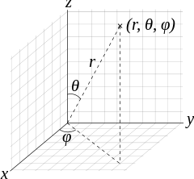
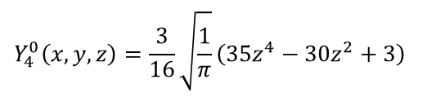
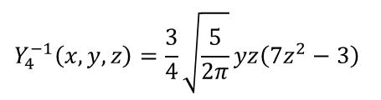
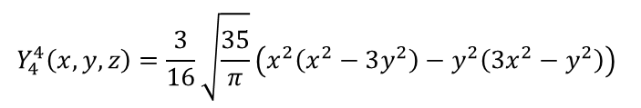
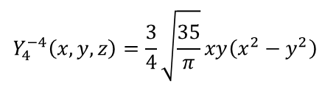
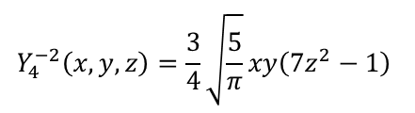
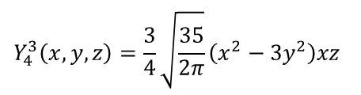
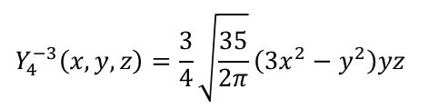
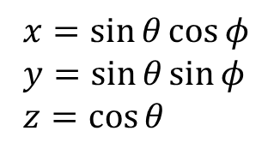
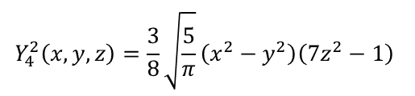
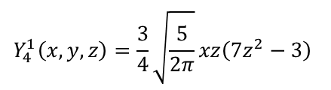
Deriving ${\hat{R}}_{Z}\left(α\right)$ & ${\hat{R}}_{X}\left( \frac{π}{2} \right)$
https://en.wikipedia.org/wiki/Table_of_spherical_harmonics#Real_spherical_harmonics
$$Y_{4}^{−4}\left(x,y,z\right)=\frac{3}{4}\sqrt{\frac{35}{π}}xy\left(x^{2}−y^{2}\right)$$
$$Y_{4}^{0}\left(x,y,z\right)=\frac{3}{16}\sqrt{\frac{1}{π}}\left(35z^{4}−30z^{2}+3\right)$$
$$Y_{4}^{4}\left(x,y,z\right)=\frac{3}{16}\sqrt{\frac{35}{π}}\left(x^{2}\left(x^{2}−3y^{2}\right)−y^{2}\left(3x^{2}−y^{2}\right)\right)$$
$$Y_{4}^{−3}\left(x,y,z\right)=\frac{3}{4}\sqrt{\frac{35}{2π}}\left(3x^{2}−y^{2}\right)yz$$
$$Y_{4}^{1}\left(x,y,z\right)=\frac{3}{4}\sqrt{\frac{5}{2π}}xz\left(7z^{2}−3\right)$$
$$Y_{4}^{−2}\left(x,y,z\right)=\frac{3}{4}\sqrt{\frac{5}{π}}xy\left(7z^{2}−1\right)$$
$$Y_{4}^{2}\left(x,y,z\right)=\frac{3}{8}\sqrt{\frac{5}{π}}\left(x^{2}−y^{2}\right)\left(7z^{2}−1\right)$$
$x=\sin{θ}\cos{φ}$
$y=\sin{θ}\sin{φ}$
$z=\cos{θ}$
$$Y_{4}^{−1}\left(x,y,z\right)=\frac{3}{4}\sqrt{\frac{5}{2π}}yz\left(7z^{2}−3\right)$$
$$Y_{4}^{3}\left(x,y,z\right)=\frac{3}{4}\sqrt{\frac{35}{2π}}\left(x^{2}−3y^{2}\right)xz$$
$${{\hat{R}}_{Z}\left(α\right)}_{i,j}=\int_{0}^{2π}{\int_{0}^{π}{Y_{4}^{i}\left(\sin{θ}\cos\left(φ+α\right),\sin{θ}\sin\left(φ+α\right),\cos{θ}\right)⋅Y_{4}^{j}\left(\sin{θ}\cos{φ},\sin{θ}\sin{φ},\cos{θ}\right)\sin{θ}ⅆθ}ⅆφ}$$
$${{\hat{R}}_{X}\left( \frac{π}{2} \right)}_{i,j}=\int_{0}^{2π}{\int_{0}^{π}{Y_{4}^{i}\left(\sin{θ}\cos{φ},−\cos{θ},\sin{θ}\sin{φ}\right)⋅Y_{4}^{j}\left(\sin{θ}\cos{φ},\sin{θ}\sin{φ},\cos{θ}\right)\sin{θ}ⅆθ}ⅆφ}$$
➔ use Computer Algebra Systems (CAS): Mathematica, Maple, Sage

Slide 8
Sage code (https://cloud.sagemath.com)
Y4_4(x,y,z) = 3/4*sqrt(35/pi)*x*y*(x^2 - y^2)
Y4_3(x,y,z) = 3/4*sqrt(35/(2*pi))*(3*x^2 - y^2)*y*z
Y4_2(x,y,z) = 3/4*sqrt(5/pi)*x*y*(7*z^2 - 1)
Y4_1(x,y,z) = 3/4*sqrt(5/(2*pi))*y*z*(7*z^2 - 3)
Y40(x,y,z) = 3/16*sqrt(1/pi)*(35*z^4 - 30*z^2 + 3)
Y41(x,y,z) = 3/4*sqrt(5/(2*pi))*x*z*(7*z^2 - 3)
Y42(x,y,z) = 3/8*sqrt(5/pi)*(x^2 - y^2)*(7*z^2 - 1)
Y43(x,y,z) = 3/4*sqrt(35/(2*pi))*(x^2 - 3*y^2)*x*z
Y44(x,y,z) = 3/16*sqrt(35/pi)*(x^2*(x^2 - 3*y^2) - y^2*(3*x^2 - y^2))
Y4 = [Y4_4, Y4_3, Y4_2, Y4_1, Y40, Y41, Y42, Y43, Y44]
for i in range(9):
v = []
for j in range(9):
Si(theta, phi) = Y4[i](sin(theta)*cos(phi+a), sin(theta)*sin(phi+a), cos(theta))
Sj(theta, phi) = Y4[j](sin(theta)*cos(phi), sin(theta)*sin(phi), cos(theta))
v.append(integral(Si(theta, phi) * Sj(theta, phi) * sin(theta), theta, 0, pi).integrate(phi, 0, 2*pi))
print v
for i in range(9):
v = []
for j in range(9):
Si(theta, phi) = Y4[i](sin(theta)*cos(phi), -cos(theta), sin(theta)*sin(phi))
Sj(theta, phi) = Y4[j](sin(theta)*cos(phi), sin(theta)*sin(phi), cos(theta))
v.append(integral(Si(theta, phi) * Sj(theta, phi) * sin(theta), theta, 0, pi).integrate(phi, 0, 2*pi))
print v

Slide 9

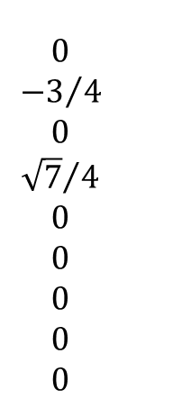
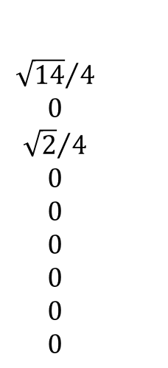

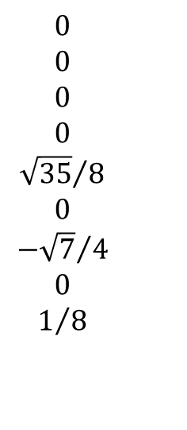


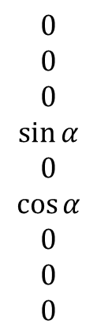

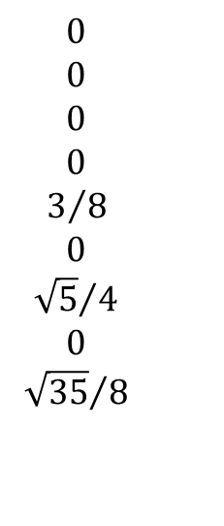










Matrices written down
$$\cos{4α}$$
$$0$$
$$0$$
$$0$$
$$0$$
$$0$$
$$0$$
$$0$$
$$−\sin{4α}$$
$$0$$
$$\cos{3α}$$
$$0$$
$$0$$
$$0$$
$$0$$
$$0$$
$$−\sin{3α}$$
$$0$$
$$0$$
$$0$$
$$\cos{2α}$$
$$0$$
$$0$$
$$0$$
$$−\sin{2α}$$
$$0$$
$$0$$
$$0$$
$$0$$
$$0$$
$$\cos{α}$$
$$0$$
$$−\sin{α}$$
$$0$$
$$0$$
$$0$$
$$0$$
$$0$$
$$0$$
$$0$$
$$1$$
$$0$$
$$0$$
$$0$$
$$0$$
$$0$$
$$0$$
$$0$$
$$\sin{α}$$
$$0$$
$$\cos{α}$$
$$0$$
$$0$$
$$0$$
$$0$$
$$0$$
$$\sin{2α}$$
$$0$$
$$0$$
$$0$$
$$\cos{2α}$$
$$0$$
$$0$$
$$0$$
$$\sin{3α}$$
$$0$$
$$0$$
$$0$$
$$0$$
$$0$$
$$\cos{3α}$$
$$0$$
$$\sin{4α}$$
$$0$$
$$0$$
$$0$$
$$0$$
$$0$$
$$0$$
$$0$$
$$\cos{4α}$$
$${\hat{R}}_{Z}\left(α\right)=$$
$$0$$
$$0$$
$$0$$
$$0$$
$$0$$
$${−\sqrt{14}}/4$$
$$0$$
$${\sqrt{2}}/4$$
$$0$$
$$0$$
$${−3}/4$$
$$0$$
$${\sqrt{7}}/4$$
$$0$$
$$0$$
$$0$$
$$0$$
$$0$$
$$0$$
$$0$$
$$0$$
$$0$$
$$0$$
$${−\sqrt{2}}/4$$
$$0$$
$${−\sqrt{14}}/4$$
$$0$$
$$0$$
$${\sqrt{7}}/4$$
$$0$$
$$3/4$$
$$0$$
$$0$$
$$0$$
$$0$$
$$0$$
$$0$$
$$0$$
$$0$$
$$0$$
$$3/8$$
$$0$$
$${\sqrt{5}}/4$$
$$0$$
$${\sqrt{35}}/8$$
$${\sqrt{14}}/4$$
$$0$$
$${\sqrt{2}}/4$$
$$0$$
$$0$$
$$0$$
$$0$$
$$0$$
$$0$$
$$0$$
$$0$$
$$0$$
$$0$$
$${\sqrt{5}}/4$$
$$0$$
$$1/2$$
$$0$$
$${−\sqrt{7}}/4$$
$${−\sqrt{2}}/4$$
$$0$$
$${\sqrt{14}}/4$$
$$0$$
$$0$$
$$0$$
$$0$$
$$0$$
$$0$$
$$0$$
$$0$$
$$0$$
$$0$$
$${\sqrt{35}}/8$$
$$0$$
$${−\sqrt{7}}/4$$
$$0$$
$$1/8$$
$${\hat{R}}_{X}\left( \frac{π}{2} \right)=$$

Slide 10
















Going between ZYZ (3D) ⬄ SH (9D)
$$0$$
$$0$$
$$0$$
$$0$$
$$\sqrt{7}$$
$$0$$
$$0$$
$$0$$
$$\sqrt{5}$$
$$f\left(α,β,γ\right)≔{\hat{R}}_{Z}\left(γ\right)⋅{\hat{R}}_{X}\left(−\frac{π}{2} \right)⋅{\hat{R}}_{Z}\left(β\right)⋅{\hat{R}}_{X}\left( \frac{π}{2} \right)⋅{\hat{R}}_{Z}\left(α\right)⋅\hat{h}$$
$$\hat{h}≔$$
ZYZ ➔ SH
SH ➔ ZYZ
Minimize $E\left(α,β,γ\right)$ using Conjugate Gradient
$$g\left(f_{in}\right)≔\underset{\left(α, β,γ\right)∈ℝ^{3}}{arg min}{{\left\|f_{in}−f\left(α,β,γ\right)\right\|}^{2}}$$
$$−4\sin{4α}$$
$$0$$
$$0$$
$$0$$
$$0$$
$$0$$
$$0$$
$$0$$
$$−4\cos{4α}$$
$$0$$
$$−3\sin{3α}$$
$$0$$
$$0$$
$$0$$
$$0$$
$$0$$
$$−3\cos{3α}$$
$$0$$
$$0$$
$$0$$
$$−2\sin{2α}$$
$$0$$
$$0$$
$$0$$
$$−2\cos{2α}$$
$$0$$
$$0$$
$$0$$
$$0$$
$$0$$
$$−\sin{α}$$
$$0$$
$$−\cos{α}$$
$$0$$
$$0$$
$$0$$
$$0$$
$$0$$
$$0$$
$$0$$
$$0$$
$$0$$
$$0$$
$$0$$
$$0$$
$$0$$
$$0$$
$$0$$
$$\cos{α}$$
$$0$$
$$−\sin{α}$$
$$0$$
$$0$$
$$0$$
$$0$$
$$0$$
$$2\cos{2α}$$
$$0$$
$$0$$
$$0$$
$$−2\sin{2α}$$
$$0$$
$$0$$
$$0$$
$$3\cos{3α}$$
$$0$$
$$0$$
$$0$$
$$0$$
$$0$$
$$−3\sin{3α}$$
$$0$$
$$4\cos{4α}$$
$$0$$
$$0$$
$$0$$
$$0$$
$$0$$
$$0$$
$$0$$
$$−4\sin{4α}$$
$$\frac{dE}{dα}=−2{\left(f_{in}−f\left(α,β,γ\right)\right)}^{⊤}\frac{df}{dα}$$
$$\frac{d{\hat{R}}_{Z}}{dα}=$$
$$\frac{df}{dα}={\hat{R}}_{Z}\left(γ\right)⋅{\hat{R}}_{X}\left(−\frac{π}{2} \right)⋅{\hat{R}}_{Z}\left(β\right)⋅{\hat{R}}_{X}\left( \frac{π}{2} \right)⋅\frac{d{\hat{R}}_{Z}}{dα}⋅\hat{h}$$

Slide 11










Toy example: interpolating two frames
$$t=0$$
$$t=1$$
$$f_{0}=f\left(α_{0},β_{0},γ_{0}\right)$$
$α_{0}={53}^{∘}$
$β_{0}={60}^{∘}$
$γ_{0}={356}^{∘}$
$$\left(α_{t},β_{t},γ_{t}\right)=\underset{\left(α, β,γ\right)∈ℝ^{3}}{arg min}{{\left\|\left(1−t\right) f_{0}+t{ f}_{1}−f\left(α,β,γ\right)\right\|}^{2}}$$
$$f_{1}=f\left(α_{1},β_{1},γ_{1}\right)$$
$α_{1}={160}^{∘}$
$β_{1}={43}^{∘}$
$$γ_{1}=2^{∘}$$

Slide 12






Real examples with tetrahedral meshes

Slide 13

Small differences from [Huang11]
Per-vertex discretization
⬄ per-face (Crouzeix-Raviart) discretization
#vertices ≪ #faces ➔ much smaller problem size (x0.1)
Normal alignment properly handled
No global nonlinear solve w.r.t. $\left\{ \left(α_{i},β_{i},γ_{i}\right) \right\}$
Only Laplacian smoothing + per-vertex nonlinear projection

Slide 14
Recent arXiv paper [Ray & Sokolov 2015]
Unified view toward 2D & 3D problems
Better handling of normal alignment
“Feasibility” constraint linearized & integrated into iterative solve
SH cookbook, concise pseudocode
http://arxiv.org/abs/1507.03351

Slide 15

Small ideas for further improvements
Fix 3D frames on boundary using 2D frames
Decouple 9 SH coeffs ➔ x1/9 dimensionality
Jacobi-style iteration ➔ simple & parallel
Other scattered-data-interpolation tools (RBF / MLS) ?
(Not my main focus anyway)
Instant Field-Aligned Meshes [Jakob, Tarini, Panozzo, Sorkine-Hornung, SIGGRAPH Asia 2015]

