Slide 1



Browsing garlic-site/eepsite
http://check.kovri.i2p
HTTP proxy
127.0.0.1:4446
I2P
dest = check.kovri.i2p
You
check.kovri.i2p
Web server

Slide 2


Client tunnel example: Irc2P
IRC client
Server info
LimeChat
url = 127.0.0.1
port = 6669
HexChat
tunnels.conf
type = irc
address = 127.0.0.1
port = 6669
dest = irc.kovri.i2p
127.0.0.1:6669
I2P
dest = irc.kovri.i2p
You
irc.kovri.i2p
IRC server

Slide 3

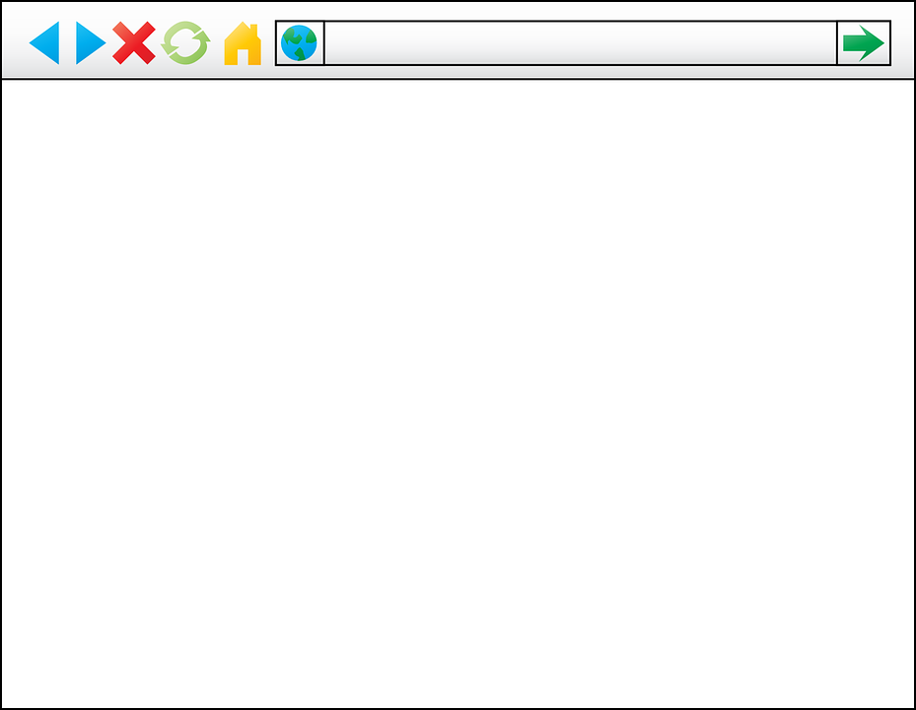
Server tunnel example: Website hosting
HTTP daemon
http://127.0.0.1:80
http://472h…po3a.b32.i2p
It works!
I2P
It works!
dest = 472h…po3a.b32.i2p
472h…po3a.b32.i2p
tunnels.conf
type = http
address = 127.0.0.1
port = 80
b32 addr. gen.
You
Site visitor

