Slide 1
A
B
INNER JOIN
©advenoh

Slide 2
A
B
LEFT OUTER JOIN
©advenoh

Slide 3
A
B
RIGHT OUTER JOIN
©advenoh

Slide 4
A
B
FULL OUTER JOIN
©advenoh

Slide 5



LEFT OUTER JOIN
©advenoh

Slide 6

RIGHT OUTER JOIN
©advenoh

Slide 7
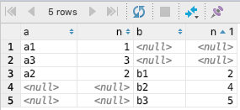
FULL OUTER JOIN
©advenoh

