Slide 1

Cache Libraries
Dima Ionut Daniel

Slide 2
Contents
What is Cache?
Cache Libraries
Conclusions
Bibliography

Slide 3

What is Cache?
Caches are tremendously useful in a wide variety of use cases.
We can use caches when a value is expensive to compute or retrieve, and you will need its value on a certain input more than once.

Slide 4
Cache Libraries
Common Java Cache libraries:
Guava
EhCache
Inifinispan
MemCached
Redis
Spring Cache

Slide 5
Guava
Guava caches are local to a single run of your application.
They do not store data in files, or on outside servers

Slide 6
Guava (cont.)
Obtaining a Cache is done using the CacheBuilder builder pattern.
Guava provides three basic types of eviction: size-based eviction, time-based eviction, and reference-based eviction.
CacheBuilder provides two approaches to timed eviction:
expireAfterAccess(long, TimeUnit) - only expire entries after the specified duration has passed since the entry was last accessed by a read or a write. Note that the order in which entries are evicted will be similar to that of size-based eviction.
expireAfterWrite(long, TimeUnit) - expire entries after the specified duration has passed since the entry was created, or the most recent replacement of the value. This could be desirable if cached data grows stale after a certain amount of time.

Slide 7
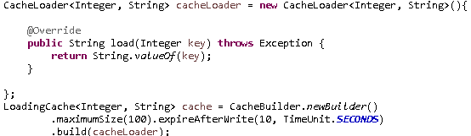
Guava (cont.)
At any time, you may explicitly invalidate cache entries rather than waiting for entries to be evicted. This can be done:
individually, using Cache.invalidate(key)
in bulk, using Cache.invalidateAll(keys)
to all entries, using Cache.invalidateAll()
If your cache should not grow beyond a certain size, just use CacheBuilder.maximumSize(long).

Slide 8
Guava (cont.)
We can specify a removal listener for your cache to perform some operation when an entry is removed, via CacheBuilder.removalListener(RemovalListener).
Removal listener operations are executed synchronously by default, and since cache maintenance is normally performed during normal cache operations, expensive removal listeners can slow down normal cache function!
If we have an expensive removal listener, use RemovalListeners.asynchronous(RemovalListener, Executor) to decorate a RemovalListener to operate asynchronously.

Slide 9
Guava (cont.)
Refreshing is not quite the same as eviction.
Using LoadingCache.refresh(K), refreshing a key loads a new value for the key, possibly asynchronously.
The old value (if any) is still returned while the key is being refreshed.

Slide 10
Guava (cont.)
By using CacheBuilder.recordStats(), you can turn on statistics collection for Guava caches. The Cache.stats() method returns a CacheStats object, which provides statistics such as
hitRate(), which returns the ratio of hits to requests
averageLoadPenalty(), the average time spent loading new values, in nanoseconds
evictionCount(), the number of cache evictions

Slide 11
Guava (cont.)
Caches built with CacheBuilder do not perform cleanup and evict values "automatically," or instantly after a value expires, or anything of the sort. Instead, it performs small amounts of maintenance during write operations, or during occasional read operations if writes are rare.
If your cache does writes only rarely and you don't want cleanup to block cache reads, you may wish to create your own maintenance thread that calls Cache.cleanUp() at regular intervals.

Slide 12
EhCache
EhCache is an open source, cache for boosting performance, and simplifying scalability.
We can use Ehcache as a general-purpose cache or a second-level cache for Hibernate.
We can integrate it with third-party products such as ColdFusion, Google App Engine, Spring.

Slide 13
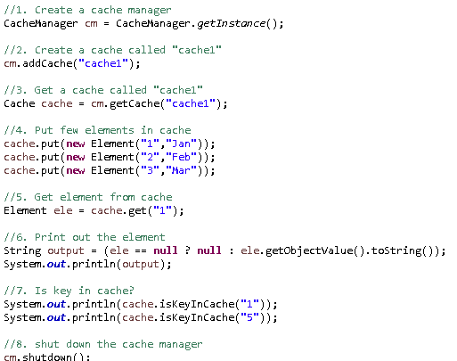
EhCache (cont.)
Sample usage of CacheManager and Cache classes.

Slide 14
EhCache (cont.)
We can define the cache behavior using xml(s):
<ehcache xmlns:xsi="http://www.w3.org/2001/XMLSchema-instance"
xsi:noNamespaceSchemaLocation="ehcache.xsd"
updateCheck="true“ monitoring="autodetect" dynamicConfig="true">
<diskStore path="java.io.tmpdir" />
<cache name="movieFindCache"
maxEntriesLocalHeap="10000"
maxEntriesLocalDisk="1000"
eternal="false"
diskSpoolBufferSizeMB="20"
timeToIdleSeconds="300" timeToLiveSeconds="600"
memoryStoreEvictionPolicy="LFU"
transactionalMode="off">
<persistence strategy="localTempSwap" />
</cache>
</ehcache>

Slide 15
Infinispan
Infinispan is a high scalability data grid platform written in Java.
Infinispan is based on JBoss Cache code.
Is more scalable than JBoss Cache.
Several ideas for JSR-107(Java Temporary Cache API) and JSR-347(Data Grid for java platform) have come from Infinispan.

Slide 16
Infinispan (cont.)
API
Map API
RESTful API for remote access
Support for non-JVM clients via RESTful API
Operational modes
Clustered and non-clustered operation modes
Distribution with optional L1 caching
JTA support
JTA-compliant transaction manager
Supports batching
Pluggable cache stores
Configurable
Support for custom implementations
Eviction and expiration
FIFO and LRU based eviction policies
Expiration of data based on lifespan and idle time
Management
JMX statistics and monitoring
JOPR-based GUI management

Slide 17
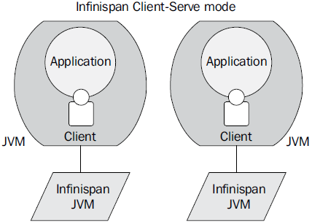
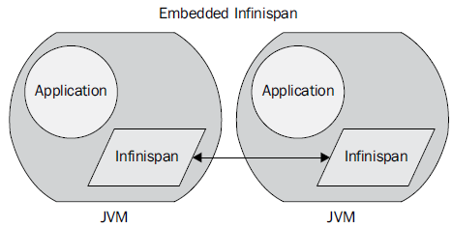
Infinispan (cont.)
Infinispan operational modes:
embedded: in the same JVM with applications
client-server: start instance remote and connect using a variety of different protocols
Starting a cache in embedded mode requires only the CacheManager interface.

Slide 18
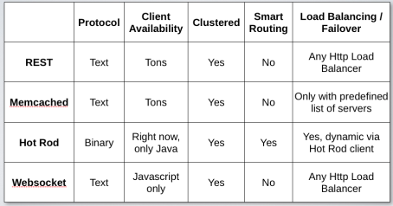
Infinispan (cont.)
In embedded mode the node instances are able to find each other and are sharing the distributing data across the grid.
In client/server mode, clients are connecting using different clients protocols. Clients can be written in Java,Jython, JRuby, Scala, Groovy, etc.
The server can be started:
Non-gui mode: startServer -r <protocol> where protocol can be: hotrod, memcached, websocket
Gui demo mode: runGuiDemo

Slide 19
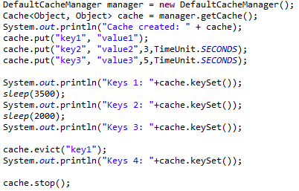
Infinispan (cont.)
The core interface of Infinispan is org.infinispan.Cache(extends the ConcurrentMap).
Storing data in memory provides the fastest data access.
Mechanisms to control memory usage:
Eviction
Expiration
Eviction is used to prevent your application from running out of memory using configuration or programmatically.
We can attach lifespan and/or maximum idle times to entries.

Slide 20
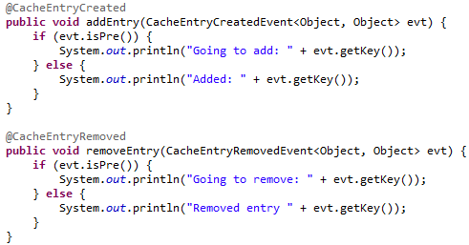
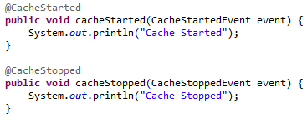
Infinispan (cont.)
We can receive notifications when certain events happen.
Listeners can be attached to Cache and Cache Manager.
At cache-level there are events such as adding or removing entries from the cache.
At cache manager level events are related to the startup/shutdown of the cache or topology change in the cluster.
Listeners are marked using the @org.infinispan.notifications.Listener annotation.
There are a large number of annotations to use for Infinispan events.

Slide 21
Infinispan (cont.)
We can configure Infinispan:
declarative: based on XML.
programatic: based on Infinispan API
The XML configuration contains 3 sections:
global: global settings shared among all cache instances
default: default behaviour for all named caches
namedCache: additional configuration for named caches.
Sample of elements that can be configured:
Clustering
Eviction
Expiration
Loaders
Locking
Transaction
Indexing
Data Container

Slide 22
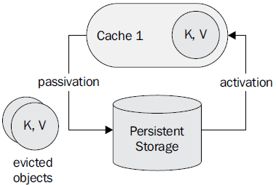
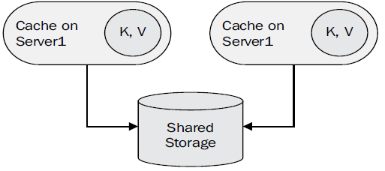
Infinispan (cont.)
Entries can be saved also in other storages using cache storage.
CacheLoader - loads entry from persistent storage
CacheStore - stores entries to persistent storage.
When passivation is enabled entries that are evicted are removed from memory, and they are persisted using a cache store.
Activation involves loading the entry into memory, and then removing it from the cache store.

Slide 23
Infinispan (cont.)
CacheStores can be also chained.
Samples of CacheStore implementations:
FileCacheStore – store persistent data on non transactional filesystem.
BdbjeCacheStore – oracle BerkeleyDB cache store implementation.
JdbcBinaryCacheStore/JdbcStringBasedCacheStore/JdbcMixedCacheStore
CasandraCacheStore
CloadCacheStore – uses Jclouds for CRUD operation on Amazon S3 or Amazon EC2.
HBCacheStore
RemoteCacheStore
JdbmCacheStore

Slide 24
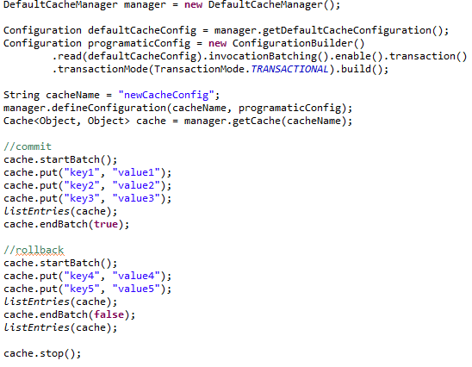
Infinispan (cont.)
It’s simple to use batch and is less expensive then transactions.
Multiple operations are grouped and executed “atomically”.
Can be integrated with JTA.

Slide 25
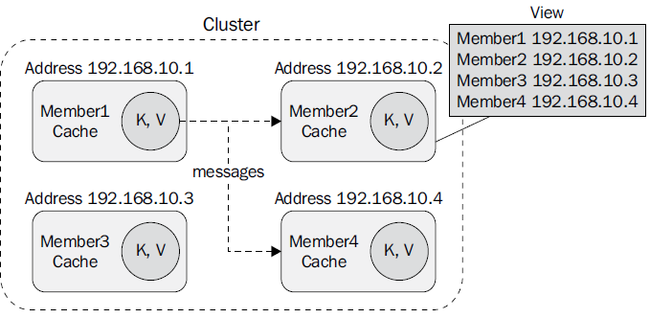
Infinispan (cont.)
A cluster consists of a number of Infinispan instances.
Each cluster in turn has a view, which is the list of cluster members.
Infinispan uses JGroups for communications within a cluster.
The distribution has a default JGroups configuration containing:
Jgroups-udp.xml : discovery configuration, using UDP
Jgroups-tcp.xml: uses TCP transport and UDP multicast for discovery
Jgroups-ec2.xml: TCP transport and experimental S3_PING protocol for discovery.
JGroups configuration parameters are passed at JVM startup.

Slide 26
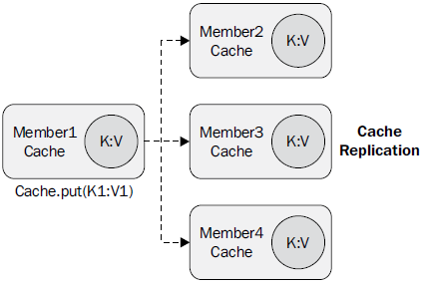
Infinispan (cont.)
Any cache from the cluster can define a cluster cache mode:
replication: replica
distribution: default, increases scalability
invalidation: doesn't share data, remove data from another remote caches minimizing network traffic.
All clustering modes provide for automatic discovery of new members in a cluster.
Replication is the simplest clustered mode. After a new member joins a cluster, if state transfer is enabled.
Replication can be synchronous or asynchronous.

Slide 27
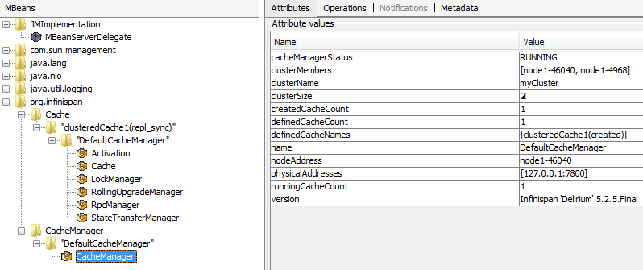
Infinispan (cont.)
Infinispan uses JMX to expose management operations and statistical data.
Expanding the org.infinispan folder statistics will be found on Cache and CacheManager nodes.
We can use RHQ server to monitor

Slide 28
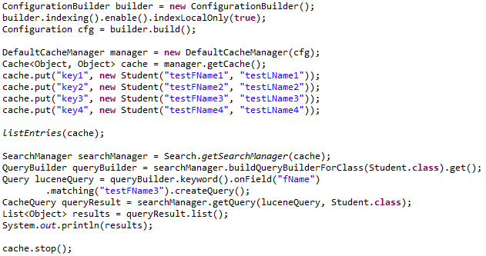
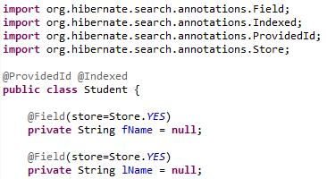
Infinispan (cont.)
Infinispan can be used with CDI.
The asynchronous API provides non-blocking cache methods: put, get, and remove.
Infinispan exposes a querying API that allows users to write queries using either Lucene's object-oriented query API or Hibernate Search's compatible, but much simpler.

Slide 29
Infinispan (cont.)
PROS:
High scalability
Documented, API
Can be integrated very easy.
Scalable
Transactions
Plugable

Slide 30
MemCached
Memcached is a general-purpose distributed memory caching system.
Memcached is free and open-source under BSD licence.
Memcached runs on Unix-like OS and Windows.

Slide 31
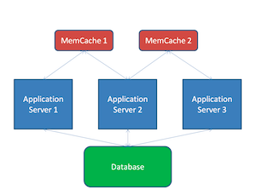
MemCached (cont.)
Memcached server can listen on TCP or UDP port for caching calls.

Slide 32
MemCached (cont.)
On Ubuntu, Memcahed can be installed using: sudo apt-get install memcahed.
In order to verify the installation was done with success use following command : ps aux | grep memcahed.
Memcache was designed with Linux and not windows, but there is also Windows distribution and dll for Win x64 OS.
To install run following command in cmd using administrator: memcached.exe –d install
To start: memcached.exe –d start

Slide 33
MemCached (cont.)
On Unix the configuration can be found on /etc/memcached.conf.
Memcached can be used with languages as: PHP, Ruby, Python, Java, Rails, Django, Play.
Memcached default listening interface is 127.0.0.1
Memcached will start on default port 11211 waiting for TCP connections.
The number of thread used is 4.
Memcached starts with 64MB RAM assigned.
The number of simulatenous incoming connections can be limited.Default value is 1024.

Slide 34
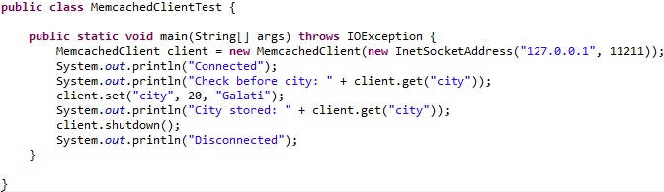
MemCached (cont.)
We need to include the spymemcached library in order to use Memcache.
MemcachedClient creates the memcached connection.
The set method works like "fire and forget" and it's not blocking.
The get method is synchronous and blocks until data is retrieved.
We can store Java Serializable objects.

Slide 35
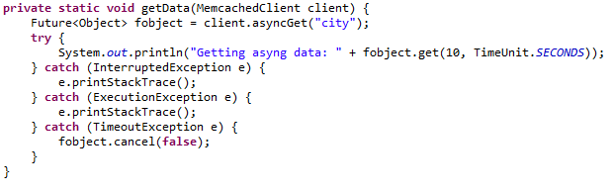
MemCached (cont.)
Spymemcahed offers asynchronous API with asyncGet method that returns a Future object.
If we get timeout expired, we receive TimeoutException and it's best to safely cancel the operation using the cancel() method.

Slide 36
MemCached (cont.)
Pros:
Memcached is cross-platform.
Memcached never blocks.
Memcached is cheap.
Cons:
If we update content it's best to delete associated keys related to new content so that data is new. If we don't do this we have stale content
Memcached requires size requirements.
Volatility.
Security issues as Memcached doesn’t require security information.

Slide 37
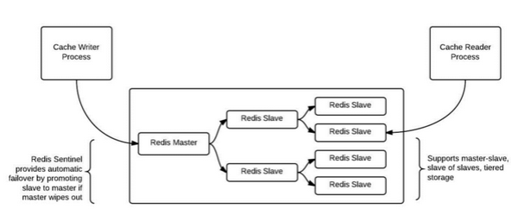
Redis
Redis is a data structure server.
It's open-source, networked, in-memory, and stores keys with optional durability.
Redis is the most popular key-value database.
The name Redis means REmote DIctionary Server.

Slide 38
Redis (cont.)
Persistence
Redis typically holds the whole dataset in memory.
Persistence is achieved with technique called snapshotting, and is a semi-persistent durability mode where the dataset is asynchronously transferred from memory to disk from time to time, written in RDB dump format.
By default, Redis syncs data to the disk at least every 2 seconds, with more or less robust options available if needed.
In the case of a complete system failure on default settings, only a few seconds of data would be lost.

Slide 39
Redis (cont.)
Replication
Redis supports master-slave replication.
Data from any Redis server can replicate to any number of slaves.
A slave may be a master to another slave. This allows Redis to implement a single-rooted replication tree.
The Publish/Subscribe feature is fully implemented, so a client of a slave may SUBSCRIBE to a channel and receive a full feed of messages PUBLISHed to the master, anywhere up the replication tree.
Replication is useful for read (but not write) scalability or data redundancy.

Slide 40
Redis (cont.)
Performance
When the durability of data is not needed, the in-memory nature of Redis allows it to perform extremely well compared to database systems that write every change to disk before considering a transaction committed.
There is no notable speed difference between write and read operations.
Redis operates as a single process and single-threaded.
A single Redis instance cannot utilize parallel execution of tasks e.g. stored procedures.

Slide 41
Redis (cont.)
Redis is an in-memory persistent key-value store.
Redis does hold all the data in memory and it does write that out to disk for persistence.
The reality is that Redis exposes five different data structures, only one of which is a typical key-value structure.

Slide 42

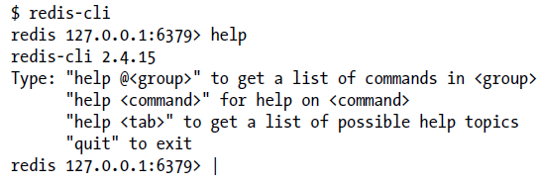
Redis (cont.)
We can start Redis with default settings for the server using redis-server command.
We can connect to Redis using redis-cli tool.

Slide 43
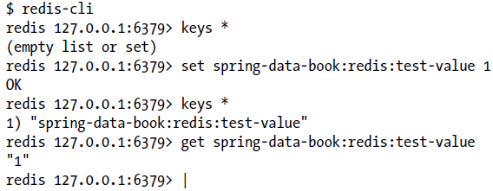
Redis (cont.)
We can set key/value information using the SET command.
To retrieve the value data of key the GET command isused.
In order to retrieve information about key/value pair the keys command is used.
The DEL command can be used to delete key/values pair.

Slide 44
Redis (cont.)
Redis maps keys to types of values.
Redis supports not only strings, but also abstract data types:
Lists of strings
Sets of strings (collections of non-repeating unsorted elements)
Sorted sets of strings (collections of non-repeating elements ordered by a floating-point number called score)
Hash tables where keys and values are strings
The type of a value determines what operations (called commands) are available for the value itself.

Slide 45
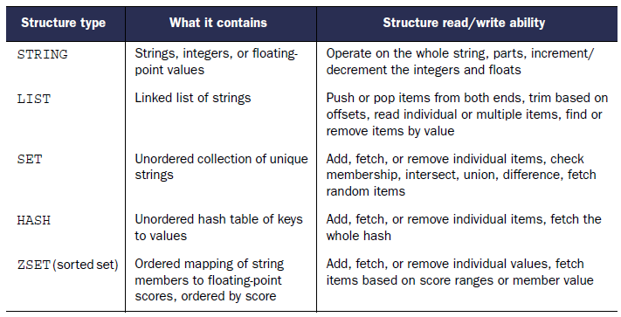
Redis (cont.)

Slide 46
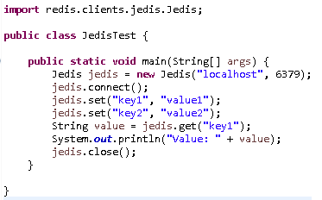
Redis (cont.)
Jedis is a redis java client.
Jedis is fully compatible with the redis.

Slide 47
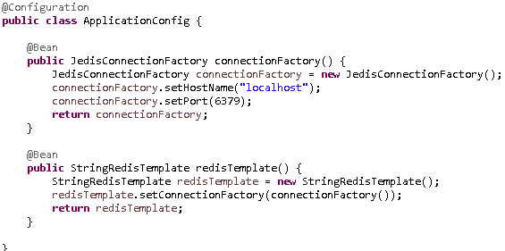
Redis (cont.)
The Spring Data Redis (or SDR) framework makes it easy to write Spring applications that use the Redis key value store by eliminating the redundant tasks and boiler plate code required for interacting with the store through Spring’s excellent infrastructure support.

Slide 48
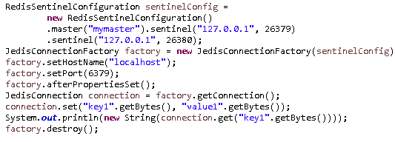
Redis (cont.)
For dealing with high available Redis there is support for Redis Sentinel using RedisSentinelConfiguration.

Slide 49
Redis (cont.)
From the framework perspective the data stored in Redis is just bytes.
While Redis supports various types, for the most part these refer to the way the data is stored rather then what it represents.
The conversion between the user (custom) types and raw data (and vice-versa) is handled in Spring Data Redis through the RedisSerializer interface which as the name implies, takes care of the serialization process.
Multiple implementations are available out of the box:
StringRedisSerializer
JdkSerializationRedisSerializer
OxmSerializer (Object/XML mapping)
JacksonJsonRedisSerializer (JSON format)
Jackson2JsonRedisSerializer (JSON format)

Slide 50
Redis (cont.)
Redis Sentinel provides high availability for Redis.
Redis Sentinel provides tasks such as monitoring, notifications and acts as a configuration provider for clients.
Sentinel capabilities:
Monitoring: checks if your master and slave instances are working as expected.
Notification:. can notify the system administrator, another computer programs, via an API, that something is wrong with one of the monitored Redis instances.
Automatic failover: can start a failover process where a slave is promoted to master, the other additional slaves are reconfigured to use the new master
Configuration provider: acts as a source of authority for clients service discovery: clients connect to Sentinels in order to ask for the address of the current Redis master responsible for a given service.

Slide 51
Spring Cache
Spring Cache annotations:
@Cacheable triggers cache population
@CacheEvict triggers cache eviction
@CachePut updates the cache without interfering with the method execution
@Caching regroups multiple cache operations to be applied on a method
@CacheConfig shares some common cache-related settings at class-level

Slide 52

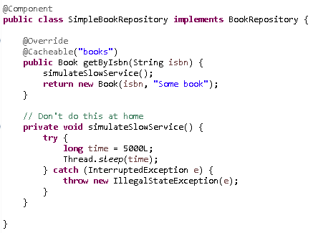
Spring Cache (cont.)
The method that returns the Book element is annotated with @Cacheable.

Slide 53
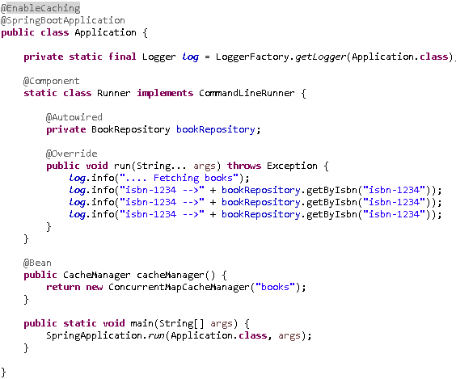
Spring Cache (cont.)
In order to enable spring cache we need to use the @EnableCaching annotation.

Slide 54

Spring Cache (cont.)
The cache is nothing but a key-value store which stores the data based on certain key.
In Spring framework based caching, the method arguments of cached method acts as the source of Key generation.
Every key is essentially the Hash-code of these arguments.
To provide a different default key generator, one needs to implement the org.springframework.cache.KeyGenerator interface.

Slide 55
Spring Cache (cont.)
Spring framework also supports conditional caching letting user to cache certain methods based on some conditions.
Bellow we cache profiles only for those users who have profileId greater than 50.

Slide 56
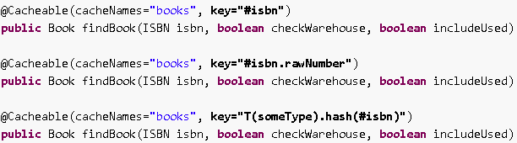
Spring Cache (cont.)
The @Cacheable annotation allows the user to specify how the key is generated through its key attribute.

Slide 57

Spring Cache (cont.)
Spring cache allows not just population of a cache store but also eviction.
This process is useful for removing stale or unused data from the cache.
There are cases when multiple annotations of the same type, such as @CacheEvict or @CachePut need to be specified.

Slide 58
Conclusions
Pros:
faster access to valid cached resources
saving on costly use of bandwidth
providing cached resources even when origin server is down
Cons:
slower performance if the resource isn't found in the cache
Obtaining a stale copy of a resource when an uptodate copy is needed

Slide 59

Bibliography
https://code.google.com/p/guava-libraries/wiki/CachesExplained
http://www.ehcache.org/documentation
http://en.wikipedia.org/wiki/Redis
Manning – Redis in Action

