Slide 1

JUnit 4
Dima Ionut Daniel

Slide 2
Contents
What is JUnit?
Features
Concepts
Arhitecture
Core
Test Runners
Rule API
Hamcrest Matchers
Software Testing Principles
Test Coverage
Mocks
Conclusions
Bibliography

Slide 3

What is JUnit ?
JUnit is a unit testing framework for Java.
JUnit it's used for test-driven development.
JUnit is open source and documented.

Slide 4
Features
Separate test class instances and class loaders for each unit test to avoid side effects.
JUnit annotations to provide resource initialization and call methods: @Before, @BeforeClass, @After, @AfterClass.
A variety of assert methods to make it easy to check the results of the tests.
Provides test runners for running tests.
Integration with tools like And, Maven.
Integration with IDEs like Eclipse, NetBeans, ItelliJ, Jbuilder.

Slide 5
Concepts
Test - a method with a @Test annotation
Test Class - class that contains one or more tests represented by methods annotated with @test.
Test Suite - a group of tests, is a convenient way to group together tests that are related.
Test Runner - a runner of test suites
Assert - defines the conditions that are being tested

Slide 6
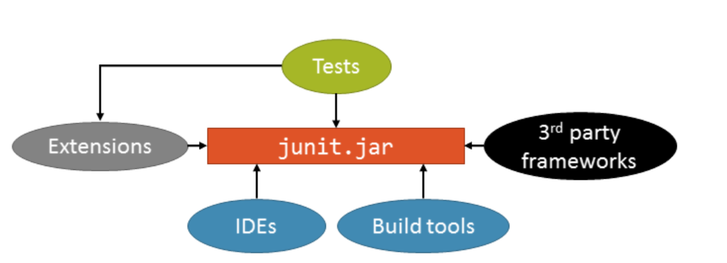
Arhitecture
JUnit 4 is completely monolithic

Slide 7
Core
A unit test examines the behavior of a distinct unit of work.
By contract, integration tests and acceptance tests examine how various components interact.
A unit of work is a task that isn't directly dependent on the completion of any other task.

Slide 8
Core (cont.)
The unit testing framework should follow:
each unit test should run independently of all other unit tests
the framework should detect and report errors test by test
it should be easy to define which unit tests will run

Slide 9
Core (cont.)
JUnit creates a new instance of the tests class before invoking each @Test method.
This help provide independence between test methods and avoid unintentional side effects in the test code
To perform test validation, we use the assert methods provided by the Assert class.

Slide 10
Core (cont.)
assertArrayEquals("message", A, B) | asserts the equality of the A and B arrays.
assertEquals("message", A, B) | asserts the equality of objects A and B. This assert invokes the equals() method on the first object against the second.
assertSame("message", A, B) | asserts that the A and B objects are the same object, using the == operator.
assertTrue("message", A) | asserts that the A condition is true.
assertNotNull("message", A) | asserts that the A object isn’t null.

Slide 11
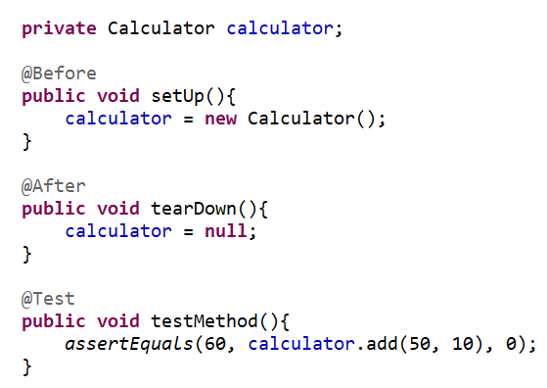
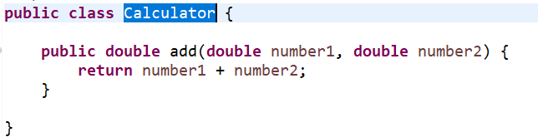
Core (cont.)

Slide 12
Core (cont.)
The Parameterized test runner allows to run a test many times with different sets of parameters.
The test class needs to be annotated with @RunWith annotation and Parameterized class argument.
The test class needs to have a method static public method called getTestParamters that returns a java.util.Collection, without parameters and with @Parameters annotation.
The Collection elements must contain an array of identical length elements, that must match the number of arguments of the test public constructor.

Slide 13
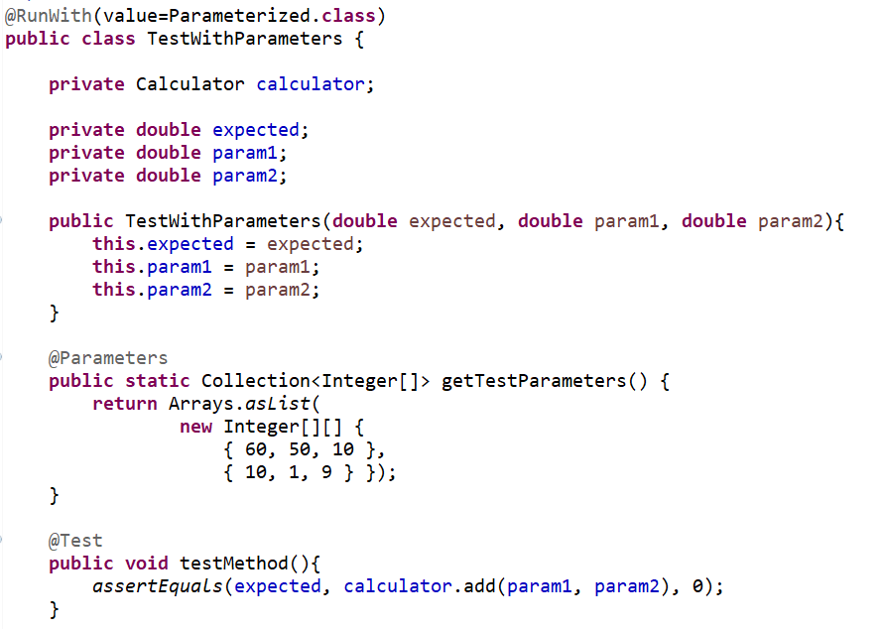
Core (cont.)

Slide 14
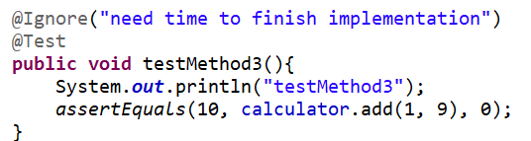
Core (cont.)
Sometimes it happens that the code is not completely ready while running a test case.
As a result, the test case fails or might fail. The @Ignore annotation helps in this scenario and instructs JUnit Core to skip the test.
It’s a good practice to always specify a reason for skipping a test.

Slide 15
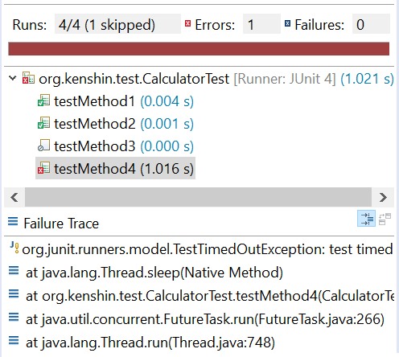
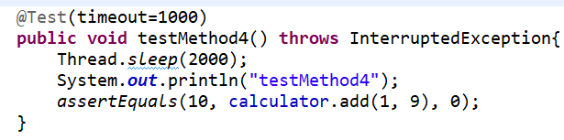
Core (cont.)
JUnit provides a handy option of Timeout.
If a test case takes more time than specified number of milliseconds, then JUnit will automatically mark it as failed.
The timeout parameter is used along with @Test annotation.

Slide 16
Test Runners
JUnit4 is build with backward compatibility with version 3.8.x.
JUnit will use a default test runner if none is provided based on the test class.
If there is a need to run Junit tests with specific test runner then the @RunWith annotation is used.

Slide 17
Test Runners (cont.)
org.junit.internal.runners.JUnit38ClassRunner | It’s used for backward compatibility with test cases written with Junit 3.8
org.junit.runners.JUnit4 | This runner will start the test cases as a Junit 4 test case
org.junit.runners.Parameterized | A Parameterized test runner runs same sets of tests with different parameters
org.junit.runners.Suite | It contains different tests.

Slide 18
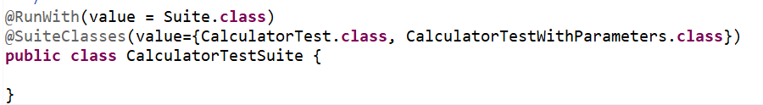
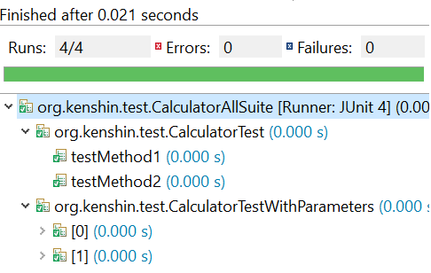
Test Runners (cont.)
The @SuiteClasses annotation is used to specify what test classes to be used for the suite.

Slide 19
Rule API
JUnit provides several useful, predefined rules as part of the library
These rules can be found under org.junit.rules package

Slide 20
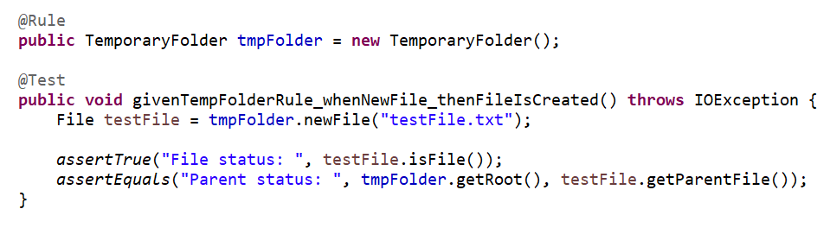
Rule API (cont.)
The TemporaryFolder rule
Sometimes we need access to a temporary file or folder.
However, managing the creation and deletion of these files can be cumbersome.
We can use the TemporaryFolder rule so we can manage the creation/deletion of files/folders.
From JUnit 4.13 we can create the TemporaryFolder objects as TemporaryFolder.builder().assureDeletion().build();

Slide 21
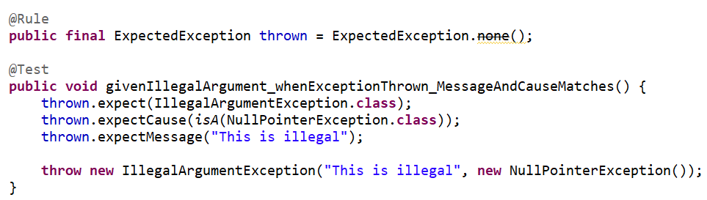
Rule API (cont.)
The ExpectedException Rule
We can use the ExpectedException rule to verify that some code throws an expected exception.

Slide 22
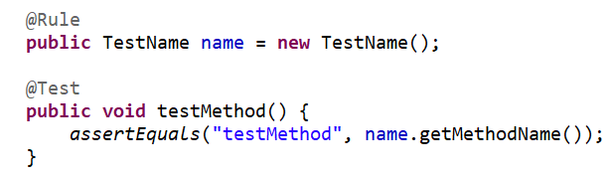
Rule API (cont.)
The TestName Rule
The TestName rule provides the current test name inside a given test method

Slide 23
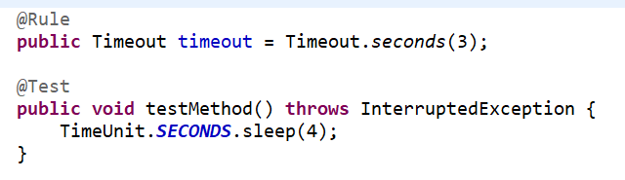
Rule API (cont.)
The Timeout Rule
The Timeout rule represents an alternative to using the timeout parameter.

Slide 24
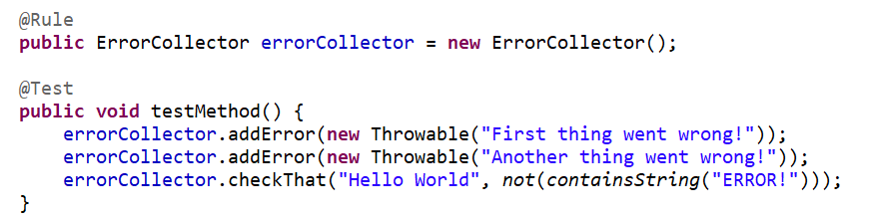
Rule API (cont.)
The ErrorCollector Rule
This rule allows the execution of a test to continue after the first problem is found
When the test run, the execution continues, but the test will fail at the end.

Slide 25
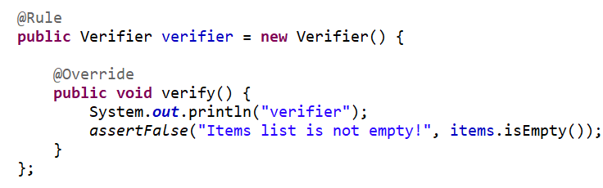
Rule API (cont.)
The Verifier Rule
The Verifier rule is an abstract class that we can use to verify additional behavior

Slide 26
Rule API (cont.)
The DisableOnDebug Rule
Sometimes we may need to disable a rule when we're debugging, like Timeout rule.
@Rule
public DisableOnDebug disableTimeout = new DisableOnDebug(Timeout.seconds(30));

Slide 27
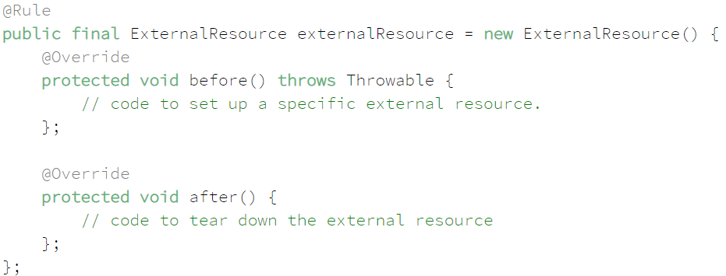
Rule API (cont.)
The ExternalResource Rule
We can extend the abstract class ExternalResource to set up an external resource before a test, such as a file or database connection.

Slide 28
Rule API (cont.)
Sometimes we need to apply a rule at the test class level, and we need to use the @ClassRule annotation. This annotation is like @Rule but wraps a rule around the whole test so the class rule needs to be a static field.
We can write our custom rule by implementing the TestRule interface.
We can use chain rules by using RuleChain custom rule that contains a list of rules.

Slide 29
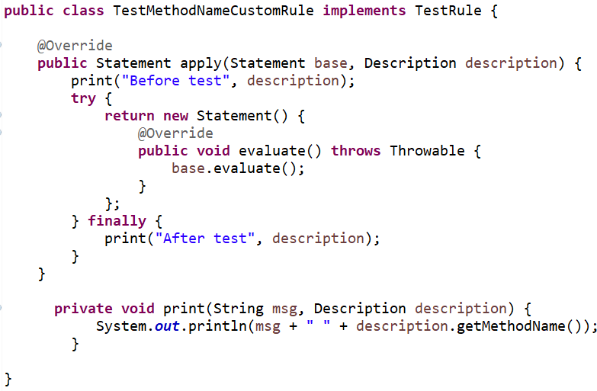
Rule API (cont.)

Slide 30
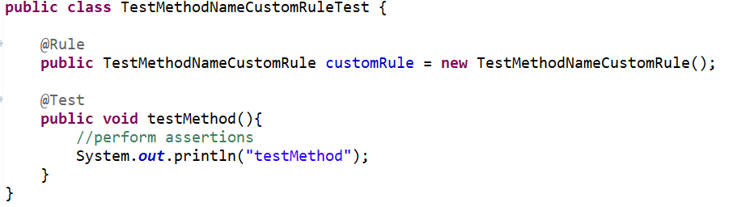
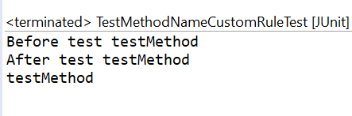
Rule API (cont.)

Slide 31
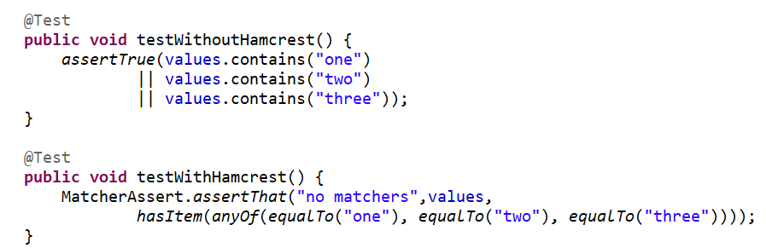
Hamcrest Matchers
Hamcrest is a library that contains a lot of useful matchers objects: constraints, predicates.
Hamcrest isn't a testing framework, it helps specifying simple matching rules.

Slide 32
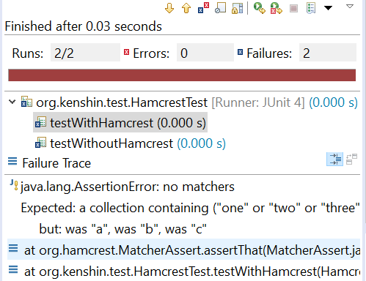
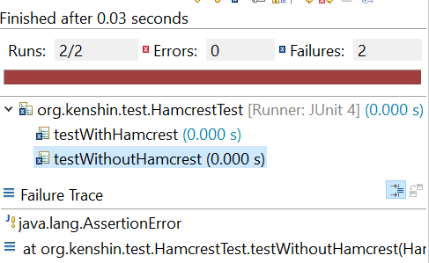
Hamcrest Matchers (cont.)
Hamcrest offers more feedback when JUnit tests are failing.

Slide 33
Hamcrest Matchers (cont.)
Commonly used Hamcrest matchers
Core | Logical
anything | matches absolutely anything.
is | used only to improve the readability of your statements.
allOf | checks to see if all contained matchers match, like && operator
anyOf | checks to see if any of the contained matchers Match, like || operator
not | like the ! operator in Java
instanceOf, isCompatibleType | are instances of one another
sameInstance | tests object identity

Slide 34
Hamcrest Matchers (cont.)
Core | Logical
notNullValue, nullValue | tests for null values or non-null value
hasProperty | tests whether a JavaBean has a certain property
hasEntry, hasKey, hasValue | tests whether a given Map has a given entry, key, or value.
hasItem, hasItems | tests a given collection for the presence of an item or items.
closeTo, greaterThan, greaterThanOrEqual, lessThan, lessThanOrEqual | test whether given numbers are close to, greater than, greater than or equal to, less than, or less than or equal to a given value.
equalToIgnoringCase | tests whether a given string equals another one, ignoring the case.
containsString, endsWith, startWith | test whether the given string contains, starts with, or ends with a certain string.

Slide 35
Software Testing Principles
The main goal of unit testing is to verify that the application works as expected and to catch bugs early.
Unit tests:
allow greater test coverage than functional tests
increase team productivity
improve implementation
document expected behavior
enables code coverage and other metrics
give confidence to refactor and make changes

Slide 36
Software Testing Principles (cont.)
Test types:
Acceptance testing : application must meet the customer's needs
Stress/load testing : tests the system under stress, under load to check it’s scalability
Integration testing: combine unit of works into a workflow
Unit testing : tests unit of work, small pieces
Functional testing :

Slide 37
Software Testing Principles (cont.)
Black box vs white box testing
A black box test has no knowledge of the internal state or behavior of the system. The test relies on the external system interface to verify its correctness. Tools that can accomplish these tasks are: HTTPUnit, HTMLUnit, Selenium.
In white box testing or glass box testing we use the knowledge of the implementation to create tests and drive the testing process.

Slide 38
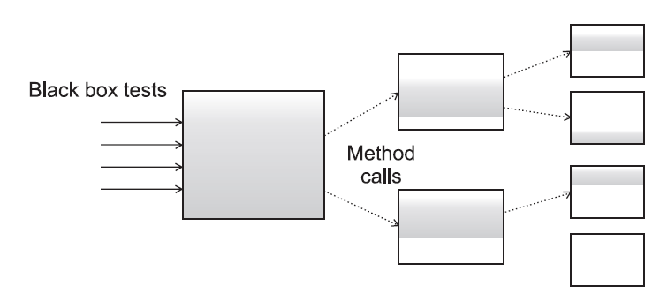
Test Coverage
Writing unit tests help us a lot in the development/testing process.
In black box testing there is a partial test coverage

Slide 39
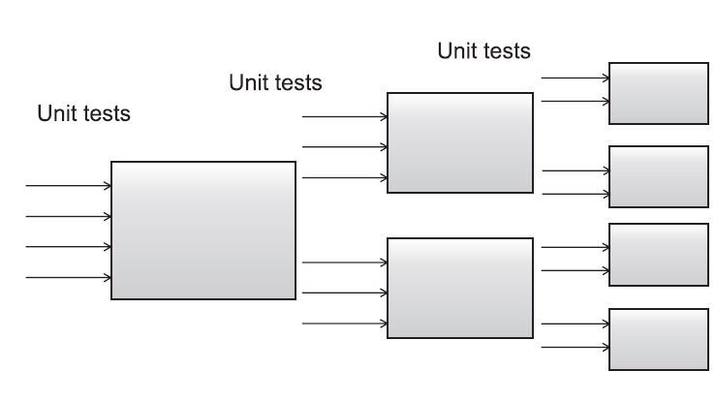
Test Coverage (cont.)
We can achieve higher test coverage using white box testing with unit tests.

Slide 40
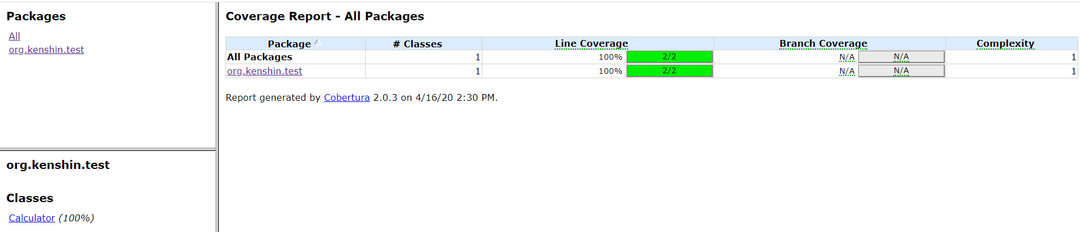
Test Coverage (cont.)
Cobertura :
is a code coverage tool that integrates with JUnit
it open source, it integrates with Ant, Maven
generates reports in HTML or XML format
computes the percentage of code lines and code branches for each class, package, entire project

Slide 41
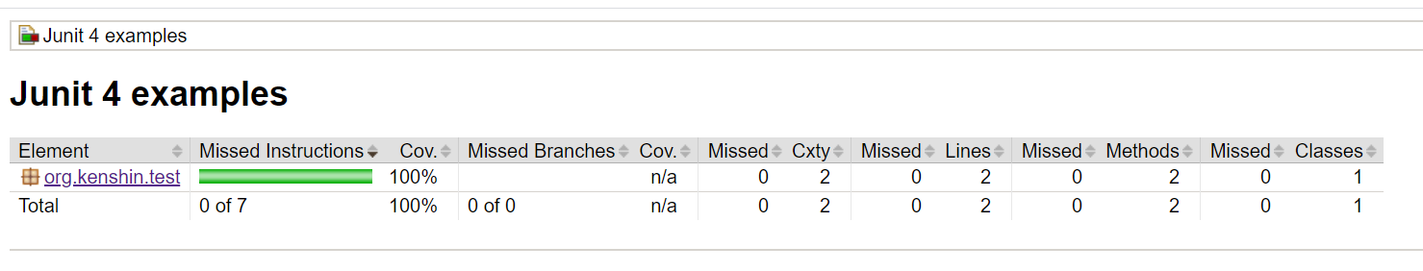
Test Coverage (cont.)
Jacoco (Java Code Coverage):
it's open source
based on java byte code and works also without source code
several report formats: HTML, XML, CSV
can be integrated with Ant, Maven

Slide 42
Test Coverage (cont.)
Other code coverage tools:
Jcov: well integrated with Oracle test infrastructure (JavaTest, JTReg)
Atlasian Clover: for Java and Groovy
Serenity: for acceptance testing
CodeCover: for Java and COBOL
EMMA: oldest most popular coverage tool
Gretel: used by the University of Oregon
Parasoft Jtest: has a large suite of purposes

Slide 43
Mocks
Testing in isolation offers strong benefits.
Mock objects (or mocks) are perfect for testing a portion of code logic in isolation from the rest of the code.
Mocks don't implement any logic, they're empty shells that provide methods to let the test control the behavior of the business.
Only stubs implements business logic.

Slide 44
Mocks (cont.)
Mock frameworks:
EasyMock
Jmock
JMockit
Mockito
Powermock

Slide 45
Conclusions
JUnit allows to write code faster, which increase quality
JUnit tests can be run automatically and then check their own results and provide immediate feedback
JUnit is documented

Slide 46

Bibliography
https://en.wikipedia.org/wiki/JUnit
https://www.tutorialspoint.com/junit/junit_overview.htm
https://www.baeldung.com/junit-4-rules
Manning – JUnit in Action Second Edition

