Slide 1

AllureReport
Dima Ionut Daniel

Slide 2
Contents
What is AllureReport?
Features
Terminology
Architecture
Core
Internals
Attachements
Test Step
Visual Analytics
History
Timeline
Export
Conclusion
Bibliography

Slide 3

What is AllureReport?
Allure Report tool is a flexible lightweight test report tool.
It is an open-source multi-language test reporting tool.
It builds a detailed representation of what has been tested and extracts as much information as possible from everyday test execution.

Slide 4
Features
Rich Visual Representation: the reports are visually appealing and provide a clean and intuitive layout, making it easy to navigate through test results.
Test History: allows users to compare test results over time, helping teams understand trends and changes in test outcomes.
Detailed Reporting: each test case comes with detailed information, including steps, logs, attachments, and error messages, aiding in troubleshooting.
Multi-language Support: supports various programming languages and testing frameworks, including Java, Python, Ruby, PHP, and more, making it versatile for different projects.
Integration: it integrates seamlessly with popular test frameworks like JUnit, TestNG, NUnit, and others, as well as CI/CD tools like Jenkins, TeamCity, and GitLab CI.

Slide 5
Features (cont.)
Customizable: users can customize the reports to include specific information relevant to their testing needs, such as tags or specific test case attributes.
Step Grouping: test steps can be grouped logically, allowing for better organization and readability in the reports.
Parameterization: users can parameterize tests to provide different input values, and these can be reported clearly in Allure.
Attachments and Logs: the ability to attach additional files like screenshots, logs, and other artifacts directly to test results enhances the context for each test case.
Dashboard: provides a dashboard view summarizing the overall status of the test suite, including metrics like passed, failed, and skipped tests.

Slide 6
Features (cont.)
Execution Time: it tracks and displays the execution time for each test case, which can help identify long-running tests.
Filtering and Sorting: users can filter and sort tests based on various parameters, such as status (passed, failed, etc.), duration, and tags.
Test Case Grouping: tests can be grouped by various criteria, such as features, severity, or any custom tags, for better organization.
Cross-Browser Testing Support: supports reporting for tests run across multiple browsers, useful for web application testing.
Localization: it can be localized to support multiple languages, making it accessible to a global audience.

Slide 7
Terminology
Test Case
a single unit of testing that checks a specific aspect of the application.
each test case can have various attributes, such as name, status, and description.
Test Suite
a collection of test cases that are grouped together.
test suites can represent a module, feature, or any logical grouping of tests.
Test Run
an execution of a test suite or a set of test cases.
each run can have different parameters, configurations, or environments.
Attachment
any additional files or data that can be associated with a test case, such as screenshots, logs, or other artifacts that provide more context about the test execution.
Step
an action or a specific operation within a test case.
steps can be nested, allowing for a hierarchical structure that represents the flow of the test case.

Slide 8
Terminology (cont.)
Label
a way to categorize or tag test cases and suites.
labels can be used for filtering or organizing tests in the report.
Status
indicates the outcome of a test case, such as passed, failed, skipped, or broken.
Environment
represents the configuration under which the tests are executed, including details like the operating system, browser version, and any other relevant settings.
History
a feature that allows users to view previous test runs and their results, providing insights into trends and regressions over time.
Categories
used to group test cases based on certain criteria, facilitating better organization and filtering in reports.

Slide 9
Terminology (cont.)
Severity
an indication of the importance or impact of a test case, often used to prioritize tests or issues.
Execution Time
the amount of time it takes to run a test case or suite, which can help identify performance issues.
Custom Annotations
supports custom annotations that allow users to extend the functionality of the reports and add specific metadata to test cases.
Allure Command-Line Interface (CLI)
a tool that allows users to generate reports from the test execution results stored in a specific format.
Widgets
Visual components in the Allure report that display key metrics and summaries, such as the number of tests, pass/fail rates, and trends.

Slide 10
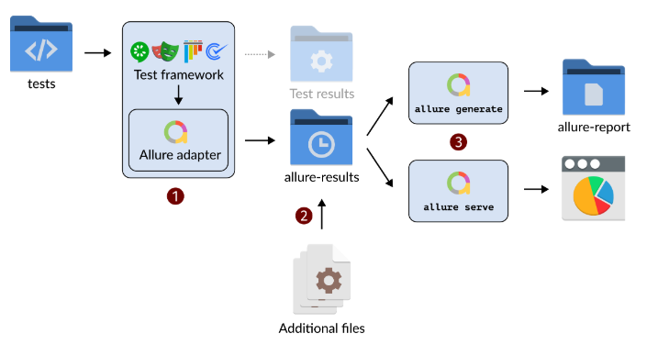
Architecture

Slide 11
Core
A test reports generated with Allure Reports are basically small HTML websites intended to be viewed in a web browser.
By default, a test report is not one file, but rather a directory containing various files (HTML, JSON and other types), sometimes distributed as a ZIP archive.
The most reliable method of opening such a report is to use the allure open command in a terminal.

Slide 12
Core (cont.)
The allure open command opens the generated report in a web browser.
Usage: allure open [options] <report-dir>
Example: allure open /home/user/myproject/build/allure-report
The command starts a local web server configured to show the report directory's contents.
By default, the web server works at a local IP address (such as 127.0.1.1) and a randomly generated port.
We can override this behavior with the --host and --port arguments.

Slide 13
Core (cont.)
The allure serve command generates a report and serves it on a local server.
Usage: allure serve [options] <results-dir>
Example: allure serve ./allure-results
This command will generate the report from the specified results directory (where the raw test results are stored) and open it in your default web browser. The report will be served at a local port.

Slide 14
Core (cont.)
The allure generate command generates a report from the test results.
Usage: allure generate [options] <results-dir> [<report-dir>]
Example: allure generate ./allure-results --out ./allure-report
This generates a static report that can be later viewed by opening the report-dir in a web browser.
If no report-dir is specified, the report will be generated in a default location.

Slide 15
Core (cont.)
The allure display command displays the detailed information about the specified test results.
Usage: allure display [options] <results-dir>
Example: allure display ./allure-results
This command provides a quick output of the results from the results directory, allowing users to see key metrics or information about the test executions directly in the console.

Slide 16
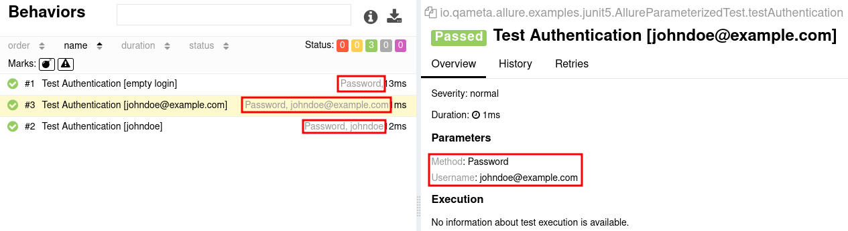
Core (cont.)
Parametrized tests
Sometimes we want to run the same test multiple times, each with different set of values.
For instance, you may want to make sure that the system behavior does not change whether some string is empty or not.

Slide 17
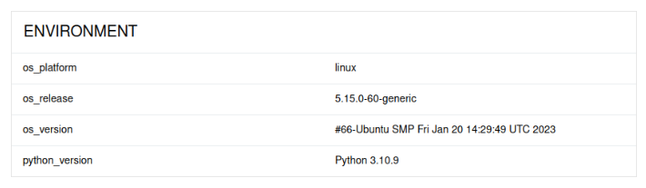
Core (cont.)
Environment information
For the main page of the report, we can collect various information about the environment in which the tests were executed.
Its a good idea to use this to remember the OS version, programming language version, etc.
This may help the future reader investigate bugs that are reproducible only in some environments.

Slide 18
Core (cont.)
Improving navigation in your test report
A big enough project can have hundreds or even thousands of tests
When collecting information about tests, Allure can organize the results into easy-to-grasp tree structures.
With such a structure, a reader of the test report can easily navigate to the test results they need.
Allure generates different trees on the Suites, Behaviors, or Packages tabs of the report.

Slide 19
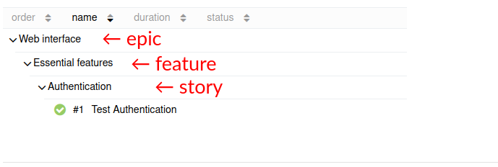
Core (cont.)
Behavior-based hierarchy
Epics, features and user stories are widely-used terms organizing tests for said features.
An epic is a large set of features that the team aims to develop and test.
A feature is described as a set of user stories that describe how the software is expected to behave in different scenarios.

Slide 20
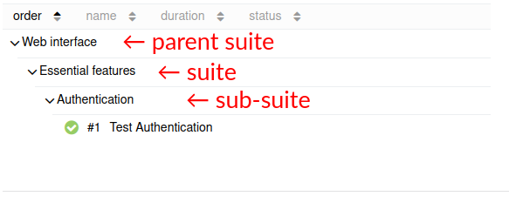
Core (cont.)
Suite-based hierarchy
A test suite is an abstract term for any group of tests, with its actual meaning depending on the specifics of your project.
Allure adapters for all test frameworks provide ways to indicate a test's suite, with most of them also providing ways to indicate parent suites and sub-suites, for the total of up to three levels of hierarchy

Slide 21
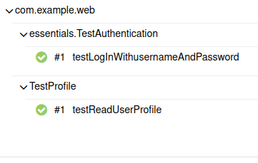
Core (cont.)
Package-based hierarchy
Sometimes, its convenient to organize tests by packages, closely following the structure of the code.
To place a test in the tree on the Packages tab, Allure normally uses the actual names of the module and the function in which the test is implemented.

Slide 22
Core (cont.)
Allure uses colors to represent the statuses in the filters, lists and graphs throughout the test report. Test statuses:
Passed
(green) is a test that finished successfully
Failed
(Red) is a test that encountered an unexpected behavior in the system under test.
Skipped
(gray) is a test that was included in the test plan but then not executed
Broken
(yellow) is a test that failed because of a test defect
Unknown
(violet) when the Allure adapter did not explicitly set any other status for it

Slide 23
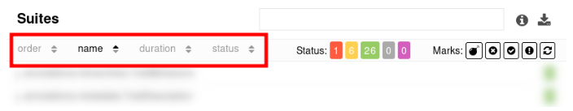
Core (cont.)
Sorting
The Behaviors, Suites, Packages, and Categories tabs in a test report generated by Allure provide various ways to sort and filter the list of tests.
Click on a label in the header to change how the tests are sorted.
The possible sorting criteria are:
the order of execution
the name: the title of a test or a group of tests
the duration of execution
the status tests finished with

Slide 24
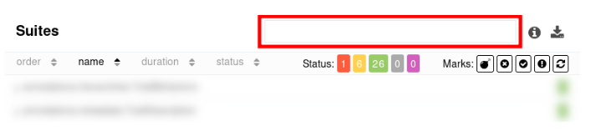
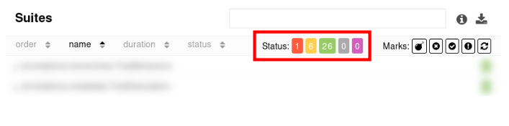
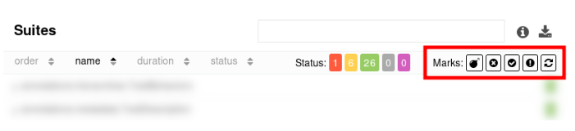
Core (cont.)
In the search box, enter some text to see only the tests that contain it text in their title.
Click on the colored buttons to hide or show all the tests that finished with a specific status.
Click on a button with an icon to enable or disable a filter by a specific mark set by Allure.

Slide 25
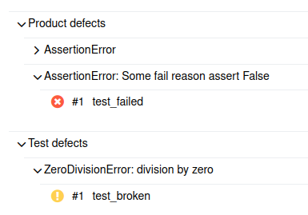
Core (cont.)
Defect categories
Defects can be divided into categories based on the statuses and output messages of the corresponding tests.
On the Categories tab in a test report, the tests are grouped by their category and then by their error message.
The tests that do not belong to any category are not displayed on the tab.

Slide 26
Core (cont.)
Export metrics
In a test report directory, the export subdirectory contains files that can be imported to InfluxDB or Prometheus for building custom graphs.
The export/influxDbData.txt file contains aggregate test data in the line protocol format for InfluxDB. When imported, it created the following measurements.
The export/prometheusData.txt file contains aggregate test data in the text-based format format for Prometheus. When imported, it created the following metrics.

Slide 27
Internals
Allure Report consists of a framework adapter and the allure command-line utility.
We run the tests normally from the command line, from your IDE, etc.
In addition to printing or saving the test results in its own format the Allure Report adapter receives the data from a test framework.
The adapter saves data in the Allure file formats into a separate directory.
We generate the HTML report by using one of the two Allure command-line commands.
allure generate processes the test results and saves an HTML report into the specified directory. To view the report, use the allure open command.
allure serve creates the same report as allure generate but puts it into a temporary directory and starts a local web server configured to show this directory's contents.

Slide 28
Internals (cont.)
Test result file
A test result file stores data related to a single run of a single test.
The data is stored as a JSON object. Each file is named {uuid}-result.json, where {uuid} is a randomly generated identifier. Identifiers:
uuid (string)
A unique identifier of the test result.
historyId (string)
An identifier used by Allure Report. Two runs of the same test with the same set of parameters will always have the same historyId.
testCaseId (string)
An identifier used by Allure TestOps. Two runs of the same test will always have the same testCaseId.

Slide 29
Internals (cont.)
Metadata
name (string)
The title of the test or the name of the step.
fullName (string)
A unique identifier based on the file name and the test name.
description (string)
The description of the test or step in Markdown format.
descriptionHtml (string)
The description of the test or step in HTML format.
links (array)
An array of links added to the test or step.
labels (array)
An array of various labels added to the test or step.
parameters (array)
An array of parameters added to the test or step.
attachments (array)
An array of attachments added to the test or step.

Slide 30
Internals (cont.)
Container file
A container file describes a set of initialization and finalization steps related to certain tests.
The data is stored as a JSON object. Each file is named {uuid}-container.json, where {uuid} is a randomly generated identifier.
uuid (string)
A unique identifier of the test result.
start (integer)
The time when the execution of the initialization steps started, in the UNIX timestamp format. Normally, it is equal or close to the earliest start time from the befores.
stop (integer)
The time when the execution of the finalization steps finished, in the UNIX timestamp format. Normally, it is equal or close to the latest stop time from the afters.
children (array)
The uuid values of the test results for which this fixture was added.
befores (array)
An array of initialization steps that were executed before the tests.
afters (array)
An array of finalization steps that were executed after the tests.

Slide 31
Internals (cont.)
Categories file
The categories.json file in the test results directory, if present, defines custom defect categories.
The data is stored as a JSON array of objects.
name (string)
The name of the category.
messageRegex (string)
The regular expression that the test result's message should match.
traceRegex (string)
The regular expression that the test result's trace should match.
matchedStatuses (array)
An array of statuses that the test result should be one of. Possible values are: “failed”, “broken”, “passed”, “skipped”, “unknown”. See Test statuses.
flaky (boolean)
Whether the test result should be marked as flaky.

Slide 32
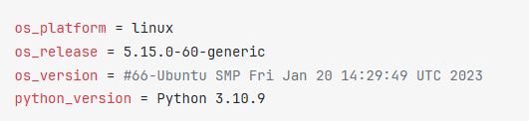
Internals (cont.)
Environment file
The environment.properties file in the test results directory, if present, defines a set of key-value pairs to display in the test report.

Slide 33
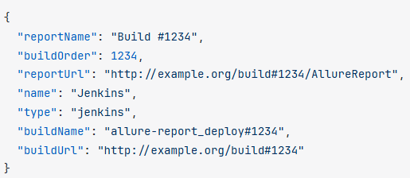
Internals (cont.)
Executor file
The executor.json file in the test results directory, if present, should contain information about the CI build that produced the test report.
Its automatically generated by various CI integration plugins.

Slide 34
Internals (cont.)
History files
The history directory is used for transferring simplified information between consecutive test reports.
The directory is being generated as part of the test report generation and then can be copied to the test results directory for the new report, either manually or by a CI integration plugin.
The information in the history directory is used for displaying the History tab in the test details and various graphs.
The directory contains the following files:
history.json
history-trend.json
duration-trend.json
retry-trend.json
categories-trend.json

Slide 35
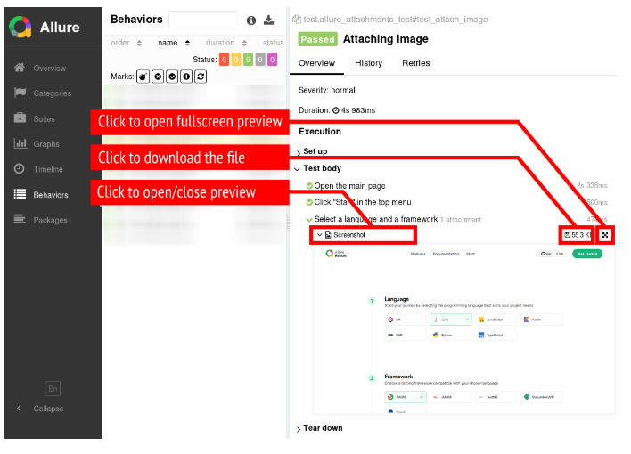
Attachements
Attachments
When investigating an unexpected test failure, sometimes its convenient to not just read the list of completed steps, but also see the same data the test saw.
We can attach any kinds of files to the whole test result or to the current test step or fixture.
Media types: image/bmp, image/gif, image/jpeg, image/png, image/svg+xml, image/tiff, image/*.

Slide 36
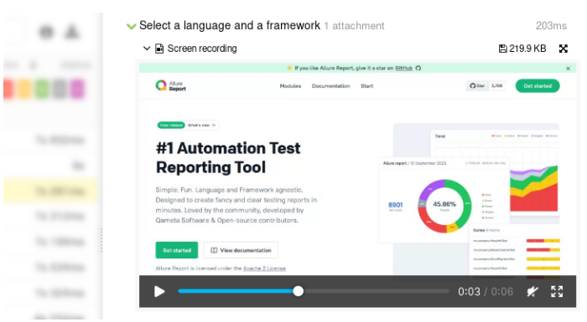
Attachements (cont.)
Videos
Attaching such a video to the test report serves a purpose similar to attaching a screenshot.
The reader will be able to better understand how the system reacted to the user input or other events and what caused an unexpected behavior.
Media types: video/mp4, video/ogg, video/webm.

Slide 37
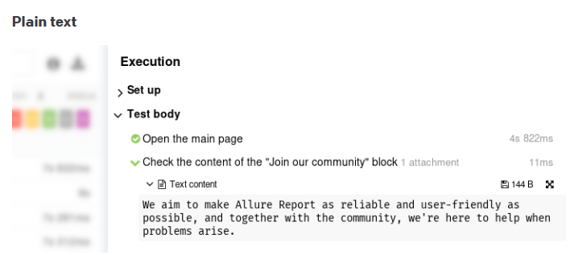
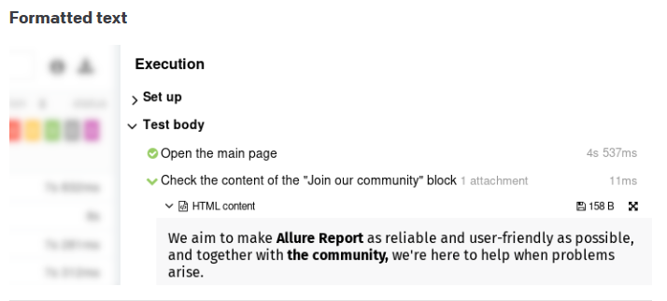
Attachements (cont.)
Text
Attaching texts to the test report can serve various purposes: from checking texts fround in a user interface under test to storing full logs of some complex operations.
Media types: text/html, text/plain, text/*.

Slide 38
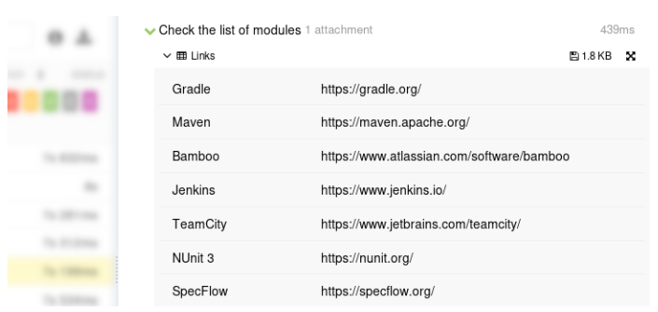
Attachements (cont.)
Tables
We can present arbitrary data as tables in Allure Report.
We can format the data as comma-separated values (CSV) or tab-separated values (TSV) and attach it to the test result.
The table will be displayed on the test result page without need to download and open the file.
Media types: text/csv, text/tab-separated-values.

Slide 39
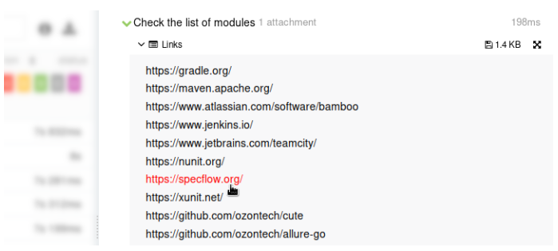
Attachements (cont.)
URI lists
We can collect and analyze a list of links.
By attaching the list of links to the test report, you will help the future reader inspect them again manually when investigating a failure.
The URI list format is just that: a list of URIs, one URI per line. Allure Report will make each link clickable in the test report.
Media types: text/uri-list.

Slide 40
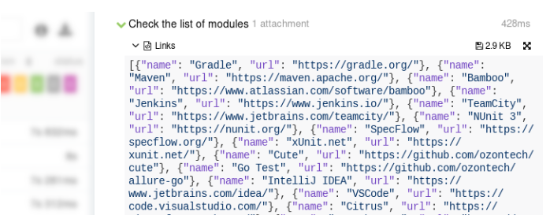
Attachements (cont.)
Documents
We can attach XML, JSON, or YAML document to your test report and specify the corresponding media type.
Allure Report will display the document with syntax highlighting enabled.
Media types: text/xml, application/xml, application/json, application/yaml.

Slide 41
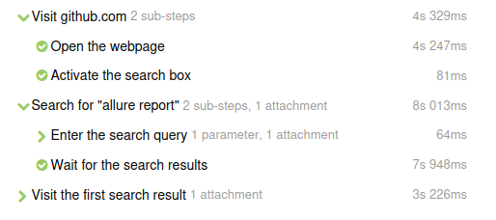
Test Step
Test steps
Test steps are a mechanism for structured logging.
A step allows us to view the execution results of the entire code block.
A step may also contain nested steps forming a tree-like structure.
In the test report, Allure displays steps in chronological order, preserving the nesting structure.
For each step, it shows its separate duration, status, and, optionally, parameters and attached files.

Slide 42
Test Step (cont.)
Using steps in your test serves two purposes:
simplify test debugging
improve test documentation
Steps help you see which sections of the test code were executed and which were not.
But unlike a traditional log entry, each step is an interval, not an instant.
The report can be improved even further by adding attachment to the steps.
One common practice is to log the state of a graphical user interface by attaching a screenshot on each step.

Slide 43
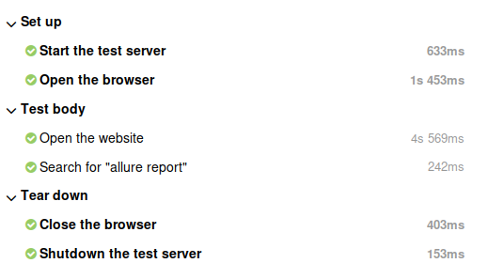
Test Step (cont.)
Fixtures
A fixture, also known as a hook, is a piece of code that runs before or after a test or a group of tests.
The code that runs before tests is often referred to as a “setup function”, and the code that runs after tests as a “teardown function”.
Disabling fixtures can help keep the report clean and readable, but keep in mind that having all fixtures listed can be useful, e.g., for detecting timing issues.

Slide 44
Test Step (cont.)
Step statuses
Each test step has its own status.
The status of a step does not have to be the same as the status of the whole test — e.g., you can have a failed step within a passed test.
If a step is implemented as a function or a lambda function, it usually gets assigned the Passed status if the code runs normally, or the Failed or Broken status if it is throws an exception.
If a step is a no-op step, it gets assigned the Passed status by default.

Slide 45
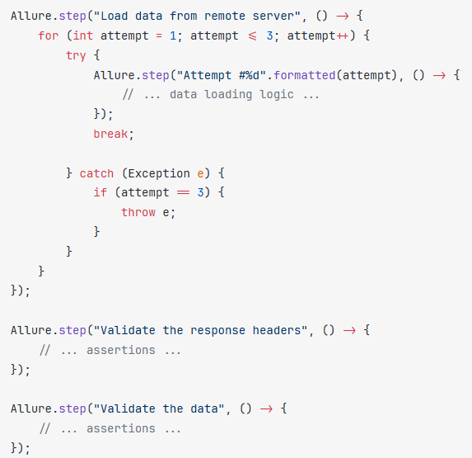
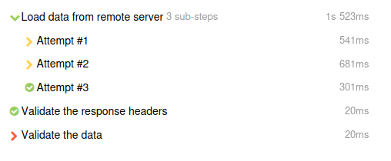
Test Step (cont.)
The example below demonstrates how test statuses can help the reader understand the test results. Here, the step statuses indicate that the first two attempts failed, but the code caught the exceptions and proceeded to the third attempt which was successful.

Slide 46
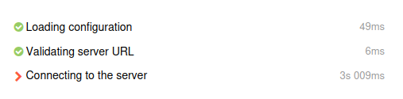
Test Step (cont.)
Step durations
The step duration is calculated by the Allure Report.
The result is displayed next to the step name in the test report.

Slide 47
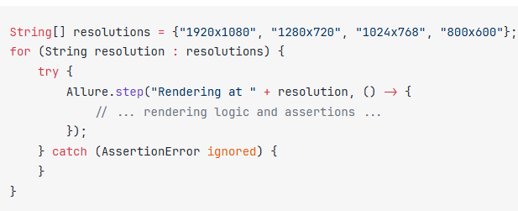
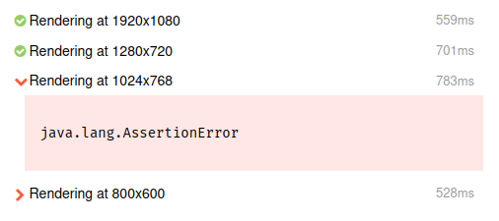
Test Step (cont.)
Exceptions in steps
When we write steps as reusable functions or lambda functions, Allure takes care of logging any exception thrown by the functions.
The exception's message and stack trace are attached to the step, and the step gets the Failed or Broken status depending on the exception type.

Slide 48
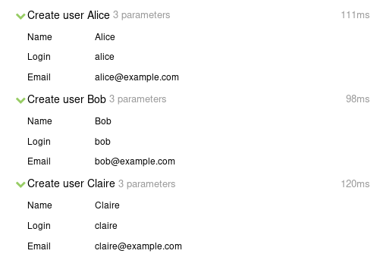
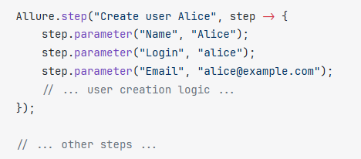
Test Step (cont.)
Step parameters
Step parameters are a way to describe the data that the step worked with.
This is not to be confused with the test parameters that characterize the whole test.

Slide 49
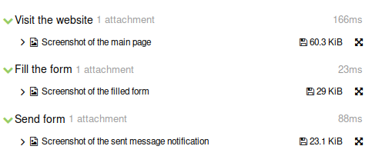
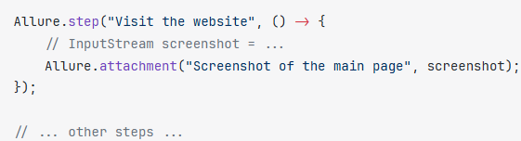
Test Step (cont.)
Step attachments
Allure Report supports attaching arbitrary files to a step.
Its used to describe either the input data the step processed (similar to step parameters) or the output data it received from somewhere.
Attaching files to steps can be a way of telling the reader a chronological story, in which certain screenshots or other files illustrate certain moments of the test execution.

Slide 50
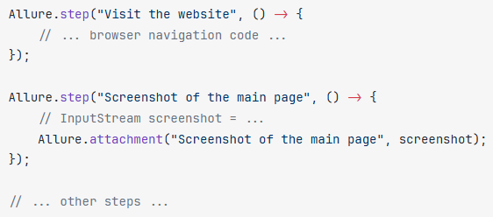
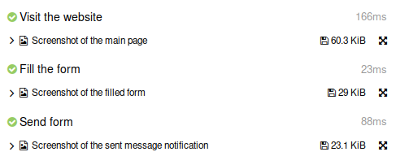
Test Step (cont.)
Attachment-only steps
Allure Report supports a special case called an “attachment-only step”.
Its a step that does not contain any sub-steps and contains exactly one attachment with the same name as the step itself.
Allure Report will simplify such a step visually, showing just the attachment, while preserving its position in relation to other steps.

Slide 51
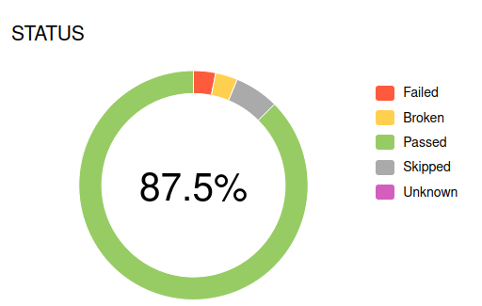
Visual Analytics
A test report generated by Allure displays some data in the form of graphs.
Both the Overview tab and the Graphs tab present a pie diagram showing how many tests got each status.
The number in the center of the pie chart indicates the percentage of test cases that passed successfully.

Slide 52
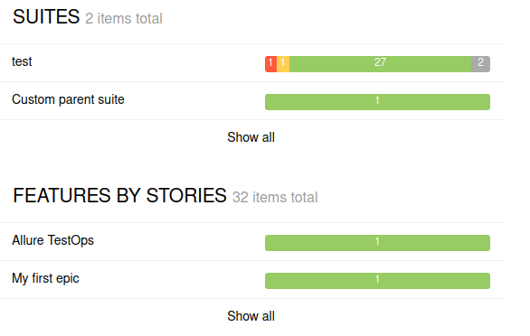
Visual Analytics (cont.)
Suites and Features by stories
The Overview tab contains the Suites and Features by stories blocks that present groups of tests from the Suite-based hierarchy and Behavior-based-hierarchy, respectively.

Slide 53
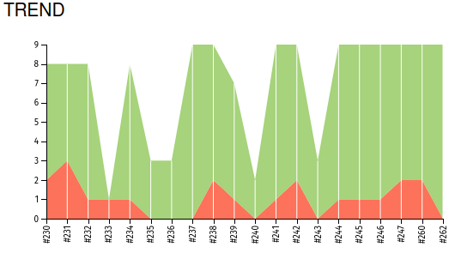
Visual Analytics (cont.)
Trend graphs
The trend graphs on the Overview and Graphs tabs show how a certain value changed over time.
Each vertical line corresponds to a certain version of the test report, with the last line on the right corresponding to the current version.

Slide 54
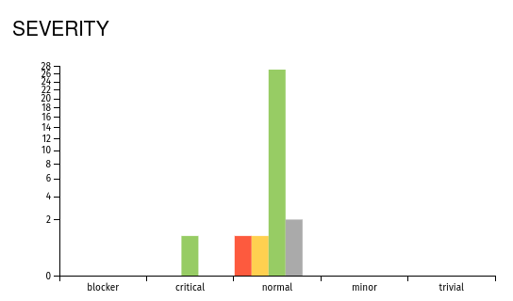
Visual Analytics (cont.)
Severity graph
The Graphs tab contains the severity graph which shows number of tests, grouped by both their statuses and severity.
If the Severity metadata field is not explicitly set for a test, the test is treated as having the “normal” severity level and is displayed in the middle section, while the tests with other severity levels are placed to the left or right of it.

Slide 55
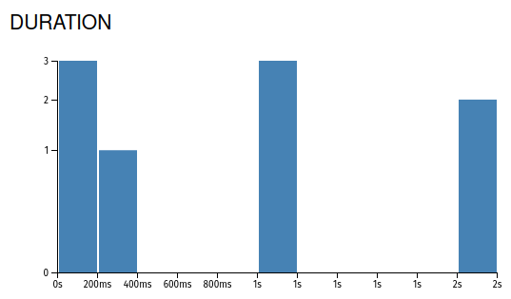
Visual Analytics (cont.)
Duration graph
The Graphs tab contains the duration graph, where all the tests are divided into groups based on how long it took to complete them.

Slide 56
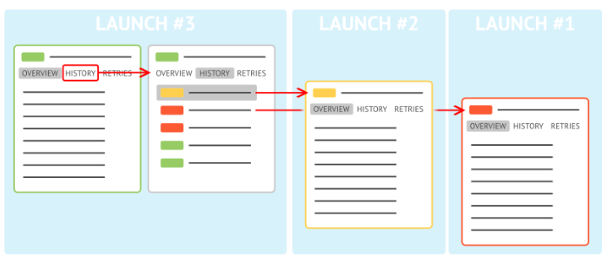
History
If a certain test fails now, it is useful to know whether it also failed yesterday or even last week.
We can navigate between multiple runs of the same test, both across different reports via Tests history and within a single one via Retries.
Each time Allure generates a test report, it also generates data into the history subdirectory.

Slide 57
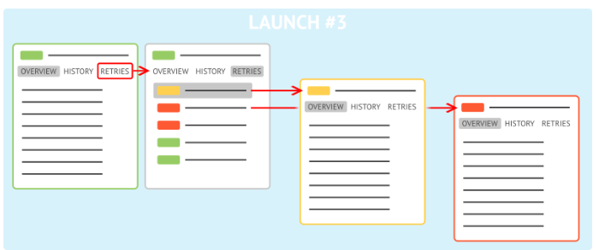
History (cont.)
Retries
When we run the same test multiple times, Allure produces a separate test result file for each run.
The test report then includes the status and other information from the latest file, with the other runs shown as retries.

Slide 58
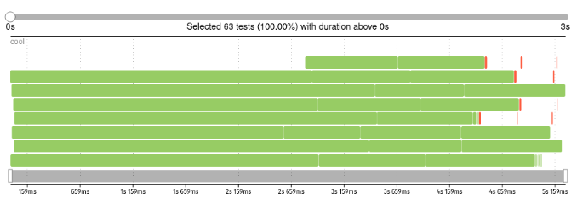
Timeline
The graph on the Timeline tab shows the order and the durations of all tests' executions.
When a test framework runs tests in parallel, it does so using a set of worker processes.
Each worker can only run one test at a time, but then the worker can be re-used to run another test.
In the graph, each row represents a single worker process, and each rectangle on it represents a single test's execution.

Slide 59


Timeline (cont.)
We can find the causes of various test failures or slowdowns just by looking at the timeline.
When some tests are significantly slower than the others, the corresponding rectangles on the graph will be the largest.
If the tests work on a web resource, and the resource goes offline for a while, a lot of seemingly unrelated tests may fail simultaneously.
Such a situation can manifest itself as a set of failed (red) tests in one area.

Slide 60
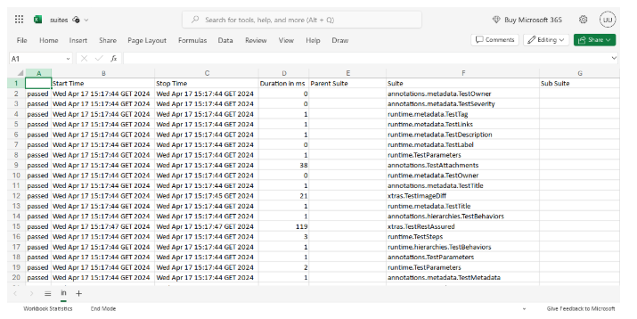
Export
Export to CSV
Allure Report automatically generates CSV files that you can open and analyze in external software, such as Microsoft Excel or Google Sheets.
We can get these files by using the Download CSV file on top of the corresponding tab in the HTML report or just by browsing to the data subdirectory in the output directory.

Slide 61
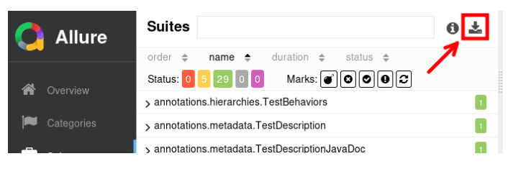
Export (cont.)
Suites data
To get the suites CSV file, click the Download CSV button on the Suites tab, or just open the file directly as data/suites.csv in the output directory.

Slide 62
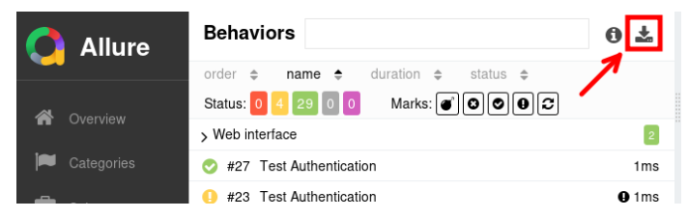
Export (cont.)
Behaviors data
To get the behaviors CSV file, click the Download CSV button on the Behaviors tab, or just open the file directly as data/behaviors.csv in the output directory.

Slide 63
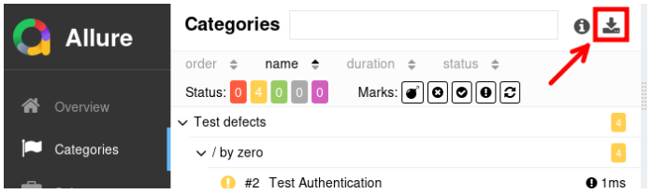
Export (cont.)
Categories data
To get the categories CSV file, click the Download CSV button on the Categories tab, or just open the file directly as data/categories.csv in the output directory.

Slide 64
Conclusion
Pros
Detailed Reports
Integration
Rich Features
Historical Data
Visual Appeal
Cons
Learning Curve
Performance Overhead
Documentation
Dependency Management

Slide 65

Bibliography
https://allurereport.org/docs/
https://qameta.io/blog/allure-report-hands-on/

