Slide 1

Cucumber
Dima Ionut Daniel

Slide 2
Contents
What is Cucumber?
History
Features
Architecture
Core
Conclusion
Bibliography

Slide 3

What is Cucumber?
Cucumber is an open-source tool used for behavior-driven development (BDD).
BDD is a software development approach that emphasizes collaboration between developers, QA testers, and non-technical stakeholders to ensure that the software meets business requirements.

Slide 4
History
Cucumber was originally written in the Ruby programming language and was originally used exclusively for Ruby testing as a complement to the RSpec BDD framework.
Cucumber now supports a variety of different programming languages through various implementations, including Java and JavaScript.
There is a port of Cucumber to .NET called SpecFlow, now superseded by Reqnroll.

Slide 5
Features
Gherkin Syntax: Cucumber tests are written in a language called Gherkin, which uses a simple, human-readable format. The syntax uses keywords like "Given," "When," and "Then" to describe the behavior of the application. This makes it easier for non-technical stakeholders to understand and contribute to the specifications.
Executable Specifications: The Gherkin scenarios can be executed as automated tests. Each scenario is linked to step definitions written in a programming language (such as Ruby, Java, JavaScript, or Python), allowing these specifications to be both human-readable and executable.
Integration with Testing Frameworks: Cucumber can be integrated with various testing frameworks and tools, making it a versatile choice for automated testing. It works well with tools like Selenium for browser testing, Appium for mobile testing, and many others.

Slide 6
Features (cont.)
Cross-Platform: Cucumber is not limited to a specific programming language or framework. It supports multiple languages, allowing teams to adopt it within their existing tech stacks.
Collaboration and Communication: By using a common language to describe application behavior, Cucumber promotes collaboration between technical and non-technical team members, reducing misunderstandings and ensuring that everyone has a shared understanding of what the software should do.
Support for Various Platforms: Cucumber can be used for testing web applications, APIs, and mobile applications, making it a flexible choice for a wide range of projects.

Slide 7
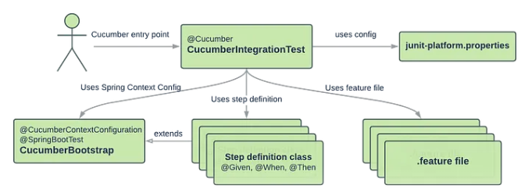
Architecture
High Level Diagram on Cucumber Spring Boot Setup

Slide 8
Core
Gherkin is a domain-specific language used in Behavior-Driven Development (BDD) for defining test cases in a human-readable format.
It allows stakeholders, including non-technical participants, to collaborate on software requirements and create executable specifications.

Slide 9
Core (cont.)
Behavior-Driven Development (BDD) is a software development approach that enhances collaboration between developers, testers, and non-technical stakeholders such as business analysts and product owners.
Benefits:
Improved Communication: By using a shared language, BDD helps bridge the gap between technical and non-technical team members.
Better Understanding of Requirements: Writing scenarios helps clarify requirements and expectations.
Early Detection of Issues: Automated tests written in BDD can be run frequently to catch bugs early in the development process.
Documentation: The scenarios serve as living documentation that evolves as the software changes.

Slide 10
Core (cont.)
Key Features of Gherkin:
1. Readable Syntax
Gherkin uses a simple, structured syntax that is easy to read and write.
It resembles plain English, making it accessible to all team members, including business analysts, testers, and developers.
2. Structure:
Gherkin scenarios are typically written in a Given-When-Then format:
Given: Describes the initial context or preconditions.
When: Describes the action or event that triggers the behavior.
Then: Describes the expected outcome or result.

Slide 11
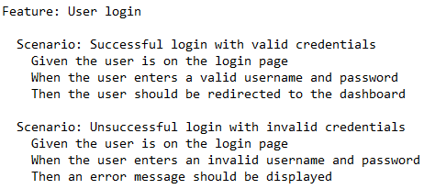
Core (cont.)
3. Tags:
Gherkin allows the use of tags to categorize scenarios, which can be useful for filtering or organizing tests.
4. Data Tables:
Gherkin supports the use of data tables to provide multiple sets of input data for a single scenario, promoting reusability and clarity.
5. Comments:
Lines starting with # are treated as comments, allowing for annotations and explanations within the Gherkin file.

Slide 12
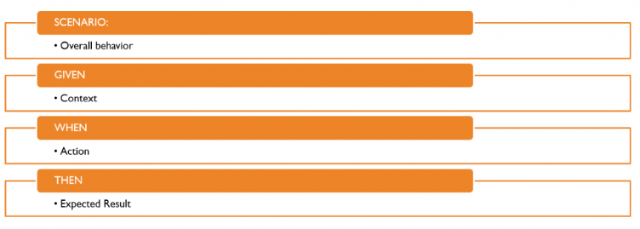
Core (cont.)
Basic Gherkin structure for acceptance criteria

Slide 13
Core (cont.)
Main Gherkin keywords:
Feature: describes a feature of the application. It provides a high-level description of what is being tested.
Scenario(or Example): represents a single test case or scenario that describes a specific situation.
Scenario Outline(or Scenario Template): used to run the same scenario multiple times with different inputs. It is often used with examples.
Given: sets up the initial context or preconditions for the scenario.
When: describes the action or event that triggers the behavior being tested.

Slide 14
Core (cont.)
Then: Describes the expected outcome or result after the action is performed.
And: Can be used to add additional conditions or actions to the Given, When, or Then steps.
But: Similar to "And," it is used to add a contrasting condition or action.
Examples: Used in conjunction with Scenario Outline to provide a table of input values for the scenario.
Background: Provides a context that is shared across multiple scenarios within a feature.

Slide 15
Core (cont.)
Rule: introduced since Gherkin v6, it represents one business rule that should be implemented. It provides additional information for a feature. A Rule is used to group together several scenarios that belong to this business rule.
# is used for comments
| is used for data tables
@ are used for tags: allow you to categorize and organize your scenarios and feature files.

Slide 16
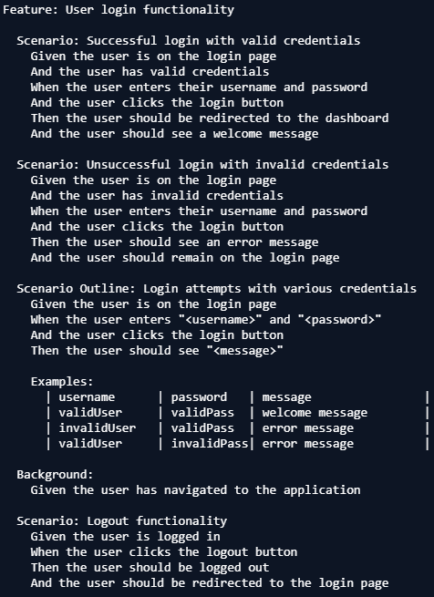
Core (cont.)

Slide 17
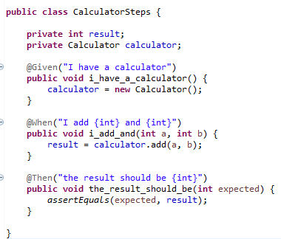
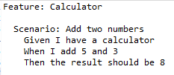
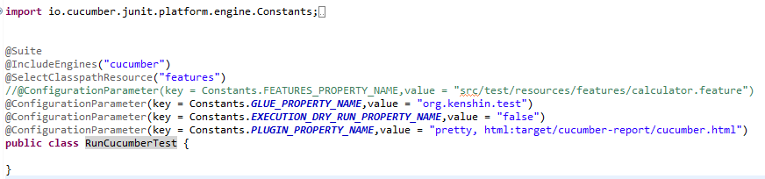
Core (cont.)
/src/test/resources/calculator.feature

Slide 18
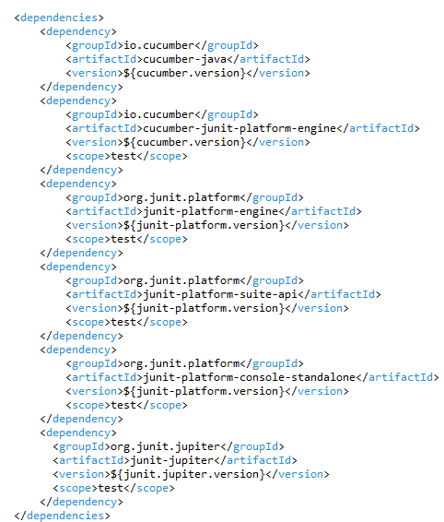
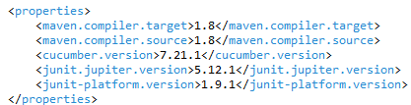
Core (cont.)

Slide 19
Conclusion
Pros:
Readable Syntax
Automation Support
BDD Approach
Cross-Platform
Integration with CI/CD Tools
Cons:
Learning Curve
Maintenance Challenges
Dependency on other tools
Overhead
Performance

Slide 20

Bibliography
https://en.wikipedia.org/wiki/Cucumber_(software)
https://cucumber.io/docs/guides/
https://marcellodelbono.it/given-when-then/

