Slide 1

Rest-assured
Dima Ionut Daniel

Slide 2
Contents
What is Rest-assured?
History
Features
Arhitecture
Core
Conclusion
Bibliography

Slide 3

What is Rest-assured?
Rest-Assured is a popular open-source Java library used for testing RESTful web services.
It simplifies the process of testing and validating REST APIs by providing a domain-specific language (DSL).
The library was released as open-source software under the Apache License 2.0, allowing developers to use, modify, and distribute it freely.

Slide 4
History
Rest-Assured was created by Johan Halby and was initially released around 2011.
The library was developed to make it easier for Java developers to test RESTful APIs without having to write extensive boilerplate code.

Slide 5
Features
Ease of Use: Rest-Assured provides a simple and intuitive API that allows developers to write tests with minimal boilerplate code. It integrates well with popular testing frameworks like JUnit and TestNG.
HTTP Methods Support: It supports all standard HTTP methods (GET, POST, PUT, DELETE, PATCH, etc.), making it versatile for testing various types of API interactions.
Request and Response Validation: Rest-Assured allows you to easily set request parameters, headers, and body content. It also provides mechanisms to validate responses, including status codes, headers, and body content (using JSON or XML path expressions).
Authentication: The library supports various authentication mechanisms, such as OAuth, Basic authentication, and Digest authentication, making it easier to test secured APIs.
Supports BDD (Behavior-Driven Development).

Slide 6
Features (cont.)
JSON and XML Support: Rest-Assured has built-in support for parsing and validating JSON and XML responses, making it suitable for APIs that use these formats.
Integration with Testing Frameworks: It can be easily integrated with popular Java testing frameworks like JUnit, TestNG, and Cucumber, allowing for seamless test execution and reporting.
Extensibility: You can extend Rest-Assured's functionality through custom matchers, request filters, and response filters, enabling more complex testing scenarios.
Error Handling: It provides mechanisms to handle and validate error responses, making it easier to test edge cases and failure scenarios.

Slide 7
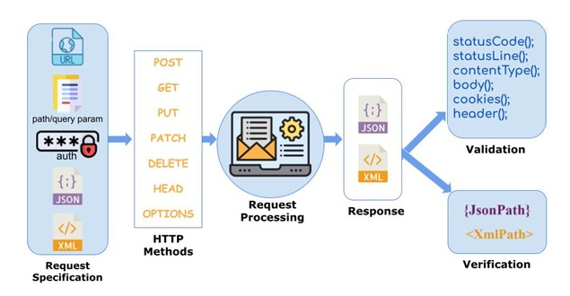
Arhitecture

Slide 8
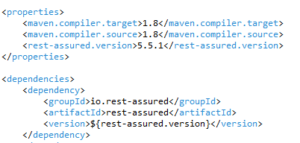
Core
Rest-assured java library can be found at https://rest-assured.io .
REST Assured includes JsonPath and XmlPath .

Slide 9
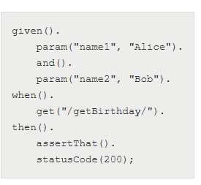
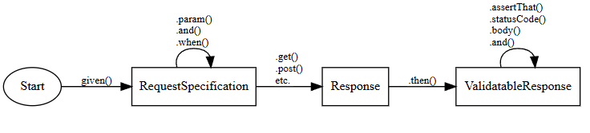
Core (cont.)
Rest-assured Fluent API.

Slide 10
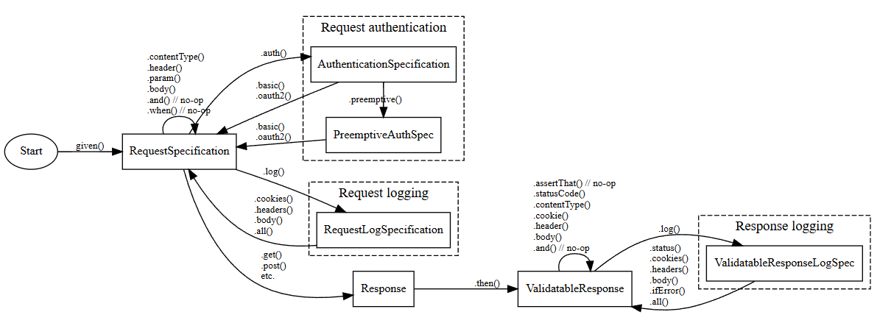
Core (cont.)
Commonly used parts of REST assured fluent API.

Slide 11

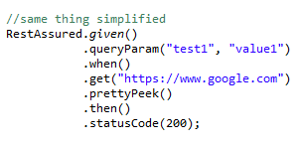
Core (cont.)
RequestSpecification
Represents the request that is being sent to the server.
Allows you to define request parameters, headers, cookies, and body.

Slide 12
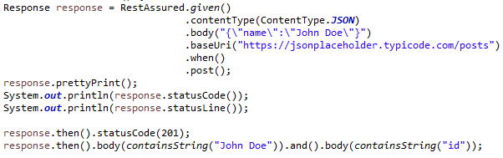
Core (cont.)
Response
Represents the HTTP response received from the server.
Provides methods to extract response data and perform assertions.
Example: Response response = request.get("/endpoint");

Slide 13
Core (cont.)
ResponseSpecification
Used to define the expected response characteristics.
You can set up common assertions for responses, which can be reused.
RestAssured:
The main class used to configure and execute requests.

Slide 14
Core (cont.)
ValidatableResponse object is responsible for performing validation (assertions) of the HTTP response.
Its assertThat() method is just syntactic sugar that reads nicely between then() and the following assertion method calls.
It provides methods to check the HTTP status code, the headers, the response body, etc.

Slide 15
Core (cont.)
Basic Authentication
Response response = given()
.auth()
.preemptive()
.basic("username", "password")
.when()
.get("/secure-endpoint");

Slide 16
Core (cont.)
Bearer Token Authentication
Response response = given()
.header("Authorization", "Bearer your_token")
.when()
.get("/secure-endpoint");

Slide 17
Core (cont.)
Handling JSON Responses
String itemName = response.jsonPath().getString("items[0].name");
Handling XML Responses
String itemName = response.xmlPath().getString("item[0].name");

Slide 18
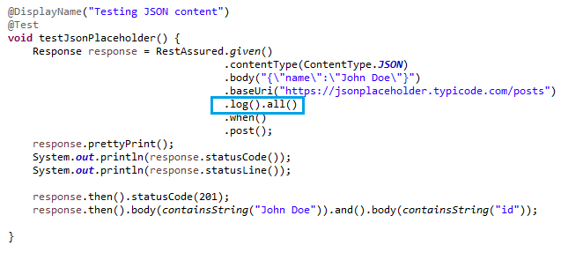
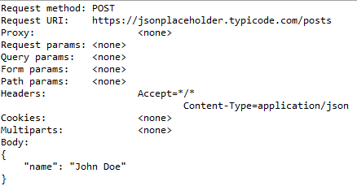
Core (cont.)
REST Assured's fluent API also lets you perform logging using .log().body() on RequestSpecification.

Slide 19
Conclusion
Pros:
Follows the BDD approach and uses keywords like given(), when(), and then()
Very rich in the ready-made assertion
The response is given in JSON or XML, so it is easy to parse and validate
Support JSONPath and XMLPath to parse the JSON or XML response
Can be easily integrated with testing frameworks like JUnit, TestNG
Cons:
Does not support the testing of SOAP (Simple Object Access Protocol) APIs explicitly

Slide 20

Bibliography
https://rest-assured.io/
https://ultra.guide/bin/view/Automation/RestAssuredsFluentInterfaceDesign

