Slide 1

rSocket
Dima Ionut Daniel

Slide 2
Contents
What is rSocket?
Features
Terminology
Architecture
Core
Implementation
Conclusion
Bibliography

Slide 3

What is rSocket?
RSocket is an application protocol initially developed by Netflix, that supports Reactive Streams.
RSocket is a binary protocol for use on byte stream transports such as TCP, WebSockets, and Aeron.
It enables the following symmetric interaction models via async message passing over a single connection.

Slide 4
Features
Support for interaction models beyond request/response such as streaming responses and push
Application-level flow control semantics (async pull/push of bounded batch sizes) across network boundaries
Binary, multiplexed use of a single connection
Support resumption of long-lived subscriptions across transport connections
Need of an application protocol in order to use transport protocols such as WebSockets and Aeron

Slide 5
Terminology
Frame: A single message containing a request, response, or protocol processing.
Fragment: A portion of an application message that has been partitioned for inclusion in a Frame. See Fragmentation and Reassembly.
Transport: Protocol used to carry RSocket protocol. One of WebSockets, TCP, or Aeron. The transport MUST provide capabilities mentioned in the transport protocol section.
Stream: Unit of operation (request/response, etc.).
Request: A stream request. May be one of four types. As well as request for more items or cancellation of previous request.
Payload: A stream message (upstream or downstream). Contains data associated with a stream created by a previous request. In Reactive Streams and Rx this is the 'onNext' event.

Slide 6
Terminology (cont.)
Complete: Terminal event sent on a stream to signal successful completion. In Reactive Streams and Rx this is the 'onComplete' event.
Client: The side initiating a connection.
Server: The side accepting connections from clients.
Connection: The instance of a transport session between client and server.
Requester: The side sending a request. A connection has at most 2 Requesters. One in each direction.
Responder: The side receiving a request. A connection has at most 2 Responders. One in each direction.

Slide 7
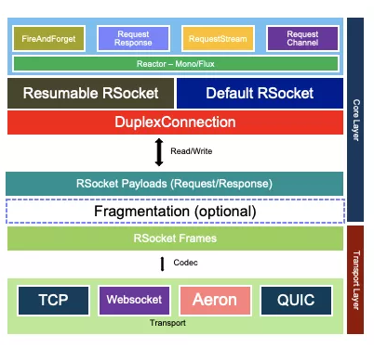
Architecture

Slide 8
Core
The RSocket protocol does however provide the necessary communication mechanisms for client and server to maintain state and re-establish sessions on new transport connections.
It supports session resumption, to allow resuming long-lived streams across different transport connections. This is particularly useful for mobile‹–›server communication when network connections drop, switch, and reconnect frequently.
HTTP/2 requires TCP.
RSocket requires TCP, WebSockets or Aeron(over UDP).
Proxies that behave correctly for HTTP/2 will behave correctly for RSocket.
RSocket is fully reactive and even its APIs are integrated seamlessly with reactive programming.

Slide 9
Core (cont.)
RSocket follows a versioning scheme consisting of a numeric major version and a numeric minor version.
RSocket assumes that all version changes (major and minor) are backward incompatible.
A client can pass a version that it supports via the Setup Frame.
It is up to a server to accept clients of lower versions than what it supports.

Slide 10
Core (cont.)
RSocket provides mechanisms for applications to distinguish payload into two types: data and metadata.
The distinction between the types in an application is left to the application.
The following are features of Data and Metadata.
Metadata can be encoded differently than Data.
Metadata can be "attached" (i.e. correlated) with the following entities:
Connection via Metadata Push and Stream ID of 0
Individual Request or Payload (upstream or downstream)

Slide 11
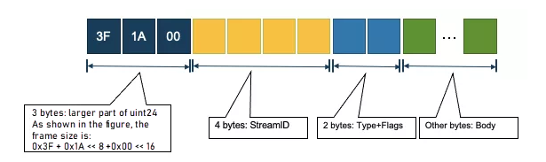
Core (cont.)
Frame is the minimum unit of RSocket message.
A frame consists of a header of 6 bytes and a body.
The 4 bytes in the header represent StreamID, 6 bits represent Frame Type, and 10 bits represent Flags.
The structure of the body varies among different frame types.
Commonly used frames with Payload contain Metadata and Data.
If the transport layer does not support frame division (such as TCP), RSocket uses uint24 of 3 bytes to represent the frame length, so the maximum frame size is 16 MB.
If a frame exceeds 16 MB, RSocket supports frame division and recombination. In other words, a frame is divided into smaller frames, and the receiver recombines them automatically.

Slide 12
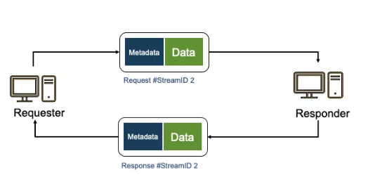
Core (cont.)
Developers generally deal with Payload, which is similar to an HTTP message.
Payload can be a request or response. It consists of two binary parts:
Metadata, which is similar to HTTP header
Data, which is similar to HTTP body

Slide 13
Core (cont.)
The transport layer supports encoding and decoding binary streams into frames.
RSocket allows you to customize the maximum frame size, which is 16 MB by default. When a frame exceeds 16 MB, it is divided into N small frames and recombined when received. As mentioned when introducing frames, this feature is called Fragmentation.
RSocket uses the Reactor core library to support four communication modes, which are abstracted as advanced APIs.

Slide 14
Core (cont.)
Frame type | Value | Description
Reserved | 0x00 | Reserved
SETUP | 0x01 | Sent by client to initiate protocol processing
LEASE | 0x02 | Sent by responder to grant the ability to send requests
KEEPALIVE | 0x03 | Connection keepalive
REQUEST_RESPONSE | 0x04 | Request single response
REQUEST_FNF | 0x05 | A single one way message
REQUEST_STREAM | 0x06 | Request a completable stream
REQUEST_CHANNEL | 0x07 | Request a completable stream in both directions

Slide 15
Core (cont.)
Frame type | Value | Description
REQUEST_N | 0x09 | Request N more items with Reactive Streams
CANCEL | 0x09 | Cancel outstanding request
PAYLOAD | 0x0A | Payload on a stream
ERROR | 0x0B | Error at connection or application level
METADATA_PUSH | 0x0C | Async metadata frame
RESUME | 0x0D | Replaces SETUP for resuming operation
RESUME_OK | 0x0E | Sent in response to a RESUME if possible
EXT | 0x0F | Used to extend more frame types

Slide 16
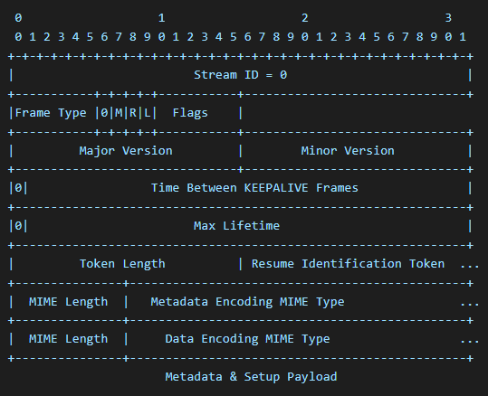
Core (cont.)
The SETUP frame is sent by the client to inform the server of the parameters under which it desires to operate. The usage and message sequence used is shown in Connection Establishment.
One of the important parameters for a connection is the format, layout, and any schema of the data and metadata for frames.

Slide 17
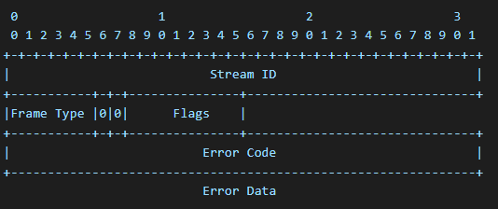
Core (cont.)
ERROR frames are used for errors on individual requests/streams as well as connection errors and in response to SETUP frames.

Slide 18
Core (cont.)
Error Type | Value | Description
RESERVED | 0x00000000 | Reserved
INVALID_SETUP | 0x00000001 | The Setup frame is invalid for the server. Stream ID MUST be 0.
UNSUPPORTED_SETUP | 0x00000002 | Some (or all) of the parameters specified by the client are unsupported by the server. Stream ID MUST be 0.
REJECTED_SETUP | 0x00000003 | The server rejected the setup, it can specify the reason in the payload. Stream ID MUST be 0.
REJECTED_RESUME | 0x00000004 | The server rejected the resume, it can specify the reason in the payload. Stream ID MUST be 0.
CONNECTION_ERROR | 0x00000101 | The connection is being terminated.

Slide 19
Core (cont.)
Error Type | Value | Description
CONNECTION_CLOSE | 0x00000102 | The connection is being terminated. Receiver of this frame MUST wait for outstanding streams to terminate before closing the connection.
APPLICATION_ERROR | 0x00000201 | Application layer logic generating a Reactive Streams onError event. Stream ID MUST be > 0.
REJECTED | 0x00000202 | Despite being a valid request, the Responder decided to reject it. The Responder guarantees that it didn't process the request.
CANCELED | 0x00000203 | The Responder canceled the request but may have started processing it. Stream ID MUST be > 0.
INVALID | 0x00000204 | The request is invalid. Stream ID MUST be > 0.
RESERVED | 0xFFFFFFFF | Reserved for Extension Use

Slide 20
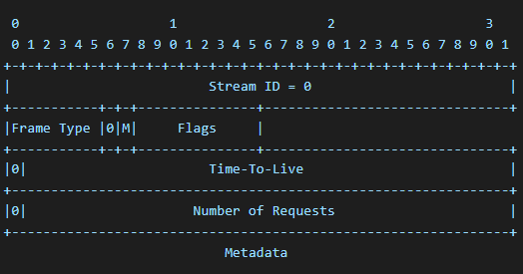
Core (cont.)
The LEASE semantics are to control the number of individual requests (all types) that a Requester may send in a given period. The only responsibility the protocol implementation has for the LEASE is to honor it on the Requester side.
The Responder application is responsible for the logic of generation and informing the Responder it should send a LEASE to the peer Requester.
Requester MUST respect the LEASE contract. The Requester MUST NOT send more than Number of Requests specified in the LEASE frame within the Time-To-Live value in the LEASE.

Slide 21
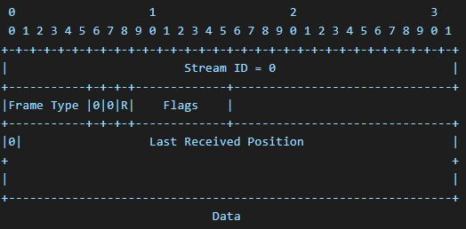
Core (cont.)
KEEPALIVE frames MUST always use Stream ID 0 as they pertain to the Connection.
KEEPALIVE frames MUST be initiated by the client and sent periodically with the (R)espond flag set.
KEEPALIVE frames MAY be initiated by the server and sent upon application request with the (R)espond flag set.

Slide 22
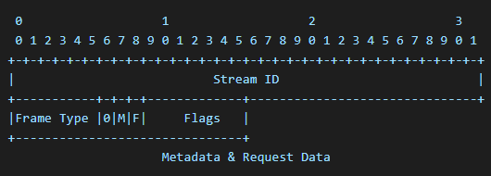
Core (cont.)
REQUEST_RESPONSE Frame

Slide 23
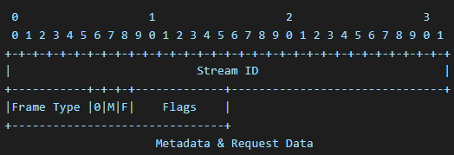
Core (cont.)
REQUEST_FNF (Fire-n-Forget) Frame

Slide 24
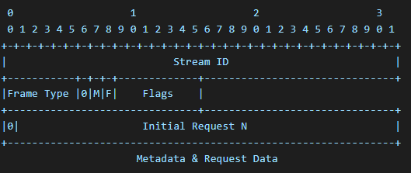
Core (cont.)
REQUEST_STREAM Frame

Slide 25
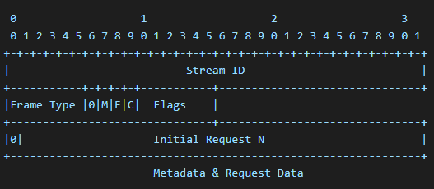
Core (cont.)
REQUEST_CHANNEL Frame

Slide 26
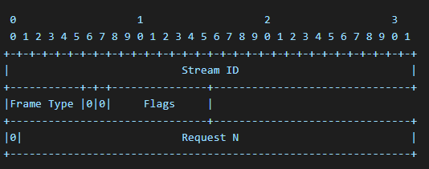
Core (cont.)
REQUEST_N Frame

Slide 27
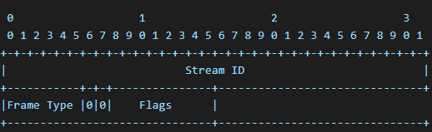
Core (cont.)
CANCEL Frame

Slide 28
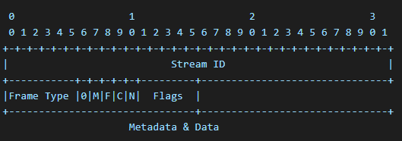
Core (cont.)
PAYLOAD Frame

Slide 29
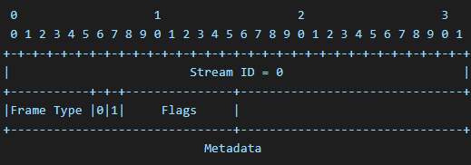
Core (cont.)
A Metadata Push frame can be used to send asynchronous metadata notifications from a Requester or Responder to its peer.
METADATA_PUSH frames MUST always use Stream ID 0 as they pertain to the Connection.
Metadata tied to a particular stream uses the individual Payload frame Metadata flag.

Slide 30
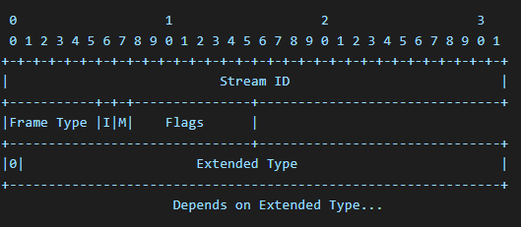
Core (cont.)
EXT (Extension) Frame

Slide 31
Core (cont.)
JDK has launched reactive standard APIs. Apart from the Processor, its core interfaces only contain Publisher, Subscriber, and Subscription.
Publisher is responsible for producing data. The only method in it is subscribe, which starts a new subscription after receiving a Subscriber.
Subscriber is responsible for subscribing to consumption data.
Subscription defines the context of a Subscription, such as canceling or notifying of obtaining the next N data entries.

Slide 32
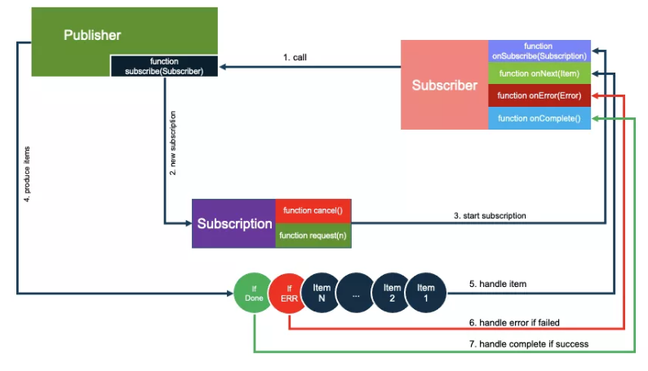
Core (cont.)

Slide 33
Core (cont.)
Create a subscriber and start subscribing to Publisher
Generate the context subscription
When Publisher is ready, call onSubscribe.
Publisher begins to produce data
Call back onNext for each successfully produced data entry
If production fails, call back onError and end the current subscription.
When all the data is produced, call back onComplete and end the current subscription.
You can call subscription during the process to cancel the subscription at any time or send a notification about producing the next N elements by request(n). This process is called backpressure.

Slide 34
Core (cont.)
It supports 4 communication modes:
Request response (1:1)
Request stream (1:N)
Request channel (M:N)
Fire and forget (1:0)

Slide 35
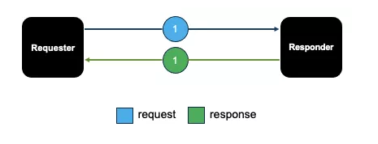
Core (cont.)
Request/Response
The client sends a request, and the server receives the request and returns a response.

Slide 36
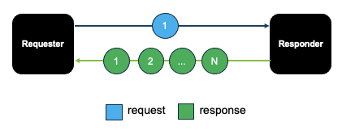
Core (cont.)
Request stream
The client sends a request, and the server returns N responses.
Conventional MQ typically uses the RequestStream mode.

Slide 37
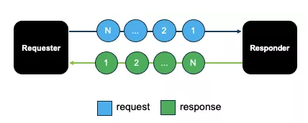
Core (cont.)
Request channel
Create a channel context so both parties can send messages.
IM is a typical RequstChannel scenario.

Slide 38
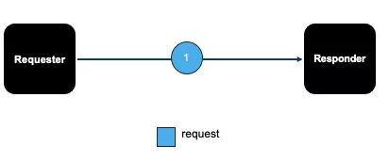
Core (cont.)
Fire and forget
This mode supports sending a request without sending a response message.
Practical scenarios: such as event tracking and log reporting.
A response in these scenarios is not needed, and it does not matter if several requests are lost.

Slide 39
Core (cont.)
The process of the client in RSocket connecting to the Server is called Setup.
After the connection is established, the direction logic of message sending and receiving is specified:
When the Client sends a request to the Server, the request ID is always an odd number.
When the Server sends a request to the Client, the request ID is always an even number.

Slide 40
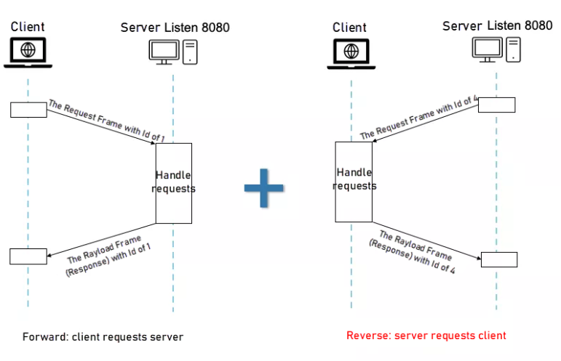
Core (cont.)
The communication is bi-directional

Slide 41
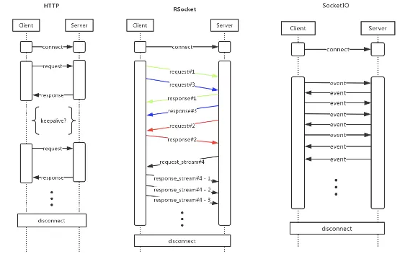
Core (cont.)
RSocket is more efficient and supports more scenarios than HTTP.
It eliminates head-of-line blocking.
Compared with event-based frameworks, such as SocketIO, RSocket requests have a clear context, are refined, and APIs are easy to use.

Slide 42
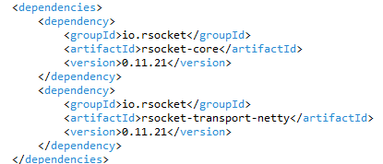
Core (cont.)
We have java rSocket implementation, we can use it by adding the rsocket-core and rsocket-transport-netty dependencies.

Slide 43
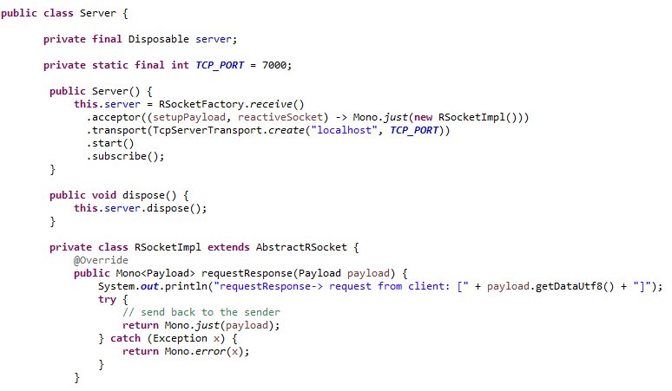
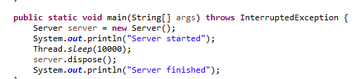
Core (cont.)
Server request response communication example

Slide 44
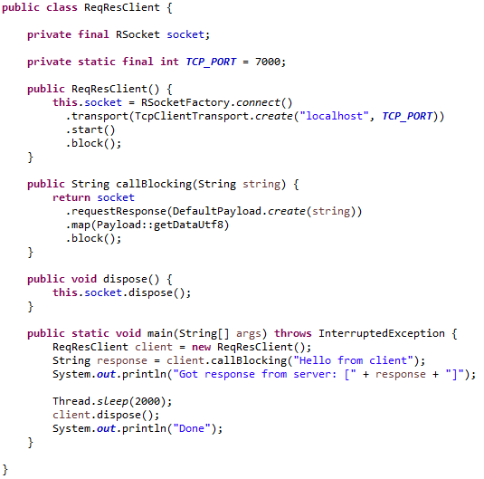
Core (cont.)
Client request/response communication mode example

Slide 45
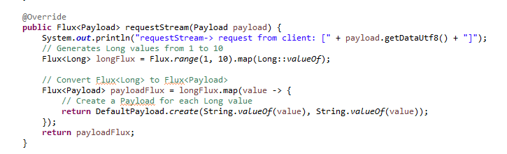
Core (cont.)
Server request stream communication mode example

Slide 46
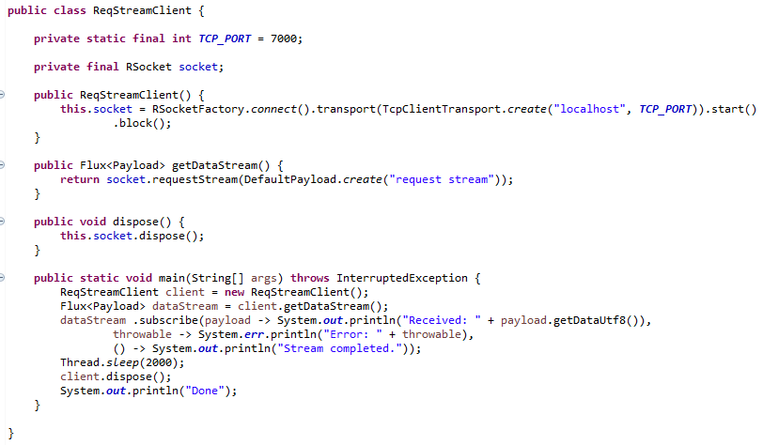
Core (cont.)
Client Request stream communication mode example

Slide 47
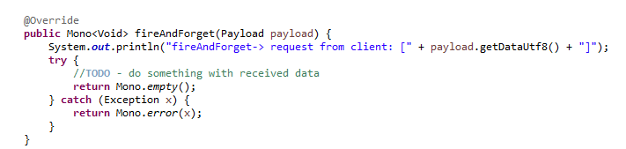
Core (cont.)
Server fire and forgot mode communication example

Slide 48
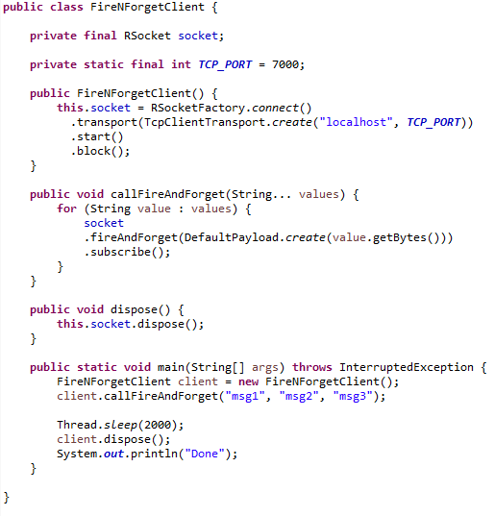
Core (cont.)
Client fire and forgot communication mode example

Slide 49
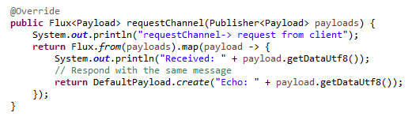
Core (cont.)
Server channel communication mode example

Slide 50
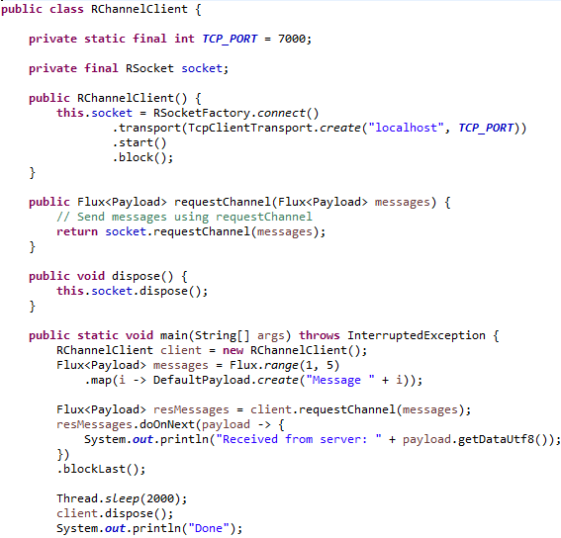
Core (cont.)
Client channel communication mode example

Slide 51
Implementation
Driver | Transport(s) | Version | Core support | Resumption | Leasing | RPC
rsocket-java | aeron (UDP) akka reactor-netty (TCP, WS) | 1.0 | x |  | x | x
rsocket-js | Nodejs net (TCP) Plain (WS) | 1.0 | x | x |  | x
rsocket-net | System.Net (TCP, WS) | 1.0 | x |  |  | x
rsocket-cpp | Folly (TCP) | 1.0 | x | x
rsocket-go | Go NET (TCP) | 1.0 | x |  |  | x

Slide 52
Implementation (cont.)
Driver | Transport(s) | Version | Core support | Resumption | Leasing | RPC
rsocket-kotlin | ktor multiplatform (TCP, WS) | 1.0 | x
rsocket-py | asyncio (TCP, WS) | 1.0 | x |  | x
rsocket-swift | SwiftNIO (TCP, WS) Network.framework | 0.0.1
rsocket-rust | Tokio (TCP, WS) | 1.0 | x

Slide 53
Conclusion
Pros:
Fast binary protocol
Reactive and asynchronous
Multiple communication modes
Has backpressure mechanism
Transport agnostic
Language Agnostic
Cons:
Complexity
Less Mature Ecosystem
Overhead
Debugging Challenges
Limited Adoption
Learning Curve

Slide 54

Bibliography
https://en.wikipedia.org/wiki/RSocket
https://rsocket.io/
https://www.baeldung.com/rsocket
https://www.alibabacloud.com/blog/a-brief-on-rsocket-and-reactive-programming_598219

