Slide 1

Jenkins
Dima Ionut Daniel

Slide 2
Contents
What is Jenkins?
Continuous Integration
Installing & Setup
Configuring Jenkins
Advanced Setup
Build Jobs
Security
Notification
Code Quality
Maintenance
Conclusions
Bibliography

Slide 3

What is Jenkins?
originally called Hudson
open source continuous integration tool written in Java
provides continuous integration services for software development
server-based system running in a servlet container
released under the MIT License, Jenkins is free software
Jenkins can be extended via Plugins

Slide 4
Continuous Integration
Continuous integration aims to improve the quality of software. Principles of CI:
Maintain a code repository - use of a revision control system for the project's source code.
Automate the build - a single command should have the capability of building the system.
Monitor code repository - involves a tool that monitors your version control system for changes. Whenever a change is detected, this tool automatically compiles and tests your application.

Slide 5
Continuous Integration (cont.)
Keep the build fast - The build needs to complete rapidly, so that if there is a problem with integration, it is quickly identified.
Make the build self-testing - all tests should run to confirm the correct behavior.
Check results from the latest build - parse the build results and interpret them.
Automate deployment - allow the running of scripts after a build finishes.

Slide 6
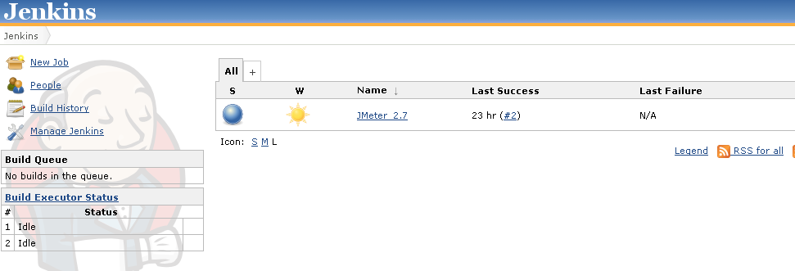
Installing & Setup
Jenkins is a Java web application and requires JDK 1.6
We can start Jenkins from the command line as: java -jar jenkins.war.
It would start as default on port 8080. (http://localhost:8080/jenkins)

Slide 7
Configuring Jenkins
Configure Maven -If we have Maven installed on your machine we can provide the path in the MAVEN_HOME field or install one online.
Configure JDK -If we have JDK installed on your machine we can provide the path in the JAVA_HOME field or install one online.
Configure Ant - If we have Ant installed on your machine we can provide the path in the ANT_HOME field or install one online.
Notification - when a Jenkins build breaks, and when it works again, it can send out email messages to the team.
Using plugins, you can also send instant messages or SMS messages, post entries on Twitter, etc.
Pag 57 -More Reporting—Displaying Javadocs

Slide 8
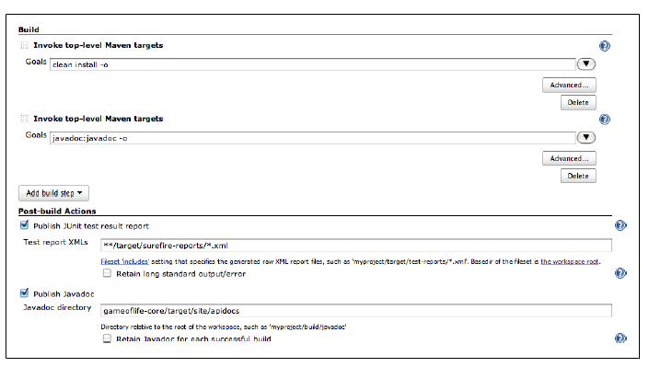
Configuring Jenkins (cont.)
Javadoc comments are an important source of low-level technical documentation.
Jenkins can integrate Javadoc API documentation directly into the Jenkins website.
In the Goals field we place javadoc:javadoc—this will tell Maven to generate the Javadoc documentation.

Slide 9
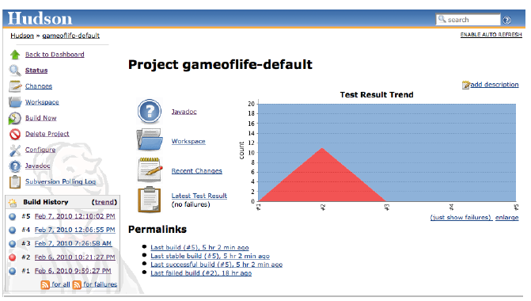
Configuring Jenkins (cont.)
Cobertura is an open source code coverage tool that works well with both Maven and Jenkins.
Jenkins Cobertura plugin can generate the code coverage metrics for Jenkins to record and display.

Slide 10
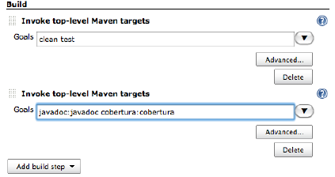
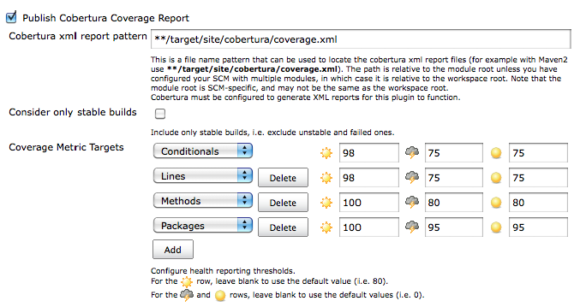
Configuring Jenkins (cont.)

Slide 11
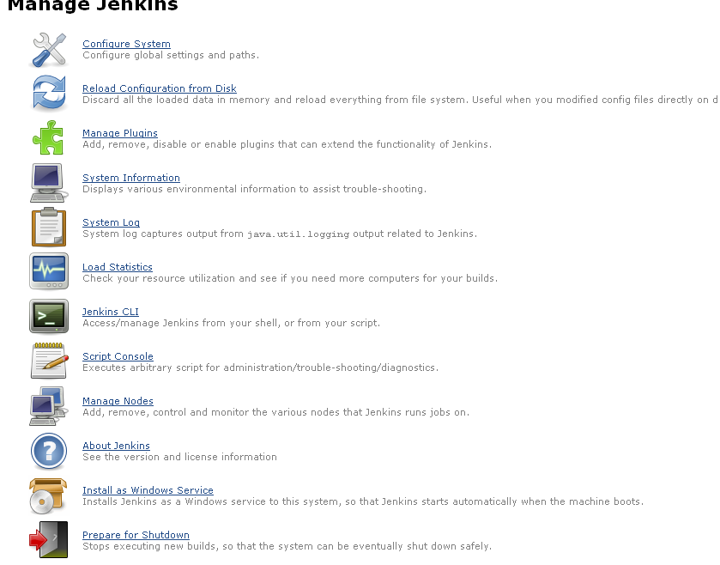
Configuring Jenkins (cont.)

Slide 12
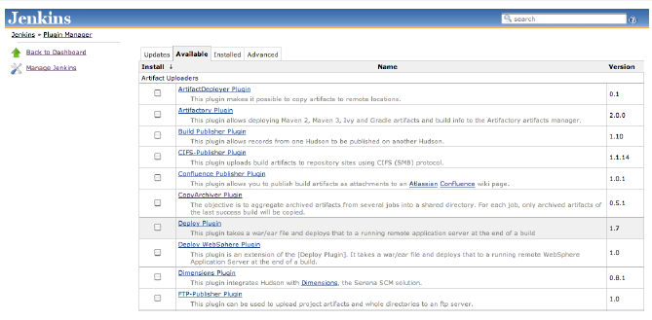
Configuring Jenkins (cont.)
Jenkins Plugin Manager can manage plugins.

Slide 13
Advanced Setup
We can start Jenkins as standalone application by running the: “java -jar jenkins.war” command.
By default, Jenkins will run on the 8080 port.
We can change the port using the --httpPort option (java -jar jenkins.war --httpPort=8081).
We can change the default AJP13 port using the --ajp13Port option(java -jar jenkins.war --httpPort=8081 --ajp13Port=8010).

Slide 14
Advanced Setup(cont.)
Other useful options:
--prefix: define the context path for your Jenkins server. (java -jar jenkins.war --prefix=jenkins)
--daemon: start Jenkins as a background task.
--logfile: By default, Jenkins writes its logfile into the current directory (java -jar jenkins.war --logfile=/var/log/jenkins.log).
We can shutdown the server by accesing the URL: http://<host>:<port>/exit

Slide 15
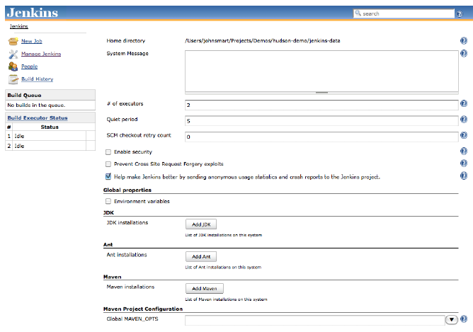
Advanced Setup(cont.)
The most important Jenkins administration page is the Configure System screen.

Slide 16
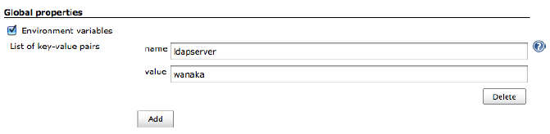
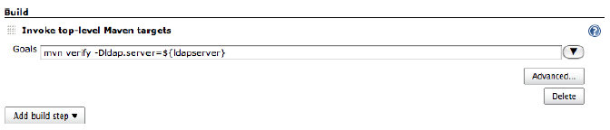
Advanced Setup(cont.)
The Global Properties section lets you define variables that can be managed centrally but used in all of your build jobs.

Slide 17
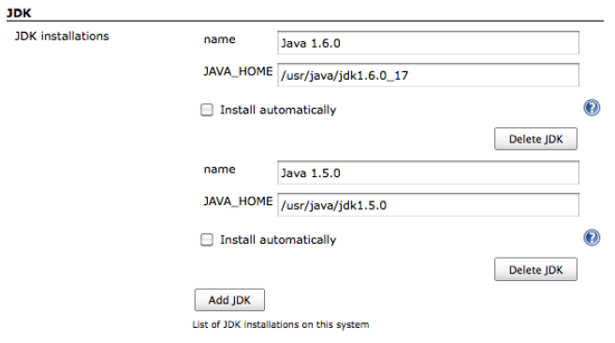
Advanced Setup(cont.)
One of the most common uses of Jenkins has been to build Java applications.
Jenkins naturally provides excellent built-in support for Java.

Slide 18
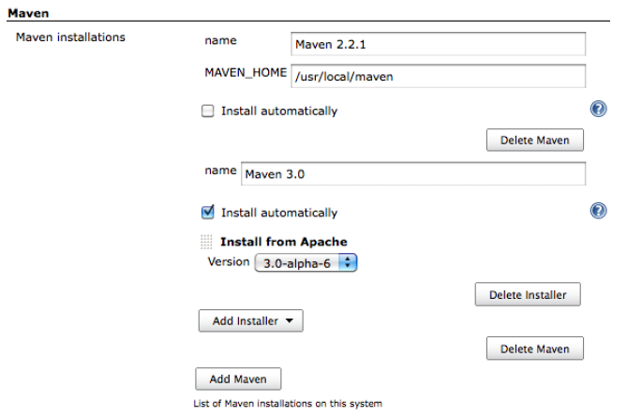
Advanced Setup(cont.)
Maven is a high-level build scripting framework for Java.
In Maven the project uses a standard, well defined build life cycle—compile, test, package, deploy, and so forth.

Slide 19
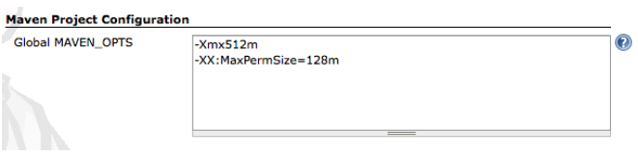
Advanced Setup(cont.)
Sometimes we need to pass Java system options to the Maven build process.
We can set the MAVEN_OPTS variable.
In Jenkins, you can set a system-wide default value, to be used across all projects

Slide 20
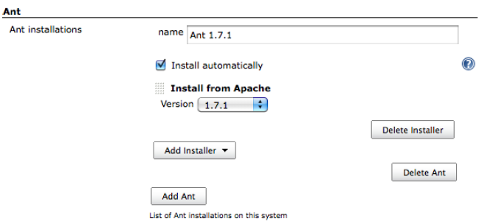
Advanced Setup(cont.)
Ant is a widely-used and very well-known build scripting language for Java.
It is a flexible, extensible, relatively low-level scripting language, used in a large number of open source projects.

Slide 21
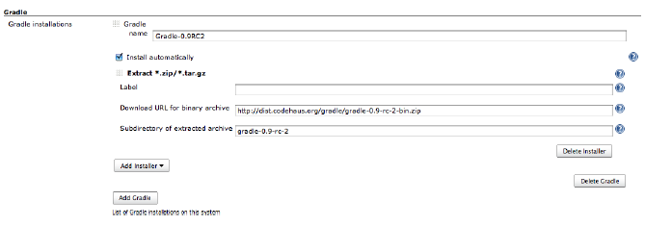
Advanced Setup(cont.)
Gradle is a relatively new open source build tool for the Java Virtual Machine.
Build scripts for Gradle are written in a Domain Specific Language (DSL) based on Groovy.

Slide 22
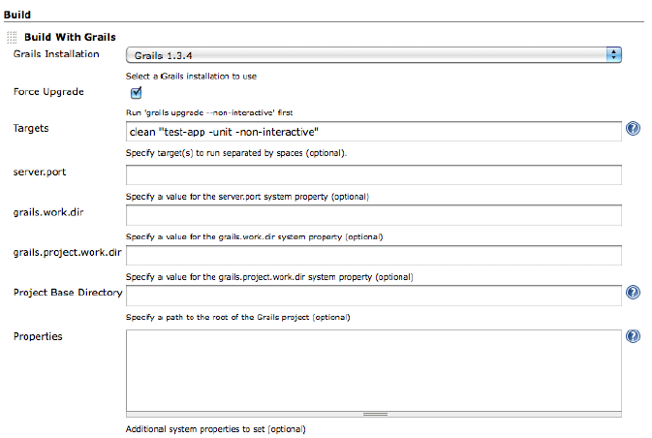
Advanced Setup(cont.)
Grails is an open source dynamic web application framework built on Groovy and many well-established open source Java frameworks such as Spring and Hibernate.
Jenkins provides excellent support for Grails builds.

Slide 23
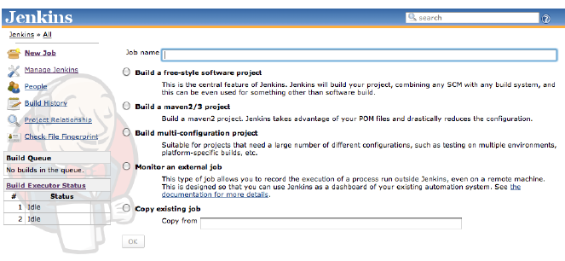
Build Jobs
Build jobs are the basic currency of a Continuous Integration server.
A build job is a particular way of compiling, testing, packaging, deploying or otherwise doing something with the project.
Creating a new build job in Jenkins is simple: just click on the “New Job” menu item on the Jenkins dashboard.

Slide 24
Build Jobs (cont.)
Jenkins supports several different types of build jobs:
Freestyle software project: build jobs are general-purpose build jobs, which provides a maximum of flexibility.
Maven project: build job specially adapted to Maven projects.
Monitor an external job: lets you keep an eye on non-interactive processes, such as cron jobs.
Multiconfiguration job: (“matrix project”) lets you run the same build job in many different configurations.

Slide 25
Build Jobs (cont.)
Once you have configured your version control system, you need to tell Jenkins when to kick off a build.
In a Freestyle build, there are three basic ways a build job can be triggered:
Start a build job once another build job has completed
Kick off builds at periodical intervals
Poll the SCM for changes

Slide 26
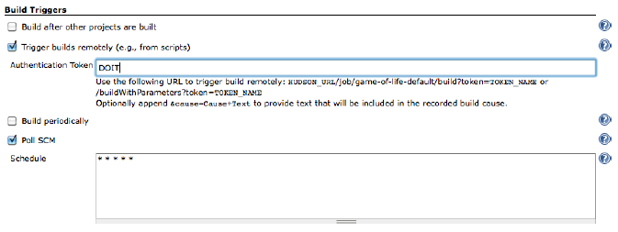
Build Jobs (cont.)
We can trigger remotely build by simply invoking URL like: http://SERVER/jenkins/job/PROJECTNAME/build.
We can use remote tokens also into URL: http://SERVER/jenkins/job/PROJECTNAME/build?token=DOIT.

Slide 27
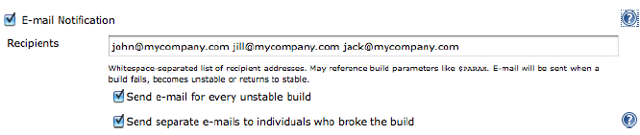
Build Jobs (cont.)
Jenkins provides support for email notification.
We can activate this by ticking the “E-mail Notification” checkbox in the Post-build Actions.
Jenkins will send a message when a previously failing or unstable build succeeds, to let everyone know that the problem has been resolved.

Slide 28
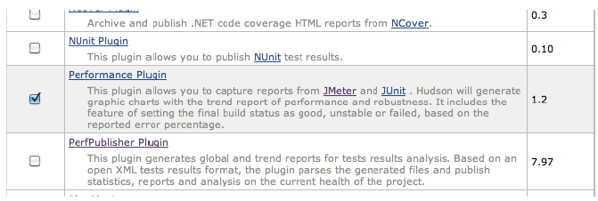
Build Jobs (cont.)
JMeter is a popular open source performance and load testing tool.
It simulates the actions of a browser or client application, sending requests of various sorts (HTTP, SOAP, JDBC, JMS and so on) to your server.
Once you have configured your build script to handle JMeter, you can set up a performance test build in Jenkins.

Slide 29
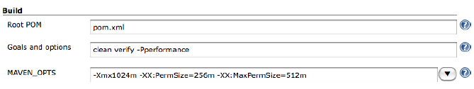
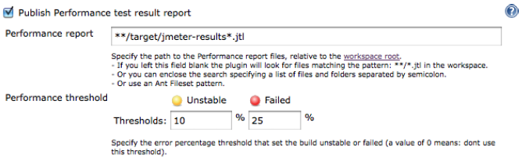
Build Jobs (cont.)
Once you have the plugin installed, you can set up a performance build job in Jenkins.

Slide 30
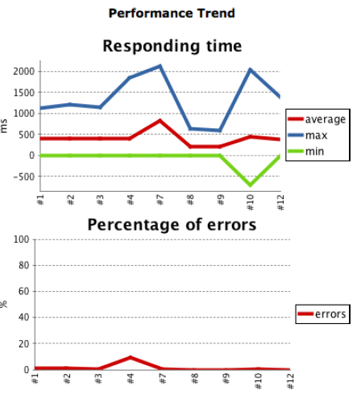
Build Jobs (cont.)
When the build job runs, the Performance plugin will produce graphs keeping track of overall response times and of the number of errors.
The graph gives you an overview of performance over time.

Slide 31
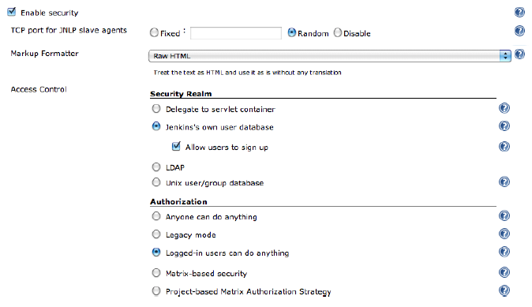
Security
Jenkins supports several security models, and can integrate with several user repositories.
Security Realms determines where Jenkins will look for users during authentication.

Slide 32
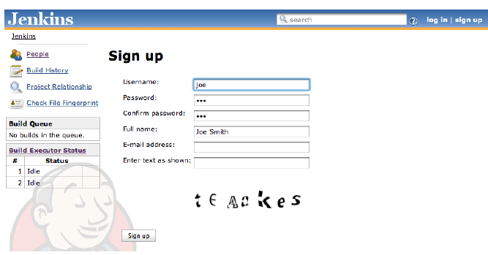
Security (cont.)
The “Allow users to sign up” option will display a Sign up link at the top of the screen to let users create their own user account as required.
It's a good idea for developers to use their SCM username here: in this case, Jenkins will be able to work out what users contributed to the SCM changes that triggered a particular build.

Slide 33
Notification
There are two main classes of notification strategies, passive and active (or pull/push).
Passive notification (pull) requires the users to consult the latest build status, and includes RSS feeds, build radiators, and (to a certain extent) emails.
Active notification (push) will pro-actively alert the developers when a build fails, and includes methods such as desktop notifiers, chat, and SMS.

Slide 34
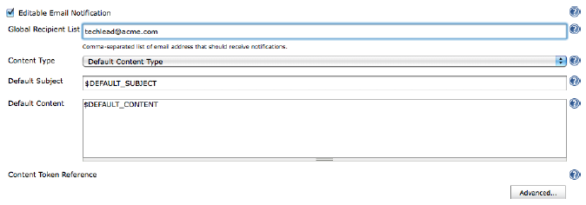
Notification (cont.)
Email is the most obvious and most common form of CI notification.
By default, Jenkins email notification is a rather blunt tool.
The Email-ext plugin lets you define a more refined email notification strategy.
This plugin adds an Editable Email Notification checkbox , which effectively replaces the standard Jenkins email notification.

Slide 35
Notification (cont.)
We can include a token in the message template using the familiar dollar notation.
${DEFAULT_SUBJECT}: default email subject configured in the Jenkins system configuration page
${DEFAULT_CONTENT}: default email content configured in the Jenkins system configuration page
${PROJECT_NAME}: The project’s name
${BUILD_NUMBER}: Current build number
${BUILD_STATUS}: Current build status (failing, success, etc.)
${CAUSE}: The cause of the build
${BUILD_URL} A link to the corresponding build job page on Jenkins

Slide 36
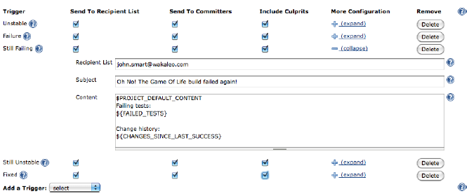
Notification (cont.)
The Advanced button lets you define a more sophisticated notification strategy, based on the concept of triggers

Slide 37
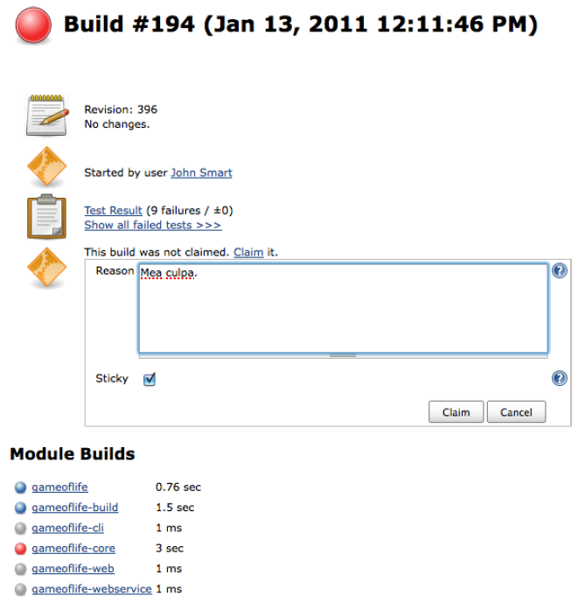
Notification (cont.)
When a build does fail, it can be useful to know that someone has spotted the issue and is working on it.
This avoids having more than one developer waste time by trying to fix the same problem separately.
The Claim plugin lets developers indicate that they have taken ownership of the broken build, and are attempting to fix it.

Slide 38
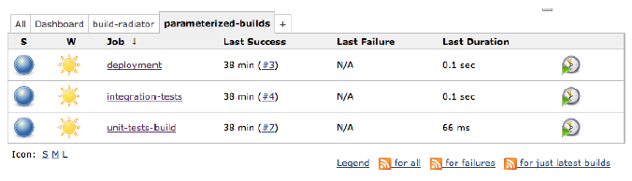
Notification (cont.)
Jenkins also provides convenient RSS feeds for its build results.
Many common browsers (Firefox in particular) and email clients also support RSS feeds.
RSS feeds can be a great information source on overall build results, and let you see the state of your builds at a glance without having to connect to the server.

Slide 39
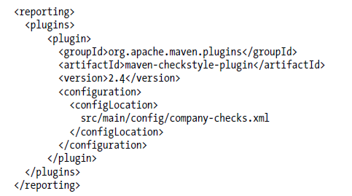
Code Quality
Checkstyle is a static analysis tool for Java.
Checkstyle is a flexible tool that should have its place in any Java-based code quality analysis strategy.
Checkstyle supports a very large number of rules, including ones relating to naming conventions, annotations, javadoc comments, class and method size, code complexity metrics, poor coding practices, and many others.

Slide 40
Code Quality (cont.)
Jenkins Plugin Manager can manage plugins. – pag 225/249

Slide 41
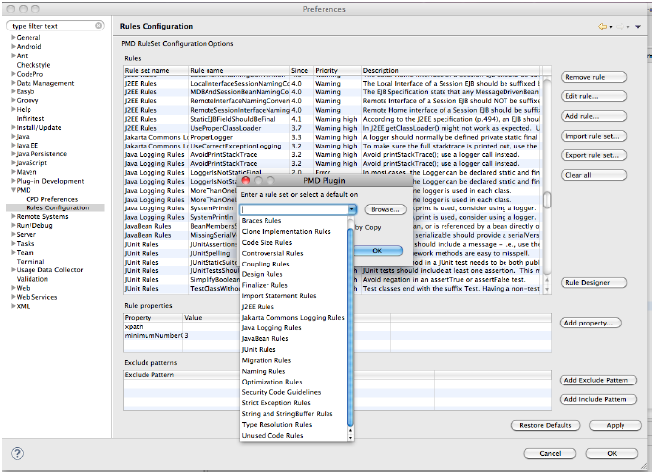
Code Quality (cont.)
PMD is a popular static analysis tool which focuses on potential coding problems such as unused or suboptimal code, code size and complexity, and good coding practices.
PMD also comes with CPD, a robust open source detector of duplicated and near duplicated code.

Slide 42
Code Quality (cont.)
FindBugs is a powerful code quality analysis tool that checks your application byte code
for potential bugs, performance problems.
FindBugs can detect some fairly significant issues such as null pointer exceptions, infinite loops, and unintentionally accessing the internal state of an object.
Unlike many other static analysis tools, FindBugs tends to find a smaller number of issues, but of those issues, a larger proportion will be important.

Slide 43
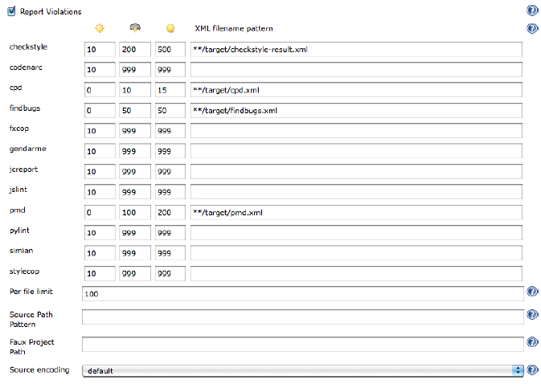
Code Quality (cont.)
One of the most useful code quality plugins for Jenkins is the Violations plugin.
This plugin does a great job on reporting on the code quality metrics generated for individual builds and trends over time.
The plugin caters for reports on code quality metrics coming from a large range of static analysis tools, including: Checkstyle, CPD, PMD, FindBugs, and jcreport

Slide 44
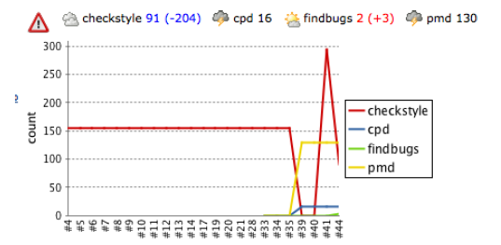
Code Quality (cont.)
We can check violations over time.

Slide 45
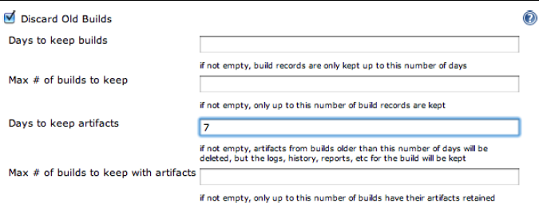
Maintenance
Build History takes disk space.
Jenkins analyzes the build records when it loads a project configuration.
The simplest way to keep a cap on disk usage is to limit the number of builds a project maintains in its history.

Slide 46
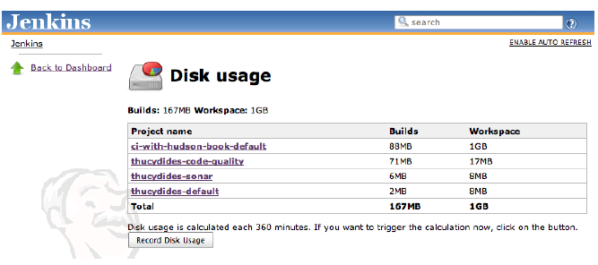
Maintenance (cont.)
The Disk Usage plugin is very useful.

Slide 47
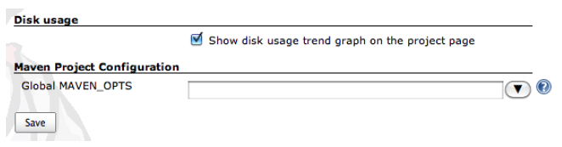
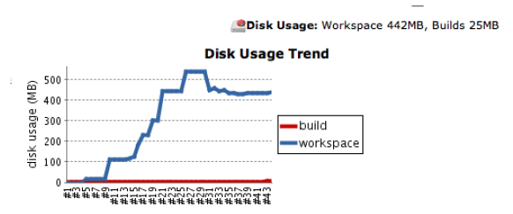
Maintenance (cont.)
We can display the amount of disk space used in each project over time.

Slide 48
Conclusions
Jenkins supports lots of plugins.
Jenkins is good for continuous integration.
Jenkins is cloud-enabled.

Slide 49

Bibliography
Jenkins The Definitive Guide
Packtpub Jenkins Continuous Integration Cookbook
http://en.wikipedia.org/wiki/Continuous_integration
http://en.wikipedia.org/wiki/Jenkins_%28software%29

