Slide 1

Cline
Dima Ionut Daniel

Slide 2
Contents
What is Cline?
Features
Goals
Arhitecture
Core
Conclusion
Bibliography

Slide 3


What is Cline?
Cline is an open-source AI coding assistant that works inside Visual Studio Code.
It helps developers write, edit, debug, and understand code using natural language.
Unlike basic code completion tools, Cline can plan and execute multi-step development tasks with user approval.

Slide 4
Features
Autonomous Coding
Creates new features from prompts
Refactors existing code
Fixes bugs
Generates tests and documentation
Terminal Integration
Executes terminal commands
Installs dependencies
Runs builds and tests
Requests approval before executing commands
File Management
Reads multiple project files
Creates, edits, and deletes files
Understands entire project structure
AI Model Support
Works with multiple LLM providers
Supports models from OpenAI, Anthropic, Google, OpenRouter, and local models (via Ollama)

Slide 5
Features (cont.)
Code Understanding
Explains complex code
Answers questions about the codebase
Identifies dependencies and architecture
Browser Automation (MCP/Extensions)
Can interact with web applications for testing
Captures screenshots
Automates repetitive browser tasks (when configured)
MCP (Model Context Protocol) Support
Connects to external tools and services
Accesses databases, APIs, GitHub, documentation, etc.
Extends capabilities through MCP servers
Human-in-the-Loop Safety
Asks for permission before:
Running commands
Modifying important files
Accessing external resources

Slide 6
Goals
Increase developer productivity by automating repetitive coding tasks.
Accelerate software development from idea to implementation.
Understand the entire codebase to provide context-aware assistance.
Reduce manual effort in debugging, refactoring, testing, and documentation.
Integrate development tools (terminal, GitHub, databases, APIs) into a single AI workflow.
Keep developers in control by requiring approval for sensitive actions.
Support flexible AI usage by working with multiple AI models and providers.
Improve code quality through consistent suggestions, testing, and documentation generation.

Slide 7
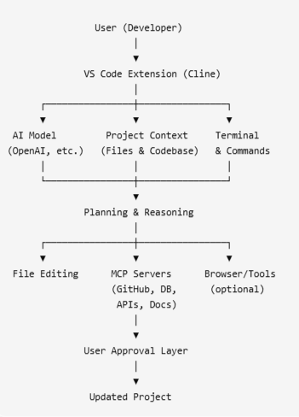
Arhitecture
Cline architecture

Slide 8
Arhitecture (cont.)
Main Components
VS Code Extension
User interface
Receives prompts
Displays responses
Manages workflow
AI Model
Interprets user requests
Generates code
Plans multi-step tasks
Explains and reviews code
Context Manager
Reads project files
Maintains codebase context
Supplies relevant information to the AI

Slide 9
Arhitecture (cont.)
Execution Engine
Edits files
Runs terminal commands
Executes tests and builds
Coordinates task execution
MCP Layer
Connects to external tools
GitHub
Databases
APIs
Documentation
Browser automation
Approval/Safety Layer
Requests confirmation before:
Running commands
Editing important files
Using external tools

Slide 10
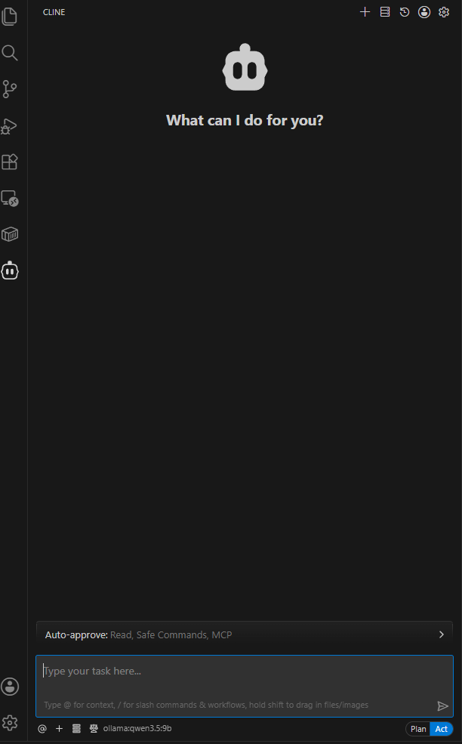
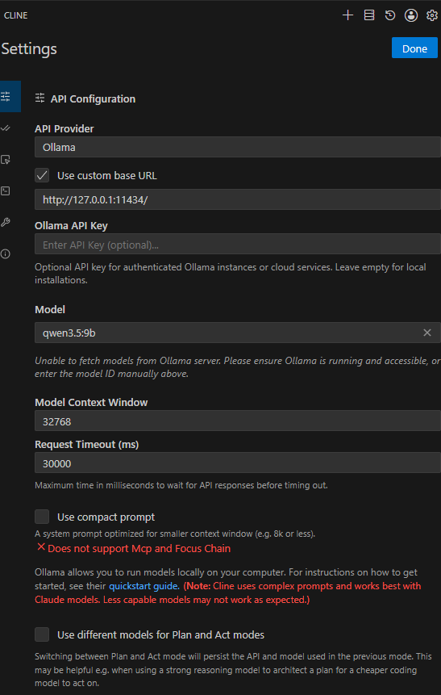
Core
Cline can easy be installed as extension to Vistual Studio Code

Slide 11
Core (cont.)
Cline separates planning from execution, allowing developers to validate an approach before making any changes to the codebase. This reduces mistakes and improves transparency.
Typical Workflow
Start in Plan mode and describe what you want to build
Let Cline explore relevant files and understand the codebase
Discuss the approach, considering edge cases and potential issues
When confident in the plan, switch to Act mode
Cline implements the solution based on your planning session

Slide 12
Core (cont.)
Plan Mode (Think First)
Purpose: Analyze and design without modifying the project.
What Cline can do
Read and understand the entire codebase
Search files and dependencies
Explain existing code
Discuss architecture and trade-offs
Identify edge cases
Create an implementation strategy
Restrictions
Cannot edit files
Cannot execute terminal commands
Best for
New features
Architecture design
Debugging complex issues
Learning an unfamiliar codebase
Security or code reviews

Slide 13
Core (cont.)
Act Mode (Execute)
Purpose: Implement the approved plan.
What Cline can do
Create, edit, and delete files
Execute terminal commands
Install dependencies
Run builds and tests
Refactor code
Generate documentation
Safety
Requests user approval before sensitive actions
Retains all context from the Plan phase, so no information is lost when switching modes.

Slide 14
Core (cont.)
Cline lets you reference files, folders, terminal output, Git changes, and URLs directly in the prompt using @ mentions.
This provides the AI with the right context while keeping conversations concise.
Feature | Example
Reference a file | @/src/auth.ts
Reference a folder | @/src/components/
Include compiler errors | @problems
Include terminal output | @terminal
Review Git changes | @git-changes
Reference a commit | @a1b2c3d
Use external documentation | @https://react.dev/...
Drag & Drop | Add files, PDFs, CSVs, Excel files, or images directly into the chat

Slide 15
Core (cont.)
Slash commands are built-in shortcuts that help manage conversations, preserve context, automate workflows, and improve productivity. They are invoked by typing / in the Cline chat.
Command | Purpose
/newtask | Starts a new task while carrying over the important context from the current conversation.
/smol | Compresses the conversation history to save context without losing key information.
/deep-planning | Investigates the codebase and creates a detailed implementation plan before coding.
/newrule | Creates reusable rules for coding style, communication, or project standards.
/explain-changes (VS Code) | Generates AI explanations for Git diffs, commits, or pull requests.
/reportbug | Collects diagnostics and prepares a useful bug report for the Cline team.

Slide 16
Core (cont.)
/newtask works like a developer handoff. It packages what matters (overall plan, work accomplished, relevant files, next steps) into a fresh task with a clean context window, leaving behind the noise of tool calls and implementation details.
/smol (or its alias /compact) compresses your conversation history while preserving essential context. Unlike /newtask which creates a new task, /smol condenses your current conversation into a comprehensive summary, freeing up context window space while allowing you to continue working in the same task.
/deep-planning
Transform Cline into a meticulous architect who investigates your codebase, asks clarifying questions, and creates a comprehensive implementation plan before writing any code. Deep planning follows a four-step process:
Silent Investigation - Cline explores your codebase structure and patterns
Discussion - Targeted questions about requirements and approach
Plan Creation - Generates implementation_plan.md with detailed specifications
Task Creation - Creates a new task with trackable implementation steps

Slide 17
Core (cont.)
Checkpoints is one of Cline's most valuable features because it lets developers experiment without fear.
It automatically saves snapshots of the project after each action, making it easy to compare changes or roll back to a previous state without affecting the project's Git history.
Key Features
Automatic snapshots after every action
Compare changes using visual diffs
Restore previous states in one click
Separate from Git (does not modify your commits or branches)
Persist across editor sessions
Restore Option | Use Case
Restore Files | Undo code changes while keeping the conversation
Restore Task Only | Keep the code, but revert the conversation to an earlier point
Restore Files & Task | Restore both the code and the conversation to a previous checkpoint

Slide 18
Core (cont.)
Subagents is one of Cline's advanced productivity features.
The main idea is that instead of one AI agent doing all the work sequentially, Cline can launch multiple specialized, read-only research agents in parallel, each investigating a different part of the codebase.
The main agent then combines their findings into a single response. This speeds up analysis while keeping the main conversation's context clean.
Key Capabilities
Parallel codebase analysis
Search different folders simultaneously
Investigate multiple features independently
Separate context for each subagent (prevents context overload)
Return concise summaries to the main agent
Faster understanding of large projects
Note: Subagents are read-only. They can inspect files and run read-only commands, but they cannot edit files, use MCP servers, browse the web, or create additional subagents.

Slide 19
Core (cont.)
Cline supports both global and project-level configuration, allowing developers to customize its behavior across all projects or define team-specific settings that are shared with a repository.
Cline configuration lives in two scopes:
Global configuration in ~/.cline/ (applies globally across all Cline applications, including IDE, CLI, and SDK).
Project configuration in .cline/ (applies only to the current workspace).

Slide 20
Core (cont.)
The primary root is ~/.cline/, with structured app state under ~/.cline/data/:
~/.cline/
data/
settings/
providers.json # API keys and provider configuration
global-settings.json # Global settings
cline_mcp_settings.json # MCP settings
teams/ # Team state
sessions/ # Session data
db/ # SQLite databases (for example cron.db)
workflows/ # Global workflows
rules/ # Global rules
hooks/ # Global hooks
skills/ # Global skills
agents/ # Global agent definitions
plugins/ # Global plugins (.js, .ts)
cron/ # Global cron specs

Slide 21
Core (cont.)
Project-level configuration lives in .cline/ at your repository root:
.cline/
rules/ # Project rules
skills/ # Project skills
hooks/ # Lifecycle hooks
agents/ # Project agent definitions
plugins/ # Project plugins
cron/ # Workspace cron specs

Slide 22
Core (cont.)
Environment Variables
Variable | Description
CLINE_DATA_DIR | Custom data directory (replaces ~/.cline/data/)
CLINE_HUB_ADDRESS | Override hub address (default: 127.0.0.1:25463)
CLINE_SESSION_BACKEND_MODE | Force backend mode (local, hub, remote, auto)
CLINE_SANDBOX | Enable sandbox mode
CLINE_SANDBOX_DATA_DIR | Sandbox session storage directory
CLINE_HOOKS_DIR | Additional hooks directory
CLINE_COMMAND_PERMISSIONS | JSON policy restricting shell commands

Slide 23
Conclusion
Pros:
Open-source – Transparent and community-driven.
Works with multiple AI models – Supports OpenAI, Anthropic, Google, OpenRouter, Ollama, etc.
Project-wide understanding – Analyzes entire codebases, not just the current file.
Automates development tasks – Coding, debugging, refactoring, testing, and documentation.
Terminal integration – Can run builds, tests, and install dependencies.
Extensible via MCP – Connects to databases, APIs, GitHub, browsers, and other tools.
User approval for actions – Reduces the risk of unintended changes.
Improves developer productivity – Handles repetitive and time-consuming tasks
Cons:
AI output isn't always correct – Generated code requires review and testing.
Can consume many tokens – Large projects may increase API usage and costs.
Performance depends on the AI model – Better models typically provide better results.
Learning curve – Advanced features like MCP require setup and configuration.
May struggle with very large codebases – Context window limitations can affect understanding.
Needs internet access for most cloud models – Unless using a local model.
Approval steps can slow workflows – Safety confirmations may interrupt rapid iteration.
Not a replacement for developers – Human oversight is still necessary for architecture, security, and critical decisions.

Slide 24

Bibliography
https://github.com/cline/cline
https://cline.bot

