Slide 1

Jasmine
Dima Ionut Daniel

Slide 2
Contents
What is Jasmine?
Features
Core
Bibliography

Slide 3

What is Jasmine?
Jasmine is an open-source behavior-driven testing framework for JavaScript.
It aims to run on any JavaScript-enabled platform, to not intrude on the application nor the IDE, and to have easy-to-read syntax.
It is heavily influenced by other unit testing frameworks, such as ScrewUnit, JSSpec, JSpec, and RSpec.

Slide 4
What is Jasmine? (cont.)
Jasmine follows Behavior Driven Development (BDD) procedure to ensure that each line of JavaScript statement is properly unit tested.
Jasmine provides a small syntax to test the smallest unit of the entire application instead of testing it as a whole.

Slide 5
Features
Does not depend on any other JavaScript framework.
Does not require any DOM.
The syntax used in Jasmine framework is clean and obvious.
Heavily influenced by Rspec, JS Spec, and Jspec.
Open-source framework and easily available in different versions like stand-alone, ruby gem, Node.js, etc.

Slide 6
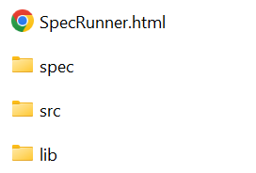
Core
Jasmine is very easy to implement in any kind of development methodology.
We need to download the standalone library files from the official website https://jasmine.github.io/ and implement the same in your application.
After we download the jasmine-standalone version, we'll see a folder structure like:

Slide 7
Core (cont.)
In src folder we create HelloWorld.js:
var helloworld = function() {
return 'Hello World';
};
To create a test case, we create in spec folder the file HelloWorldsSpec.js
describe("Hello World", function() {
it("should Return Hello world",function() {
expect(helloworld()).toEqual('Hello World');
});
});

Slide 8
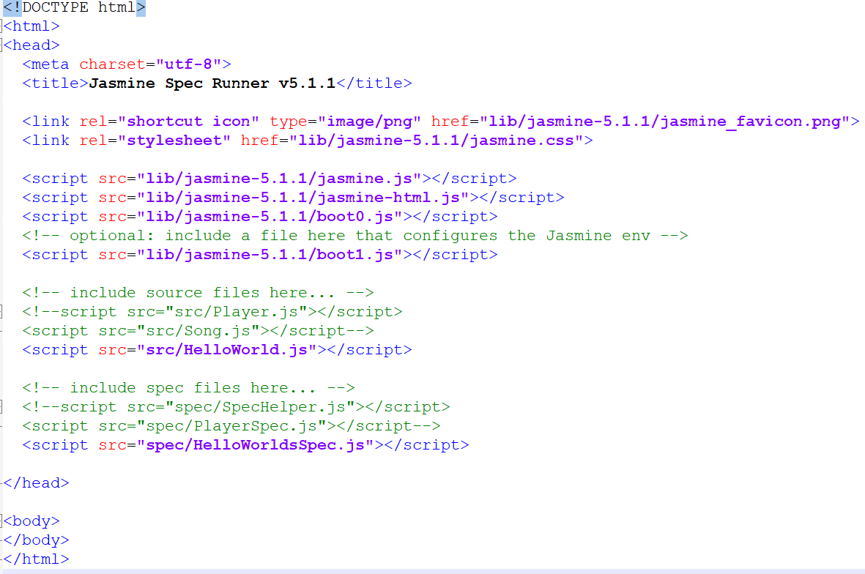
Core (cont.)
In SpecRunner.html we add the 2 java script file references.

Slide 9
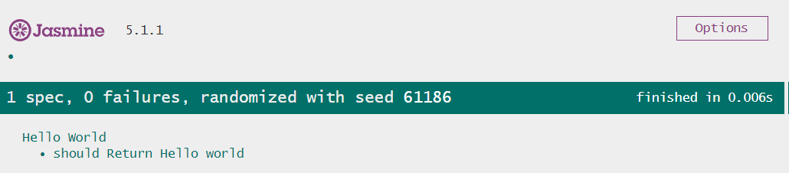
Core (cont.)
The final step is to run the SpecRunner.html file and check the results.

Slide 10
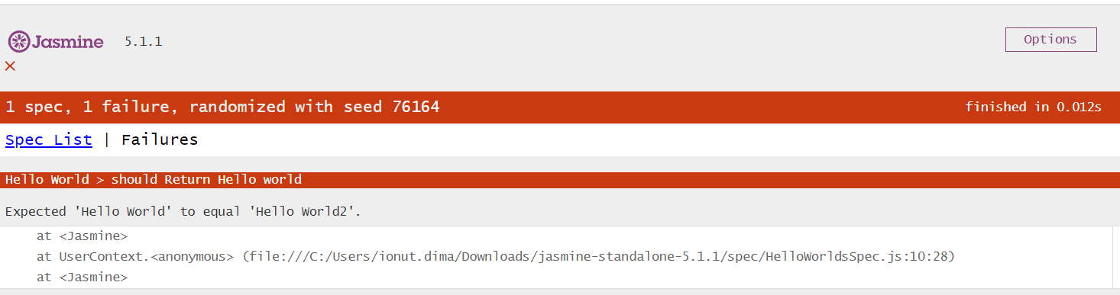
Core (cont.)
We can simulate an error case, bu checking for other value different than "Hello World"

Slide 11
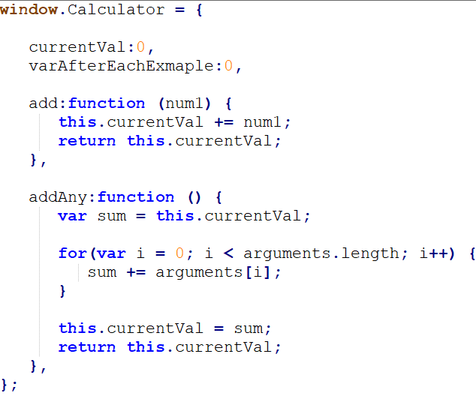
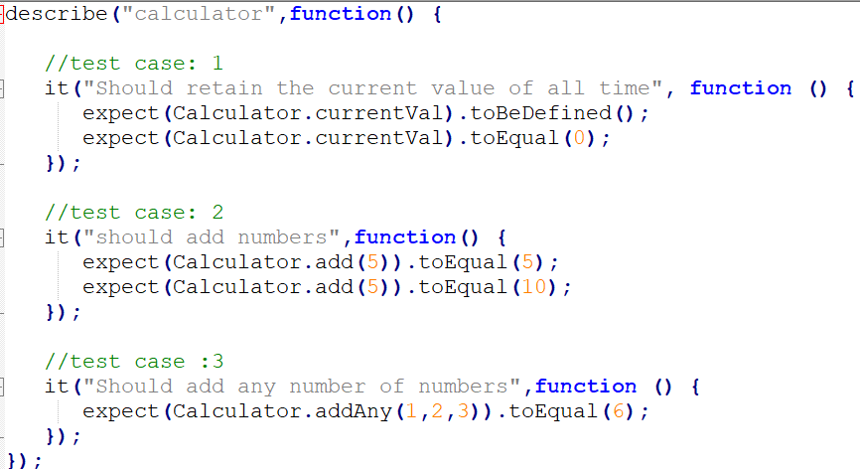
Core (cont.)
Suite is the basic building block of Jasmine framework.
The collection of similar type test cases written for a specific file or function is known as one suite.
It contains two other blocks, one is “Describe()” and another one is “It()”.
One Suite block can have only two parameters, one “name of that suite” and another “Function declaration” that makes a call to our unit functionality that is to be tested.

Slide 12
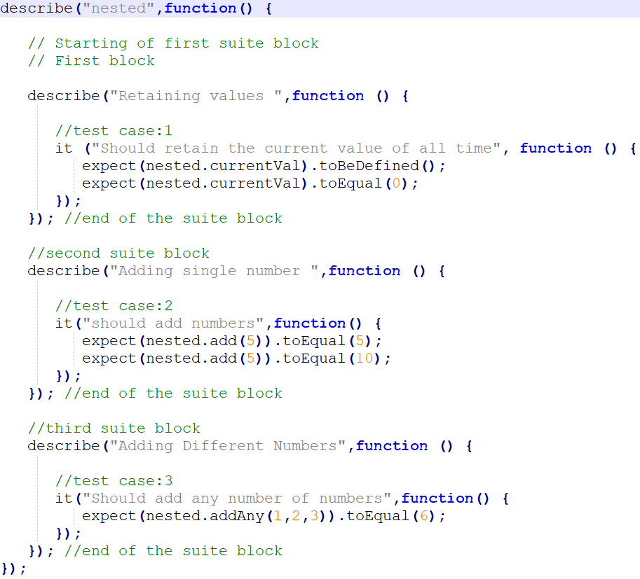
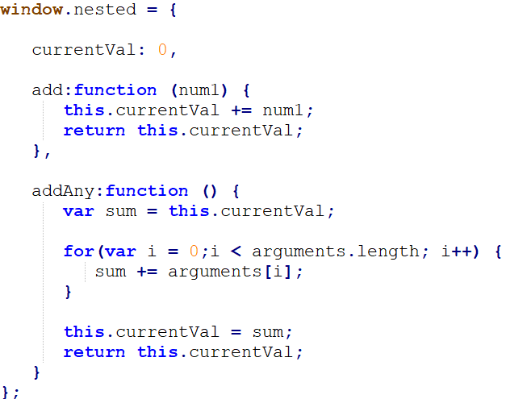
Core (cont.)
Suite block can have many suite blocks inside another suite block.

Slide 13
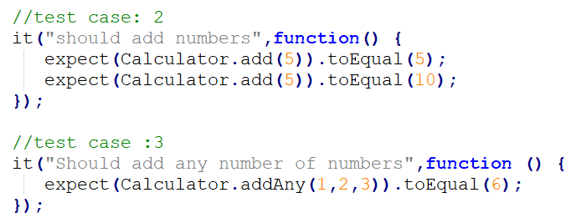
Core (cont.)
Jasmine is a testing framework; hence it always aims to compare the result of the JavaScript file or function with the expected result.
Matcher works similarly in Jasmine framework.
Matchers are the JavaScript function that does a Boolean comparison between an actual output and an expected output.
There are two type of matchers Inbuilt matcher and Custom matchers.
In the example toEqual() is the inbuilt matcher which will compare the result of the add() and addAny() methods with the arguments passed to toEqual() matchers.

Slide 14
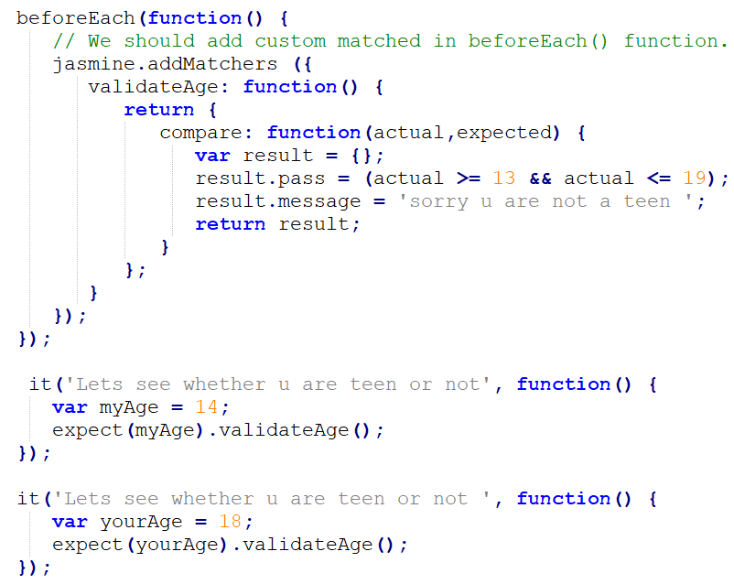
Core (cont.)
The matchers which are not present in the inbuilt system library of Jasmine is called as custom matcher.
Custom matcher needs to be defined explicitly().
In the bellow example, validateAge() works as a matcher which is validating your age with some range.

Slide 15
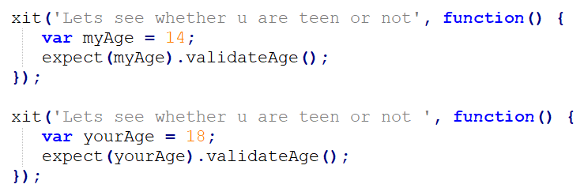
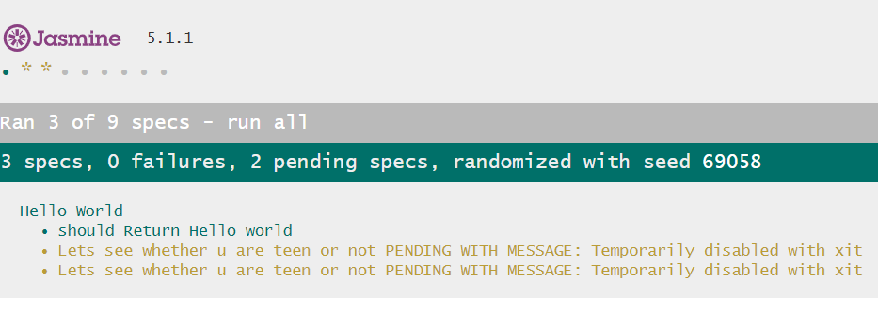
Core (cont.)
Jasmine also allows the developers to skip one or more than one test cases. These techniques can be applied at the Spec level or the Suite level. Depending on the level of application, this block can be called as a Skipping Spec and Skipping Suite respectively. We use "x" just before it statement to skip.

Slide 16
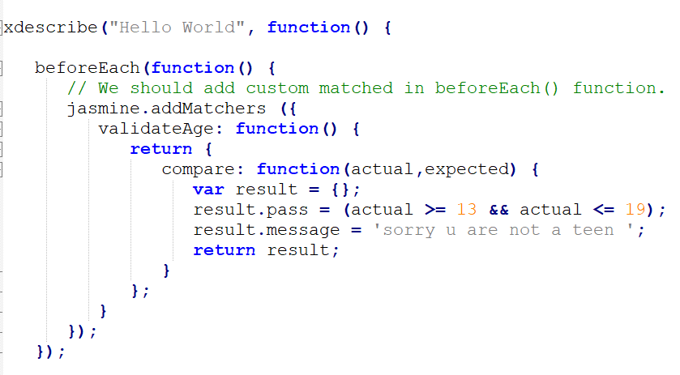
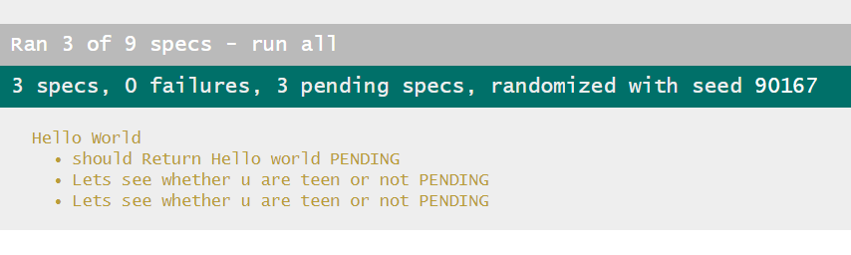
Core (cont.)

Slide 17
Core (cont.)
ToEqual() is the simplest matcher present in the inbuilt library of Jasmine. It just matches whether the result of the operation given as an argument to this method matches with the result of it or not.
not.toEqual() works exactly opposite to toEqual() and is used when we need to check if the value does not match with the output of any function.
toBe() matcher works in a similar way as toEqual(), however they are technically different from each other. toBe() matcher matches with the type of the object whereas toEqual() matches with the equivalency of the result.
not.toBe() is the negation of the toBe().

Slide 18
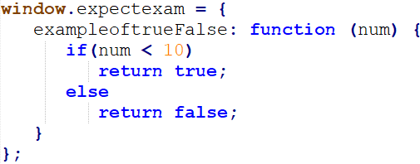
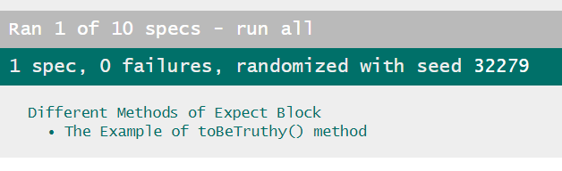
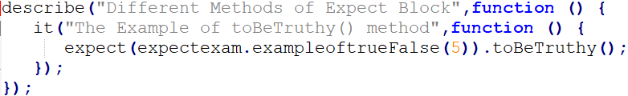
Core (cont.)
toBeTruthy() is used to check whether the result is equal to true.
toBeFalsy() works the same way as toBeTruthy() method, it matches the output to be false.

Slide 19
Core (cont.)
Jasmine also provides different methods to provide sequentially of the JS output.
toContain() matchers provide us the facility to check whether any element is a part of the same array or some other sequential objects.
toBeCloseTo() matcher matches whether the actual value is close to the expected value.
ToMatch() matcher works on String type variable, helpful to find whether a specific String is present in the expected output or not.
Jasmine provides a special matcher to check this special type of testing scenario that is toBeNaN().

Slide 20
Core (cont.)
Jasmine provides a different variety of method to check whether the actual output is Null, defined or undefined.
toBedefined() is used to check whether any variable in the code is predefined or not.
toBeUndefined() helps to check whether any variable is previously undefined or not, basically it works simply opposite to the previous matcher that is toBeDefined.
toBeNull() helps to check null values.
toBeGreaterThan() helps to check greater than condition.
toBeLessThan() helps to check the less than condition of the test scenario.

Slide 21
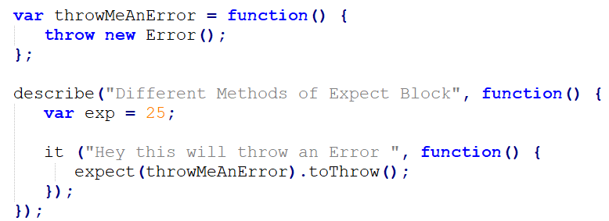
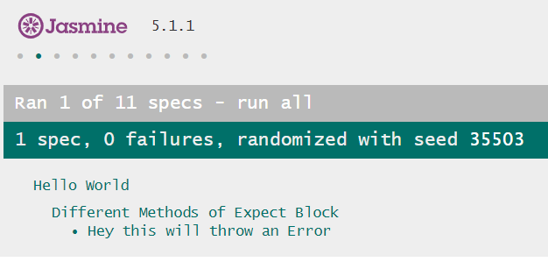
Core (cont.)
Jasmine provides some useful matchers to check exception of the program.

Slide 22
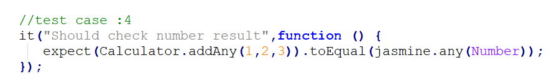
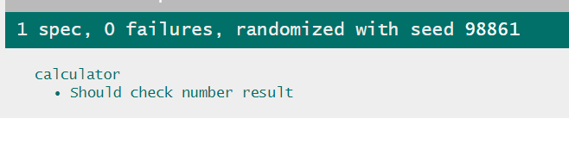
Core (cont.)
Any is the special matcher that is used when we are not sure about the output.

Slide 23
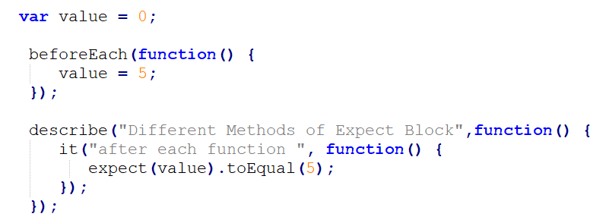
Core (cont.)
Jasmine has before and after each functionality where we can execute some pieces of code before and after execution of each spec.
This functionality is very useful for running the common code in the application.

Slide 24
Core (cont.)
Jasmine spies allows to spy on your application function calls.
There are two types of spying technology available in Jasmine.
The first methodology can be implemented by using spyOn() and the second methodology can be implemented using createSpy() .
spyOn() is inbuilt into the Jasmine library which allows you to spy on a definite piece of code.

Slide 25
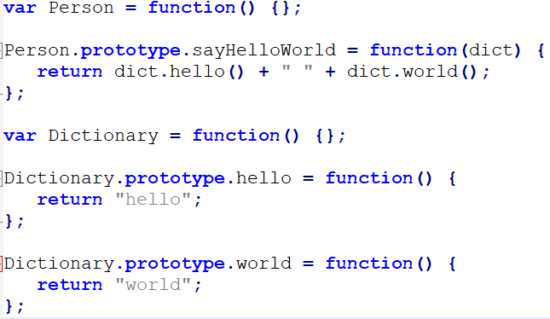
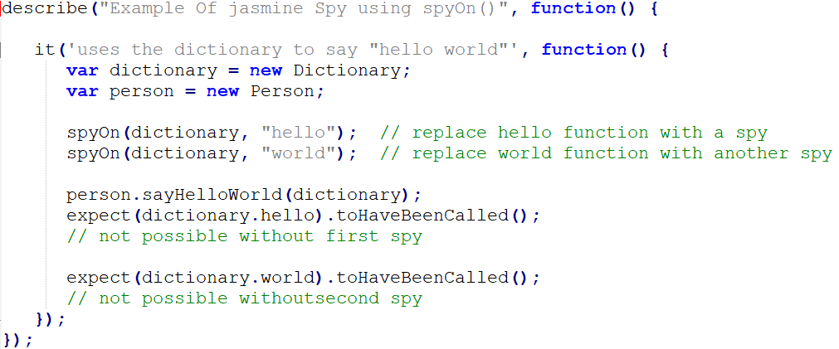
Core (cont.)

Slide 26
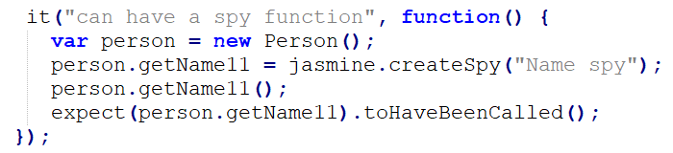
Core (cont.)
Another method of obtaining the spying functionality is using createSpy().
We are calling the getName11() of the Person object.
Although this function is not present in the person object in spy Jasmine.js, we are not getting any error and hence the output is green and positive.
The createSpy() method mimics the functionality of the getName11().

Slide 27

Bibliography
https://en.wikipedia.org/wiki/Jasmine_(software)
https://www.tutorialspoint.com/jasminejs/index.htm
https://jasmine.github.io/pages/docs_home.html
Evan Hahn – JavaScript Testing with Jasmine

