Slide 1

ProtoBuf
Dima Ionut Daniel

Slide 2
Contents
What is ProtoBuf?
Features
Core
Bibliography

Slide 3

What is ProtoBuf?
Protocol Buffers (Protobuf) is a free and open-source cross-platform data format, language-neutral extensible mechanism used to serialize structured data.
Google developed Protocol Buffers for internal use and provided a code generator for multiple languages under an open-source license.
The design goals for Protocol Buffers emphasized simplicity and performance.
It was designed to be smaller and faster than XM, JSON.
Protocol Buffers are like the Apache Thrift, Ion, and Microsoft Bond protocols.

Slide 4
Features
Compact data storage
Fast parsing
Availability in many programming languages
Optimized functionality through automatically -generated class
Cross-language compatibility

Slide 5
Core
Data structure schemas, called messages and services are described in a proto definition file (.proto) and compiled with protoc.
This compilation generates code that can be invoked by a sender or recipient of these data structures.
Messages are serialized into a binary wire format which is compact, forward- and backward-compatible, but not self-describing.

Slide 6
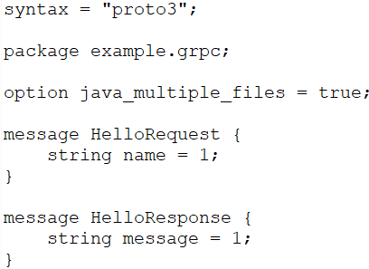
Core (cont.)
Protobuf message syntax:
“message” defines the structure of the message sent between gRPC components
has a name formatted with camel case.
contains the types fields
each file has: name, data types , unique identifying number

Slide 7
Core (cont.)
Comments can be added to the .proto files: // or /*..*/
Data types: double, float, int32, string, bool, Bytes.
Field names contains only lower-case letters, and the concatenation should be done with “_”.
Repeated fields are indicating by “repeated” work, fields can contain a list of values.
We can define enums using the “enum” word:
Allow defining pre-set list of values to a field, each value is assigned a number
MUST have first value with its underlying value equals to 0
Values should be in upper case contacted with “_”.

Slide 8
Core (cont.)
The “package” work provides unique name prefix to al the messages and services from the .proto file.
Other message type from other .proto files can be imported and used.
The “oneof” word is used when a message has a lots of fields and we need only one field to have a value.
The “map” word is used to define a hashtable/dictionary with unique keys. Keys can be integral or string.
Default values:
string → empty string
bool → false
numeric → 0
Enums → the first defined enum value, which must be 0
bytes → empty bytes
The “service” word is used to define services

Slide 9
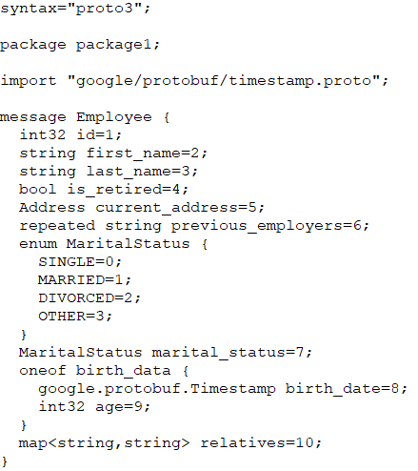
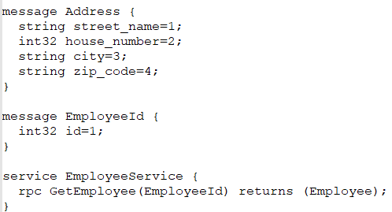
Core (cont.)

Slide 10
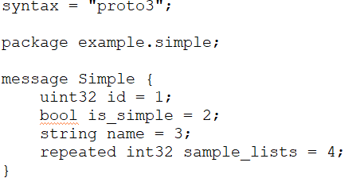

Core (cont.)
We can use the protoc utility to generate classes in many programming languages.

Slide 11
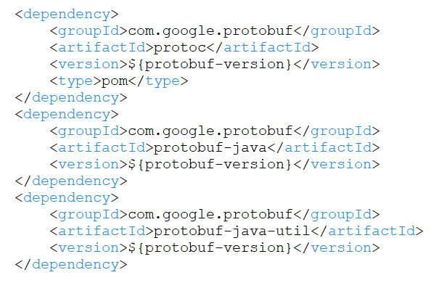
Core (cont.)
We can create a java project and add the following dependencies to use the generated classes.

Slide 12
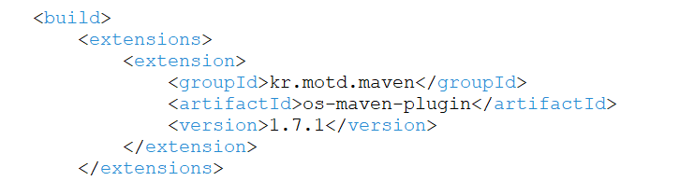
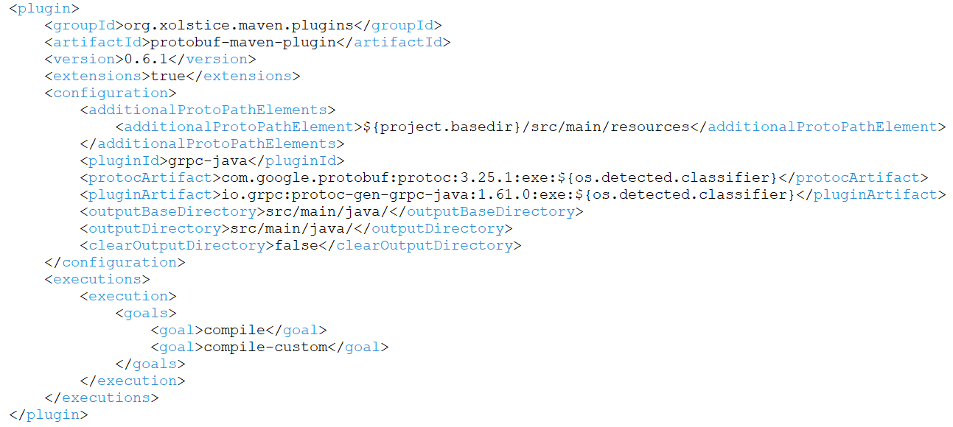
Core (cont.)
We can use the maven plugin protobuf-maven-plugin to generate the classes.

Slide 13
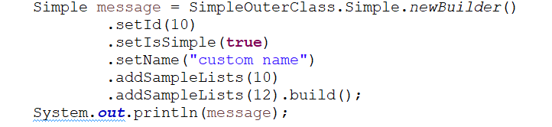
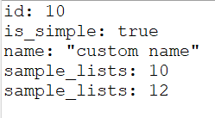
Core (cont.)
We can use the builder pattern to build and populate the Simple generated object.

Slide 14
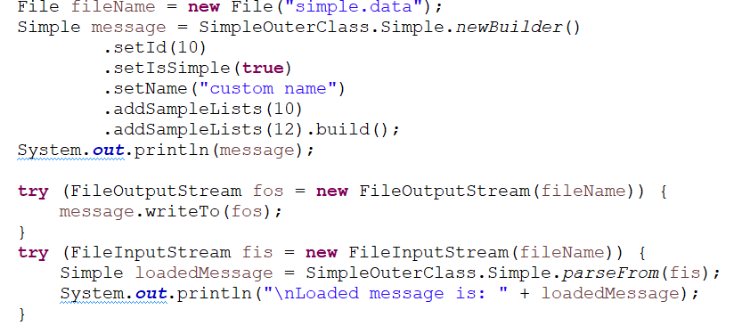

Core (cont.)
After the object is created, we can write/read from files.
The created file simple.data will contain binary data.

Slide 15
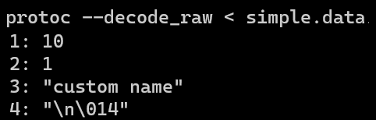
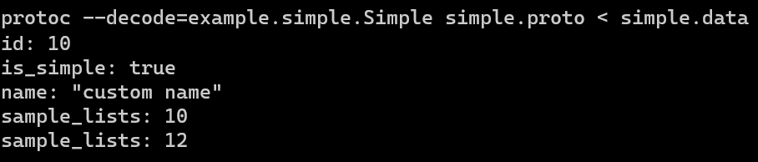
Core (cont.)
We can use the –decode_raw to decode binary data.
We can use the –decode to print binary data.

Slide 16
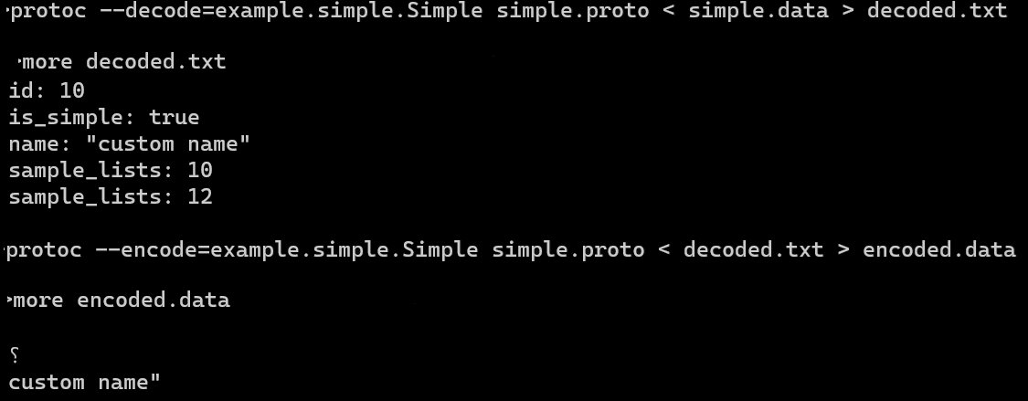
Core (cont.)
We can use –encode to encode binary data:

Slide 17
Core (cont.)
The same messages can be read by code written in any supported programming language.
We can use Java on one platform capture data from one software system, serialize it based on a .proto definition, and then extract specific values from that serialized data in a separate Python application running on another platform.
Supported languages by the protocol buffers compiler, protoc:
C++
C#
Java
Kotlin
Objective-C
PHP
Python
Ruby

Slide 18
Core (cont.)
Tags:
smallest tag: 1
largest tag: 536,870,911
Google reserved tags: 19000 to 19999
Basic rules when updating proto files:
do not change tags
add new fields
use reserved tags

Slide 19

Bibliography
https://en.wikipedia.org/wiki/Protocol_Buffers
https://protobuf.dev/

