Slide 1

gRPC
Dima Ionut Daniel

Slide 2
Contents
What is gRPC?
History
Features
Core
gRPC utility
gRPC vs REST
Others
Bibliography

Slide 3

What is gRPC?
gRPC (Remote Procedure Call) is a cross-platform open-source high performance remote procedure call (RPC) framework.
gRPC was initially created by Google, which used a single general-purpose RPC infrastructure called Stubby to connect the large number of microservices running within and across its data centers from about 2001.
In March 2015, Google decided to build the next version of Stubby and make it open source.
It uses HTTP/2 for transport, Protocol Buffers as the interface description language, and provides features such as authentication, bidirectional streaming and flow control, blocking or nonblocking bindings, and cancellation and timeouts.

Slide 4
What is gRPC (cont.)?
It generates cross-platform client and server bindings for many languages.
Most common usage scenarios include connecting services in a microservices style architecture or connecting mobile device clients to backend services.
gRPC's complex use of HTTP/2 makes it impossible to implement a gRPC client in the browser, instead requiring a proxy.
gRPC supports the usage of Transport Layer Security (TLS) and token-based authentication.
Connection to Google services must use TLS. There are two types of credentials: channel credentials and call credentials.
For token-based authorization, gRPC provides Server Interceptor and a Client Interceptor.

Slide 5
History
Google developed a new API standard, only for internal use
Google called this API, Stubby
It was meant to connect to large number of microservices running within and across data centers for over a decade.
In 2015, Google decided to create another version of Stubby, and make it open-source under gRPC name.
During it’s first year of the launch, it was adopted by large companies.
Due it’s popularity, in 2017 gRPC became part of Cloud Native Computing Foundation.

Slide 6

Features
Simple Service Definition
Start quickly and scale
Works across languages and platforms
Bi-directional streaming and integrating auth

Slide 7
Core
gRPC is a modern open-source high performance Remote Procedure Call (RPC) framework that can run in any environment.
gRPC uses Protobuf as payload, and HTTP/2 as transport layer.
There are 4 communications styles:
Unary: basic client/response model
Client streaming: client opens connection to the server and sends multiple messages to the server.
Server streaming: client opens connection to the server and server sends multiple messages to the client.
Bi-directional: client opens connection, and both client and server are sending messages.

Slide 8
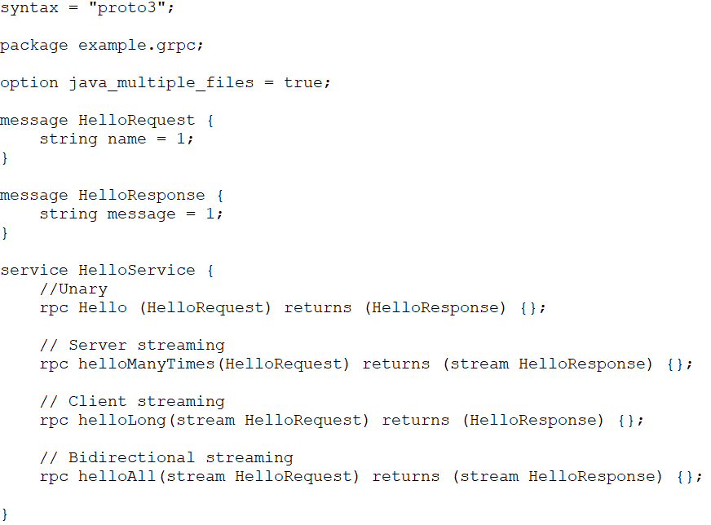
Core (cont.)
We need to define in a .proto file the messages and the services.

Slide 9
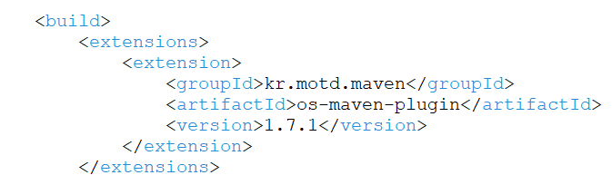
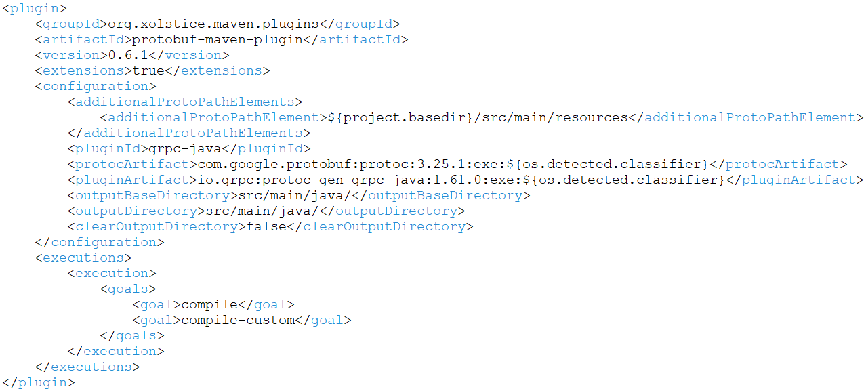
Core (cont.)
Using the protoc compiler we generate the java classes, or we can use the protobuf-maven-compiler to do that.

Slide 10
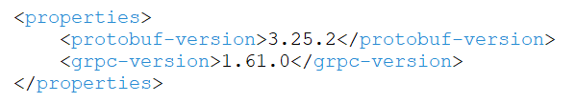
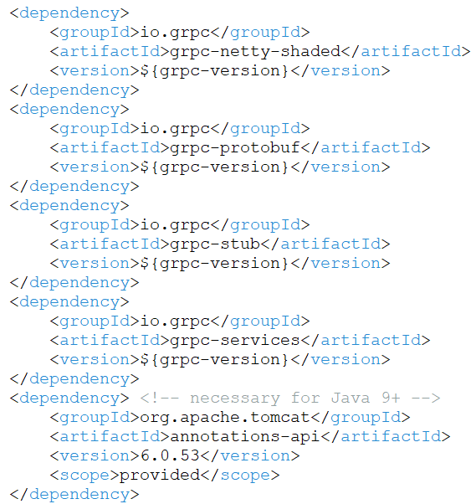
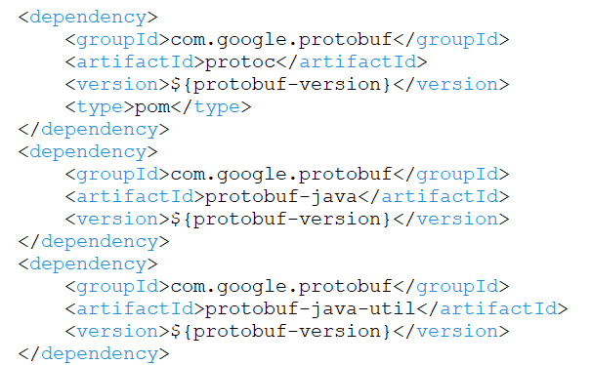
Core (cont.)
To properly setup the java project we need to have protobuf and grpc java libraries.

Slide 11
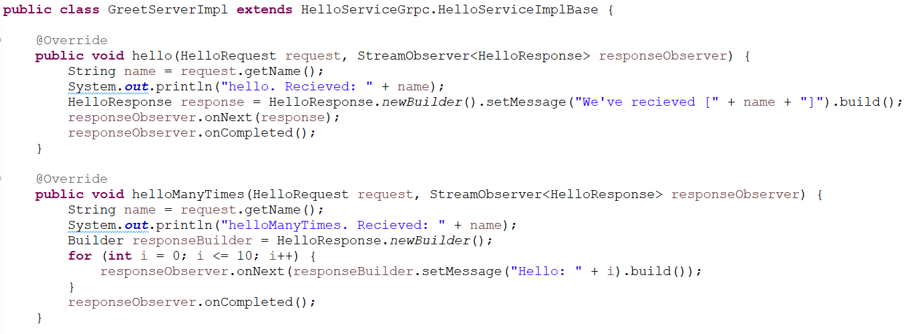
Core (cont.)
After we’ve generated the stubs, we need to implement the abstract generated class to create an actual server implementation.
The “hello” method is used for unary RPC style and “helloManyTimes” as server streaming RPC style.

Slide 12
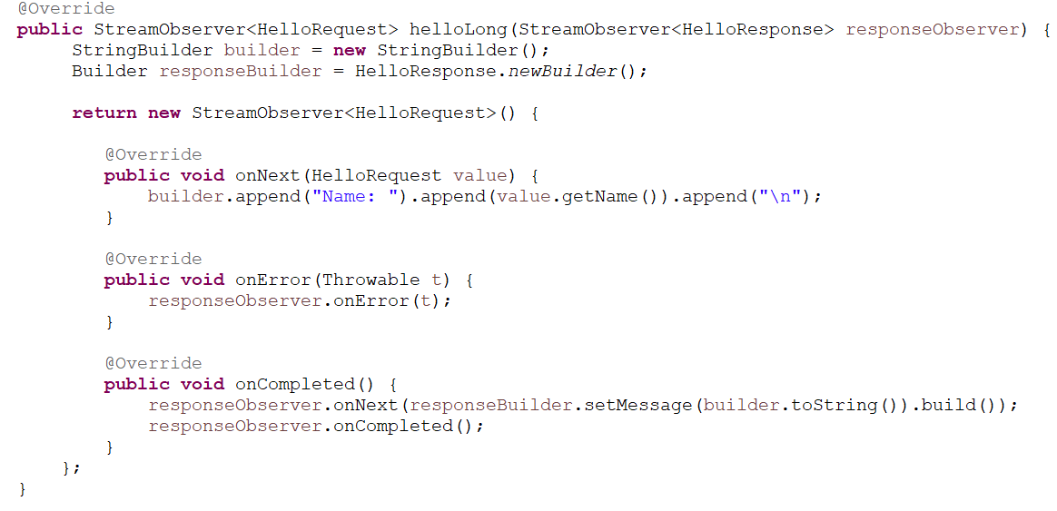
Core (cont.)
We’ve used the “helloLong” method for client streaming RPC style.

Slide 13
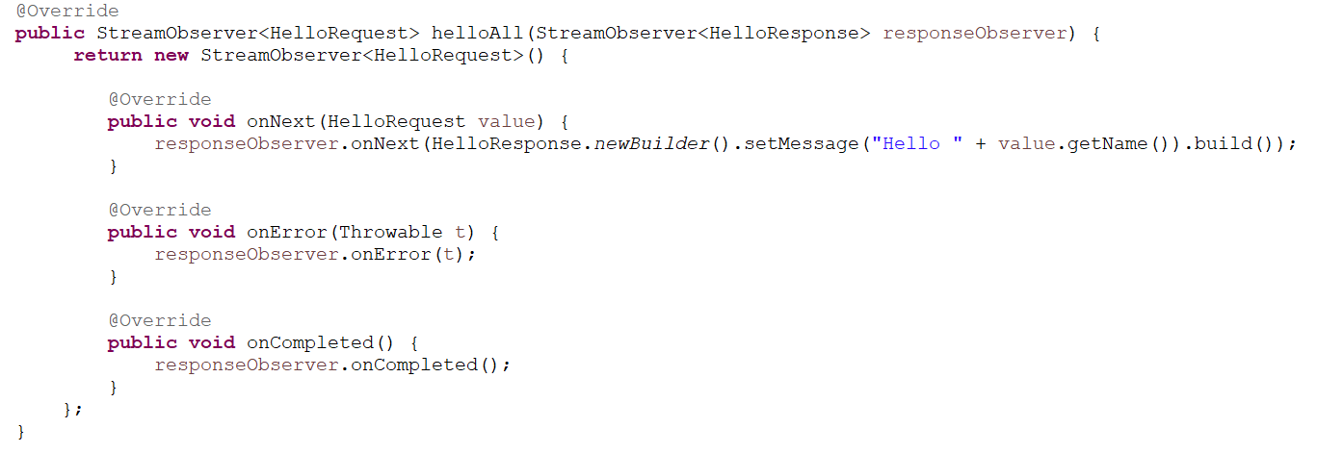
Core (cont.)
We’ve used the “helloAll” method for bi-directional communication RPC style.

Slide 14
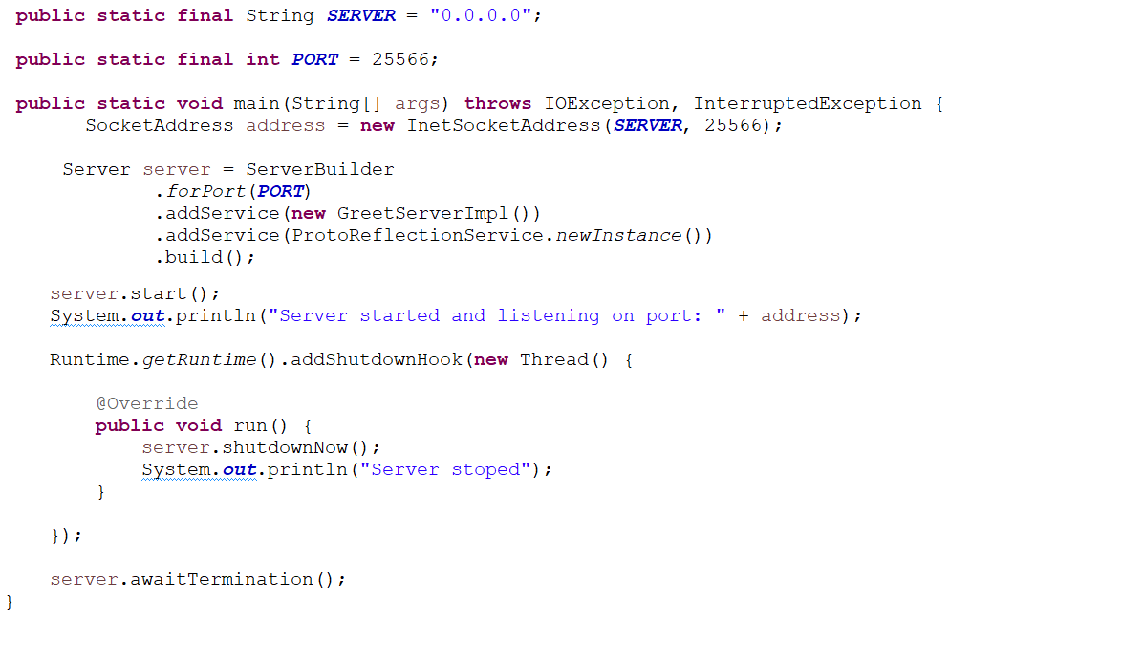
Core (cont.)
After we’ve implemented the server stub abstract class, we need to use this service to start a server.

Slide 15
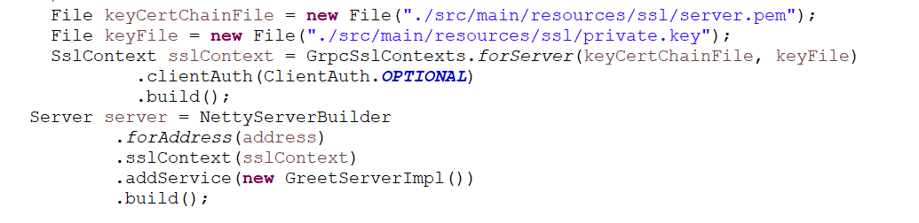
Core (cont.)
So, on server side we use the ServerBuilder object to create a server on a specific network interface, port and register for services.
If we need to enable TLS, then we’ll need the key certificate chain and the private key.

Slide 16
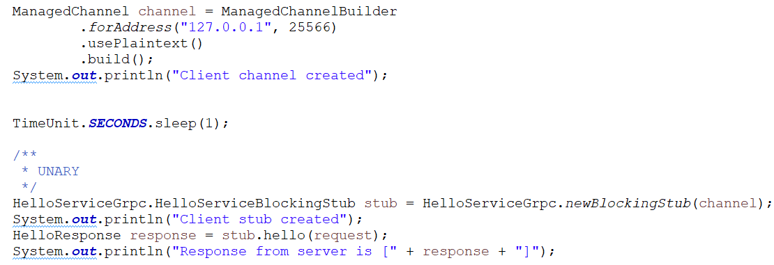
Core (cont.)
On client side we need to create a ManagedChannel object, where we specify the traffic type: plaintext or encrypted and after that we create a stub client: blocking or non-blocking.
With that stub we can perform gRPC calls.

Slide 17
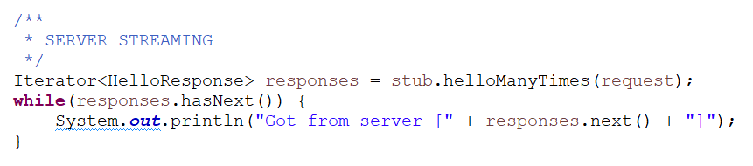
Core (cont.)
In the case of server streaming, we’ll receive an Iterator object that will contain all the messages from the server.

Slide 18
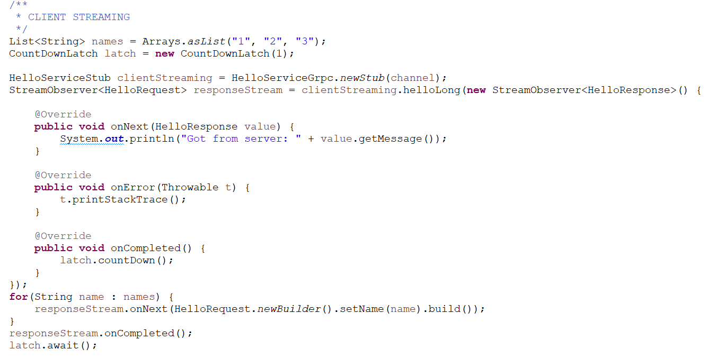
Core (cont.)

Slide 19
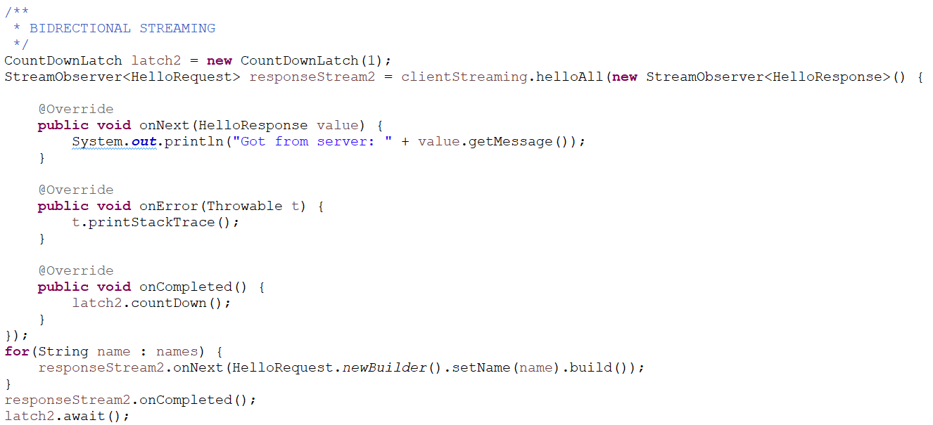
Core (cont.)

Slide 20
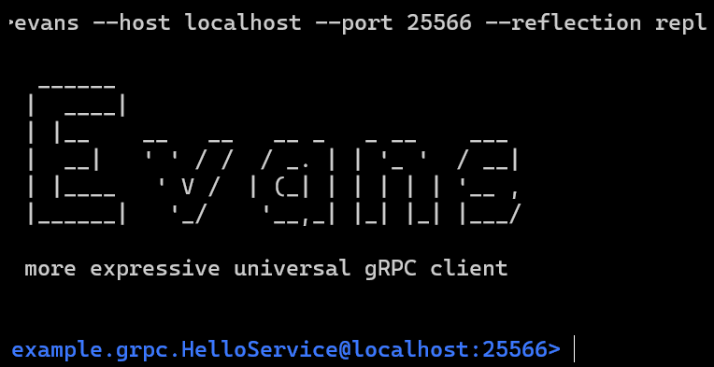
GRPC utility
Evans is a nice gRPC client.
If we enable the io.grpc.protobuf.services.ProtoReflectionService service on server side, we can query important objects with the evans client.

Slide 21
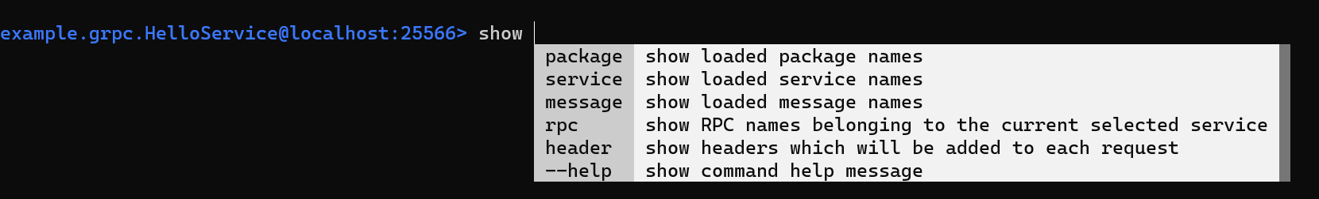
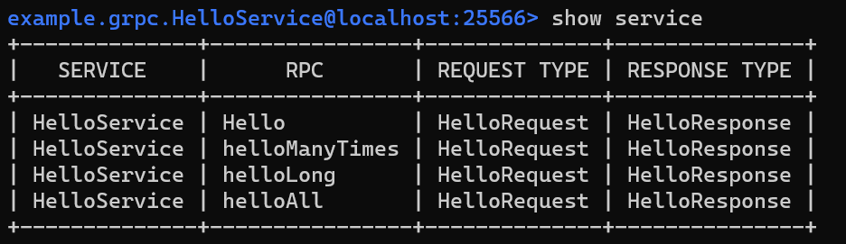
GRPC utility (cont.)
Evans CLI has nice autocomplete functionality.
The “show service” command shows all the available services with methods.

Slide 22
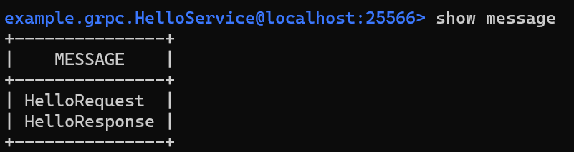
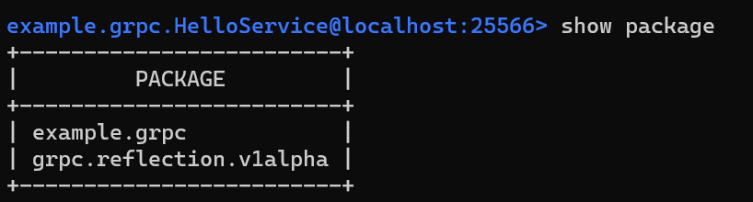
GRPC utility (cont.)
The “show message” command shows all the used messages.
The “show package” command shows all the packages.

Slide 23
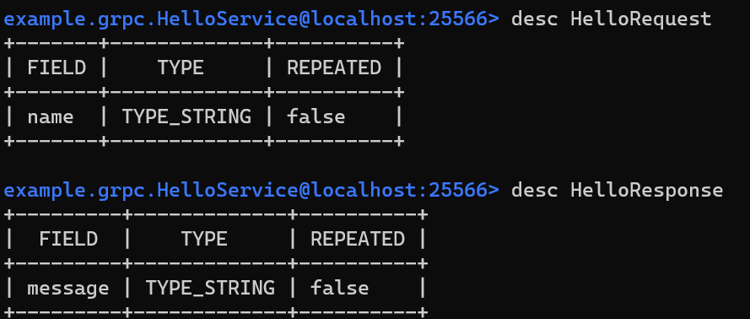
GRPC utility (cont.)
The “desc” command is very useful because provides the message definition.

Slide 24
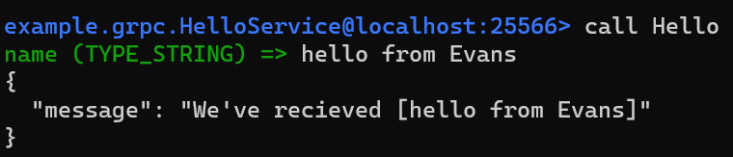
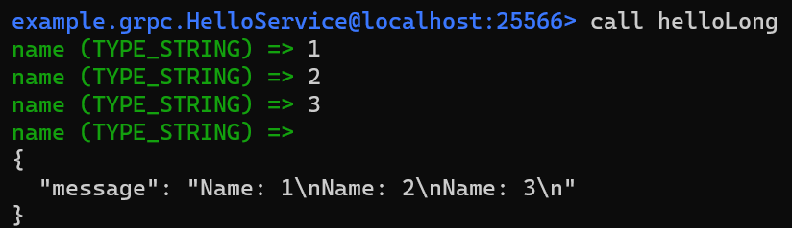
GRPC utility (cont.)
The “call” command can be used to trigger gRPC call.
CTRL+D is used when we use client streaming RPC style to signal that the client finished sending the data.

Slide 25
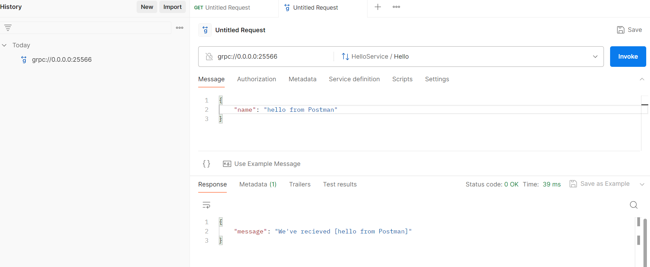
GRPC utility (cont.)
We can use Postman as gRPC client to test gRPC endpoints. We click new → gRPC. After that we put the url grpc://<IP>:<PORT> of the gRPC endpoint and we can make a call.

Slide 26
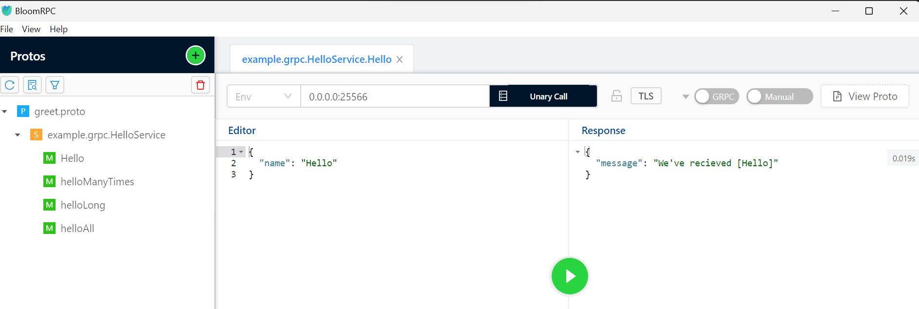
GRPC utility (cont.)
We can use BloomRPC as gRPC client to test gRPC servers.
We import the .proto that contains the message and the service with the operations and after that we can make gRPC calls.

Slide 27
gRPC vs REST
 | gRPC | REST
Data Format | Uses Protobuf to encode data as binary | Uses plaintext data formats: XML and XML
Data validation | Validates every message | Requires extra validation
Communication pattern | Supports unary, client streaming, server streaming, bi-directional | Supports only unary request/response pattern
Design patterns | Defined callable functions | Uses HTTP methods to grant access to resources
Code generation | Supports code generation in many programming languages | No native support for code generation
Primary use case | Microservices architecture | Public API or other API where ease of use is a priority
Browser support | Yes, via gRPC-Web | Yes (native)
Payload Size | Small | Medium/Large

Slide 28
gRPC vs REST (cont.)
gRPC and REST have several distinguishing features that make them well-suited for different use cases.
REST is the most used API architecture today.
REST is ideal choice if you need to create a public API, as developers at other organizations will be able to easily integrate it into their own applications.
gRPC, on the other hand, was designed to support highly efficient, language-agnostic communication in distributed systems.
gRPC’s use of Protobuf for binary data serialization makes it the better choice for applications that demand low latency and high throughput, while its support for different streaming patterns make it ideal for real-time chat and video applications.

Slide 29
gRPC vs REST (cont.)
Use gRPC when:
we need high-performance, low-latency environment.
we need full-duplex streaming capabilities.
services are written in multiple languages.
Use JSON when:
human-readability and simplicity are critical.
we need to use HTTP methods explicitly (GET, POST, PUT, DELETE).
the application is browser-based or you're dealing with cross-origin requests.

Slide 30
gRPC vs REST (cont.)
Same information using JSON uses 9 bytes, where gRPC uses 2 bytes.
JSON:
{
"id":42
}
gRPC:
0x08 0x2a

Slide 31
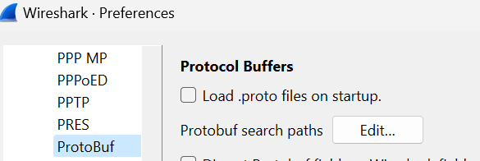
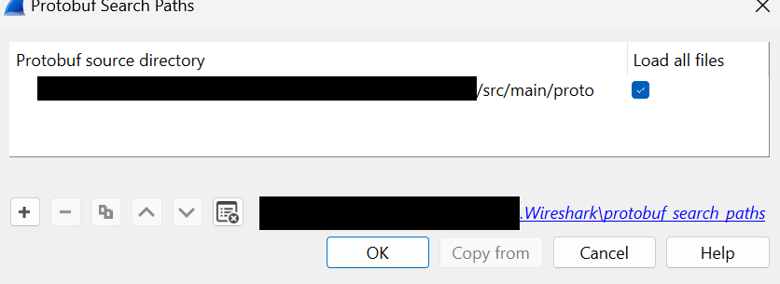
Others
We can capture the HTTP/2 traffic and decode the data send using Protobuf if we load the used .proto files.
To do that go to Wireshark, Edit → Preferences → Protocols → Protobuf. Client the “Protof search paths Edit…” button.
From there we select the folder where we have the .proto file and check the “Load all files” checkbox.

Slide 32
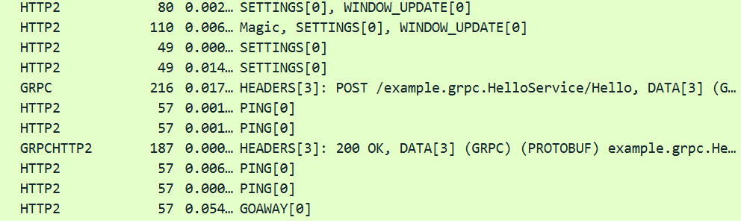
Others (cont.)
We configure Wireshark to decode the specific port traffic to HTTP2 and we can see the packages.

Slide 33
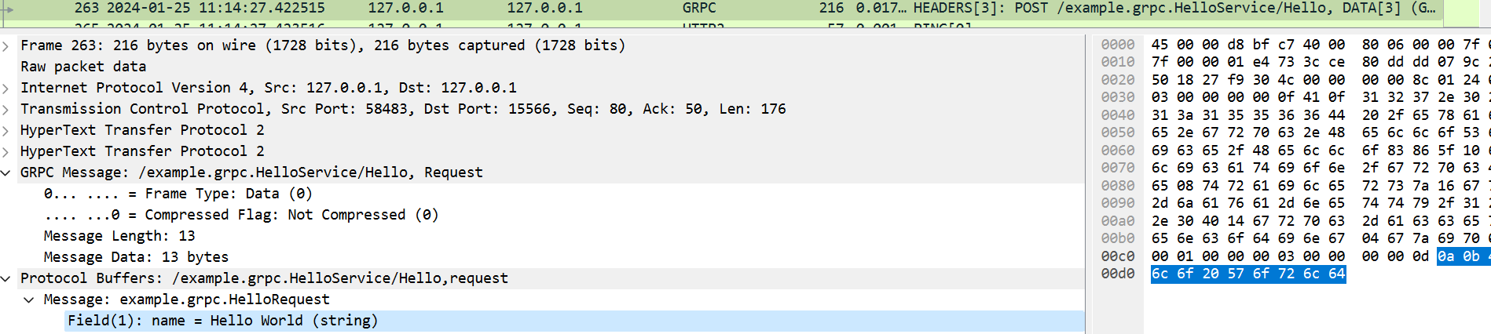
Others (cont.)
If Wireshark loaded the proper .proto files we can decode the actual request/response payload sent.

Slide 34
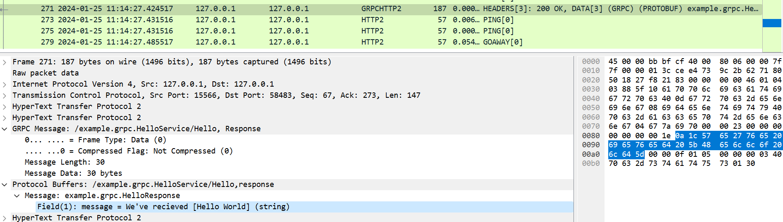
Others (cont.)
If we inspect the HTTP/2 packages, we’ll see a bunch of custom HTTP/2 headers used by gRPC like: grpc-status, grpc-accept-encoding.
The HTTP/2 content-type header is set to “application/grpc” and the method used is POST.

Slide 35

Bibliography
https://en.wikipedia.org/wiki/GRPC
https://github.com/ktr0731/evans
https://grpc.io/
https://blog.postman.com/grpc-vs-rest
https://encore.dev/resources/grpc-vs-json

