Slide 1

ASN.1
Dima Ionut Daniel

Slide 2
Contents
What is ASN.1?
ASN1 Architecture
ASN1 Syntax
Basic Encoding Rules
Distinguished Encoding Rules
ASN1 Java Libraries
ASN1 Java Compiler
Bibliography

Slide 3

What is ASN.1?
Abstract Syntax Notation One (ASN.1) is a standardized notation used for describing the data structures carried by messages exchanged between communicating parts.
It is developed and maintained by ITU-T as ITU-T X.680 to X.683 (ISO/IEC 8824-1 to 4).
ASN.1 is a standard and notation that describes rules and structures for representing, encoding, transmitting, and decoding data in telecommunications and computer networking.

Slide 4
What is ASN.1? (cont.)
ASN.1 defines the abstract syntax of information but does not restrict the way the information is encoded.
The standard ASN.1 encoding rules include:
Basic Encoding Rules (BER)
Canonical Encoding Rules (CER)
Distinguished Encoding Rules (DER)
XML Encoding Rules (XER)
Canonical XML Encoding Rules (CXER)
Extended XML Encoding Rules (E-XER)
Packed Encoding Rules (PER, unaligned: UPER, canonical: CPER)
Generic String Encoding Rules (GSER)

Slide 5
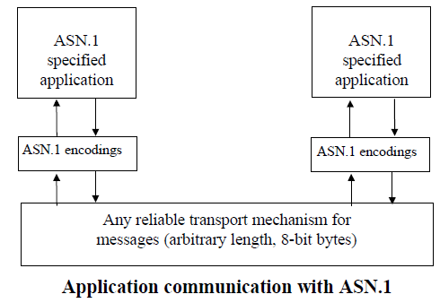
ASN1 Architecture
The major advantage of having layers is to enable reusability of carrier mechanisms to support a range of different higher-layer protocols or applications.

Slide 6
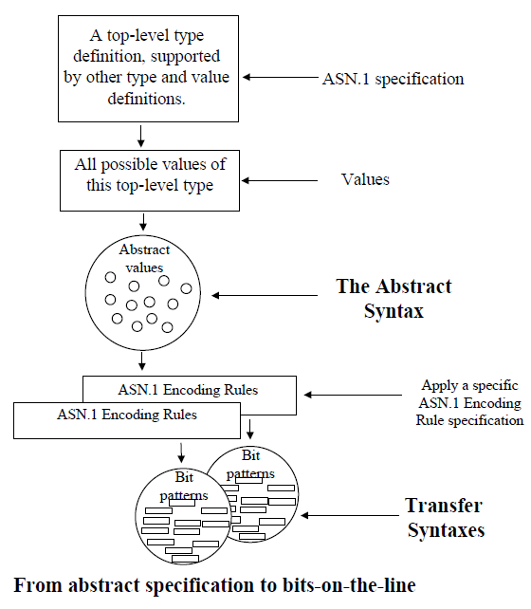
ASN1 Architecture(cont.)
In ASN.1, the bit-patterns in a transfer syntax are always a multiple of 8 bits, for easy carriage in a wide range of carrier protocols).

Slide 7
ASN1 Syntax
In ASN.1, a type is a set of values.
For some types, there are a finite number of values, and for other types there are an infinite number.
ASN.1 has four kinds of type:
simple types, which are "atomic" and have no components
structured types, which have components;
tagged types, which are derived from other types
other types, which include the CHOICE type and the ANY type
Types and values can be given names with the ASN.1 assignment operator (::=).

Slide 8
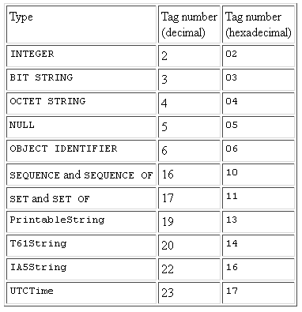
ASN1 Syntax
There are four classes of tag:
Universal: for types whose meaning is the same in all applications; these types are only defined in X.208.
Application: for types whose meaning is specific to an application, such as X.500 directory services;
Private, for types whose meaning is specific to a given enterprise.
Context-specific, for types whose meaning is specific to a given structured type;
The types with universal tags are defined in X.208, which also gives the types' universal tag numbers.

Slide 9
ASN1 Syntax
ASN.1 types and values are expressed in a flexible, programming-language-like notation, with the following special rules:
Layout is not significant; multiple spaces and line breaks can be considered as a single space.
Comments are delimited by pairs of hyphens (--), or a pair of hyphens and a line break.
Identifiers (names of values and fields) and type references (names of types) consist of upper- and lower-case letters, digits, hyphens, and spaces; identifiers begin with lower-case letters; type references begin with upper-case letters.

Slide 10
ASN1 Syntax
Simple Types:
BIT STRING, an arbitrary string of bits (ones and zeroes).
IA5String, an arbitrary string of IA5 (ASCII) characters.
INTEGER, an arbitrary integer.
NULL, a null value.
OBJECT IDENTIFIER, an object identifier, which is a sequence of integer components that identify an object such as an algorithm or attribute type.
OCTET STRING, an arbitrary string of octets (eight-bit values).
PrintableString, an arbitrary string of printable characters.
T61String, an arbitrary string of T.61 (eight-bit) characters.
UTCTime, a "coordinated universal time" or Greenwich Mean Time (GMT) value.
Simple types fall into two categories: string types and non- string types

Slide 11
ASN1 Syntax
Structured types
SEQUENCE, an ordered collection of one or more types.
SEQUENCE OF, an ordered collection of zero or more occurrences of a given type.
SET, an unordered collection of one or more types.
SET OF, an unordered collection of zero or more occurrences of a given type.
Tagging is useful to distinguish types within an application; it is also commonly used to distinguish component types within a structured type.
There are two ways to tag a type: implicitly and explicitly.
Other types in ASN.1 include the CHOICE and ANY types.
The CHOICE type denotes a union of one or more alternatives.
The ANY type denotes an arbitrary value of an arbitrary type.

Slide 12
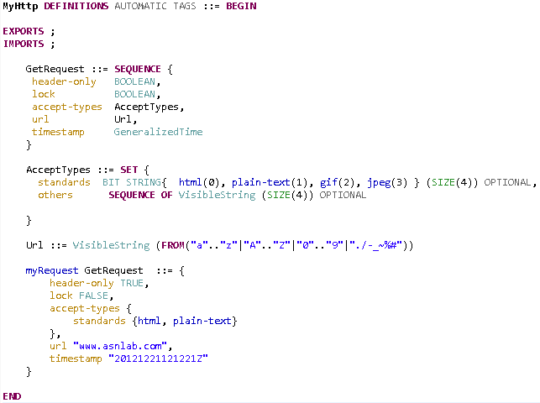
ASN1 Syntax (cont.)

Slide 13
Basic Encoding Rules
The Basic Encoding Rules(BER) for ASN.1 give one or more ways to represent any ASN.1 value as an octet string.
There are three methods to encode an ASN.1 value under BER, the choice of which depends on the type of value and whether the length of the value is known.
The three methods are:
primitive, definite-length encoding;
constructed, definite- length encoding;
constructed, indefinite-length encoding.

Slide 14
Basic Encoding Rules (cont.)
In each method, the BER encoding has three or four parts:
Identifier octets. These identify the class and tag number of the ASN.1 value, and indicate whether the method is primitive or constructed.
Length octets. For the definite-length methods, these give the number of contents octets. For the constructed, indefinite-length method, these indicate that the length is indefinite.
Contents octets. For the primitive, definite-length method, these give a concrete representation of the value. For the constructed methods, these give the concatenation of the BER encodings of the components of the value.
End-of-contents octets. For the constructed, indefinite- length method, these denote the end of the contents. For the other methods, these are absent.

Slide 15
Distinguished Encoding Rules
The Distinguished Encoding Rules for ASN.1, abbreviated DER, are a subset of BER
DER is intended for applications in which a unique octet string encoding is needed, as is the case when a digital signature is computed on an ASN.1 value.
DER adds the following restrictions to the rules:
When the length is between 0 and 127, the short form of length must be used
When the length is 128 or greater, the long form of length must be used, and the length must be encoded in the minimum number of octets.
For simple string types and implicitly tagged types derived from simple string types, the primitive, definite-length method must be employed.
For structured types, implicitly tagged types derived from structured types, and explicitly tagged types derived from anything, the constructed, definite-length method must be employed.

Slide 16
ASN1 Java Libraries
Java ASN1 libraries:
ASNLAB
jASN1 – OpenMUC
JAC – Java ASN1 Compiler
ASN library from Mobicents
These Java libraries have been designed to facilitate the exchange of structured data between application programs over network.

Slide 17
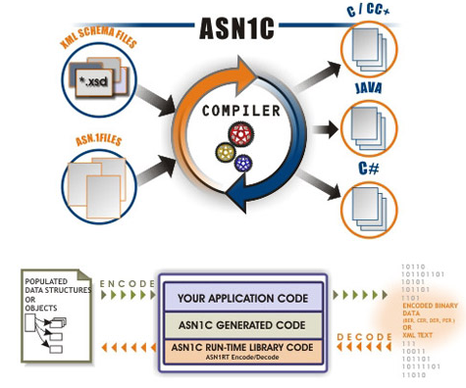
ASN1 Java Compiler
The ASN.1 Java Compiler Tools package consists of a compiler and a set of feature-rich runtime jar files.
The compiler maps ASN.1 types into Java classes.
With scalable converter classes, message can be decoded even without message entity.

Slide 18
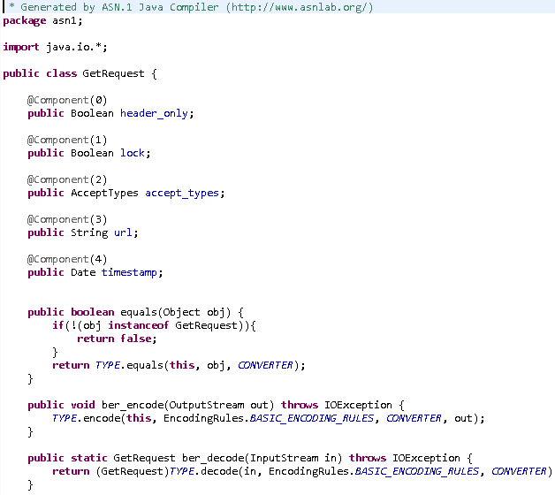
ASN1 Java Compiler (cont.)
Bellow it’s an example of generated object using ASN template.

Slide 19
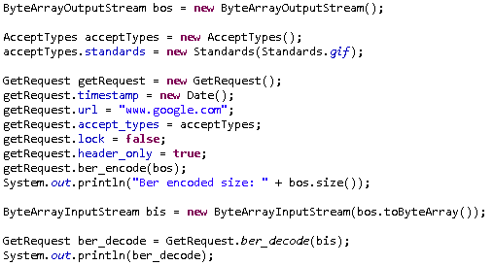
ASN1 Java Compiler (cont.)
Based on the ASN template, java classes are generated and can very easy use to encode/decode messages.
Bellow it’s an example using generated objects by ASNLab library.

Slide 20

Bibliography
http://en.wikipedia.org/wiki/Abstract_Syntax_Notation_One
http://www.asnlab.com/asnjc/overview.html
http://sourceforge.net/projects/jac-asn1/
http://luca.ntop.org/Teaching/Appunti/asn1.html
http://www.obj-sys.com/products/asn1c/index.php
ASN.1 Complete by John Larmouth

Slide 21
Questions ?

