Slide 1

Nginx
Dima Ionut Daniel

Slide 2
Contents
What is Nginx?
Features
Arhitecture
Core
HTTP Module
Reverse Proxy
Load Balancer
Caching
Access Control
Rewrite Module
Conclusions
Bibliography

Slide 3

What is Nginx ?
Nginx is a web server that can be used as a reverse proxy, load balancer, mail proxy and HTTP cache.
Nginx is free and open-source software, released under the terms of the 2-clause BSD license.
Nginx was the second-most widely used web server across all "active" sites.

Slide 4
Features
Easy to configure in order to serve static web content or to act as a proxy server.
Can be deployed to also serve dynamic content on the network.
Uses an asynchronous event-driven approach, rather than threads, to handle requests.
Nginx's modular event-driven architecture can provide predictable performance under high loads.

Slide 5
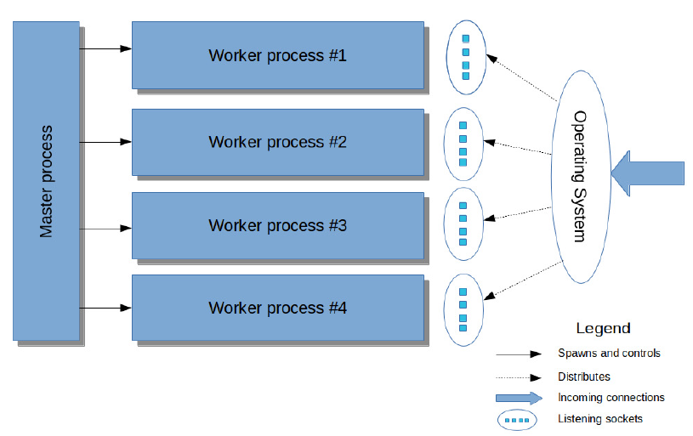
Arhitecture

Slide 6
Arhitecture (cont.)
A single Nginx instance consists of the master process and worker processes.
Worker processes wait on listening sockets and accept incoming connections.
The master process is responsible for all startup, shutdown and maintenance tasks:
Reading and re-reading configuration files
Opening and reopening log files
Creating listening sockets
Starting and restarting worker processes
Forwarding signals to the worker processes
Starting a new binary

Slide 7
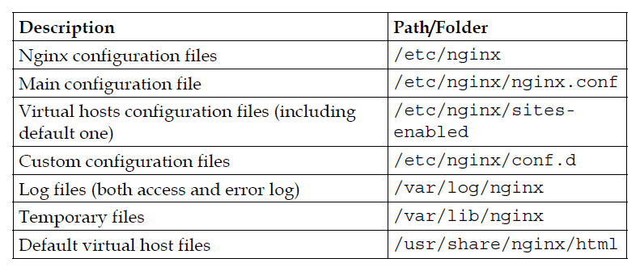
Core
The Ubuntu Linux distribution contains a prebuilt package for Nginx.
sudo apt update
sudo apt-get install nginx
sudo service nginx start

Slide 8
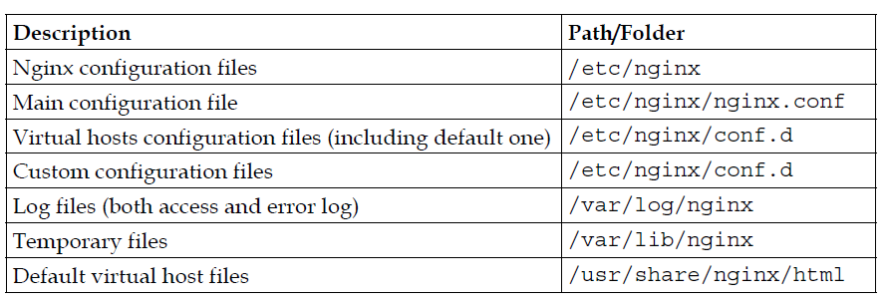
Core (cont.)
Nginx is not provided out of the box in Red Hat Enterprise Linux or CentOS.
We need to use the Extra Packages for Enterprise Linux (EPEL) repository.
yum install nginx

Slide 9
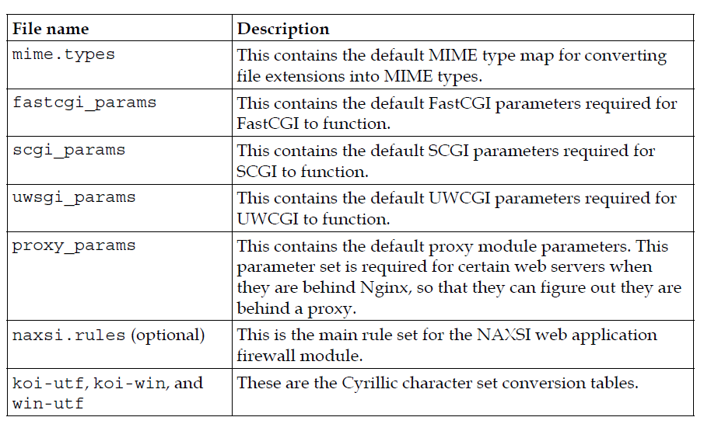
Core (cont.)
The nginx folder contains a set of parameter files.

Slide 10
Core (cont.)
In the configuration file, the directives are delimited by a semicolon (;).
Some of the directives may have a block ({}) instead of a semicolon.
A section is a block that contains a list of other directives.
Variables are named objects prefix by dollar symbol ($) and can only appear inside the http section.

Slide 11
Core (cont.)
Any Nginx configuration section can contain inclusions of other files via include directive.
The include directive can also contain a globed path with wild cards, either relative or absolute.
include /etc/nginx/conf/site-defaults.conf;
include /etc/nginx/sites-enabled/*.conf;

Slide 12
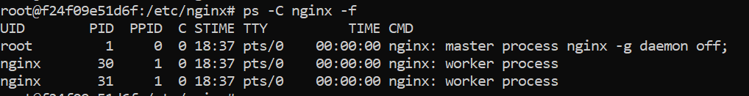
Core (cont.)
Nginx will read and parse the configuration file, create a PID file, open log files, create listening sockets, and start worker processes.
Once worker processes have started, a Nginx instance is able to respond to incoming connections.
This is what a running Nginx instance looks like in the process list:
ps –C nginx -f

Slide 13
Core (cont.)
Main directives:
user → defines user credentials used by worker process
worker_processes → defines the number of workers. Best to set this to the available CPU cores.
error_log → path to the error log file
pid → defines a file that store the process ID of the main process.
log_format → defines the format of the logs and associated parameters
access_log → list of requests that users have made to the server

Slide 14

Core (cont.)
Nginx CLI parameters:
-v → print version
-V → print NGINX version, compiler version and configure parameters
-t → don’t run, just test the configuration file
-c → specify which configuration file NGINX should use instead of the default

Slide 15
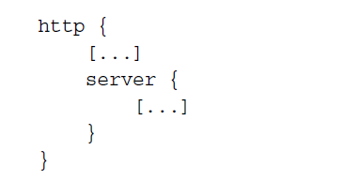
HTTP Module
The HTTP module introduces three new logical blocks:
http: This block is inserted at the root of the configuration file.
server: This block allows you to declare a website.
location: The location block lets you define a group of settings to be applied to a particular location on a website.

Slide 16
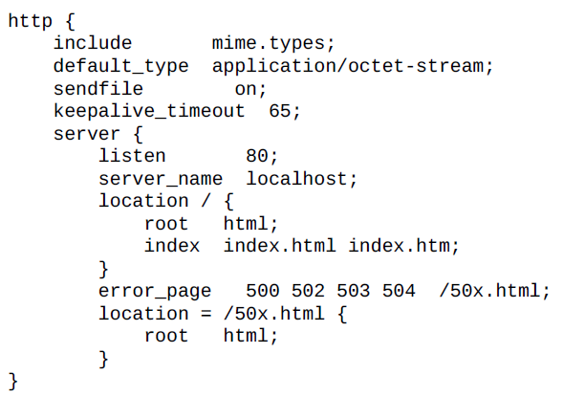
HTTP Module (cont.)
The http section must contain at least one server section in order to process HTTP requests.
Sample /etc/nginx/nginx.conf configuration to start a web server on port 80

Slide 17
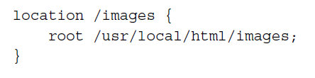
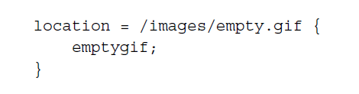
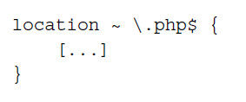
HTTP Module (cont.)
The upstream section configures a logical server that Nginx can pass requests to for further processing.
The location directive takes parameters that specify a pattern that is matched against the path of the request URI.
There are three types of location patterns: simple, exact, and regular expression location patterns.

Slide 18
HTTP Module (cont.)
The directives let fine-tune your network settings by configuring the TCP socket options.
listen
Specifies the IP address and/or the port to be used by the listening socket that serves the website. Sites are generally served on port 80 (the default value) via HTTP, or 443 via HTTPS.
Syntax: listen [address][:port] [additional options];
Additional options:
default_server: Specifies this server block to be used as the default website for any request received at the specified IP address and port
ssl: Specifies that the website should be served over SSL
spdy: Enables support for the SPDY protocol if the SPDY module is present
proxy_protocol: Enables the PROXY protocol for all the connections accepted on this port
Other options are related to the bind and listen system calls: backlog=num,rcvbuf=size, sndbuf=size, accept_filter=filter, deferred, setfib=number, and bind

Slide 19
HTTP Module (cont.)
server_name
This assigns one or more hostnames to the server block. When Nginx receives an HTTP request, it matches the Host header of the request against all the server blocks. The first server block to match this hostname is selected.
tcp_nodelay
Enables or disables the TCP_NODELAY socket option for keep-alive connections only. Quoting the Linux documentation on sockets programming:
“TCP_NODELAY is for a specific purpose; to disable the Nagle buffering algorithm. It should only be set for applications that send frequent small bursts of information without getting an immediate response, where timely delivery of data is required (the canonical example is mouse movements).”

Slide 20
HTTP Module (cont.)
tcp_nopush
Enables or disables the TCP_NOPUSH (FreeBSD) or TCP_CORK (Linux) socket option. Note that this option applies only if the sendfile directive is enabled. If tcp_nopush is set to on, Nginx attempts to transmit all the HTTP response headers in a single TCP packet.
sendfile
If this directive is enabled, Nginx uses the sendfile kernel call to handle file transmission. If disabled, Nginx handles the file transfer by itself. Depending on the physical location of the file being transmitted (such as NFS), this option may affect the server performance.
root
This directive defines the document root containing the files that you wish to serve to your visitors.

Slide 21
HTTP Module (cont.)
error_page
This allows you to affect URIs to the HTTP response code and optionally, to substitute the code with another.
Syntax: error_page code1 [code2…] [=replacement code] [=@block | URI]
error_page 404 /not_found.html;
alias
alias is a directive that you place in a location block only. It assigns a different path for Nginx to retrieve documents for a specific request.

Slide 22
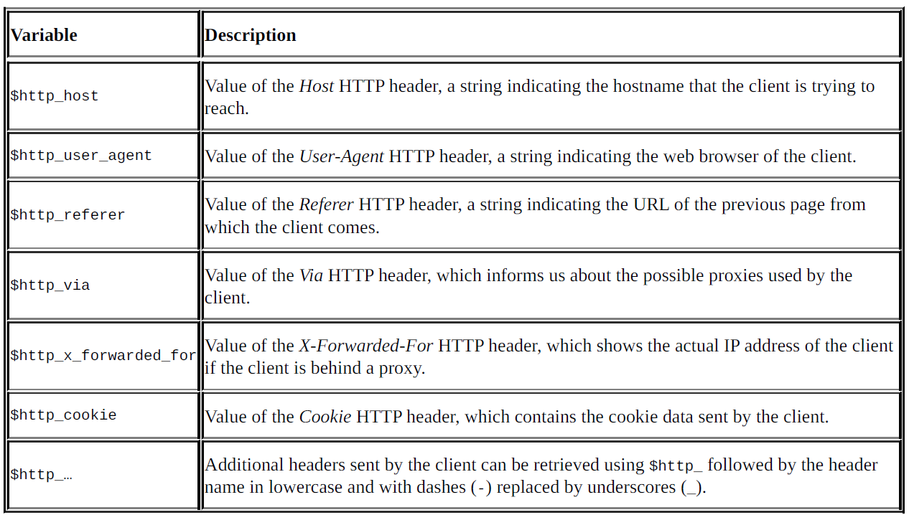
HTTP Module (cont.)
Nginx lets us access client request headers under the form of variables

Slide 23
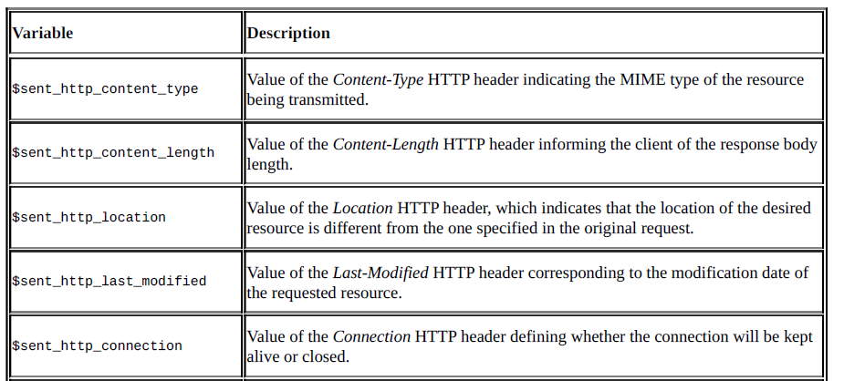
HTTP Module (cont.)
Nginx lets us access client response headers:

Slide 24
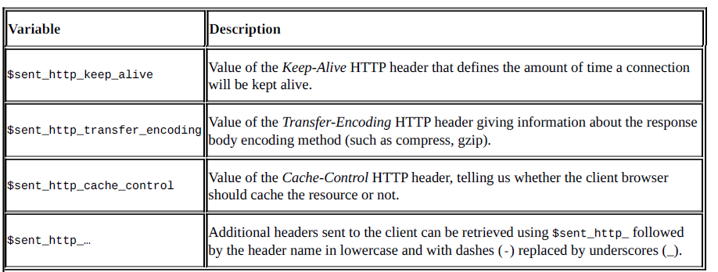
HTTP Module (cont.)
Nginx lets us access client response headers:

Slide 25
Reverse Proxy
Reverse Proxy is a type of proxy server which retrieves resources on behalf of a client from one or more servers.
Benefits:
hides the existence of the original backend servers
can protect the back-end servers from web-based attacks, DOS, etc.
can provide great caching functionality
can optimize the content by compressing it
can act as SSL termination proxy
request routing

Slide 26
Reverse Proxy (cont.)
proxy_pass
Forwards the request to the proxied servers specified along with the directive.
location / {
proxy_pass http://127.0.0.2
}
location /admin {
proxy_pass http://127.0.0.3
}

Slide 27
Reverse Proxy (cont.)
proxy_set_header
This directive can add custom headers to the proxied request
To add X-Real-IP header on proxy we need to use: proxy_set_header X-Real-IP $remote_addr;
On the backend server we use $http_x_real_ip; to retrieve the real IP.

Slide 28
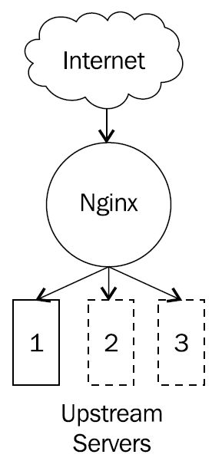
Load Balancer
Load Balancer can be used to distribute traffic between servers.
One important feature of load balancers is health checking the backend servers.
The upstream block can be used to specify the group of servers for which we want to distribute the traffic.

Slide 29
Load Balancer (cont.)
upstream backend {
server 127.0.0.2;
server 127.0.0.3;
}
server {
listen 80;
server_name localhost;
location / {
proxy_pass http://backend;
}
}

Slide 30
Load Balancer (cont.)
Nginx supports 2 types of health checks:
Active Health Checks (Nginx Plus)
Passive Health Checks
Active Health Check
Nginx Plus can periodically check the health by sending special health check requests to each servers and check for the response
If there is any communication error, timeout or receives responses with codes other then 2XXX or 3XX, the upstream server is marked as unhealthy
Passive health Check
Nginx monitors the communication between client and the upstream server.
If the upstream server is not responding, the passive health check will consider the server to be unhealthy.

Slide 31
Load Balancer (cont.)
max_fails → sets the number of failed attempts that must occur during the fail_timeout period for the server to be marked as unavailable
fail_timeout → sets the time during which several failed attempts must happen for the server to be marked unavailable and the time for which the server is marked unavailable
upstream backend {
server 127.0.0.2 max_fails=2 fail_timeout=30s;
server 127.0.0.3 max_fails=2 fail_timeout=30s;
}

Slide 32
Load Balancer (cont.)
Server weight allows to customize the request flow
This is achieved with the parameter weight.
upstream backend {
server 127.0.0.2 weight=2;
server 127.0.0.3 ;
}
The directive least_conn activates the load-balancing algorithm where the server with the least number of active connections is chosen for the next new connection.

Slide 33
Load Balancer (cont.)
The keepalive directive is used to keep open several connections per worker to an upstream server.
upstream apache {
server 127.0.0.1:8080;
keepalive 32;
}
location / {
proxy_http_version 1.1;
proxy_set_header Connection "";
proxy_pass http://apache;
}

Slide 34
Caching
Caching has lots of benefits:
it reduces the overhead of server's resources
decreases the network bandwidth
pages are loaded faster

Slide 35
Caching (cont.)
Cache-Control headers are used to specify various directives for caching mechanism.
These headers are used to define checking policies with various directives provided by the headers.
Cache-Control:no-store
Cache-Control:no-cache
Cache-Control:no-store,no-cache,must-revalidate

Slide 36
Caching (cont.)
All png resources will have the HTTP header Cache-Control set to no-store.
location ~ \.(png) {
root /var/www/websites/;
add_header Cache-Control no-store;
}

Slide 37
Access Control
There are directives to allow or deny clients to access resources found on server.
location /admin {
allow 127.0.0.2;
deny all;
}
location /admin {
include /var/etc/nginx/whiteList;
deny all;
}

Slide 38
Access Control (cont.)
limit_rate directives can limit the rate of response transmission to a client.
location /downloads {
root /var/www/downloads;
limit_rate 50k;
}

Slide 39
Rewrite Module
The rewrite module in NGINX allows the creation go new rules as well as translating legacy Apache rewrite rules into NGINX's format.
The rewrite module is a simple regular expression
The break parameter may also be used as a directive on its own, to stop rewrite module directive processing within an if block or another context in which the rewrite module is active.
if ($bwhog) {
limit_rate 300k;
break;
}

Slide 40
Rewrite Module (cont.)
Another way to stop the processing of the rewrite module directives is to return control to the main http module processing the request.
location = /image404.html {
return 404 "image not found\n";
}

Slide 41
Rewrite Module (cont.)
Directive | Description
break | ends the processing of the rewrite module directives found within the same context.
if | Evaluates a condition, and if true follows the rewrite module directives specified within the context set up using the following format: if (condition) { … }
return | Stops processing and returns the specified code to the client.

Slide 42
Rewrite Module (cont.)
The condition may be any of the following:
a variable name: false if empty or any string starting with 0
string comparison: using the = and != operators
regular expression matching: using the ~ (case-sensitive) and the ~* (case-insensitive) positive operators and their negative counterparts !~ and !~*
file existence: using the -f and ! –f operators
directory existence: using the -d and ! -d operators
file, directory, or symbolic link existence: using the -e and ! –e operators
file executability: using the -x and ! -x operators

Slide 43
Rewrite Module (cont.)
The directive rewrite_log activate notice log level of rewrite to error_log.
The set directive sets a given variable to a specific value.
The rewrite directive changes the URI from one matched by the regular expression in the first parameter to the string in the second parameter.

Slide 44
Conclusions
NGINX is one of the most popular web servers and reverse proxies
It offers high performance
Easy to learn
Can be extended using custom modules

Slide 45

Bibliography
https://en.wikipedia.org/wiki/Nginx
https://nginx.org/en/docs/
Packt Publishing - Nginx HTTP Server Third Edition
Packt Publishing - Nginx Essentials
Packt Publishing - Mastering Nginx
Udemy – Beginners Guide to master the HTTP protocol and NGINX

