Slide 1

TLS
Dima Ionut Daniel

Slide 2
Contents
What is TLS?
History
Cryptography
SSL Operation
Message Format
OpenSSL
Bibliography

Slide 3

What is TLS?
Transport Layer Security (TLS) and its predecessor, Secure Sockets Layer (SSL) are cryptographic protocols that provide communications security over a computer network.
The primary goal of the Transport Layer Security protocol is to provide privacy and data integrity between two communicating computer applications.
The connection is private because symmetric cryptography is used to encrypt the data transmitted.

Slide 4
What is TLS? (cont.)
The keys for this symmetric encryption are generated uniquely for each connection and are based on a shared secret negotiated at the start of the session (TLS handshake protocol).
The server and client negotiate the details of which encryption algorithm and cryptographic keys to use before the first byte of data is transmitted.
The negotiation of a shared secret is both secure and reliable (no attacker can modify the communications during the negotiation without being detected).
The identity of the communicating parties can be authenticated using public-key cryptography.

Slide 5
History
Netscape developed the original SSL protocols.
Version 1.0 was never publicly released because of serious security flaws in the protocol; version 2.0, released in February 1995, "contained a number of security flaws which ultimately led to the design of SSL version 3.0".
Released in 1996, SSL version 3.0 represented a complete redesign of the protocol produced by Paul Kocher working with Netscape engineers Phil Karlton and Alan Freier, with a reference implementation by Christopher Allen and Tim Dierks of Consensus Development.
Newer versions of SSL/TLS are based on SSL 3.0.
The 1996 draft of SSL 3.0 was published by IETF as a historical document in RFC 6101.
SSL 2.0 was deprecated (prohibited) in 2011 by RFC 6176.
SSL 3.0 was deprecated in June 2015 by RFC 7568.

Slide 6
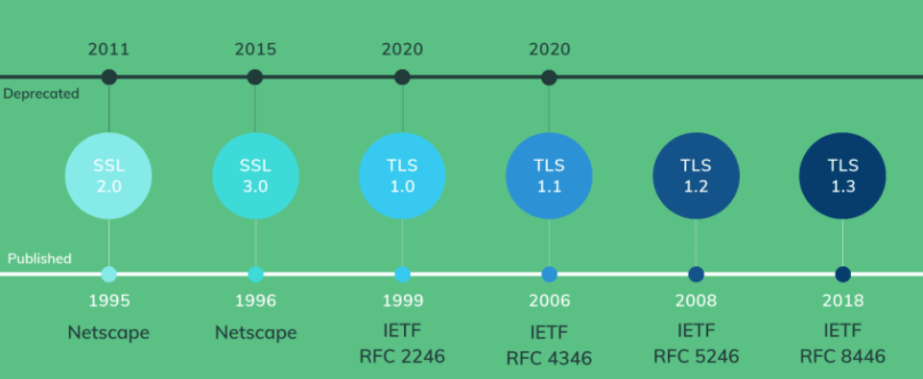
History (cont.)
TLS 1.0 was first defined in RFC 2246 in January 1999 as an upgrade of SSL Version 3.0 and written by Christopher Allen and Tim Dierks of Consensus Development.
TLS 1.1 was defined in RFC 4346 in April 2006, as an update from TLS version 1.0.
TLS 1.2 was defined in RFC 5246 in August 2008 and is based on the earlier TLS 1.1 specification.
As of July 2016, TLS 1.3 is a working draft, and details are provisional and incomplete.

Slide 7
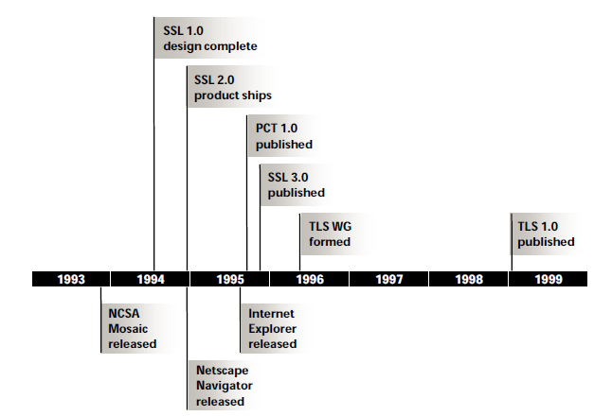
History (cont.)

Slide 8
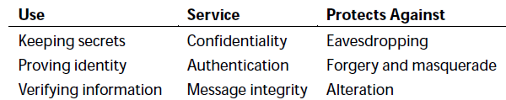
Cryptography
Cryptography is derived from the Greek for "secret writing".
To validate the information cryptographic functions called hash functions are used.
Cryptographic hash functions resemble checksums or cyclic redundancy check (CRC) codes that are common error detection mechanisms.
2 hash functions are essential to SSL implementations: Message Digest 5(MD5) and Secure Hash Algorithm(SHA)

Slide 9
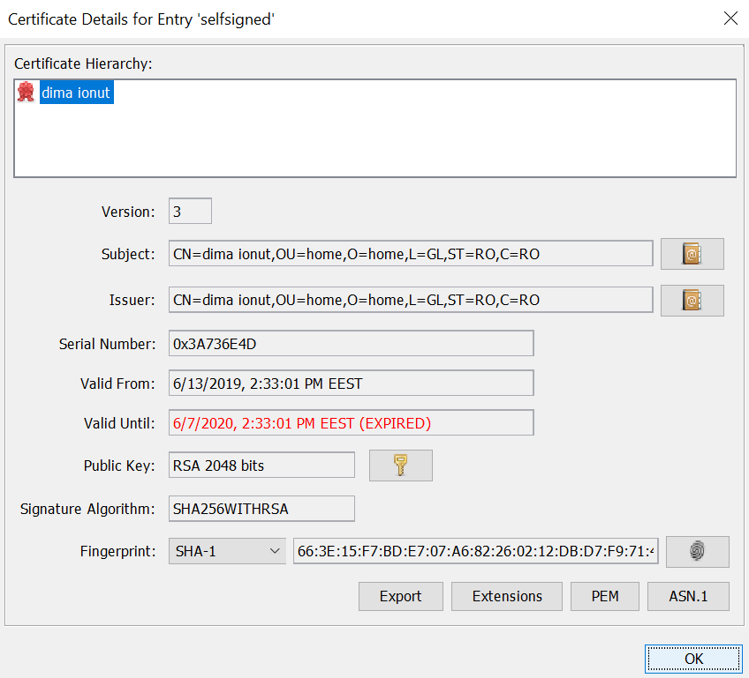
Cryptography (cont.)
A certificate contains a public key.
The certificate, in addition to containing the public key, contains additional information such as issuer, what the certificate is supposed to be used for, and other types of metadata.
Typically, a certificate is itself signed by a certificate authority (CA) using CA's private key. This verifies the authenticity of the certificate.

Slide 10
Cryptography (cont.)
There are 2 cryptographic techniques:
secret key
public key
With secret key cryptography both parties know the same information: the key and the endeavor to keep that key secret.
Because the secret is known by both parties the technique is called symmetric encryption.
The information after encryption process is called cipher text.

Slide 11
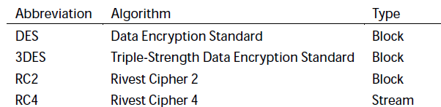
Cryptography (cont.)
Ciphers may be either: stream ciphers or block ciphers.
Stream ciphers process input data a byte at a time and can accept any size of input for encryption.
Block ciphers operates only on fixed-sized blocks of data, typically 8 bytes in size.
Block ciphers require less computation resources.
Encrypting data using a block cipher requires breaking the data into blocks.
If the last block doesn't contain exactly the right amount of data, then dummy data is filled (padding).

Slide 12
Cryptography (cont.)
Private/symmetric key features:
Based on single common shared secret key
Faster than public key encryption
Both sender and receiver should have the shared key
Algorithms:
AES (Advanced Encryption Standard)
DES (Data Encryption Standard)
3DES
IDEA (International Data Encryption Algorithm)
Blowfish (Drop-In replacement for DES or IDEA)
Twofish (Blowfish’s successor, very fast)

Slide 13
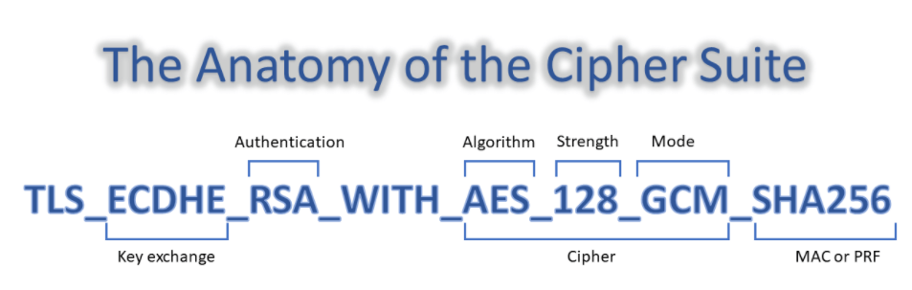
Cryptography (cont.)

Slide 14
Cryptography (cont.)
Public key(asymmetric) cryptography has each of the 2 parties use separate keys:
one for encryption (public key)
another one for decryption (private key)
Public key encryption is powerful but extremely complex.
A good approach is to share the secret key over a secure channel done with public/private keys.
This special type is algorithm is known as key exchange algorithm.

Slide 15
Cryptography (cont.)
Public/Asymmetric algorithms:
RSA (Rivest Shamir Adleman)
DSA (Digital Signature Algorithm)
ECC (Elliptical Curve Cryptography), ECDH (Diffie-Helman), ECDSA.
RSA is not good for key exchange, best to use ECDH.

Slide 16
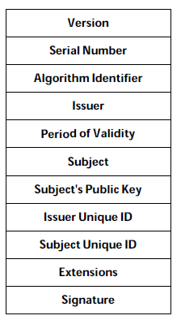
Cryptography (cont.)
Public key certificates contains lots of information like:
issuer: identifies the organization that has issued the certificate
period of validity: certificates expire after a certain time.
subject: issuer's signature

Slide 17
Cryptography (cont.)
X509 - PKIX (Public Key Infrastructure) certificate - RFC 5280/6818
Encoding:
DER (Distinguished Encoding Rules), binary DER encoding certs (.cer/.crt)
PEM (Privacy Enhance Mail), ASCII Base64 armored data prefix with "--- BEGIN===" (.cer/.crt/.pem)
Extensions:
.crt: nix convention of binary DER or Base64 PEM
.cer: Microsoft convention of binary DER or Base64 PEM
.key: public/private PKCS#8 keys, DER or PEM

Slide 18
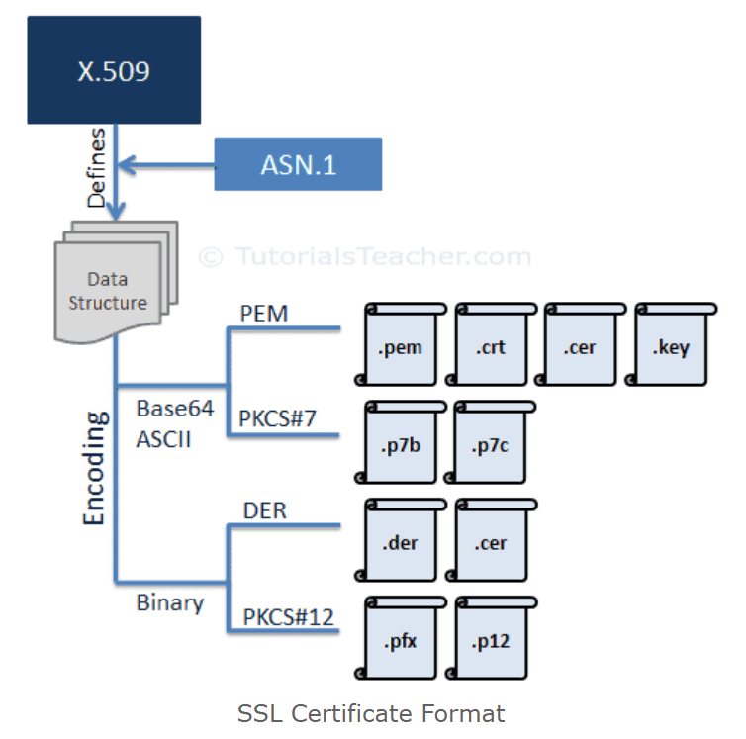
Cryptography (cont.)

Slide 19
SSL Operation
The SSL protocol consists of a set of messages and rules about when to send each one.
The Secure Sockets Layer protocol defined 2 different roles for the communicating parties: client and server.
The client initiates the secure communications, and the server responds to client's requests.

Slide 20
SSL Operation (cont.)
When SSL clients and servers communicates, they exchange SSL messages:
Alert: informs the other party of possible security breach or communication failure.
ApplicationData: actual information that the 2 parties exchange, which is encrypted, authenticated and/or verified by SSL.
Certificate: a message that carries the sender's public key certificate.
CertificateRequest: a request by the server that the client provide its public key certificate.
CertificateVerify: a message from the client that verifies that is knows the private key corresponding to its public key certificate.

Slide 21
SSL Operation (cont.)
ChangeCipherSpec: indication to begin using agreed-upon security services (such as encryption).
ClientHello: a message from the client indicating the security services it desires and is capable of supporting.
ClientKeyExchange: a message from the client carrying cryptographic keys for the communications.
Finished: an indication that all initial negotiations are complete and secure communications have been established.

Slide 22
SSL Operation (cont.)
HelloRequest: a request by the server that the client start (or restart) the SSL negotiation process.
ServerHello: a message from the server indicating the security services that will be used for the communications.
ServerHelloDone: an indication from the server that it has completed all its requests of the client for establishing communications.
ServerKeyExchange: a message from the server carrying cryptographic keys for the communications.

Slide 23
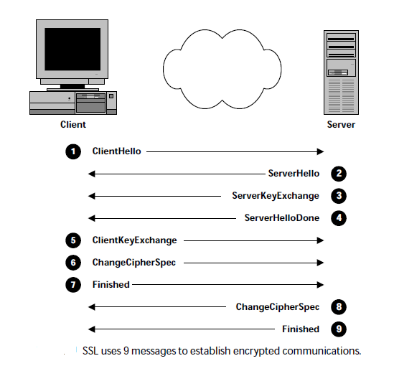
SSL Operation (cont.)

Slide 24
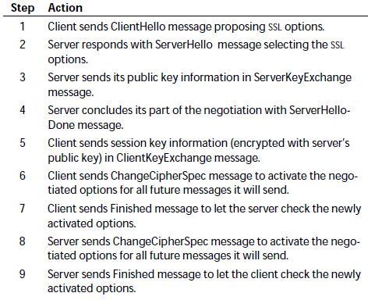
SSL Operation (cont.)

Slide 25
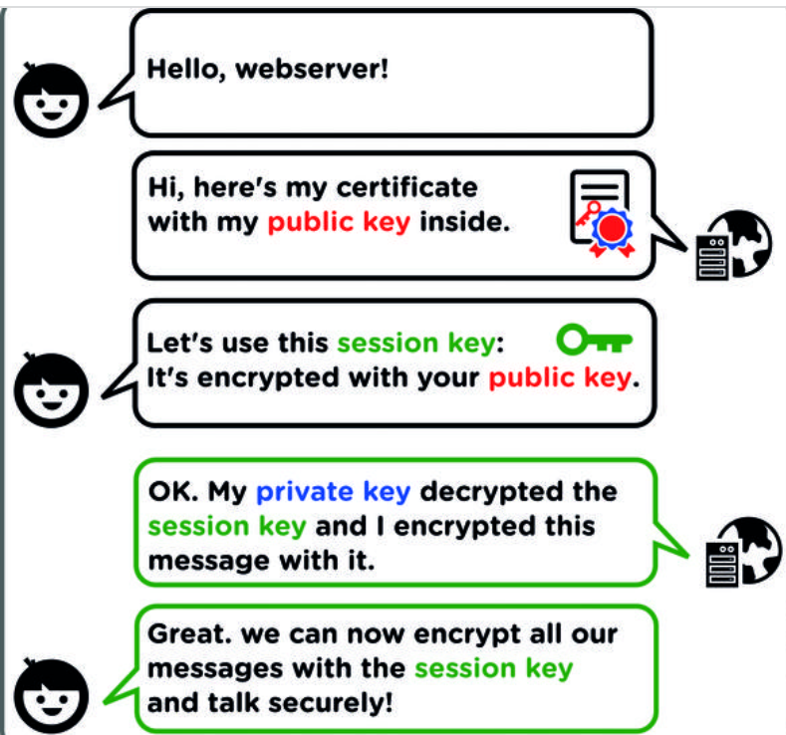
SSL Operation (cont.)

Slide 26
SSL Operation (cont.)
The ClientHello message starts the SSL communication.
The client asks the server to begin the SSL negotiation.
ClientHello components:
Version → highest version of SSL protocol that the client can support.
RandomNumber → 32-byte random number used to seed the cryptographic calculations.
SessionID → identifies the SSL session.
CipherSuites → list of cryptographic parameters that the client can support.
CompressionMethods → identifies data compression methods that the client can support.

Slide 27
SSL Operation (cont.)
The contents of a ServerHello are much the same as a ClientHello.
ServerHello components:
Version → highest version of SSL protocol that the client can support.
RandomNumber → 32-byte random number used to seed the cryptographic calculations.
SessionID → identifies the SSL session.
CipherSuites → list of cryptographic parameters that the client can support.
CompressionMethods → identifies data compression methods that the client can support.

Slide 28
SSL Operation (cont.)
The server sends ServerKeyExchange message after the ServerHello message.
The message complements CipherSuite field of the ServerHello.
While the CipherSuite field indicates the cryptographic algorithms and key sizes, this message contains the public key.
The client will use the server's public key to encrypt a session key.

Slide 29
SSL Operation (cont.)
The ServerHelloDone message informs the client that the server has inished with its initial negociation message.
Once the client receives a ServerHelloDone it can move to the next phase of establishing the securre communications.
After the server has finished its part of the initial SSL negotiation the client responds with a ClientKeyExchange message.
The ClientKeyExchange tells the server the client's key information.

Slide 30
SSL Operation (cont.)
After the client sends key information in a ClientKeyExchange message the preliminary SSL negotiation is complete.
ChangeCipherSepc is a special SSL message that indicates the security services should be invoked.
Immediately after sending the ChangeCipherSpec message each system also sends a Finished message.
The Finished message allow both systems to verify that the negotiation has been successful, and that security has not been compromised.

Slide 31
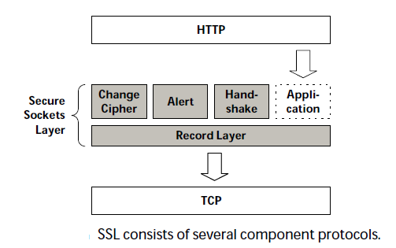
Message Format
The SSL protocol consists of several different components.
4 sources create SSL message: ChangeCipherSpec, Alert, Handshake and Application protocols.
The Record Layer protocol accepts all the messages then formats and frames them passing to the transport layer.

Slide 32
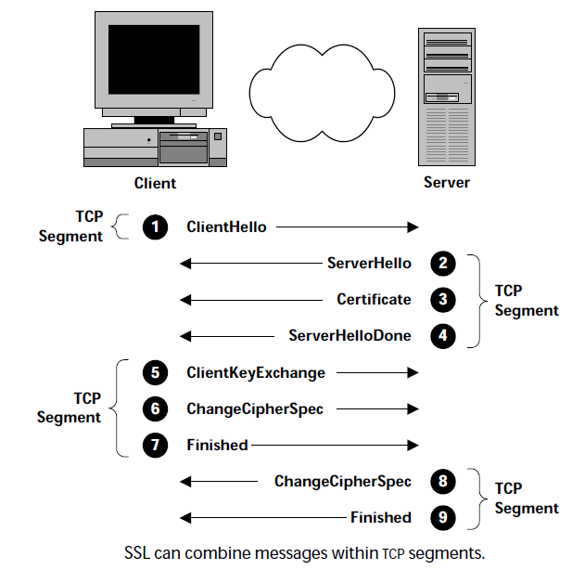
Message Format (cont.)

Slide 33
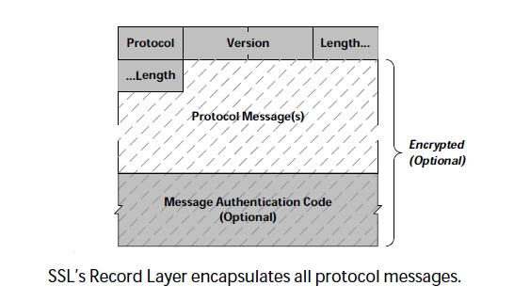
Message Format (cont.)
The Record Layer is responsible for encryption.

Slide 34
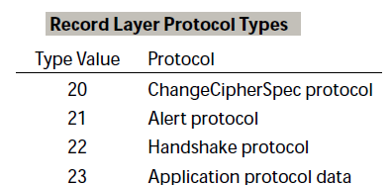
Message Format (cont.)
The SSL specification defines 4 different higher-layer protocols that the Record Layer can encapsulate.

Slide 35


Message Format (cont.)
The ChangeCipherSpec message is very simple.
The Alert protocol message has only 2 fields.

Slide 36
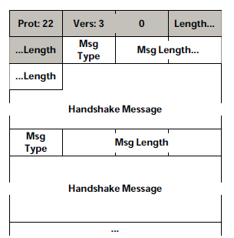
Message Format (cont.)
The Handshake protocol messages can be combined.

Slide 37
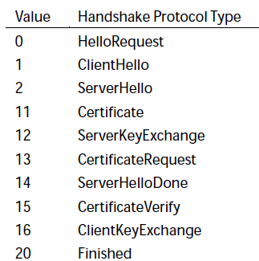
Message Format (cont.)
Handshake protocol type values:

Slide 38
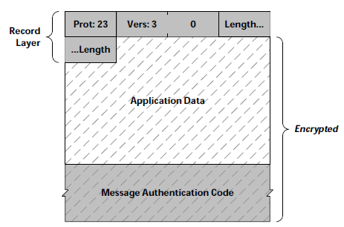
Message Format (cont.)
The SSL protocol supports both stream and block encryption ciphers.

Slide 39
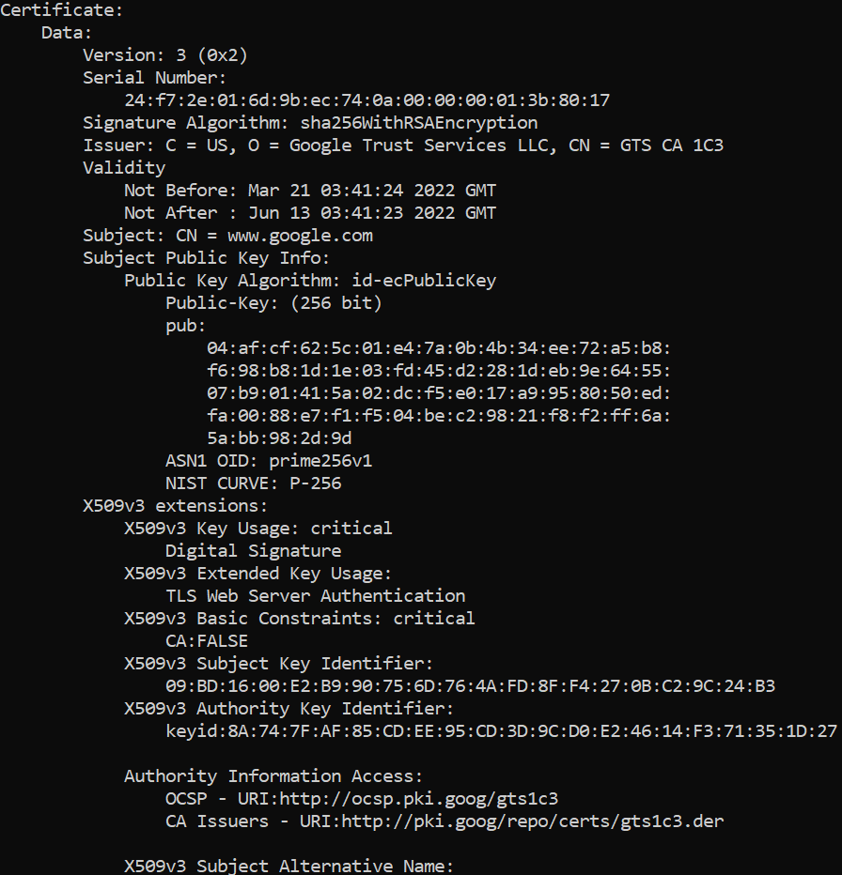
OpenSSL
openssl s_client -connect www.google.com:443 < /dev/null | openssl x509 -text

Slide 40
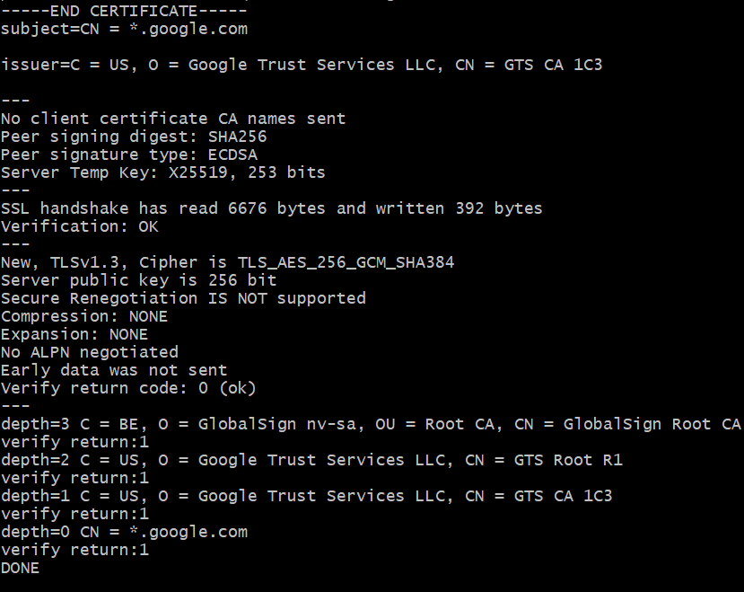
OpenSSL (cont.)
openssl s_client -connect google.com:443 < /dev/null

Slide 41

Bibliography
https://en.wikipedia.org/wiki/Transport_Layer_Security
Wiley - SSL and TLS Essentials

