Slide 1

Redis
Dima Ionut Daniel

Slide 2
Contents
What is Spring Session?
Architecture
Core
Basics
Date Types
Jedis
Spring Redis
Redis vs MemcaheD
Redis Sentinel
Bibliography

Slide 3

What is Redis?
Redis is a data structure server.
It's open-source, networked, in-memory, and stores keys with optional durability.
Redis is the most popular key-value database.
The name Redis means REmote DIctionary Server.

Slide 4
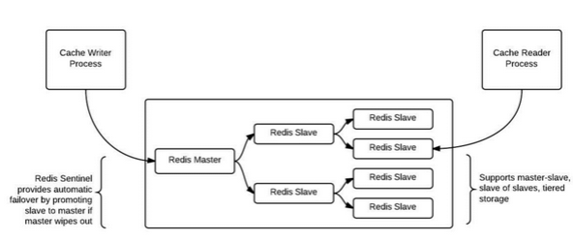
Architecture

Slide 5
Core
Persistence
Redis typically holds the whole dataset in memory.
Persistence is achieved with technique called snapshotting, and is a semi-persistent durability mode where the dataset is asynchronously transferred from memory to disk from time to time, written in RDB dump format.
By default, Redis syncs data to the disk at least every 2 seconds, with more or less robust options available if needed.
In the case of a complete system failure on default settings, only a few seconds of data would be lost.

Slide 6
Core (cont.)
Replication
Redis supports master-slave replication.
Data from any Redis server can replicate to any number of slaves.
A slave may be a master to another slave. This allows Redis to implement a single-rooted replication tree.
The Publish/Subscribe feature is fully implemented, so a client of a slave may SUBSCRIBE to a channel and receive a full feed of messages PUBLISHed to the master, anywhere up the replication tree.
Replication is useful for read (but not write) scalability or data redundancy.

Slide 7
Core (cont.)
Performance
When the durability of data is not needed, the in-memory nature of Redis allows it to perform extremely well compared to database systems that write every change to disk before considering a transaction committed.
There is no notable speed difference between write and read operations.
Redis operates as a single process and single-threaded.
A single Redis instance cannot utilize parallel execution of tasks e.g. stored procedures.

Slide 8
Basics
Redis is an in-memory persistent key-value store.
Redis does hold all the data in memory and it does write that out to disk for persistence.
The reality is that Redis exposes five different data structures, only one of which is a typical key-value structure.

Slide 9
Basics (cont.)
Redis is an extremely high-performance, lightweight data store.
It provides key/value data access to persistent byte arrays, lists, sets, and hash data structures.
It supports atomic counters and also has an efficient topic-based pub/sub messaging functionality.
Redis servers can also be clustered together to provide for very flexible deployment.
It’s easy to interact with Redis from the command line using the redis-cli binary that comes with the installation.

Slide 10

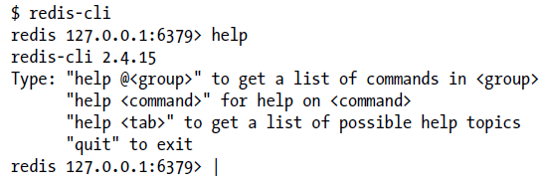
Basics (cont.)
We can start Redis with default settings for the server using redis-server command.
We can connect to Redis using redis-cli tool.

Slide 11
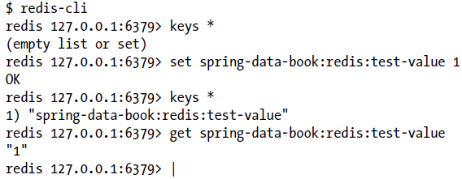
Basics (cont.)
We can set key/value information using the SET command.
To retrieve the value data of key the GET command isused.
In order to retrieve information about key/value pair the keys command is used.
The DEL command can be used to delete key/values pair.

Slide 12
Data Types
Redis maps keys to types of values.
Redis supports not only strings, but also abstract data types:
Lists of strings
Sets of strings (collections of non-repeating unsorted elements)
Sorted sets of strings (collections of non-repeating elements ordered by a floating-point number called score)
Hash tables where keys and values are strings
The type of a value determines what operations (called commands) are available for the value itself.

Slide 13
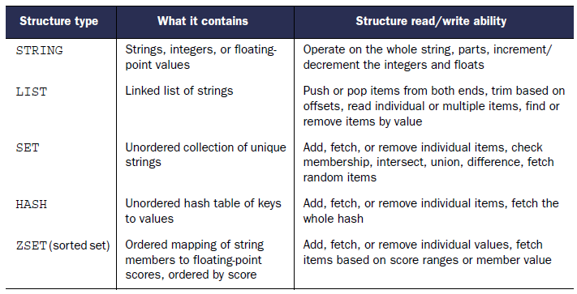
Data Types (cont.)

Slide 14
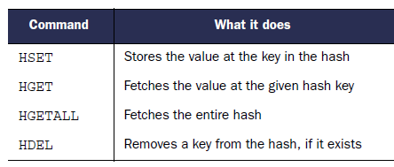
Data Types (cont.)
Strings are the most basic data structures available in Redis.
The command strlen <key> can be used to get the length of a key’s value.
Integer commands: incr, incrby, decr and decrby.
Hashes are like strings.
The important difference is that they provide an extra level of indirection: a field.
Commands used are: hset,hget, hgetall, hkeys, hdel.
hset key1 level 10
hget key1 level
hgetall key1

Slide 15
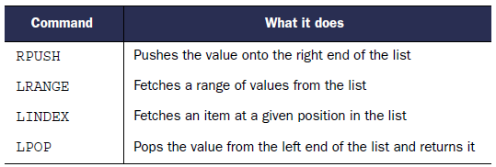
Data Types (cont.)
List represents an ordored sequence of strings.
rpush list-key item
rpush list-key item2

Slide 16
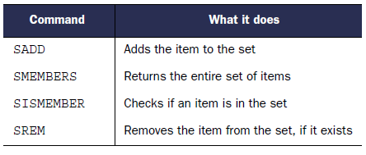
Data Types (cont.)
Sets are used to store unique values and provide a number of set-based operations, like unions.
Sets aren’t ordered but they provide efficient value-based operations.
Commands: sadd, sismember, sinter
sadd friends:leto ghanima paul chani jessica
sismember friends:leto jessica

Slide 17
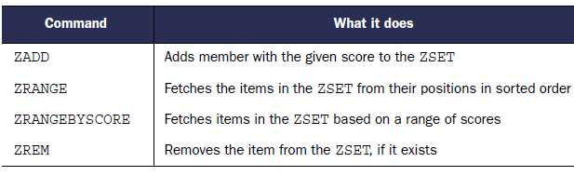
Data Types (cont.)
Sorted Sets is a powerful data structure.
Sorted sets are like sets but with a score.
The score provides sorting and ranking capabilities.
zadd friends:duncan 70 ghanima 95 paul 95 chani 75 jessica 1 vladimir

Slide 18
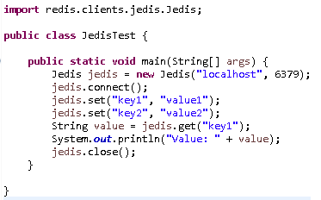
Jedis
Jedis is a redis java client.
Jedis is fully compatible with the redis.

Slide 19
Jedis (cont.)
Features supported:
Sorting
Connection handling
Commands operating on all the kind of values
Commands operating on string values
Commands operating on hashes
Commands operating on lists
Commands operating on sets
Commands operating on sorted sets
Transactions
Pipelining
Publish/Subscribe
Persistence control commands
Remote server control commands
Connection pooling

Slide 20
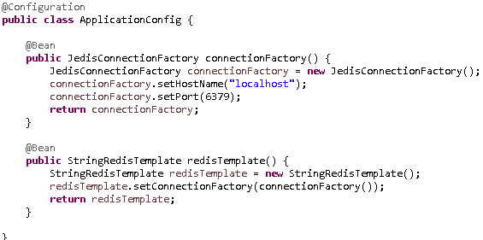
Spring Redis
The Spring Data Redis (or SDR) framework makes it easy to write Spring applications that use the Redis key value store by eliminating the redundant tasks and boiler plate code required for interacting with the store through Spring’s excellent infrastructure support.

Slide 21
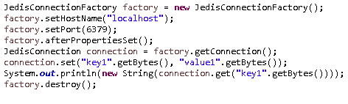
Spring Redis (cont.)
We can create programmatically a JedisConnectionFactory and JedisConnection objects.
LettuceConnectionFactory can be share the same thread-safe native connection for all non-blocking and non-transactional operations

Slide 22
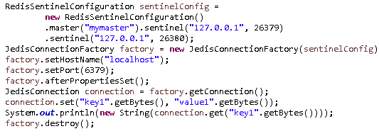
Spring Redis (cont.)
For dealing with high available Redis there is support for Redis Sentinel using RedisSentinelConfiguration.

Slide 23
Spring Redis (cont.)
RedisTemplate is in fact the central class of the Redis module due to its rich feature set.
The template offers a high-level abstraction for Redis interactions.
The template provides operations views that offer rich, generified interfaces for working against a certain type or certain key.

Slide 24
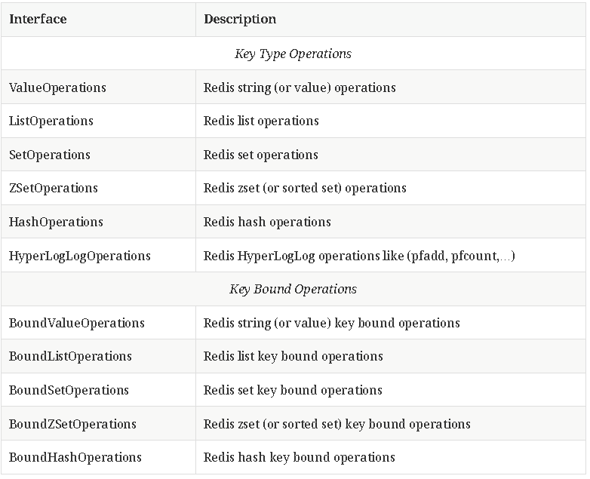
Spring Redis (cont.)

Slide 25
Spring Redis (cont.)
From the framework perspective the data stored in Redis is just bytes.
While Redis supports various types, for the most part these refer to the way the data is stored rather then what it represents.
The conversion between the user (custom) types and raw data (and vice-versa) is handled in Spring Data Redis through the RedisSerializer interface which as the name implies, takes care of the serialization process.
Multiple implementations are available out of the box:
StringRedisSerializer
JdkSerializationRedisSerializer
OxmSerializer (Object/XML mapping)
JacksonJsonRedisSerializer (JSON format)
Jackson2JsonRedisSerializer (JSON format)

Slide 26
Redis vs MemcacheD
Memcached Pros:
Low complexity
Simple to configure
Few command macros == simple to master
Atomic increment and decrement
Simple to cluster -- uses a hashing algorithm at the client to find keys in a cluster
Runs like a rock -- memcached requires a nuclear strike to fall over
Can withstand a member dying
Many years in production
Every programming language has a memcached library.
Memcached Cons:
Doesn't do anything besides be an in-memory key/value store
Caches sharded by client do not scale across AWS zones
Unbalanced memcached clusters require a full system restart
Adding a member to the pool requires reconfiguring and rebooting the client
Seriously doesn't do anything besides be an in-memory key/value store

Slide 27
Redis vs MemcacheD (cont.)
Redis Pros:
Stores data in a variety of formats: list, array, sets and sorted sets
Pipelining! Multiple commands at once
Blocking reads -- will sit and wait until another process writes data to the cache
Mass insertion of data to prime a cache
Does pub/sub... if you want to do pub/sub through your cache
Partitions data across multiple redis instances
Can back data to disk
Redis Cons:
Super complex to configure -- requires consideration of data size to configure well
SENTINEL, the automated failover which promotes a slave to master, is perpetually on the redis unstable branch
Master-slave architecture means if the master wipes out, and SENTINEL doesn't work, the system is sad
Lots of server administration for monitoring and partitioning and balancing...

Slide 28
Redis vs MemcacheD (cont.)
If we need to cache database queries or REST round trips or numbers or page fragments, use memcached.
Most cached data types and caching needs are simple and straight forward.
If we need to do operations on cached datasets at once, or need to spread one enormous cache over a geographically challenged area, or read-write splitting against caching use redis.

Slide 29
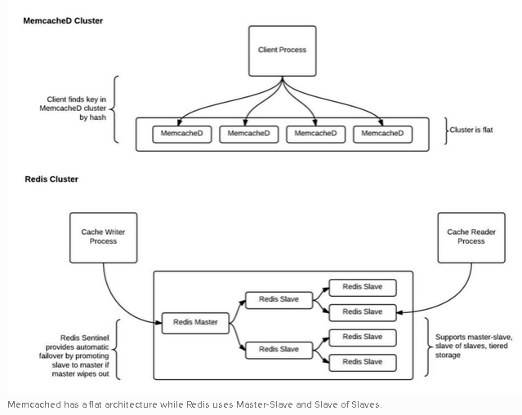
Redis vs MemcacheD (cont.)

Slide 30
Redis Sentinel
Redis Sentinel provides high availability for Redis.
Redis Sentinel provides tasks such as monitoring, notifications and acts as a configuration provider for clients.
Sentinel capabilities:
Monitoring: checks if your master and slave instances are working as expected.
Notification:. can notify the system administrator, another computer programs, via an API, that something is wrong with one of the monitored Redis instances.
Automatic failover: can start a failover process where a slave is promoted to master, the other additional slaves are reconfigured to use the new master
Configuration provider: acts as a source of authority for clients service discovery: clients connect to Sentinels in order to ask for the address of the current Redis master responsible for a given service.

Slide 31

Bibliography
http://en.wikipedia.org/wiki/Redis
Manning – Redis in Action
http://www.bigdatalittlegeek.com/blog/2014/3/25/memcached-vs-redis
http://redis.io/topics/sentinel

