Slide 1

Drools
Dima Ionut Daniel

Slide 2
Contents
What is Drools?
Drools Goals
Drools Concepts
Drools Core
Drools Rules
Distribution
Drools Guvnor
Other Rules Engines
Bibliography

Slide 3

What is Drools?
Drools is a open source business rule management system (BRMS) written in Java.
Drools supports the JSR-94(Java Rules Engine API) standard for its business rule engine.
It is licensed under the Apache License v2.0.
Components of the JBoss Community version:
Drools Guvnor (Business Rules Manager) – a centralized repository for Drools Knowledge Bases
Drools Expert (rule engine) – uses the rules to perform reasoning
Drools Flow (process/workflow), or jBPM 5 – provides for workflow and business processes
Drools Fusion (event processing/temporal reasoning) – provides for complex event processing
Drools Planner (automated planning) – optimizes automated planning, including NP-hard planning problems

Slide 4
Drools Goals
Easier to understand: easier to understand for a business analyst
Dealing with evolving complexity: much easier to add new, modify, or remove existing rules than to change the code.
Flexibility: deals better with changes to the requirements or changes to the data model.
Performance: the performance of the system doesn't depend on the number of rules.
Reusability: The rules are kept in one place.
Unifying: The Drools platform brings unification of rules and processes.
Redeploying: It is possible to change/redeploy rules and processes without even stopping the whole application.

Slide 5
Drools Concepts
Rules
The heart of the Rules Engine where you specify conditions (if ‘a’ then ‘b’).
Facts
Facts are the data on which the rules will act upon.
From Java perspective, Facts are the POJO (Plain Old Java Object).
Agenda
It’s a logical concept.
The agenda is the logical place where activations are waiting to be fired.

Slide 6
Drools Concepts (cont.)
Session
A Knowledge Session in Drools is the core component to fire the rules.
Holds all the rules and other resources.
For the rules engine to work, Facts are inserted into the session and when a condition is met, the subsequent rule gets fired.
A Session is of two types:
Stateless Knowledge Session
Stateful Knowledge Session
Activations
Activations are the then part of the rule. Activations are placed in the agenda where the appropriate rule is fired.

Slide 7
Drools Core
The rules starts with a package name which acts as a namespace for rules.
The rule names within a package must be unique.
The KnowledgeBase interface manages a collection of rules, processes, and internal types.
The knowledge definitions are grouped into knowledge packages.
The knowledge definitions can be added or removed.
The main purpose of the KnowledgeBase object is to store and reuse them, because their creation is expensive; The object maintains a reference to all created knowledge sessions.

Slide 8
Drools Core (cont.)
The StatefulKnowledgeSession interface is an entry/exit point to the Drools engine.
It has methods for inserting, updating, or retracting facts.
The StatefulKnowledgeSessionis object is also used to set a session's global variables.
Event handlers can be registered on the KnowledgeBase object for auditing, debugging, or other purposes.
The objects inserted into rule engine are referred to as a facts.
The fireAllRules method executes the basic rules.

Slide 9
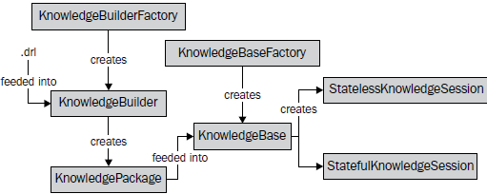
Drools Core (cont.)
The KnowledgeBuilder is responsible for building KnowledgePackages from knowledge definitions (rules, processes, and types).
The knowledge definitions can be in various formats.
If there were any problems with building, the KnowledgeBuilder object will report errors through these two methods: hasErrors and getError.

Slide 10
Drools Core (cont.)
The special characters, # or //, can be used to mark single-line comments.
Global variables are variables assigned to a session. They can be used for various reasons as follows:
For input parameters (for example, constant values that can be customized from session to session).
For output parameters (for example, reporting—a rule could write some message to a global report variable).
Entry points for services such as logging, which can be used within rules.
Functions are a convenience feature. They can be used in conditions and consequences. Functions represent an alternative to the utility/helper classes.

Slide 11
Drools Core (cont.)
Dialect
A dialect specifies the syntax used in any code expression that is in a condition or in a consequence.
The default value is Java.
Drools currently supports one more dialect called MVEL.
Salience
Salience is a very important feature of Rule Syntax.
Salience is used by the conflict resolution strategy to decide which rule to fire first.
By default, it is the main criterion.
The default salience value is 0.

Slide 12
Drools Rules
Drools can work with all the native Java types and more.
Rule imports have the same functions as standard Java imports.
A package is a group of related rules.
Dialect specifies the syntax used in any code expression.
Drools supports following dialects: mvel and java(the default value).

Slide 13
Drools Rules (cont.)
And element: can be implicitly used within conditions. (Ex: Customer( name == "John", age < 26 ) )
Or element: can be used within conditions. (Ex: Customer( name == "John" || age < 26 ) )
Not element: matches on the nonexistence of a fact in the session. (Ex: not Account( type == Account.Type.SAVINGS ) )
Exists element: evaluates to true only if the rule session contains at least one instance of a given type. (Ex: exists Account( type == Account.Type.SAVINGS ) )
Eval element: execute any dialect-specific code that returns true or false.
This element: refer to the current fact.
MemberOf element tests whether an element is in a collection.

Slide 14
Drools Rules (cont.)
Drools comes with these convenient methods for working with the current KnowledgeSession:
modify: updates existing facts in the session.
insert: used for inserting new facts into the session.
retract: is used for removing existing facts from the session.
Rule attributes are used to modify/enhance the standard rule behavior.
All attributes are defined between the rule and when keywords.
salience: is used by the conflict resolution strategy to decide which rule to fire.
no-loop: informs the rule engine that a rule should be activated only once per matched facts.
dialect: specifies the dialect used

Slide 15
Drools Rules (cont.)
Advantages of a Rule Engine:
Logic and Data Separation
The data resides in the Domain Objects and the business logic resides in the Rules.
Declarative Programming
Rules make it easy to express solutions to difficult problems and get the solutions verified as well.
Business Analysts can easily read and verify a set of rules.

Slide 16
Drools Rules (cont.)
Speed and Scalability
With the help of Drools the application becomes very scalable.
If there are frequent change requests, one can add new rules without having to modify the existing rules.
Centralization of Knowledge
By using Rules, you create a repository of knowledge (a knowledge base) which is executable.
Rules are so readable that they can also serve as documentation.

Slide 17
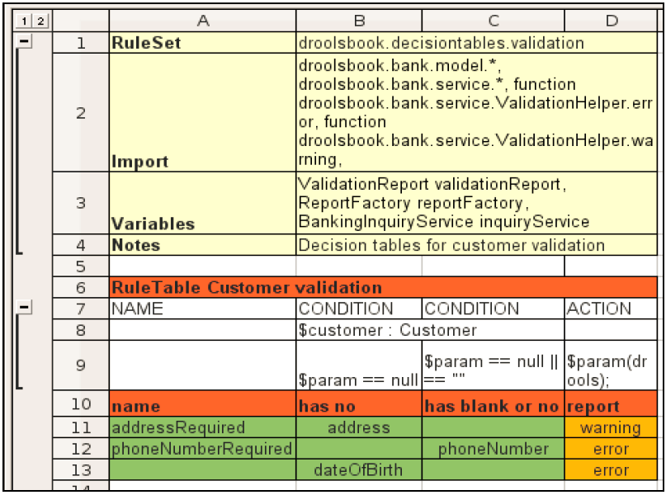
Drools Rules (cont.)
The decision tables are another form of human-readable rules that is useful when there are lots of similar rules with different values.
Rules that share the same conditions with different parameters can be used in a decision table.
Decision tables can be represented in an Excel spreadsheet (the .xls file) or a comma separated value (the .csv file) format.

Slide 18
Drools Rules (cont.)
Every file for defining decision tables starts with a global configuration section.
The configuration consists of the name-value pairs.
RuleSet defines the package
Import specifies the used classes, including static imported functions
Variables are used for globals
Notes can be any text
Functions can be used to write local functions (as in the .drl format)
Worksheet specifies the sheet to be used; by default only the first sheet is checked for rules

Slide 19
Drools Rules (cont.)
The following column types are available:
CONDITION: This defines a single rule condition or constraint and checks whether the following row can contain a type for this condition, and if it doesn't, then the next row must define a full condition.
ACTION: This is a rule action and Drools will then assume that the next line is a method that should be called on this global/variable.
PRIORITY: This is used for defining rule salience.
NAME: By default, rule names are autogenerated, and NAME can be used to explicitly specify the name.
No-loop or Unloop: This specifies the rule No-loop attribute.
XOR-GROUP: This specifies the rule agenda-group.

Slide 20
Drools Rules (cont.)
Advantages of a decision table:
They are easy to read and understand.
They are a very common tool used by analysts.
Refactoring can be quicker.
They provide some separation between the rules and data.
Any formatting available in a spreadsheet editor can be applied to present these data in a more readable manner .
The Eclipse Drools plugin can also be used to validate a spreadsheet.

Slide 21
Drools Rules (cont.)
Disadvantages of a decision table:
They can be difficult to debug/write these rules.
Decision tables shouldn't be used if the rules don't share many conditions.
XLS is a binary format, which makes version management more difficult.

Slide 22
Distribution
Guvnor - Business Rule Management System
Expert - Production Rules
Flow - Workflow
Fusion - Complex Event Processing

Slide 23
Drools Guvnor
BRMS - Business Rule Management System
Centralized knowledgebase
Web-based rule authoring that can manage rules.
Versioning of rules

Slide 24
Drools Guvnor (cont.)
Drools supports JSR 94 standard for its business rule engine and enterprise framework for creating, maintaining of policies in an organization.
The main roles of people who would use Guvnor are: Business Analyst, Rule expert, Developer, Administrators

Slide 25
Other Rules Engines
Other Rules Engine built in Java:
EasyRules
OpenRules
Jess
Zilones

Slide 26

Bibliography
http://en.wikipedia.org/wiki/Drools
http://www.tutorialspoint.com/drools
PacktPub – Drools Developers Cookbook
PacktPub – Drools Jboss Rules 5.X Developers Guide

Slide 27
Questions ?

