Slide 1

JSS 7
Dima Ionut Daniel

Slide 2
Contents
What is JSS?
Features
Architecture
Core
Configuration
SCTP
ASN
ISUP
M3UA
TCAP
SCCP
Bibliography

Slide 3

What is JSS?
Restcomm jSS7 is the only Open Source Java based implementation of the SS7 protocol stack.
Mobicents provides a open source software solution implementing MTP2,3, ISUP, SCCP, TCAP, CAMEL, MAP, INAP protocols for a dedicated equipment and also M3UA (SIGTRAN) over IP.

Slide 4
Features
Provides implementation for MTP2, MTP3, ISUP, SCCP, TCAP, CAMEL (Phase I, Phase II, Phase III and Phase IV) and MAP protocols for a dedicated equipment.
Has in-built support for SIGTRAN (M3UA) over IP.
Restcomm jSS7 is based on an easily scalable and configurable load-balancing architecture.
Restcomm jSS7 comes with JSLEE TCAP, MAP, CAP and ISUP Resource Adaptors (RA).

Slide 5
Features (cont.)
The major functional modules of the jSS7 are:
1. SS7 Service restcomm-ss7-service
2. Signaling Gateway restcomm-ss7-sgw
3. Shell shell
4. SS7 Simulator restcomm-ss7-simulator

Slide 6
Architecture
The Restcomm jSS7 is logically divided into two sections:
The lower section provides implementation for SS7 Level 2 and Level 3. This section is therefore influenced by the type of SS7 hardware (Level 1) used.
The upper section provides implementation for SS7 Level 4 and above.

Slide 7
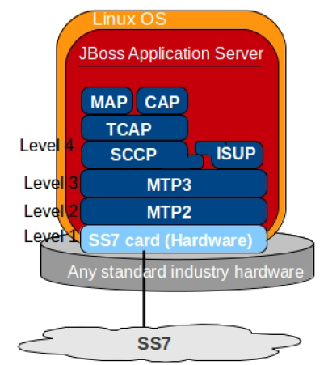
Architecture

Slide 8
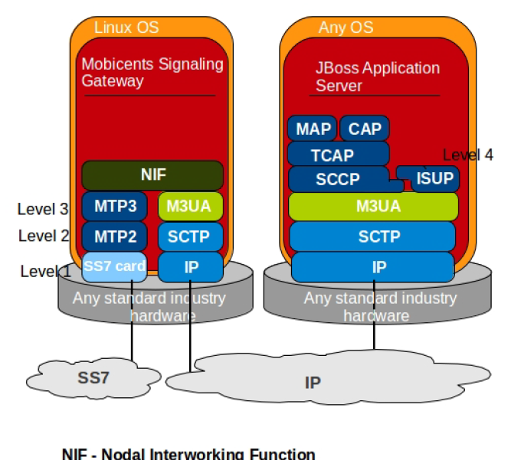
Architecture

Slide 9
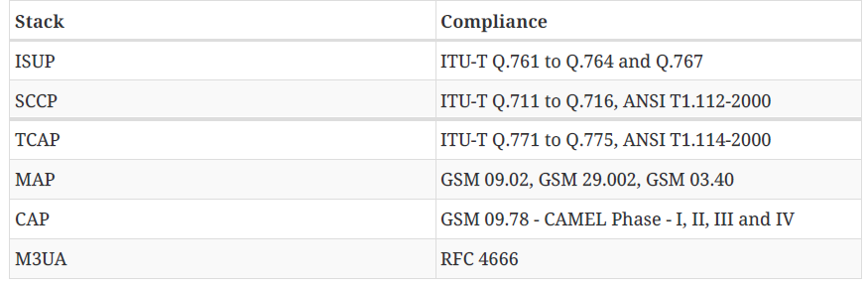
Core
Restcomm jSS7 is a software based implementation of the SS7 protocol.
It provides implementation for Level 2 and above in the SS7 protocol Stack.
Restcomm jSS7 adheres to the standards specified by ITU and ANSI.

Slide 10
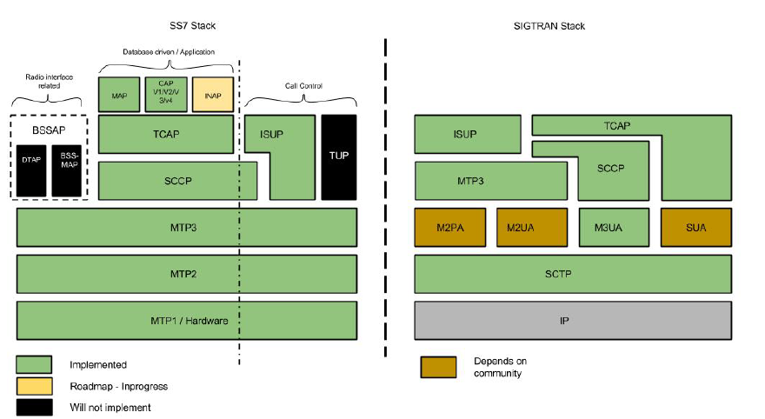
Core (cont.)

Slide 11
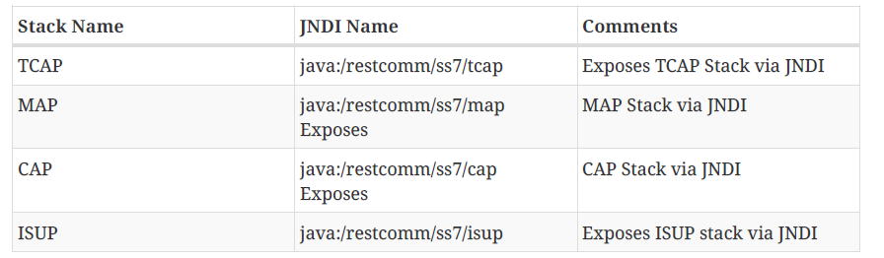
Core (cont.)
M3UA, SCCP and TCAP stacks are compliant with ANSI standard.
ANSI support for MAP, CAP and ISUP is not ready.
SS7 Service creates an instance of higher layer of the Restcomm Stack and binds the instance to JNDI.
SS7 Service is a JMX based service deployed in JBoss Application Server.

Slide 12
Core (cont.)
We can use the shell utility to connect to the SS7 managed instance.
connect <IP > <PORT> (eg: connect 127.0.0.1 3435)
discconnect
We can press TAB to see available commands.

Slide 13
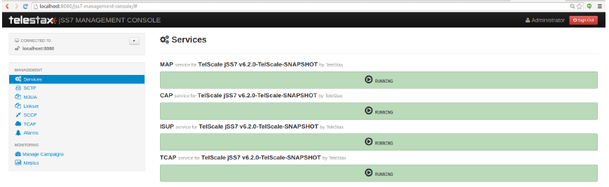
Core (cont.)
We can use also the Web console: http://localhost:8080/jss7-management-console/.

Slide 14
Configuration
Configuration is done through an XML descriptor file named jboss-beans.xml located at $JBOSS_HOME/server/profile_name/deploy/restcomm-ss7-service/META-INF.
Default jboss-beans.xml contains only m3ua usage.
Templates for usage of Dialogic boards or m3ua and Dialogic boards together can be found in the release binaries in folders: ss7/template/META-INF-dialogic and ss7/template/META-INF-m3ua-dialogic.

Slide 15
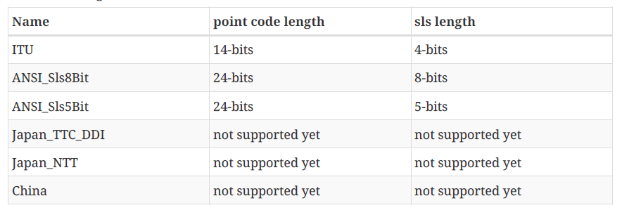
Configuration (cont.)
MTP Level 3 routes messages based on the routing label in the signaling information field (SIF) of message signal units.
The routing label is comprised of the destination point code (DPC), originating point code (OPC), and signaling link selection (SLS) field.
Overtime different standards came up with different routing label format.
For example An ANSI routing label uses 7 octets; an ITU-T routing label uses 4 octets.

Slide 16
Configuration (cont.)
Restcomm jSS7 SCCP allows configuring multiple MTP3 layers for same SCCP stack.
This allows to have multiple local point-code and connecting to various networks while SCCP layer remains same SccpExecutor accepts sccp commands and executes necessary operations.

Slide 17
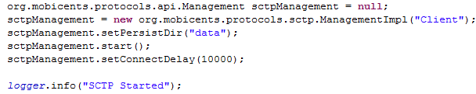

Configuration (cont.)
When sctpManagement.start() is called, jSS7 searches for a file named Client_sctp.xml in the directory path set by user by calling sctpManagement.setPersistDir("<your directory path>").

Slide 18
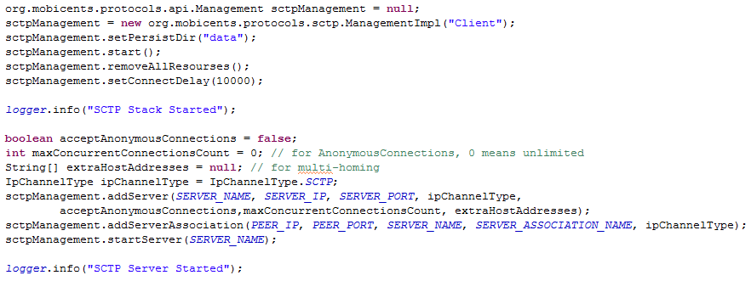
Configuration (cont.)
We need to add the Association and/or Server depending on whether the setup will be acting as client or server or both.
Normally a configured set of Association and/or Server are stored in the xml config file and it's recommended.
If we want to remove all previously configured Associations and Servers we need to call removeAllResourses(), after the Stack is started.

Slide 19
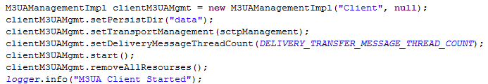
Configuration (cont.)
Once M3UA is configured and started, next step is to add the As, Asp and routing rules for M3UA.
Configured set of As, Asp and routing rules is stored in Client_m3ua1.xml.
If we want to remove all previously configured As, Asp and routing rules you need to call removeAllResourses(), after the Stack is started.

Slide 20
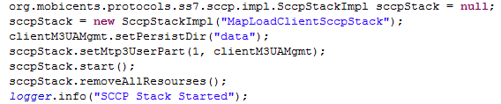
Configuration (cont.)
A set of As, Asp and routing rules depends on whether stack acts as Application Server side or Signaling Gateway side or just peer-to-peer (IPSP) client/server side.
One of the best features of jSS7 is it supports multiple MTP3 layers and we can have combination of many MTP3 layers.

Slide 21
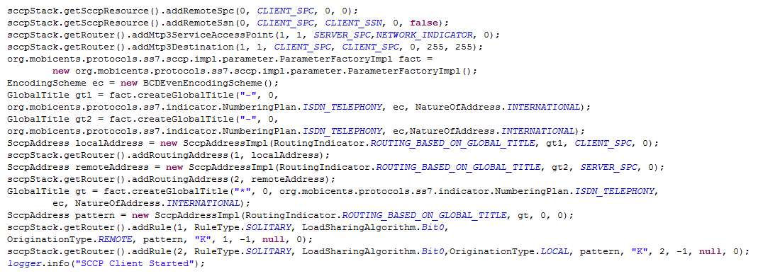
Configuration (cont.)

Slide 22
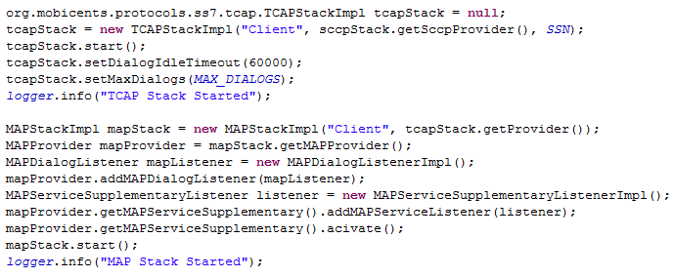
Configuration (cont.)

Slide 23
SCTP
Stream Control Transmission Protocol (SCTP) is a Transport Layer protocol, serving in a similar role to the popular protocols Transmission Control Protocol (TCP) and User Datagram Protocol (UDP).
The protocol was defined by the IETF Signaling Transport (SIGTRAN) working group in 2000 and is maintained by the IETF Transport Area (TSVWG) working group.
RFC 4960 defines the protocol.
RFC 3286 provides an introduction.

Slide 24
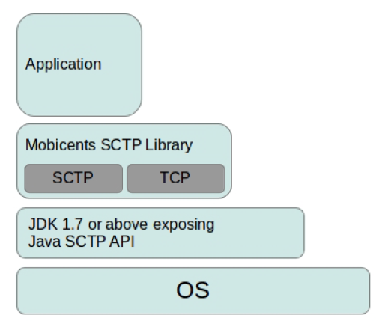
SCTP (cont.)
Restcomm SCTP Library is providing the convenient API’s over Java SCTP, hence can be used only with version JDK 1.7 or above.
Restcomm SCTP Library can also create the TCP sockets exposing same high level API’s hence application using Restcomm SCTP Library can work seamless with TCP or SCTP.

Slide 25
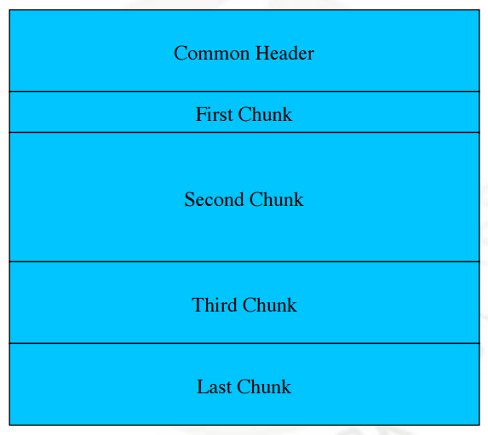
SCTP (cont.)
SCTP message format:

Slide 26
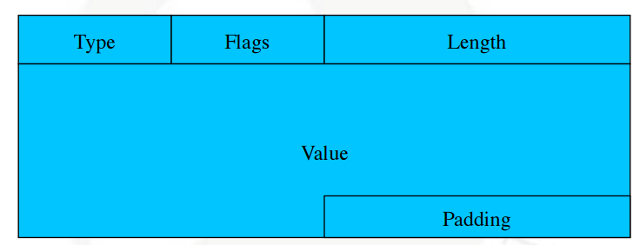
SCTP (cont.)
SCTP chunk format:

Slide 27
SCTP (cont.)
SCTP Chunk Types:
INIT, INIT-ACK, COOKIE-ECHO, COOKIE-ACK.
DATA, SACK.
SHUTDOWN, SHUTDOWN-ACK, SHUTDOWNCOMPLETE.
HEARTBEAT, HEARTBEAT-ACK.
ERROR, ABORT.
FORWARD-TSN.
ASCONF, ASCONF-ACK.
AUTH.

Slide 28
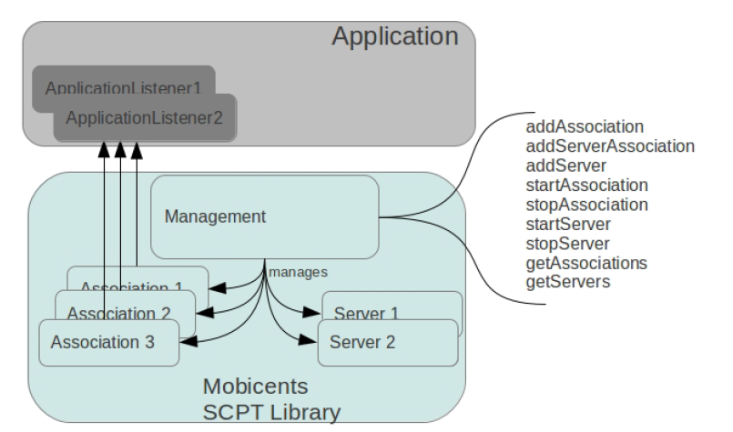
SCTP (cont.)

Slide 29
SCTP (cont.)
The SCTP library is acting as server side waiting for client to connect or client side initiating connection.
The management controls the associations and servers.
The Application can execute commands to create/delete associations/servers.
Association is a protocol relationship between endpoints.
The Application using Restcomm SCTP Library calls management interface to create new instance of association and keeps reference to this instance for lifetime of association for sending the PayloadData.

Slide 30
ASN
Abstract Syntax Notation One (ASN.1) is the standard for describing data structures in telecommunication and computer networking world.
ASN.1 provides a set of formal rules for describing the structure of objects.
The specification describes abstract objects that are independent of machine-specific encoding techniques.

Slide 31
ASN (core.)
ASN defined data can be encoded using one of these encoding rules:
Basic Encoding Rules (BER)
Canonical Encoding Rules (CER)
Distinguished Encoding Rules (DER)
XML Encoding Rules (XER)
Packed Encoding Rules (PER)
Generic String Encoding Rules (GSER)

Slide 32
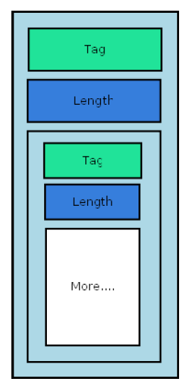
ASN (core.)
Encoded data structure contains three elements:
Tag: Unique value, which identifies the type of data.
Length: Indicates the length of the current data structure.
Payload: Depending on the definition, this can be a simple value (like an integer), or it can carry another ASN encoded data structure.

Slide 33
ISUP
The ISDN (Integrated Services Digital Network) User Part or ISUP is part of the Signaling System No. 7.
It is used to set up telephone calls in the public switched telephone network (PSTN).
An ISUP message contains a fixed header containing the circuit identification code and the ISUP message type, followed by other fields.
These messages are transmitted in various stages of call setup and release.

Slide 34
ISUP (cont.)
The most common messages are:
Initial address message (IAM) — First message sent to inform the partner switch that a call has to be established on the CIC contained in the message. Contains the called number, type of service (speech or data) and optional parameters.
Subsequent address message (SAM) — For networks that support overlap dialing procedures, and then in the case that the IAM did not contain the full called number, one or more SAMs follow containing additional digits. This message is not supported by networks that only support en bloc dialing procedures.

Slide 35
ISUP (cont.)
Address complete message (ACM) — Message returned from the terminating switch when the subscriber is reached and the phone starts ringing, or when the call traverses an interworking point and the intermediate trunk is seized.
Call progress (CPG) — Contains additional information about the progress of a call. Normally sent after the ACM when the status of the call changes from that reported in the ACM.
Answer message (ANM) — Sent when the subscriber picks up the phone, a resource is connected or answer supervision is returned by an interworking point. Normally charging starts at this moment. It is required that the call be cut through in both directions by this point.

Slide 36
ISUP (cont.)
Connect (CON) — Sent when the call is answered by an automatic terminal. This message replaces the ACM, CPG and ANM for calls that are answered by automatic terminals.
Release (REL) — Sent to clear the call when a subscriber goes on hook. This is also sent (in direct response to an IAM) if the terminating switch determines that the call cannot be completed. In either case, the terminating switch provides a cause value in the message to explain the reason for the release, e.g., "User busy".
Release complete (RLC) — Acknowledgment of the release – the circuit is idle afterward and can be used again.

Slide 37
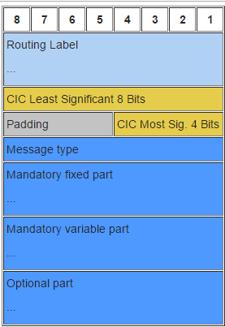
ISUP (cont.)
Signalling Information Field (SIF) for all ISUP Message Signal Units (MSU) contain the following components:
Routing Label
Circuit Identification Code
Message Type
Mandatory Fixed Part
Mandatory Variable Part
Optional Part

Slide 38
M3UA
M3UA is a protocol for supporting the transport of any SS7 MTP3-User signaling (e.g., ISUP and SCCP messages) over IP using the services of the Stream Control Transmission Protocol.
It can be used between a Signaling Gateway (SG) and a Media Gateway Controller (MGC) or IP-resident Database, or between 2 IP-based applications.

Slide 39
M3UA (cont.)
Terminology:
Application Server (AS):
A logical entity serving a specific Routing Key.
The AS contains a set of one or more unique Application Server Processes, of which one or more is normally actively processing traffic.
Application Server Process (ASP):
A process instance of an Application Server.
Contains an SCTP endpoint and may be configured to process signaling traffic within more than one Application Server.

Slide 40
M3UA (cont.)
Association:
An association refers to an SCTP association.
The association provides the transport for the delivery of MTP3-User protocol data units and M3UA adaptation layer peer messages.
IP Server Process (IPSP):
A process instance of an IP-based application.
is essentially the same as an ASP, except that it uses M3UA in a point-to-point fashion.
Layer Management:
is a nodal function that handles the inputs and outputs between the M3UA layer and a local management entity.

Slide 41
M3UA (cont.)
MTP:
The Message Transfer Part of the SS7 protocol.
MTP3:
MTP Level 3, the signalling network layer of SS7.
MTP3-User:
Any protocol normally using the services of the SS7 MTP3 (e.g., ISUP, SCCP, TUP, etc.).
Signalling Gateway Process (SGP):
A process instance of a Signalling Gateway.
It serves as an active, backup, load-sharing, or broadcast process of a Signalling Gateway.

Slide 42
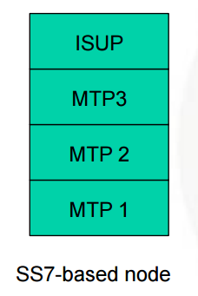
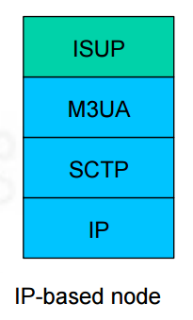
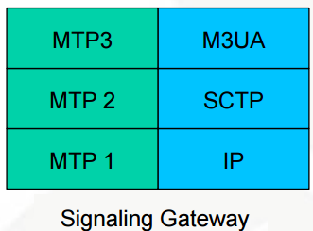
M3UA (cont.)

Slide 43
TCAP
TCAP supports the exchange of non-circuit related data between applications across the SS7 network using the SCCP connectionless service.
Queries and responses sent between SSPs and SCPs are carried in TCAP messages.
In mobile networks (IS-41 and GSM), TCAP carries Mobile Application Part (MAP) messages sent between mobile switches and databases to support user authentication, equipment identification, and roaming.

Slide 44
TCAP (cont.)
Transaction Capabilities Application Part, from ITU-T recommendations Q.771-Q.775 or ANSI T1.114 is a protocol for Signalling System 7 networks.
TCAP is used to transport INAP in Intelligent Networks and MAP in mobile phone networks.

Slide 45
TCAP (cont.)
TCAP messages are sent over the wire between machines.
TCAP primitives are sent between the application and the local TCAP stack.
All TCAP messages are primitives but there are primitives that are not messages.
A TCAP primitive is made up of one or more TCAP components.

Slide 46
TCAP (cont.)
An ITU-T TCAP primitive may be one of the following types:
Unidirectional: a single primitive with no subsequent primitives. Sometimes referred to as a Notice.
Begin: start a dialog, further primitives will follow.
Continue: send a subsequent primitive on an existing dialog, further primitives will follow.
End: the last primitive on an existing dialog, Close an existing dialog.
Abort: an error has caused the dialog to close.
Cancel: the invoke timer has expired without a response being received (this is a primitive but not a message)

Slide 47
SCCP
The Signalling Connection Control Part (SCCP) is a network layer protocol that provides extended routing, flow control, segmentation, connection-orientation, and error correction facilities in Signaling System 7 telecommunications networks.
SCCP relies on the services of MTP for basic routing and error detection.
SCCP provides connectionless and connection-oriented network services and global title translation (GTT) capabilities above MTP Level 3.
Although MTP provides routing capabilities based upon the Point Code, SCCP allows routing using a Point Code and Subsystem number or a Global Title.

Slide 48

Bibliography
http://www.itu.int/rec/T-REC-Q/en/
https://tools.ietf.org/html/rfc4666
https://en.wikipedia.org/wiki/Transaction_Capabilities_Application_Part
https://en.wikipedia.org/wiki/Signalling_Connection_Control_Part
SS7 Stack User Guide

