Slide 1

LMStudio
Dima Ionut Daniel

Slide 2
Contents
What is LMStudio?
History
Features
Architecture
Models
Core
Conclusion
Bibliography

Slide 3


What is LMStudio?
LM Studio is a desktop application that allows users to run and interact with large language models (LLMs) locally on their own computer.
It provides a simple interface to download, manage, and chat with open-source AI models offline, while also offering developer tools like a local API server for building AI applications.

Slide 4
History
LM Studio was created in 2023 by Yagil Burowski and developed by Element Labs with the goal of making local AI accessible to a wider audience. Its development was strongly influenced by the rapid rise of open-source large language models such as LLaMA, which made it possible to run powerful AI systems outside the cloud.
The first public version of LM Studio was released in May 2023, offering a simple interface where users could download models and chat with them locally on their own computers. This marked an important shift toward more private and offline AI usage.

Slide 5
History (cont.)
Throughout 2024, the platform expanded significantly, adding cross-platform support and improving performance. As adoption grew, LM Studio introduced more advanced features, including the ability to interact with personal documents (RAG), enhanced developer tools, and better optimization for different hardware setups.
By 2025, LM Studio had become one of the most popular tools for running local LLMs, supported by funding and a growing user base. Development continued into 2026 with further improvements such as server (headless) mode, faster processing, and a more refined user experience.
Overall, LM Studio evolved quickly from a simple local chatbot interface into a comprehensive platform for running, testing, and integrating AI models directly on personal devices.

Slide 6
Features
Core Features
Run LLMs locally (offline) on your computer
Chat interface (GUI) for easy interaction
Cross-platform support (Windows, macOS, Linux)
Works with multiple model families (LLaMA, Mistral, Gemma, etc.)
Model Management
Built-in model browser (Hugging Face integration)
Search, filter, and download models inside the app
Supports GGUF & MLX model formats
Shows model size, quantization, and VRAM requirements
Chat & Interaction
Chat with models in real time
Chat with your own documents (RAG)
Split-view chat (compare outputs)
Chat export & history management

Slide 7
Features (cont.)
Developer Features
OpenAI-compatible local API server
REST API endpoints (e.g., /v1/chat)
SDK support (Python, TypeScript)
Developer mode + in-app documentation
Can run without GUI (server/CI deployment)
Performance & Optimization
GPU + CPU acceleration support
GPU layer control (VRAM optimization slider)
Continuous batching (parallel requests)
KV caching (faster multi-turn chats)
Flash Attention (speed & memory optimization)
AI Capabilities
Supports agent-like workflows & tool usage
Structured outputs (JSON, etc.)
Works with embedding models for RAG
Enables local AI app development

Slide 8
Features (cont.)
Privacy & Control
100% local processing (no data sent to cloud)
No tracking or data collection
Full control over models and data
UI & Usability
Beginner-friendly Discover page for models
Modern UI with split view & controls
Adjustable context length & inference settings

Slide 9
Architecture
LM Studio is designed with a layered architecture that enables local execution of large language models efficiently and privately.
User Interface (UI)
Desktop application (chat-style interface)
Handles user input and displays responses
Model selection and configuration tools
Conversation history and prompt controls
Application Core
Manages workflow between UI and model engine
Handles prompt processing and context management
Controls sessions and response streaming

Slide 10
Architecture (cont.)
Inference Engine (Backend)
Runs LLMs locally on CPU or GPU
Built on optimized runtimes (e.g., llama.cpp)
Generates tokens and streams responses in real time
Optimizes performance based on hardware
Model Layer
Stores downloaded models locally (disk-based)
Supports formats like GGUF
Runs quantized open-source models (LLaMA, Mistral, etc.)
Optimized for memory and speed efficiency
Local API Server
OpenAI-compatible REST API
Enables integration with external applications
Supports automation and custom AI workflows

Slide 11
Models
LM Studio supports a wide range of open-source large language models (LLMs) that can run locally on your computer. These models are typically optimized versions designed for efficiency and performance on consumer hardware.
LLaMA family (Meta AI)
LLaMA 2 and LLaMA 3 variants
Strong general-purpose reasoning and chat ability
Widely used benchmark models for local AI
Mistral models
Mistral 7B, Mixtral (Mixture-of-Experts)
High performance with lower compute requirements
Good balance between speed and quality
Google open models
Gemma models (2B, 7B, etc.)
Lightweight and efficient
Suitable for fast local inference

Slide 12
Models (cont.)
Multimodal models (limited support)
Some models can handle text + images (experimental)
Example families: LLaVA-based models
Quantized models (important concept)
GGUF format models (core format used in LM Studio)
Smaller, faster versions of large models
Allow running AI on laptops and consumer GPUs

Slide 13
Models (cont.)
Microsoft / Phi models
Phi-2, Phi-3 family
Small models with surprisingly strong reasoning
Optimized for low-resource devices
Code-focused models
Code LLaMA
DeepSeek Coder
StarCoder models
Used for programming, code generation, debugging

Slide 14
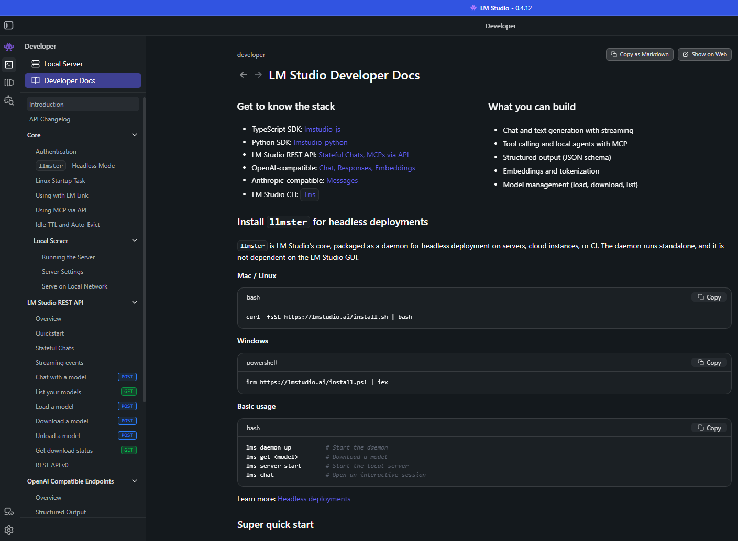
Core
LMStudio has a nice GUI but also can be used from CLI.

Slide 15
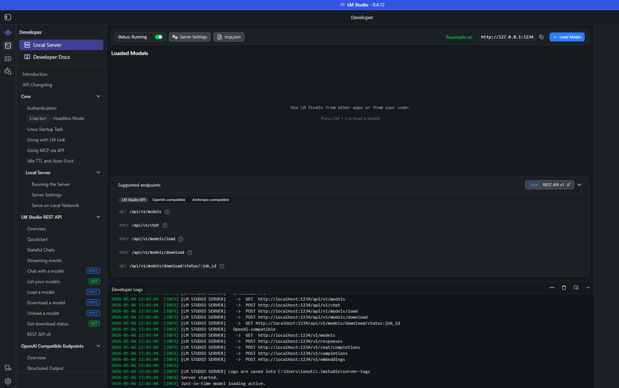
Core (cont.)
We can start local Open AI alike server to be used, it will start on port 1234

Slide 16
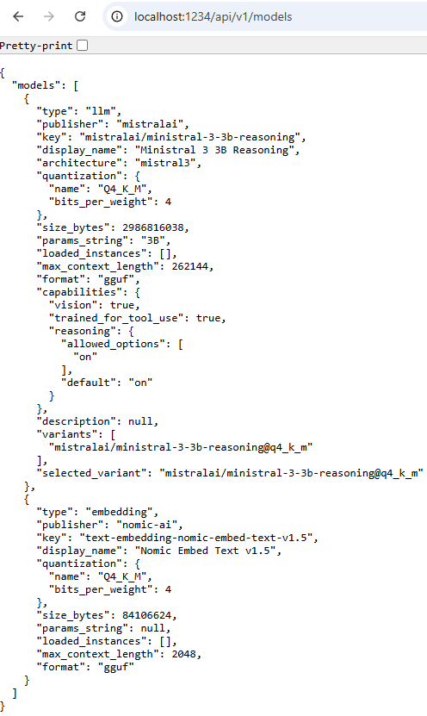
Core (cont.)
The local server in LM Studio exposes an OpenAI-compatible API, so most endpoints mirror OpenAI’s structure but run fully locally.
Once the Open AI alike server is started we can access it’s endpoints from base URL http://localhost:1234

Slide 17
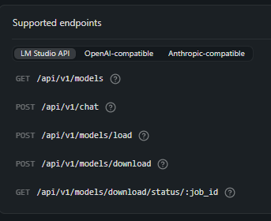
Core (cont.)
LM Studio Native API (Internal Control Layer)
Used for full local system control and model management.
GET /api/v1/models
List all available models
POST /api/v1/chat
Native chat endpoint (LM Studio format)
POST /api/v1/models/load
Load a model into memory
POST /api/v1/models/download
Download a model from the library
GET /api/v1/models/download/status/:job_id
Check download progress
Purpose:
Low-level control of models and runtime inside LM Studio.

Slide 18
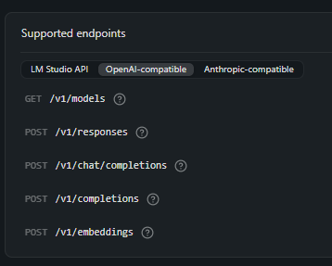
Core (cont.)
OpenAI-Compatible API (Developer Standard)
Used to integrate with existing AI apps and frameworks.
GET /v1/models
List available models
POST /v1/chat/completions
Chat-based generation (ChatGPT-style)
POST /v1/completions
Classic text completion
POST /v1/embeddings
Generate vector embeddings
POST /v1/responses (newer abstraction layer)
Unified structured response format
Purpose:
Drop-in replacement for OpenAI API (local instead of cloud).

Slide 19
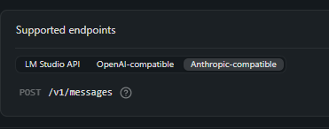
Core (cont.)
Anthropic-Compatible API (Claude-style)
Used for apps designed around Claude’s API format.
POST /v1/messages
Chat interaction using message-based format
Purpose:
Compatibility with Anthropic/Claude-based applications.

Slide 20
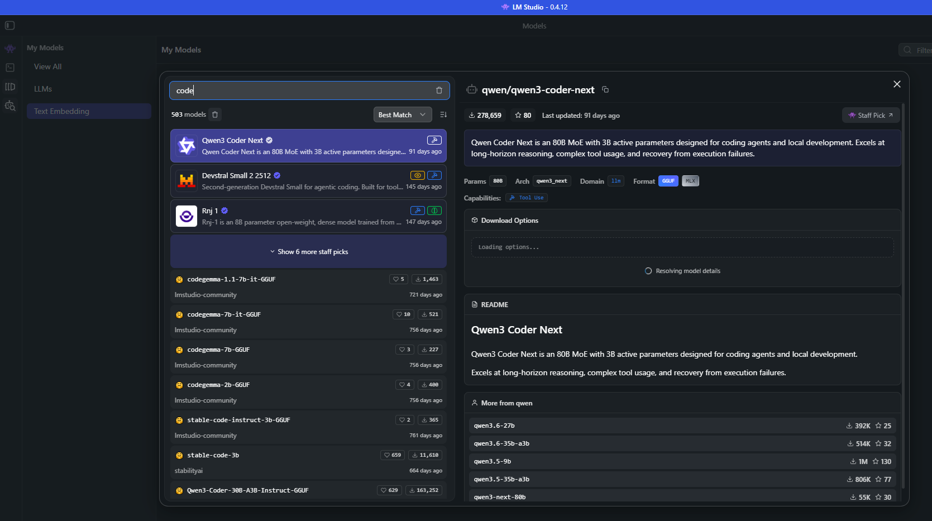
Core (cont.)
We can choose what models to download and interact from the GUI.

Slide 21
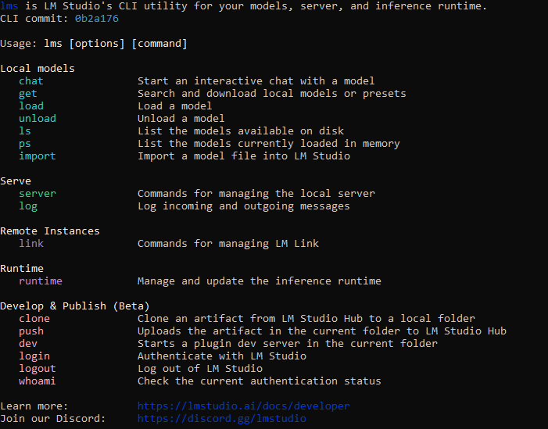
Core (cont.)
lms is the command-line interface tool used to control models, run inference, and manage the local server.

Slide 22
Core (cont.)
Local Model Management
lms chat
Starts an interactive chat session with a selected model (terminal-based chat).
lms get
Searches and downloads models or presets from the LM Studio library.
lms load
Loads a model into memory so it can be used for inference.
lms unload
Removes a model from memory to free system resources.
lms ls
Lists all models stored on your device.
lms ps
Shows models currently running in memory.
lms import
Imports a local model file into LM Studio.

Slide 23
Core (cont.)
Server Management
lms server
Starts or manages the local API server (used for app integration).
lms log
Displays request/response logs from the server for debugging.
Runtime Control
lms runtime
Manages and updates the inference engine (model execution backend).
Remote / Cloud Features
lms link
Manages connections to LM Studio remote instances (LM Link).

Slide 24
Core (cont.)
Development & Publishing (Advanced)
lms clone
Downloads projects or artifacts from LM Studio Hub.
lms push
Uploads local projects to LM Studio Hub.
lms dev
Starts a development server for plugin building.
Authentication
lms login
Logs into LM Studio account.
lms logout
Logs out of the account.
lms whoami
Shows current logged-in user status.

Slide 25
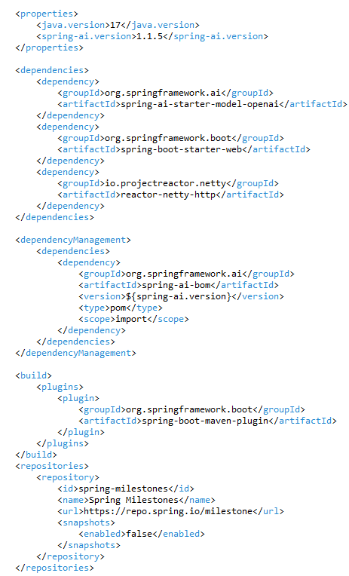
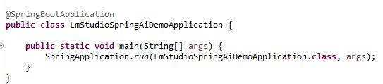
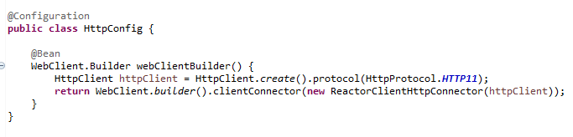
Core (cont.)
We can use Spring AI to interact with LM Studio, OpenAI API compatible.
We enforce HTTP1/1 protocol instead of default HTTP/2.

Slide 26
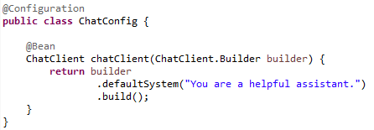
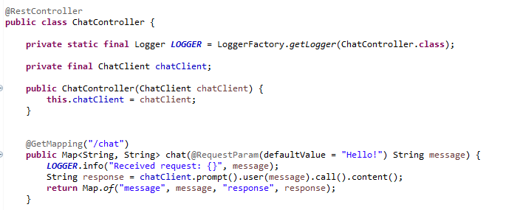
Core (cont.)
We create an AI agent exposed via REST Controller.

Slide 27
Conclusion
Pros:
Runs fully offline (no internet required)
Strong data privacy (nothing leaves your device)
No API costs (free after setup)
Easy to use with GUI (no coding needed)
Supports many open-source LLMs
Built-in chat interface + local API server
Cons:
Requires powerful hardware (RAM/GPU limitations)
Models are often smaller/less capable than cloud models
Setup & model downloads can be large and slow
Limited performance speed on weaker machines
No automatic updates like cloud AI services
Fewer advanced features compared to enterprise platforms

Slide 28

Bibliography
https://lmstudio.ai/

