Slide 1

Kubernetes
Dima Ionut Daniel

Slide 2
Contents
What is Kubernetes ?
History
Features
Arhitecture
Core
Cloud Providers
Conclusions
Bibliography

Slide 3

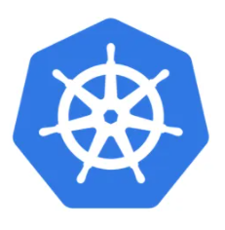
What is Kubernetes ?
Kubernetes is an open-source container-orchestration system for application deployment, scaling and management.
It was designed by Google and now is maintained by the Cloud Native Computing Foundation.
It works with containers tools and runs containers in a cluster, with images build using Docker.

Slide 4
What is Kubernetes ? (cont)
Many cloud services offer a Kubernetes-based platform or infrastructure as a service (PaaS or IaaS) on which Kubernetes can be deployed as a platform-providing service.
Many vendors also provide their own branded Kubernetes distributions.

Slide 5
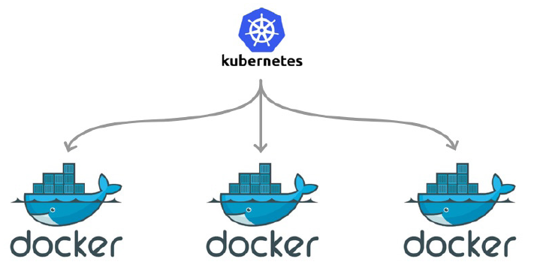
What is Kubernetes ? (cont)
Docker and Kubernetes are complementary technologies.
Kubernetes orchestrates deployments of containers and will instruct Docker to fire up the containers.
Kubernetes is the orchestrator and Docker is the container runtime engine.

Slide 6
History
Kubernetes was founded by Joe Beda, Brendan Burns and Craig McLuckie.
The original codename within Google was Project 7, referring to the Star Trek ex-Borg character Seven of Nine.
The original Borg project was written entirely in C++, but the rewritten Kubernetes system is implemented in Go.
Kubernetes v1.0 was released on 21 July 2015.

Slide 7
Features
Automated rollouts and rollbacks
Kubernetes progressively rolls out changes to your application or its configuration, while monitoring application health to ensure it doesn't kill all your instances at the same time.
If something goes wrong, Kubernetes will rollback the change for you.
Take advantage of a growing ecosystem of deployment solutions.
Storage orchestration
Automatically mount the storage system of your choice, whether from local storage, a public cloud provider such as GCP or AWS, or a network storage system such as NFS, iSCSI, Gluster, Ceph, Cinder, or Flocker.
Automatic bin packing
Automatically places containers based on their resource requirements and other constraints, while not sacrificing availability.
Mix critical and best-effort workloads in order to drive up utilization and save even more resources.

Slide 8
Features (cont.)
IPv4/IPv6 dual-stack
Allocation of IPv4 and IPv6 addresses to Pods and Services
Self-healing
Restart's containers that fail, replaces and reschedules containers when nodes die, kills containers that don't respond to your user-defined health check, and doesn't advertise them to clients until they are ready to serve.
Service discovery and load balancing
No need to modify your application to use an unfamiliar service discovery mechanism.
Kubernetes gives Pods their own IP addresses and a single DNS name for a set of Pods and can load-balance across them.

Slide 9
Features (cont.)
Secret and configuration management
Deploy and update secrets and application configuration without rebuilding your image and without exposing secrets in your stack configuration.
Batch execution
In addition to services, Kubernetes can manage your batch and CI workloads, replacing containers that fail, if desired.
Horizontal scaling
Scale your application up and down with a simple command, with a UI, or automatically based on CPU usage.
Designed for extensibility
Add features to your Kubernetes cluster without changing upstream source code.

Slide 10
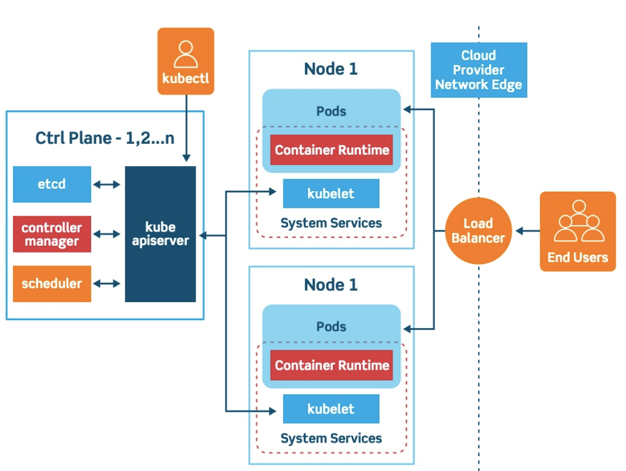
Arhitecture

Slide 11
Architecture (cont.)
Kubernetes defines a set of building blocks called primitives, which provides a mechanism that deploys, maintain and scale applications based on CPU, memory or custom metrics.
Kubernetes is loosely coupled and extensible to meet different workloads.
Kubernetes follows the primary/replica architecture.
The components of Kubernetes can be divided into those that manage an individual node and those that are part of the control plane.

Slide 12
Core
Master components globally monitor the cluster and respond to cluster events.
The are 5 master components:
kube-apiserver - REST API endpoint to server as frontend for K8S control plane
etcd - key value store for the cluster data
kube-scheduler - watches new workloads/pods and assigns them to a node
kube-controller-manager - central controller that watches the node, replication set, endpoints
cloud-controller-manager - interacts with underlying cloud provider to manage resources

Slide 13
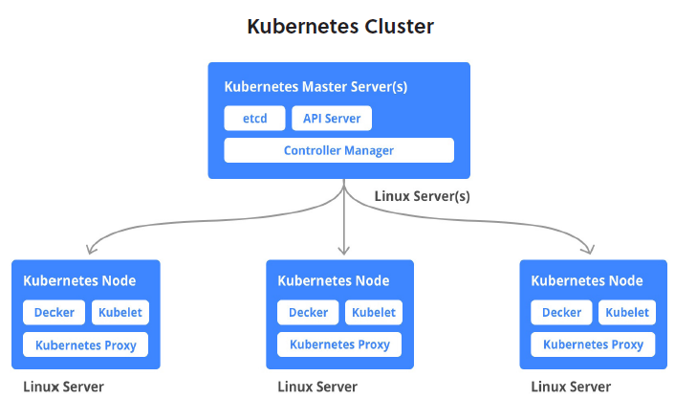
Core (cont.)
Node components run on every node.
kubelet - agent running on the node to inspect health and report to master
kube-proxy - maintains the network rules
container runtime - software for running the containers

Slide 14
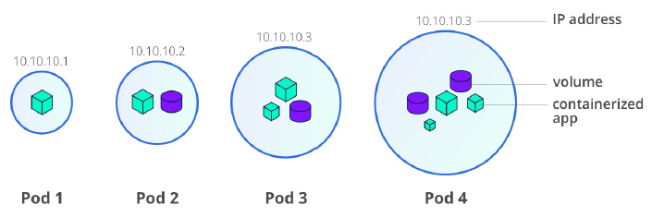
Core (cont.)
Kubernetes workloads are divided into 2 major components:
pods (basic building block)
controllers (ReplicaSet, Deployment, StatefulSet, CronJob,etc).
A pod is the smallest and simplest unit in its object model.
A pod encapsulates 1 or more containers as well as storage resources, an IP address and rules on how the container(s) should run.

Slide 15
Core (cont.)
Pods are meant to be an atomic unit in K8S and they run a single instance of a given application.
However sometimes a multi-container pod makes sense if they are closely-related.
In a typical deployment, pods are not directly created by programmer. Instead the controller schedule a pod to run on a node.
A pod can only exists on a single node.
A pod can never be in a partially-deployed state. If a pert of the pod never comes up it's considered unhealthy and fails.
A pod is not healed but rather treated as a disposable component. If a pod becomes unhealthy, the controller will kill the pod and start up another pod, replacing rather than healing it.

Slide 16
Core (cont.)
Pods are usually deployed indirectly via controllers.
ReplicaSet deploys specified replicas of the pod.
Deployments allow for rolling updates and easy rollbacks on top of ReplicaSets.
StatefulSets are like Deployments, but it maintains a "sticky identity" for each of the pods.
CronJobs manage time-based jobs.

Slide 17
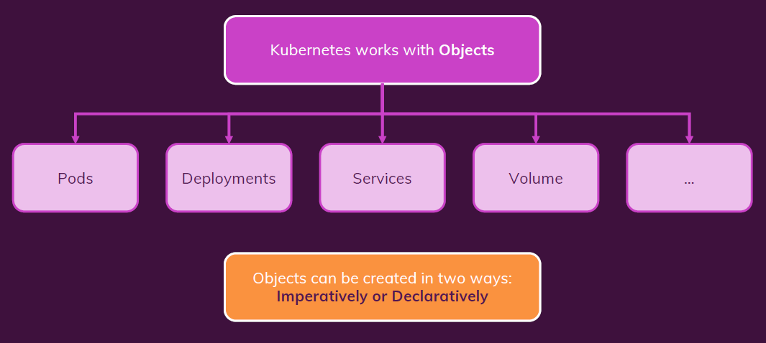
Core (cont.)

Slide 18
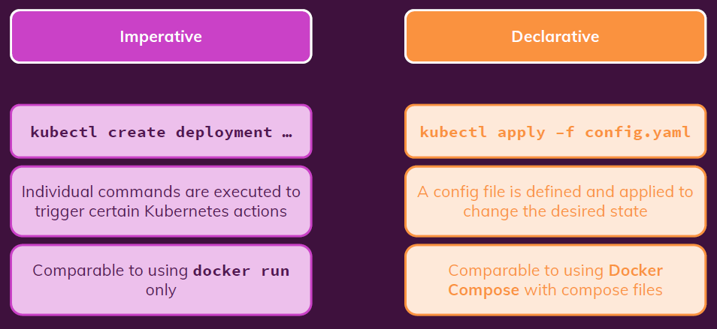
Core (cont.)

Slide 19
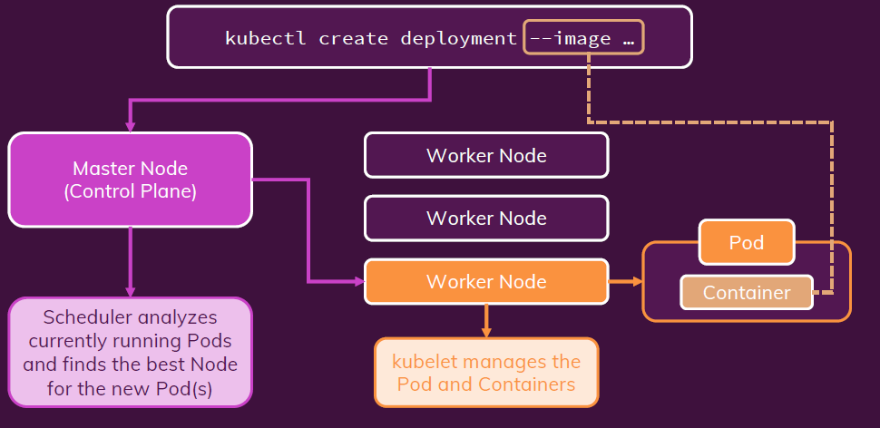
Core (cont.)

Slide 20
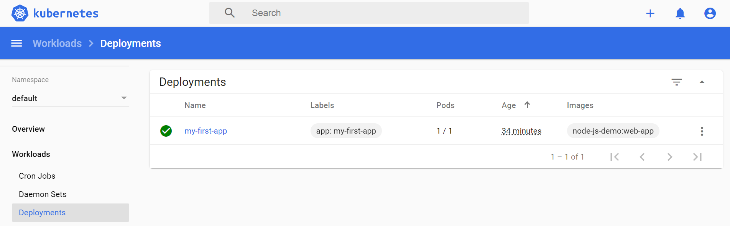
Core (cont.)
Sample deployment command: “kubectl create deployment my-first-app --image=node-js-demo:web-app”
From the K8S Dashboard we can see the deployment.

Slide 21

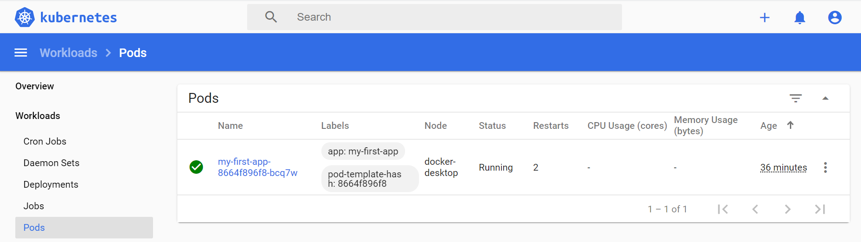
Core (cont.)
After we create a deployment, a pod will be spawn and we can expose the port of the application from the container using the command: "kubectl expose deployment my-first-app --type=LoadBalancer --port=8080“ .
Possible expose types: ClusterIP (default value), LoadBalancer, ExternaName, Headless.
From the K8S Dashboard we can see the spawn pod or by calling from command line: “kubectl get pods”

Slide 22
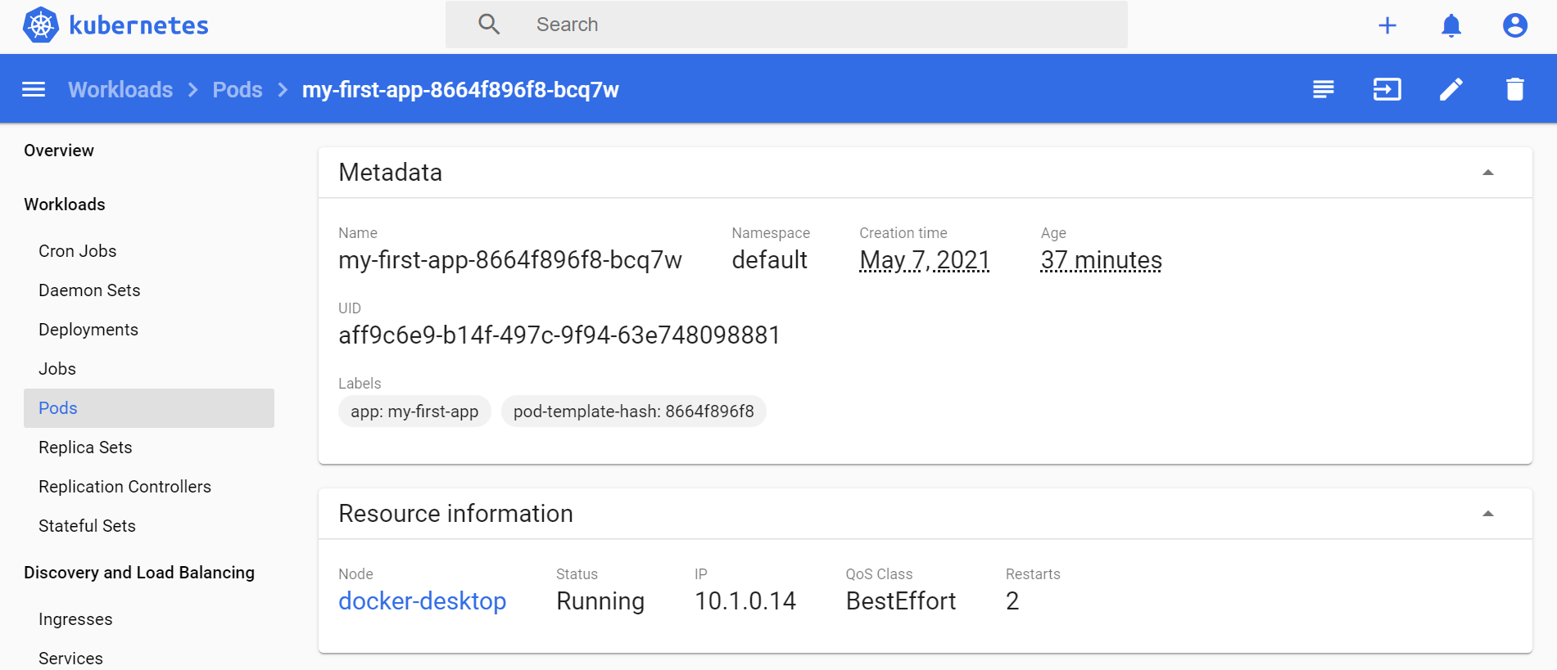
Core (cont.)
Extra details for a running pod.

Slide 23
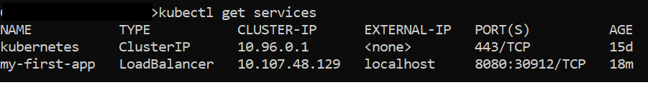
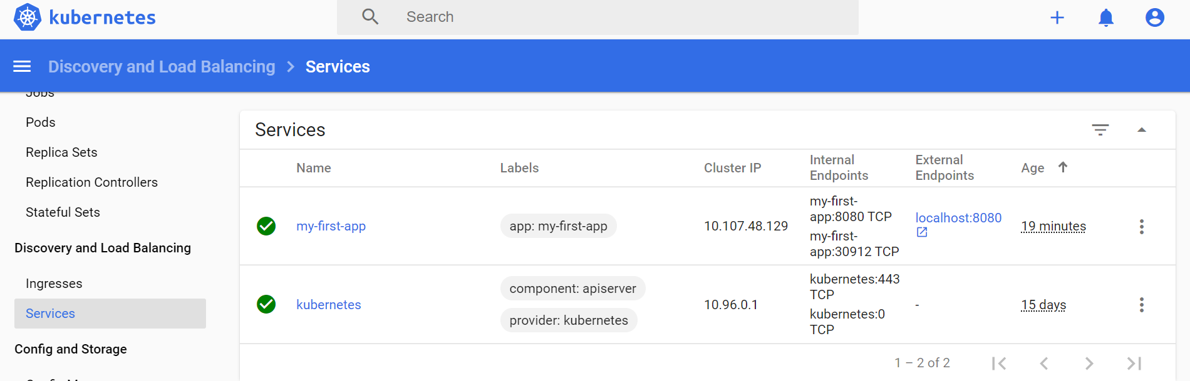
Core (cont.)
After we expose the pod deployment, we can see extra details in the Services tab, or calling the command: “kubectl get services”

Slide 24
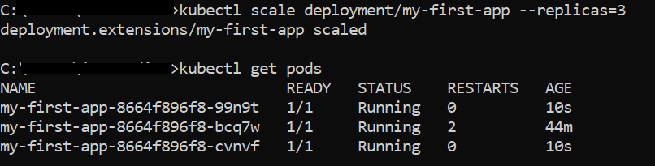
Core (cont.)
We can scale a deployment by using the command “kubectl scale deployment/my-first-app –replicas=3”

Slide 25
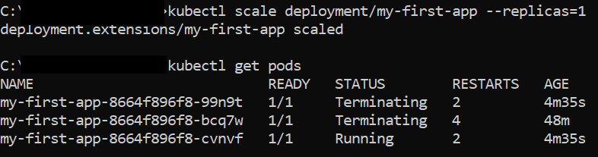

Core (cont.)
We can rollback the changes by typing the same command but with replicas parameter set to 1.
The other 2 pods will have the status “Terminating” and at the end will de removed.

Slide 26

Core (cont.)
We can update deployments if we change the contents of the docker images, using the command: “kubectl set image deployment/my-first-app node-js-demo=node-js-demo:web-app2”
We can check the rollout status of the deployment by using the command: “kubectl rollout status deployment/my-first-app”

Slide 27
Core (cont.)
To undo to a previous deployment, we need to run the following command: "kubectl rollout undo deployment/my-first-app“.
To jump to a specific deployment, we us the extra parameter --to-revision as: "kubectl rollout undo deployment/my-first-app --to-revision=1“
To check the history of the deployments we need to run the command: “kubectl rollout history deployment/my-first-app”

Slide 28
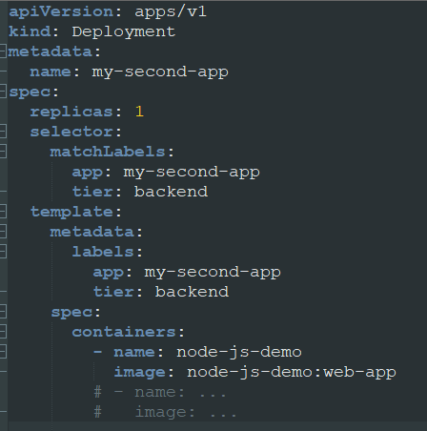
Core (cont.)
We can write and load a deployment using the command: “kubectl apply -f deployment.yaml”
Contents of deployment.yaml file listed bellow:

Slide 29
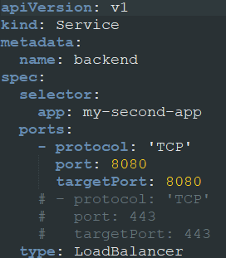
Core (cont.)
Services can be load using the same command: “kubectl apply -f services.yaml”
Contents of services.yaml file listed bellow:

Slide 30
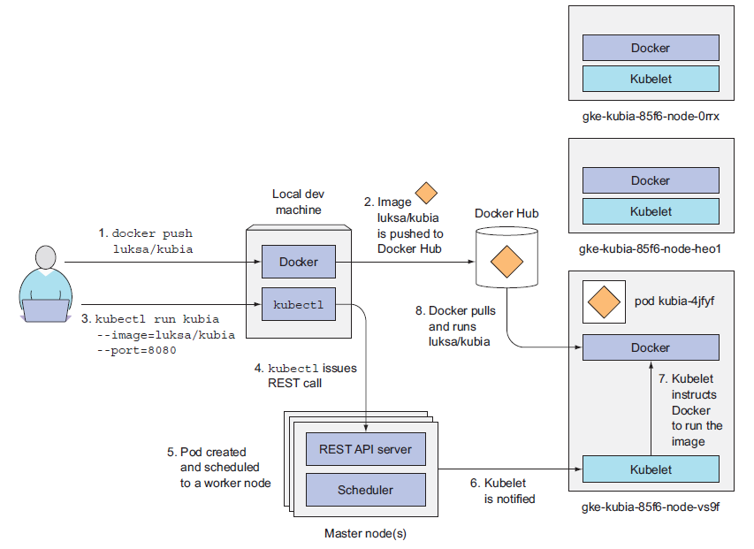
Core (cont.)
K8S usage on local machine.

Slide 31
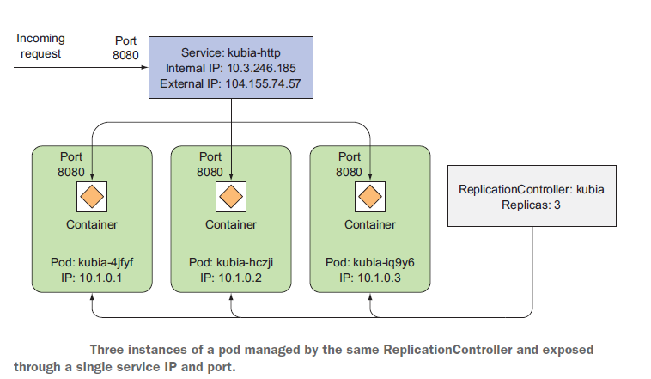
Core (cont.)
Scaling example:

Slide 32
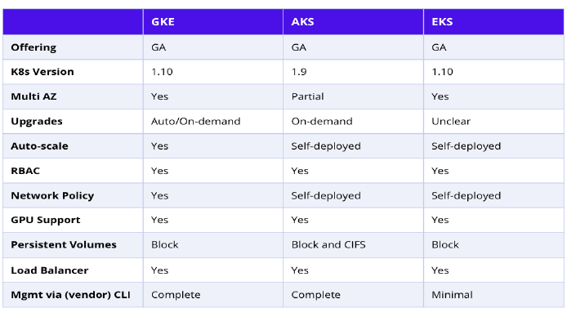
Cloud Providers
There are 3 major Kubernetes cloud providers:
Amazon Elastic Container Service for Kubernetes (Amazon EKS)
Azure Kubernetes Service (AKS)
Google Kubernetes Engine (GKE)

Slide 33
Conclusions
Pros:
Can improve productivity
Is a future proof solution
Help to make the application run more stable
Can be cheaper than other alternatives
Cons:
Can be an overkill for simple applications
Is very complex and the transition can be cumbersome
Can be more expensive than its alternatives

Slide 34

Bibliography
https://en.wikipedia.org/wiki/Kubernetes
https://platform9.com/blog/kubernetes-enterprise-chapter-2-kubernetes-architecture-concepts/
https://kubernetes.io/
Leverege – An Introduction to Kubernetes
Manning – Kubernetes in Action
Udemy – Docker & Kubernetes: The Practical Guide

