Slide 1

AngularJS
Dima Ionut Daniel

Slide 2
Contents
What is AngularJS?
Goals
Architecture
Features
Core
Directives
Filter and Modules
Forms
Services
Routing
Testing
Conclussion
Bibliography

Slide 3

What is AngularJS?
AngularJS is an JS open-source web application framework maintained by Google.
Provides a framework for client-side model–view–controller (MVC) architecture along with components commonly used in rich Internet applications.
AngularJS de-emphasizes DOM manipulation with the goal of improving testability and performance.

Slide 4
Goals
decouple DOM manipulation from application logic.
decouple the client side of an application from the server side.
provides structure for the building an application: from designing the UI, through writing the business logic, to testing.

Slide 5
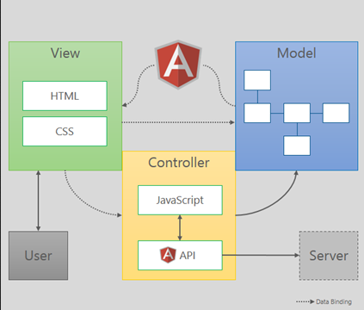
Architecture
View →presentation of data in a particular format
Model →responsible for managing application data
Controller → responds to user input and performs interactions on the data model

Slide 6

Architecture (cont.)
AngularJS components:
Controllers - essential component
View/Directives - communicate with user interaction
Services - contain real business logic

Slide 7
Features
AngularJS features:
Two way bindings – merging data between Model and HTML elements
Dirty checking - allows Angular to watch for variables that may or may not exist.
Dependency Injection – resolves and injects dependencies
Directives – for writing templates in HTML

Slide 8
Core
The HTML code that tells Angular we want our page to be dynamically controlled is :
<html ng-app="myApp">
<head></head>
<body></body>
</html>

Slide 9
Core (cont.)
The tasks performed by the bootstrapper occur in three phases after the DOM has been loaded:
Creation of a new Injector
Compilation of the directives that decorate the DOM
Linking of all directives to scope
AngularJS directives allow the developer to specify custom and reusable HTML-like elements and attributes that define data bindings and the behavior of presentation components.

Slide 10
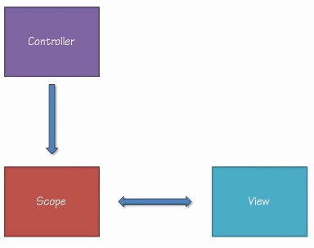
Core (cont.)
Controller communicates with the view using the $scope variable.
The primary responsibility of the controller is to create the $scope.

Slide 11
Directives
AngularJS uses directives to augment HTML with extra functionality.
Directives are a convenient way to declaratively call JavaScript functions.
Directives, in Angular JS, are essentially JavaScript functions that are invoked when the Document Object Model (DOM) is compiled by the Angular JS framework.
In AngularJS, expressions are not evaluated against the global window object; instead, they are evaluated against a scope object.

Slide 12
Directives (cont.)
Directives can be declared as:
As an attribute: <span my-directive></span>
As an element: <my-directive></my-directive>
As a class: <span class="my-directive: expression;"></span>
As a comment: <!-- directive: my-directive expression -->

Slide 13
Directives (cont.)
Event directives:
ngClick
ngDblClick
ngMousedown
ngMouseenter
ngMouseleave
ngMousemove
ngMouseover
ngMouseup
ngChange

Slide 14
Directives (cont.)
ng-app → Declares the root element of an AngularJS application, under which directives can be used to declare bindings and define behavior.
ng-bind → Sets the text of a DOM element to the value of an expression.
ng-model →Similar to ng-bind, but establishes a two-way data binding between the view and the scope.
ng-model-options → Allows tuning how model updates are done.
ng-class →Allows class attributes to be dynamically loaded.
ng-controller →Specifies a JavaScript controller class that evaluates HTML expressions.
ng-repeat →Instantiate an element once per item from a collection.

Slide 15
Directives (cont.)
ng-show & ng-hide → Conditionally show or hide an element.
ng-switch →Conditionally instantiate one template from a set of choices.
ng-view →The base directive responsible for handling routes that resolve JSON before rendering templates driven by specified controllers.
ng-if →Basic if statement directive that allow to show the following element if the conditions are true.
ng-aria →A module for accessibility support of common ARIA attributes.
ng-animate →A module provides support for JavaScript, CSS3 transition and CSS3 keyframe animation hooks within existing core and custom directives

Slide 16
Directives (cont.)
The ng-show directive can display or hide content.
<p ng-show="true">Visible 1</p>
<p ng-show="false">Not visible 2</p>
<p ng-show="1 == 1">Visible 3</p>
<p ng-show="1 == 2">Not visible 4</p>

Slide 17

Directives (cont.)
Every time user clicks the button the count variable incremented.
<!doctype html>
<html ng-app>
<head>
<script src="js/angular.min.js"></script>
</head>
<body>
<button ng-click="count = count + 1" ng-init="count = 0">Increment</button>
count: {{count}}
</body>
</html>

Slide 18
Directives (cont.)
Every time user

Slide 19
Filter and Modules
AngularJS filters format the value of an expression for display to the end user.
They don’t actually change the underlying data, but they do change how it is displayed in the particular case in which the filter is applied.
AngularJS ships with a very handy set of filters:
number
lowercase
date
limitTo
json

Slide 20
Filter and Modules (cont.)
<html><head>
<script src="js/angular.min.js"></script>
<script>
var someData = {
firstName: 'JENNA',
surname: 'GRANT',
dateJoined: new Date(2010, 2, 23),
consumption: 123.659855,
plan: 'super-basic-plan'
};
angular.module('myAppName', [])
.controller('FirstCtrl', function($scope) {
$scope.data = someData;
});
</script>
</head>
<body ng-controller="FirstCtrl">
<p>Consumption: {{data.consumption | number }}</p>
</body></html>

Slide 21
Filter and Modules (cont.)
<html><head>
<script src="js/angular.min.js"></script>
<script>
var someData = {
monthlyUsageHistory:[1,2,3,4,5,6]
};
angular.module('myAppName', [])
.controller('FirstCtrl', function($scope) {
$scope.data = someData;
});
</script>
</head>
<body ng-controller="FirstCtrl">
<ul>
<li ng-repeat="gigabytes in data.monthlyUsageHistory | limitTo:5">
{{ gigabytes | number:3}}
</li>
</ul>
</body></html>

Slide 22
Filter and Modules (cont.)
A module is a collection of controllers, directives, filters, services, and other configuration information.
The default module is the module that AngularJS will use as the entry point into your application.
// Create a new module
var myAppModule = angular.module('myAppModule', []);
// configure the module with a controller
myAppModule.controller('MyFilterDemoCtrl', function ($scope) {
// controller code would go here
});

Slide 23
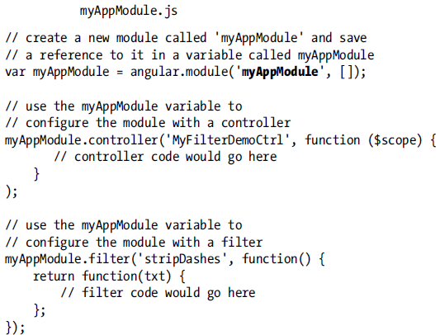
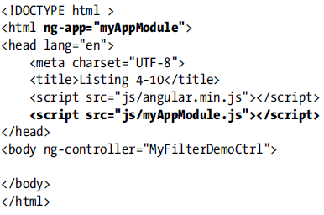
Filter and Modules (cont.)
We can create an angular module and import it in an html page for usage.

Slide 24
Forms
AngularJS relies upon some relatively new, though well supported, HTML5 features when working with forms.
The form element defines the form and contains input elements.
Input elements can be of type:
button
checkbox
file
hidden
image
password
radio
reset
submit
text

Slide 25
Forms (cont.)
We can bind data in Angular using the ng-model directive.
<input type="text" name="firstName" ng-model="firstName"/>
<form name="registrationForm" ng-submit="person.register()">
On submit button the register function will be called.
$scope.person.register = function () {
<!-- pending implementation -->
}

Slide 26
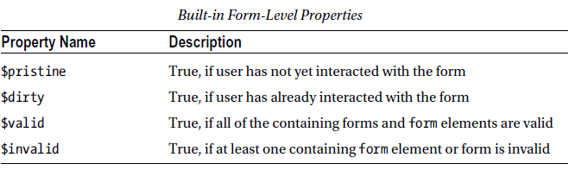
Forms (cont.)
We need to validate the data that users enter into our forms.
Validation can and should be done on the server, and that server-side processes are usually capable of handling much more complex validation rules, we still have to perform first-line-of-defense validation in the web browser.

Slide 27
Services
Service encapsulates business logic, it's a worker object.
Services are often stateless.
Services aren't necessarily over-the wire.
Services are reusable, easy to maintain.
SRP(Single Responsibility principles).
Services can be injected (in controllers,filters).
Services are easy to test.

Slide 28
Services (cont.)
The $window service is essentially a reference to the browser’s window object.
The $location Service is based on window.location object.
The $document Service refers to the window.document object.
The $resource service is similar to $http, but is for REST calls.
The $compile service used internally by AngularJs
The $parse service similar to $compiler service.

Slide 29
Services (cont.)
The $cacheFactory service used for caching features.
The $anchorScroll service is used to scrolling(, using anchors).
The $local service used for localization date,time.
The $timeout service to launch timeouts.
The $filter service has access to custom filters.
The $cookieStore service used for cookies.
The $exceptionHandler service used for error handling.

Slide 30
Services (cont.)
Angular services provide a mechanism for keeping data around for the lifetime of an application and for communicating across controllers in a consistent manner.
myAppName.factory('dateTimeService', function () {
var dateTimeSvc = {};
dateTimeSvc.getDate = function () {
return new Date().toDateString();
}
dateTimeSvc.getTime = function () {
return new Date().toTimeString();
}
return dateTimeSvc;
});

Slide 31
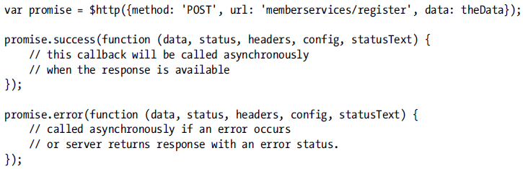
Services (cont.)
The $http service can be use to simulate the XMLHttpRequest object, for communicating with servers.
Ajax is a technique for communicating asynchronously with servers.

Slide 32
Routing
AngularJS excels when it comes to the creation of single-page applications(SPAs).
With an SPA:
- we can provide a much more responsive user experience
- decrease the load on our web servers

Slide 33
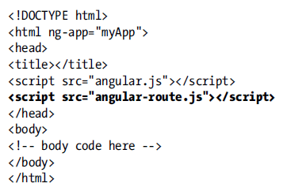
Routing (cont.)
As the Angular routing system is defined within an optional module called ngRoute.

Slide 34
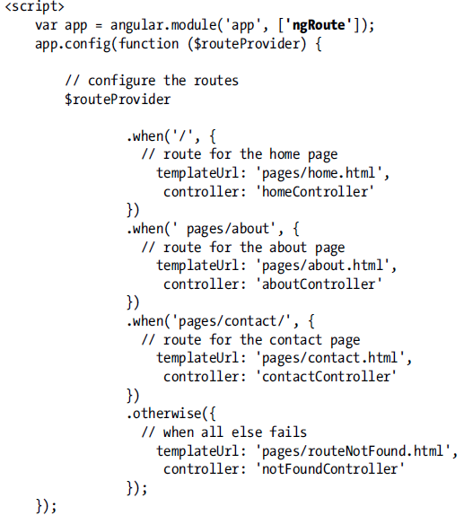
Routing (cont.)

Slide 35
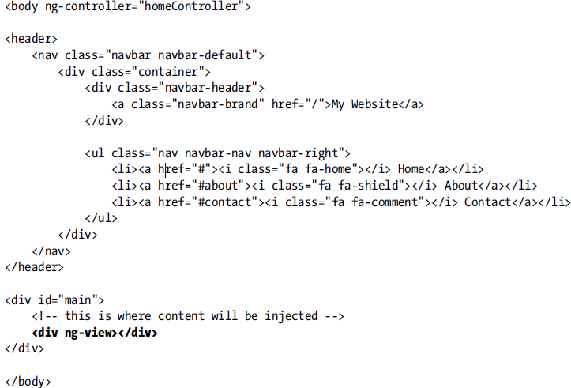
Routing (cont.)

Slide 36
Testing
Karma
testing automation tool, former name as "Testacular"
independent of Angular
very fast, specially when using Chrome.
Karma can be installed using npm(node js package manager);

Slide 37
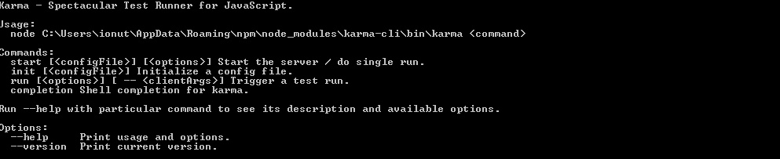
Testing (cont.)
In order to install deps: npm install –g karma karma-chrome-launcher karma-jasmine

Slide 38
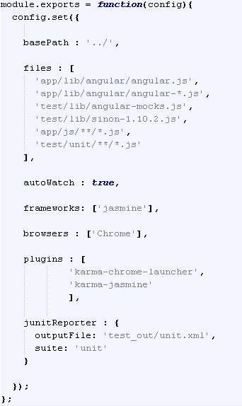
Testing (cont.)
In order to start testing use karma start karma.conf.
Karma will open the browser and start testing the files.

Slide 39
Conclussion
Angular is developed by Google.
Angular has lots of features, extensions.
Angular it’s comprehensive.

Slide 40

Bibliography
http://en.wikipedia.org/wiki/AngularJS
Apress – Beginning AngularJS
Pluralsight - AngularJS Fundamentals by Eames, Cooper

Slide 41
Questions ?

