Slide 1

Playwright
Dima Ionut Daniel

Slide 2
Contents
What is Playwright?
History
Features
Goals
Arhitecture
Core
Locators
Assertions
Debugging
Playwright vs Selenium
Best Practices
Conclusion
Bibliography

Slide 3


What is Playwright?
Playwright is an open-source browser automation framework developed by Microsoft for reliable end-to-end testing of modern web applications. It supports Chromium, Firefox, and WebKit browsers through a single, consistent API.
Playwright supports programming languages like JavaScript, Python, C# and Java, though its main API was originally written in Node.js.
It supports all modern web features including network interception and multiple browser contexts and provides automatic waiting, which reduces the flakiness of tests.

Slide 4
History
Playwright was announced by Microsoft in January 2020.
It was developed to address the need for a unified API for cross-browser testing and to overcome limitations in existing tools like Puppeteer, Cypress and Selenium.
A team of engineers, including those who had previously worked on Puppeteer at Google, contributed to its development.
The stable 1.0 release arrived May 6, 2020, featuring auto-waiting, network interception, and multi-browser support from day one.
Rapid evolution followed with test runner integration, device emulation, and CI/CD compatibility, reaching over 62k GitHub stars by 2024.

Slide 5
Features
Auto-waiting: Automatically waits for elements to be actionable, eliminating flaky tests from timing issues.
​Network interception: Mock and modify API requests/responses for precise test control.
​Device emulation: Simulates mobile devices, viewports, geolocation, and permissions.
​Browser contexts: Run isolated sessions in one browser for parallel testing and multi-user scenarios.
​Code-gen tool: Records actions to generate test code in Java, JS, Python, or .NET.
​Test runner: Built-in support for fixtures, retries, parallel execution, and CI/CD integration.

Slide 6
Goals
Cross-browser reliability: Provide consistent automation for Chromium, Firefox, and WebKit without configuration differences.
​Flake elimination: Deliver resilient tests through auto-waiting and web-first assertions that eliminate timing-related failures.
​No compromises on scenarios: Support complex workflows spanning multiple tabs, origins, users, and contexts without limitations.
​Full isolation and speed: Achieve test independence via isolated browser contexts with minimal overhead for fast parallel execution.
​Modern web coverage: Handle SPAs, mobile emulation, network control, and shadow DOM natively for comprehensive testing.

Slide 7
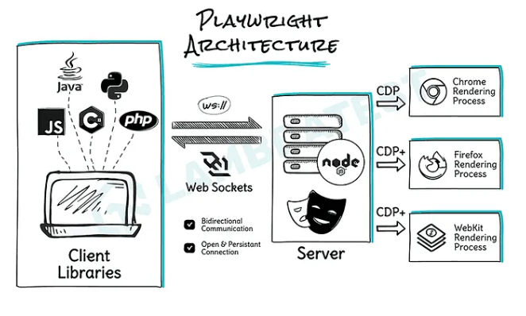
Arhitecture

Slide 8
Arhitecture (cont.)
Key Architectural Elements
Playwright client:
  test scripts are written, using Playwright’s API bindings for languages like JavaScript, Python, Java, and .NET.
Playwright server:
  acts as the intermediary, translating client commands into browser-understandable instructions and managing browser instances.
  the server is powered by Node.js, even if you’re not directly using JavaScript or Node in your test code.
WebSockets:
  Playwright utilizes WebSockets for efficient, bidirectional communication between the client and server, running over TCP.
  This persistent connection significantly enhances speed compared to HTTP’s request-response model.
  while the initial connection is over HTTP, it is then upgraded to a websocket connection.
​CDP (Chrome DevTools) is the protocol originally developed by the Chrome team to remotely control and inspect Chromium-based browsers (like Chrome, Edge).

Slide 9
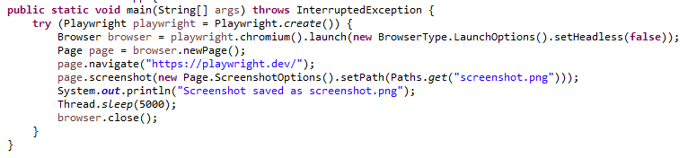
Core
We need to add this dependency in our maven project
<dependency>
  <groupId>com.microsoft.playwright</groupId>
  <artifactId>playwright</artifactId>
  <version>1.57.0</version>
  </dependency>
Bellow is an example how to launch Chromium in GUI mode.

Slide 10
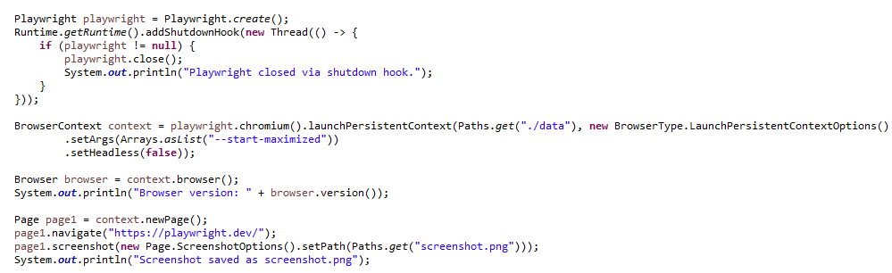
Core (cont.)
We can launch Playwright using consistent data storage (non incognito)

Slide 11
Core (cont.)
Core framework elements:
  Playwright
  Browser
  BrowserContext
  Page
  Locators

Slide 12
Core (cont.)
Playwright
  Playwright playwright = Playwright.create();
  The main engine that starts everything.
  The factory that can launch browsers.
  Starts the Playwright process
  Gives access to browser types: chromium(), firefox() , webkit()
  It manages the connection between your Java code and the browser engines.

Slide 13
Core (cont.)
Browser
  Browser browser = playwright.chromium().launch();
  An actual running browser instance.
  Opens a real browser process
  Can run headless or headed
  Hosts multiple BrowserContexts
  One Browser can contain multiple isolated contexts.

Slide 14
Core (cont.)
BrowserContext
  An isolated session inside the browser.
  Each context has:
    Separate cookies
    Separate local storage
    Separate session storage
    Separate cache
  We can simulate different users

Slide 15
Core (cont.)
Page
  Page page = context.newPage();
  A single browser tab.
  A tab inside an incognito window.
  Almost all test logic happens on the Page: navigation, clicking, typing, assertions, screenshots, network interception

Slide 16
Core (cont.)
Locators
  A Locator is a smart way to find elements on a page.
  page.locator("#login-button").click();
  Unlike Selenium, Playwright does NOT immediately fetch the element.
    It waits until the element is:
    Attached to DOM
    Visible
    Enabled
    Stable
    This reduces flaky tests dramatically.

Slide 17
Locators
Locators
Locator Method | Description | Java Example
page.locator(selector) | CSS, XPath, or custom selector engine. Supports chaining with has/hasText filters. | page.locator("#submit-btn") page.locator("xpath=//button[@type=\"submit\"]") page.locator(".card").filter(new Locator.FilterOptions().setHasText("Sale"))
page.getByRole(role, options) | Locate by ARIA role + accessible name. Best practice for buttons, links, headings. | page.getByRole(AriaRole.BUTTON, new Page.GetByRoleOptions().setName("Sign in")) page.getByRole(AriaRole.CHECKBOX, new Page.GetByRoleOptions().setName("Accept terms"))
page.getByLabel(text) | Find form control by associated <label> text. | page.getByLabel("Email address") page.getByLabel("Password").fill("secret")
page.getByPlaceholder(text) | Find input by placeholder attribute. | page.getByPlaceholder("Search products...")
page.getByText(text, options) | Find element containing text. setExact(true) for full match. | page.getByText("Welcome back") page.getByText("Hello", new Page.GetByTextOptions().setExact(true))

Slide 18
Locators (cont.)
Locators
Locator Method | Description | Java Example
page.getByAltText(text) | Find image/element by alt text (accessibility). | page.getByAltText("Company logo")
page.getByTitle(text) | Find element by title attribute. | page.getByTitle("Close dialog")
page.getByTestId(id) | Find by data-testid (configurable via Selectors.setTestIdAttribute). | page.getByTestId("checkout-button")
frameLocator.locator(...) | Scope locators inside iframes via page.frameLocator() or locator.frameLocator(). | page.frameLocator("#payment-frame") .getByLabel("Card number")

Slide 19
Locators (cont.)
Common Uses of Playwright Locators
  Click an Element
    page.locator("#login-button").click();
  Fill Input Field
    page.locator("#username").fill("admin");
  Type Text (with delay)
    page.locator("#search").type("Playwright");
  Get Text from Element
    String text = page.locator(".message").textContent();
  Check Element Visibility
    boolean isVisible = page.locator("#success").isVisible();
  Assert Element Contains Text
    assertTrue(page.locator(".alert").textContent().contains("Success"));

Slide 20
Locators (cont.)
Locators Options and Chaining
Method / Option | Description | Java Example
.first() / .last() / .nth(n) | Select element by index when multiple matches. | page.getByRole(AriaRole.LISTITEM).first().click();
.filter(options) | Narrow matches by text or nested locator. | locator.filter(new Locator.FilterOptions().setHasText("Active"))
.and(other) | Intersection — element matching both locators. | button.and(page.getByTitle("Submit"))
.or(other) | Union — element matching either locator. | page.getByRole(AriaRole.BUTTON).or(page.getByRole(AriaRole.LINK))

Slide 21
Locators (cont.)
Locators Options and Chaining
Method / Option | Description | Java Example
setHas / setHasNot | Filter by child locator presence (Page.locator options). | page.locator("div.card", new Page.LocatorOptions().setHas(page.getByText("New")))
setHasText / setHasNotText | Filter by contained text pattern. | page.locator("tr", new Page.LocatorOptions().setHasText("John"))
.describe(name) | Annotate locator for trace/report readability. | page.getByRole(AriaRole.BUTTON).describe("Login button")
.normalize() [1.60] | Convert locator to best-practice form (role, test id). | Locator best = page.locator("#btn").normalize();

Slide 22
Locators (cont.)
Common Uses of Playwright Locators
  Select from Dropdown
    page.locator("#country").selectOption("USA");
  Check / Uncheck Checkbox
    page.locator("#remember-me").check();
  Hover Over Element
    page.locator(".menu").hover();
  Get Nth Element
    page.locator(".product-item").nth(0).click();
  Filter Elements by Text
    page.locator(".product-item").filter(new Locator.FilterOptions().setHasText("Laptop")).click();

Slide 23
Locators (cont.)
Key Advantages of Locators
Built-in Auto-Waiting
  Automatically waits for:
  Element to appear in DOM
  Element to be visible
  Element to be enabled
  Element to be stable (not moving)
  No need for manual waits or sleeps
  Reduces flaky tests significantly
Auto-Retry Mechanism
  Retries actions and assertions until timeout
  Handles dynamic UI updates smoothly
  Great for modern SPA frameworks (React, Angular, Vue)

Slide 24
Locators (cont.)
Key Advantages of Locators
Lazy Evaluation (Dynamic Resolution)
  Locator does NOT immediately find the element
  It resolves the element at the moment of action
  Prevents stale element reference issues
Works Seamlessly with Assertions
  Integrated waiting for conditions
  Assertions retry automatically
  Cleaner test code
Resilient to DOM Changes
  Works well with re-rendered components
  Handles virtual DOM updates automatically
  Less brittle than traditional element handling

Slide 25
Locators (cont.)
Key Advantages of Locators
Accessibility-First Approach
  getByRole() uses ARIA roles
  Encourages better accessibility practices
  Aligns tests with real user behavior
Built-in Filtering & Chaining
  Can chain locators
  Can filter by text or child elements
  Makes complex element targeting clean and readable
Timeout Control Per Action
  Can define custom timeouts
  Fine control over waits

Slide 26
Locators (cont.)
Key Advantages of Locators
Eliminates Stale Element Problems
  Unlike Selenium’s WebElement
  No need to re-find elements manually
  Handles DOM refresh internally
Designed for Modern Web Apps
  Built specifically for:
  Dynamic content
  AJAX-heavy apps
  SPAs
  Much more stable in real-world apps

Slide 27
Locators (cont.)
BrowserType.LaunchOption - Arguments
Option (setXxx) | Type | Description
setHeadless | boolean | Run without UI. Default: true. Set false for debugging.
setSlowMo | double | Slow down operations by N ms — useful for demos/debug.
setTimeout | double | Maximum time (ms) to wait for browser launch. Default 180000.
setChannel | String | Browser channel: 'chrome', 'msedge', 'chrome-beta', etc.
setArgs | List<String> | Extra CLI args passed to browser (e.g. --disable-gpu).
setIgnoreDefaultArgs | boolean|List | Ignore default browser arguments.
setExecutablePath | Path | Path to custom browser executable.
setDownloadsPath | Path | Directory for downloaded files.
setEnv | Map<String,String> | Environment variables for browser process.
setProxy | Proxy | Proxy settings (server, username, password).
setChromiumSandbox | boolean | Enable/disable Chromium sandbox.

Slide 28
Locators (cont.)
BrowserType.LaunchOption - Arguments
Option (setXxx) | Type | Description
setDevtools | boolean | Auto-open DevTools (Chromium only).
setHandleSIGINT | boolean | Close browser on Ctrl+C. Default true.
setHandleSIGTERM | boolean | Close browser on SIGTERM.
setHandleSIGHUP | boolean | Close browser on SIGHUP.
setViewportSize | ViewportSize | Browser window size (width x height).
setUserAgent | String | Custom User-Agent string.
setLocale | String | Browser locale, e.g. 'en-GB', 'ro-RO'.
setTimezoneId | String | Timezone ID, e.g. 'Europe/Bucharest'.
setGeolocation | Geolocation | Mock GPS coordinates (latitude/longitude).
setPermissions | List<String> | Grant permissions: 'geolocation', 'camera', etc.
setOffline | boolean | Emulate offline network mode.

Slide 29
Locators (cont.)
BrowserType.LaunchOption - Arguments
Option (setXxx) | Type | Description
setStorageState | Path|String | Load cookies/localStorage from saved state.
setBaseURL | String | Base URL for page.navigate("/path") shortcuts.
setColorScheme | ColorScheme | LIGHT, DARK, or NO_PREFERENCE.
setDeviceScaleFactor | double | Emulate Retina/high-DPI displays.
setIsMobile | boolean | Emulate mobile device.
setHasTouch | boolean | Enable touch support.
setRecordVideo | VideoSize | Record video of all pages in context.
setRecordHar | RecordHarOptions | Record HAR (network log) for replay.
setIgnoreHTTPSErrors | boolean | Ignore SSL certificate errors.
setExtraHTTPHeaders | Map | Extra HTTP headers for every request.
setAcceptDownloads | boolean | Auto-accept downloads. Default true.

Slide 30

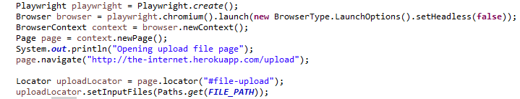
Locators (cont.)
We can login using Auth credentials
We can use upload form

Slide 31
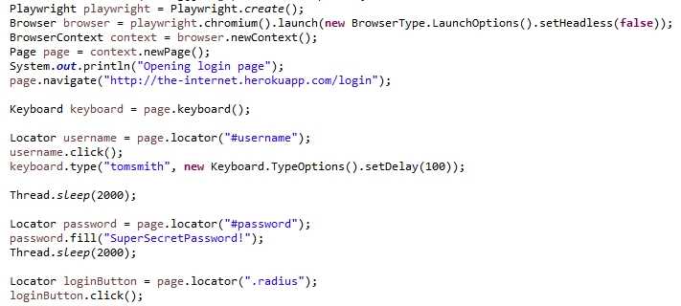
Locators (cont.)
We can login to form emulating user by typing with delay

Slide 32
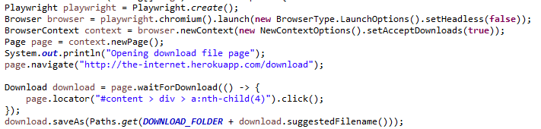
Locators (cont.)
We can download files and store them locally

Slide 33
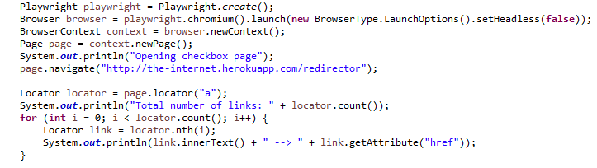
Locators (cont.)
Example with iterating the link and getting the text

Slide 34
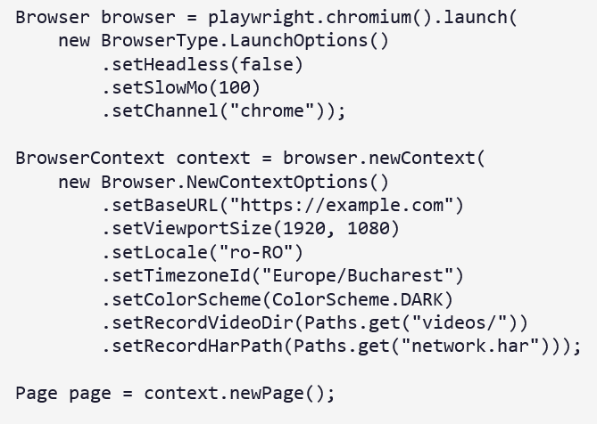
Locators (cont.)
Launch and context example:

Slide 35
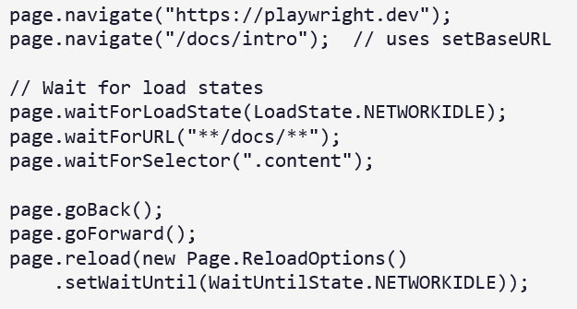
Locators (cont.)
Navigation and waiting examples:

Slide 36
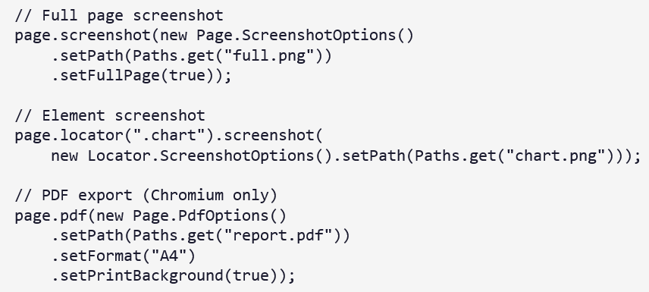
Locators (cont.)
Screenshots and PDF:

Slide 37
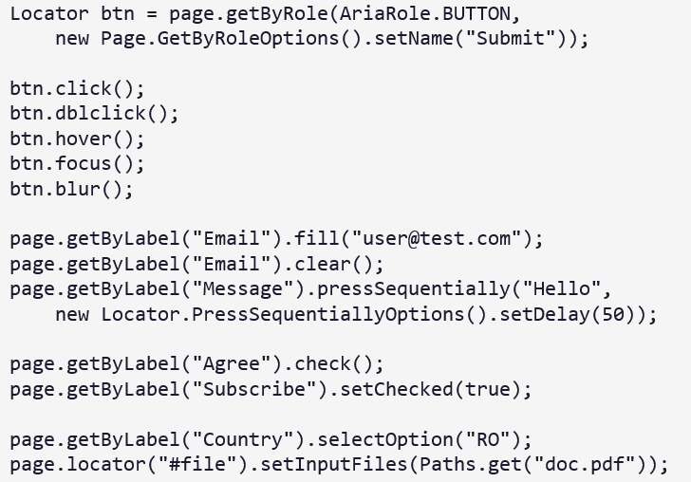
Locators (cont.)
User interactions:

Slide 38
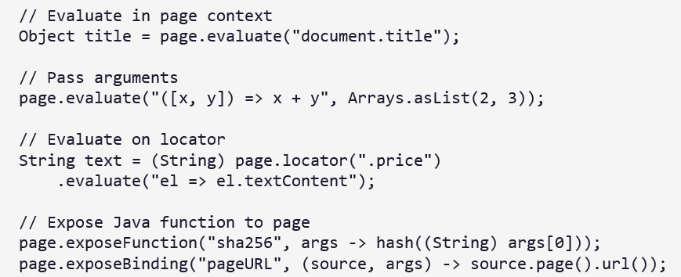
Locators (cont.)
JavaScript Evaluation and handles

Slide 39
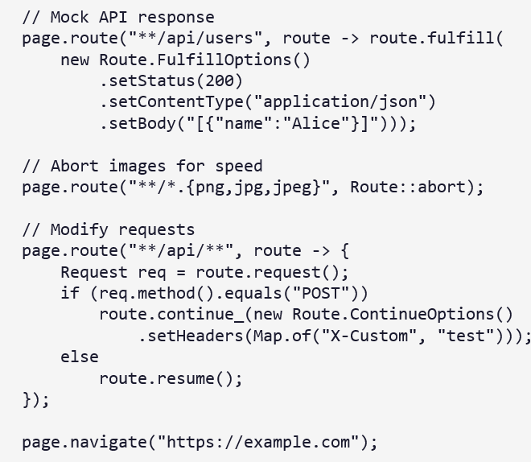
Locators (cont.)
Network Interception and Mocking

Slide 40
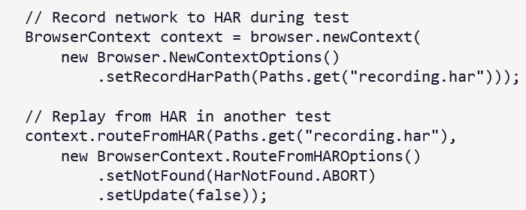
Locators (cont.)
HAR Replay and routeFromHAR

Slide 41
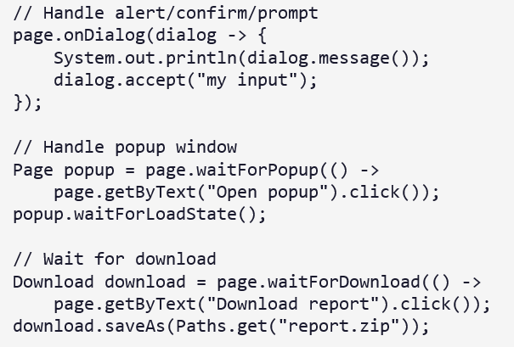
Locators (cont.)
Dialog, Popups and Downloads

Slide 42
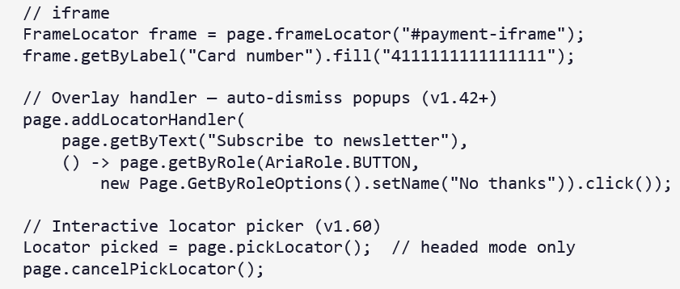
Locators (cont.)
Frames, Tabs and Locator Handlers

Slide 43
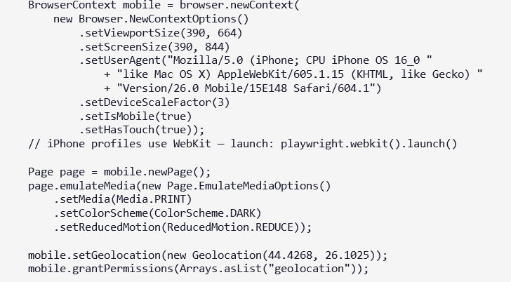
Locators (cont.)
Device Emulation & Media

Slide 44
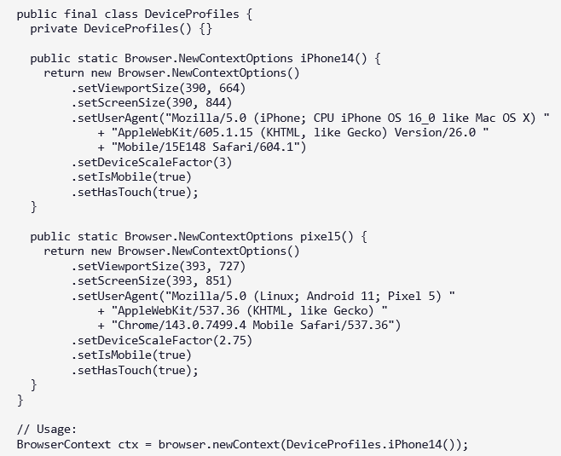
Locators (cont.)
DeviceProfiler Helper class

Slide 45
Assertions
Use com.microsoft.playwright.assertions.PlaywrightAssertions.
Assertions auto-retry until condition is met or timeout expires.
Eliminates manual Thread.sleep() and explicit wait boilerplate.
Import static: import static com.microsoft.playwright.assertions.PlaywrightAssertions.*;
Default assertion timeout: 5 seconds (configurable).

Slide 46
Assertions (cont.)
LocatorAssertions – common methods
Assertion | Description | Java Example
assertThat(loc).isVisible() | Element is visible. | assertThat(page.getByText("OK")).isVisible();
assertThat(loc).isHidden() | Element is not visible. | assertThat(page.getByText("Loading")).isHidden();
assertThat(loc).isEnabled() | Element is enabled. | assertThat(submitBtn).isEnabled();
assertThat(loc).isDisabled() | Element is disabled. | assertThat(submitBtn).isDisabled();
assertThat(loc).isChecked() | Checkbox/radio is checked. | assertThat(checkbox).isChecked();
assertThat(loc).hasText(text) | Element has text (substring). | assertThat(loc).hasText("Success");
assertThat(loc).hasValue(value) | Input has value. | assertThat(input).hasValue("admin");

Slide 47
Assertions (cont.)
LocatorAssertions – common methods
Assertion | Description | Java Example
assertThat(loc).hasAttribute(n, v) | Element has attribute. | assertThat(link).hasAttribute("href", "/home");
assertThat(loc).hasClass(name) | Element has CSS class. | assertThat(div).hasClass("active");
assertThat(loc).hasCSS(prop, val) | Computed CSS property. | assertThat(el).hasCSS("color", "rgb(0, 0, 0)");
assertThat(loc).hasCount(n) | Number of matching elements. | assertThat(items).hasCount(5);
assertThat(loc).containsText(text) | Contains text substring. | assertThat(p).containsText("partial");
assertThat(page).hasTitle(title) | Page title match. | assertThat(page).hasTitle("Playwright");
assertThat(page).hasURL(url) | Page URL match. | assertThat(page).hasURL("**/dashboard");

Slide 48
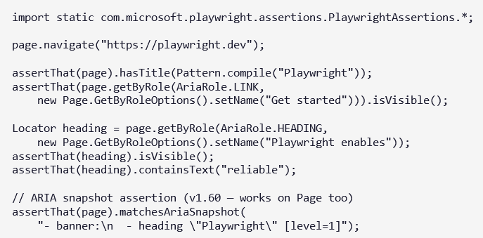
Assertions (cont.)
Assertions example:

Slide 49
Debugging
Headed mode: setHeadless(false) — watch tests run in real browser.
Slow motion: setSlowMo(100) — delay between actions.
Trace Viewer: record traces on failure — step-by-step replay with snapshots.
Playwright Inspector: PWDEBUG=1 — pause and step through tests.
Codegen: auto-generate Java test code by recording browser actions.
Locator.highlight() — visually highlight matched elements.
page.screenshot() on failure — attach to test reports.
Video recording via setRecordVideoDir in context options.

Slide 50
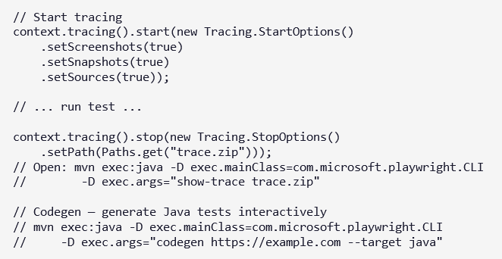
Debugging (cont.)
Tracing & code gen

Slide 51
Playwright vs Selenium
Feature | Playwright | Selenium
Architecture | Direct communication with browser via CDP / native protocols | Uses WebDriver protocol (client → driver → browser)
Speed | Faster (no WebDriver layer) | Slower (extra WebDriver layer)
Auto-Waiting | Built-in auto-waiting | Manual waits required (WebDriverWait)
Flakiness | Lower (auto-wait + retry) | Higher (due to timing issues)
Stale Element Issue | No stale element issues (lazy locators) | Common problem
Multiple Tabs Handling | Simple & built-in | More complex
iFrame Handling | Cleaner frame handling | Requires switching context manually
Parallel Execution | Built-in parallel support | Requires Selenium Grid or external setup

Slide 52
Playwright vs Selenium (cont.)
Feature | Playwright | Selenium
Browser Isolation | BrowserContext provides isolation inside same browser | New browser instance needed for clean state
Network Interception | Built-in network mocking & interception | Limited / complex
API Testing | Built-in API testing support | Not built-in
Headless Mode | Fully optimized headless mode | Supported
Cross-Browser Support | Chromium, Firefox, WebKit | Chrome, Firefox, Edge, Safari
Mobile Emulation | Built-in device emulation | Limited
Language Support | Java, Python, C#, JS, TS | Java, Python, C#, JS, Ruby
Community & Maturity | Newer (since 2020) | Very mature (since 2004)
Built-in Test Runner | Built-in test runner (JS) | No (needs JUnit/TestNG)

Slide 53
Playwright vs Selenium (cont.)
When to Use Selenium?
  Large legacy projects
  Need very broad browser coverage
  Organization already invested in Selenium Grid
  Long-term enterprise stability focus
When to Use Playwright?
  Modern web applications (React, Angular, Vue)
  Need speed & reliability
  Want less flaky tests
  Need API mocking
  Multi-user / parallel-heavy testing

Slide 54
Best Practices
Use getByRole, getByLabel, getByTestId — avoid brittle CSS/XPath.
One BrowserContext per test for full isolation (cookies, storage).
Use web-first assertions (assertThat) instead of Thread.sleep().
Configure setBaseURL — navigate with relative paths.
Use page.addLocatorHandler for cookie banners and modals.

Slide 55
Best Practices (cont.)
Enable tracing on CI: start trace, stop on failure only.
Store auth state: context.storageState() → reuse in later tests.
Tag tests with @Tag, run in parallel with JUnit 5 parallel config.
Use locator.describe() for readable trace reports.
Pin playwright version in pom.xml (1.60.0) for reproducible builds.

Slide 56
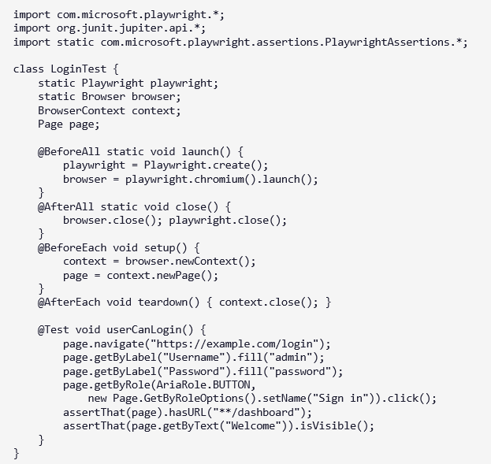
Best Practices (cont.)

Slide 57
Conclusion
Pros:
  Auto-waiting: Eliminates flaky tests by automatically waiting for elements to be actionable.
  ​Cross-browser support: Single API works across Chromium, Firefox, and WebKit browsers.
  ​Network control: Intercept, mock, and modify API requests/responses easily.
  ​Fast execution: Isolated browser contexts enable parallel tests with minimal overhead.
  ​Rich tooling: Code-gen, inspector, and trace viewer speed up test creation and debugging.
Cons:
  Resource intensive: Multiple browser instances consume significant CPU/memory.
  ​Learning curve: Extensive features overwhelm beginners despite modern APIs.
  ​Complexity: Multiple approaches for same task lead to over-engineered frameworks.
  ​Limited integrations: Fewer out-of-box dashboard/reporting options than Cypress.
  ​Maintenance overhead: Frequent updates require keeping browser binaries current.

Slide 58

Bibliography
https://en.wikipedia.org/wiki/Playwright_(software)
https://playwright.dev
https://samedesilva.medium.com/playwright-architecture-simple-breakdown-69f64ea4de3d

