Slide 1

GraphQL
Dima Ionut Daniel

Slide 2
Contents
What is Graphql?
History
Features
Architecture
Core
Conclussion
Bibliography

Slide 3

What is GraphQL?
GraphQL is a data query and manipulation language for APIs that allows a client to specify what data it needs ("declarative data fetching").
A GraphQL server can fetch data from separate sources for a single client query and present the results in a unified graph.
It is not tied to any specific database or storage engine.

Slide 4
History
Facebook started GraphQL development in 2012 and released it as open source in 2015.
In 2018, GraphQL was moved to the newly established GraphQL Foundation, hosted by the non-profit Linux Foundation.
On 9 February 2018, the GraphQL Schema Definition Language became part of the specification.

Slide 5
Features
Single Endpoint: expose a single endpoint through which all requests are made.
Flexible Queries: clients can request exactly the data they need and nothing more.
Strongly Typed Schema: strongly typed and uses a schema definition language (SDL) to define its data structure. The schema described the types of data that can be queried and how they relate to each other.
Introspection: allows clients to query the schema itself, enabling tools that can provide auto-completion or real-time documentation of the API.
Hierarchical Structure: queries are structured in hierarchical format, resembling the way the data is structured.

Slide 6
Features (cont.)
Batched Requests: can handle multiple resource requests in one go, allowing clients to retrieve all the data then need in a single query instead of making several round trips to the server.
Real-time Updates: supports subscriptions, enabling clients to receive real-time updates whenever there are changes to the data, making useful for applications that require live data feeds.
Version less API: because the client specifies its data requirements in each request, changes to the server's schema can be handled more smoothly, which minimizes the need for versioning.
Mutations: supports not only fetching data but also modifying it through mutations. This allows clients to perform CRUD operations in a single request, enhancing the flexibility of interactions.
Custom Resolvers: allows developers to implements custom logic for data fetching by defining resolvers. Resolvers can connect to various data sources, including databases, APIs or any other services.

Slide 7
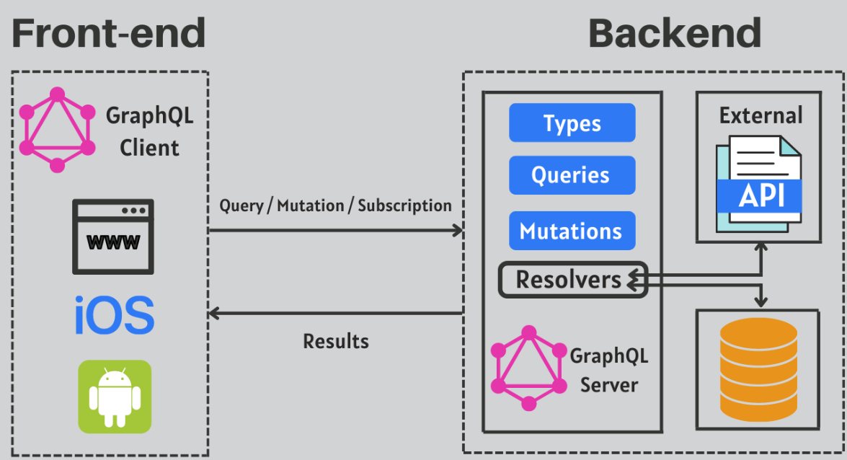
Architecture

Slide 8
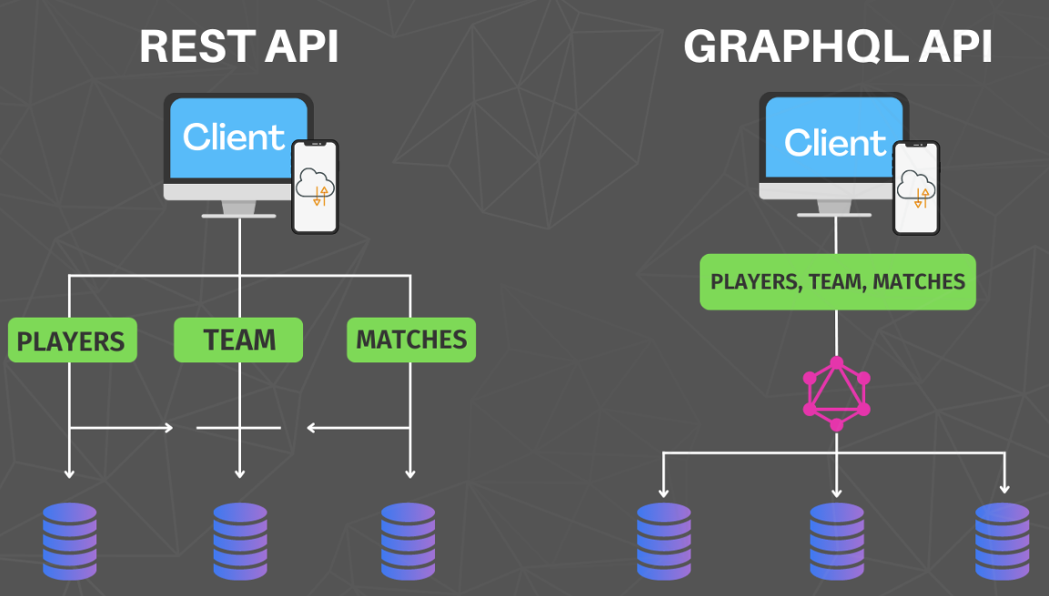
Architecture (cont.)
REST vs GraphQL

Slide 9
Core
GraphQL is a query language for our API and a server-side runtime for executing queries using a type system that we define for our data.
It's an alternative to REST & SOAP in most cases will replace them.
GraphQL isn't tied to any specific databases or storage engine.
GraphQL is technology for client / server data exchange.

Slide 10
Core (cont.)
The GraphQL Schema Language allows us to create a consistent schema across languages.
This means that if you’re using Java, JavaScript or Go you will understand a GraphQL schema because it is language agnostic.
Object types and fields are a common type that you will work with in any GraphQL Schema.
Once you have your models in place in your Spring application you will need to define what objects and fields you want to make available in your API.

Slide 11
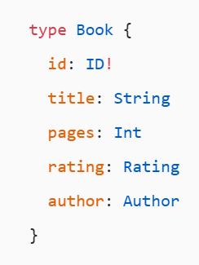
Core (cont.)
The values on the left are the field names
The values on the right are the types
ID, String & Int are built-in Scalar types
Rating & Author are Object Types that you define
The ! simply tells us that you can always expect a value back and will never need to check for null.

Slide 12
Core (cont.)
GraphQL comes with the following scalar types out of the box:
Int: A signed 32-bit integer.
Float: A signed double-precision floating-point value.
String: A UTF-8-character sequence.
Boolean: true or false.
ID: The ID scalar type represents a unique identifier. The ID type is serialized in the same way as a String; however, defining it as an ID signifies that it is not intended to be human-readable.

Slide 13
Core (cont.)
Root Operation Types:
Query: Used to read data
Mutation: Used to create, update and delete data
Subscription: Like a query allowing you to fetch data from the server. Subscriptions offer a long-lasting operation that can change their result over time.

Slide 14
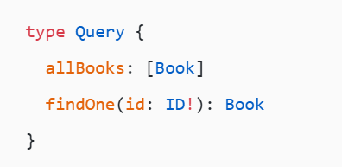
Core (cont.)
The following defines the Query operation in our schema. The values on the left are the field names (query names) and the values on the right are the return type. In the first example the brackets around Book simply means that it could return more than 1.
Each field on a GraphQL object type can have one or more arguments. The findOne query above defines a single argument of type ID. The ! states that the ID can’t be null and must be supplied.

Slide 15
Core (cont.)
GraphQL Java was released in 2015 shortly after Facebook open sourced GraphQL.
GraphQL Java is the server-side execution engine, and it does this one thing really well.
GraphQL for Java has been tried and tested by some of the biggest companies in the world, including Twitter.

Slide 16
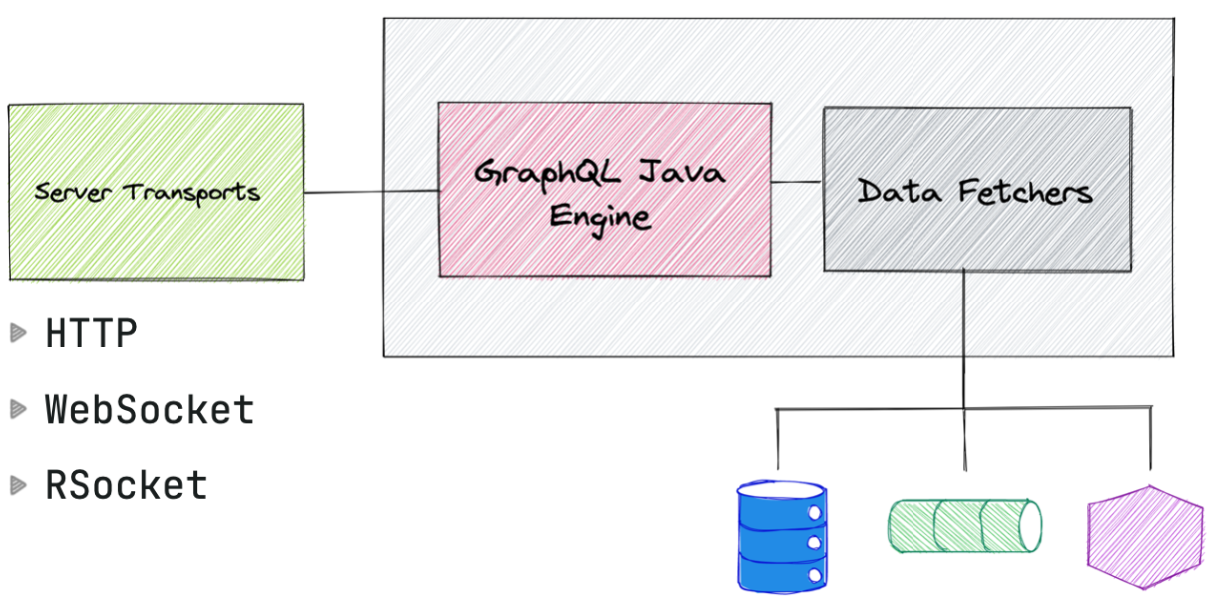
Core (cont.)
Spring for GraphQL makes sure that is taking care of the transport and application content type: HTTP and JSON related topics.

Slide 17
Core (cont.)
When we select Spring GraphQL as a dependency in the Spring Initializer you will get the spring-boot-starter-gaphql dependency added to your build.
Spring Boot Starter GraphQL
Dependency Management
Auto Configuration
Properties
Metrics
GraphiQL UI and Schema Pages

Slide 18
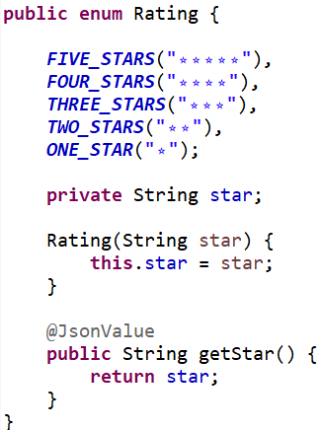
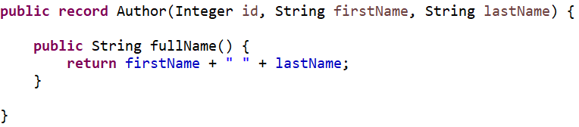
Core (cont.)
We create a spring boot application that has web and graphql components.
We define first POJO objects like: Book, Author, Rating.

Slide 19
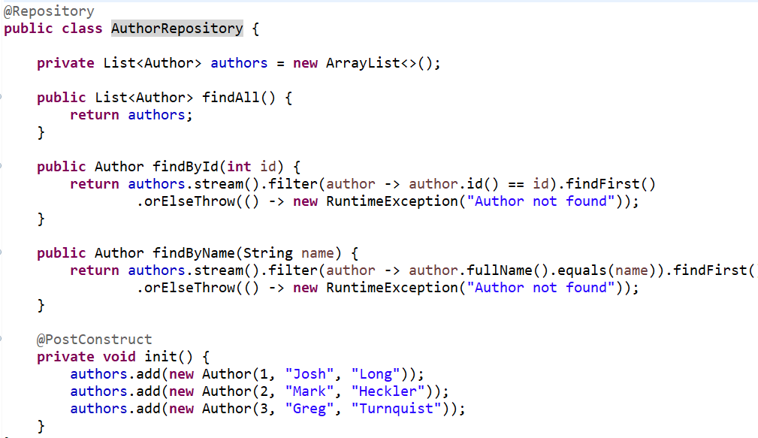
Core (cont.)
We create Spring repositories for data retrieval

Slide 20
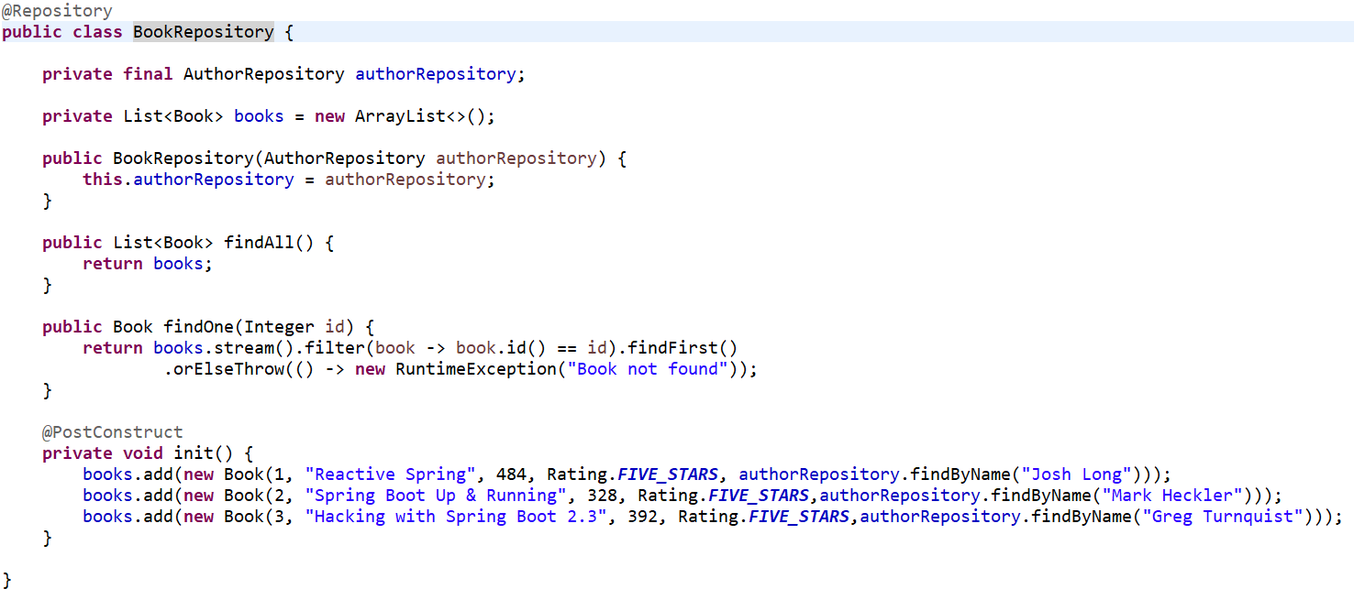
Core (cont.)

Slide 21
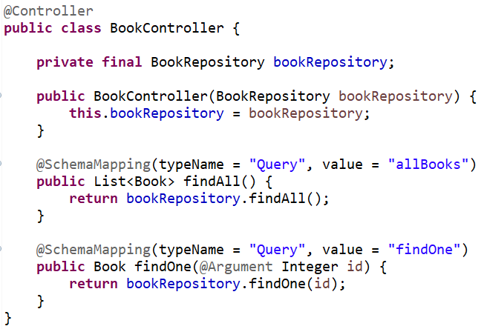
Core (cont.)
We define a Spring controller that will process client GraphQL requests and use Spring repository to process the data. After that the data is retrieved to the GraphQL client.
@SchemaMapping annotation is doing the schema mappings.
@Argument is used to retrieve request parameters and will bind a to a method parameter.

Slide 22
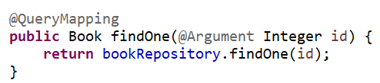
Core (cont.)
In GraphQL there are special annotations for root types like @QueryMapping, @MutationMapping, and @SubscriptionMapping.
@QueryMapping is a composed annotation that acts as a shortcut for @SchemaMapping with typeName="Query".
The trick here is that the value is derived from the method name. This means that if your method name matches the name of the query defined in your schema all you need is the @QueryMapping annotation.

Slide 23
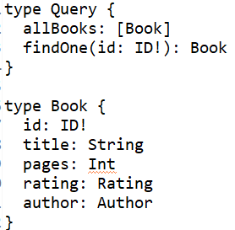
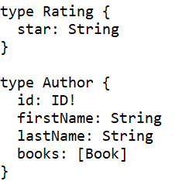
Core (cont.)
In the /src/main/resources/graphql folder we create a file schema.graphqls that contains the GraphQL schema.
We've created a root level operation called Query, with the query allBooks that will return a list of books.
We have also 3 types: Rating, Book and Author.

Slide 24

Core (cont.)
GraphiQL is a graphical interactive in-browser GraphQL IDE.
GraphiQL is disabled by default so if you would like to use it you will need to enable it application.properties.

Slide 25
Core (cont.)
Graphiql IDE provides a user-friendly interface for developers to interact with and test the GraphQL queries and mutations.
Interactive Query Editor: has syntax-highlighted code editor where users can write GraphQL queries, mutations, and subscriptions.
Auto-Completion: Provides intelligent auto-completion for types, fields, and arguments based on the GraphQL schema. This helps reduce syntax errors and speeds up query writing.
Documentation Explorer: A built-in documentation panel allows users to easily browse the GraphQL schema, view type definitions, and understand available fields, parameters, and types. This is especially helpful for discovering data structures and relationships.
Variable and Query Parameters: Users can define variables and pass them into queries, making it easier to handle dynamic data and parameterized requests.
Support for Multiple Operations: enables users to define and execute multiple operations (queries or mutations) within the same file, making it easier to reuse and test them.

Slide 26
Core (cont.)
Execution History: Users can view a history of executed queries, which aids in debugging and allows for easy re-execution of previous requests.
Network Inspector: Provides a built-in console to inspect network requests and responses, helping developers understand how their queries interact with the GraphQL server.
Integration with Other Tools: Can be easily integrated into various developer tools and frameworks, such as Apollo Client and Relay, to enhance the development experience.
Customizable UI: Developers can customize the appearance and behavior of the GraphiQL interface to suit their preferences.
GraphQL Subscriptions: Support for GraphQL subscriptions allows users to test real-time data queries, enhancing the capabilities for applications that rely on live data updates.
Console Logging: can log useful information and errors to the console, making it easier to debug issues that arise during query execution.

Slide 27
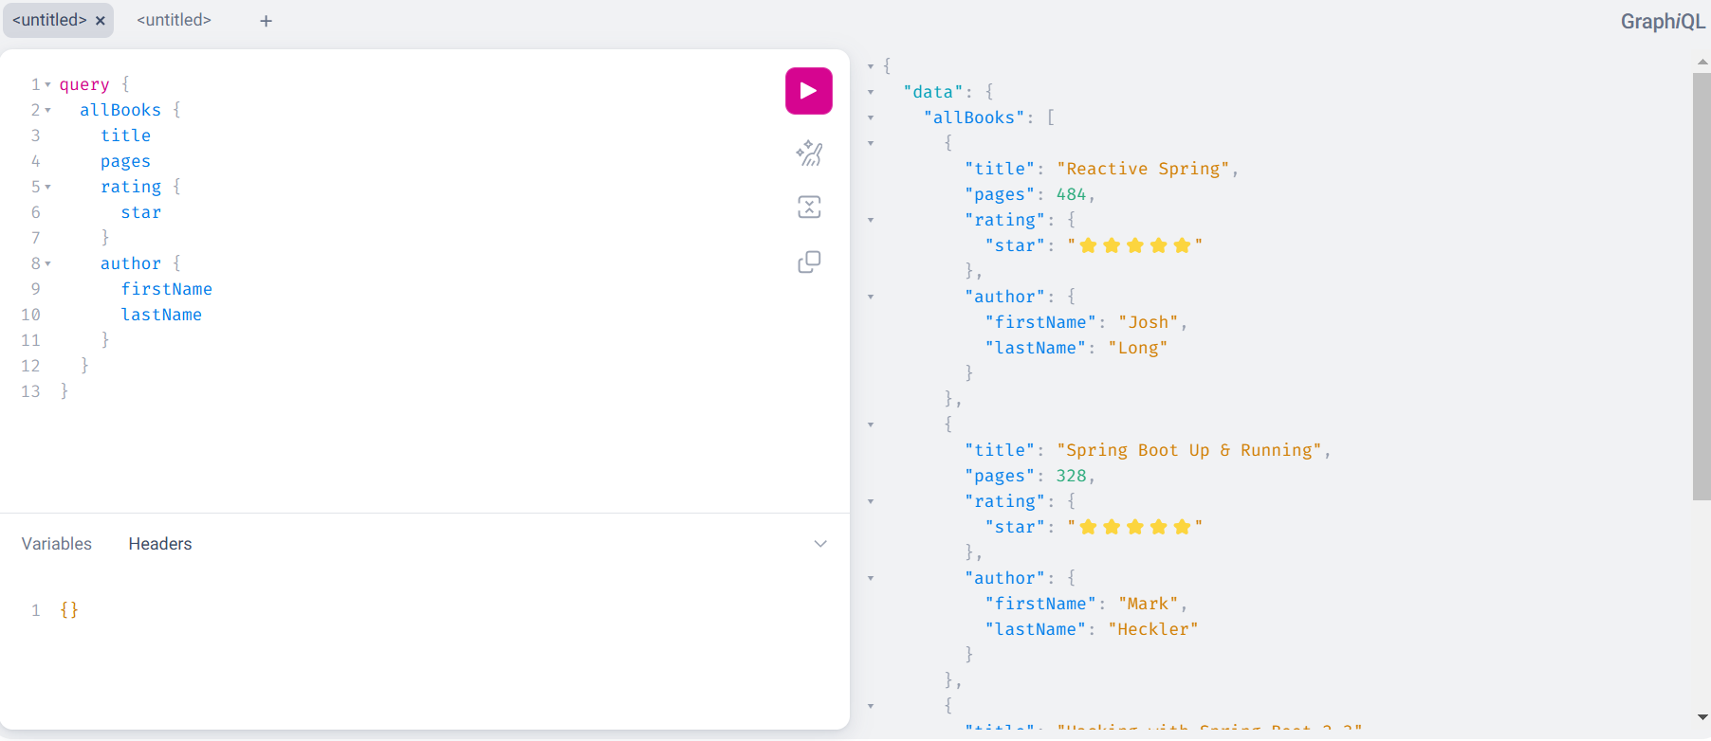
Core (cont.)
From web browser we access the context /graphiql and we type in the left side the query that we want to perform

Slide 28
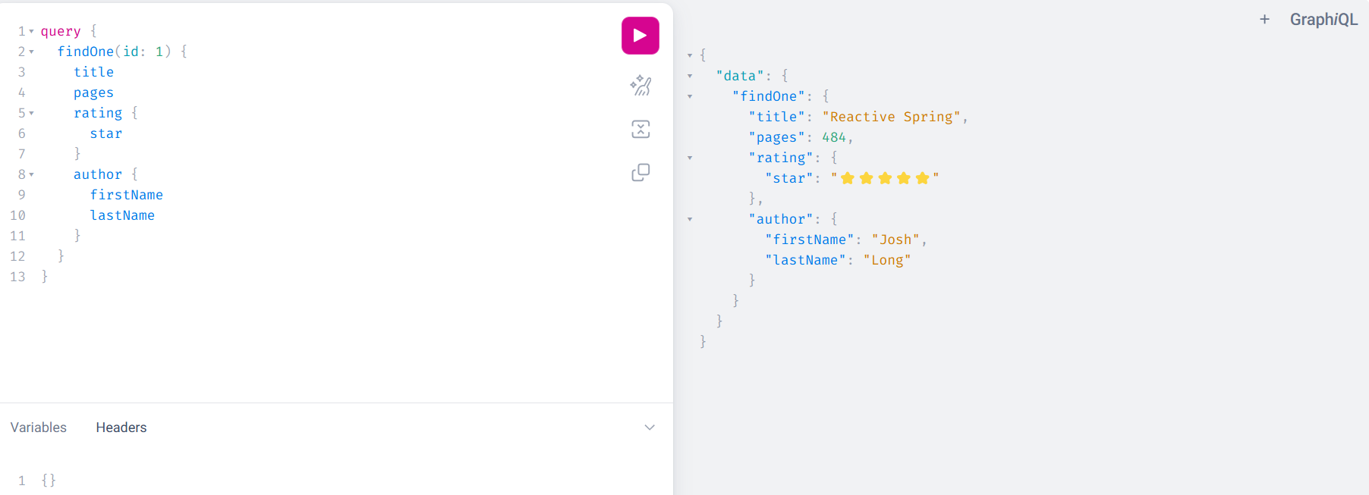
Core (cont.)
Exemple using query parameters. On the right side we get the response from the server.

Slide 29

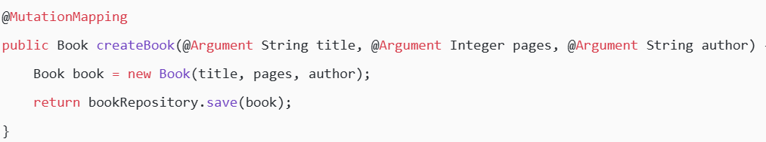
Core (cont.)
Example of a simple mutation:

Slide 30
Conclussion
Pros:
Flexible Queries
Single Endpoint
Strongly Typed Schema
Versioning
Real-time Capabilities
Introspection
Cons:
Complexity
Learning Curve
Caching Challenges
Security Risks

Slide 31

Bibliography
https://en.wikipedia.org/wiki/GraphQL
https://graphql.org/
https://capsquery.com/blog/8-reasons-why-when-to-use-graphql-over-rest/
https://www.danvega.dev/blog/spring-for-graphql

