Slide 1

Servlet 4.0
Dima Ionut Daniel

Slide 2
Contents
What is Servlet?
History
Servlet 4.0 new features
Java EE 8
HTTP 2
Java SE 9 support for HTTP 2
Bibliography

Slide 3

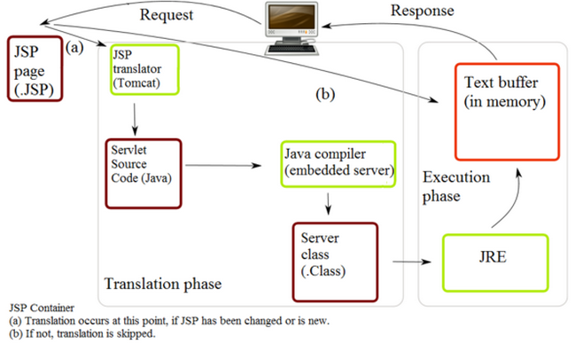
What is Servlet?
A servlet is a Java programming language class that is used to extend the capabilities of servers that host applications accessed by means of a request-response programming model.
Servlets can respond to any type of request, can be used to extend the applications hosted by web servers.

Slide 4
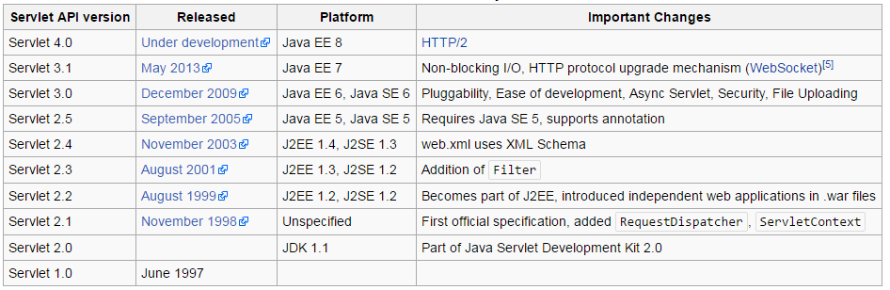
History
The Servlet specification was created by Sun Microsystems, with version 1.0 finalized in June 1997.
Starting with version 2.3, the specification was developed under the Java Community Process.

Slide 5
Servlet 4.0 new features
Servlet 4.0 API will use HTTP 2 features:
Request/Response multiplexing
Stream Prioritization
Server Push
Upgrade from HTTP 1.1

Slide 6
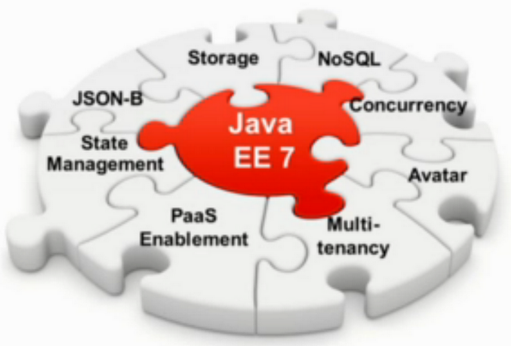
JAVA EE 8

Slide 7
JAVA EE 8 (cont.)
Java EE 8 wants to bring:
HTML 5/Web Tier Enhancements
Infrastructure for running in the Cloud
Ease of development / CDI alignment
Security interceptors
WebSocket scopes
HTTP 2 support
JSON binding
Action-based MVC

Slide 8
JAVA EE 8 (cont.)
Java EE 8 comprises new JSRs/APIs:
JSR 107: JCache - Java Temporary Caching API
JSR 367: Java API for JSON Binding (JSON-B)
JSR 371: Model-View-Controller (MVC 1.0)
JSR 373: Java EE Management API 2
JSR 375: Java EE Security API

Slide 9
HTTP 2
HTTP/2 is the second major version of the HTTP network protocol used by the World Wide Web.
HTTP/2 is based on SPDY.
The HTTP/2 specification was published as RFC 7540 in May 2015.

Slide 10
HTTP 2 (cont.)
HTTP 2 has lots of new features:
Binary Framing
Request/Response multiplexing
Stream Prioritization
Server Push
Header Compression
Upgrade from HTTP 1.1
ALPN (or NPN)
101 Switching protocols

Slide 11
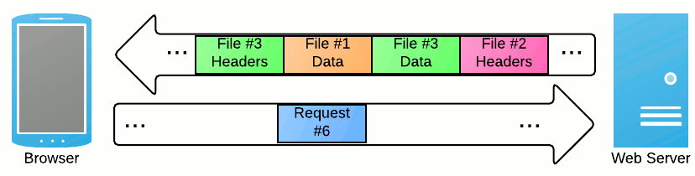
HTTP 2 (cont.)
HTTP 2 is about using the underlying network connections more efficiently.
HTTP 2 changes how requests and responses travel on the wire.

Slide 12
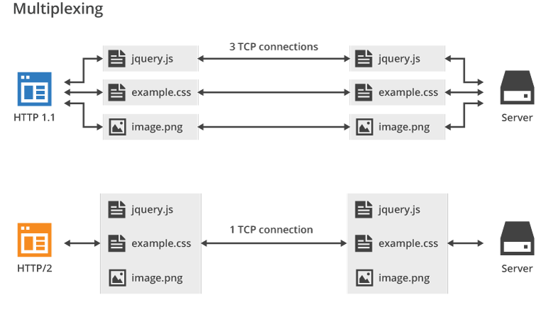
HTTP 2 (cont.)
Multiplexing is a method in HTTP/2 by which multiple HTTP requests can be sent and responses can be received asynchronously via a single TCP connection.
Multiplexing is the heart of HTTP/2 protocol.

Slide 13
HTTP 2 (cont.)
The basic protocol unit of HTTP/2 is a frame.
In HTTP/2, frames are exchanged over a TCP connection instead of text-based messages.
Before being transmitted an HTTP message is split into individual HTTP/2 frames.
HTTP/2 provides different types of frames for different purposes, such as HEADERS, DATA, SETTINGS, or GOAWAY frames.

Slide 14
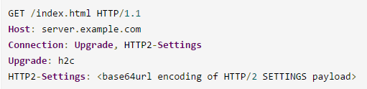
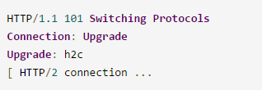
HTTP 2 (cont.)
When establishing an HTTP connection the server has to know which network protocol to use.
There are two ways to inform the server that it should use HTTP/2:
1)Initiate HTTP/2 protocol response using the HTTP Upgrade header.
An HTTP/2-compatible server would accept the upgrade with a Switching Protocols response.
After the empty line terminating the 101 response, the server would begin sending HTTP/2 frames.

Slide 15
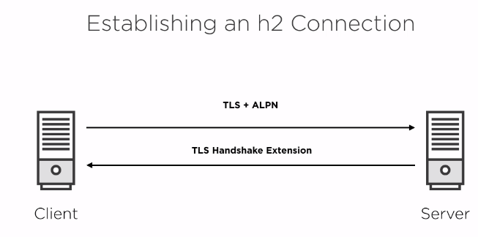
HTTP 2 (cont.)

Slide 16
HTTP 2 (cont.)
2)ALPN
For TLS-based connections you could use the Application-Layer Protocol Negotiation (ALPN) extension.
ALPN allows a TLS connection to negotiate which application-level protocol will be running across it.
ALPN is not supported by Java 8.
ALPN support will be coming in Java 9 (see JEP 244)
To use ALPN today you would have to use ALPN libraries that are external to the JDK, like Jetty project.

Slide 17
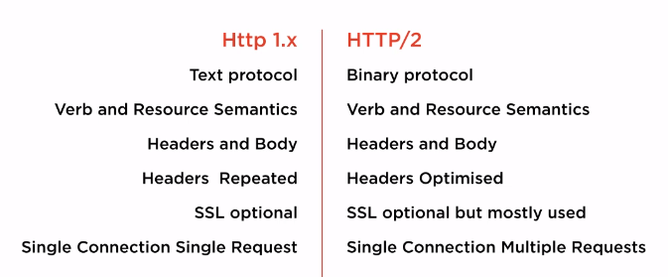
HTTP 2 (cont.)

Slide 18
Java SE 9 support for HTTP 2
JEP 110: HTTP/2 client
defines a new HTTP client API that implements HTTP/2 and WebSocket and can replace the legacy HttpURLConnection API.
Supports both HTTP 1.1 and 2.
Easy to use

Slide 19
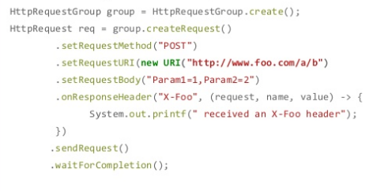
Java SE 9 support for HTTP 2 (cont.)
Blocking mode: one thread per request/response
send request
get response
Non-blocking mode: handle multiple request/response interactions in single thread using non-blocking API
analogues to NIO selectors

Slide 20
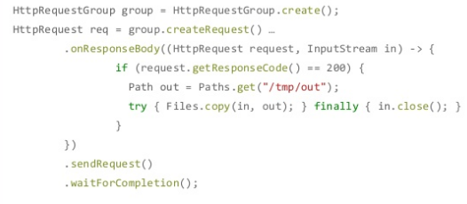
Java SE 9 support for HTTP 2 (cont.)
For handling responses we can use the lambda style callback handlers.

Slide 21

Bibliography
http://en.wikipedia.org/wiki/Java_Servlet
http://www.slideshare.net/delabassee/delabassee-http2
https://blogs.oracle.com/theaquarium/entry/servlet_4_0

