Slide 1

MCP
Dima Ionut Daniel

Slide 2
Contents
What is Ollama?
History
Features
Architecture
Models
Core
Open WebUI
Conclusion
Bibliography

Slide 3


What is Ollama?
Ollama is an open-source tool and platform that enables users to run and manage large language models (LLMs) directly on their local machines instead of relying on cloud services.
This approach provides greater privacy, data control, offline use, faster response times, and reduced reliance on external servers

Slide 4
History
Ollama was founded in 2023 by Jeffrey Morgan and Michael Chiang with the goal of making AI-powered tools more accessible, emphasizing local AI model execution, data privacy, and user-friendly integration.
It was created to allow developers and organizations to run, manage, and interact with large language models (LLMs) locally on their own hardware, avoiding reliance on cloud services.

Slide 5
History (cont.)
Ollama progressed through several versions:
Version 1.0: Basic NLP capabilities supporting simple text interactions.
Version 2.0: Introduction of transformer-based models that improved contextual understanding and response accuracy.
Version 3.0 and later: Added multimodal support (handling text and images), advanced reasoning modes, tool calling for integration with external APIs, and scalability improvements for enterprise use cases.
Recent updates (2024–2025) have focused on enhanced streaming responses, tool integration, local-cloud hybrid collaboration (e.g., Stanford Hazy Research's Minions protocol for encrypted local-remote communication), and adding cutting-edge multimodal engines and models like Google Gemma and LLaMA 3.x.

Slide 6
Features
It bundles all necessary components: model weights, configuration files, and dependencies—into a self-contained environment to run LLMs smoothly and without conflicts on your system.
Running models locally means your sensitive data never leaves your computer, increasing security and privacy, and eliminating the need for an internet connection.
It supports a variety of popular open-source LLMs such as LLaMA-3, Mistral, Qwen2.5v1,Gemma3, Deepseek-r1, etc.
Best performance occurs on computers with discrete GPUs (NVIDIA or AMD), though CPU-based setups can work with slower processing.
Is designed to be lightweight, flexible, and integrates easily into development workflows.

Slide 7
Features (cont.)
Local Execution: a foundational principle is running LLMs locally on user devices, avoiding cloud dependency. This enhances data privacy, security, faster inference, and control over one's data, an important distinction from cloud-based AI models.
Model Parameters and Customization: Allows fine-tuning inference parameters like temperature (randomness of output), top_p (nucleus sampling threshold), and top_k (limiting token choices), giving users control over the creativity and focus of model outputs.
Modularity and Extensibility: Supports adding custom models, tools, and agents to build complex AI systems, including agent orchestration with capabilities such as Retrieval-Augmented Generation (RAG), memory management, and external tool integration (web search, API calls).

Slide 8
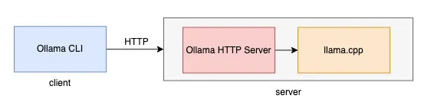
Architecture
Ollama uses a Client-Server architecture, where:
The Client interacts with the user via the command line.
The Server can be started through one of several methods: command line, desktop application (based on the Electron framework), or Docker.
The Client and Server communicate using HTTP.

Slide 9
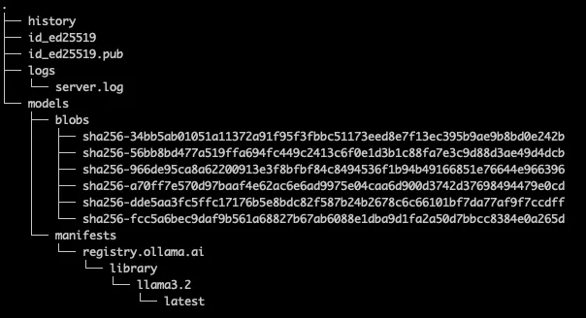
Architecture (cont.)
The default local storage folder for Ollama is $HOME/.ollama.
The default path can be changed in settings.

Slide 10
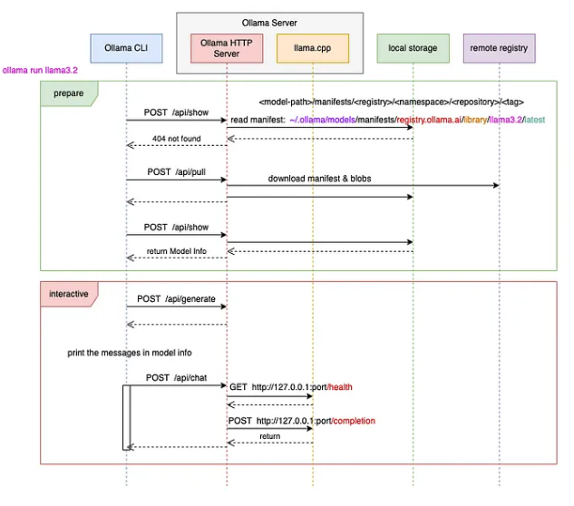
Architecture (cont.)
Ollama Conversation Processing Flow

Slide 11
Models
Llama 3.2 is a versatile model for natural language processing (NLP) tasks, like text generation, summarization, and machine translation. Its ability to understand and generate human-like text makes it popular for developing chatbots, writing content, and building conversational AI systems.
Mistral handles code generation and large-scale data analysis, making it ideal for developers working on AI-driven coding platforms. Its pattern recognition capabilities enable it to tackle complex programming tasks, automate repetitive coding processes, and identify bugs.
Code Llama excels at programming-related tasks, such as writing and reviewing code. It automates coding workflows to boost productivity for software developers and engineers.

Slide 12
Models (cont.)
LLaVA is a multimodal model capable of processing text and images, which is perfect for tasks that require visual data interpretation. It’s primarily used to generate accurate image captions, answer visual questions, and enhance user experiences through combined text and image analysis.
Phi-3 is designed for scientific and research-based applications. Its training on extensive academic and research datasets makes it particularly useful for tasks like literature reviews, data summarization, and scientific analysis.
Gemma 3 is a state-of-the-art multimodal large language model (LLM) developed by Google DeepMind, designed to process both text and image inputs with extended context capabilities and broad multilingual support. It is part of the Gemma family of lightweight open models ranging from 1 billion to 27 billion parameters, optimized for efficient deployment on consumer-grade hardware.

Slide 13
Models (cont.)
Qwen LLM is a versatile family of large language models (LLMs) and large multimodal models (LMMs) developed by Alibaba Cloud’s Qwen Team. It includes models that process text, images, and audio, pretrained on massive multilingual and multimodal datasets, and fine-tuned ("post-trained") for alignment with human preferences to enable natural and engaging interactions.
Dolphin, Multilingual Multitask ASR Model (Speech Recognition) was developed by Dataocean AI and Tsinghua University, this Dolphin is a multilingual automatic speech recognition (ASR) system supporting 40 Eastern languages and 22 Chinese dialects.
Granite 3.3 s a family of advanced large language models (LLMs) developed by IBM, designed for high-performance tasks involving natural language understanding, generation, speech recognition, translation, and retrieval-augmented generation (RAG).

Slide 14
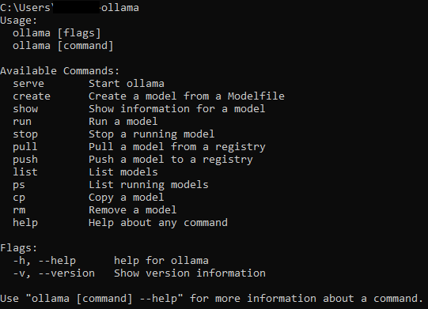
Core
After we’ve installed ollama we can use the CLI to perform various operations with LLM.

Slide 15
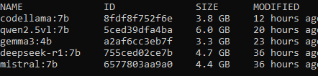
Core (cont.)
ollama list command can be used to list the available models

Slide 16
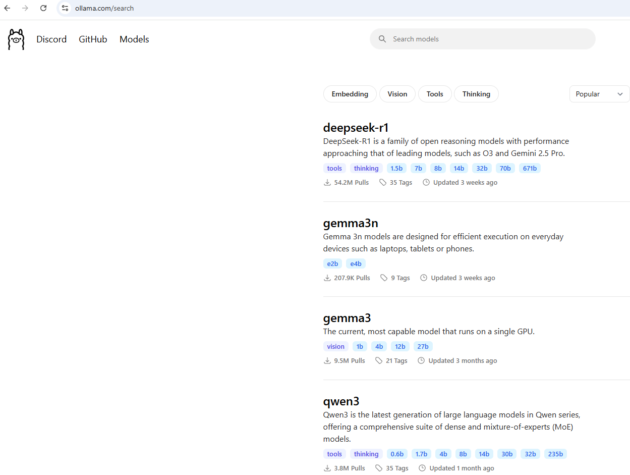
Core (cont.)
ollama pull command can be retrieve from the repository a certain model.
We can check the available models from https://ollama.com/library

Slide 17
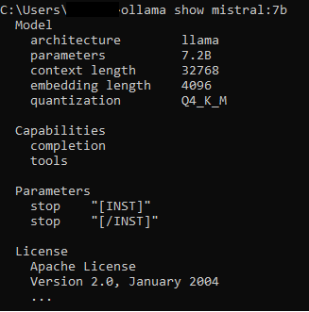
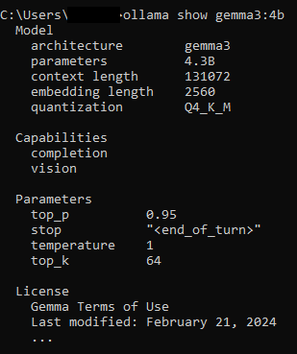
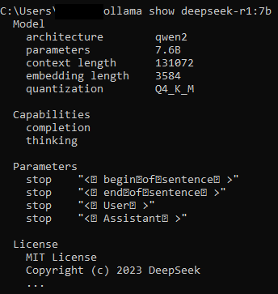
Core (cont.)
ollama show command can be used to show specific model information.

Slide 18

Core (cont.)
ollama ps command shows the list of running models, if they are used.

Slide 19
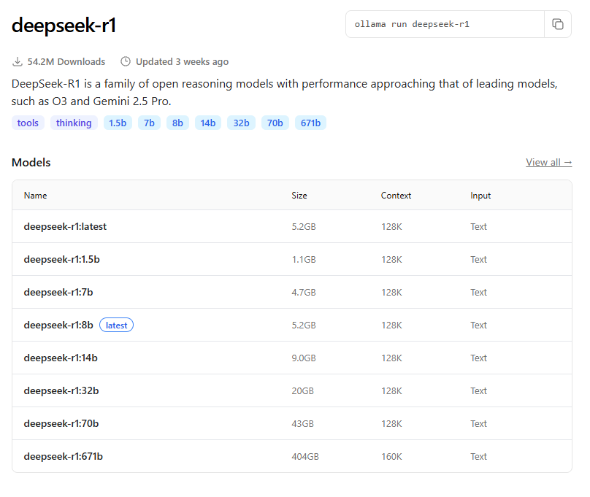
Core (cont.)
For deepseek-r1 we can see various variations of this model. The higher number of parameters, the greater the performance of this model, but also we need a more powerful PC.
We should have at least 8 GB of RAM available to run the 7B models, 16 GB to run the 13B models, and 32 GB to run the 33B models.

Slide 20
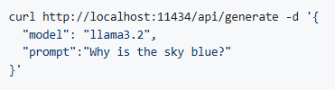
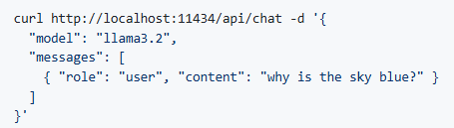
Core (cont.)
The ollama serve command will start the Ollama web server on http://localhost:11434/
Ollama exposes a REST API for running and managing models.
The REST API is described in details in Github

Slide 21
Core (cont.)
GGUF (GPT-Generated Unified Format) is a file format specifically designed for storing models, particularly large language models (LLMs
Ollama supports importing GGUF models in the Modelfile:
FROM ./vicuna-33b.Q4_0.gguf
ollama create example -f Modelfile
ollama run example

Slide 22
Open WebUI
Open WebUI is an extensible, feature-rich, and user-friendly self-hosted AI platform designed to operate entirely offline.
Open WebUI is an open-source, self-hosted web interface platform designed to provide a user-friendly, ChatGPT-like graphical dashboard for interacting with large language models (LLMs) such as those managed by Ollama.
It can be installed using pip install open-webui and started with open-webui commands.

Slide 23
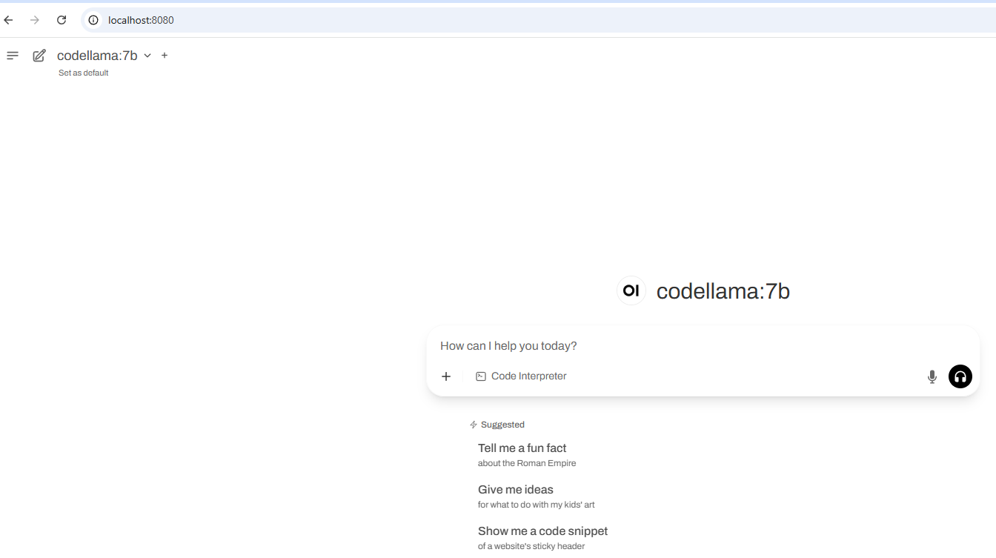
Open WebUI (.cont)
Once the WebUI is installed we can access the dashboard using http://localhost:8080/

Slide 24
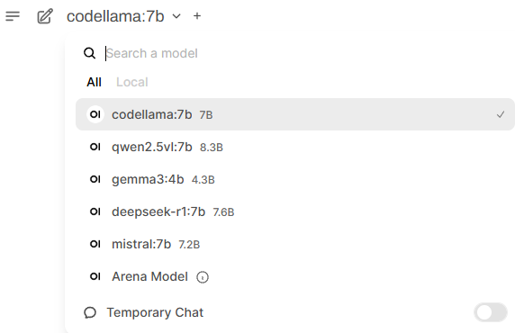
Open WebUI (.cont)
The Open WebUI is operating with ollama and detects the available models to use

Slide 25
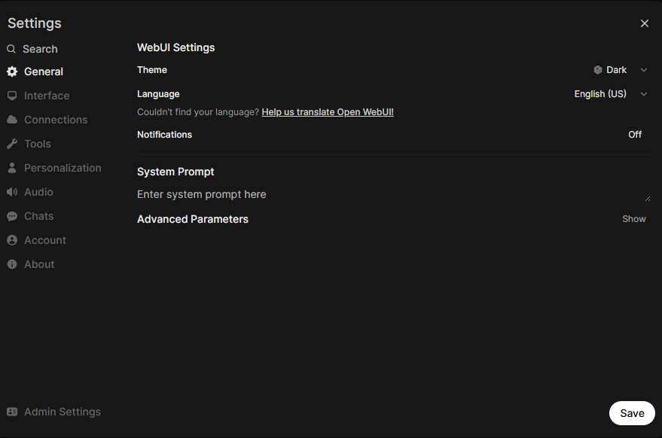
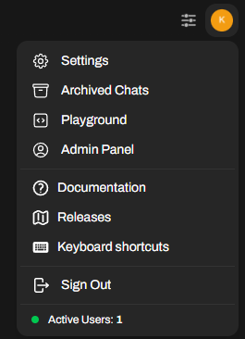
Open WebUI (.cont)
We can configure various settings with the admin panel.

Slide 26
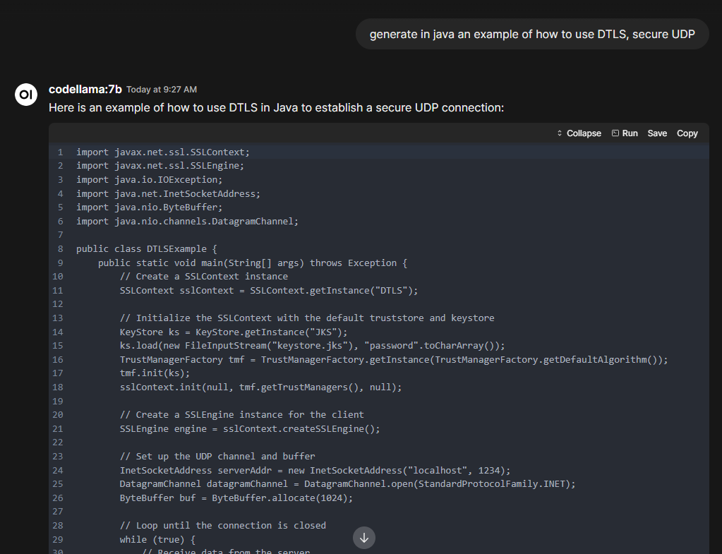
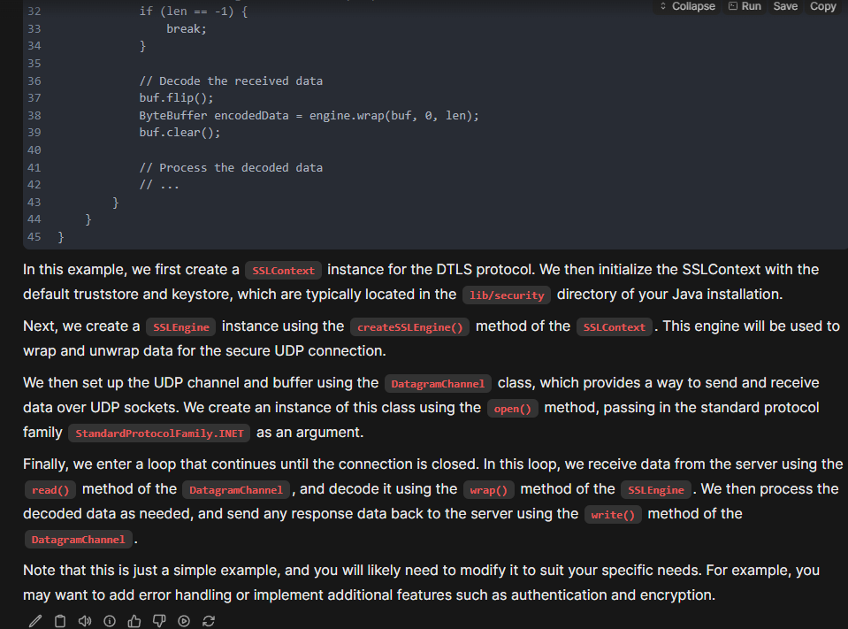
Open WebUI (.cont)
The Open WebUI is very easy to use.

Slide 27
Conclusion
Pros:
Enhanced privacy and data security
No reliance on cloud services
Customization flexibility
Friendly developer CLI and GUI
Cost savings
Cross platform support
Model interoperability
Cons:
Limited Cloud scale features
Platform maturity
Hardware requirements

Slide 28

Bibliography
https://ollama.com/
https://github.com/ollama/ollama
https://www.hostinger.com/tutorials/what-is-ollama
https://www.cohorte.co/blog/a-comprehensive-guide-to-ollama
https://docs.openwebui.com
https://github.com/open-webui/open-webui

