Slide 1

Spark
Dima Ionut Daniel

Slide 2
Contents
What is Spark?
Core
Templates
JSON
Conclussion
Bibliography

Slide 3

What is Spark?
Spark is a tiny framework for creating web applications in Java 8 with minimal effort.
Spark is a free and open source software web application framework and domain-specific language.
Spark was created in 2011 by Per Wendel, and was completely rewritten for version 2 in 2014.

Slide 4
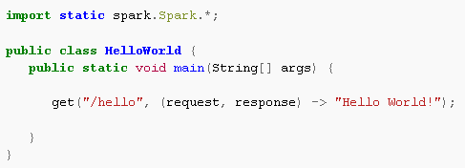
Core
Spark runs on an embedded Jetty web server by default, but can be configured to run on other webservers.
Spark is intended for "quickly creating web-applications in Java with minimal effort."

Slide 5
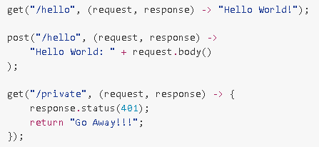
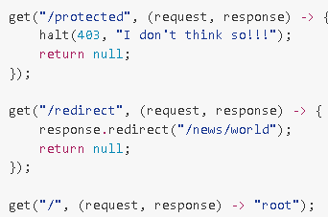
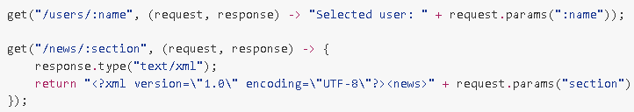
Core (cont.)
Spark is very easy to configure.

Slide 6
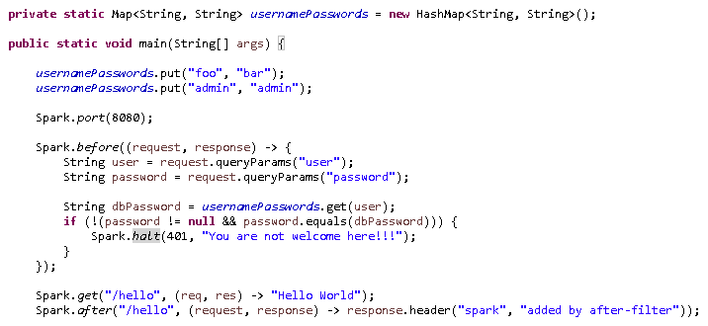
Core (cont.)
Spark can execute filters also using before() and after() methods.

Slide 7
Core (cont.)
Spark can serve also static files, using the staticFileLocation() method..
We can redirect what method to call based on the Accept header.

Slide 8
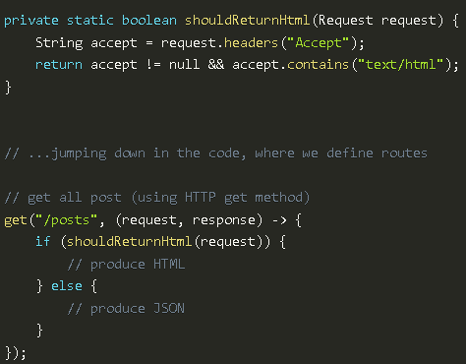
Core (cont.)
We can get headers for the HTTP request.

Slide 9
Templates
Spark supports these template engines:
Apache Velocity
FreeMarker
Mustache
Handlebars
Jade
Pebble
Water

Slide 10
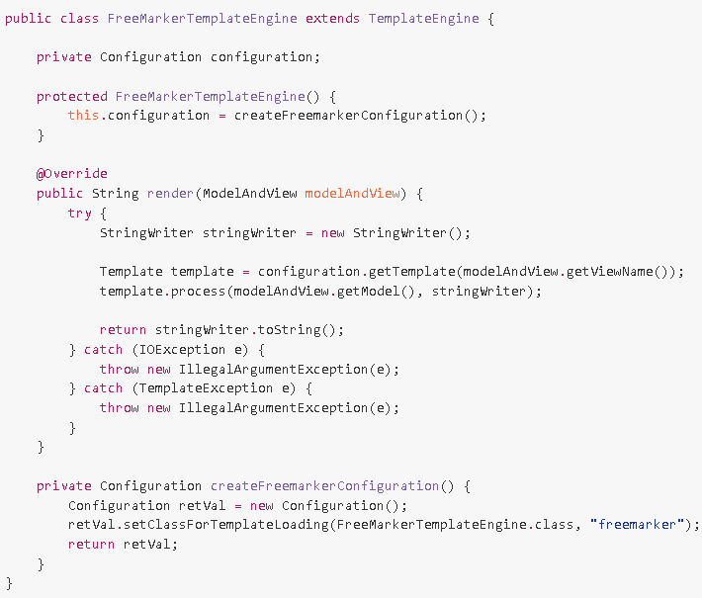
Templates (cont.)
Spark can work with template engines also.

Slide 11
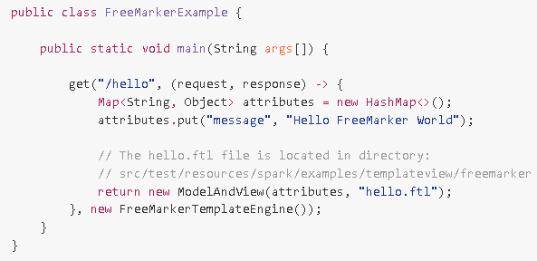
Templates (cont.)
Bellow is a sample for using FreeMarker template engine with Spark.

Slide 12
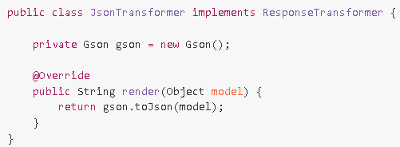
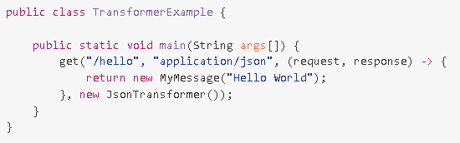
JSON
Spark can render very easy JSON information:

Slide 13
Conclussion
Spark is easy to use and we can build very easy web content.

Slide 14

Bibliography
https://en.wikipedia.org/wiki/Spark_%28software%29
http://sparkjava.com/

Slide 15
Questions ?

