Slide 1

A2A
Dima Ionut Daniel

Slide 2
Contents
What is A2A?
Goals
Features
Use Cases
Arhitecture
Concepts
Core
A2A vs MCP
Conclusion
Bibliography

Slide 3

What is A2A?
The A2A (Agent-to-Agent) protocol is an open standard that lets AI agents from different frameworks, vendors, and organizations communicate and collaborate seamlessly.
It creates a shared language for interoperability, enabling autonomous agents—independent problem-solvers—to team up and break down silos.
Originally developed by Google; now hosted by the Linux Foundation.
Latest stable specification: v1.0.0 (2026).
Enables agents built with different frameworks, languages, and vendors to discover each other, delegate tasks, and exchange results.
Agents collaborate as opaque (black-box) peers — internal memory, tools, and reasoning are not exposed.
Complements MCP (Model Context Protocol): MCP connects agents to tools; A2A connects agents to agents.

Slide 4
Goals
Interoperability - bridge communication between disparate agentic systems.
Collaboration - delegate tasks, exchange context, work on complex requests.
Discovery - dynamically find and understand other agents' capabilities.
Flexibility - sync request/response, SSE streaming, async push notifications.
Security - enterprise-grade patterns (TLS, OAuth 2.0, API keys, signed Agent Cards).
Asynchronicity - native support for long-running and human-in-the-loop tasks

Slide 5
Goals (cont.)
Design principles that shape the protocol:
Simple - reuses HTTP, JSON-RPC 2.0, and Server-Sent Events (SSE)
Enterprise Ready - authentication, authorization, tracing, monitoring
Async First - designed for long-running tasks and human-in-the-loop flows
Modality Agnostic - text, files, structured JSON/data, UI references via Parts
Opaque Execution - collaboration based on declared capabilities, not internal state

Slide 6
Features
Standardized Messaging & Communication
Structured message formats (often JSON, XML, or domain-specific schemas)
Defined performatives (e.g., request, inform, propose, accept, reject)
Asynchronous communication support
Message routing and delivery guarantees
Agent Identity & Addressability
Unique agent identifiers (Agent IDs)
Discovery mechanisms (directory services or registries)
Capability advertisement (agents declare what they can do)
Autonomy & Local Decision-Making
Each agent controls its own state and goals
No mandatory central controller
Agents decide when/how to respond

Slide 7
Features (cont.)
Negotiation & Coordination Mechanisms
Contract Net Protocol-style task bidding
Auctions and market-based coordination
Consensus or voting mechanisms
Multi-step dialogue flows
Shared Ontology & Semantics
Common vocabulary or schema definitions
Domain models to ensure semantic interoperability
Explicit meaning of message types and actions
Trust, Security & Authentication
Agent authentication (keys, tokens, certificates)
Secure transport (TLS, encrypted messaging)
Access control and permissions
Reputation or trust scoring mechanisms

Slide 8
Features (cont.)
State & Context Management
Conversation tracking (session IDs, correlation IDs)
Memory of past interactions
Context propagation across workflows
Scalability & Distributed Architecture
Peer-to-peer or federated communication
Horizontal scaling across nodes
Fault tolerance and graceful degradation
Extensibility & Interoperability
Pluggable behaviors or skill modules
Versioned protocol definitions
Compatibility across different agent frameworks
Observability & Monitoring
Logging of agent interactions
Audit trails
Explainability mechanisms (why an agent made a decision)

Slide 9
Use Cases
Multi-Agent AI Systems (LLM & Autonomous Agents)
Smart Grids & Energy Management
Supply Chain & Logistics Optimization
IoT & Smart Environments
Autonomous Vehicles & Traffic Systems
Financial Trading & Market Simulation
Robotics & Swarm Systems
Healthcare Coordination Systems
Enterprise Workflow Automation

Slide 10
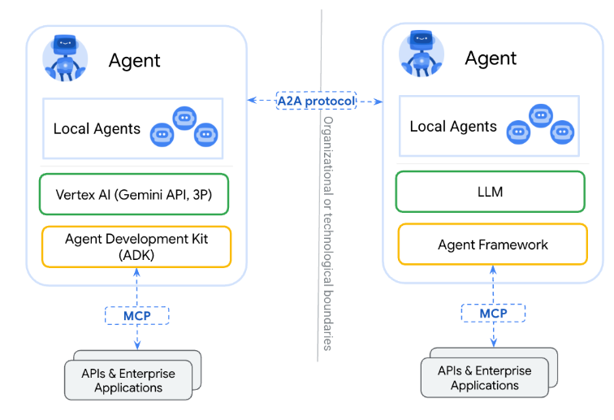
Arhitecture

Slide 11
Concepts
Agent – Autonomous entity with its own goals, state, and decision-making capability
Autonomy – Agents control their own actions and can accept, reject, or delegate tasks
Message Passing – Structured communication between agents (sender, receiver, content, context)
Performatives (Speech Acts) – Intent types such as request, inform, propose, accept, reject
Interaction Protocols – Defined conversation patterns (e.g., negotiation, bidding, consensus)
Goals & Intent – Agents act based on internal objectives or utility functions

Slide 12
Concepts (cont.)
Environment – The shared physical, digital, or simulated space agents operate in
Shared Ontology – Common vocabulary and semantic understanding between agents
Trust & Security – Authentication, authorization, encryption, and reputation mechanisms
Coordination & Negotiation – Task allocation, conflict resolution, and collaboration strategies
Decentralization – Peer-to-peer structure with no mandatory central controller
State & Context Management – Conversation tracking, memory, and multi-step workflow handling

Slide 13
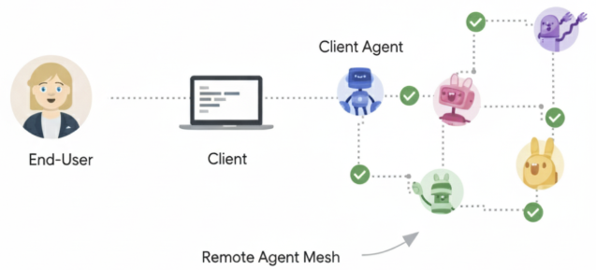
Core
Core Actors in A2A Interactions:
User: The end user, which can be a human operator or an automated service. The user initiates a request or defines a goal that requires assistance from one or more AI agents.
A2A Client (Client Agent): An application, service, or another AI agent that acts on behalf of the user. The client initiates communication using the A2A protocol.
A2A Server (Remote Agent): An AI agent or an agentic system that exposes an HTTP endpoint implementing the A2A protocol. It receives requests from clients, processes tasks, and returns results or status updates. From the client's perspective, the remote agent operates as an opaque (black-box) system, meaning its internal workings, memory, or tools are not exposed.

Slide 14
Core (cont.)
Fundamental Communication Elements
Element | Description | Purpose
Agent Card | A JSON metadata document describing an agent's identity, capabilities, endpoint, skills, and authentication requirements. | Enables clients to discover agents and understand how to interact with them securely and effectively.
Task | A stateful unit of work initiated by an agent, with a unique ID and defined lifecycle. | Facilitates tracking of long-running operations and enables multi-turn interactions and collaboration.
Message | A single turn of communication between a client and an agent, containing content and a role ("user" or "agent"). | Conveys instructions, context, questions, answers, or status updates that are not necessarily formal artifacts.
Part | The fundamental content container used within Messages and Artifacts. A Part holds one of: text content, a file reference (URL or inline bytes), or structured data. | Provides flexibility for agents to exchange various content types within messages and artifacts.
Artifact | A tangible output generated by an agent during a task (for example, a document, image, or structured data). | Delivers the concrete results of an agent's work, ensuring structured and retrievable outputs.

Slide 15
Core (cont.)
Interaction Mechanisms
Request/Response (Polling): Clients send a request and the server responds. For long-running tasks, the client periodically polls the server for updates.
Streaming with Server-Sent Events (SSE): Clients initiate a stream to receive real-time, incremental results or status updates from the server over an open HTTP connection.
Push Notifications: For very long-running tasks or disconnected scenarios, the server can actively send asynchronous notifications to a client-provided webhook when significant task updates occur.

Slide 16
Core (cont.)
The Agent Card is a JSON document acting as a digital business card for AI agents, sharing key metadata for discovery and interaction setup.
Clients use it to assess suitability for tasks, format requests, and ensure secure communication.
It covers identity, service endpoint (URL), A2A capabilities, authentication needs, and available skills.

Slide 17
Core (cont.)
A task represents a unit of work needed to accomplish a request. It has a unique ID and progresses through a lifecycle of defined states (submitted, working, input-required, completed, failed). Tasks are useful for multi-turn processing or long-running agent-to-agent collaboration.
Message, as a fundamental unit of communication, a message depicts a single exchange or turn in a conversation. It contains one or more parts holding the actual content. Messages relay answers, context, instructions, prompts, questions, replies and status updates.

Slide 18
Core (cont.)
An artifact is a tangible product generated by the A2A server as a result of its work. It can be a document, image, spreadsheet or any other deliverable. Like messages, artifacts consist of one or more parts and can be incrementally streamed.
A part is a piece of content inside a message or an artifact. Parts have various types based on the data they carry. A TextPart is a vessel for text, a FilePart represents files and a DataPart encompasses structured JSON (JavaScript Object Notation) data.

Slide 19
Core (cont.)
AI agents need to first find each other and understand their capabilities.
A2A standardizes agent self-descriptions through the Agent Card.
The key information included in an Agent Card is as follows:
Identity: Includes name, description, and provider information.
Service Endpoint: Specifies the url for the A2A service.
A2A Capabilities: Lists supported features such as streaming or pushNotifications.
Authentication: Details the required schemes (e.g., "Bearer", "OAuth2").
Skills: Describes the agent's tasks using AgentSkill objects, including id, name, description, inputModes, outputModes, and examples.

Slide 20
Core (cont.)
Discovery Strategies
1. Well-Known URI
This approach is recommended for public agents or agents intended for broad discovery within a specific domain.
A2A Servers make their Agent Card discoverable by hosting it at a standardized, well-known URI on their domain. The standard path is https://{agent-server-domain}/.well-known/agent-card.json, following the principles of RFC 8615.
2. Curated Registries (Catalog-Based Discovery)
This approach is employed in enterprise environments or public marketplaces, where Agent Cards are often managed by a central registry.
The curated registry acts as a central repository, allowing clients to query and discover agents based on criteria like "skills" or "tags".
3.Direct Configuration / Private Discovery
This approach is used for tightly coupled systems, private agents, or development purposes, where clients are directly configured with Agent Card information or URLs.

Slide 21
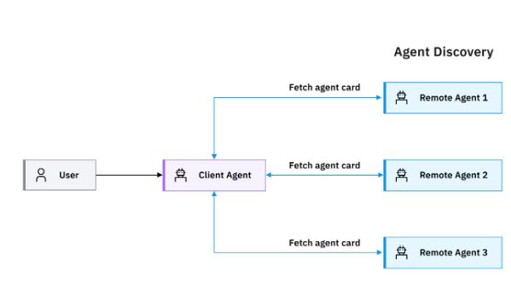
Core (cont.)
The A2A protocol follows a client-server model setup with a three-step workflow:
Discovery
Authentication
Communication

Slide 22
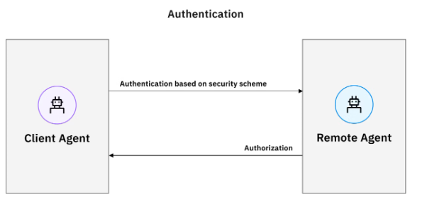
Core (cont.)
Authentication
Once the client agent identifies a remote agent capable of fulfilling the designated task, it then goes through authentication according to the security scheme indicated in the agent card. A2A supports security schemes aligned with the OpenAPI specification, such as API keys, OAuth 2.0 and OpenID Connect Discovery.

Slide 23
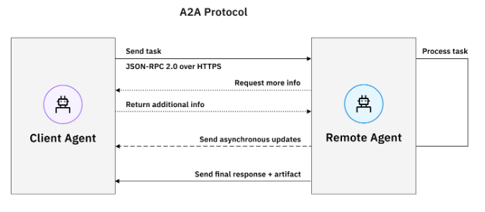
Core (cont.)
Communication
Communication starts with a client agent sending a task to the chosen remote agent. Agent-to-agent communication occurs over HTTPS for secure transport, with JSON-RPC (Remote Procedure Call) 2.0 as the format for data exchange.

Slide 24
Core (cont.)
Each Task progresses through defined states:
submitted — task acknowledged by the server
working — agent is actively processing
input-required — agent needs more information from the client
auth-required — client must provide credentials (v1.0)
completed — task finished successfully
failed / canceled / rejected — terminal error or cancellation states
Clients track tasks via Get Task (polling), SSE streaming, or push notifications.

Slide 25
Core (cont.)
Java stack for A2A (as of mid-2026):
A2A Java SDK (org.a2aproject.sdk) v1.1.0.Final — official client/server library
spring-ai-a2a v0.3.0 — Spring Boot auto-configuration (community project)
Spring Boot 4.0+ and Spring AI 2.0.0-M2+ required
You provide three beans: AgentCard, AgentExecutor, ChatClient
Framework auto-configures: JSON-RPC endpoints, task lifecycle, Agent Card publishing
Endpoints (with context-path /a2a):
POST /a2a — sendMessage (JSON-RPC)
GET /a2a/card — Agent Card discovery
GET /a2a/tasks/{id} — task status

Slide 26
Core (cont.)
<dependency>
<groupId>org.springaicommunity</groupId>
<artifactId>spring-ai-a2a-server-autoconfigure</artifactId>
<version>0.3.0</version>
</dependency>
<dependency>
<groupId>org.springframework.ai</groupId>
<artifactId>spring-ai-starter-model-openai</artifactId>
<!-- Spring AI 2.0.0-M2+ with Spring Boot 4.0 -->
</dependency>
Requirements: Java 17+, Maven 3.8+, OPENAI_API_KEY (or other model provider)

Slide 27
Core (cont.)
AgentCard + AgentExecutor
@Bean
public AgentCard agentCard(@Value("${server.port:8080}") int port) {
return new AgentCard.Builder()
.name("Weather Agent")
.description("Provides weather forecasts")
.url("http://localhost:" + port + "/a2a/")
.protocolVersion("1.0")
.capabilities(new AgentCapabilities.Builder()
.streaming(false).build())
.skills(List.of(new AgentSkill.Builder()
.id("weather_search").name("Weather Search")
.description("Current weather and forecasts").build()))
.build();
}
@Bean
public AgentExecutor agentExecutor(ChatClient.Builder builder, WeatherTools tools) {
ChatClient chat = builder.clone()
.defaultSystem("You are a weather assistant.")
.defaultTools(tools).build();
return new DefaultAgentExecutor(chat, (c, ctx) ->
c.prompt().user(DefaultAgentExecutor
.extractTextFromMessage(ctx.getMessage())).call().content());
}

Slide 28
Core (cont.)
@Tool and application.yml
@Service
public class WeatherTools {
@Tool(description = "Get current weather for a location")
public String getCurrentWeather(
@ToolParam(description = "City, e.g. London, UK") String location) {
return "Weather in " + location + ": Sunny, 22°C";
}
}
# application.yml
server:
port: 8080
servlet.context-path: /a2a
spring:
ai:
a2a.server.enabled: true
openai.api-key: ${OPENAI_API_KEY}

Slide 29
Core (cont.)
Calling remote A2A agents
// Discover agent and send a message via A2A Java SDK
A2ACardResolver resolver = new A2ACardResolver(
new JdkA2AHttpClient(), "http://localhost:8081",
"/a2a/card", null);
Client client = Client.builder(resolver.getAgentCard())
.withTransport(JSONRPCTransport.class, new JSONRPCTransportConfig())
.build();
client.sendMessage(new Message.Builder()
.role(Message.Role.USER)
.parts(List.of(new TextPart("Plan a trip to Paris")))
.build());
// Or wrap remote agents as @Tool methods for multi-agent orchestration

Slide 30
Core (cont.)
Testing A2A agent with CURL
curl -X POST http://localhost:8080/a2a \
-H 'Content-Type: application/json' \
-d '{
"jsonrpc": "2.0",
"method": "message/send",
"id": "1",
"params": {
"message": {
"role": "user",
"parts": [{"kind": "text", "text": "Weather in London?"}]
}
}
}'
Discover Agent Card: GET http://localhost:8080/a2a/card

Slide 31
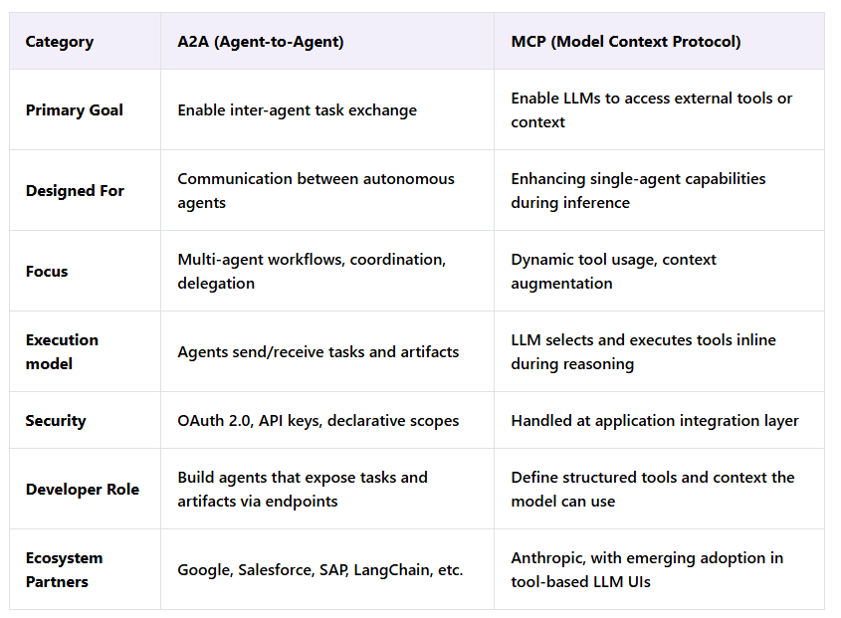
A2A vs MCP

Slide 32
Conclusion
Pros:
Decentralized coordination – No central controller required.
Scalable collaboration – Agents can negotiate, delegate, and specialize.
Flexibility – Enables dynamic task sharing.
Autonomy – Agents can make independent decisions.
Cons:
Complex design – Requires message standards and conflict resolution.
Security risks – Trust, authentication, and spoofing issues.
Debugging difficulty – Emergent behaviors can be unpredictable.
Interoperability challenges – Agents from different frameworks may not align.

Slide 33

Bibliography
https://developers.googleblog.com/en/a2a-a-new-era-of-agent-interoperability/
https://a2a-protocol.org/
https://blog.logto.io/a2a-mcp
https://medium.com/ai-cloud-lab/building-multi-agent-ai-app-with-googles-a2a-agent2agent-protocol-adk-and-mcp-a-deep-a94de2237200
https://www.ibm.com/think/topics/agent2agent-protocol
https://github.com/a2aproject/A2A — protocol repository
https://github.com/a2aproject/a2a-java — official A2A Java SDK

