Slide 1

GraalVM
Dima Ionut Daniel

Slide 2
Contents
What is GraalVM?
Concepts
Core
Truffle
GraalVM
Other VMs
Bibliography

Slide 3

What is GraalVM ?
GraalVM is a Java VM and JDK based on HotSpot/OpenJDK, implemented in Java.
It supports additional programming languages and execution modes, like ahead-of-time compilation of Java applications for fast startup and low memory footprint.
The first production-ready version, GraalVM 19.0, was released in May 2019.
The most recent version is GraalVM 22.1.0, made available in April 2022.

Slide 4
What is GraalVM ? (cont.)
GraalVM is a high-performance VM that provides the runtime for modern cloud-native applications.
Cloud-native applications are built based on the service architecture.
The microservices runtimes demand a different set of requirements.
Smaller footprint
Quicker bootstrap
Polyglot and interoperability

Slide 5
Concepts
Java has been very successful because of its write once, run anywhere design principle.
Traditionally, there two ways of running application code:
Compilers: Application code is directly compiled to machine code.
Interpreters: Application code is interpreted to machine code line by line.
JVM has taken the best of both interpreters and compilers.

Slide 6
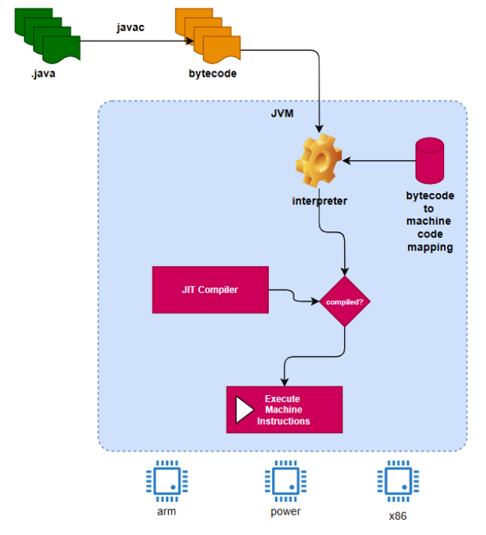
Concepts (cont.)
JVM runs the Java code using both the interpreter and compiler approaches.

Slide 7
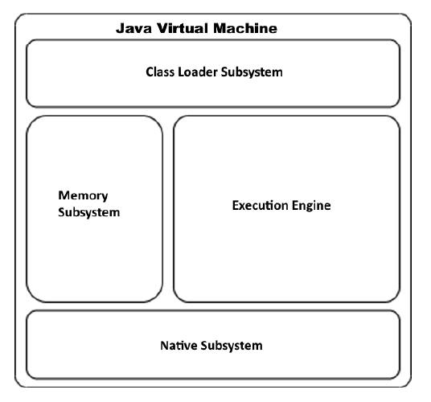
Concepts (cont.)
High level architecture of the JVM.

Slide 8
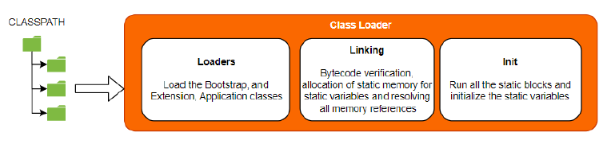
Concepts (cont.)
The class loader subsystem is responsible for:
allocating all the relevant .class files and loading these classes to the memory.
linking and verifying the schematics of the .class file before the classes are initialized and loaded to memory.
The class loader subsystem has the following three key functionalities: loading, linking, initializing.

Slide 9
Concepts (cont.)
There are three types of class loaders as part of this system:
Bootstrap: loads all the classes that are required to run any Java application. This is a core part of the JVM and is
implemented in the native language.
Extensions: load all the extensions to the JDK found in the jre/lib/ext directory.
Application: loads the application classes in the application class path CLASSPATH env variable.

Slide 10
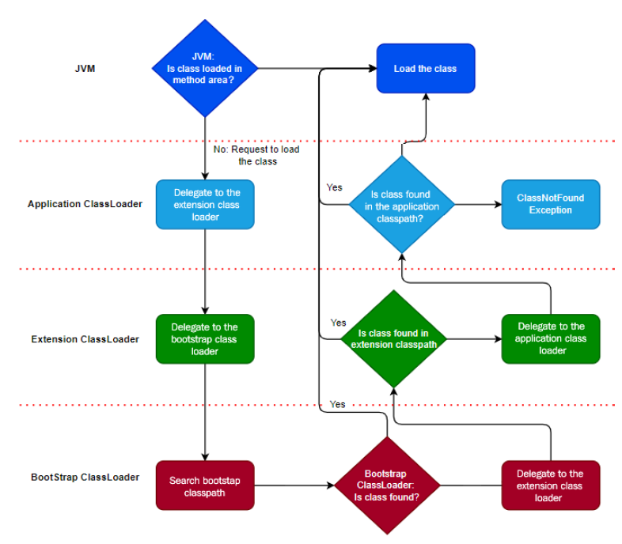
Concepts (cont.)
The class loader implements the delegation pattern when it searches the classes.

Slide 11
Concepts (cont.)
Once the classes are loaded into the memory, the class loader subsystem will perform linking.
The linking process consists in verification, preparation and resolution.
Exception that might occur in this process:
ClassNotFoundException
NoClassDefFoundError
ClassCastException
UnsatisfiedLinkError
ClassCircularityError
ClassFormatError
ExceptionInInitializerError

Slide 12
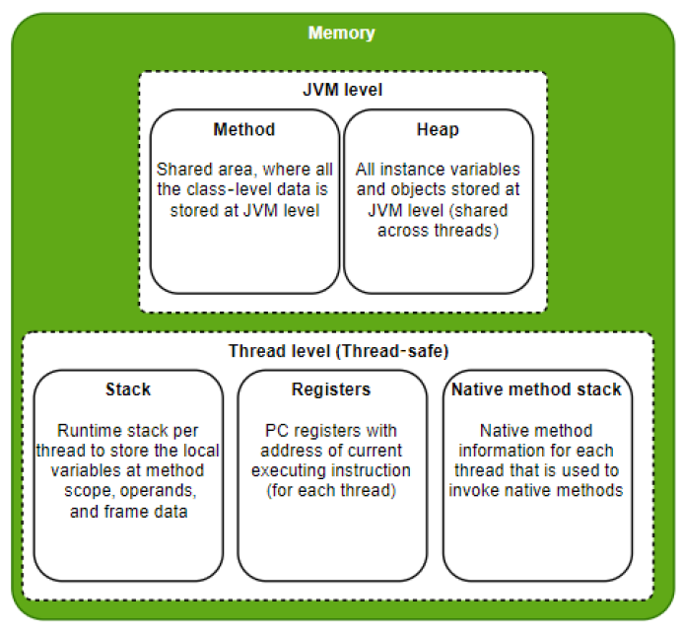
Concepts (cont.)
The memory subsystem is one of the most critical subsystems of the JVM.
The memory subsystem has two areas: JVM level and thread level.

Slide 13
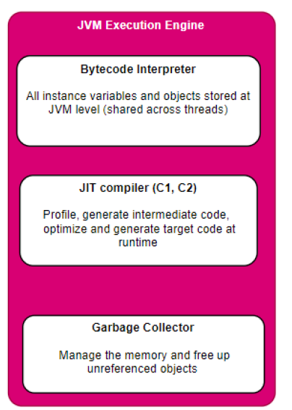
Concepts (cont.)
The JVM execution engine is the core of the JVM.

Slide 14
Concepts (cont.)
Bytecode interpreter
JVM bytecode interpreter picks each instruction from the .class file and converts it to machine code and executes it.
The instructions are executed in sequence, and even if the same method is called several times, it goes through each instruction, interprets it, and then executes.

Slide 15
Concepts (cont.)
JIT Compiler
The JIT compiler identifies areas where the code can be optimized and compiles them to target machine.
A combination of bytecode and compiled code snippets provide the optimum way to execute the class files.
JVM introduced two types of compilers, C1 (client) and C2 (server), and the recent versions of JVM use the best of both for optimizing and compiling the code at runtime.

Slide 16
Concepts (cont.)
C1 compiler
Performance counter was introduced, which counted the number of times a particular method/snippet of code is executed.
Once a method/code snippet is used a particular number of times (threshold), then that particular code snippet is compiled, optimized, and cached by the C1 compiler.
C2 compiler
While the code is getting executed, the JVM will perform runtime code profiling and come up with code paths and hotspots.
This is also known as a hotspot.
C1 is faster and good for short-running applications, while C2 is slower and heavy, but is ideal for long-running processes such as daemons and servers, so the code performs better over time.

Slide 17
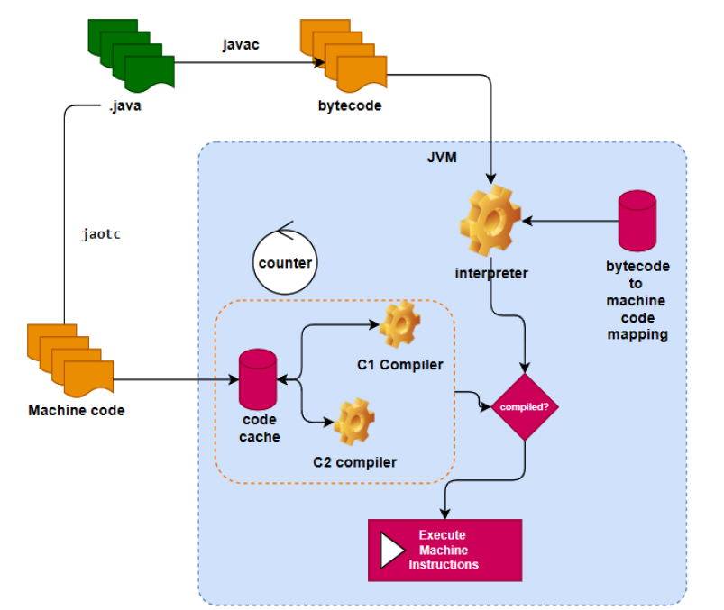
Concepts (cont.)
Java ahead-of-time compilation
The ahead-of-time compilation option was introduced with Java 9 with jaotc, where Java application code can be directly compiled to generate final machine code. The code is compiled to a target architecture, so it is not portable.

Slide 18
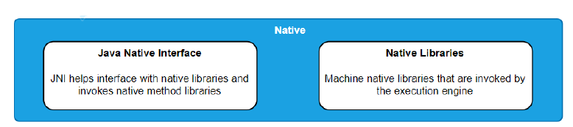
Concepts (cont.)
Native subsystem
Java allows programmers to access native libraries.
Java Native Interface (JNI) provides an abstraction layer and interface specification for implementing the bridge to access the native libraries.

Slide 19
Core
Smaller footprint
The applications are composed of granular modular components (microservices) for high scalability.
A smaller footprint also helps us to make changes and deploy them rapidly and continuously.
Quicker bootstrap
Scalability is one of the most important requirements.
With a smaller footprint, it's also expected that microservices boot up quickly to start handling the load.
Polyglot and interoperability
Polyglot is the reality: each language has its own strengths and will continue to have.

Slide 20
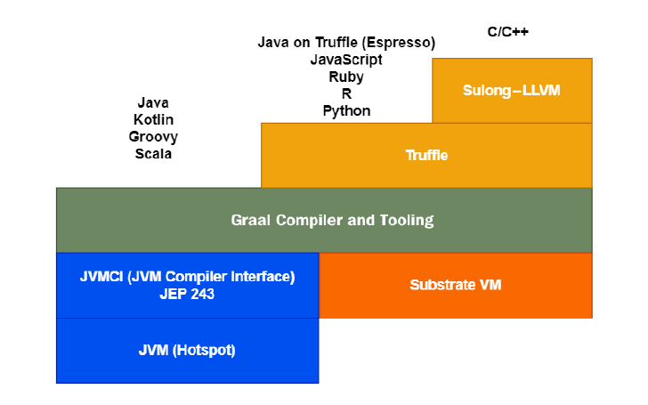
Core (cont.)
GraalVM is built on Java, supports Java, JavaScript, Python, R, Ruby, C, and C++.
It provides an extensible framework called Truffle that allows any language to be built and run on the platform.
GraalVM also provides AOT compilation to build native images with static linking.

Slide 21
Core (cont.)
JVM HotSpot is the regular Java HotSpot VM.
The C2 compiler, which is part of the HotSpot VM, is replaced with the Graal JIT compiler implementation.
The Graal JIT compiler is an implementation of Java Virtual Machine Compiler Interface (JVMCI) and plugs into the Java VM.
JVMCI was introduced in Java 9 and allows compilers to be written as plugins that JVM can call for dynamic compilation.

Slide 22
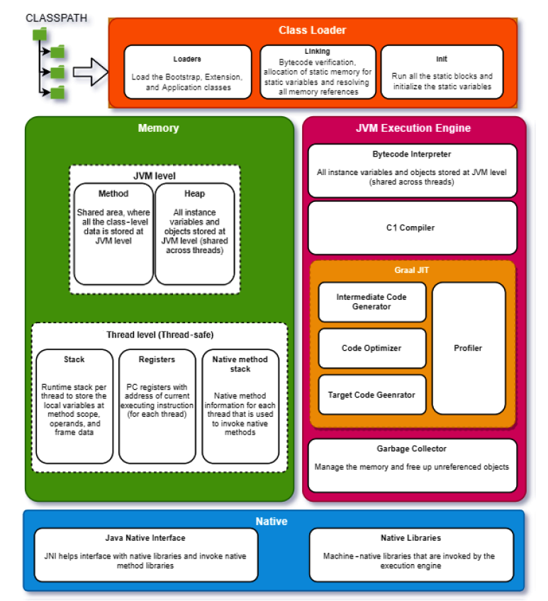
Core (cont.)

Slide 23
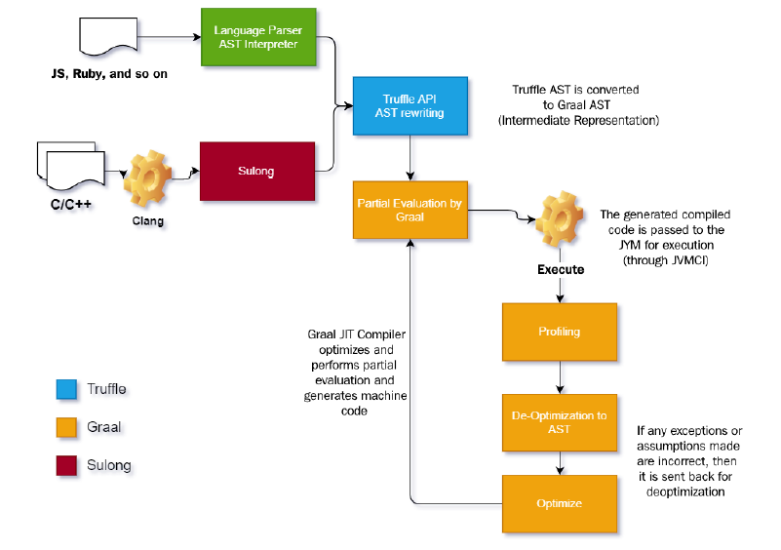
Core (cont.)
The Graal compiler is built on JVMCI and provides a better JIT compiler and replaces the JIT compiler in JVM and incorporates further optimization.
One of the differences between the JVM JIT compiler and Graal JIT is that Graal JIT is built to optimize the intermediate code representation.

Slide 24
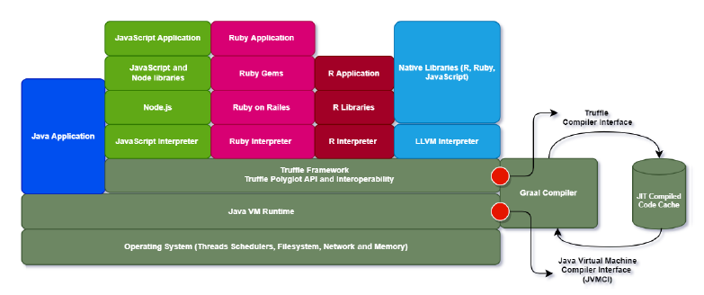
Truffle
Truffle is an open source library for building the interpreters and the tools/utilities.
The Truffle API is used to build language interpreters that can run on GraalVM, leveraging the optimizations provided by GraalVM.

Slide 25
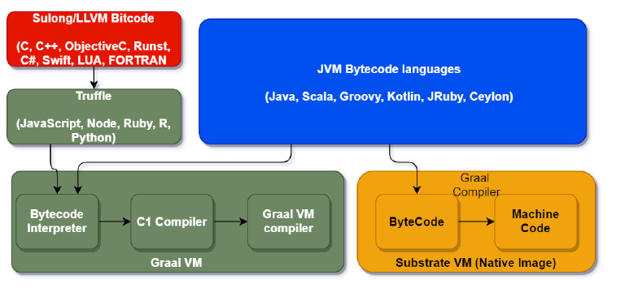
Truffle (cont.)
Truffle and Graal compilation flowchart

Slide 26
GraalVM
GraalVM can be downloaded from https://www.graalvm.org/
After installation we can check the version by using java –version command

Slide 27
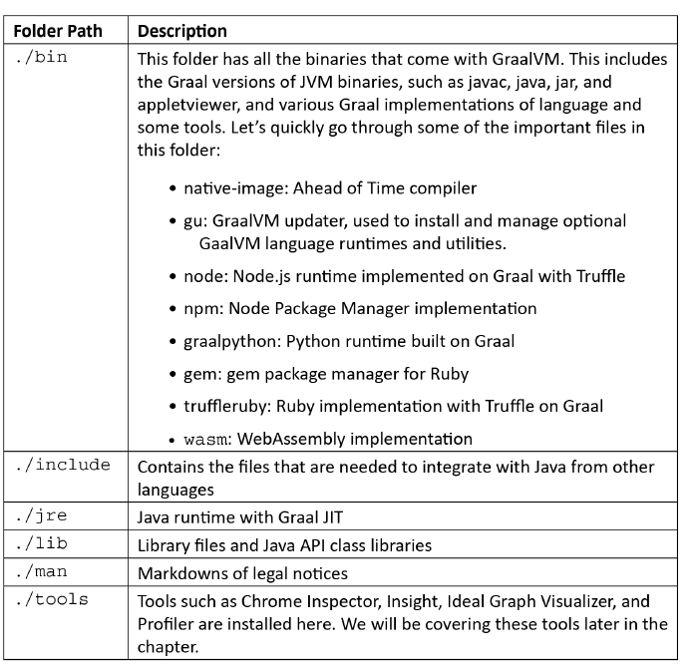
GraalVM (cont.)

Slide 28
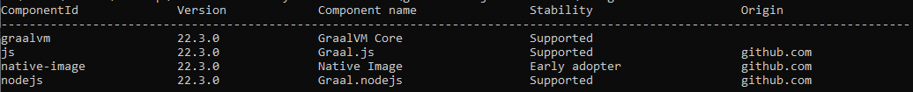
GraalVM (cont.)
Graal Updater is one of the very important tools that is used to install optional runtimes.
To check the runtimes that are available, execute gu list.

Slide 29
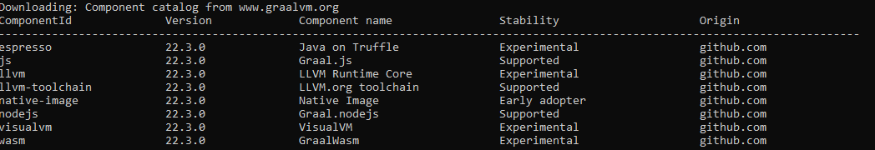
GraalVM (cont.)
We can install runtimes using gu install <runtime> .
To check available plugins we can run the gu available command.

Slide 30
Other VMs
AdoptOpenJDK
Amazon Corretto
Azul Zulu
Bck2Brwsr
CACAO
Codename One
DoppioJVM
Eclipse OpenJ9
GraalVM CE
HaikuVM
HotSpot
HotSpot
Jamiga
JamVM
Jelatine JVM
Jikes RVM (Jikes Research Virtual Machine)
JVM.go
Liberica JDK
leJOS
Maxine
Multi-OS Engine
RopeVM
uJVM
The above VMs are free and open-source

Slide 31
Other VMs (cont.)
Azul Zing JVM
CEE-J
Excelsior JET
GraalVM EE
Imsys AB
JamaicaVM (aicas)
JBlend (Aplix)
MicroJvm (IS2T – Industrial Smart Software Technology)
OJVM
PTC Perc
SAP JVM
Waratek CloudVM for Java
The above VMs are proprietary implementations

Slide 32
Conclussion
Pros:
Faster startup
Lower memory footprint
Boost performance
Cons:
Documentation needs to be improved
Support of microservices needs to be enhanced
Custom support service is not up to the mark

Slide 33

Bibliography
https://en.wikipedia.org/wiki/GraalVM
Packt – Supercharge your applications with GraalVM

Slide 34
Questions ?

