Slide 1

Micronaut
Dima Ionut Daniel

Slide 2
Contents
What is Micronaut?
Architecture
Concepts
Goals
Core
Security
Data
Truffle
Bibliography

Slide 3

What is Micronaut ?
Micronaut is a modern, JVM-based, full stack Java framework designed for building modular, easily testable JVM applications with support for Java, Kotlin, and Groovy.
It is designed to avoid reflection, thus reducing memory consumption and improving start times.
It was created by Graeme Rocher, who also created the Grails framework.

Slide 4
Architecture
Micronaut:
is a modern cloud native framework
uses dependency injection to reduce memory footprint and startup time.
has support for Java, Kotlin and Groovy
has a reactive stack

Slide 5
Concepts
Dependency Injection:
Known as Inversion of Control
Flexible coupled components
Easy testing and integration
Micronaut Injection:
Inspired from Spring DI & Google Dagger
Independent:
micronaut-inject-java
micronaut-inject-groovy

Slide 6
Concepts (cont.)
Aspect Oriented Programming (AOP)
Aims to increase modularity
Separation of cross-cutting concerns
Sensible Defaults and Auto-Configuration:
Checks for the dependencies
Checks presence of certain classes in classpath
Checks existence of certain beans
Activated by some properties

Slide 7
Goals
Use reflection as last resort
Minimal use of proxy
No runtime bytecode generation
Instead use annotation processing during compile time
Optimize startup time
Reduce memory footprint
Provide clear error handling

Slide 8
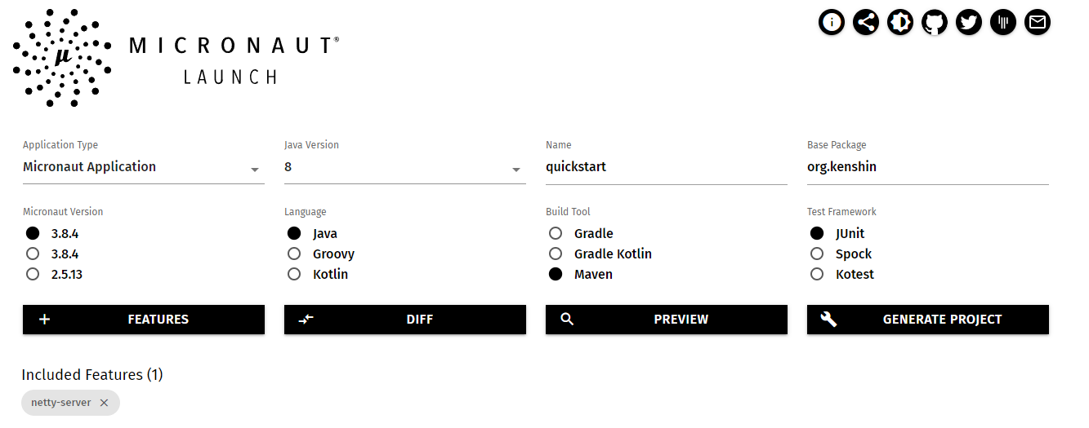
Core
Micronauts applications can be created very easy by accessing https://micronaut.io/launch and generate the project stub.

Slide 9

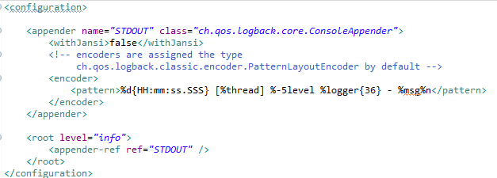
Core (cont.)
Any Micronaut application cand be started by calling the io.micronaut.runtime.Micronaut class.
By default the logging framework is logback.

Slide 10
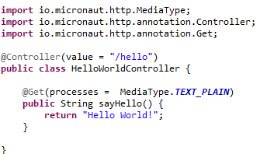
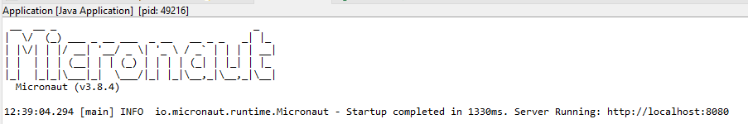
Core (cont.)
A simple REST controller can be created using the @Controller annotation.

Slide 11
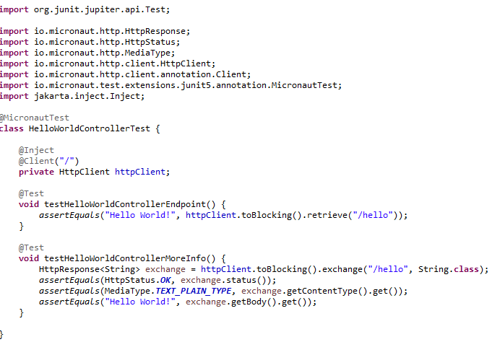
Core (cont.)
Micronauts junits tests can be easy done with @MicronautTest annotation.

Slide 12
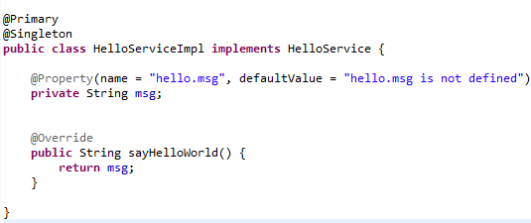
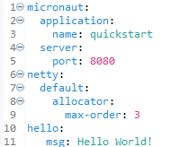
Core (cont.)
Properties from application.yml can be read using the @Property annotation.

Slide 13
Core (cont.)
Micronaut Web Module:
Server:
Netty Non-Blocking IO connectors
Reactive HTTP request processing
JSON bindings with Jackson
Web Sockets
HTTP/2
Client:
Low level HTTP client
Declarative HTTP client with @Client
Non-Blocking
Streaming JSON over HTTP
Retry and Circuit Breaker

Slide 14
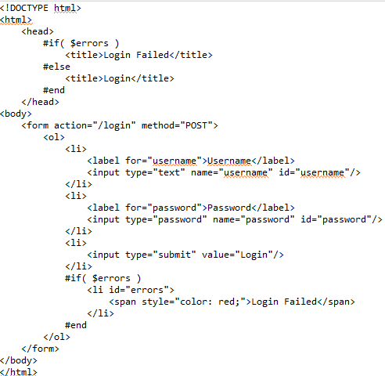
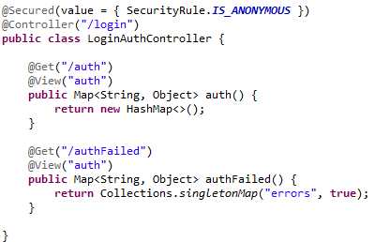
Security
We can use JWT security module to enhance the application to restrict access based on user/roles.
We create into resources/views the auth.vm velocity view that is used to send a POST request to /login endpoint.

Slide 15
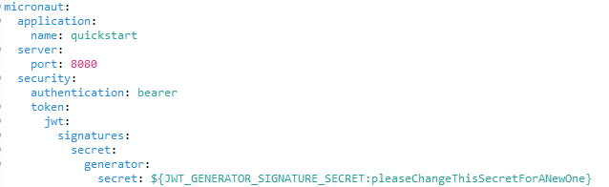
Security (cont.)
Into the application.yml we define the security strategy

Slide 16
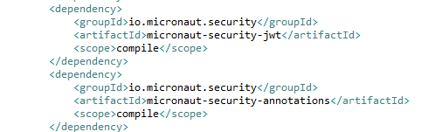
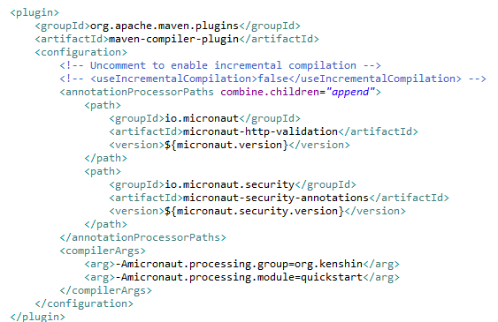
Security (cont.)
Into the pom.xml setup we need to add micronaut-security-jwt, micronaut-security-annotations dependencies. Make sure that into the maven-compiler-plugin we are using the annotationProcessorPath updated.

Slide 17
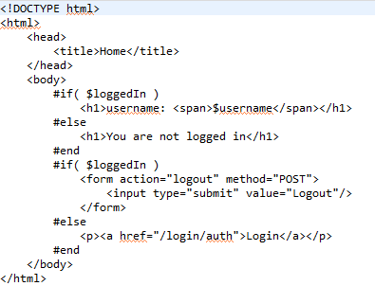
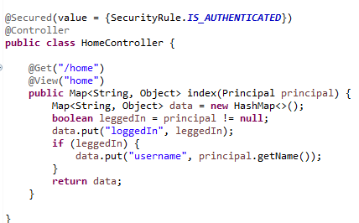
Security (cont.)
Secured controllers are used with @Secured annotation specifying the list of allowed roles.
The @View annotation is used to help the controller of what view to used: home.vm

Slide 18
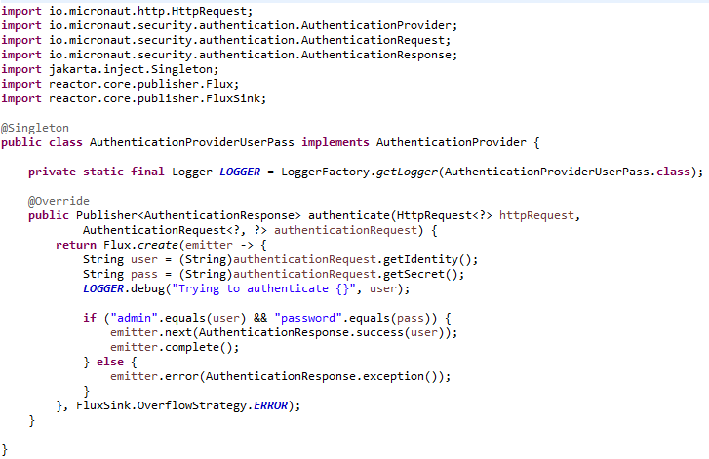
Security (cont.)
We need to implement the AuthenticationProvider interface, where we specify the auth business logic.

Slide 19
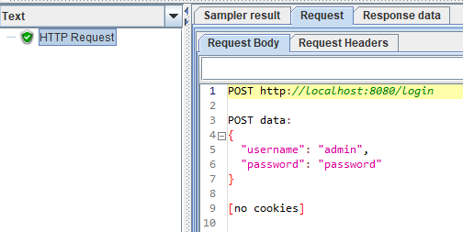
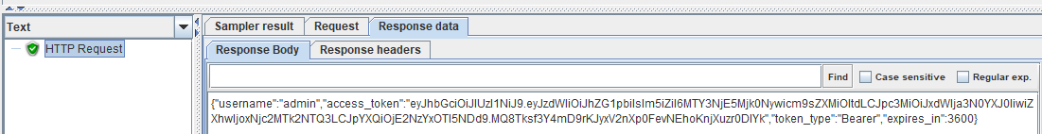
Security (cont.)
We need first to send a POST request to the /login endpoint the JWT token.

Slide 20
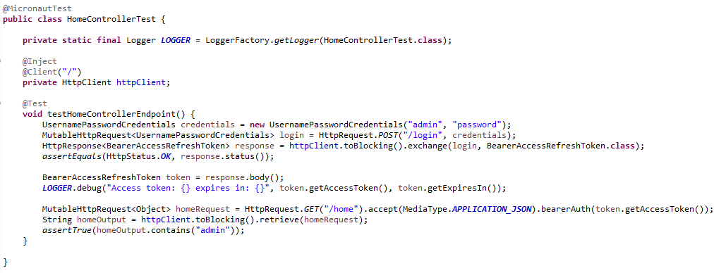
Security (cont.)
Bellow is an example of a micronaut junit test that first authenticates and obtains the JWT token.

Slide 21
Data
Micronaut Data:
precomputed queries at compilation time
reflection free AOP → no runtime overhead
type safe
uses JPA and Hibernate as default implementation
uses proprietary JDBC to compute queries

Slide 22
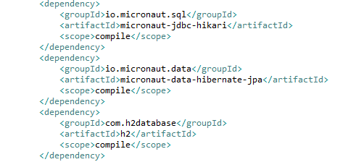
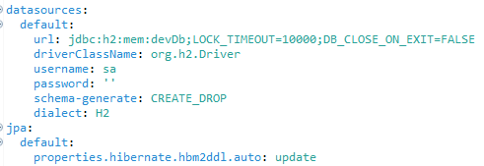
Data (cont.)
In order to use Micronaut Data to access SQL databases we need to configure the pom.xml to include the needed dependencies and application.yml

Slide 23
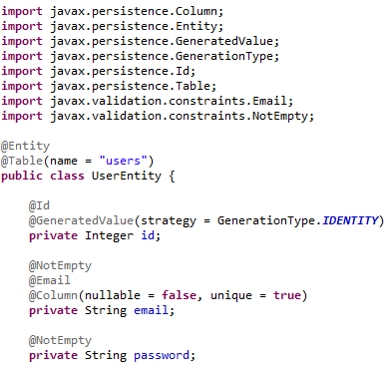
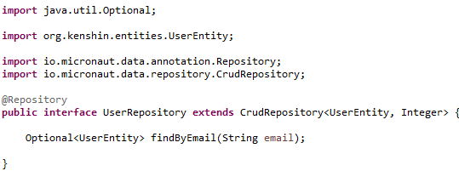
Data (cont.)
We can use JPA entities with Micronaut data CRUD repositories.

Slide 24
Conclussion
Pros:
Serverless support
Open source
Tiny memory footprint
Fast startup time
Minimal overhead
Simplified reactive programming

Slide 25

Bibliography
https://docs.micronaut.io/latest/guide/
Udemy – Learn Micronaut – cloud native microservices with java

Slide 26
Questions ?

