Slide 1

Quarkus
Dima Ionut Daniel

Slide 2
Contents
What is Quarkus?
Goals
Core
Database
Performance
Conclussion
Bibliography

Slide 3

What is Quarkus ?
Quarkus is a java framework tailored for deployment on Kubernetes.
Key technology components around it are OpenJDK HotStpot and GraalVM.
Quarkus is designed around the container-first and K8 philosophy, optimizing for low memory usage and fast startup times.

Slide 4
Goals
Quarkus pushes Java to the Cloud
Optimize startup time
Reduce memory footprint

Slide 5
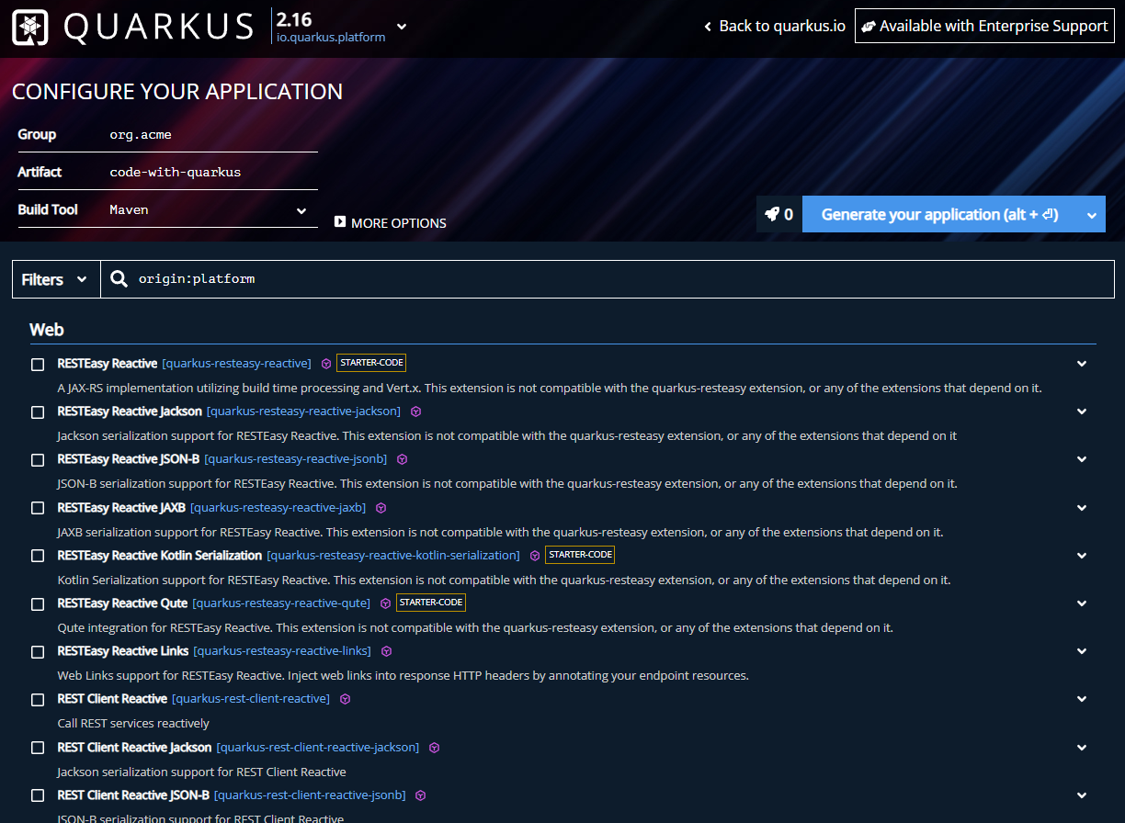
Core
We can generate a project by accessing https://code.quarkus.io/ and setup the needed features.

Slide 6
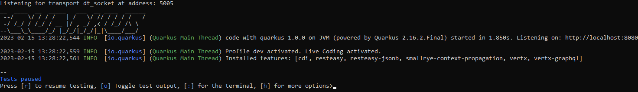
Core (cont.)
To start a quarkus application from maven we can run the “mvn quarkus:dev” command.

Slide 7
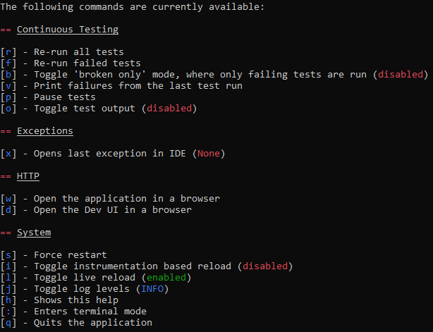
Core (cont.)
By pressing the “h” key we can see all the available options:

Slide 8
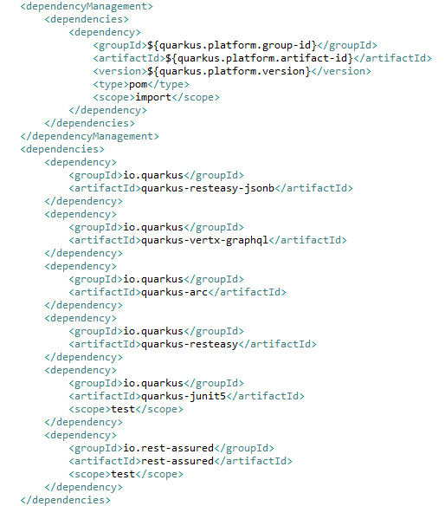
Core (cont.)
The pom.xml file contains the most important dependencies for the quarkus to work.

Slide 9
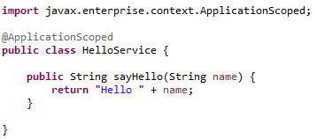
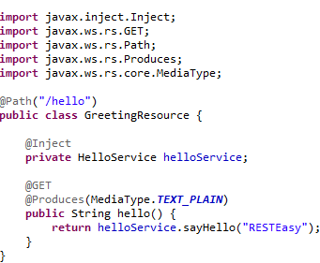
Core (cont.)
Using RESTEasy we can deploy REST controllers using JAX-RS annotations.

Slide 10
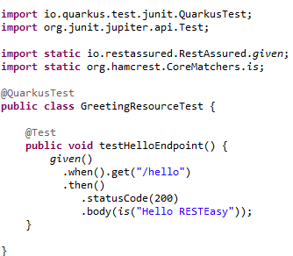


Core (cont.)
We can create Quarkus Junits using @QuarkusTest annotation for testing.

Slide 11
Core (cont.)
We can build a native image by first making sure we have GraalVM installed on the system and afterwards build the Quarkus project using “mvn package –Pnative” command.

Slide 12
Core (cont.)
Quarkus has a CDI extension called Quarkus ARC.
CDI annotations used in Quarkus:
@Inject: identifies injectable constructors, methods and fields
@Qualifier: identifies qualifier annotations
@ApplicationScoped: one instance of a bean per application
@RequestScoped: one instance of a bean per request
@Observes: identifies the event parameter of an observer method

Slide 13
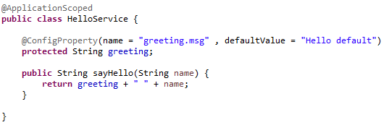
Core (cont.)
In Quarkus, for using application properties the bellow API is used:
@ConfigProperty: binds the injection point with a configured value
ConfigProvider: central class to access a config
Config: resolves the property value by searching though all the configuration sources
ConfigSource: provides configuration values from a specific place
Converter: converts a configured values from String to a Java type

Slide 14
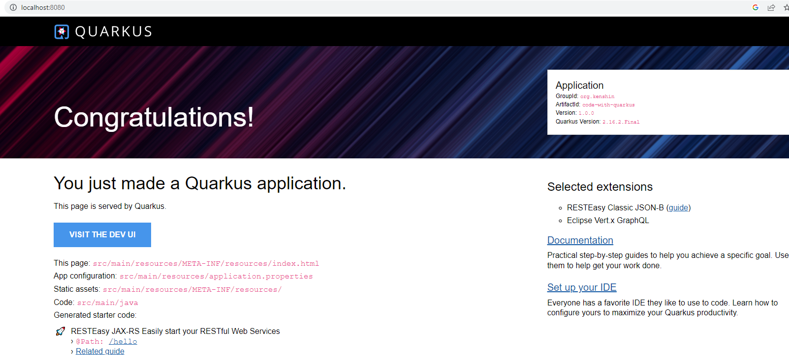
Core (cont.)
After we start the quarkus application we can access the development console from http://localhost:8080

Slide 15
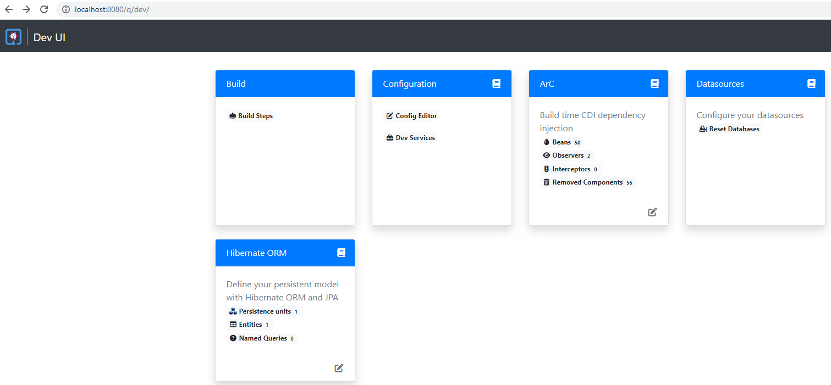
Core (cont.)
The http://localhost:8080/q/dev gives us more details about internal Quarkus deployed services

Slide 16
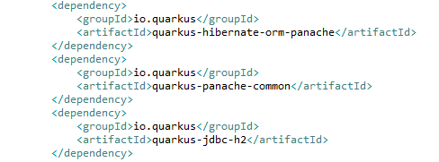
Database
Quarkus can access SQL databases using Hibernate Penache ORM.
Penache is build on top of JPA.
Into the project we need to add the quarkus-hibernate-orm-penache and quarkus-penache-common dependencies. For H2 in memory DB we need to add quarkus-jdbc-h2 dependency.

Slide 17
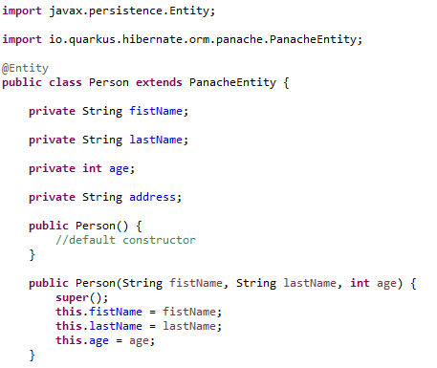
Database (cont.)
All entities are annotated with @Entity from JPA and extends PenacheEntity class.

Slide 18
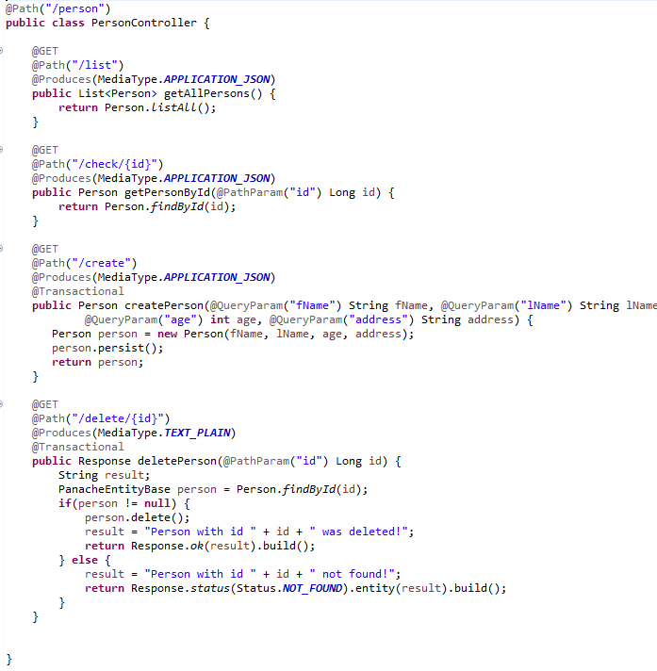
Database (cont.)
Bellow controller uses only GET endpoints for CRUD operations.

Slide 19
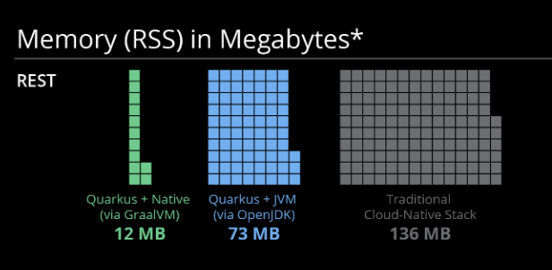
Performance

Slide 20
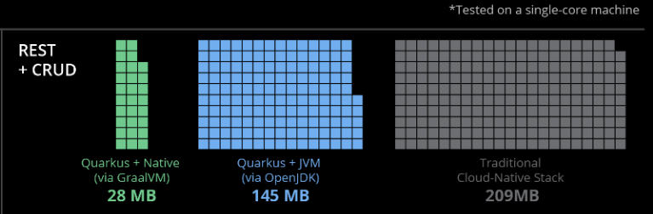
Performance (cont).

Slide 21
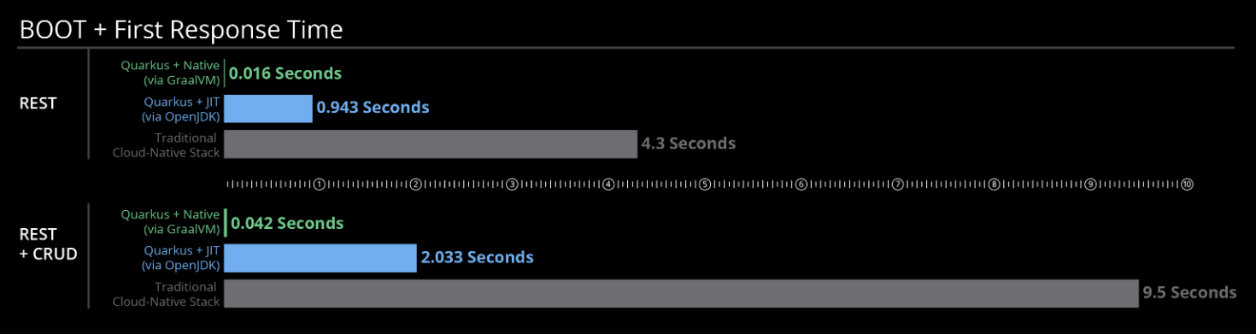
Performance (cont).

Slide 22
Conclussion
Pros:
Low memory footprint
Low startup time
Open-source
Functions (Faas) or serverless
Reactive stack

Slide 23

Bibliography
https://quarkus.io/guides/
https://en.wikipedia.org/wiki/Quarkus

Slide 24
Questions ?

