Slide 1

Crawler4j
Dima Ionut Daniel

Slide 2
Contents
What is Crawler4j ?
Web Crawler
URL
Architecture
Algorithm
Core
Config
Conclussion
Bibliography

Slide 3

What is Crawler4j ?
Crawler4j is an open source web crawler for Java which provides a simple interface for crawling the Web.
Published under Apache License 2.0, see LICENSE.

Slide 4
Web Crawler
A web crawler (spider) is an internet bot that systematically browses the WWW, typically for the purpose of Web indexing (web spidering).
Web Search engines and some other sites use Web crawling or spidering software to update their web content or indices.
Crawlers consume resource on visited systems and often visit sites without approval.
There is a mechanism for public sites (includes robots.txt) that indicates what parts of a website to be processed by bots.
Crawlers can validate hyperlinks and HTML code.

Slide 5
Web Crawler (cont.)
A web crawler starts with a list of URLs to visit, called seeds.
As the crawler visits the URLs, it identifies all the hyperlinks in the page and adds them to the list of URL to visit, called crawl frontier.
URLs from the frontier are recursively visited according to a set of policies.

Slide 6
Web Crawler (cont.)
The behavior of a spider is the outcome of a combination of policies:
a selection policy which states the pages to download
a re-visit policy which states when to check the changed to the pages
a politeness policy that states how to avoid overloading web sites
a parallelization policy that states how to coordinate distributed web crawlers

Slide 7
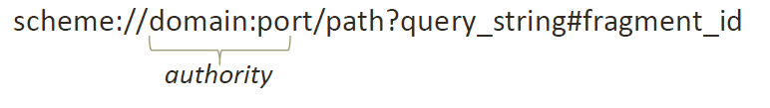
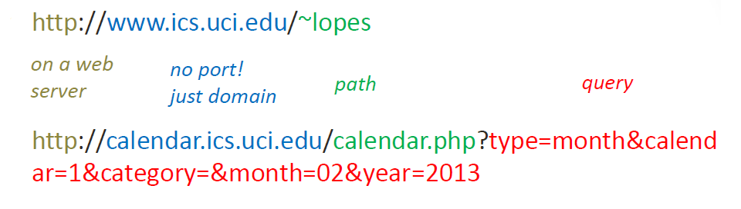
URL
A Uniform Resource Locator (URL) refers to a web resource that specifies its location on a computer network and a mechanism for retrieving it. A URL is a specific type of Uniform Resource Identifier(URI).
URL specification: http://www.w3.org/Addressing/URL/url-spec.txt

Slide 8
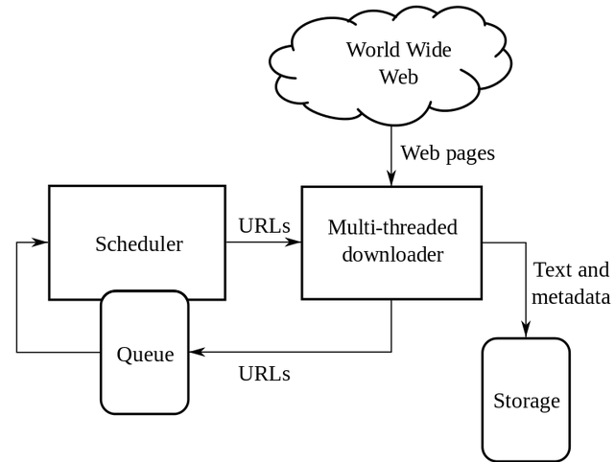
Architecture

Slide 9
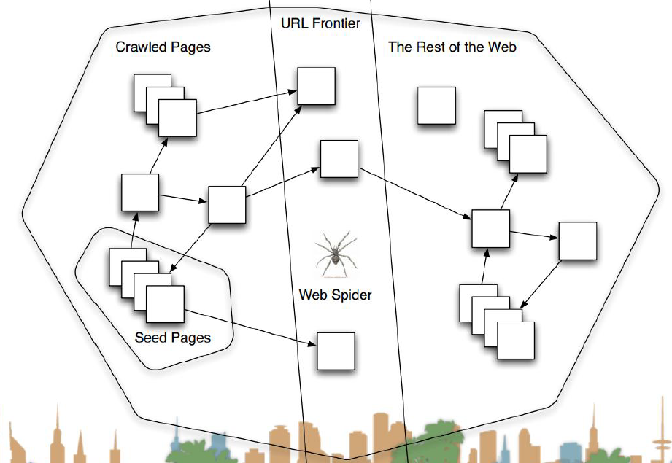
Algorithm

Slide 10
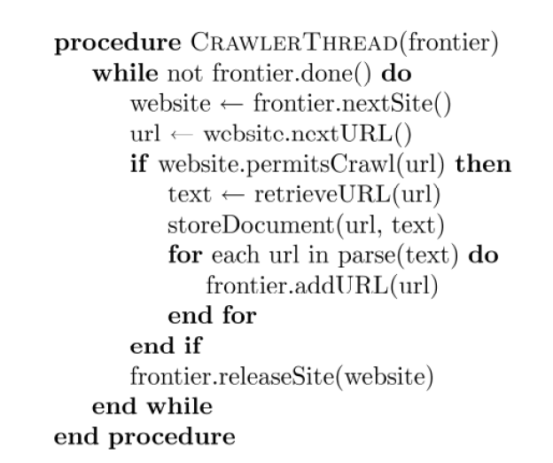
Algorithm (cont.)

Slide 11
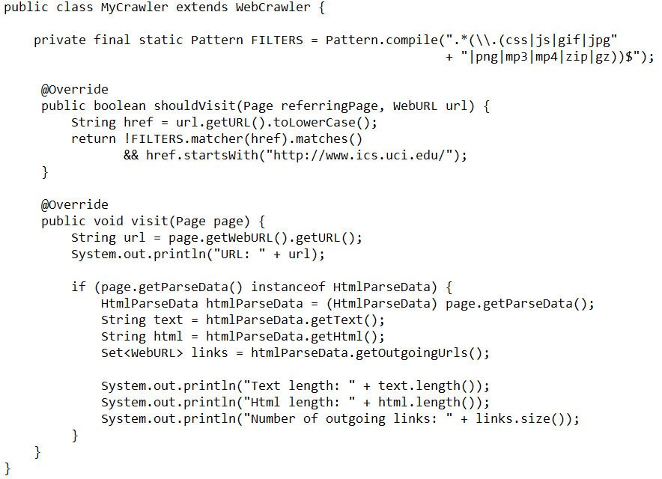
Core
In order to create a crawler we extends the WebCrawler class.
This class decides which URLs should be crawled and handles the downloaded page.

Slide 12
Core (cont.)
There are two main functions that should be overridden:
shouldVisit: decides whether the given URL should be crawled or not. In the above example, this example is not allowing .css, .js and media files and only allows pages within 'www.ics.uci.edu' domain.
visit: is called after the content of a URL is downloaded successfully. We can easily get the url, text, links, html, and unique id of the downloaded page.

Slide 13
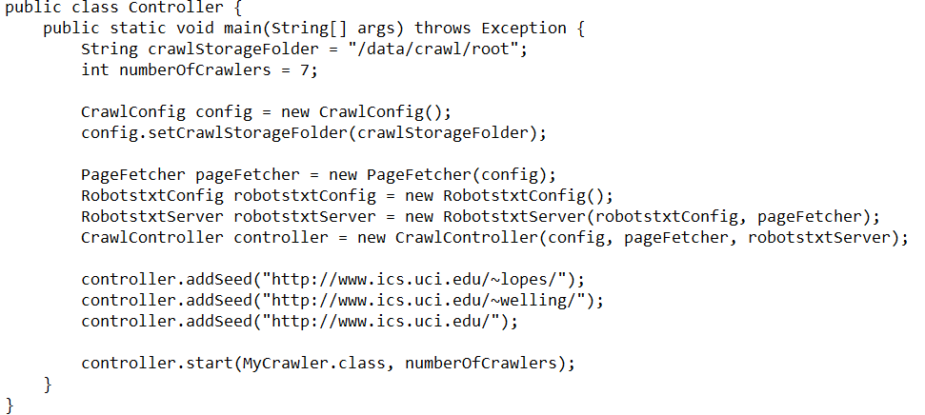
Core (cont.)
We need to implement a controller class which specifies the seeds of the crawl, the folder in which intermediate crawl data should be stored and the number of concurrent threads

Slide 14
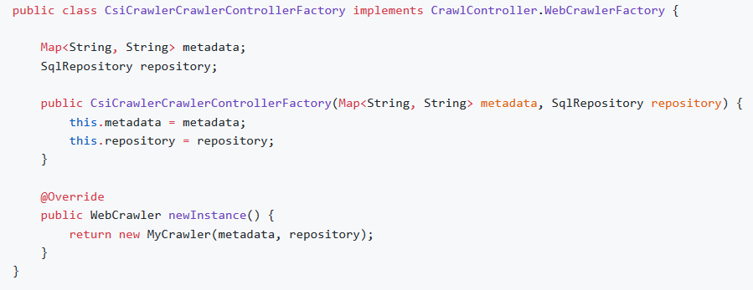
Core (cont.)
Using a factory can be convenient to integrate crawler4j in a IoC environement or to pass information or a collaborator to each WebCrawler instance.

Slide 15
Core (cont.)
To use a factory just call the right method in the CrawlController

Slide 16
Config
The controller class has a mandatory parameter of type CrawlConfig.
Instances of this class can be used for configuring crawler4j.

Slide 17
Config (cont.)
Crawl depth
By default there is no limit on the depth of crawling. But you can limit the depth of crawling. For example, assume that you have a seed page "A", which links to "B", which links to "C", which links to "D". So, we have the following link structure:
A -> B -> C -> D
Since, "A" is a seed page, it will have a depth of 0. "B" will have depth of 1 and so on. You can set a limit on the depth of pages that crawler4j crawls. For example, if you set this limit to 2, it won't crawl page "D". To set the maximum depth you can use:
crawlConfig.setMaxDepthOfCrawling(maxDepthOfCrawling);

Slide 18
Config (cont.)
Enable SSL
To enable SSL simply:
CrawlConfig config = new CrawlConfig();
config.setIncludeHttpsPages(true);

Slide 19
Config (cont.)
Maximum number of pages to crawl
Although by default there is no limit on the number of pages to crawl, you can set a limit on this:
crawlConfig.setMaxPagesToFetch(maxPagesToFetch);

Slide 20
Config (cont.)
Enable Binary Content Crawling
By default crawling binary content (i.e. images, audio etc.) is turned off. To enable crawling these files:
crawlConfig.setIncludeBinaryContentInCrawling(true);

Slide 21
Config (cont.)
Politeness
crawler4j is designed very efficiently and has the ability to crawl domains very fast (e.g., it has been able to crawl 200 Wikipedia pages per second). However, since this is against crawling policies and puts huge load on servers (and they might block you!), since version 1.3, by default crawler4j waits at least 200 milliseconds between requests. However, this parameter can be tuned:
crawlConfig.setPolitenessDelay(politenessDelay);

Slide 22
Config (cont.)
Proxy
crawlConfig.setProxyHost("proxyserver.example.com");
crawlConfig.setProxyPort(8080);
If your proxy also needs authentication:
crawlConfig.setProxyUsername(username);
crawlConfig.setProxyPassword(password);

Slide 23
Config (cont.)
Resumable Crawling
Sometimes you need to run a crawler for a long time. It is possible that the crawler terminates unexpectedly. In such cases, it might be desirable to resume the crawling. You would be able to resume a previously stopped/crashed crawl using the following settings:
crawlConfig.setResumableCrawling(true);
We should note that it might make the crawling slightly slower.

Slide 24
Config (cont.)
User agent string
User-agent string is used for representing your crawler to web servers. See here for more details. By default crawler4j uses the following user agent string:
"crawler4j (https://github.com/yasserg/crawler4j/)"
However, you can overwrite it:
crawlConfig.setUserAgentString(userAgentString);

Slide 25
Conclusion
Crawler4j is very easy to use and it’s documented.
Project can be found on GitHub: https://github.com/yasserg/crawler4j

Slide 26

Bibliography
https://en.wikipedia.org/wiki/Web_crawler
https://en.wikipedia.org/wiki/URL
https://github.com/yasserg/crawler4j

Slide 27
Questions ?

