Slide 1

Qdrant
Dima Ionut Daniel

Slide 2
Contents
What is Qdrant?
Features
Use Cases
Arhitecture
Concepts
Core
Java Client
Comparison
Best Practices
Conclusion
Bibliography

Slide 3

What is Qdrant?
Qdrant (read: quadrant) is a vector similarity search engine and vector database.
It provides a production-ready service with a convenient API to store, search, and manage points—vectors with an additional payload Qdrant is tailored to extended filtering support. It makes it useful for all sorts of neural-network or semantic-based matching, faceted search, and other applications.
Qdrant is written in Rust, which makes it fast and reliable even under high load.

Slide 4
Features
Vector Search
High-performance similarity search for high-dimensional vectors.
Supports distance metrics: Cosine similarity, Euclidean (L2), and Dot product.
Metadata Filtering
Store additional metadata (payload) with vectors.
Filter search results by metadata fields (tags, numeric ranges, categories).
Persistence & Storage
Data can be persisted to disk for durability.
Optional in-memory mode for fast testing.
Scalability
Efficiently handles millions of vectors.
Horizontal scaling possible for larger workloads.

Slide 5
Features (cont.)
SDKs & APIs
Official clients in Python, Java, JavaScript, and Go.
Supports REST API and gRPC API for language-agnostic integration.
Docker & Cloud
Official Docker images for easy local deployment.
Managed Qdrant Cloud with free and paid tiers.
Built-in Dashboard
Web UI for inspecting collections, points, and running searches.
Supports browsing vectors and metadata interactively.
LLM & Embedding Friendly
Perfect for RAG (retrieval-augmented generation) pipelines.
Stores embeddings from OpenAI, HuggingFace, or custom models.
Batch Operations
Bulk upsert and delete points for efficient data management.

Slide 6
Use Cases
Semantic Search / Similarity Search
Store embeddings of documents, articles, or products.
Search by meaning rather than exact keywords.
Example:
Find the most relevant FAQs for a user query.
Search similar research papers or legal documents.
Retrieval-Augmented Generation (RAG)
Combine Qdrant with LLMs to provide context-aware answers.
Store embeddings of a knowledge base and retrieve relevant content for AI-generated responses.
Example:
Customer support chatbots providing context from company docs.
AI assistants summarizing or answering questions using stored data.

Slide 7
Use Cases (cont.)
Recommendation Systems
Match users with items/products based on vector similarity.
Supports both content-based and embedding-based recommendations.
Example:
Suggesting similar movies, products, or playlists.
Personalized learning content recommendations.
Image & Multimedia Search
Store image or audio embeddings generated by models like CLIP.
Perform similarity searches to find visually or aurally similar content.
Example:
Search by image instead of text.
Find similar songs or visual patterns.

Slide 8
Use Cases (cont.)
Anomaly Detection
Compare new vectors to a reference set to identify outliers.
Example:
Fraud detection based on transaction embeddings.
Detect unusual behavior in IoT or logs.
Personalization & User Profiles
Represent users as embeddings based on activity, preferences, or behavior.
Match them with content or offers using vector similarity.
Example:
Personalized e-commerce recommendations.
Tailored news feeds.

Slide 9
Arhitecture
Qdrant is designed as a high-performance, vector search database with support for metadata filtering, persistence, and real-time updates. Its architecture can be understood in several layers:
Vector Engine: stores and indexes high-dimensional vectors. Uses HNSW (Hierarchical Navigable Small World) graphs for fast nearest neighbor search.
Collections: logical grouping of vectors, similar to tables in SQL. Each collection has a vector size, distance metric, and optional metadata schema.
Points: Individual entries in a collection, consisting of:
A vector (embedding)
A payload (metadata like tags, text, numeric values)
A unique ID
Payload / Metadata Store: stores the associated metadata for filtering during searches. Supports structured queries.
Persistence Layer: saves vectors and metadata to disk for durability. Supports recovery and safe shutdowns.

Slide 10
Arhitecture (cont.)
Indexing & Search
Uses HNSW graph for approximate nearest neighbor search (ANN):
Efficient for high-dimensional vectors.
Supports billions of vectors with sub-second latency.
Search is filtered by metadata if provided, using a separate filtering engine.
Supports dynamic inserts and deletes without rebuilding the entire index.
API Layer
REST API
Exposes endpoints for CRUD operations: create collections, upsert points, search vectors.
gRPC API
Faster and language-agnostic alternative for production workloads.
SDKs
Official clients for Python, Java, JavaScript, Go.
Wrap API calls in idiomatic language interfaces.

Slide 11
Arhitecture (cont.)
Deployment Architecture
Single-node
Local or Docker deployment. Suitable for dev/testing and small workloads.
Clustered / Multi-node
Qdrant supports horizontal scaling for production:
Sharding: splitting collections across nodes.
Replication: high availability and fault tolerance.
Managed Qdrant Cloud provides clustering out of the box.

Slide 12
Concepts
Collections
A collection is like a “table” in a traditional database.
Defines:
Vector size (dimension of embeddings)
Distance metric (Cosine, Euclidean, Dot product)
Optional metadata schema
All points (vectors + payloads) are stored in a collection.
Points
The fundamental unit of data in Qdrant.
Each point contains:
Vector – high-dimensional embedding representing the data.
Payload / Metadata – optional key-value pairs for filtering (e.g., category, timestamp).
ID – unique identifier for the point.

Slide 13
Concepts (cont.)
Payload / Metadata
Extra information attached to points.
Can be text, numeric, boolean, or structured objects.
Used for filtering results during searches.
Example: {"category": "science", "published_year": 2023}
Vector Index (HNSW)
Qdrant uses HNSW (Hierarchical Navigable Small World) graphs for indexing vectors.
Enables fast approximate nearest neighbor search (ANN) even with millions of points.
Supports dynamic insertions and deletions without rebuilding the index.
Distance Metrics
Qdrant supports multiple distance metrics for vector similarity:
Cosine – measures angle between vectors. Common for embeddings.
Euclidean (L2) – measures straight-line distance.
Dot Product – often used in neural networks for similarity scoring.

Slide 14
Concepts (cont.)
Upsert
“Upsert” = Insert or Update.
Qdrant allows adding new points or updating existing ones by ID.
Supports bulk upsert for efficiency.
Filters
When searching, you can filter results using metadata conditions:
Example: only search vectors where category = "tech" and rating > 4.
Allows hybrid search: vector similarity + structured filtering.

Slide 15
Concepts (cont.)
Collections Configurations
Vector Parameters: size, distance metric
Replication / Sharding: for scaling across nodes (advanced use)
Persistence settings: in-memory vs disk-backed storage
Search / Query Concepts
Query Vector: the embedding you use to search.
Top-K Results: number of closest vectors to return.
Score: similarity metric returned with each result.
Payload filtering: optional, based on metadata.

Slide 16
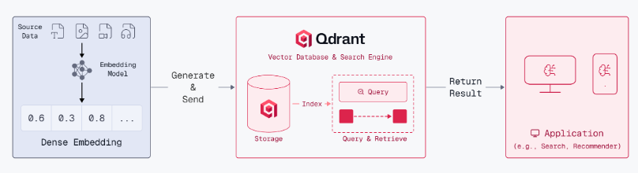
Core
Vector search is an advanced retrieval method that finds data based on semantic meaning rather than exact keywords.
It works by converting unstructured data (text, images, audio) into dense vector embeddings that capture their conceptual essence.
These vectors are placed in a high-dimensional space, so items with similar meanings are near each other, enabling searches like “climate change” to also find content about “global warming” even without matching words.

Slide 17
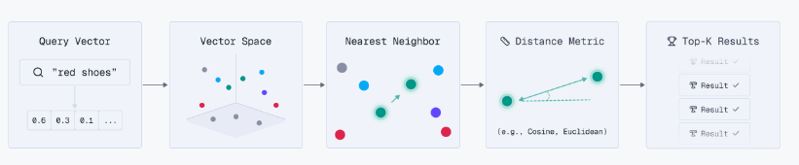
Core (cont.)
Vector search uses Top-K retrieval, where a user query is converted into a query vector.
The engine finds the K most similar document vectors based on similarity scores.
The value of K controls the trade-off between search breadth and precision, letting developers fine-tune results.
To deliver the most robust search experience, Qdrant enables Hybrid Retrieval with semantic and lexical search.

Slide 18
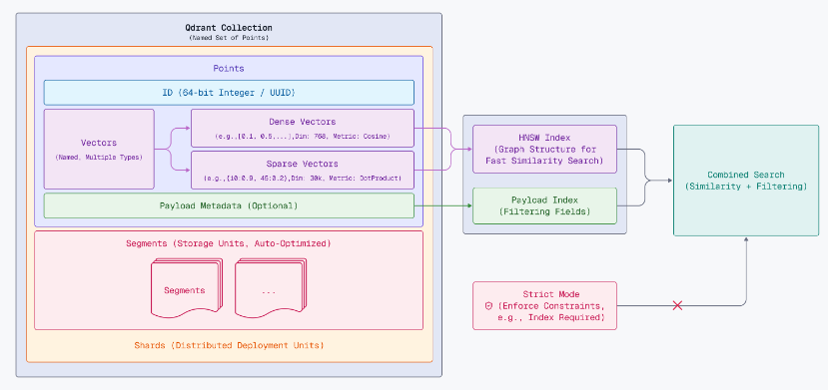
Core (cont.)
Qdrants operates in a client-server architecture, providing official client libraries for Python, JavaScript/TypeScript, Rust, Go, .NET, and Java.
However, Qdrant exposes HTTP and gRPC interfaces to facilitate integration with virtually any programming language.

Slide 19
Core (cont.)
A collection is a named set of points (vectors with a payload) among which you can search.
The vector of each point within the same collection must have the same dimensionality and be compared by a single metric.
Named vectors can be used to have multiple vectors in a single point, each of which can have their own dimensionality and metric requirements.
Qdrant supports these most popular types of metrics:
Dot product: Dot
Cosine similarity: Cosine
Euclidean distance: Euclid
Manhattan distance: Manhattan

Slide 20
Core (cont.)
The points are the central entity that Qdrant operates with.
A point is a record consisting of a vector and an optional payload.
We can search among the points grouped in one collection based on vector similarity.
Qdrant supports using both 64-bit unsigned integers and UUID as identifiers for points.
Examples of UUID string representations:
simple: 936DA01F9ABD4d9d80C702AF85C822A8
hyphenated: 550e8400-e29b-41d4-a716-446655440000
urn: urn:uuid:F9168C5E-CEB2-4faa-B6BF-329BF39FA1E4

Slide 21
Core (cont.)
Qdrant combines vector and traditional (payload) indexes to enable fast semantic search with filtering.
The vector index accelerates similarity search, while payload indexes speed up filtering.
Indexes are configured at the collection level, but not every segment has them—whether a segment gets an index depends on the optimizer settings and the number of stored points.

Slide 22
Core (cont.)
Qdrant collections are divided into segments, each with independent vector and payload storage, indexes, and an ID mapper linking internal and external IDs. Segments usually store non-overlapping data, but duplicate points are handled by deduplication.
Segments can be appendable (allowing add, delete, query) or non-appendable (read and delete only). Each collection must have at least one appendable segment, and segments can have different configurations.
Vector storage options:
In-memory – stores all vectors in RAM for maximum speed; disk used only for persistence.
Memory-mapped (memmap) – maps disk files into virtual memory, using page cache; flexible on RAM usage and nearly as fast as in-memory with enough RAM.
This design balances search speed, storage efficiency, and flexibility.

Slide 23
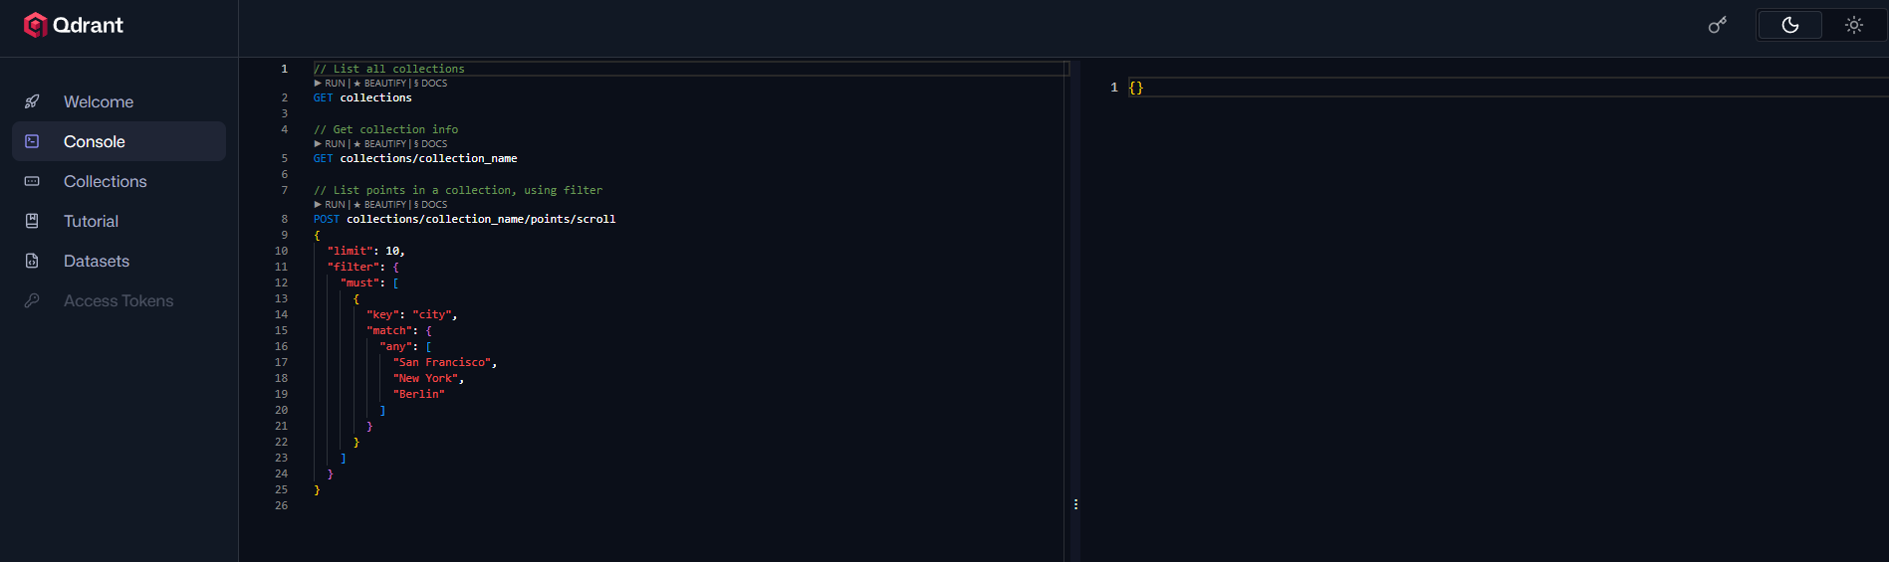
Core (cont.)
Qdrant Web UI
You can manage both local and cloud Qdrant deployments through the Web UI.
If we’ve set up a deployment locally with the Qdrant Quickstart, navigate to http://localhost:6333/dashboard .

Slide 24
Core (cont.)
In the Qdrant Web UI, we can:
Run HTTP-based calls from the console
List and search existing collections
Learn from our interactive tutorial

Slide 25
Core (cont.)
Qdrant Dashboard Features
Collections Overview
View all collections in your Qdrant instance.
See collection names, vector size, distance metric, and number of points.
Browse Points / Vectors
Inspect individual points (vectors) in a collection.
View associated metadata/payload and IDs.
Vector Search / Query Testing
Run search queries directly from the dashboard.
Input a query vector (or text to embed via API) and get Top-K results.
Test similarity search and filtering interactively.
Filtering and Hybrid Search
Apply payload/metadata filters when searching.
Combine semantic vector search with structured queries.

Slide 26
Core (cont.)
Qdrant Dashboard Features
Collection Management
Create new collections with custom vector size, distance metric, and optimizer settings.
Delete collections or modify configurations (limited).
Visualization & Metrics
See number of points, index info, and storage usage per collection.
Quick insight into memory vs disk usage and segment distribution.
API Playground
Built-in interface to send REST API requests to your Qdrant instance.
Helps test endpoints for inserts, searches, updates, and deletes.
Quick Actions / Data Management
Bulk insert points.
Delete points or entire collections.
Inspect HNSW index properties and payload indexes.

Slide 27
Java Client
Maven dependency: io.qdrant:client:1.18.4
Built on gRPC (port 6334) — high-performance binary protocol.
Two-layer design:
QdrantClient — high-level async API with convenience overloads
QdrantGrpcClient — low-level gRPC (TLS, API key, channel config)
All methods return ListenableFuture<T> (Guava) — fully asynchronous.
Implements AutoCloseable — manages gRPC channel lifecycle.
JavaDoc: https://qdrant.github.io/java-client/

Slide 28
Java Client (cont.)
Setup, authentication, and collection creation
// Connection
QdrantClient client = new QdrantClient(
QdrantGrpcClient.newBuilder("localhost", 6334, false).build());
// TLS + API key (production)
QdrantClient prod = new QdrantClient(
QdrantGrpcClient.newBuilder("cluster.qdrant.io", 6334, true)
.withApiKey("your-api-key").build());
// Create collection (384-dim cosine)
client.createCollectionAsync("my_collection",
VectorParams.newBuilder().setSize(384)
.setDistance(Distance.Cosine).build()).get();
// Health check
var health = client.healthCheckAsync().get();

Slide 29
Java Client (cont.)
Insert points and run similarity + filtered search
// Upsert point with payload
client.upsertAsync("my_collection", List.of(
PointStruct.newBuilder().setId(id(1))
.setVectors(vectors(0.05f, 0.61f, 0.76f))
.putAllPayload(Map.of("city", value("London"),
"price", value(1200))).build())).get();
// Similarity search
List<ScoredPoint> results = client.searchAsync(
SearchPoints.newBuilder().setCollectionName("my_collection")
.addAllVector(List.of(0.2f, 0.1f, 0.9f, 0.7f))
.setLimit(5).build()).get();
// Filtered search
client.searchAsync(SearchPoints.newBuilder()
.setCollectionName("my_collection")
.addAllVector(queryVector)
.setFilter(Filter.newBuilder()
.addMust(range("price", Range.newBuilder().setLte(1500)))
.addMust(matchKeyword("city", "London")).build())
.setLimit(10).build()).get();

Slide 30
Java Client (cont.)
Unified Query API, hybrid search, recommendations
import static io.qdrant.client.QueryFactory.*;
// Nearest neighbor via unified Query API
client.queryAsync(QueryPoints.newBuilder()
.setCollectionName("my_collection")
.setQuery(nearest(0.1f, 0.2f, 0.3f, 0.4f))
.setLimit(5).build()).get();
// Hybrid: RRF fusion of dense + sparse
client.queryAsync(QueryPoints.newBuilder()
.setCollectionName("my_collection")
.setQuery(fusion(Fusion.RRF))
.addPrefetch(...dense...).addPrefetch(...sparse...)
.setLimit(5).build()).get();
// Recommend (positive/negative examples)
client.recommendAsync(RecommendPoints.newBuilder()
.setCollectionName("my_collection")
.addPositive(id(100)).addNegative(id(50))
.setLimit(10).build()).get();

Slide 31
Java Client (cont.)
Payload CRUD, retrieve, update vectors, delete, count
// Set / overwrite / delete payload
client.setPayloadAsync("my_collection",
Map.of("status", value("active")), List.of(id(1)),
true, null, Duration.ofSeconds(5)).get();
client.overwritePayloadAsync("my_collection",
Map.of("status", value("archived")), List.of(id(1)),
true, null, Duration.ofSeconds(5)).get();
// Retrieve, update vectors, delete
var points = client.retrieveAsync("my_collection",
List.of(id(1)), true, true, null).get();
client.updateVectorsAsync("my_collection", pointVectors,
true, null, Duration.ofSeconds(5)).get();
client.deleteAsync("my_collection", List.of(id(1))).get();
long count = client.countAsync("my_collection", null, true).get();

Slide 32
Java Client (cont.)
Pagination, batch operations, payload indexes, facets
// Scroll (paginate all points)
var page = client.scrollAsync(ScrollPoints.newBuilder()
.setCollectionName("my_collection").setLimit(100).build()).get();
// Batch search
client.searchBatchAsync("my_collection",
List.of(search1, search2), null).get();
// Payload index
client.createPayloadIndexAsync("my_collection",
"category", PayloadSchemaType.Keyword,
null, true, null, Duration.ofSeconds(30)).get();
// Facet counts
client.facetAsync(FacetCounts.newBuilder()
.setCollectionName("my_collection")
.setKey("category").setLimit(10).build()).get();

Slide 33
Java Client (cont.)
Management, aliases, backups, distributed operations
// Collection management
client.listCollectionsAsync().get();
client.getCollectionInfoAsync("my_collection").get();
client.updateCollectionAsync(updateRequest).get();
client.deleteCollectionAsync("my_collection").get();
// Aliases (zero-downtime migration)
client.createAliasAsync("production", "my_collection_v2").get();
// Snapshots
client.createSnapshotAsync("my_collection").get();
client.createFullSnapshotAsync().get();
// Cluster & shard keys (multitenancy)
client.createShardKeyAsync(shardKeyRequest).get();
client.getCollectionClusterInfoAsync("my_collection").get();

Slide 34
Java Client (cont.)
Collections:
createCollectionAsync
recreateCollectionAsync
deleteCollectionAsync
updateCollectionAsync
listCollectionsAsync
getCollectionInfoAsync
collectionExistsAsync
Points:
upsertAsync
retrieveAsync
deleteAsync
countAsync
scrollAsync
batchUpdateAsync

Slide 35
Java Client (cont.)
Factories: QueryFactory, ConditionFactory, VectorFactory, ValueFactory
Snapshots & Aliases:
createSnapshotAsync
createAliasAsync
updateAliasesAsync
healthCheckAsync
Vectors:
updateVectorsAsync
deleteVectorsAsync
createVectorNameAsync
deleteVectorNameAsync
Payload:
setPayloadAsync
overwritePayloadAsync
deletePayloadAsync
clearPayloadAsync

Slide 36
Java Client (cont.)
Search:
searchAsync
searchBatchAsync
searchGroupsAsync
queryAsync
queryBatchAsync
queryGroupsAsync
Cluster:
getCollectionClusterInfoAsync
createShardKeyAsync
listShardKeysAsync
deleteShardKeyAsync
Advanced:
recommendAsync
discoverAsync
facetAsync
searchMatrixPairsAsync
searchMatrixOffsetsAsync

Slide 37
Comparison
Qdrant compares with vector databases and search engines:
vs Pinecone: Qdrant is open-source & self-hostable; Pinecone is SaaS-only
vs Milvus: Both distributed; Qdrant has filterable HNSW built-in
vs Weaviate: Both open-source; Qdrant excels at filtered ANN performance
vs Chroma: Qdrant is production-grade at scale; Chroma is simpler/dev-focused
vs Elasticsearch: ES is text-first; Qdrant is purpose-built for vectors
vs pgvector: pgvector fits existing Postgres; Qdrant scales horizontally
vs FAISS: FAISS is in-process library; Qdrant is a full server with API
Qdrant strengths: Rust performance, hybrid search, quantization, Java gRPC client

Slide 38
Best Practices
Best practices:
Create payload indexes BEFORE bulk upsert
Replication factor ≥ 2 for production HA
shard_number = node count for optimal throughput
Enable quantization when RAM is constrained
Use aliases for zero-downtime migrations
Reuse single QdrantClient instance in Java apps
Regular snapshots for disaster recovery

Slide 39
Best Practices (cont.)
Deployment options:
Open Source: Docker, Kubernetes, binary (docker run -p 6333:6333 -p 6334:6334 qdrant/qdrant)
Managed Cloud: AWS, GCP, Azure with auto-scaling & backups
Hybrid / Private Cloud: your K8s, Qdrant-managed or air-gapped
Qdrant Edge: embedded search for edge devices
Integrations: LangChain, LlamaIndex, Spring AI, Haystack (40+ frameworks)

Slide 40
Conclusion
Pros:
Open-source & free – Apache 2.0 license, self-hostable with persistent storage.
High performance – Rust-based, optimized for fast similarity search on large datasets.
Vector search support – Cosine similarity, dot product, Euclidean distance.
Metadata filtering – Rich payload filtering alongside vector search.
Scalable – Can handle millions of vectors efficiently; supports horizontal scaling.
Multi-language SDKs – Official clients for Python, Java, JavaScript, Go.
Docker-ready – Easy to run locally or in production.
Cloud option – Free and paid managed Qdrant Cloud.
Built-in dashboard – For browsing collections, points, and running queries.
LLM-friendly – Works well for RAG pipelines and storing embeddings.
Cons:
No dedicated Spring AI starter – Integration with Spring Boot requires manual setup.
Infrastructure needed – Self-hosting requires Docker or server setup.
Dashboard is basic – Built-in UI is functional but not highly polished; richer visualization requires third-party tools like 1bench.
Smaller ecosystem – Compared to Pinecone or Weaviate, fewer native integrations and plugins.
Advanced clustering/replication – Requires more configuration for high availability at very large scale.
Memory usage – Large collections require significant RAM if not using disk-backed storage.

Slide 41

Bibliography
https://github.com/qdrant/qdrant
https://qdrant.tech/documentation
https://api.qdrant.tech

