Slide 1

Grafana
Dima Ionut Daniel

Slide 2
Contents
What is Grafana?
Architecture
Configuration
Concepts
Core
Conclussion
Bibliography

Slide 3

What is Grafana?
Grafana is a leading open source application for visualizing large-scale measurement data.
It provides a poweful and elegant way to create, share and explore data and dashboards from a metric database.
Grafana features pluggable panels and data sources allowing easy extensibility. There is currently rich support for Grahite, InfluxDB, OpenTSDB.
Grafana is licensed under the Apache 2.0 agreement.

Slide 4
What is Grafana? (cont.)
Grafana is easily installed via Debian/Ubuntu package (.deb), via Redhat/Centos package (.rpm) or using binaries.
Grafana can be installed on Windows, Docker, Mac OS X.

Slide 5
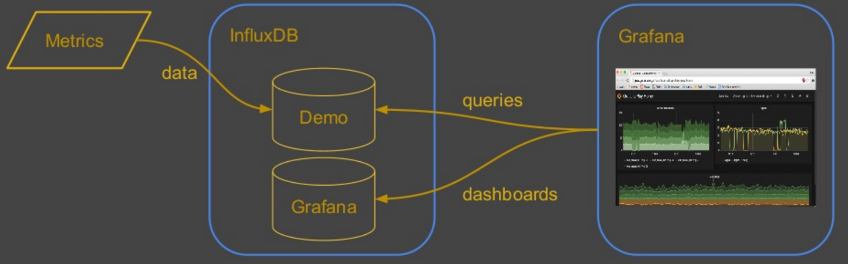
Architecture

Slide 6
Configuration
The Grafana back-end has a number of configuration options that can be specidied in a .ini configuration file.
Config file locations:
Default configuration: /conf/defaults.ini
Custom configuration: /conf/custom.ini
The custom configuration file path can be overriden using the --config parameter.
All options in the configuration file can be overridden using envinorment variables using the syntax: GF_<SectionName>_<KeyName>.
Every section name is the text within the brackets.

Slide 7
Concepts
Data Source →Grafana supports many different storage backends for the time series data. The query language and capabilities of each Data Source are different.
Row → logical divider within a Dashboard and is used to group Panels together. Rows are always 12 „units” wide.
Panel → basic visualization building block in Grafana. Each panel provides a Query Editor that allows to extract the perfect visualization to display.
Query Editor → expses capabilities of the data source and allows to query the metrics.
Dashboard →where it all comes togheter.

Slide 8
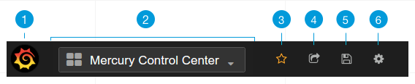
Core
Header of the Dashboard explain:
1. Side menubar toggle
Dashboard droptown:
3. Star Dashboard
4. Share Dashboard
5. Save dashboard
6. Setings

Slide 9
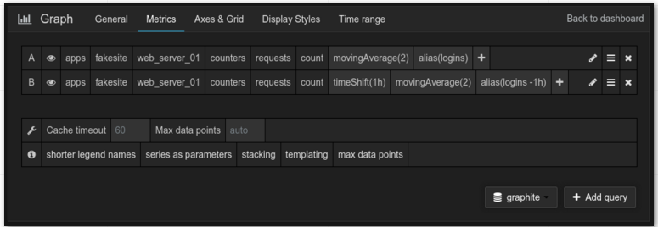
Core (cont.)
We add panels via row menu.
To edit graph we need to click on the graph title to open the panel menu, then Edit.

Slide 10
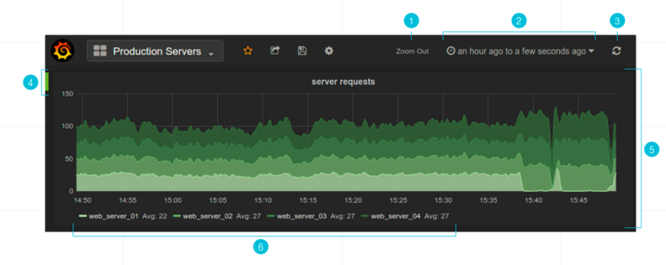
Core (cont.)
1. Zoom out time range
2. Time picker dropdown
3. Manual refresh button
4. Row controls menu
5. Dashboard panel
6. Graph legend

Slide 11
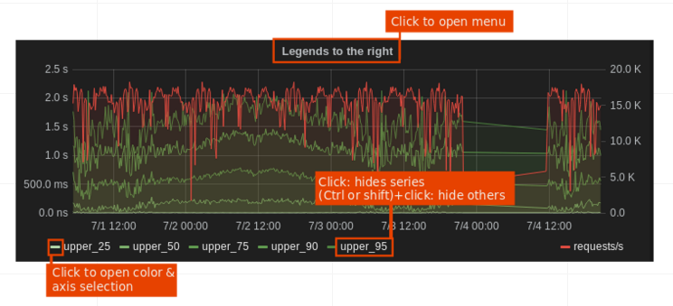
Core (cont.)
The main panel in Grafana is simply named Graph.
It provides a very rich set of graphing options.

Slide 12
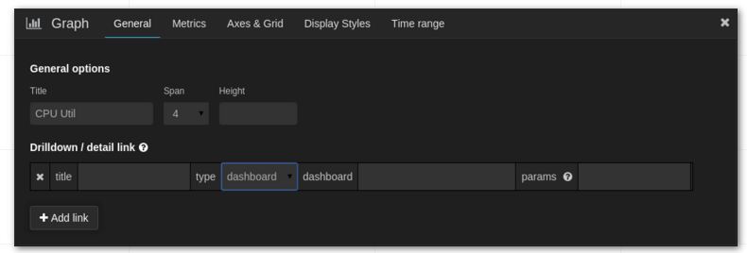
Core (cont.)
The general tab allows customization of a panel’s appearance and menu options.

Slide 13
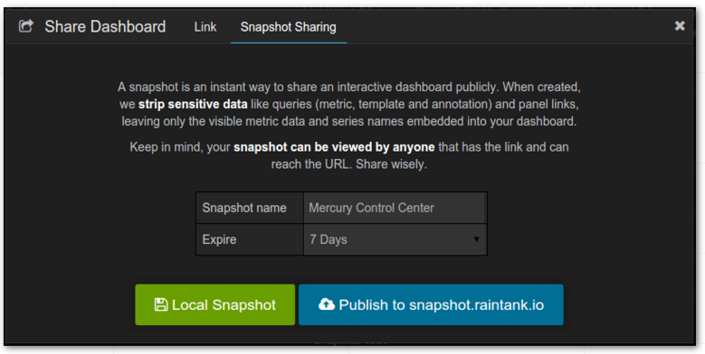
Core (cont.)
Grafana provides a number of ways to share a dashboard or a specific panel.
It’s very easy to share a dashboard via share icon in the top navigation.

Slide 14
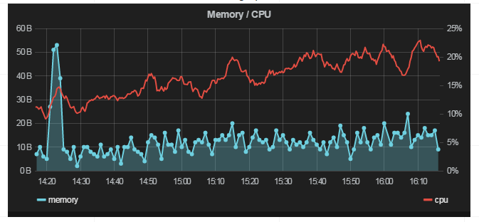
Core (cont.)
We can embed a panel using an iframe on another web site.

Slide 15
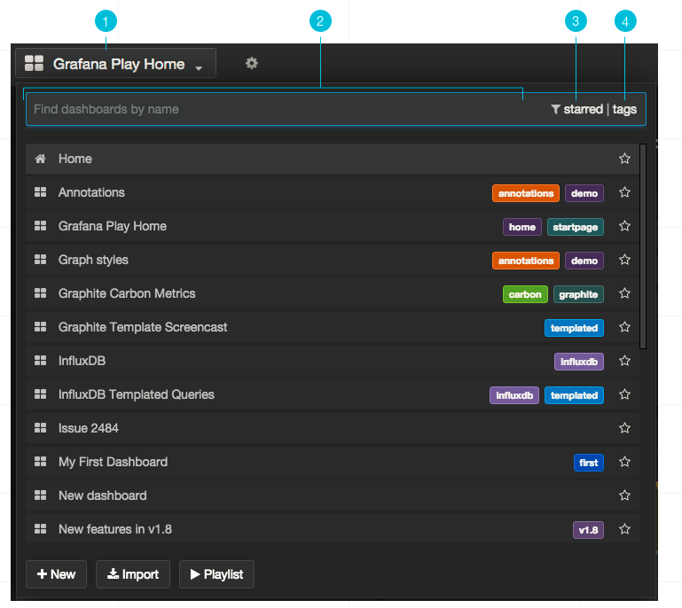
Core (cont.)
Dashboards can be search by the dashboard name, tags or by filtered by starred status.

Slide 16
Conclussion
PROS:
Graphite Target Editor
Graphing
Dashboards
SQL-Like syntax

Slide 17

Bibliography
https://grafana.wikimedia.org/
http://docs.grafana.org/

Slide 18
Questions ?

