Slide 1

Undertow
Dima Ionut Daniel

Slide 2
Contents
What is Undertow?
Architecture
Features
Core
Request Lifecyle
Undertow Servlet
HTTP/2
Conclusions
Bibliography

Slide 3

What is Undertow?
Undertow is a flexible performant web server written in java, providing both blocking and non-blocking API’s based on NIO.
Undertow is designed to be fully embeddable, with easy to use fluent builder APIs.
Undertow’s lifecycle is completely controlled by the embedding application.
Undertow is sponsored by JBoss and is the default web server in the Wildfly Application Server.

Slide 4
Architecture
Undertow is based on XNIO.
The XNIO project provides a thin abstraction layer over Java NIO.
XNIO provides a channel abstraction, that abstracts away the underlying tranport.
The XNIO worker manages both IO threads using a thread pool.
XNIO also provides support for SSL.

Slide 5
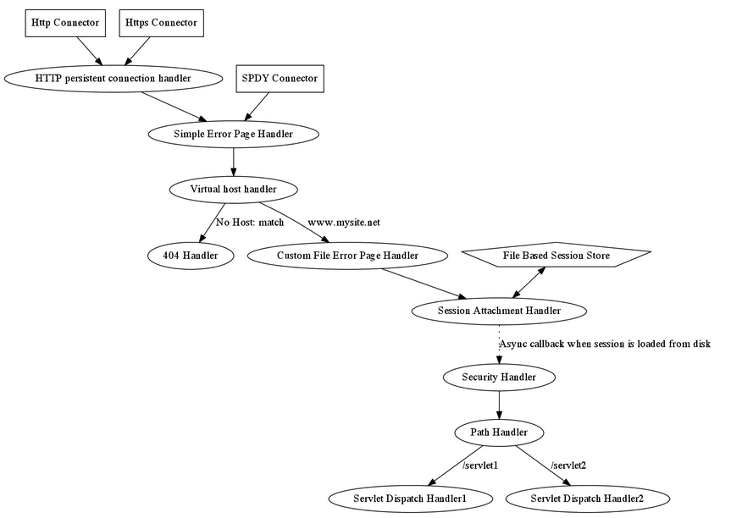
Architecture (cont.)

Slide 6
Features
Lightweight:
Undertow core jar coming in at under 1Mb.
HTTP Upgrade Support:
Support for HTTP upgrade, to allow multiple protocols to be multiplexed over the HTTP port.
Web Socket Support:
Undertow provides full support for Web Sockets, including JSR-356 support.

Slide 7
Features (cont.)
Servlet 3.1:
support for Servlet 3.1, including support for embedded servlet. It is also possible to mix both Servlets and native undertow non-blocking handlers in the same deployment.
Embeddable:
Undertow can be embedded in an application or run standalone with just a few lines of code.
Flexible:
An Undertow server is configured by chaining handlers together. It is possible to add as much or as little functionality as you need, so you don’t pay for what you are not using.

Slide 8
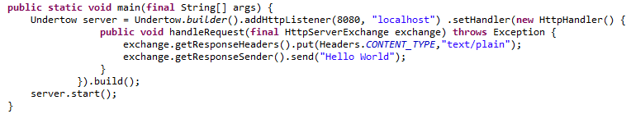
Core
There are 2 way to bootstrap Undertow.
Usage of io.undertow.Undertow builder API.
Assemble a server using XNIO and Undertow listener
The bellow example starts a simple server listening on port 8080.

Slide 9
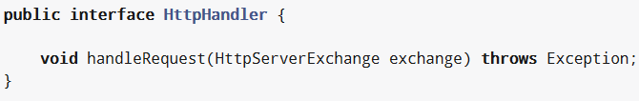
Core (cont.)
The main functionality of Undertow is provided by the io.undertow.server.HttpHandler interface.
These handler can be chaind together.

Slide 10
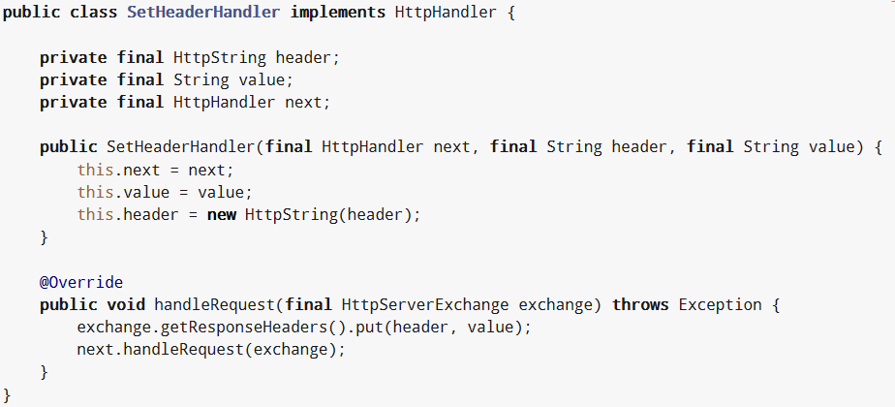
Core (cont.)
Sample HttpHandler implementation.

Slide 11
Request Lifecyle
When a connection is established XNIO invokes the io.undertow.server.HttpOpenListener.
The listener creates a new io.undertow.server.HttpServerConnection to hold state associated with the connection.
The HTTP read listener is responsible for parsing the incoming request and creating the io.undertow.server.HttpServerExchange. This obhect contains both the request and response state.

Slide 12
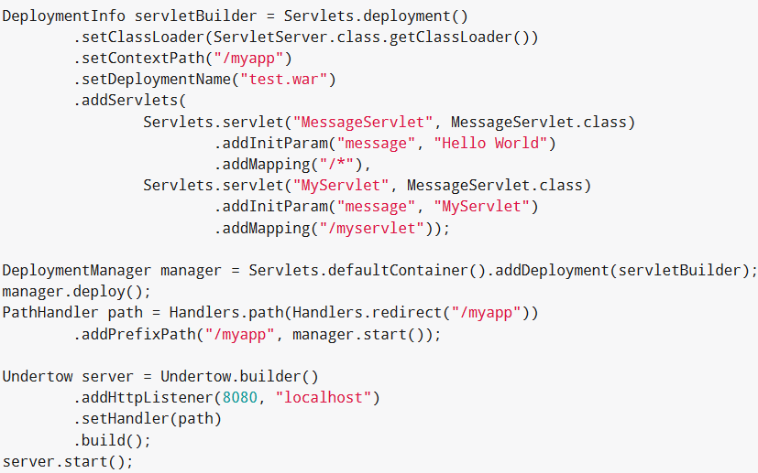
Undertow Servlet
Sample bellow for servlet deployment.

Slide 13
HTTP/2
HTTP/2 is a new protocol, intended as a higher performance alternative to HTTP/1.1.
HTTP/2 has the following key features compared to HTTP/1.1
Binary Protocol:
it's more efficient on the wire, however as a result it is no longer human readable without using tools to decode the protocol.
Multiplexing:
a client can send multiple requests on the same connection, and the server can respond in whatever order the responses become available.
Header Compression:
HTTP/2 uses HPACK header compression to greatly compress headers.
Server Push:
allows a server to send additional cacheable resources to the client that the client has not explicitly asked for.

Slide 14
HTTP/2 (cont.)
HTTP/2 is a framed protocol.
The maximum size of a frame is 2^24-1 (16,777,215) octets.
A frame header contains the following information:
The frame length
The frame type
Flags
Stream identifier

Slide 15
HTTP/2 (cont.)
HTTP/2 is multiplexing.
It allows multiple requests to be active at once, and the responses can be interleaved on the wire as they become available.
This is done through the concept of streams, in HTTP/2 every request/response pair is mapped to a stream.
Streams are initiated by a HEADERS frame from the client, or a PUSH_PROMISE frame from the server.
All HTTP/2 frames include a stream identifier in the header, which allows an endpoint to determine which request the frame belongs to.
By default there is no limit to the number of concurrent streams that can be active on a connection, although the server can impose a limit using a SETTINGS frame to limit the amount of server resources a single client can consume.

Slide 16
HTTP/2 (cont.)
HTTP/2 introduces a fot of header compression called HPACK.
HPACK allows for very efficient header compression, without being vulnerable to compression related attacks such as CRIME. HPACK provides the following
The ability to encode large headers using a fixed Huffman encoding
The ability to encode commonly used headers as a variable length integer, rather than re-sending the whole header each time
All headers sent via HTTP/2 (in HEADERS, CONTINUATION and PUSH_PROMISE frames) are sent in the HPACK format.
PACK works by having both endpoints maintain a copy of a header table (the dynamic table). When an endpoint sends a header to the remote endpoint it can instruct the remote endpoint to store it in its dynamic table.

Slide 17
HTTP/2 (cont.)
HTTP/2 can use Server Push.
First introduced in the SPDY protocol, server push allows a server to send unsolicited request+response pairs to a client.
For example if a client requests /index.html, and the server knows that /index.html contains a reference to /logo.png the server might decide to immediately push logo.png rather than waiting for the client to request it.
To push a response to the client the server opens a stream using a PUSH_PROMISE frame, which contains the complete set of request header fields that the server attributes to the request.

Slide 18
HTTP/2 (cont.)
Once the initial connection has been established both the client and the server must send a connection preface.
The client sends the string PRI * HTTP/2.0\r\n\r\nSM\r\n\r\n, followed by HTTP/2 SETTINGS frame, which may be empty.
The server must send a SETTINGS frame (which may be empty).
Once the connection preface has been exchanged the connection is considered established, and the endpoints can use it to communicate.

Slide 19
HTTP/2 (cont.)
The upcoming Wildfly 9 release supports HTTP2, which includes new features like request multiplexing and server push.
The complexity comes because HTTP2 as implemented by major browsers requires the use of TLS; it requires a extension called ALPN (application layer protocol negociation).
Support for ALPN will be coming in Java 9 and it’s not present in JDK7 or JDK8.
Undertow supports HTTP2 Draft 15.

Slide 20
Conclusions
Undertow it’s a very fast web server build on XNIO.

Slide 21

Bibliography
http://undertow.io

