Slide 1

Consul
Dima Ionut Daniel

Slide 2
Contents
What is Consul?
Features
Basic
Key/Value Store
Web UI
Service Discovery
Health Checks
Bibliography

Slide 3

What is Consul?
Consul is a consistent data store that uses gossip to form dynamic clusters.
It can store key/value data, but also can register watches that can be used for variety of tasks.
Consul implements service discovery system embedded.
Consul provides health checks through HTTP and TCP requests.

Slide 4
Features
Service Discovery:
can provide a service for other service to discover.
Health Checking:
can provide any number of health checks.
Key/Value Store:
has hierarchical key/value store.
Multi Datacenter:
we can grow multiple regions.

Slide 5
Basic
Consul is a distributed highly available system.
Every node that provides services to Consul runs a Consul agent.
The agent is responsible for health checking the services on the node as well as the node itself.
Agents talks to one or more Consul servers.

Slide 6
Basic (cont.)
Consul server are where data is stored and replicated.
Consul can function with 1 server but it's recommended to have HA and use 3 to 5 server.
A cluster of Consul servers is recommended for reach datacenter.

Slide 7
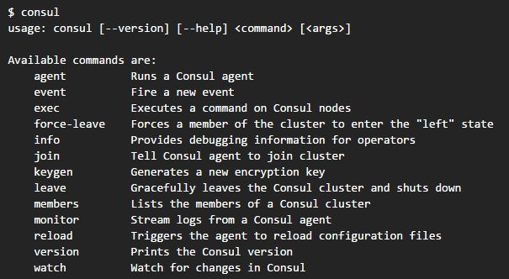
Basic (cont.)
Consul must be installed on every node that will be a member of a Consul cluster.
After Consul is installed we can use the "consul" command to start consul.

Slide 8
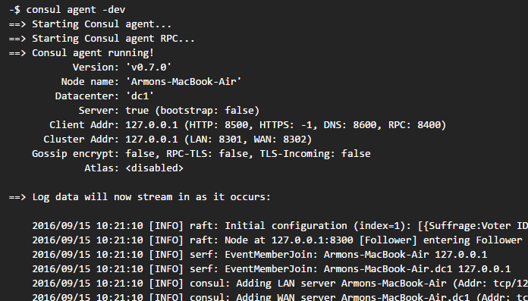
Basic (cont.)
The Consul agent can run either in client or server mode.
Each datacenter must have at least one server, but it's recommended from 3 to 5 servers.
During development mode consul agents can be easy started using following command: "consul agent -dev".

Slide 9
Basic (cont.)
Consul uses the hostname as the default node name.
If the hostnames contains periods, DNS queries to that node won't work.
To avoid this we can set explicitly the name of the node using the -node flag.

Slide 10
Basic (cont.)
In order to see all members of the cluster we can run "consul members" command.
Additional metadata can be viewed using the -detailed flag.
The output of the members command is based on the gossip protocol.
Consul provides HTTP and DNS API.
By default Consul agent's DNS server runs on port 8600 by default.

Slide 11
Key/Value store
Consul provides a Key/Value store.
This can be used to hold dynamic configuration, assist in service configuration, build leader election, etc.
There are 2 ways to interact with Consul KV store:
- HTTP API
- Consul KV CLI.
consul kv put config/max 20
consul kv get config/max

Slide 12
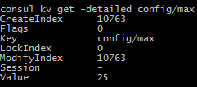

Key/Value store (cont.)
We can obtain detailed information about a certain KV node using –detailed flag.
It's possible to list all keys from the store using the "recurse" option.

Slide 13
Key/Value store (cont.)
To update a value we use the same "put" option as when inserting a new key/value element.
To delete a key from Consul KV store we can use the delete option.
consul kv delete config/max
We can delete an entire prefix using recuse option
consul kv delete -recurse config

Slide 14
Web UI
Consul comed with a functional web UI out of the box.
Web UI can be used for viewing all services, nodes, health checks, their status and for CRUD operations on key/value data.
UI automatically supports multi-datacenter.
The default ULR for the UI is http://localhost:8500/ui.

Slide 15
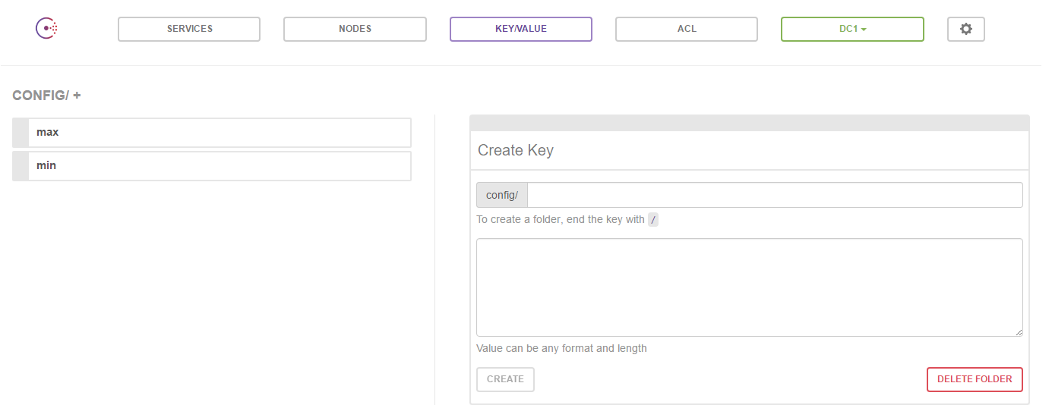
Web UI (cont.)

Slide 16
Service Discovery
A service can be registered either by providing a service definition or by using HTTP API.
We need to create a directory for Consul configuration.
Consul loads all configuration files. Mostly on unix the directory is named /etc/consul.d.
cat /etc/consul.d/rails.json
'{"service":{"name":"web", "tags":["rails"], "port":80}}'

Slide 17
Service Discovery (cont.)
Using HTTP API we can query the services:
curl http://localhost:8500/v1/catalog/service/web
The HTTP API can be used to add, remove, modify services dynamically.

Slide 18
Health Checks
Similar to a server, a check can be registered by providing a check definition or by using HTTP API.
cat /etc/consul.d/ping.json
{"check":{"name“ : "ping", "script": "ping -c1 google.com>dev/null", "interval": "30s"}}
The health check of type "script" runs as the same user that started the Consul process.
If the command exits with a non-zero exit code then the node will be flagged unhealthy.

Slide 19
Health Checks (cont.)
cat /etc/consul.d/web.json
{"service": {"name": "web", "tags": ["rails"], "port": 80,
"check": {"script": "curl localhost >/dev/null 2>&1", "interval": "10s"}}}‘
We can query using HTTP API the health states of the services:
curl http://localhost:8500/v1/health/state/critical

Slide 20

Bibliography
https://www.consul.io/
The DevOps 2.0 Toolkit – Automating The Continuous Deployment Pipeline with Containerized Microservices

