Slide 1

Jackson
Dima Ionut Daniel

Slide 2
Contents
What is Jackson?
Features
Core
Type Mapping
Annotations
Bibliography

Slide 3

What is Jackson?
Jackson is a high-performance JSON processor for Java.
The library is fast, lightweight, and ergonomic.
Jackson provides many ways of working including simple POJO converted to/from JSON for simple cases.
Jackson also provides a set of annotations for mapping too.

Slide 4
Features
Generic output features
Error handling
Output life-cycle features
Datatype-specific serialization
Annotation handling
Instrospection, property detection

Slide 5
Core
Jackson offers 3 alternative methods for processing JSON:
Streaming API:
reads/writes JSON content as discrete events
similar to StAX API
Tree Model
provides mutable in-memory tree representation of an JSON document
tree model is similar to XML DOM
Data Binding
converts JSON to/from POJO
ObjectMapper performs marshalling/unmarshalling

Slide 6
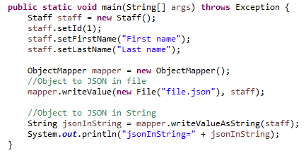
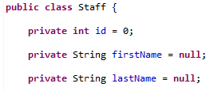
Core (cont.)

Slide 7
Core (cont.)
We can change defaults for ObjectMapper, to be used as the base for all ObjectWriter instances, using enable(feature), disable(feature) and configure(feature, state) methods.

Slide 8
Core (cont.)
Mapper object can enable/disable certain features.
Serialization features:
// to enable standard indentation ("pretty-printing"):
mapper.enable(SerializationFeature.INDENT_OUTPUT);
// to allow serialization of "empty" POJOs (no properties to serialize)
// (without this setting, an exception is thrown in those cases)
mapper.disable(SerializationFeature.FAIL_ON_EMPTY_BEANS);
// to write java.util.Date, Calendar as number (timestamp):
mapper.disable(SerializationFeature.WRITE_DATES_AS_TIMESTAMPS);

Slide 9
Core (cont.)
Mapper object can enable/disable certain features.
Deserialization features:
// to prevent exception when encountering unknown property:
mapper.disable(DeserializationFeature.FAIL_ON_UNKNOWN_PROPERTIES);
// to allow coercion of JSON empty String ("") to null Object value:
mapper.enable(DeserializationFeature.ACCEPT_EMPTY_STRING_AS_NULL_OBJECT);

Slide 10
Core (cont.)
// JsonParser.Feature for configuring parsing settings:
// to allow C/C++ style comments in JSON (non-standard, disabled by default)
mapper.configure(JsonParser.Feature.ALLOW_COMMENTS, true);
// to allow (non-standard) unquoted field names in JSON:
mapper.configure(JsonParser.Feature.ALLOW_UNQUOTED_FIELD_NAMES, true);
// to allow use of apostrophes (single quotes), non standard
mapper.configure(JsonParser.Feature.ALLOW_SINGLE_QUOTES, true);

Slide 11
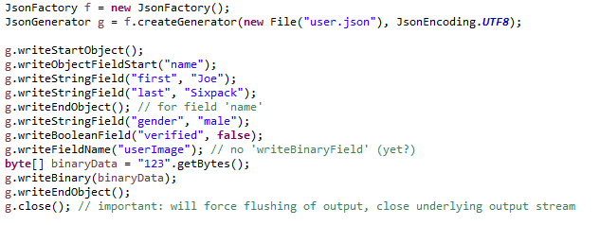
Core (cont.)
Example of using the Streaming API to generate JSON content

Slide 12
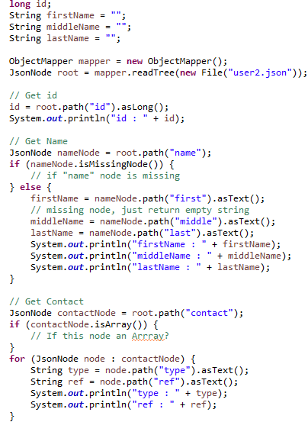
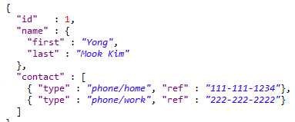
Core (cont.)
Example of using the TreeModel API to parse JSON content.

Slide 13
Core (cont.)
We can use TypeReference to convert to different objects
String json = "[{\"firstName\":\"Kenshin\"}, {\"firstName\":\"Ruroni\"}]";
List<Staff> list = mapper.readValue(json, new TypeReference<List<Staff>>(){});
String json = "{\"name\":\"Kenshin\", \"age\":33}";
Map<String, Object> map = mapper.readValue(json, new TypeReference<Map<String,Object>>(){});

Slide 14
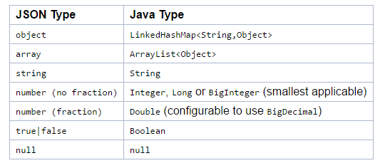
Type Mapping
JSON to Java type mapping

Slide 15
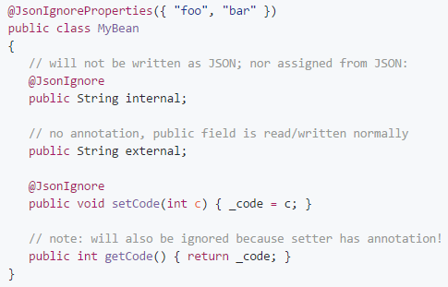
Annotations
@JsonProperty can be used to indicate the property name.
There are 2 annotations that can be used to ignore properties:
@JsonIgnore for individual properties
@JsonIgnoreProperties for class definition

Slide 16
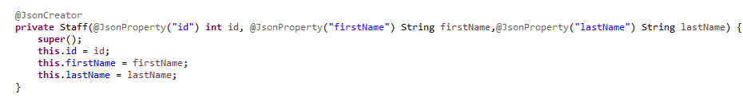
Annotations (cont.)
Jackson doesn't require the definition of "default constructor".
Another alternative is to use "factory methods".

Slide 17

Bibliography
https://en.wikipedia.org/wiki/Jackson_(API)
https://github.com/FasterXML/jackson

