Slide 1

RTP
Dima Ionut Daniel

Slide 2
Contents
What is RTP ?
Architecture
Core
Profile/Payload
Packet Header
RTCP
RTSP
Applications
Bibliography

Slide 3

What is RTP ?
Real-time Transport Protocol (RTP) is an Internet standard (STD 64,RFC 3550) for the transport of strict real-time data such as voice or video.
RTP defines the concept of RTP session.
An RTP session is identified by a transport address, and includes just one type of media.
RTP typically runs on top of UDP.
RTP was originally conceived to be used in the remit of multicast conferences in the Internet.

Slide 4
What is RTP ? (cont.)
RTP is designed for end-to-end, real-time, transfer of streaming media.
RTP was developed by Audi/Video Transport working group of the IETF standards organization.
RTP is used in conjunction with other protocols like H.323 and RTSP.
RTP is also used in the transport layer of WebRTC.

Slide 5
Core
RTP specification describes 2 sub-protocols: RTP and RTCP.
RTP facilitates the transfer or real-time data.
The control protocol RTCP is used to specify quality of service (Qos) feedback and synchronization between the media streams.
RTP sessions are initiated between communicating peers using a signaling protocol such as H.232, SIP, XMPP.

Slide 6
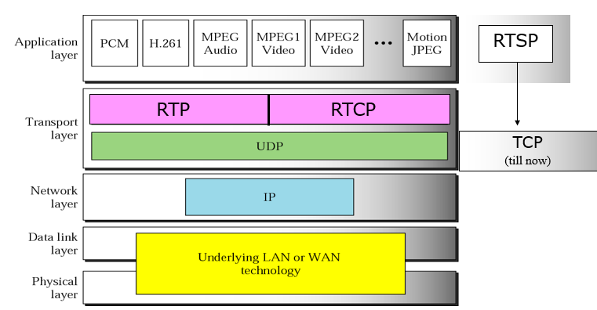
Core (cont.)
An RTP session is established for each multimedia stream.
A session consists of an IP address with a pair of ports for RTP and RTCP.
Audio and video streams use separate RTP sessions enabling a receiver to deselect a particular stream.
The ports which form a session are negotiated using other protocols such as RTSP(using SDP) and SIP.

Slide 7
Core (cont.)
All RTP and RTCP PDUs are sent to same multicast group (by all participants).
All RTP PDUs sent to an even-numbered UDP port, 2p.
All RTCP PDUs sent to UDP port 2p+1.
RTP session is sending and receiving of RTP data by a group of participants.
For each participant, a session is a pair of transport addresses used to communicate with the group
If multiple media types are communicated by the group, the transmission of each medium constitutes a session.

Slide 8
Profile/Payload
RTP can carry a range of multimedia formats and allow new formats without revising the RTP standard.
The design of RTP is based on the architectural principle known as ALF(application level framing).
RTP defined a profile and one or more associated payload formats.
The profile defines the codecs used to encode the payload data and their mapping to payload format codecs in the field Payload Type (PT) of the RTP header.
Audio payloads formats: G.711, G.723, G726, GSM, QCELP, MP3, DTMF.
Video payloads formats: H.261, H.263, H.264, MPEG-4.

Slide 9
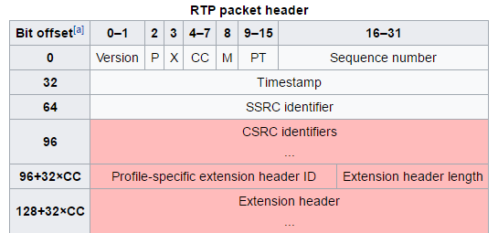
Packet Header

Slide 10
Packet Header (cont.)
The RTP header has a minimum size of 12 bytes.
After the header, optional header extensions may be present.
This is followed by the RTP payload, the format of which is determined by the particular class of application.

Slide 11
Packet Header (cont.)
Version: (2 bits) Indicates the version of the protocol. Current version is 2.
P (Padding): (1 bit) Used to indicate if there are extra padding bytes at the end of the RTP packet.
X (Extension): (1 bit) Indicates presence of an Extension header between standard header and payload data.
CC (CSRC count): (4 bits) Contains the number of CSRC identifiers (defined below) that follow the fixed header.
M (Marker): (1 bit) Used at the application level and defined by a profile. If it is set, it means that the current data has some special relevance for the application.

Slide 12
Packet Header (cont.)
PT (Payload type): (7 bits) Indicates the format of the payload. This is specified by an RTP profile.
Sequence number: (16 bits) The sequence number is incremented by one for each RTP data packet sent and is to be used by the receiver to detect packet loss and to restore packet sequence.
The RTP does not specify any action on packet loss; it is left to the application to take appropriate action. RTP provides no guarantee of delivery, but the presence of sequence numbers makes it possible to detect missing packets.

Slide 13
Packet Header (cont.)
Timestamp: (32 bits) Used to enable the receiver to play back the received samples at appropriate intervals.
SSRC: (32 bits) Synchronization source identifier uniquely identifies the source of a stream.
CSRC: (32 bits each) Contributing source IDs enumerate contributing sources to a stream which has been generated from multiple sources.
Header extension: (optional) The first 32-bit word contains a profile-specific identifier (16 bits) and a length specifier (16 bits) that indicates the length of the extension (EHL = extension header length) in 32-bit units, excluding the 32 bits of the extension header.

Slide 14
RTCP
RTP Control Protocol (RTCP) is tied to RTP.
Its basic functionality and packet structure is defined in RFC 3550.
RTCP provides out-of-band statistics and control information for an RTP session.
RTCP transports statistics for a media connection and information such as transmitted octet and packet counts, packet loss, packet delay variation, and round-trip delay time.
RTCP itself does not provide any flow encryption or authentication methods.
Secure Real-time Transport Protocol (SRTP) is defined in RFC 3711.

Slide 15
RTCP (cont.)
The primary function of RTCP is to gather statistics on quality aspects of the media distribution during a session and transmit this data to the session media source and other session participants.
RTCP provides canonical end-point identifiers (CNAME) to all session participants.

Slide 16
RTCP (cont.)
RTCP distinguishes several types of packets: sender report, receiver report, source description, and goodbye.
A standards-based extension of RTCP is the extended report packet type introduced by RFC 3611.
Sender report(SR):
the sender report is sent periodically by the active senders in a conference to report transmission and reception statistics for all RTP packets sent during the interval
Receiver report(RR):
the receiver report is for passive participants, those that do not send RTP packets
Source description(SDES):
used to send the CNAME item to session participants
it may also be used to provide additional information such as the name, e-mail address, telephone number, and address of the owner or controller of the source.
Goodbye(BYE):
A source sends a BYE message to shut down a stream.
It allows an endpoint to announce that it is leaving the conference.

Slide 17
RTSP
The Real Time Streaming Protocol (RTSP) is a network control protocol designed for use in entertainment and communications systems to control streaming media servers.
The protocol is used for establishing and controlling media sessions between end points.
Most RTSP servers use the Real-time Transport Protocol (RTP) in conjunction with Real-time Control Protocol (RTCP) for media stream delivery.
RTSP was developed by RealNetworks, Netscape and Columbia University, with the first draft submitted to IETF in 1996.

Slide 18
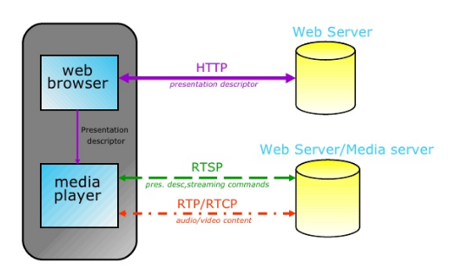
RTSP (cont.)

Slide 19
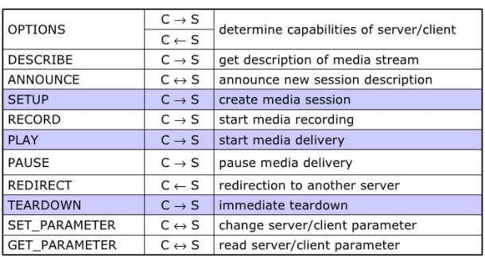
RTSP (cont.)

Slide 20
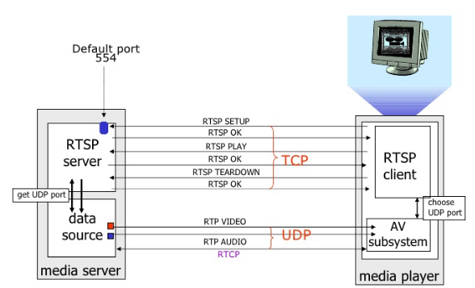
RTSP (cont.)
RTSP session:

Slide 21
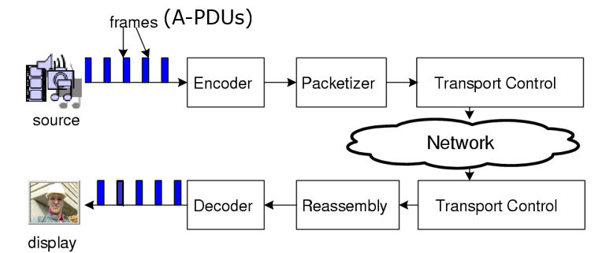
Applications
Video teleconferencing
Internet Telephony (VoIP)
Internet audio, video streaming

Slide 22

Bibliography
https://en.wikipedia.org/wiki/Real-time_Transport_Protocol
https://en.wikipedia.org/wiki/RTP_Control_Protocol
https://en.wikipedia.org/wiki/Real_Time_Streaming_Protocol
https://www.slideshare.net/Ronny72/rtprtcp-ppt

Slide 23
Questions ?

