Slide 1

Swagger
Dima Ionut Daniel

Slide 2
Contents
What is Swagger?
Features
Core
Annotations
Spring Boot Config
Bibliography

Slide 3

What is Swagger?
OpenAPI specificaton (originally known as Swagger) is a specification for machine-readable interface files for describing, producing, consuming, and visualizing RESTful Web services.
A variety of tools can generate code, documentation and test cases given an interface file.
Development of the OpenAPI Specification (OAS) is overseen by the Open API Initiative, an open source collaborative project of the Linux Foundation.

Slide 4
Features
Swagger allows to describe the structure of the API.
Swagger returns a YAML or JSON that contains a full description of the entire API.
The specification asks to include the following information:
what are all the operations that your API supports
what are the API's parameters and what does it return
does the API needs some authorization
things like terms, contact information and license to use the API

Slide 5
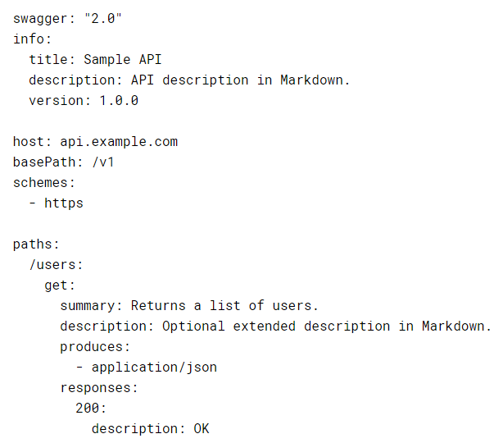
Core
Swagger can be written in JSON or YAML.

Slide 6
Core (cont.)
Every Swagger application starts with the Swagger version.
The base URL for all API calls is defined using schemes, host and basePath.
The consumes and produces sections define the MIME types supported by the API.
The paths section defined individual endpoints in your API and the HTTP methods supported by these endpoints.
Operations can have parameters that can be passed via URL path, query string, headers or request body.
For each operation we can define possible status codes.

Slide 7
Annotations
In order to generate the Swagger documentation, swagger-core offer a set of annotation to declare and manipulate the output.
Minimum of annotation that needs to be use are @Api and @ApiOperation to declare an API operation.

Slide 8
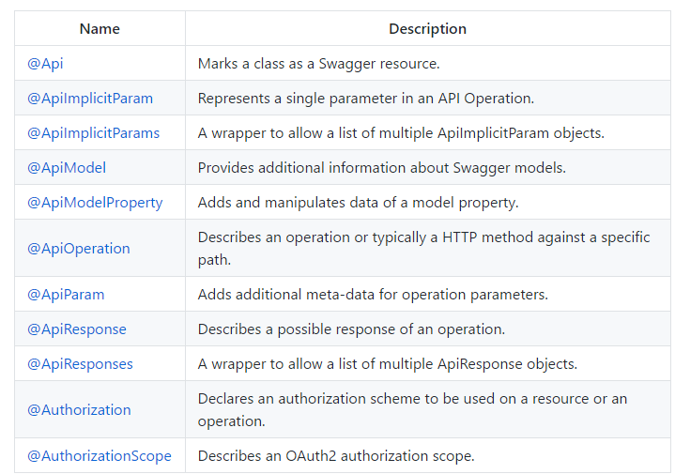
Annotations (cont.)

Slide 9
Annotations (cont.)
The @Api is used to declare a Swagger resource API and will be scanned. It serves a double purpose - it affects the Resource Listing and the API Declaration.
The @ApiOperation is used to declare a single operation within an API resource. An operation is considered a unique combination of a path and a HTTP method.
The @ApiParam is used only with the JAX-RS parameter annotations (@PathParam, @QueryParam, @HeaderParam, @FormParam and in JAX-RS 2, @BeanParam)
We can describe parameters manually using @ApiImplicitParam, @ApiImplicitParams.

Slide 10
Annotations (cont.)
The @ApiModel allows you to manipulate the meta data of a model from a simple description or name change to a definition of polymorphism.
The @ApiModelProperty allows controlling Swagger-specific definitions such as allowed values, and additional notes. It also offers additional filtering properties in case you want to hide the property in certain scenarios.

Slide 11
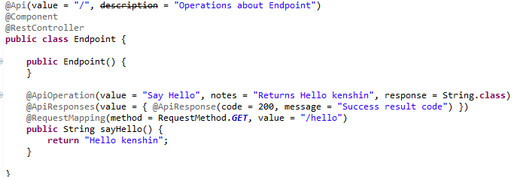
Spring Boot Config
We use the Swagger annotations to describe the REST API.

Slide 12
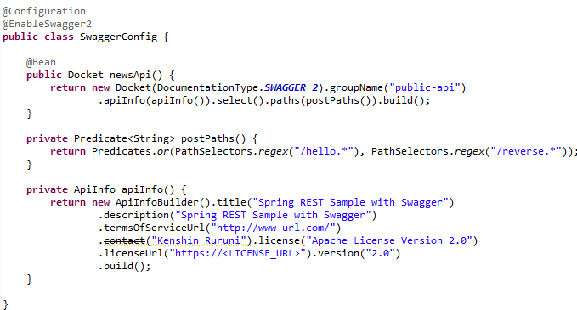
Spring Boot Config (cont.)
We can checked the deployed Swagger UI on http://localhost:8080/swagger-ui.html
The generated Swagger JSON can be found on URL: http://localhost:8080/v2/api-docs?group=public-api

Slide 13
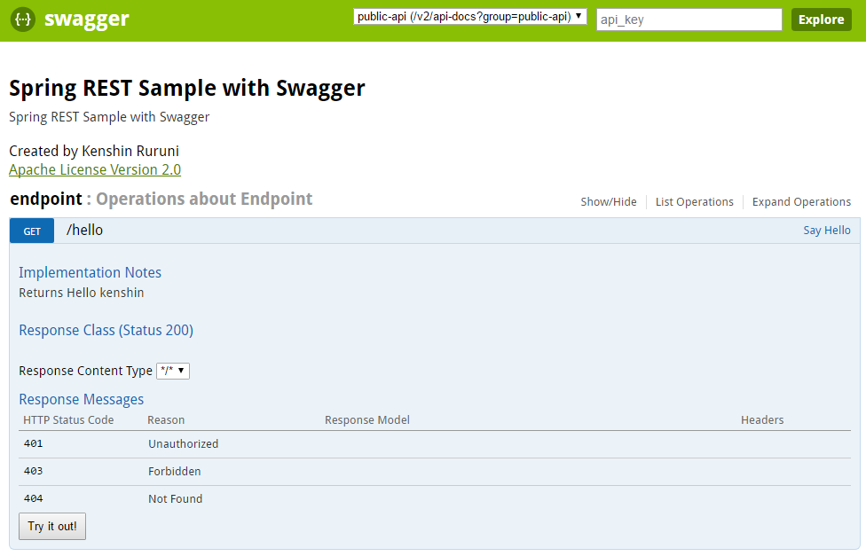
Spring Boot Config (cont.)

Slide 14
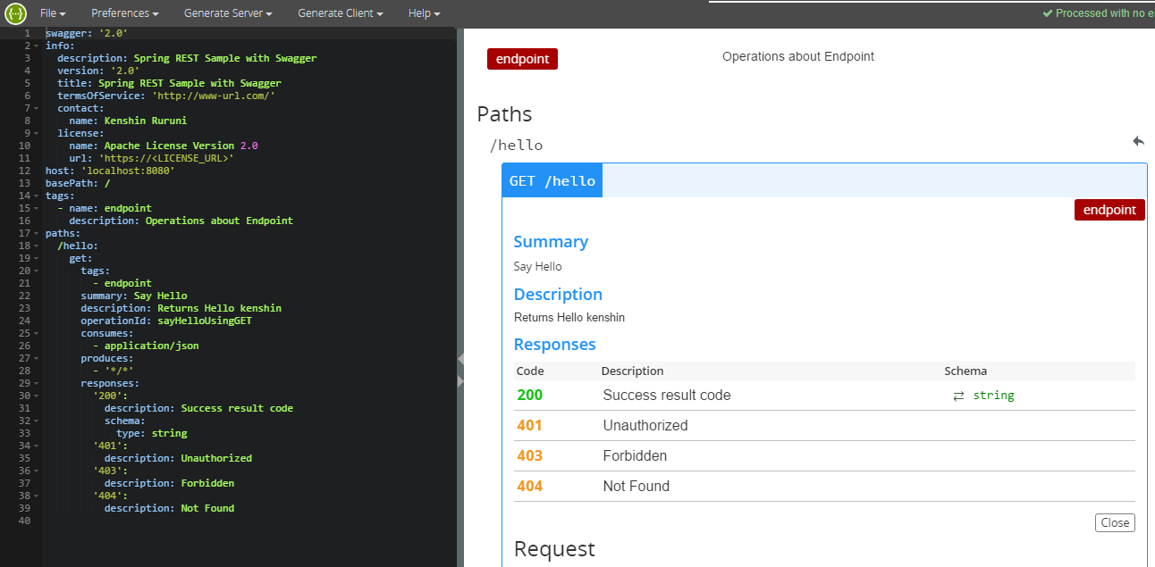
Spring Boot Config (cont.)
We can load the Swagger JSON on Swagger Online Editor: http://editor.swagger.io/#!/

Slide 15

Bibliography
https://en.wikipedia.org/wiki/OpenAPI_Specification
https://github.com/swagger-api/swagger-core/wiki/Annotations
http://www.javainuse.com/spring/boot_swagger
http://swagger.io

