Slide 1

AMQP
Dima Ionut Daniel

Slide 2
Contents
What is AMQP?
Architecture
Core
RabbitMQ
Bibliography

Slide 3

What is AMQP?
AMQP (Advanced Message Queueing Protocol) is a protocol to communicate between clients and messaging middleware servers (brokers).

Slide 4
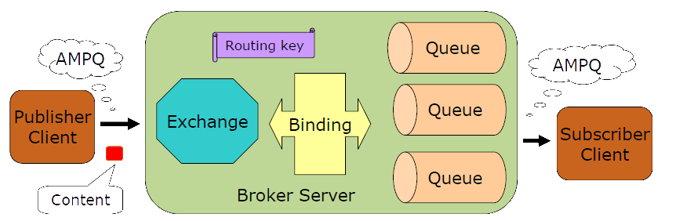
Architecture

Slide 5
Architecture (cont.)
Exchange – Receives messages and routes to a set of message queues
Queue – Stores messages until they can be processed by the application(s)
Binding – Routes messages between Exchange and Queue.
Routing Key – label used by the exchange to route Content to the queues
Content – Encapsulates application data and provides the methods to send, receive, acknowledge, etc.

Slide 6
Core
AMQ Queues:
stores and distributes messages
each message is delivered to a single client consumer
Properties (on creation):
Name: client/server name.
Durable: remains present after restart.
Auto-delete: will auto-delete when all clients have finished using it.
Private (Exclusive)/Shared: read by a single consumer.

Slide 7
Core (cont.)
The binding tells exchange how to route messages:
Queue.Bind <queue> TO <exchange> WHERE <condition>
The <condition> can involve:
message properties
header fields
content
in most cases uses a single field: "routing key"

Slide 8
Core (cont.)
An exchange accepts messages from a producer and routes the messages to queues based on the criteria.
Exchanges are matching and routing engines as they inspect messages and using bindings tables they decide how to forward the messages to queues or other exchanges.
Exchanges never stores messages.

Slide 9
Core (cont.)
In many cases the exchange examines a single key field called "routing key".
The routing key is a virtual address that the exchange may use to decide how to route the message.
For point-to-point routing, the routing key is the name of message queue.
For topic publish-subscriber routing, the routing key is usually the topic hierarchy value.

Slide 10
Core (cont.)
An AMQP message consists of a set of properties + the content.
The producer places "content" in the message and optional may set some message properties.
The producer then sends the message to an "exchange" on the server.
When the message arrives at the server, the exchange routes the message to a set of "queues" on the server.
The producer chooses how unrouteable messages are treated.

Slide 11
Core (cont.)
A single message can exist on many message queues.
When a message arrives in a message queue, the message queues tries immediately to pass it to a consumer application.
When the message queue can deliver the message to a consumer, it removes the message from its internal buffers.
It can happen immediately or after the consumer has acknowledged that it has successfully processed the message.
Producer messages and consumer acknowledgements are grouped into "transactions".

Slide 12
Core (cont.)
AMQP client application can:
create or destroy queues
define the way messages queues are filled, using bindings
select different exchanges which can completely change the routing semantics

Slide 13
Core (cont.)
There are 2 main message queues lifecycle:
Durable message queues:
shared by many consumers.
will collect messages whether or not there are consumers to receive them.
Temporary message queues:
private to one consumer and tied to that consumer.
when the consumer disconnects the message queue is deleted.

Slide 14
Core (cont.)
The standard AMQP port number has been assigned by IANA as 5672 for both TCP and UDP.
AMQP commands are grouped into classes where each class covers a specific functional domain.
There are 2 distinct method dialogues:
Synchronous request-reponse in which one peer sends a request and the other peer sends a reply.
Asynchronous notification in which one peer sends a method but expects no reply.

Slide 15
Core (cont.)
AMQP is a connected protocol.
The client opens a TCP/IP connection to the server and sends a protocol header.
The server responds with its protocol version and other properties including a list of security mechanism that is supports.(Start)
The client selects a security mechanism (Start-Ok).
The server starts the authentication process, which uses the SASL challenge-response model.(Secure)
The client sends an authentication response (Secure-Ok)
The server repeats the challenge (Secure) sending a set of parameters like maximum frame size(Tune).
The client accepts or lowers these parameters (Tune-Ok).
The client formally opens the connection and selects a virtual host (Open).
The server confirms that the virtual host is a valid choice (Open-Ok).
The client now uses the connection.
One peer (client/server) ends the connection (Close).
The other peer hand-shakes the connection end (Close-Ok).
The server and the client closes their socket connection.

Slide 16
Core (cont.)
AMQP is a multi-channel protocol that provides a way to multiplex a heavyweight TCP/IP connection.
Channels are independent of each other and can perform different functions simultaneously with other channels.
The client opens a new channel (Open).
The server confirms that the new channel is ready (Open-Ok).
The client and server use the channel.
One peer (client/server) closes the channel(Close).
The other peer hand-shakes the channel close (Close-Ok).

Slide 17
Core (cont.)
AMQP is a binary protocol.
Information is organized into "frames" of various types.
All frames have the same general format: frame header, payload and frame end.
The frame payload format depends on the frame type.
Each frame is numbered with a channel number.

Slide 18
Core (cont.)
AMQP data types are used in method framing:
Integers: used to represent sizes, quantities, limits.
Bits: used to represent on/off values.
Short strings: used to hold short text properties.
Long strings: holds chunk of binary data.
Field tables: hold name-value pairs.

Slide 19
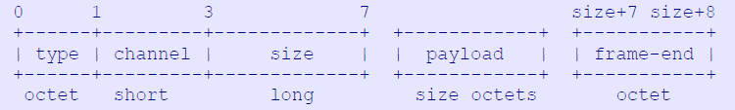
Core (cont.)
All frames consists of a header (7 octets), a payload and a "frame-end" octet that detects malformed frames.
To read a frame:
1. Read the header and check the frame type and channel.
2. Depending on the frame type, read the payload and process it.
3. Read the "frame-end" octet

Slide 20
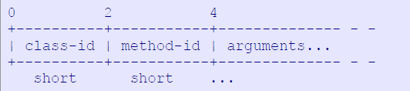
Core (cont.)
Method frames carry the high-level protocol commands(methods),
One method frame carries one command.
The method frame payload has the bellow format:

Slide 21
RabbitMQ
RabbitMQ is an Erlang implementation of an AMQP broker.
Erlang has been chosen to build it because of its intrinsic support for building highly-reliable and distributed applications.
RabbitMQ implements Version 0-9-1 of AMQP with custom extensions (as allowed by the protocol).
For data persistence, it relies on Mnesia, the in-memory/file-persisted embedded database of Erlang, and specific message storage and index files.

Slide 22
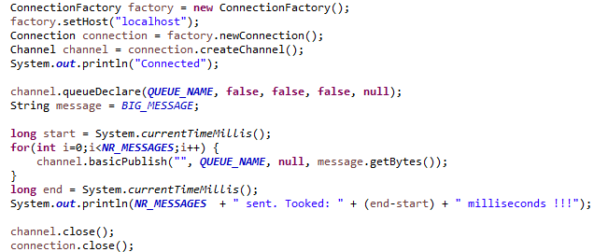
RabbitMQ (cont.)
Bellow is an example of message producer:

Slide 23
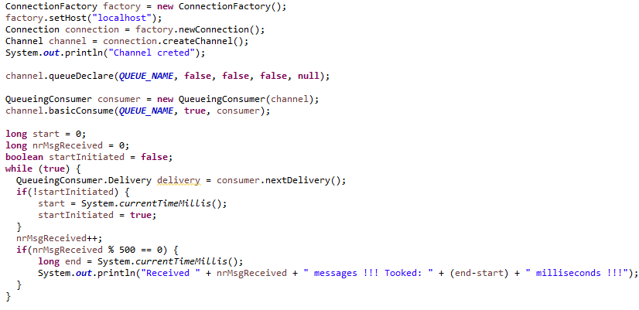
RabbitMQ (cont.)
Bellow is an example of message consumer:

Slide 24

Bibliography
Amqp0-9-1 Specification

