Slide 1

COAP
Dima Ionut Daniel

Slide 2
Contents
What is COAP?
Features
Terminology
Core
Messages
Security
Implementations
Bibliography

Slide 3

What is COAP ?
Constrained Application Protocol (COAP) is a software protocol intended to be used in very simple electronics devices, allowing them to communicate interactively over the Internet.
It is particularly targeted for small, low-power sensors, switches, valves and similar components that need to be controlled or supervised remotely, through standard Internet networks.
COAP is designed to easily translate to HTTP for simplified integration with the web, while also meeting specialized requirements such as multicast support, very low overhead, and simplicity.

Slide 4
What is COAP ? (cont.)
Multicast, low overhead, and simplicity are extremely important for Internet of Things (IoT) and Machine-to-Machine (M2M) devices.
COAP can run on most devices that support UDP or a UDP analogue.
The core of the protocol is specified in RFC 7252.

Slide 5
Features
Overhead and parsing complexity.
URI and content-type support.
Support for the discovery of resources provided by known COAP services.
Simple subscription for a resource, and resulting push notifications.
Simple caching based on max-age.
The mapping of COAP with HTTP is also defined, allowing proxies to be built providing access to COAP resources via HTTP in a uniform way
Security binding to Datagram Transport Layer Security (DTLS)

Slide 6
Terminology
Endpoint: entity participating in the CoAP protocol. Synonyms: node, host.
Sender: originating endpoint of a message
Recipient: destination endpoint of a message
Client: originating endpoint of a request.
Server: destination endpoint of a request.

Slide 7
Terminology (cont.)
Proxy: forwards requests and relays back responses.
There are 2 types of proxy: forward-proxy and reverse-proxy.
Cross-Proxy: proxy that translates between different protocols such as CoAP-to-HTTP or HTTP-toCoAP proxies.

Slide 8
Terminology (cont.)
Confirmable message: messages that require an acknowledgement.
Non-confirmable message: messages that doesn't require acknowledgement.
Acknowledgement message: message that acknowledges that a specific Confirmable message arrived.
Reset message: indicates that a specific message was received
Piggybacked response: is included right in the CoAP acknowledgement message(ACK).
Empty message: with code 0.00 which is not a rerequest nor a response.

Slide 9
Core
COAP provides a reuqest/response interaction model between endpoints.
COAP is designes to easily interface with HTTP for integration with the Web.
The main goal of CoAP is to design a generic web protocol for special requirements of an constrained envirnoment.
CoAP has somehow a subset of REST common with HTTP but optimized for M2M applications.
CoAP makes use of GET, PUT, POST and DELETE methods in a similar manner to HTTP.

Slide 10
Core (cont.)
A CoAP request is sent by a client to request an action (using a Method Code) on a resource (identified by a URI) on server.
The server sends a response with a Response code.
Unlike HTTP, CoAP deals with these interchanges asynchronously over a datagram-oriented transport such as UDP.

Slide 11
Core (cont.)
The CoAP message model is based on the exchange of messages over UDP between endpoints.
CoAP uses a short fixed-length binary header (4 bytes) that may be followed by compact binary options and a payload.
Each message contains a Message ID used to detect duplicates and for optional reliability.
Message ID is 16-bit size enables up to about 250 messages per second.

Slide 12
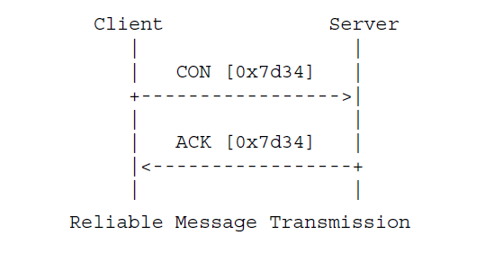
Core (cont.)
Reliability is provided by marking a message as Confirmable (CON).
A confirmable message is retransmitted using a default timeout and exponential back-off between retransmissions, until the recipient an Acknowledgement message (ACK) with same Message ID.
When a recipient is not able to process a Confirmable message it replies with a Reset message (RST) instead of an Acknowledgement(ACK).

Slide 13
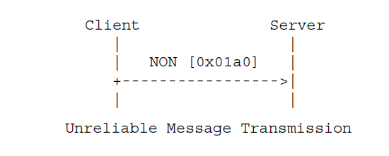
Core (cont.)
A message that doesn't require reliable transmission can be sent as a Non-confirmable message (NON).
When a recipient is not able to process a Non-confirmable message it may reply with a Reset message(RST).

Slide 14
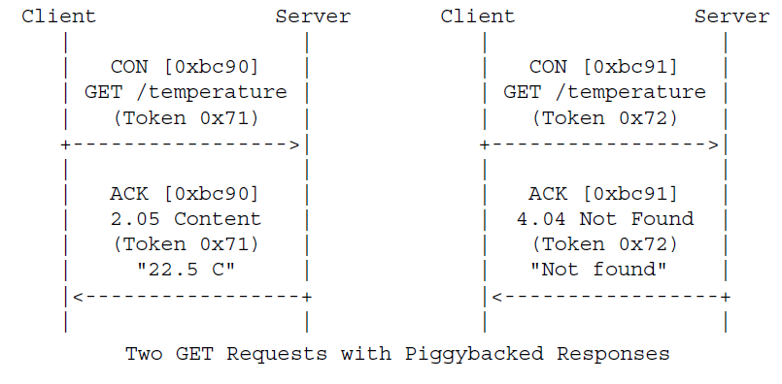
Core (cont.)
A request is carried in a Confirmable(CON) or Non-confirmable (NON) message.
If immediately available, the response to a CON request is carried in the resulting Acknowledgement (ACK) message. This is called a pigggybacked response.

Slide 15
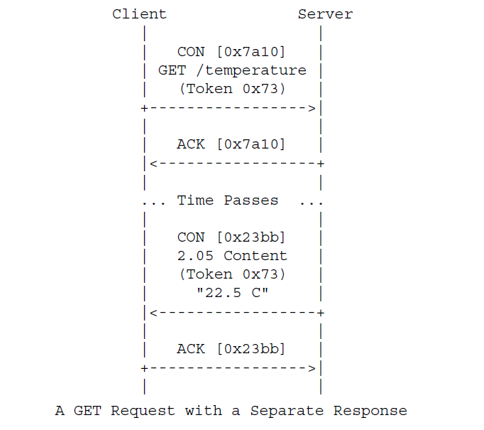
Core (cont.)
If the server is not able to respond immediately to a CON request it responds with an Empty Acknowledgement message.
When the response is ready, the server sends it in a new CON message. This is called "separate response".

Slide 16
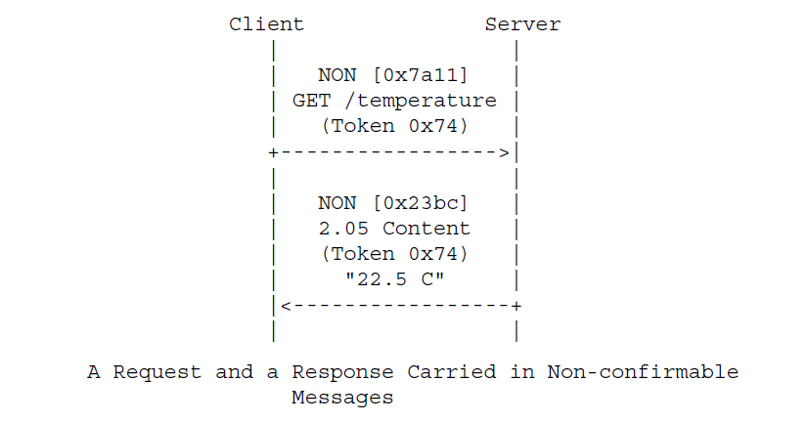
Core (cont.)
If a request is sent in an Non-Confirmable message then the response is sent using a new Non-Confirmable message. The server may instead send a Confirmable message.

Slide 17
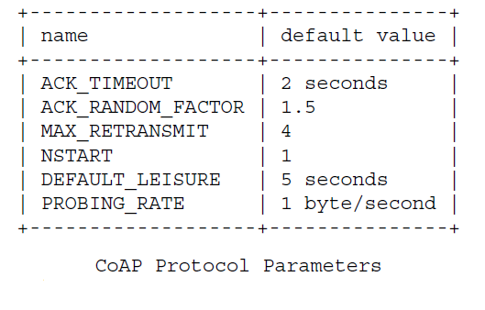
Core (cont.)
Message transmission is controller by bellow parameters:

Slide 18
Core (cont.)
The token is used to match a response with a request.
The token value is a sequence of 0-8 bytes.
Every request carries a client-generated token that the server must reply in any resulting response.

Slide 19
Core (cont.)
CoAP uses the "coap" and "coaps" URI schemes for identifying CoAP resources and providing a means of locating the resource.
CoAP URI pattern: "coap:" "//" host [":" port] path ["?" query]
By default the CoAP server is listening on port 5683.

Slide 20
Core (cont.)
Resource discovery is important for machine-to-machine interactions and is supported using the Core link Format (RFC6690).
A server is discovered by a client learning a URI that references a resource in the namespace of the server.
The CoAP default port number is 5683.
The default port number for DTLS-secured CoAP is 5684.
The discovery of resources offered by a CoAP endpoint is extremely important in M2M applications.

Slide 21
Messages
COAP makes use of two message types, requests and responses, using a simple, binary, base header format.
The base header may be followed by options in an optimized Type-Length-Value format.
COAP is by default bound to UDP and optionally to DTLS, providing a high level of communications security.

Slide 22
Messages (cont.)
CoAP defines 4 types of messages:
Confirmable
Non-Confirmable
Acknowledgement
Reset
Requests can be carried in Confirmable and Non-confirmable messages.
Responses can be carried in these as well as piggybacked in Acknowledgement messages.

Slide 23
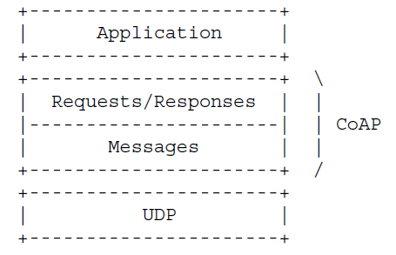
Messages (cont.)

Slide 24
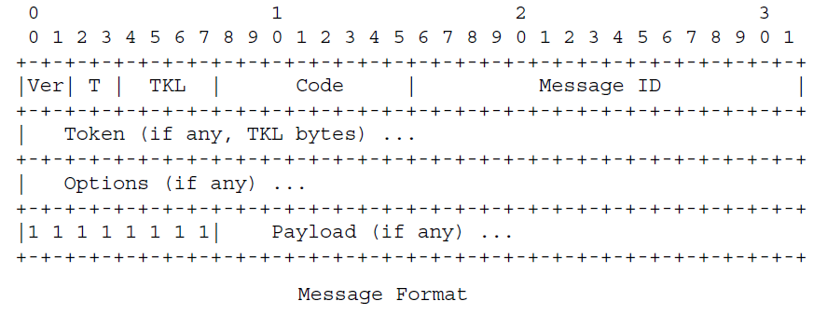
Messages (cont.)
CoAP messages are encoded in a simple binary format.
The message format starts with a fixed size 4 byte header, followed by a variable length Token value (0-8 bytes long).
After the Token value comes a sequence of 0 or more CoAP options in TLV(Type-Length-Value) format, optionally fallowed by a payload.

Slide 25
Messages (cont.)
Ver(Version): indicates the CoAP version number.
T(Type): indicates if the message is Confirmable(0) or Non-Confirmable(1), Acknowledgement(2) or Reset(3).
TKL(Token length): indicates the length of the variable-length token field.
Code: 8-bit unsigned integer, split into 30bit class and 5-bit detail. The class can indicate a request(0), success response (2), client error response (4), server error response (5). The code 0.00 indicates an Empty message.
Message ID: 16-bit unsigned integer in network byte order.

Slide 26
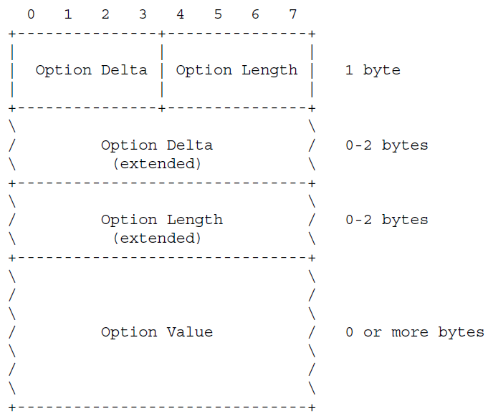
Messages (cont.)
CoAP defined a number of options that can be included in a message.
Each option instance in a message specifies the Option Number of the defined CoAP option, the length of the Option Value and the Option Value itself.

Slide 27
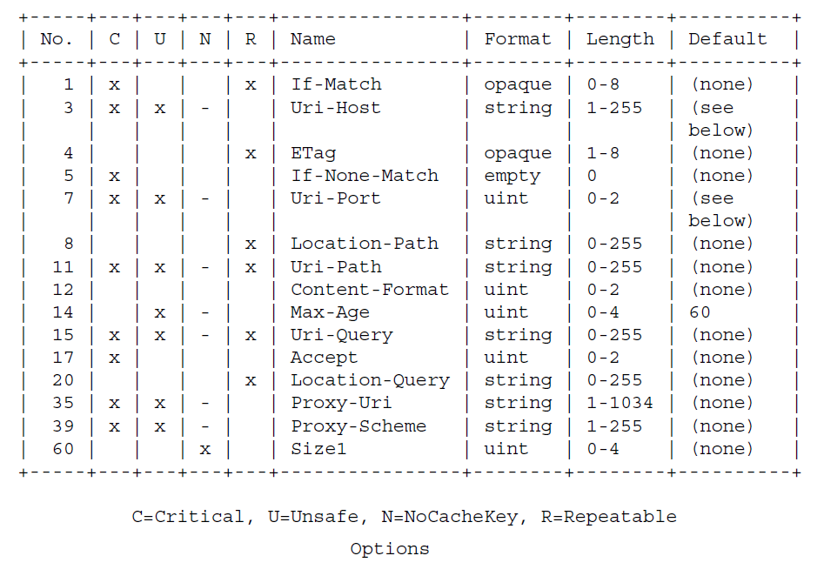
Messages (cont.)

Slide 28
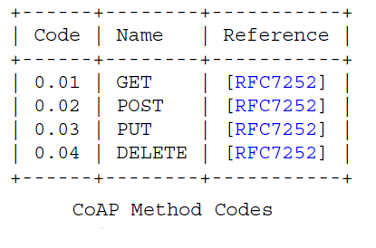
Messages (cont.)
Each entry in the sub-registry must include the Method Code in the range 0.01-0.31.

Slide 29
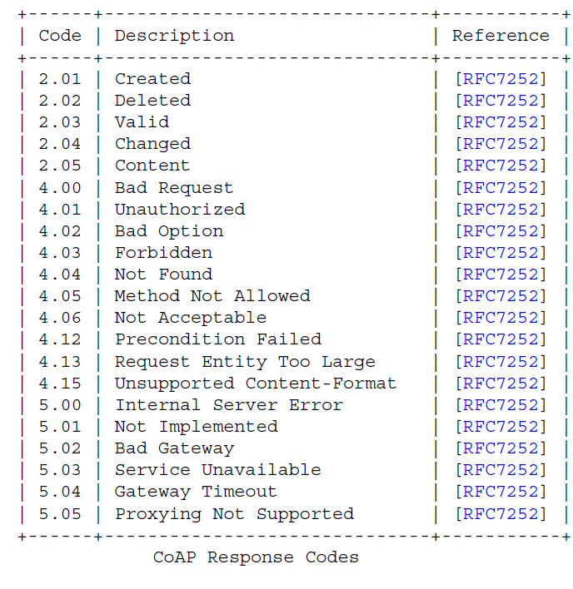
Messages (cont.)

Slide 30
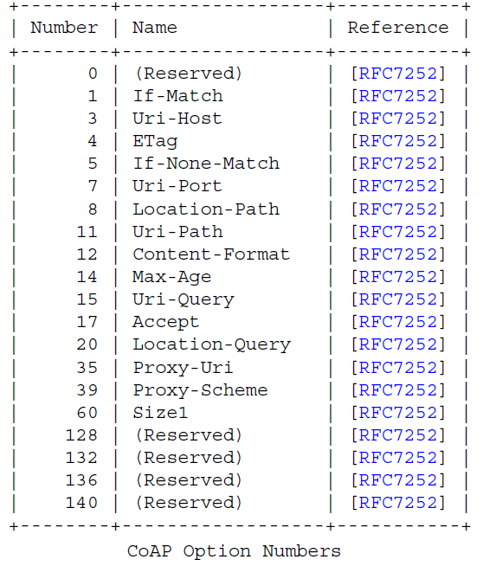
Messages (cont.)

Slide 31
Security
During the provisioning phase a CoAP device is provided with the security information that it needs.
NoSec: no protocol-level security(DTLS is disabled).
PreSharedKey: DTLS is enabled, list of pre-shared keys (RFC 4279).
RawPublicKey: DTLS is enabled and the device has an asymmetric key pair without a certificate that is validated using out-of-band mechanism (RFC 7250).
Certificate: DTLS is enabled and the device has an asymmetric key pair with an X.509 certificate (RFC 5280).

Slide 32
Security (cont.)
In the "NoSec" mode, the system sends the packets over normal UDP over IP and is indicated by the "coap" scheme and the CoAP default port.
The other 3 security modes are achieved using DTLS and are indicated by the "coaps" scheme and DTLS secured CoAP default port.

Slide 33
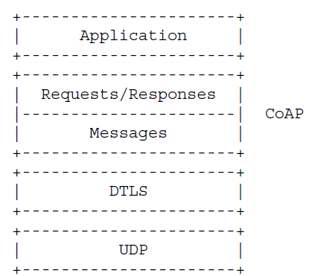
Security (cont.)
Datagram DTLS (DTLS) is defined under the RFC 6347 over UDP.

Slide 34
Implementations
The Californium (Cf) core provides the central framework with the protocol implementation to build your Internet of Things applications.
Californium (Cf) is dual-licensed under EPL and EDL.
The latter is a BSD-like license, which means the Cf COAP framework can be used together with proprietary code to implement your IoT product!
The Scandium (Sc) sub-project provides security for Californium and implements DTLS 1.2 to secure your application through ECC with pre-shared keys, certificates, or raw public keys.
nCoAP is a Java implementation of the CoAP protocol using the Netty NIO client server framework.

Slide 35
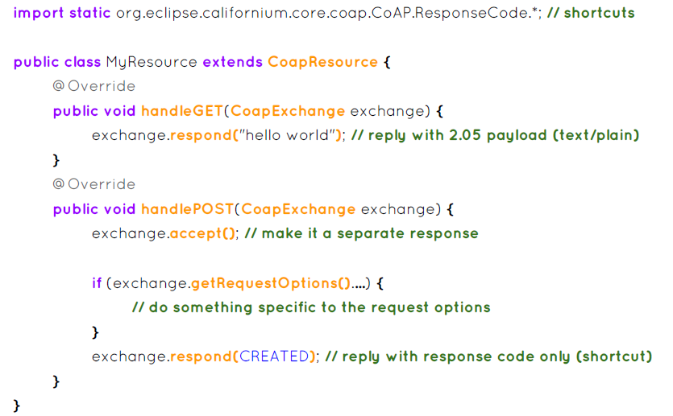
Implementations (cont.)
Sample server Californium code.

Slide 36
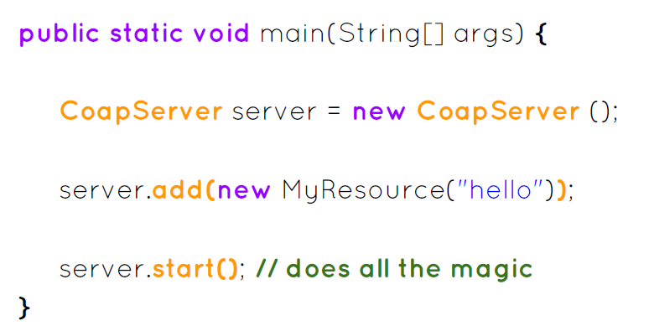
Implementations (cont.)
Sample server Californium code.

Slide 37
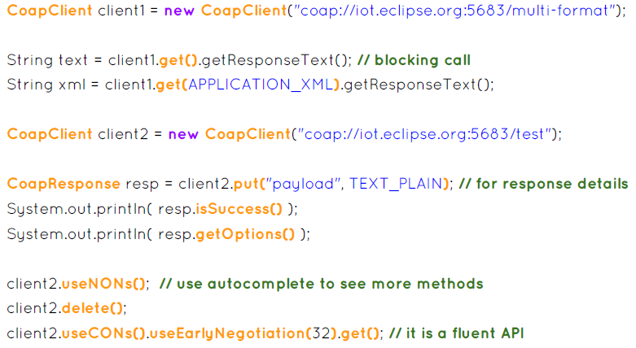
Implementations (cont.)
Sample client sync Californium code.

Slide 38
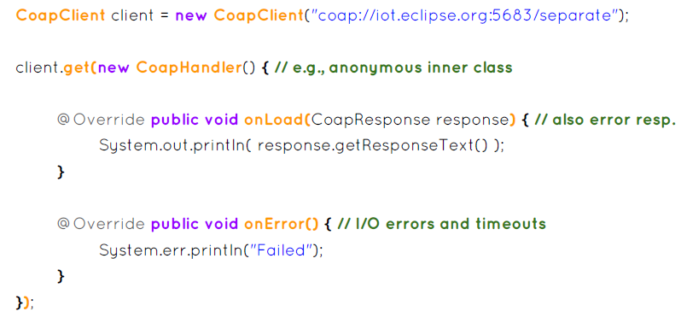
Implementations (cont.)
Sample client async Californium code.

Slide 39
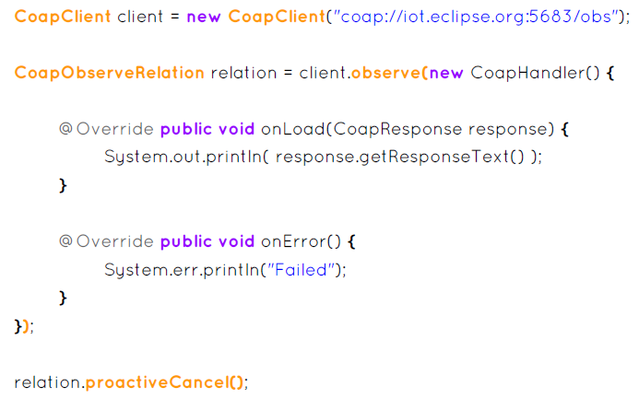
Implementations (cont.)
Sample client observe Californium code.

Slide 40
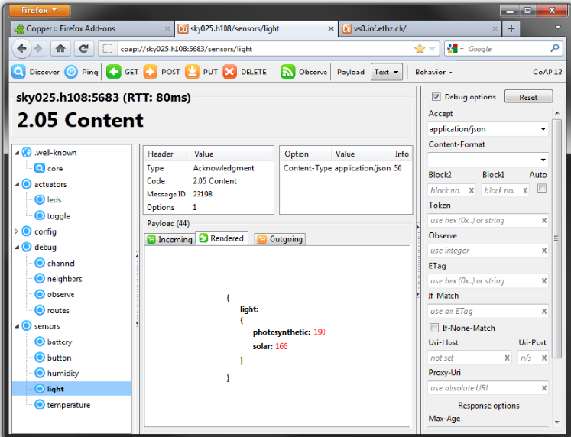
Implementations (cont.)
Copper(CU) can be used from Mozilla Firefox.

Slide 41

Bibliography
https://en.wikipedia.org/wiki/Constrained_Application_Protocol
IETF - RFC 7252 (The Constrained Application Protocol)

