Slide 1

EAP
Dima Ionut Daniel

Slide 2
Contents
What is EAP?
Features
Encapsulation
Core
EAP-TLS
EAP-TTLS
EAP-MD5
EAP-POTP
EAP-PSK
EAP-PWD
EAP-SIM
EAP-AKA
EAP-AKA’ (prime)
EAP-GTC
EAP-EKE
Leap
Bibliography

Slide 3

What is EAP?
Extensible Authentication Protocol(EAP) is an authentication framework frequently used in wireless networks and point-to-point connections.
It is defined in RFC 3748, which made RFC 2284 obsolete, and was updated by RFC 5247.
EAP provides authentication framework for providing the transport and usage of keying material and parameters generated by EAP methods.

Slide 4
What is EAP? (cont.)
There are many methods defined by RFCs and a number of vendor specific methods and new proposals exist.
EAP is not a wire protocol; instead it only defines message formats.
Each protocol that uses EAP defines a way to encapsulate EAP messages within that protocol's messages.
EAP is in wide use.
For example, in IEEE 802.11 (WiFi) the WPA and WPA2 standards have adopted IEEE 802.1X with one-hundred EAP Types as the official authentication mechanisms.

Slide 5
Features
EAP is an authentication framework, not a specific authentication mechanism.
It provides some common functions and negotiation of authentication methods called EAP methods.
There are currently about 40 different methods defined.
Methods defined in IETF RFCs include EAP-MD5, EAP-POTP, EAP-GTC, EAP-TLS, EAP-IKEv2, EAP-SIM, EAP-AKA and EAP-AKA'.
Additionally a number of vendor-specific methods and new proposals exist.

Slide 6
Encapsulation
EAP is not a wire protocol
Instead it only defines message formats.
Each protocol that uses EAP defines a way to encapsulate EAP messages within that protocol's messages.

Slide 7
Encapsulation (cont.)
The encapsulation of EAP over IEEE 802 is defined in IEEE 802.1X and known as "EAP over LANs" or EAPOL.
EAPOL was originally designed for IEEE 802.3 ethernet in 802.1X-2001, but was clarified to suit other IEEE 802 LAN technologies such as IEEE 802.11 wireless and Fiber Distributed Data Interface (ISO 9314-2) in 802.1X-2004.
The EAPOL protocol was also modified for use with IEEE 802.1AE (MACsec) and IEEE 802.1AR (Initial Device Identity, IDevID) in 802.1X-2010.

Slide 8
Encapsulation (cont.)
The Protected Extensible Authentication Protocol, also known as Protected EAP or simply PEAP, is a protocol that encapsulates EAP within a potentially encrypted and authenticated Transport Layer Security (TLS) tunnel.
The purpose was to correct deficiencies in EAP.
EAP assumed a protected communication channel, such as that provided by physical security, so facilities for protection of the EAP conversation were not provided.

Slide 9
Encapsulation (cont.)
PEAP was jointly developed by Cisco Systems, Microsoft, and RSA Security and has 3 versions: PEAPv0, PEAPv1 and PEAPv2.
PEAPv0 was the version included with Microsoft Windows XP and was nominally defined in draft-kamath-pppext-peapv0-00.
PEAPv1 and PEAPv2 were defined in different versions of draft-josefsson-pppext-eap-tls-eap.
PEAPv1 was defined in draft-josefsson-pppext-eap-tls-eap-00 through draft-josefsson-pppext-eap-tls-eap-05 and PEAPv2 was defined in versions beginning with draft-josefsson-pppext-eap-tls-eap-06.

Slide 10
Encapsulation (cont.)
Both the RADIUS and Diameter AAA protocols can encapsulate EAP messages.
They are often used by Network Access Server (NAS) devices to forward EAP packets between IEEE 802.1X endpoints and AAA servers to facilitate IEEE 802.1X.

Slide 11
Encapsulation (cont.)
The Protocol for Carrying Authentication for Network Access (PANA) is an IP-based protocol that allows a device to authenticate itself with a network to be granted access.
PANA will not define any new authentication protocol, key distribution, key agreement or key derivation protocols; for these purposes, EAP will be used, and PANA will carry the EAP payload.
PANA allows dynamic service provider selection, supports various authentication methods, is suitable for roaming users, and is independent from the link layer mechanisms.

Slide 12
Encapsulation (cont.)
EAP was originally an authentication extension for the Point-to-Point Protocol (PPP).
PPP has supported EAP since EAP was created as an alternative to the Challenge-Handshake Authentication Protocol (CHAP) and the Password Authentication Protocol (PAP), which were eventually incorporated into EAP. The EAP extension to PPP was first defined in RFC 2284, now obsoleted by RFC 3748.

Slide 13
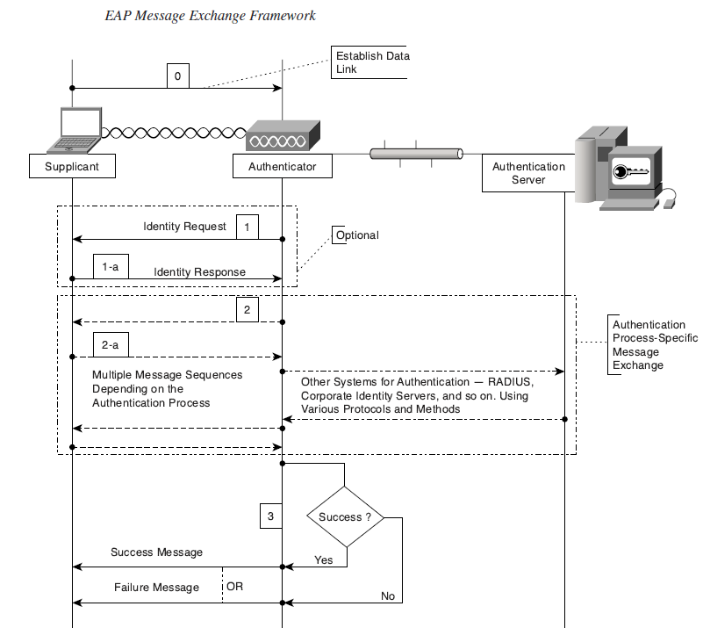
Core

Slide 14
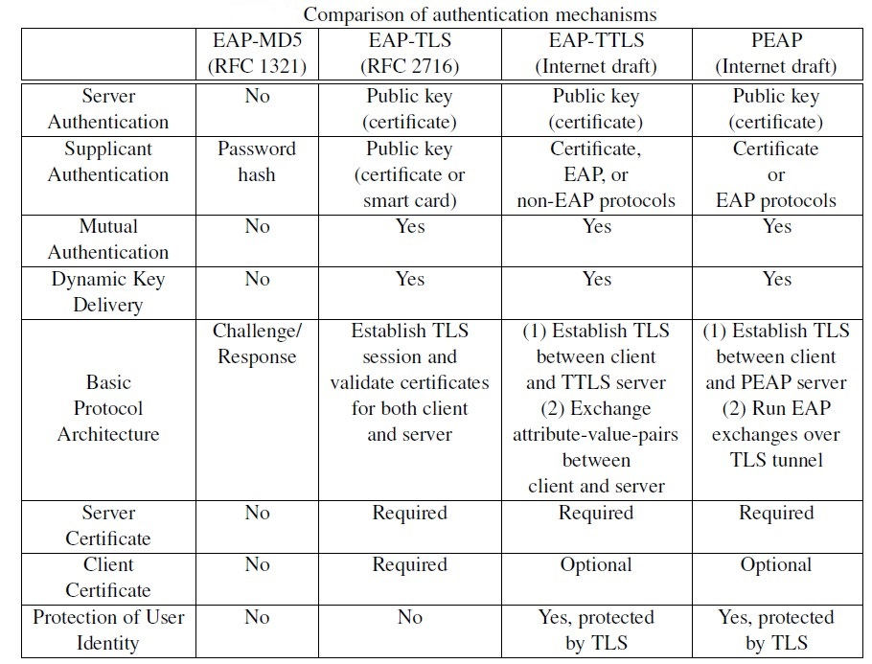
Core (cont.)

Slide 15
EAP-TLS
EAP-Transport Layer Security (EAP-TLS), defined in RFC 5216, is an IETF open standard that uses the Transport Layer Security (TLS) protocol, and is well-supported among wireless vendors.
EAP-TLS is the original, standard wireless LAN EAP authentication protocol.
EAP-TLS is still considered one of the most secure EAP standards available.
The majority of implementations of EAP-TLS require client-side X.509 certificates without giving the option to disable the requirement, even though the standard does not mandate their use.

Slide 16
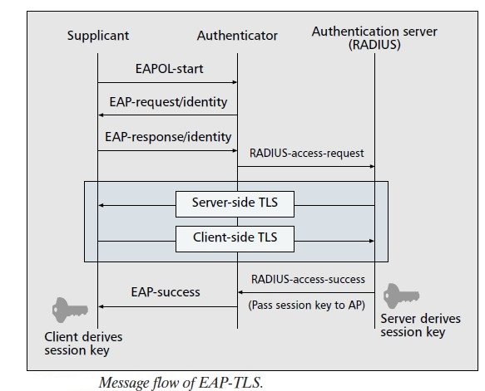
EAP-TLS (cont.)

Slide 17
EAP-TLS (cont.)
EAP-TLS uses concepts of PKI:
A WLAN client (that is, a user’s machine) requires a valid certificate to authenticate to the WLAN network
The AAA server requires a “server” certificate to validate its identity to the clients
The certificate-authority-server infrastructure issues certificates to the AAA server(s) and the clients

Slide 18
EAP-TLS (cont.)
A Public Key Infrastructure (PKI) is a management system designed to administer asymmetrical cryptographic keys and public key certificates.
It acts as a trusted component that guarantees the authenticity of the binding between a public key and security information, including identity, involved in securing a transaction with public key cryptography.

Slide 19
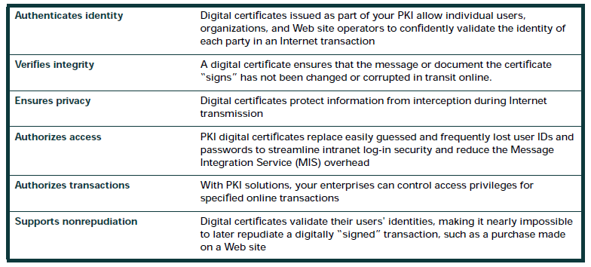
EAP-TLS (cont.)
PKI protects information in several essential ways

Slide 20
EAP-TLS (cont.)
A certificate is a cryptographically signed structure, called the digital certificate, that guarantees the association between at least one identifier and a public key.
It is valid for a limited period of time (called the validity period), fora specific usage, and under certain conditions and limitations described in a certificate policy.
The authority that issues this certificate is called the certification authority.

Slide 21
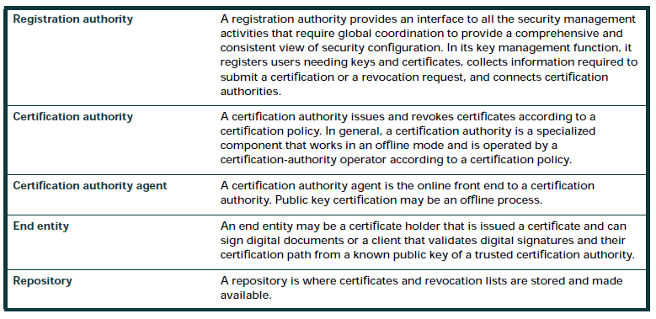
EAP-TLS (cont.)
PKI Components

Slide 22
EAP-TLS (cont.)
PKI authentication requires two elements of trust:
Private-public key pair
Certification authority
Every certificate is associated with two keys: a private key and a public key.
Only the owner of the certificate knows the private key, whereas the public key (hence its name) is known to everyone.
With this key pair, asymmetric encryption is used.

Slide 23
EAP-TLS (cont.)
EAP-TLS is based on SSL Version 3.0.
In EAP-TLS, the SSL handshake is performed over EAP, on the Internet, the SSL handshake is conducted through Transmission Control Protocol (TCP).
In EAP the end user’s machine is known as the supplicant, the access point is known as the authenticator, and the RADIUS server is known as the authentication server.

Slide 24
EAP-TLS (cont.)
EAP-TLS performs mutual SSL authentication.
This requires both the supplicant (the end user’s machine) and the authentication server (the RADIUS server) to have a certificate.
In mutual authentication, each side is required to prove its identity to the other using its certificate and its private key.

Slide 25
EAP-TLS (cont.)
EAP-TLS authentication is based on 802.1x/EAP architecture.
The supplicant and the RADIUS server must support EAP-TLS authentication.
The access point has to support the 802.1x/EAP authentication process.
Note that LEAP and EAP MD5 also use the same 802.1x/EAP authentication process.

Slide 26
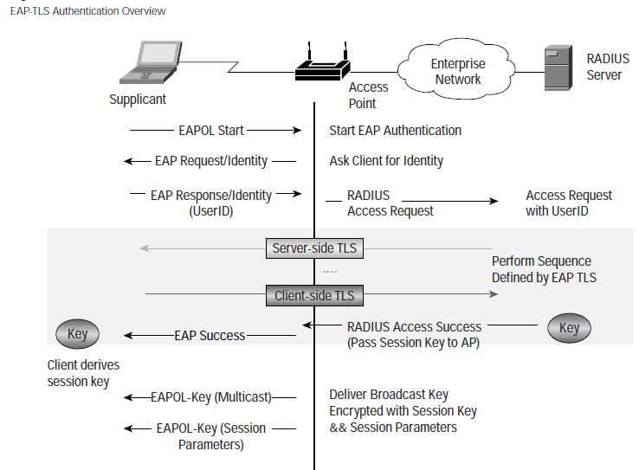
EAP-TLS (cont.)

Slide 27
EAP-TLS (cont.)
The RADIUS server provides its certificate to the client and requests the client’s certificate.
The client validates the server certificate and responds with an EAP response message containing its certificate and also starts the negotiation for cryptographic specifications (cipher and compression algorithms).
After the client’s certificate is validated, the server responds with cryptographic specifications for the session.

Slide 28
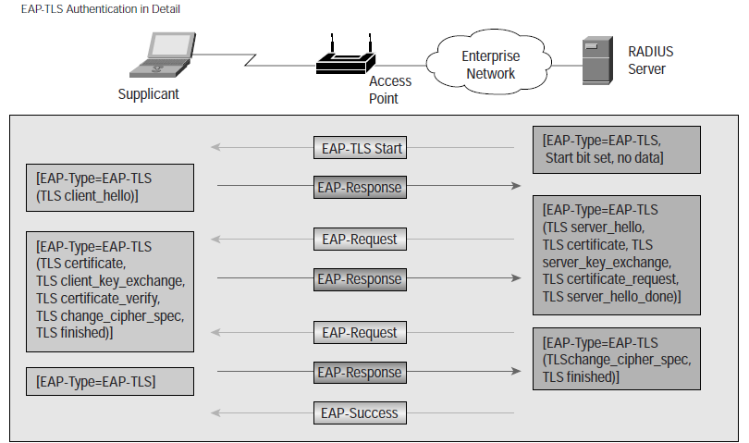
EAP-TLS (cont.)

Slide 29
EAP-TTLS
EAP-Tunneled Transport Layer Security (EAP-TTLS) is an EAP protocol that extends TLS.
Microsoft Windows started EAP-TTLS support with Windows 8.
Windows Phone 8 does not support EAP-TTLS while version 8.1 supports it.
The client can, but does not have to be authenticated via a CA-signed PKI certificate to the server.
This greatly simplifies the setup procedure since a certificate is not needed on every client.

Slide 30
EAP-TTLS (cont.)
After the server is securely authenticated to the client via its CA certificate and optionally the client to the server, the server can then use the established secure connection ("tunnel") to authenticate the client.
Two distinct versions of EAP-TTLS exist: original EAP-TTLS (a.k.a. EAP-TTLSv0) and EAP-TTLSv1.
EAP-TTLSv0 is described in RFC 5281, EAP-TTLSv1 is available as an Internet draft.

Slide 31
EAP-MD5
EAP-MD5 was the only IETF Standards Track based EAP method when it was first defined in the original RFC for EAP, RFC 2284.
It offers minimal security: the MD5 hash function is vulnerable to dictionary attacks, and does not support key generation, which makes it unsuitable for use with dynamic WEP, or WPA/WPA2 enterprise.
EAP-MD5 differs from other EAP methods in that it only provides authentication of the EAP peer to the EAP server but not mutual authentication.
By not providing EAP server authentication, this EAP method is vulnerable to man-in-the-middle attacks.
EAP-MD5 support was first included in Windows 2000 and deprecated in Windows Vista.

Slide 32
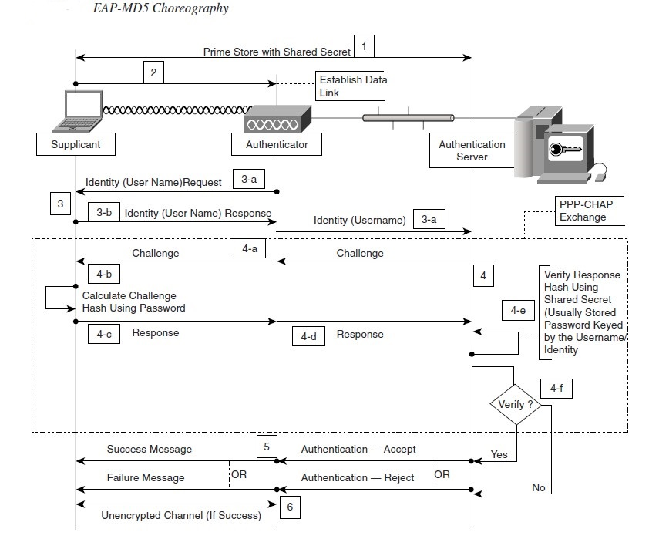
EAP-MD5 (cont.)

Slide 33
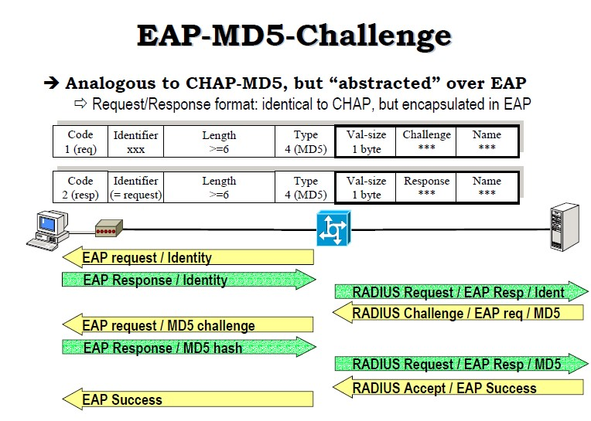
EAP-MD5 (cont.)

Slide 34
EAP-POTP
EAP-POTP (Protected One-Time Password), which is described in RFC 4793, is an EAP method developed by RSA Laboratories that uses one-time password (OTP) tokens.
The handheld hardware device or a hardware or software module running on a personal computer, to generate authentication keys.
EAP-POTP can be used to provide unilateral or mutual authentication and key material in protocols that use EAP.
The EAP-POTP method provides two-factor user authentication, meaning that a user needs both physical access to a token and knowledge of a personal identification number (PIN) to perform authentication.

Slide 35
EAP-PSK
EAP-PSK, defined in RFC 4764, is an EAP method for mutual authentication and session key derivation using a pre-shared key (PSK).
It provides a protected communication channel, when mutual authentication is successful, for both parties to communicate and is designed for authentication over insecure networks such as IEEE 802.11.
EAP-PSK is documented in an experimental RFC that provides a lightweight and extensible EAP method that does not require any public-key cryptography.
The EAP method protocol exchange is done in a minimum of four messages.

Slide 36
EAP-PWD
EAP-PWD, defined in RFC 5931, is an EAP method which uses a shared password for authentication.
The password may be a low-entropy one and may be drawn from some set of possible passwords, like a dictionary, which is available to an attacker.
The underlying key exchange is resistant to active attack, passive attack, and dictionary attack.
EAP-PWD is in the base of Android 4.0 (ICS), it is in FreeRADIUS and Radiator RADIUS servers, it is in hostapd and wpa_supplicant.

Slide 37
EAP-SIM
EAP for GSM Subscriber Identity Module (EAP-SIM) is used for authentication and session key distribution using the Subscriber Identity Module (SIM) from the Global System for Mobile Communications (GSM).
GSM cellular networks use a subscriber identity module (SIM) card to carry out user authentication.
EAP-SIM use a SIM authentication algorithm between the client and an Authentication, Authorization and Accounting (AAA) server providing mutual authentication between the client and the network.

Slide 38
EAP-SIM (cont.)
In EAP-SIM the communication between the SIM card and the Authentication Centre (AuC) replaces the need for a pre-established password between the client and the AAA server.
The A3/A8 algorithms are being run a few times, with different 128 bit challenges, so there will be more 64 bit Kc-s which will be combined/mixed to create stronger keys (Kc-s won't be used directly).
The lack of mutual authentication in GSM has also been overcome.
EAP-SIM is described in RFC 4186.

Slide 39
EAP-AKA
Extensible Authentication Protocol Method for Universal Mobile Telecommunications System (UMTS) Authentication and Key Agreement (EAP-AKA), is an EAP mechanism for authentication and session key distribution using the UMTS Subscriber Identity Module (USIM). EAP-AKA is defined in RFC 4187.

Slide 40
EAP-AKA’ (prime)
The EAP-AKA' (AKA Prime) variant of EAP-AKA, defined in RFC 5448, and is used for non-3GPP access to a 3GPP core network.
For example, via EVDO, WiFi, or WiMax.

Slide 41
EAP-GTC
EAP Generic Token Card, or EAP-GTC, is an EAP method created by Cisco as an alternative to PEAPv0/EAP-MSCHAPv2 and defined in RFC 2284 and RFC 3748.
EAP-GTC carries a text challenge from the authentication server, and a reply generated by a security token.
The PEAP-GTC authentication mechanism allows generic authentication to a number of databases such as Novell Directory Service (NDS) and Lightweight Directory Access Protocol (LDAP), as well as the use of a one-time password.

Slide 42
EAP-EKE
EAP with the encrypted key exchange, or EAP-EKE, is one of the few EAP methods that provide secure mutual authentication using short passwords and no need for public key certificates.
It is a three-round exchange, based on the Diffie-Hellman variant of the well-known EKE protocol.
EAP-EKE is specified in RFC 6124.

Slide 43
Leap
The Lightweight Extensible Authentication Protocol (LEAP) method was developed by Cisco Systems prior to the IEEE ratification of the 802.11i security standard.
Cisco distributed the protocol through the CCX (Cisco Certified Extensions) as part of getting 802.1X and dynamic WEP adoption into the industry in the absence of a standard.

Slide 44
Leap (cont.)
There is no native support for LEAP in any Windows operating system, but it is widely supported by third party client software most commonly included with WLAN (wireless LAN) devices.
LEAP support for Microsoft Windows 7 and Microsoft Windows Vista can be added by downloading a client add in from Cisco that provides support for both LEAP and EAP-FAST.
LEAP uses a modified version of MS-CHAP.
Cisco's current recommendation is to use newer and stronger EAP protocols such as EAP-FAST, PEAP, or EAP-TLS.

Slide 45
Leap (cont.)
There is no nat

Slide 46

Bibliography
https://en.wikipedia.org/wiki/Extensible_Authentication_Protocol
https://tools.ietf.org/html/rfc3748
https://tools.ietf.org/html/rfc3579

