Slide 1

RabbitMQ
Dima Ionut Daniel

Slide 2
Contents
What is RabbitMQ?
Features
AMQP
Core
Administration
Clustering
Spring
Bibliography

Slide 3

What is RabbitMQ?
RabbitMQ is open source message broker software (sometimes called message-oriented middleware) that implements the Advanced Message Queuing Protocol (AMQP).
The RabbitMQ server is written in the Erlang programming language and is built on the Open Telecom Platform framework for clustering and failover.
Client libraries to interface with the broker are available for all major programming languages.

Slide 4
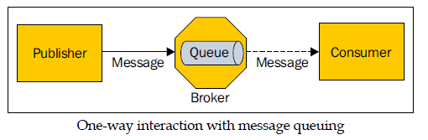
What is RabbitMQ? (cont.)
Messaging or message queuing is a style of communication between applications or components that enables a loosely coupled architecture.
Advanced Message Queuing Protocol (AMQP) is a specification that defines the semantics of an interoperable messaging protocol.
RabbitMQ is an Erlang-based implementation of AMQP, which supports advanced features such as clustering.

Slide 5
Features
Reliability
RabbitMQ offers a variety of features to let you trade off performance with reliability, including persistence, delivery acknowledgements, publisher confirms, and high availability.
Flexible Routing
Messages are routed through exchanges before arriving at queues.
Clustering
Several RabbitMQ servers on a local network can be clustered together, forming a single logical broker.
Multi-protocol
RabbitMQ supports messaging over a variety of messaging protocols.
Many Clients
There are RabbitMQ clients for almost any language you can think of.
Management UI
RabbitMQ ships with an easy-to use management UI that allows you to monitor and control every aspect of your message broker.

Slide 6
AMQP
The Advanced Message Queuing Protocol (AMQP) is an open standard that defines a protocol for systems to exchange messages.
AMQP defines not only the interaction that happens between a consumer/producer and a broker, but also the over-the-wire representation of the messages and commands that are being exchanged.
Since it specifies the wire format for messages, AMQP is truly interoperable; nothing is left to the interpretation of a particular vendor or hosting platform.

Slide 7
AMQP (cont.)
Broker: This is a middleware application that can receive messages produced by publishers and deliver them to consumers or to another broker.
Virtual host: This is a virtual division in a broker that allows the segregation of publishers, consumers, and all the AMQP constructs they depend upon, usually for security reasons (such as multitenancy).
Connection: This is a physical network (TCP) connection between a publisher/consumer and a broker. The connection only closes on client disconnection or in the case of a network or broker failure.

Slide 8
AMQP (cont.)
Channel:
This is a logical connection between a publisher/consumer and a broker.
Multiple channels can be established within a single connection.
Channels allow the isolation of the interaction between a particular client and broker so that they don't interfere with each other. This happens without opening costly individual TCP connections.
A channel can close when a protocol error occurs.

Slide 9
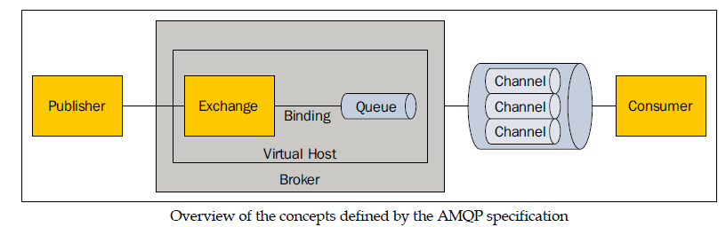
AMQP (cont.)
Exchange: This is the initial destination for all published messages and the entity in charge of applying routing rules for these messages to reach their destinations. Routing rules include the following: direct (point-to-point), topic (publish-subscribe) and fanout (multicast).
Queue: This is the final destination for messages ready to be consumed. A single message can be copied and can reach multiple queues if the exchange's routing rule says so.
Binding: This is a virtual connection between an exchange and a queue that enables messages to flow from the former to the latter. A routing key can be associated with a binding in relation to the exchange routing rule.

Slide 10
AMQP (cont.)
Java Message Service (JMS) is not interoperable and only works when compatible clients and brokers are used.
In JMS, message producers target a particular destination (queue or topic), meaning the clients need to know about the target topology.
In AMQP, the routing logic is encapsulated in exchanges, sparing the publishers from this knowledge.

Slide 11
AMQP (cont.)
MQ Telemetry Transport (MQTT) is an extremely lightweight message-queuing protocol.
MQTT focuses only on the publish-subscribe model.
Like AMQP, it is interoperable and is very well suited for massive deployments in embedded systems.
It relies on a broker for subscription management and message routing.

Slide 12
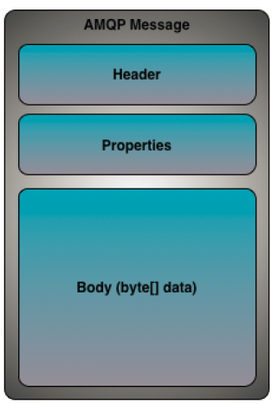
AMQP (cont.)
Message is the main entity of messaging system.
It is the atomic unit of processing of the middleware routing and queueing system and consists in:
content that is a binary data
header
properties

Slide 13
Core
RabbitMQ is an Erlang implementation of an AMQP broker.
Erlang has been chosen to build it because of its intrinsic support for building highly-reliable and distributed applications.
RabbitMQ implements Version 0-9-1 of AMQP with custom extensions (as allowed by the protocol).
For data persistence, it relies on Mnesia, the in-memory/file-persisted embedded database of Erlang, and specific message storage and index files.

Slide 14
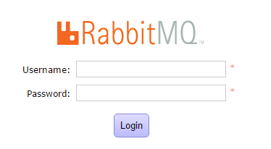
Core (cont.)
We can install the web management console using the command:
rabbitmq-plugins enable rabbitmq_management
We can access after the web management console from http://localhost:15672/.

Slide 15
Core (cont.)
We can create web users using bellow command: rabbitmqctl add_user ccm-admin hare123
After the user is create we gave administrator rights to it using: rabbitmqctl set_user_tags ccm-admin administrator
We can change password for a certain user using: rabbitmqctl change_password guest guest123
RabbitMQ supports the notion of virtual hosts, which are logical subdivisions of its execution space.
In order to create a virtual host we use the command: rabbitmqctl add_vhost dev-vhost
We set permission to the host using: rabbitmqctl set_permissions -p dev-vhost ccm-admin ".*" ".*"

Slide 16
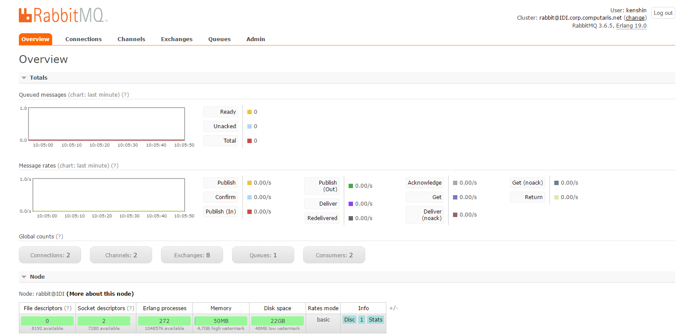
Core (cont.)

Slide 17
Core (cont.)
In order to establish a connection with the RabbitMQ we need to create ConnectionFactory/Connection objects:
ConnectionFactory factory = new ConnectionFactory();
factory.setUsername(userName);
factory.setPassword(password);
factory.setVirtualHost(virtualHost);
factory.setHost(hostName);
factory.setPort(portNumber);
Connection connection = factory.newConnection();

Slide 18
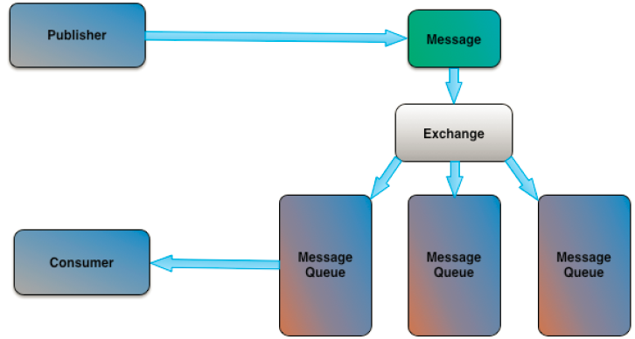
Core (cont.)
A routing strategy determines which queue (or queues) the message will be routed to.
The routing strategy bases its decision on a routing key (a free-form string) and potentially on message meta-information.

Slide 19
Core (cont.)
AMQP is a programmatic protocol that allows its clients to create and delete exchanges, queues and bindings.
RabbitMQ provides several exchange types:
direct exchange:
delivers a message based on a routing key that is provided in the message header
there is a pre-created direct exchange with the name .amq.direct.
fanout exchange:
delivers a message to all queues that are bound to the exchange.
It can be used to establish a broadcast mechanism for the delivery of messages to the queues.
There is a pre-created fanout exchange with the name .amq.fanout.

Slide 20
Core (cont.)
topic exchange:
delivers the message to queues based on a routing filter specified between the topic exchange and queues.
There is a pre-created topic exchange with the name .amq.topic.
headers exchange:
can be used to deliver messages to queues based on other message header attributes.
There are 2 pre-created headers exchange with names .amq.headers and .amq.match.

Slide 21
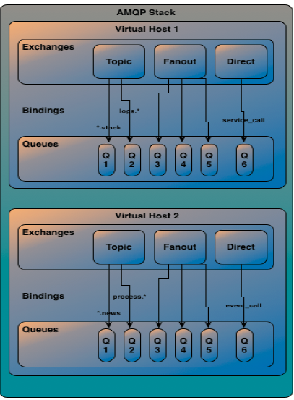
Core (cont.)

Slide 22
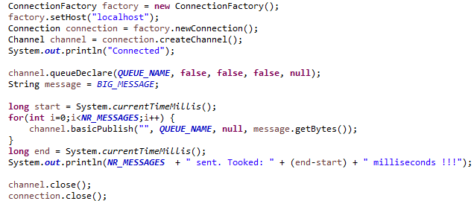
Core (cont.)

Slide 23
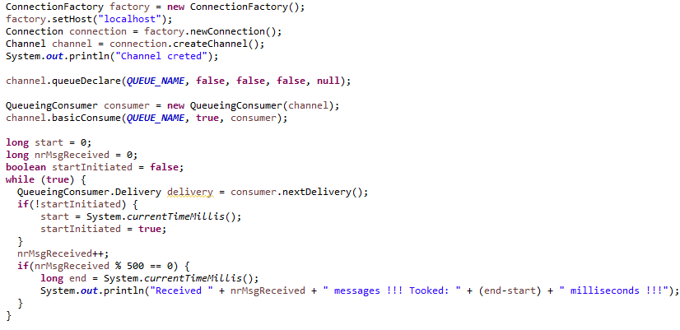
Core (cont.)

Slide 24
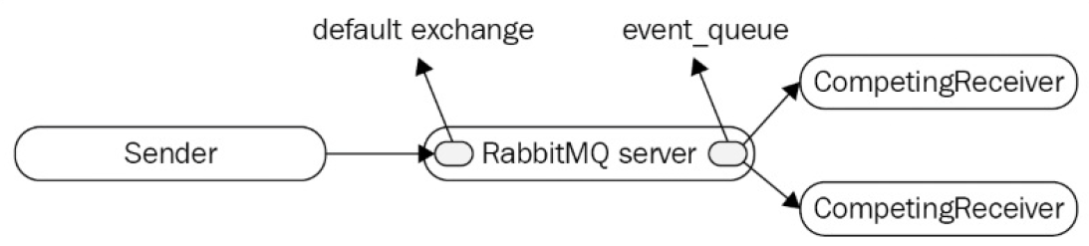
Core (cont.)
For point-to-point communication the sender can use either the default exchange or a direct exchange.

Slide 25
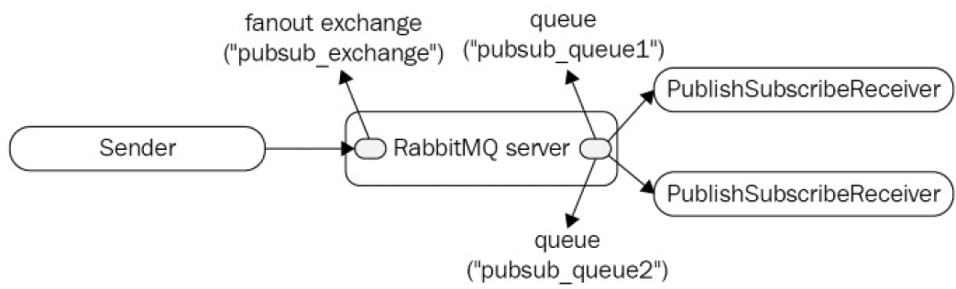
Core (cont.)
For publish-subscribers we need to use a fanout exchange and bind any number of queues to that exchange regardless of the binding key.

Slide 26
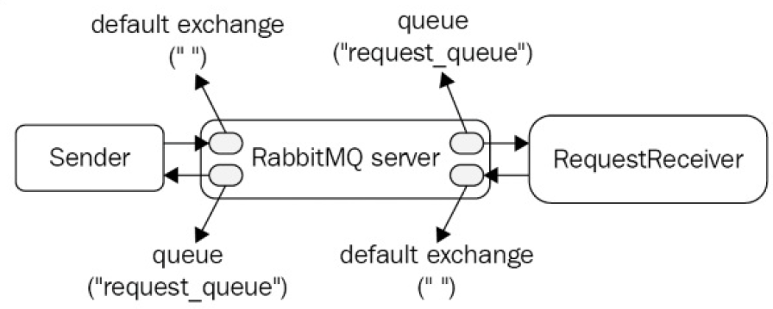
Core (cont.)
The sender sends a message to the default exchange with a routing key that matches the name of the designated request queue.
The request receiver is a subscriber to the request queue.
The request receives retrieves the value of the replyTo property from message header and creates a response message and sends it to the default exchange with a routing key that matches the replyTo property.

Slide 27
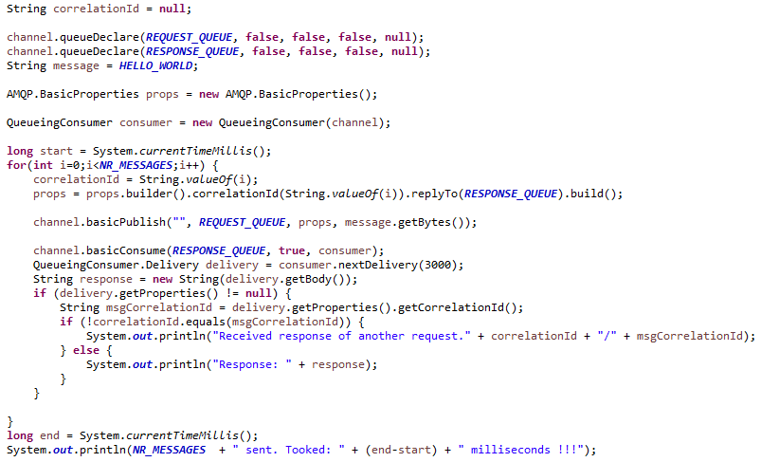
Core (cont.)

Slide 28
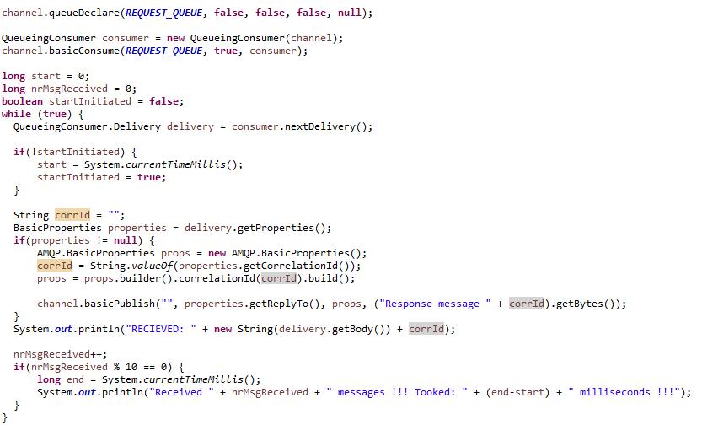
Core (cont.)

Slide 29
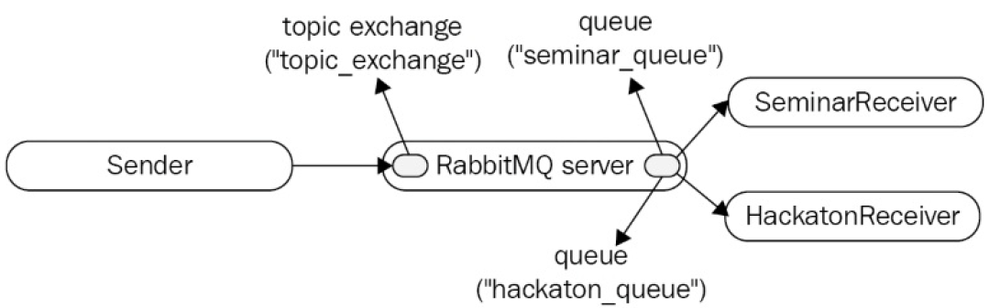
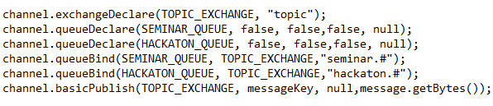
Core (cont.)
Message routing example bellow based on routing key.

Slide 30
Administration
We can pre-create in the broker queues, exchangeg so that the overhead of managing them from source code on the producer/consumer side is minimized.
We can also create users, vhosts, and policies using the management plugin or the rabbitmqctl utility.
For some administrative tasks, you can use a command line utility (rabbitmqadmin) that comes with the RabbitMQ management plugin.

Slide 31
Administration (cont.)
In order to download it, navigate to http://localhost:15672/cli/
Make sure we save it with a .py extension since it is a Python script.
All available commands for the rabbitmqadmin.py script, you can issue the following from the command line:
rabbitmqadmin.py help
rabbitmqadmin.py help subcommands

Slide 32
Administration (cont.)
Users can be created using:
rabbitmqctl add_user user password
The users have non-administrative rights and are not assigned to any vhost.
In order to make the user an admin user we need to execute bellow command:
rabbitmqctl set_user tags user administrator

Slide 33
Administration (cont.)
We can list the users using: rabbitmqctl list_users.
For changing password: rabbitmqctl change_password user new_password.
To delete an user: rabbitmqctl delete_user user.
To add a new vhost: rabbitmqctl add_vhost chat.
List vhosts: rabbitmqctl list_vhosts.
Delete a vhost: rabbitmqctl delete_vhost events.

Slide 34
Administration (cont.)
The management plugin provides an interface of REST.
http://localhost:15672/api/ should display a short description with basic examples and a reference guide for the various services.

Slide 35
Clustering
RabbitMQ clustering is based on the Erlang message-passing interface.
Communication between the nodes is established by the magic cookie(Erlang cookie) which provides a mechanism to authenticate nodes in a cluster with each other.
Once a new node is started the cookie (.erlang.cookie file) is read from home directory of the user.

Slide 36
Clustering (cont.)
Before starting the cluster it is recommended to disable the management plugin not to have conflict with the management port.
rabbitmq-plugins.bat disable rabbitmq_management
set RABBITMQ_NODENAME=instance1 &
set RABBITMQ_NODE_PORT=5701 &
rabbitmq-server.bat –detached
set RABBITMQ_NODENAME=instance2 &
set RABBITMQ_NODE_PORT=5702 &
rabbitmq-server.bat –detached
The status of the cluster can be displayed using: rabbitmqctl cluster_status

Slide 37
Spring
Spring Frameworks for RabbitMQ:
Spring AMQP: abstract layer and core library on top of the AMQP protocol.
Spring Integration: provides implementation of the enterprise integration patterns.
Spring XD(extreme data): easy handling and analytics on big data from various sources.

Slide 38
Spring (cont.)
Spring AMQP has 3 main utilities:
RabbitTemplate provides an utility to publish messages or subscribe to a RabbitMQ broker.
RabbitAdmin provides an utility to create/remove exchange, queues and bindings.
Message listener container that provide a convenient mechanism to create asynchronous listener that binds to a queue.

Slide 39
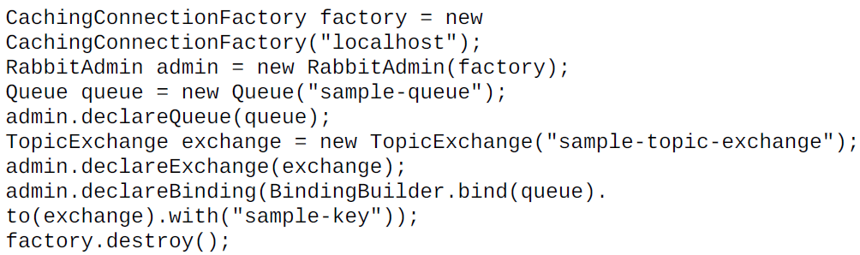
Spring (cont.)
Bellow code shows how to create a queue and bind it to an exchange using the binding key.

Slide 40
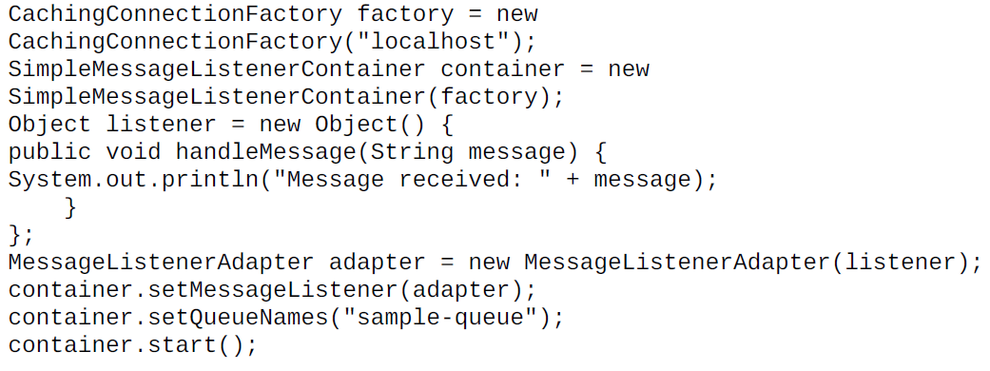
Spring (cont.)
Bellow is an example how to receive messages from a certain queue.

Slide 41

Bibliography
https://en.wikipedia.org/wiki/RabbitMQ
Packt Publishing – RabbitMQ Essentials
Packt Publishing – Learning RabbitMQ
Packt Publishing – Mastering RabbitMQ

