Slide 1

Ajax
Dima Ionut Daniel

Slide 2
Contents
What is Ajax?
History
Ajax features
Architecure
Core
Ajax Frameworks
Conclusions
Bibliography

Slide 3

What is Ajax?
Ajax (Asynchronous JavaScript and XML) is a set of web development techniques using web technologies on the client-side to create asynchronous web applications.
With Ajax web applications can send/retrieve data asynchronously.

Slide 4
Ajax features
Making Asynchronous Calls: allows you to make asynchronous calls to a web server. This allows the client browser to avoid waiting for all data to arrive before allowing the user to act once more.
User-Friendly: Ajax enabled applications will always be more responsive, faster and more user-friendly.
Increased Speed: The main purpose of Ajax is to improve the speed, performance and usability of a web application.
Callbacks: Ajax is used to perform a callback, making a quick round trip to and from the server to retrieve and/or save data without posting the entire page back to the server.

Slide 5
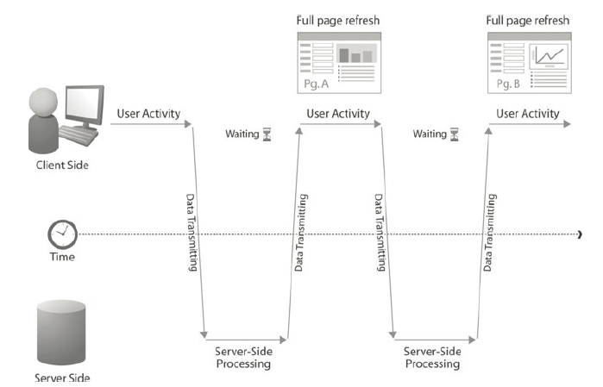
Architecture
Traditional Web Applications

Slide 6
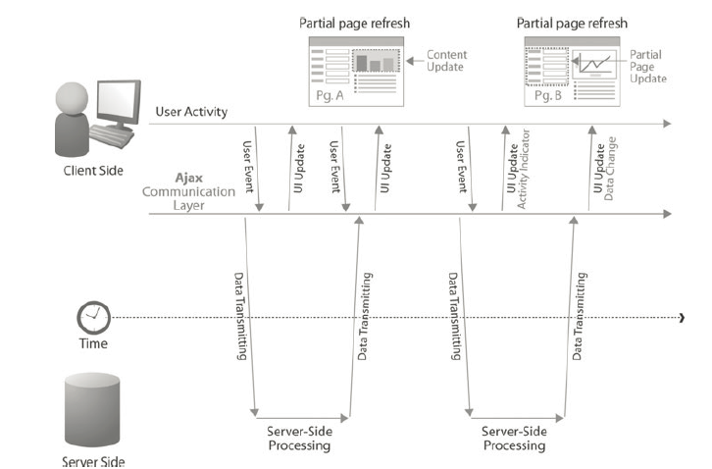
Architecture (cont.)
Ajax web flow

Slide 7
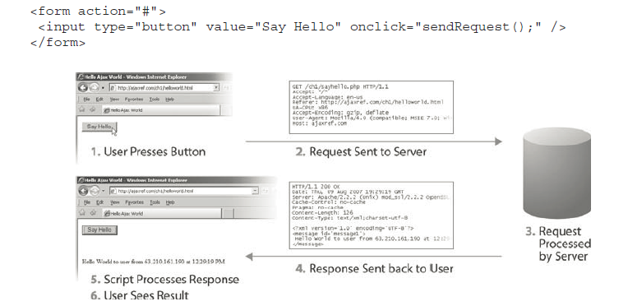
Core
We press a button and trigger an asynchronous communication request using an XMLHttpRequest (XHR) object.
The Web server will issue an XML response which will be parsed and displayed in the page.

Slide 8
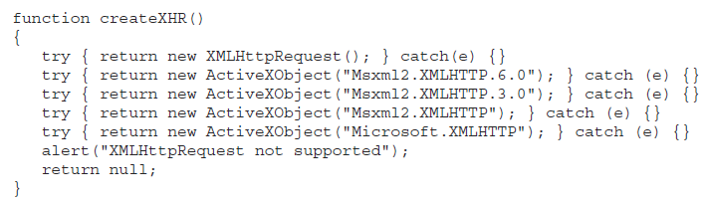
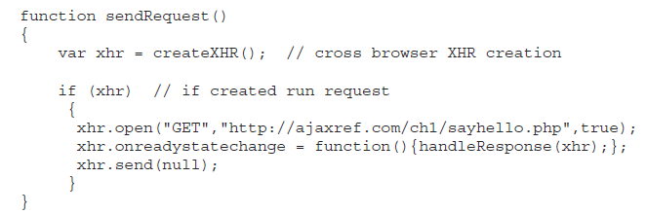
Core (cont.)

Slide 9
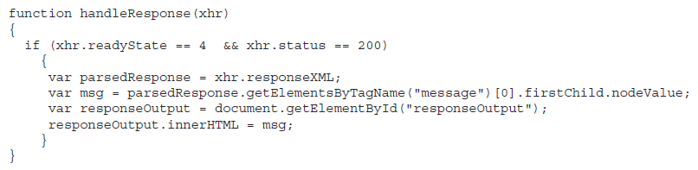
Core (cont.)
Once the browser receives data from the network, it will signal such a change by modifying the value of the readyState property of the XHR object.
The event handler for onreadystatechange should invoke the function handleResponse.

Slide 10
Core (cont.)
The core Ajax object is XMLHttpRequest.
All modern browsers have a built-in XMLHttpRequet object.
open(method, url, async)
Method can be GET or POST
The URL represents the server resource
Async indicates if the request is asynchronously or not.
send()
Sends the request to the server for GET.
send(string)
Sends the request to the server for POST.

Slide 11
Core (cont.)
To obtain the response from the server, we are using responseText, responseXML properties.
When a request to a server is sent we want to trigger some actions based on the response.
The onreadystatechange event is triggered every time the readyState changes.
The readyStatus property can have bellow values from 0 to 4:
0: request not initialized
1: server connection established
2: request received
3: processing request
4: request finished and response is ready
The status property contains the HTTP status:
200: “OK”
404: Page not found

Slide 12
Core (cont.)
Steps of AJAX Operation
A client event occurs.
An XMLHttpRequest object is created.
The XMLHttpRequest object is configured.
The XMLHttpRequest object makes an asynchronous request to the Webserver.
The Webserver returns the result containing XML document.
The XMLHttpRequest object calls the callback() function and processes the result.
The HTML DOM is updated.

Slide 13
Ajax frameworks
Ajax frameworks:
Prototype
DWR
GWT
Vaadin
ZK
ExtJS
Echo
JavaServerFaces frameworks

Slide 14
Conclusions
Pros:
Better interactivity
Easier navigation
Easy to use
Cons:
The back and refresh button are rendered useless.
It is built on javascript.

Slide 15

Bibliography
https://en.wikipedia.org/wiki/Ajax_%28programming%29
http://www.w3schools.com/ajax
The Complete Reference Ajax
Manning – Ajax in Action

