Slide 1

Dropwizard
Dima Ionut Daniel

Slide 2
Contents
What is Dropwizard?
Architecture
Features
Core
Dropwizard vs Spring Boot
Conclusions
Bibliography

Slide 3

What is Dropwizard?
Dropwizard is an open source Java framework for the rapid development of RESTful Web Services.
It includes Jetty, Jersey, Jackson, JDBI, and Hibernate, as well as a large number of additional libraries.

Slide 4
Architecture
Dropwizard uses microservice architecture style.
An application uses a suite of small services, each running in its own process.
These services are built around business capabilities and are independint.

Slide 5
Features
Jersey is the reference implementation of the JAX-RS standard (JSR 311). The Java API for RESTful Web Services make use of annotations, simplifying the development of web service applications.
Dropwizard includes Jackson, which is a fast, configurable JSON processor, and is used by Jersey to transform plain Java objects to JSON representations.
JDBI is a library that will allow us to easily create DAO interfaces in case we need database interaction.
It includes validation, monitoring, and testing modules, which we'll use to ensure that our services will behave correctly in production environments.

Slide 6
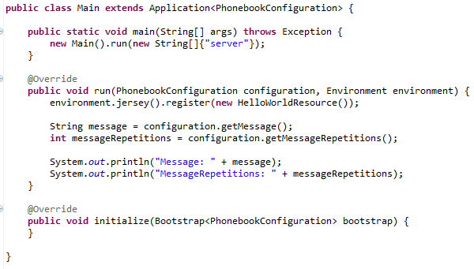
Core
Dropwizard's embedded Jetty server will try to bind to ports 8080 and 8081 by default.
Port 8080 is used by the server in order to serve incoming HTTP requests to the application, while 8081 is used by Dropwizard's administration interface.

Slide 7
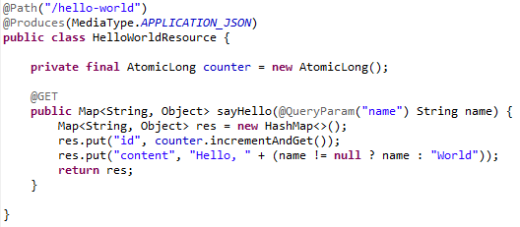
Core
The bellow classes is used to represent a REST resource.
The annotations used are the from the JAX-RS specification.

Slide 8
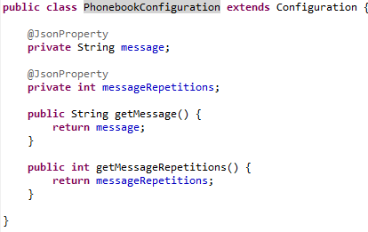
Core (cont.)
The configuration is external in YAML format (http://www.yaml.org).
The YAML is human-friendly data serialization standard. YAML files are identified by the extensions .yaml and .yml.

Slide 9
Core (cont.)
A RESTful Web Service uses four fundamental HTTP methods (verbs) mapped to CRUD operations:
POST for creating a resource
PUT for updating a resource
DELETE for deleting a resource
GET for returning the representation of a resource

Slide 10
Core (cont.)
The javax.ws.rs.Response class provides a set of ResponseBuilder methods that we can use for constructing the output data.
The method Response#ok() accepts an Object instance as the parameter, which is then serialized to our service's response format

Slide 11
Core (cont.)
Jackson is a powerful open source JSON data binder/parser and processor that facilitates the transformation of plain old Java objects to the JSON format and vice versa.
Jersey uses Jackson for its transformation needs and is part of the dropwizard-core module.
We can prevent a property from being a part of the JSON representation by adding the @JsonIgnore annotation to its getter.

Slide 12
Core (cont.)
If we need to use the database we need ot include the JDBC driver library and the dropwizard-jdbi module.
The dropwizard-jdbi module it allow to create database connection by using the JDBI library.
The DataSourceFactory can be use very easy to obtain the datasource from the yaml configuration.
database:
driverClass: com.mysql.jdbc.Driver
user: phonebookuser
password: phonebookpassword
url: jdbc:mysql://localhost/phonebook
In the custom Configuration class we add the new datasource property
@JsonProperty
private DataSourceFactory database = new DataSourceFactory();

Slide 13
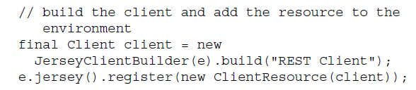
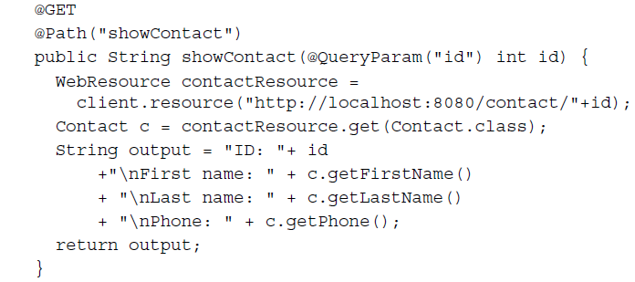
Core (cont.)
The dropwizard-client module can be use to create REST clients.

Slide 14
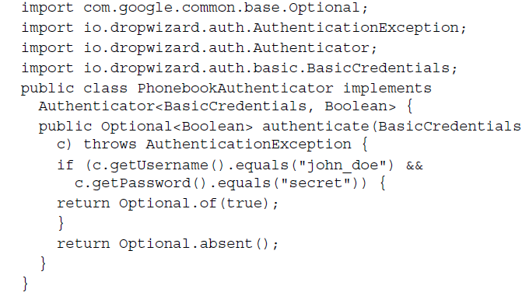
Core (cont.)
The dropwizard-auth module is used to add authentication capabilities.

Slide 15
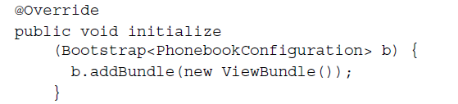
Core (cont.)
The dropwizard-views-mustache modules uses the Mustache template engine.
We need to add the ViewBundle into the initialize method.

Slide 16
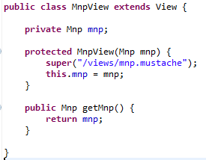
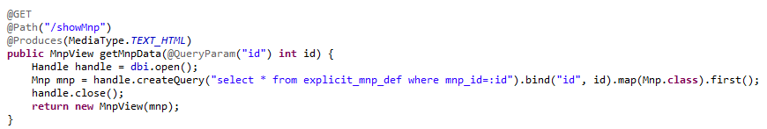
Core (cont.)
We need to create a views directory where we store the mustache files.
It’s important to use @Produces(MediaType.TEXT_HTML)

Slide 17
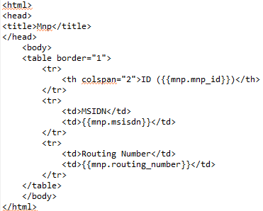
Core (cont.)
The mustache file is a text template file in html format that contains {{}} placeholders.

Slide 18
Core (cont.)
A health check is a runtime test for our application.
The health check results are accessible through the admin port of our application, which by default is 8081.
We need to implement a check() method that needs to return Result.healthy() or Result.unhealthy() in case something is going wrong.

Slide 19
Core (cont.)
We can use maven-share-plugin to create a single jar that contains all the application.
In order to start the application we need to run:
java -jar <applicationFilename.jar> server <configFileName.yaml>

Slide 20
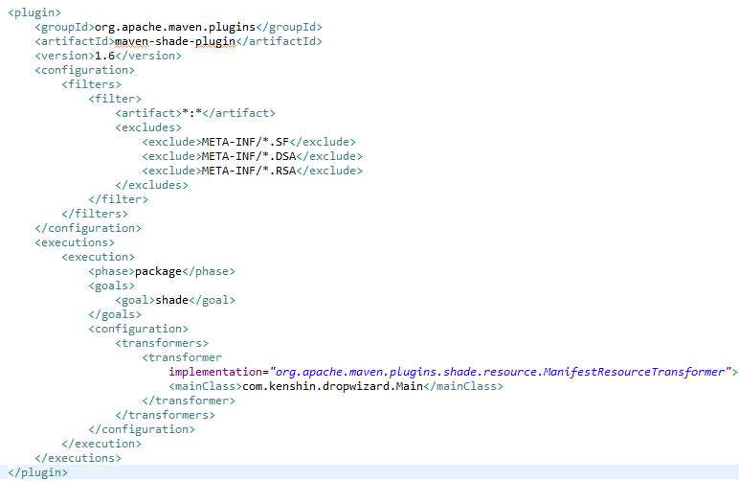
Core (cont.)

Slide 21
Dropwizard vs Spring Boot
Dropwizard and Spring Boot are very similar.
Both Spring Boot and Dropwizard create standalone jarfiles that can be deployed without needing a container.
Both are java based.
Both have monitoring, health checks, logging and other features buit-in.
Both have a focus on performance.

Slide 22
Dropwizard vs Spring Boot (cont.)
Both have DI. Dropwizard uses HK2 which is an implementation for JSR 330(Dependency Injection for Java).
Dropwizard uses shading to build fat jars while Spring Boot uses nested jars.
If we are writing a REST API in Java, Dropwizard is a great choice.
If we need to build microservices that integrate with other types of components (queues, nosql, etc), Spring Boot is good.

Slide 23
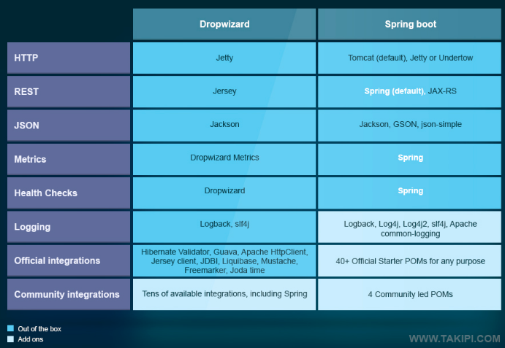
Dropwizard vs Spring Boot (cont.)

Slide 24
Conclusions
Dropwizard is light, reasonably stratified, extremely fast, and well suited for most applications.
The cons is that it actually supports Hibernate but not JPA, lacks a solid integration with IoC containers, lacks Authorization (but provides Authentication).

Slide 25

Bibliography
PacktPublishing – RESTful Web Services with Dropwizard
http://blog.takipi.com/java-bootstrap-dropwizard-vs-spring-boot/

