Slide 1

JDBI
Dima Ionut Daniel

Slide 2
Contents
What is JDBI?
Features
Core
Fluent API
SQL Object API
Conclusions
Bibliography

Slide 3

What is JDBI?
jDBI stands for Java Database Interface.
jDBI is a convenience library built on top of JDBC.
jDBI is a SQL convenience library for Java.
jDBI is licensed under the Apache License 2.0 and has no additional runtime dependencies.

Slide 4
Features
It exposes 2 different style APIs, a fluent style and a sql object style.
It attempts to expose relational database access in idiommatic Java, using collections, beans, and so on, while maintaining the same level of detail as JDBC.

Slide 5
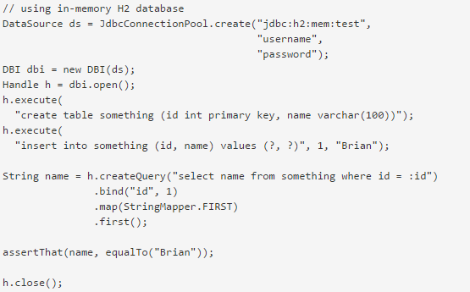
Features (cont.)
Fluent API
Obtain a connection
Prepare a statement
Fetch results

Slide 6
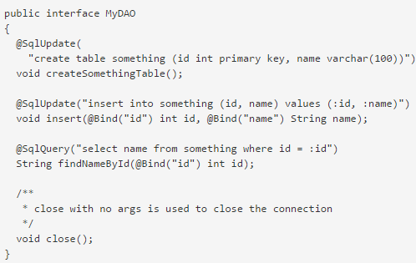
Features (cont.)
We can use SQL Object API (with annotations).

Slide 7
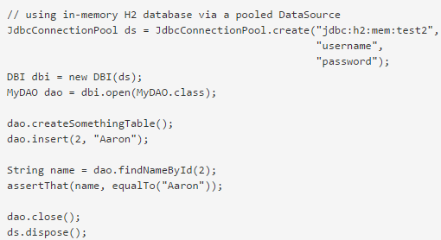
Features (cont.)
We can use annotations like:

Slide 8
Core
DBI instance represents the database instance (schema).
It allows to create Handle object, which is essentially wrapper around JDBC Connection.
DBI instances can be created from DataSource instances.
// using in-mem H2 database
DataSource ds = JdbcConnectionPool.create("jdbc:h2:mem:test", userName, pwd);
DBI database = new DBI(ds);

Slide 9
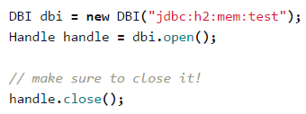
Core (cont.)
With a handle you may create and execute statements, queries, calls, batches, or prepared batches.
The DBI instance provides connections to the database via Handle instances.
DBIs can be constructed three primary ways.
pass a JDBC DataSource instance to the constructor.
pass in a combination of a JDBC url, properties, and/or a username and password.
This requires explicitly closing the handle when you are through with it.

Slide 10
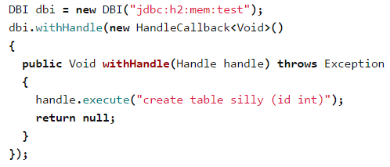
Core (cont.)
We can use callback which will receive an open handle, and will ensure it is closed when the callback complete.
Handles are used to create and execute statements, queries, calls, batches, and prepared batches.

Slide 11
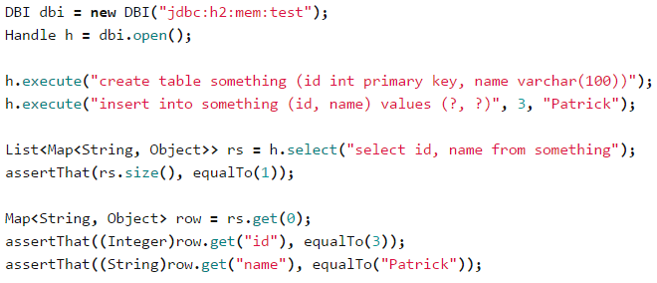
Core (cont.)
The simplest way to execute statements on a handle is direct execution via the Handle#execute and Handle#query.

Slide 12
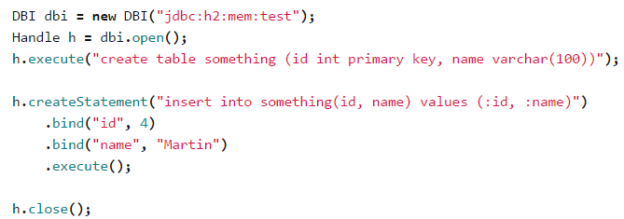
Core (cont.)
A more complex way to execute sql is to create SQLStatement instances.
Variants exist for calls, updates, queries, and prepared batches.
The call to Handle#createStatement creates an Update instance, which we then bind two named arguments to, and finally execute.

Slide 13
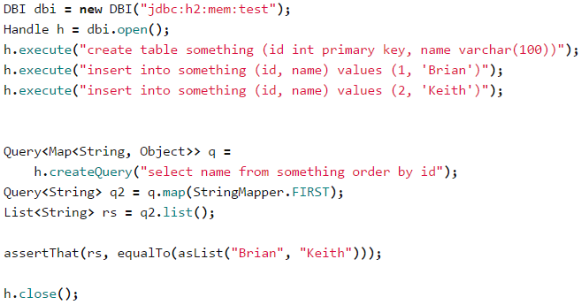
Fluent API
Query instances are SQLStatement instances specialized for SQL queries.
They are created from Handle instances, and support fluent-style method chaining.

Slide 14
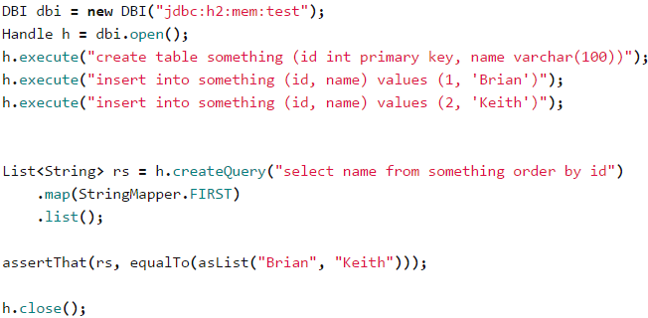
Fluent API (cont.)
The defauly representation of a result row is a Map<String, Object>, as can be seen when the Query is first created.
To map the rows to something else we use a ResultSetMapper.
We execute the query via one of several methods, in this case list(), which returns a List.

Slide 15
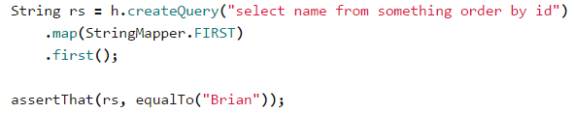
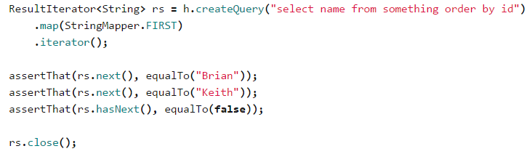
Fluent API (cont.)
The first() method sets the max rows to 1, then extracts the value from just that first row of the result set.
The iterator() method works a bit differently then first() and list().
It returns an Interator which lazily traverses the result set, leaving them open until either the iterator is closed, or the end is reached.

Slide 16
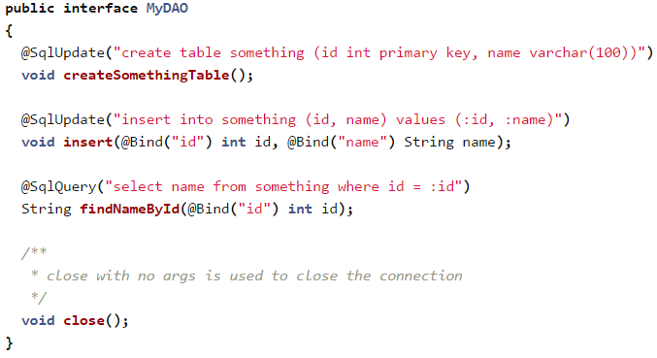
SQL Object API
The SQL Object API provides a declarative mechanism for a common JDBI usage.
To use the SQL Object API we create an interface annotated to declare the desired behavior.

Slide 17
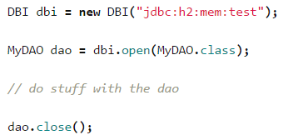
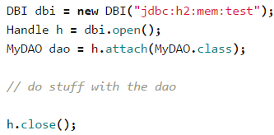
SQL Object API (cont.)
Query instances are SQLStatement method chaining.
Rather than use the DBI#open method, we can use Handle#attache method.

Slide 18

SQL Object API (cont.)
The final method for obtaining a sql object instance will obtain and release connection automatically, as it needs to.
This means that it will obtain a connection to execute a statement and then immediately release it.

Slide 19
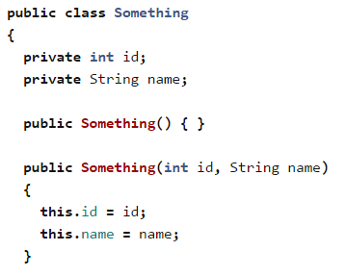
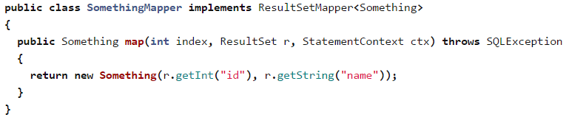
SQL Object API (cont.)
We can create object mappers.

Slide 20
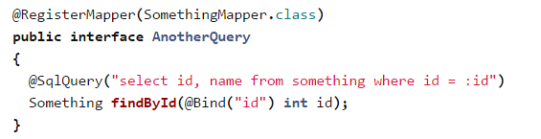
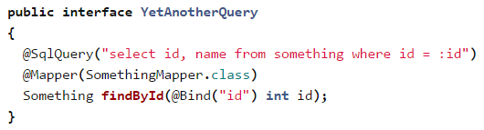
SQL Object API (cont.)
We can register mappers by using @RegisterMapper or @Mapper annotations.

Slide 21
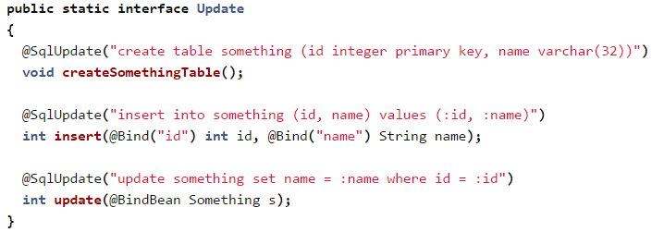
SQL Object API (cont.)
Update, insert, and data definition statements are indicated in the SQL Object API via the @SqlUpdate annotation.
The methods for these statements must have either void or int return types.
If the return type is int, the the value will be the number of rows changed.

Slide 22
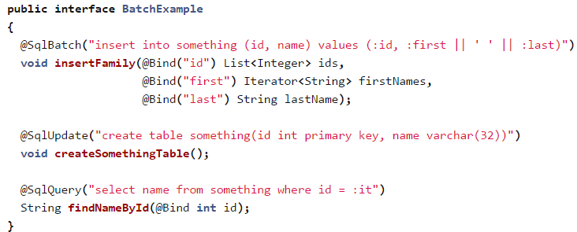
SQL Object API (cont.)
The SQL Object API supports prepared batch operations via the @SqlBatch annotation.
Batch methods must return either void or int[].
The contents of each binding in the prepared batch are determined by finding the bound arguments which are either arrays, java.util.Iterable, or java.util.Iterator instances

Slide 23
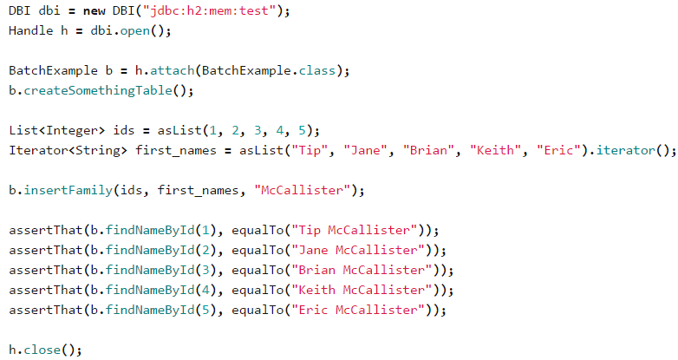
SQL Object API (cont.)
Usage of batches.

Slide 24
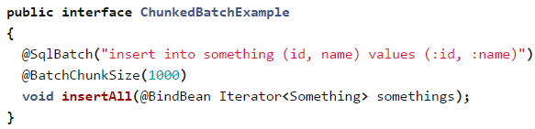
SQL Object API (cont.)
A common case for batching is to apply bulk updates in incremental batches, say of a thousand or so rows at a time, in order to be gentle on the transaction log.
The @BatchChunkSize annotation causes the batch to be processed in chunks of the specified size.

Slide 25
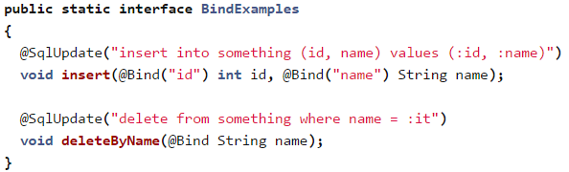
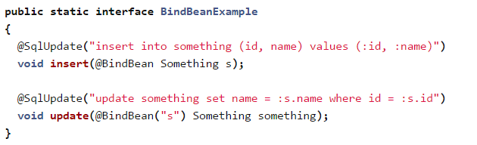
SQL Object API (cont.)
Arguments passed to properly annotated methods on sql object instances will be bound to the statements being executed.
There are two binding annotations included with JDBI, @Bind and @BindBean.

Slide 26
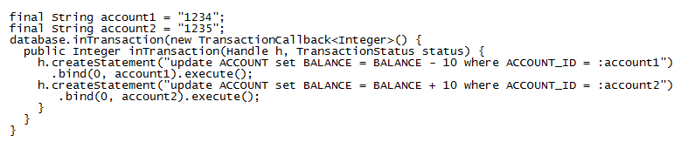
SQL Object API (cont.)
We can use transactions using the DBI#inTransaction method and the TransactionCallback.

Slide 27
Conclusions
Easy to use.
Simple SQL mapper framework.
Similar to JDBC

Slide 28

Bibliography
http://jdbi.org/
https://dzone.com/articles/jdbi-simple-convenience-layer
http://www.cowtowncoder.com/blog/archives/2010/04/entry_391.html

