Slide 1

Apache Geronimo 3
Dima Ionut Daniel

Slide 2

Contents
What is Apache Geronimo 3?
Architecture
Configuration and Administration
GShell
Conclusion
Bibliography

Slide 3

What is Apache Geronimo 3?
Apache Geronimo is an open source application server developed by the Apache Software Foundation and distributed under the Apache license.
Geronimo started as an Apache Incubator project in 2003 and in May 2004 become a top-level Apache Project. In October 2005, IBM announced a free edition of its WebSphere application server named Websphere Application Server Community Edition, which is based on Geronimo
Geronimo v1 is J2EE 1.4 compliant server
Geronimo v2 is JEE 5 compliant server.
Geronimo V3 is JEE 6 compliant server.

Slide 4
What is Apache Geronimo 3? (cont.)
Apache Geronimo 3 has transformed its kernel and it’s based on OSGI technology. It supports OSGI programming model and new technology in the OSGI enterprise marketplace, including
OSGI Blueprint Bundle
OSGI Web Application Bundle (WAB)
Enterprise Bundle Application (EBA)
The Geronimo project includes many open source components like: Apache Tomcat, Jetty, Apache ActiveMQ, Apache OpenEJB, Apache OpenJPA, Apache Derby, Apache ServiceMix, Apache Axis, Apache Scout,etc.

Slide 5
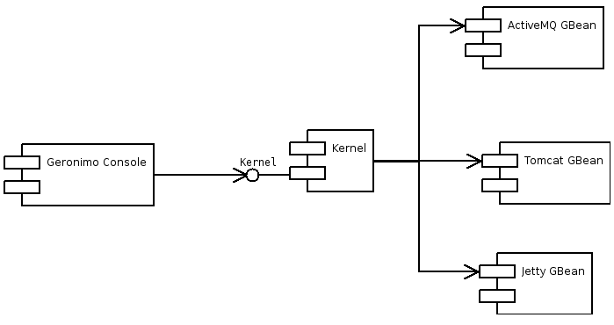
Architecture
Geronimo integrates existing open source software into the server using GBeans. A GBean is a thin wrapper around one or more pieces of functionality in the application that is exposed for use by the rest of the system.
Geronimo uses Tomcat or Jetty for the web container. The GBeans are accessed and managed via the Geronimo Kernel. The kernel allows access to the GBeans and also handles the starting and stopping of the GBeans and their dependencies.
For managing resources into an application server Sun introduced JMX( Java Management Extension) and Mbeans. Geronimo allows management via MBeans as well by creating adapters that will accept MBean requests and then delegate them to the kernel and the appropriate GBean.
Geronimo has their own implementation of the various JEE required specifications such as the Java Deployment API and the Java Management Model. Geronimo also has a rich toolset for management and deployment of applications in both web-based and command line form.

Slide 6
Architecture (cont.)
JMX has very similar concepts to GBeans. In JMX, the equivalent to GBeans is MBeans, and the equivalent to the MBeanServer is the Geronimo Kernel.
Through the kernel, GBeans in Geronimo can communicate with the management utilities while being loosely coupled and not tied to JMX. The kernel keeps track of the various GBeans in the system along with the various dependencies, references to other GBeans, attributes and methods.
The purpose of the kernel is to operate on GBeans that are hooked into Geronimo. The kernel is wrapped in a GBean just like Tomcat or ActiveMQ are using the Decorator pattern.

Slide 7
Architecture (cont.)
Implementing the GBeanLifecycle interface will allow the GBean to be notified on startup, shutdown and failure. The required methods to implement in the GBeanLifecycle interface are: doStart(), doStop() and doFail().
Apache Geronimo 3 is working on consuming the Aries Blueprint container and Apache Felix Karaf, which is the kernel of an enterprise integration runtime. The purpose of the Apache Aries is to create enterprise OSGi applications geared toward the application programming model. OSGi applications can consume existing Java EE technologies like JTA, JPA, JNDI, etc.

Slide 8
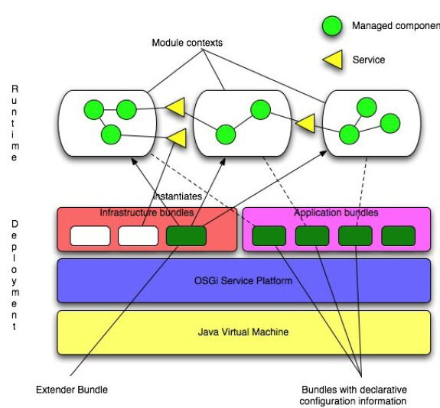
Architecture (cont.)
OSGI technology embedded as kernel.

Slide 9
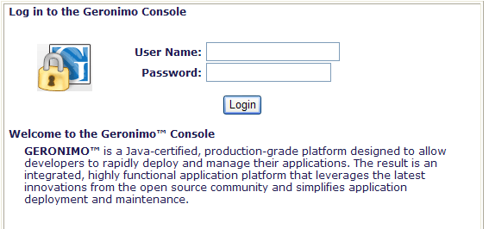
Configuration and Administration
After starting the server, the Geronimo Administrative Web Console can be found on http://localhost:8080/console.
The default administration user name and password for the Geronimo Administrative Console and command line deployment tool is system and manager. The security data in stored <geronimo_home>/var/security directory: users.properties, groups.properties. Passwords in users.properties file are encrypted by the server.

Slide 10
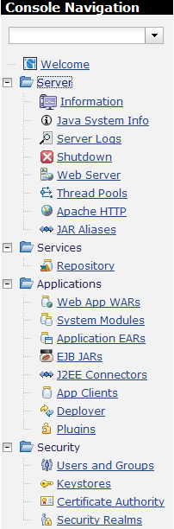
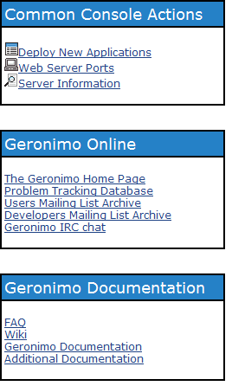
Configuration and Administration (cont.)
The left navigation panel provides access to the different tasks for administering resources in Geronimo.

Slide 11
Configuration and Administration (cont.)
Geronimo is available in three main distributions which are the Java EE 6 Certified (Big-G), Little-G and Geronimo Framework , available for both Windows and Unix (including Linux, Mac OS X) operating systems.
Little-G distribution includes a Web container and a subset of other modules from the certified Geronimo distribution.
Java EE 6 and Little-G assemblies are provided with Jetty or Tomcat Web Containers.

Slide 12
Configuration and Administration (cont.)
Geronimo provides two OSGi frameworks: Eclipse Equinox and Apache Felix. Default OSGI runtime for Geronimo is Equinox. We can easily configure which OSGi framework is used at runtime by updating the etc/onfig.properties configuration file.
It is possible to run multiple instances of Geronimo on the same machine. Each instance gets its own copy of the following at <geronimo_home>/<instance_name> .
The bin, lib and schema directories are read-only, and thus are shared between instances. The repository is not shared, which means that an application deployed in one instance will only show up in the list of deployed modules of the deployed instance.

Slide 13
GShell
GShell is a framework for building rich command-line applications.
The core of GShell provides the basic features needed by most commands, such as command-line argument/option processing, input/output redirection, preferences handling, ANSI support.
GShell can be used to implement applications similar to cvs or svn or can be used as the bootstrap launcher for much more complex applications, like Apache Geronimo.
Built-in commands: help, set, unset, clear, exit, source, echo, sleep, exec, java, wait,cat, rsh-server, rsh.
Gshell was introduced in Apache Geronimo 2.x.x version and it isn’t present in version 3.
There are also deploy/undeploy/start/stop commands that were used in Apache Geronimo 2.x.x version.

Slide 14
Gshell (cont.)
Features
Dynamic command/plugin discovery
Support for ANSI color
Rich dependency injection and component management via Plexus
Simple annotation-based CLI option/argument processing
Rich JLine console for line editing, history, input masking and tab-completion
A simple command-line syntax parser with minimal support for quoting ("", '') and for basic ${xxx} expansion

Slide 15
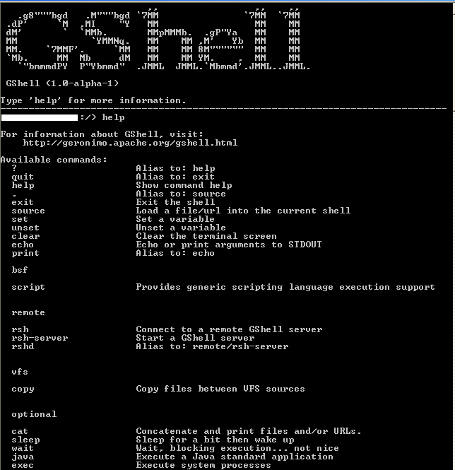
Gshell (cont.)
GShell standalone sample.

Slide 16

Conclusion
Geronimo it’s an easy to use Java EE container.

Slide 17
Bibliography
http://geronimo.apache.org/documentation.html
https://cwiki.apache.org/geronimo/
https://cwiki.apache.org/GMOxSAMPLES/
https://cwiki.apache.org/GMOxDOC30/
https://cwiki.apache.org/GMOxKB/
https://cwiki.apache.org/GMOxSBOX/
http://en.wikipedia.org/wiki/Apache_Geronimo
https://cwiki.apache.org/GSHELL/

